Slide 1
Chapter Three
Immobilized Enzyme

Slide 2
Content
Introduction
Immobilized Enzyme
Immobilized Techniques
Effect of mass transfer

Slide 3
Introduction
Enzymes are expensive, they should be utilized in an efficient manner
As catalytic molecules, enzymes are not directly used up. After the reaction the enzymes cannot be economically recovered for re-use and are generally wasted
This enzyme residue remains to contaminate the product and its removal may involve extra purification costs
Simple and economic methods must be used to separate the enzyme from the reaction product

Slide 4
Introduction
Separation of enzyme and product using a two-phase system
One phase containing the enzyme
The other phase containing the product
This is known as Immobilization

Slide 5
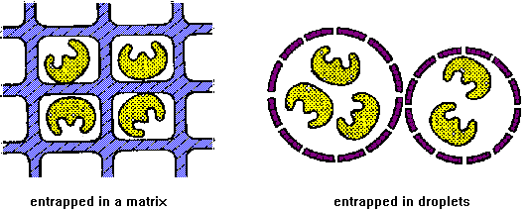
Immobilized enzyme
Enzyme immobilization is a process of confining the enzyme molecules to a solid support over which a substrate is passed and converted to products.

Slide 6
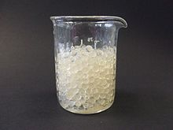
Immobilized enzyme
An immobilized enzyme is one whose movement in space has been restricted either completely or to a small limited region.

Slide 7
Why Immobilize enzymes?
Protection from degradation and deactivation.
Re-use of enzymes for many reaction cycles, lowering the total production cost of enzyme mediated reactions.
Ability to stop the reaction rapidly by removing the enzyme from the reaction solution
Enhanced stability
Easy separation of the enzyme from the product

Slide 8
An ideal carrier matrices for enzyme immobilization
Inert
Physically strong and stable
Cost effective
Regenerable
Reduction in product inhibition

Slide 9
Immobilization criteria
There are a number of requirements to achieve a successful immobilization:
The biological component must retain substantial biological activity after attachment
It must have a long-term stability
The sensitivity of the enzyme must be preserved after attachment
Overloading can block or inactivate the active site of the immobilized biomaterial, therefore, must be avoided

Slide 10
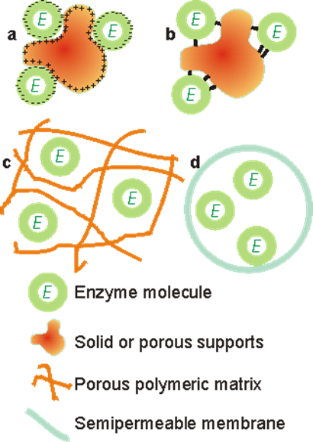
Methods of enzyme Immobilization
The three methods of enzyme Immobilization are:
Entrapment(c,d)
Surface immobilization(a,b)
Cross linking

Slide 11
Entrapment
Entrapment is the physical enclosure of enzyme in a small space , simply trapped inside the polymer matrix.
Enzymes are held or entrapped within the suitable gels or fibers.
It is done in such a way as to retain protein while allowing penetration of substrate.
Matrix entrapment and membrane entrapment, including microencapsulation, are the two major methods of entrapment.

Slide 12
Entrapment
- Matrix entrapment - membrane entrapment

Slide 13
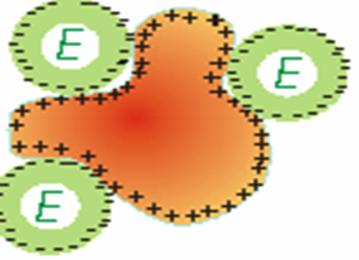
Surface Immobilization
Adsorption
Involves the physical binding of the enzyme on the surface of carrier matrix
Carrier may be organic or inorganic.
The process of adsorption involves the weak interactions like Vander Waal or hydrogen bonds.

Slide 14
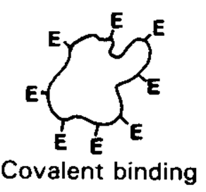
Surface Immobilization
Covalent binding
Retention of Enzyme on support surfaces by covalent bond formation
The most widely used methods for enzyme immobilization
Enzyme bind to support material via certain functional groups, such as amino, carboxyl, hydroxyl, and sulfhydryl groups

Slide 15
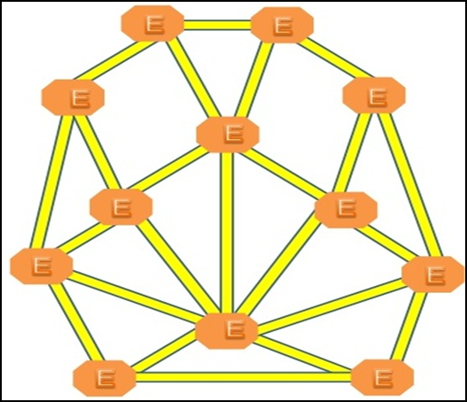
Cross-linking
Cross linking involves intermolecular cross linking of enzyme molecules in the presence/absence of solid support.

Slide 16
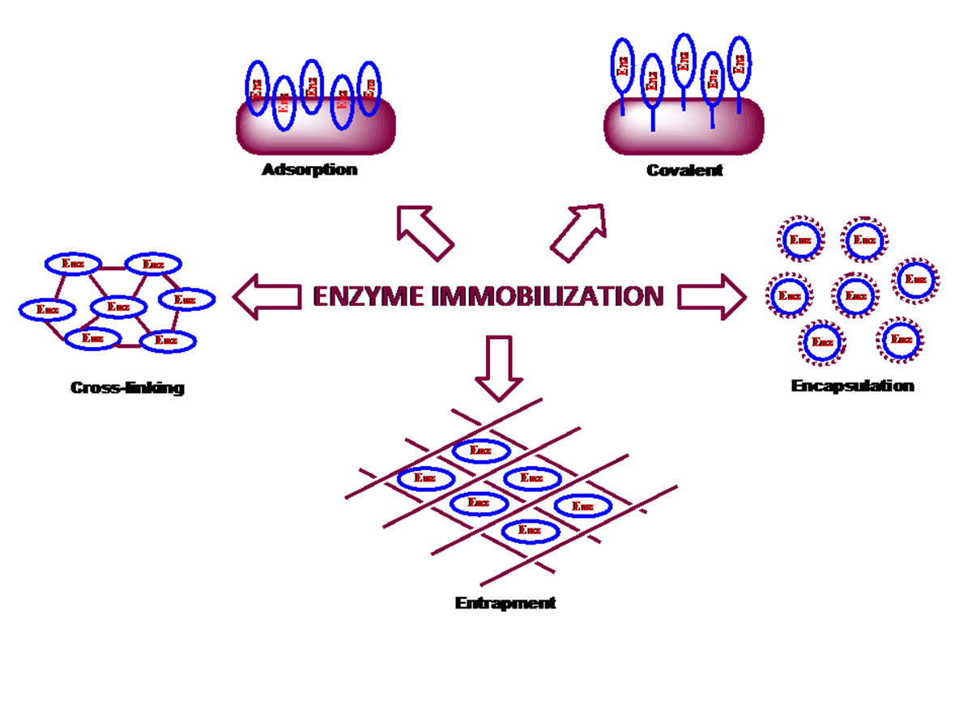

Slide 17
Comparison between the methods
Characteristics | Adsorption | Covalent coupling | Entrapment | Membrane confinement
Preparation | Simple | Difficult | Difficult | Simple
Cost | Low | High | Moderate | High
Binding force | Variable | Strong | Weak | Strong
Enzyme leakage | Yes | No | Yes | No
Applicability | Wide | Selective | Wide | Very wide
Running problems | High | Low | High | High
Matrix effects | Yes | Yes | Yes | No
Large diffusional barriers | No | No | Yes | Yes
Microbial protection | No | No | Yes | Yes

Slide 18
Advantage of immobilized enzymes
Easy separation from reaction mixture, providing the ability to control reaction times and minimize the enzymes lost in the product
Re-use of enzymes for many reaction cycles, lowering the total production cost of enzyme mediated reactions
Ability of enzymes to provide pure products
Possible provision of a better environment for enzyme activity

Slide 19
Disadvantage of immobilized enzymes
Increase the diffusion resistance, so decreases the reaction rate.
Loss of activity upon immobilization.

Slide 20
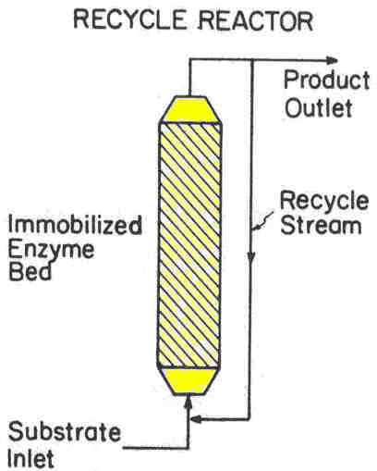
Immobilized enzyme reactor (example)
Recycle packed column reactor
- Allow the reactor to operate at high fluid velocities

Slide 21
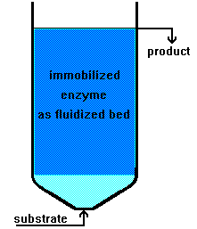
Immobilized enzyme reactor (example)
Fluidized bed reactor
- A high viscosity substrate solution
- A gaseous substrate or product in a continuous reaction system
- Care must be taken to avoid the destruction and decomposition of immobilized enzymes

Slide 22
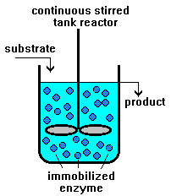
Immobilized enzyme reactor (example)
- An immobilized enzyme tends to decompose upon physical stirring.
- The batch system is generally suitable for the production of rather small amounts of chemicals.
Continuous stirred
tank reactor

Slide 23
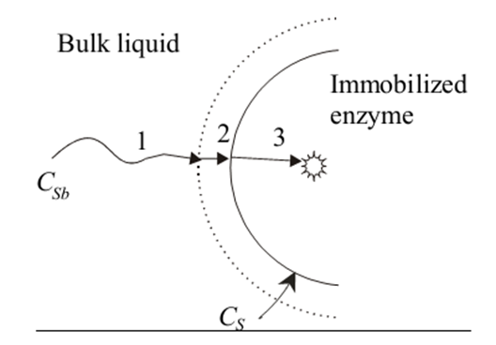
Effect of mass transfer resistance
The immobilization of enzymes may introduce a new problem which is absent in free soluble enzymes.
mass-transfer resistance is present
    due to the large particle size of immobilized enzyme
    due to the inclusion of enzymes in polymeric matrix.
Schematic diagram of z path of the substrate to z reaction site an immobilized enzyme

Slide 24
Effect of mass transfer resistance
If we follow the hypothetical path of a substrate from the liquid to the reaction site in an immobilized enzyme, it can be divided into three steps.
  Transfer from the bulk liquid to a relatively unmixed liquid layer surrounding the immobilized enzyme
  Diffusion through the relatively unmixed liquid layer
  Diffusion from the surface of the particle to the active site of the enzyme in an inert support
Notes:
EXTERNAL VS INTRAPARTICLE

Slide 25
Substrate
HIGH
S_{b}
FILM
TRANSFER
Immobilized
Enzyme
Low S concentration
CONCENTRATION DIFFERENCE
DIFFUSION
ELECTRIC ATTRACTION
DRIVING FORCE

Slide 26
HIGH
S_{b}
FILM
TRANSFER
Immobilized
Enzyme
REACTION
CONCENTRATION DIFFERENCE
DIFFUSION
ELECTRIC ATTRACTION
DRIVING FORCE
PRODUCT

Slide 27
HIGH
S_{b}
FILM
TRANSFER
Immobilized
Enzyme
INTRA-PARTICLE
TRANSFER
DIFFUSION
DRIVING FORCE

Slide 28
HIGH
S_{b}
FILM
TRANSFER
Immobilized
Enzyme
REACTION
INTRA-PARTICLE
TRANSFER
PRODUCT

Slide 29
Effect of mass transfer resistance
Mass transfer resistance are divided into two:
External mass transfer resistance
(during transfer of substrate from the bulk liquid to the relatively unmixed liquid film surrounding the immobilized enzyme and during diffusion through the relatively unmixed liquid film)
Intra-particle mass transfer resistance
(during diffusion from the surface of the particle to the active site of the enzyme in an inert support

Slide 30
External mass transfer resistance
Assumption
Enzymes are evenly distributed on the surface of a nonporous support material
All enzyme molecules are equally active
Substrate diffuses through a thin liquid film surrounding the support surface to reach the reactive surface
The process of immobilization has not altered the enzyme structure and the M-M kinetic parameters (rmax, KM) are unaltered
Ss
Sb
Enzyme
Liquid Film Thickness, L
Notes:
where CSb and CS are substrate concentration in the bulk of the solution and at the immobilized enzyme surface

Slide 31
External mass transfer resistance
Diffusional mass transfer across the liquid film:
J_{S} = k_{L} (C_{Sb} – C_{Ss})
k_{L}
C_{Sb}
C_{Ss}
Ss
Sb
liquid mass transfer coefficient (cm/s)
substrate concentration in the bulk solution (mol/cm³)
substrate concentration at the immobilized enzyme surface (mol/cm³)
Enzyme
Liquid Film Thickness, L
Notes:
-The rate of mass transfer is proportional to the driving force

Slide 32
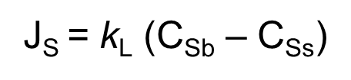
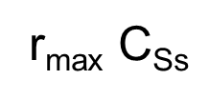
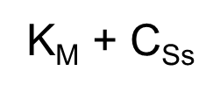
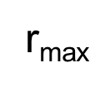
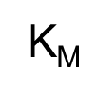
External mass transfer resistance
At steady state, the reaction rate is equal to the mass-transfer rate
Ss
Sb
=
maximum reaction rate per unit of external surface area (e.g. mol/cm2.s)
Enzyme
is the M-M kinetic constant (e.g. mol/cm3)
Liquid Film Thickness, L
Notes:
During the enzymatic reaction of an immobilized enzyme, the rate of substrate transfer is equal to that of substrate consumption. Therefore, if the enzyme reaction can be described by the Michaelis-Menten equation,

Slide 33

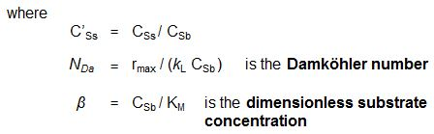
External mass transfer resistance
The above equation can be expressed in dimensionless form as:

Slide 34


Damköhler number (N_{Da})
If N_{Da} >> 1, rate of diffusion is slow and therefore it is limiting, the overall rate of reaction is controlled by:
r_{p} = J_{S} = k_{L} (C_{Sb} – C_{Ss})
If N_{Da} << 1, rate of reaction is slow and therefore it is limiting, the overall rate of reaction is controlled by:
If N_{Da} = 1, rates of diffusion and reaction are comparable
Notes:
Depending upon the magnitude of Nda the eqn can be simplified, as follows

Slide 35

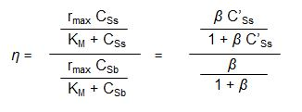
Effectiveness factor (η)
To measure the extent which the reaction rate is lowered because of resistance to mass transfer:
Effectiveness factor is a function of β and C’_{Ss}
Notes:
To measure the extent which the reaction rate is lowered because of resistance to mass transfer, we can define the effectiveness factor of an
immobilized enzyme, η, as

Slide 36
Tips
where the effectiveness factor is a function of xS and β If xS is equal to 1, the
concentration at the surface CS is equal to the bulk concentration CSb.
Substituting 1 for xS in the preceding equation yields η = 1, which indicates
that there is no mass-transfer limitation. On the other hand, if xS approaches zero,
η also approaches zero, which is the case when the rate of mass transfer is very slow compared to the reaction rate.

Slide 37
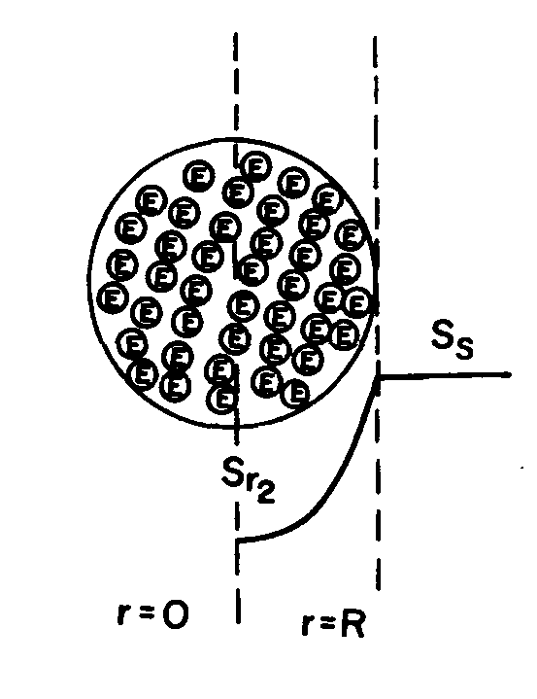
Intra-particle mass transfer resistance
Assumption:
Enzyme are uniformly distributed in spherical support particle.
Substrate diffuses through the tortuous pathway among pores to reach the enzyme
Substrate reacts with enzyme on the pore surface
Diffusion and reaction are simultaneous
Reaction kinetics are M-M kinetics

Slide 38

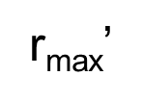
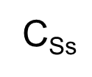

Intra-particle mass transfer resistance
Under internal diffusion limitations, the rate per unit volume is expressed in terms of the effectiveness factor as follows:
maximum reaction rate per volume of the support
M-M constant
substrate concentration on the surface of the support
effectiveness factor

Slide 39
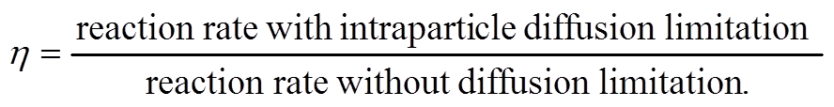
Intra-particle mass transfer resistance
Definition of the effective factor
For η < 1, the conversion is diffusion limited
For η = 1, the conversion is limited by the reaction rate

Slide 41
Group project(3/4)
Industrial Bioprocess
Production of yoghurt
Cheese production
Production of Acetic acid
Ethanol production
Beer production
Production of High Fructose Syrups
Wine production
Glutamate production
Lysine production

Slide 42
cont.……..
10. Production of Penicillin
11. Production of Bakery yeast
12. Citric acid production
13. Lactic acid production
14. Vitamin C production
15. PLA production
16. Propanediol production
17. Biodiesel production
18. Production of butter
19. Xanthan gum production

