Slide 1

Insecticides
Herbicides
Rodenticides

Slide 2
Objectives
Be familiar with major categories of insecticides:
  mechanism of action
  effects on non-insect animals
  clinical signs of toxicity
  approaches for treating toxicity
  persistence in environment
  persistence in food chain
  persistence in individual
Know how each of the specific drugs in the “Drug List for Insecticides” fits into these objectives.

Slide 3
What Makes a Good Insecticide?
Kills insects on “treated” surfaces or materials, crops, and animals
Is effective for a long period of time
Is without acute or short term effect on non-insect species
Is without long term effect on non-insect species

Slide 4
Insecticidal Chemical Overexposure
Accidental overexposure when applied to crops
Accidental exposure when mixed with animal feed
Accidental use of plant formulation rather than animal formulation
Accidental exposure following improper storage
Accidental overexposure when used medicinally

Slide 5
Potential for Toxicity depends on....
Insect – Non-insect Differences
Generally longer lasting effects of insecticidal chemicals in target insect than in nontarget,
non insect (mammalian) species
Generally insecticides target the same cellular mechanisms in insects which are affected in other animals to cause toxicity

Slide 6
Potential Additional Problems with Insecticides
Environmental persistence
Individual persistence
  Chemical
  Effect
Translocation in plants
Bioaccumulation
Factors Influencing Insecticide Toxicity
Environmental degradation of compound
Vehicle used to disperse compound
Species exposed
Exposure route
Stage in lifespan
Health status

Slide 7
Insecticides
Cholinergic Receptor Activation
  Cholinesterase inhibitors
  Nicotine-like drugs
Sodium Channel Modulators
  Pyrethrins & pyrethroids
  Organochlorines

Slide 8
Cholinesterase Inhibitor Insecticides
Organophosphates
    Not persistent chemically in individuals
    Effect is persistent in individuals
Carbamates
  Not persistent chemically in individuals
  Effect is not persistent in individuals
Both
    Some persistence in environment
    No translocation in plants
    No bioaccumulation (“up food chain”)

Slide 9
Diagnosis of ChEase Toxicity
History
Clinical Signs
Measure ChEase activity
    Blood, Brain, Retina
Detection of AntiAChEase in feed
        Granular material in GI tract
Detection of AntiAChEase in tissue

Slide 10
Treatment of ChEase Inhibitor Toxicity
Atropine
    Blocks ACh effects at muscarinic sites
    Muscarinic sites more important
    ACh sites for life
    Care in horses – ultrasensitive
Pralidoxime
    Acts on OP-cholinesterase complex
      releases OP residue
      reactivates cholinesterase
    No effect if "aging" has occurred
    Atropine first
    Not useful for carbamate poisoning
    Not harmful in carbamate poisoning

Slide 11
Treatment of ChEase Inhibitor Toxicity
Activated Charcoal
Bathing
Artificial respiration
Control seizures
  barbiturates - phenobarbital
  benzodiazepines - diazepam
Correct acid-base disturbances resulting from muscle activities
  Rehydrate

Slide 12
Nicotine as an Insecticide
  Not persistent in individuals
  Not persistent in environment
  No bioaccumulation
Nicotinoids
  Clothianidin
  Imidacloprid
  Thiacloprid

Slide 13
Nicotine Toxicity
Significantly toxic to all animals
Minimal difference in sensitivity of target insects and other animals
Mechanism of Action
Acts at all nicotinic cholinergic receptors
  CNS
  ANS Ganglia
  Skeletal Neuromuscular Junction
Mimics ACh
  Activates & desensitizes receptor

Slide 14
Pyrethrins & Pyrethroids
Pyrethrins
  Natural – from Chrysanthemum
Pyrethroids
  Synthetic
    less toxic to non-insect species
    better insecticides
Environmental Stability
  Pyrethrins < pyrethroids
  Pyrethrins
      light sensitive; degrade in air
No Persistence in Individual Organism
No bioaccumulation
Toxicity
  Greater at colder cell temperature

Slide 15
Pyrethrins & Pyrethroids
Mechanism of Action
Affects Na-channel in membranes
    → membrane depolarization
    following action potential
    action potential bursting activity
Clinical Intoxication
Type II CS syndrome
    Chewing movements
    Profuse salivation
    Pawing & burrowing (rodents)
    Body tremors and writhing
    h Startle response
    Seizures
    pyrethroids containing cyano group
      Cyfluthrin
      Fenvalerate

Slide 16
Pyrethrins & Pyrethroids
Diagnosis of Intoxication
  History
  Clinical Signs
  No characteristic lesions
  Tissue residue concentration
Treatment of Toxicity
Dermal
  Bathe
Oral
  Emetic, cathartic
  Activated charcoal
Any Route
  Counter CNS stimulant effects
  Benzodiazepines - diazepam
  Barbiturates - phenobarbital
  Symptomatic care

Slide 17
Chlorinated Hydrocarbon Insecticides
Uses in
    agriculture
    control of malaria
    control of West Nile fever
Persistent in individual
Persistent in environment
Regional bioaccumulation in plants
Bioaccumulation (in food chain)

Slide 18
Chlorinated Hydrocarbon Insecticides
DDT
    Insecticidal properties noted 1939
    Use started 1940
    Effective & cheap insecticide
  BUT…
  Induces hepatic oxidases: alters
  drug & steroid metabolism
    Carcinogen (?)
  Not used in US
  Human health hazard, & increasing
  insect resistance

Slide 19
Chlorinated Hydrocarbon Insecticides
Chlorinated Ethane Derivatives
Chlorinated Cyclodienes
Hexachlorocyclohexanes
Replacements for DDT to achieve less toxicity to non-insects
Not used legally in US since 1972 with occasional exceptions
    Aldrin
    Chlordane
    DDT
    Dieldrin
    Heptachlor
    Lindane
    Methoxychlor

Slide 20
Chlorinated Hydrocarbon Insecticides
Stability in the Environment
Absorption by Soil
    Importance of soil composition
      Sandy soil: chemicals wash through
      Organic soil: chemical absorbed to soil
Persistence in Soil
    Effect of one application may be
    persistent for years
Biological Magnification
Translocation in Plants
  Variable concentration within plant after uptake through roots
  Higher in “roughage” than in seeds
Persistence in individual
“Concentrates” in fatty tissue
  Fat serves to reduce effect of toxic compound during exposure
  Fat serves as potential source of toxic compound beyond exposure

Slide 21
Chlorinated Hydrocarbon Insecticides
Clinical Intoxication
Behavioral Aberrations
    Hypersensitivity, Apprehension, Belligerence, Later Depression
Locomotor Aberrations
    Fasiculations, Spasms, Seizures
Autonomic Phenomena
    Emesis, Salivation
Dependent Signs
      h body temperature
      h respiratory rate
      h depth of respiration
Diagnosis
History for potential exposure
Compatible clinical signs
Tissue residue analysis
    Brain and liver residue- concentration most significant in diagnosis
Characteristic lesions
    Pulmonary congestion and edema
    Hemorrhages in GI tract

Slide 22
Chlorinated Hydrocarbon Insecticides
Treatment of Toxicity
  Skin-Bathe
  GI
    Induce Emesis
    Activated charcoal
    Cathartic
CNS
  Control seizure activity
    Benzodiazepine (diazepam)
    Barbiturate (phenobarbital)
Chlorinated Hydrocarbon Insecticides Decontamination
Lactating animals
    Residue removal quicker but milk contaminated
    Administer iodinated casein to increase milk production
Young animals
    “Eliminate" residues quicker
    Actually it's i due to hbody
    mass not actual h elimination
Fattened animals to pasture
    Mobilize fat (be careful)

Slide 23

Herbicides

Slide 24

Herbicides
PHENOXY FATTY ACIDS
BIPYRIDYLIUM- PARAQUAT
DINITROCOMPOUNDS
CARBAMATES
TRIAZINES
GLYPHOSATE

Slide 25
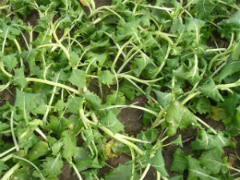
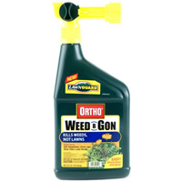
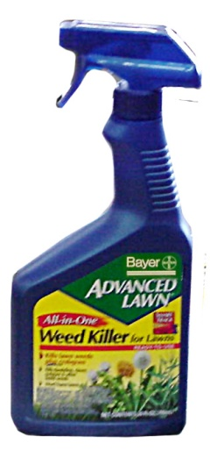

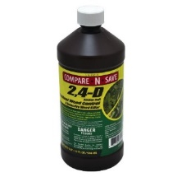
PHENOXY FATTY ACIDS
As a group, these are the most commonly used herbicides.
Post-emergent control of broadleaf weeds.
Analogs to plant hormones.
Source
  2,4-D: dichlorophenoxyacetic acid
  2,4,5-T: trichlorohenoxy acetic acid
  Silvex: trichlorophenoxy propionic acid
  2,4-D: Most common used home and garden herbicide
Exposure
  Ingestion of treated grasses, turf or pasture: diluted herbicide
  Accidental ingestion, malicious poisoning: undiluted herbicide

Slide 26
Toxicodynamics
Widely distributed, little accumulation in fat.
Short half-life, not appreciably metabolized, excreted in urine.
Not accumulated in milk.
Toxicity
Dogs appear to be most sensitive (longer half-life).
Dogs
  LD50: 100 mg/kg
  Multiple dosages of 20 mg/kg/day for 3 weeks or 25 mg/kg/day for 6 days
Cattle (Effects GI motility)
  LD50: 200 mg/kg
  100 mg/kg for 10-30 days
Single application to turf at 4 times recommended rate: No significant toxicity for 7 days post exposure (canine).

Slide 27
Herbicides
Pathology
Irritant to mucosal membranes: undiluted, concentrated forms
Clinical Symptoms:
Dogs: vomiting, passivity, myotonia, ataxia, muscular weakness (posterior limbs), clonic spasms and coma.
Cattle: Depression, muscle weakness
Elevated serum alkaline phosphatase, lactate dehydrogenase, and creatine phosphokinase suggest liver, kidney and muscle cellular injury.
Lesions:
Rumen stasis; bright green, undigested feed may be present in the rumen
Liver is swollen and friable.
Mesenteric lymph nodes and vessels are hyperemic and enlarged
Evidence of epicardial hemorrhage; hydropericardium.

Slide 28
Herbicides
Mechanism of Toxicity
  Muscle: Plasma membrane disruption (ion channels?)
  Inhibition of ribonuclease synthesis – effects protein synthesis
  Uncoupling of oxidative phosphorylation – decrease ATP
  Adducts with acetyl-CoA = 2,4-D-Ach
Treatment
  No specific antidotes
  Charcoal is effective in cattle for recent ingestion; monitor rumen atony.
  Alkaline diuresis should enhance clearance.

Slide 29
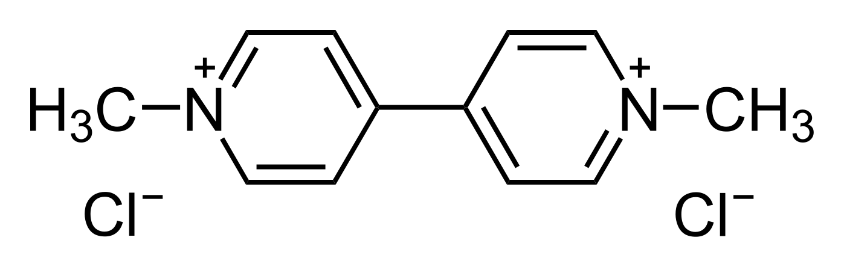
BIPYRIDYLIUM- PARAQUAT
(1,1’-dimethyl-4,4’-bipyridyl)
Contact herbicide used as a dessicant, defoliant
Water soluble, binds to clay soils.
Source
  Commercial preparations: Dextron X, Dextrone, Herbaxon, Toxer.
Concentrated forms for agriculture (5-20%solutions). Diluted forms for domestic use.
Exposure
Toxicity from agricultural application is unlikely.
Livestock: consumption of concentrates or tank mixes.
Canine: malicious poisoning.

Slide 30
BIPYRIDYLIUM- PARAQUAT
Toxicodynamics
Limited absorption (~20%)
Excreted in urine as unmetabolized compound
Concentrates in the pulmonary tissue via the polyamine transporter system (calveoli-dependent)
(10-fold greater than other organs)
Toxicity
25-75 mg/kg in cats, dogs, pigs, sheep, cattle and humans
100 mg/kg in laboratory rats

Slide 31
BIPYRIDYLIUM- PARAQUAT
Pathology
Acute toxicosis
Early - vomiting, GI irritation, diarrhea. High doses: ataxia, seizure
2-3 days – development of renal failure, hepatocellular necrosis.
  Renal injury usually reverses and function is recovered.
2-7 days – Pulmonary edema, severe respiratory distress.
  Delayed development of pulmonary fibrosis.
  Death within 8 days
Chronic toxicosis
  Mild(er) alveolar cell injury (type I cells); hyperplasia of type II cells
  Delayed development of pulmonary fibrosis

Slide 32
BIPYRIDYLIUM- PARAQUAT
Treatments
Detoxification
Emetics- early
Bentonite, Fuller’s Earth – clay absorption
Supportive Therapy
  Assisted ventilation. Oxygen is contraindicated.

Slide 33
Carbamates (chloropropham)
Asulum, Asulox
Herbicide preparations are less toxic than
carbamates used in insecticides
Inhibits acetylcholinesterase (enhances cholinergic pathways) (see Insecticide )

Slide 34
Triazines (Atrazine)
heavy use agriculturally in Midwest
domestic use in some Scotts Weed ‘N Feed products.
Plants: Blocks photosynthetic pathways
Mammals: Attenuates LH surge;
disrupts cyclicity, delayed puberty, altered lactation, pregnancy loss
Relatively toxic to ruminants.

Slide 35
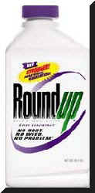
Glyphosate (ROUNDUP)
n-(phosphonomethyl) glycine
Second most used herbicide in domestic, public, and agriculture environments.
Wide margin of safety; mild intoxication has been reported in pets.
Toxicity related to: surfactant (15%v/v): fluid and electrolyte loss.
Ocular irritant, contact dermatitis
Polyethoxylated tallowamine (organic surfactant)
in vitro cytotoxicity
LD50: 5,000 mg/kg for rats
10,000 mg/kg in mice
3,530 mg/kg in goats.
Acute dermal LD₅₀ in rabbits > 2,000 mg/kg.

Slide 36
Herbicides

Slide 37
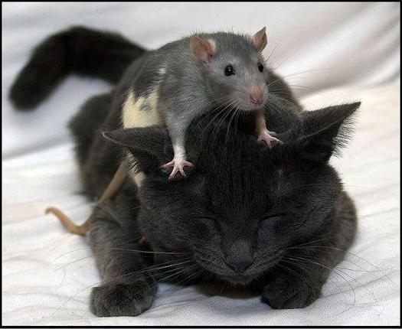
Rodenticides

Slide 38

Rodenticides
OUTLINE
Exposure Risks – General
Rodenticides of Veterinary Concern:
Bromethalin
Anticoagulants
Cholcalciferol (Vitamin D)
Metal Phosphides
Strychnine
Sources
Toxicodynamics
Symptoms/Pathology
Treatment

Slide 39
Rodenticides
Introduction
Sources
Pastes and Pellets - formulated to be attractive and palatable for direct ingestion
Tracking Powders – placed in high traffic areas, consumed when grooming.
Exposure
Ignoring safety precautions
Heavy use in place in good rodent control practice
Malicious poisoning
Risk of Toxicosis
Accessibility to pets, livestock, and wildlife
Dogs: 5th most common intoxication; estimated 20% of exposures are toxic
Cats: rarely reported; difference in exposure rates?
Livestock: Rare; controlled exposure environment.
Wildlife: Secondary exposure

Slide 40
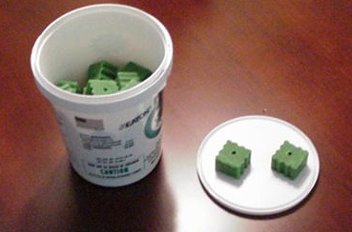
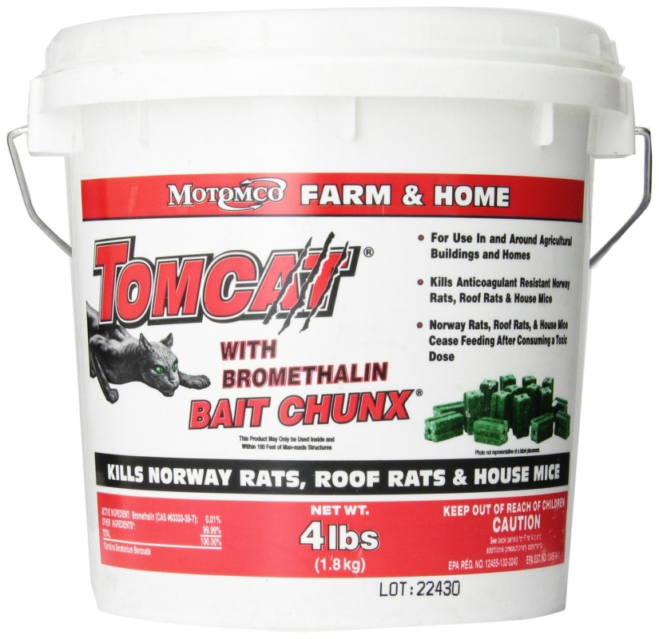
BROMETHALIN
Sources Developed in 1980s : Vengeance,
Hotshot, Sudden Death, Assault
Highly popular since 2014. Used to be the 3rd or 4th most commonly used rodenticide
Exposures: accidental ingestion by dogs and cats
Toxicodynamics
Rapid absorption from GI
Lipophilic, localizes to fat, brain Metabolism: to desmethyl bromethalin
desmethy bromethalin >> bromethalin

Slide 41

BROMETHALIN
Mechanism of Toxicity
Uncouples oxidation phosphorylation
Decreases synthesis of ATP
Loss of cellular sodium/potassium exchange
Intracellular swelling
Cell degeneration, Death
CNS tissue appears to be the most sensitive
to cellular toxicity of Bromethalin

Slide 42
BROMETHALIN
Symptoms/Pathology
Acute/Large Dose: “convulsant syndrome,”
hyperesthesia, hyperexcitability, tremors, seizures, circling, vocalization, mild to severe CNS depression, hyperthermia, and death.
Signs may occur within 4 to 18 hours of ingestion
Chronic/Low Dose: “paralytic syndrome.” onset of clinical signs is slower and sometimes delayed. Signs may take 1 to 7 days.
Ataxia, CNS depression, paresis of the hindlimbs, then progressing to
paralysis several days later.
Green Stool – colorant
Pathology – abnormal EEG, cerebral and spinal edema,
increase CSF pressure
Cerebral lipid peroxidation

Slide 43

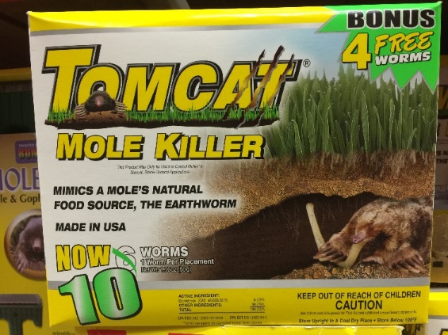
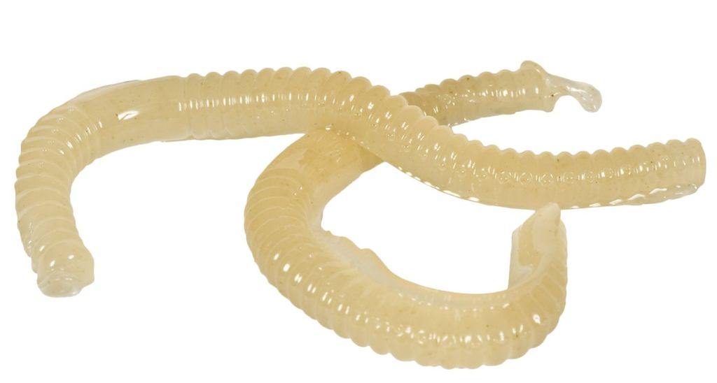
BROMETHALIN: Treatment
Treatment
No antidote
Early detoxification. Emesis, activated charcoal.
Supportive: minimize cerebral edema
with mannitol, dexamethasone
Diazepam, Phenobarbital to control seizures.
Arsenius Jigger, The Essential Defence Against the Dark Arts

Slide 44
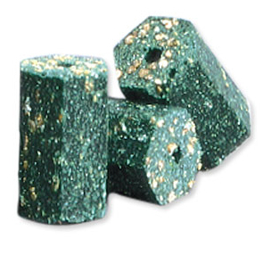
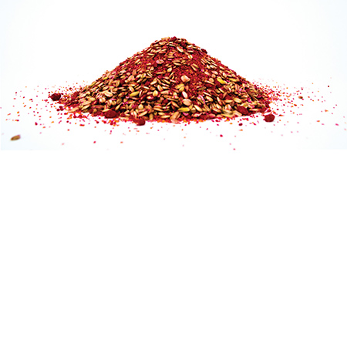
Anticoagulant Rodenticides
ANTICOAGULANTS
The toxicity of anticoagulant rodenticides is based on inhibition
of Vitamin K pathways.
Sources: At least 126 commercial products based on at least
13 different anticoagulants
Products: D-Con, Drat, Kill-Rat, Ratox, Rodex,
Storm, Talon, Void, etc.
1. 4-Hydroxycoumarins
Warfarin - used since the 1940s. Increased resistance in rat population,
now multiple doses required
Second generations 4-hydroxycoumarins – since 1970s, 80s.
Brodaficoum, bromadiolone, difethialone
Single, effective doses
Banned for consumer use; approved for commercial use - 2011
2. Indane 1,3-dione (Indanediones) - diphacinone, chlorophacinone, pindone

Slide 45
Anticoagulant Rodenticides
Mechanism of Toxicity
INACTIVE
Factors II,VII, IX, and X
carboxylation
ACTIVE
Factors II,VII, IX, and X
(carboxylated)
Vit. K epoxidase
Vitamin K1
Vitamin K epoxide
Vit. K epoxidase
Toxicodynamics
1. Absorption is slow (peak 12h) and complete (> 90%).
2. Metabolism (elimination) is slow
3. Binding to plasma proteins increases distribution
reductase

Slide 46
Pathology
Early: General – dyspnea, lethargy, weakness, pallor, anorexia
Specific - subcutaneous hematoma, epistaxis,
gingival hemorrhage, dark tarry stool.
Clinical Tests: Increased clotting times: coagulation, prothrombin, activated partial thromboplastin times all increased
2 to 8-fold.
Late Lesions: hemothorax, hemomediastimun, hemopericardium, pulmonary edema, and hemorrhage are usually fatal.
Treatment
Detoxification within 8h. Usually not practical.
Transfusion – whole blood if anemic; plasma will supply clotting factors
Antidotal Therapy – Phytonadione (Vitamin K1).
Anticoagulant Rodenticides

Slide 47
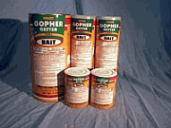
STRYCHNINE
Sources
Historical use in veterinary medicine as an analeptic,
circulatory stimulant, tonic, and ruminatoric.
Presently used as a rodenticides against gophers
and ground squirrels
Exposures:
Ingestion of rodenticide
Most common malicious poisoning of dogs.
Top Five of toxicological diagnosis (Iowa VDL)
Secondary toxicosis in raptors

Slide 48

STRYCHNINE: Mode of Action
Toxicodynamics
Rapid absorption in GI respiratory mucous membranes
Rapid accumulation and metabolism in liver
Small amounts reach CNS (site of action)
Mechanism of Toxicity
Antagonism of the inhibitory neurotransmitter glycine
Reflex arc in spinal cord and medulla
Pathology
Nervousness, restlessness, muscle tremors and tics
Acute, explosive onset of tonic to titanic seizures.
Extreme rigidity of skeletal muscles
Increased body temperature, myglobinuria from muscle damage
Laboratory Serum strychnine
Acidosis, creatine phosphokinase

Slide 49
STRYCHNINE: Treatment
Treatment
Prevent respiratory spasms (sedation) before detoxification : emetics, gastric lavage charcoal
Fluid diuresis to promote urination.
Acidification of urine aids excretion.
Control of seizures – pentobarbital
- diazepam
Mechanical respiration

Slide 50
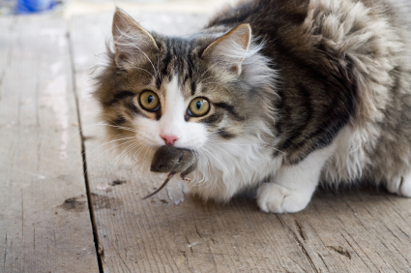
Newt Scamander, Fantastic Beasts and Where to Find Them
. . . the End

Slide 51
THANK YOU

