Slide 1
Chapter 7
Agitation and Aeration

Slide 2
Outline
Introduction
The oxygen requirement of industrial fermentation
Oxygen supply
Determination of K_{L}a value
Factors affecting K_{L}a value in fermentation vessels
Scale up

Slide 3
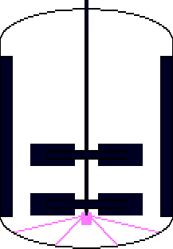
Typical Bioprocessing
Stock Culture
Raw Materials
Shake Flasks
Medium Formulation
Seed fermenter
Sterilization
Air
Agitator
Recovery
Purification
Products

Slide 4
Oxygen transfer
Majority of fermentation processes are aerobic and therefore require the provision of oxygen.
If the stoichiometry of respiration is considered then the oxidation of glucose is represented by
C6H12O6 + 6 O2 6H2O+6CO2
180 g
192g
Thus 192 g of O₂ is required for 180 g glucose
Notes:
Also oxygen is required for product formation ex: for pencillin production 2.2 gms of oxygen is required for 1g pencillin formation

Slide 5
Microorganisms take up the substrate/ nutrient from liquid
Hence both O₂ and glucose have to be available in liquid
Solubility of oxygen in water is 1.26 mmol/l at 25º_{C} or approx 8 mg/l
This will reduce further in the presence of salt or acid
This solubility is 6000 times lesser than the solubility of glucose

Slide 6
Thus it is not possible to supply entire oxygen required for batch fermentation in one addition
Oxygen will be supplied continuously at the rate of demand by the microorganism.
Oxygen is consumed quickly in aerobic cultures. For actively respiring yeast with 109 cells /ml oxygen in liquid have to be replaced 12 times in minute to keep up the cellular demand.
Notes:
O₂ in the liquid is measured as Dissolved oxygen concentration

Slide 7
Oxygen transfer
How satisfying oxygen demand?
•
–
–
Aeration and agitation
Productivity is often limited by oxygen availability
This chapter:
–
•
•
•
Oxygen requirements of industrial fermentations
Quantification of oxygen transfer (K_{L}a values)
Factors affecting K_{L}a values in fermentation
vessels
Notes:
The oxygen demand of an industrial fermentation process is normally satisfied by aerating and agitating the fermentation broth. However, the productivity of many fermentations is limited by oxygen availability and, therefore, it is important to consider the factors which affect a fermenter's efficiency in supplying microbial cells with oxygen

Slide 8
Aeration and Agitation
Aeration is to provide microorganism in submerged culture with sufficient oxygen for metabolic requirements.
Agitation ensures that a uniform suspension of microbial cells is achieved in a homogenous nutrient medium.

Slide 9
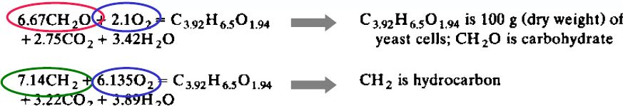
Oxygen requirement
What is happening in fact?
- Not only respiration of glucose
- Also biomass and product formation
carbohydrates
hydrocarbons oxygen demand
The more reduced the carbon source, the greater is the oxygen demand !

Slide 10
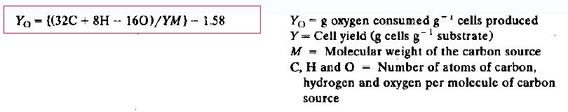
Oxygen requirement
What is happening in fact?
- Not only respiration of glucose
- Also biomass and product formation
A culture demand for oxygen is very much dependent
on the source of carbon in the medium

Slide 11
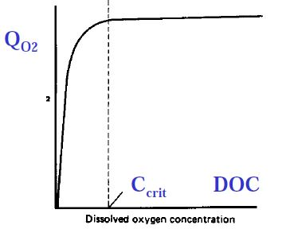
Oxygen requirement
Up to now: Overall Demand
Now: effect of dissolved oxygen (DOC) concentration on
QO2
Specific oxygen uptake rate (mmoles of oxygen / g dry weight cells and per hour)
Notes:
However, it is inadequate to base the provision of oxygen for a fermentation simply on an estimation of overall demand, because the metabolism of the culture is affected by the concentration of dissolved oxygen in the broth

Slide 12

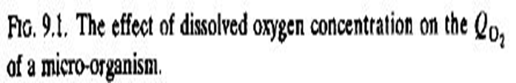
Oxygen requirement
Fig. 9.1 it may be seen that the specific oxygen uptake rate increases with increase in the dissolved oxygen concentration up to a certain point(referred to as C_{Crit}) above which no further increase in oxygen uptake rate occurs.

Slide 13

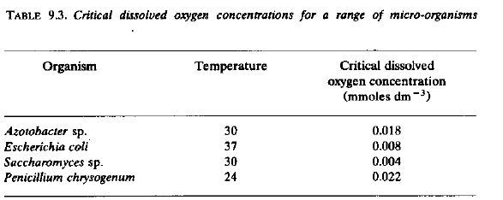
oxygen requirement
Notes:
Thus, maximum biomass production may be achieved by satisfying the organism's maximum specific oxygen demand by maintaining the dissolved oxygen concentration greater than the critical level.

Slide 14
OXYGEN
REQUIREMENTS
•
•
Max
QO2
gives
max biomass production
DOC <
Ccrit:
– Biomass production may be disturbed
– Product formation may
or
•
DOC >
Ccrit:
– Biomass production not influenced
– Product formation may
Notes:
Thus, maximum biomass production may be achieved by satisfying the organism's maximum specific oxygen demand by maintaining the dissolved oxygen concentration greater than the critical level

Slide 15
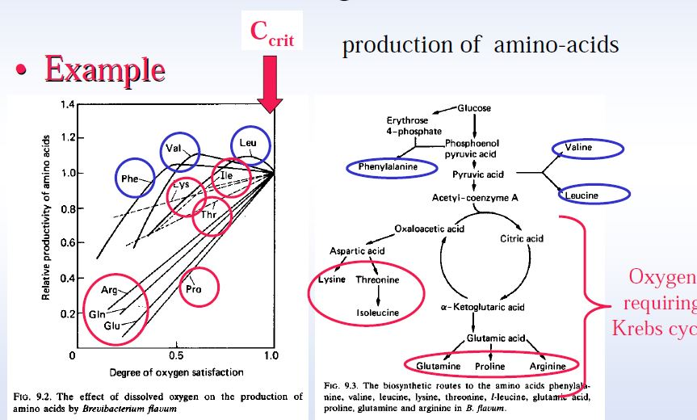
Oxygen Requirements
Oxygen excess should give rise to abundant TCA cycle intermediates, whereas oxygen
limitation should result in less glucose being oxidized via the TCA cycle, allowing more
intermediates to be available for phenylalanine, valine and leucine biosynthesis. Thus, some
degree of metabolic disruption results in greater production of pyruvate derived amino acids.
Investigating the amino acid biosynthesis by Brevibacterium flavum provides an excellent
example of the effects of the dissolved oxygen concentration on the production of a range of
closely related metabolites
Notes:
- members of the glutamate and aspartate families of amino acids was affected detrimentally by levels of oxygen satisfaction below 1.0
- whereas optimum production of phenylalanine, valine and leucine occurred at oxygen satisfaction levels of 0.55, 0.60 and 0.85, respectively

Slide 16
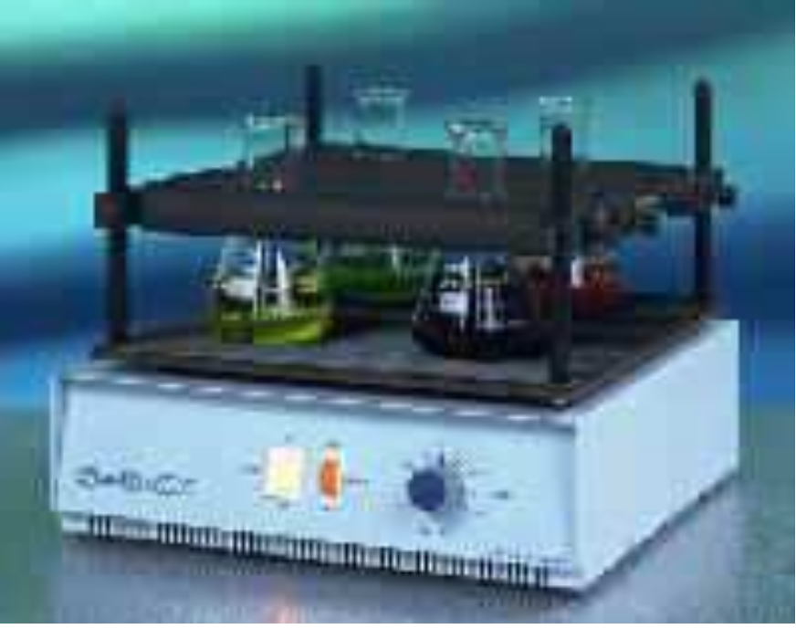
OXYGEN SUPPLY
•
•
Cheapest available source: AIR
Laboratory-scale fermentors: shake-flask technique
Notes:
The method for provision of a culture with a supply of air varies with the scale of the process:

Slide 17
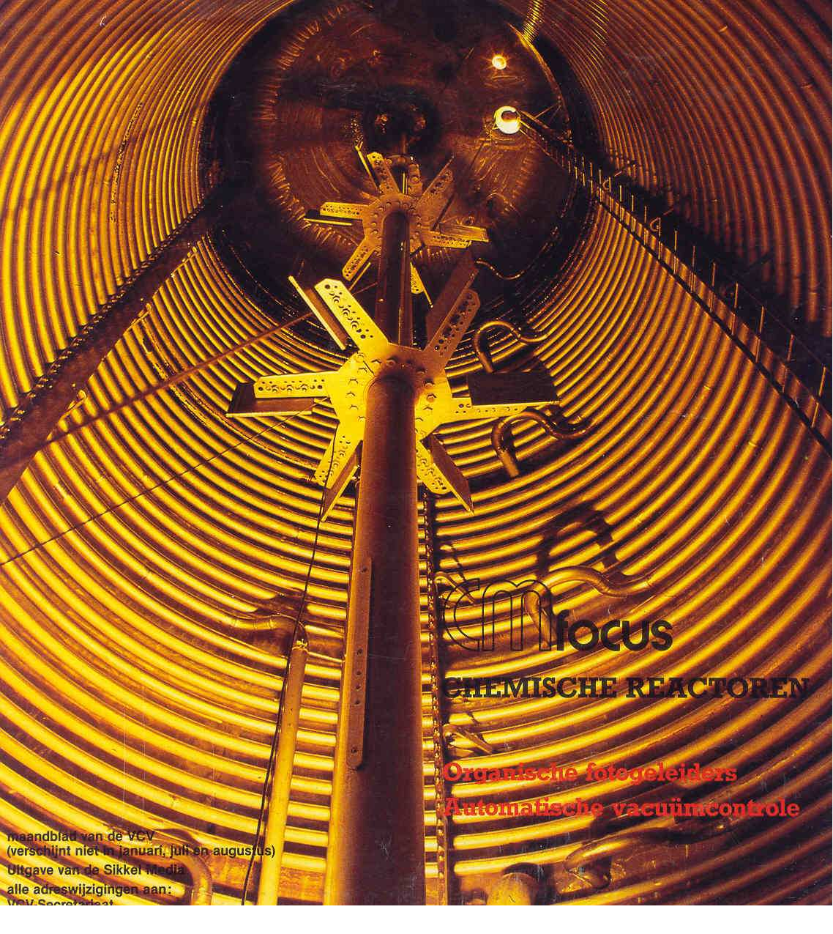
OXYGEN SUPPLY
•
•
Cheapest available source: AIR
Pilot and industrial fermentors: stirred aerated vessels

Slide 18
OXYGEN SUPPLY
•
to cell
Transfer
of
oxygen
from air
bubble
air bubble
O₂
O2
O
aerobic
micro-organism
2
1.
2.
3.
Transfer
Transfer
from bubble into medium
through medium
Uptake of dissolved oxygen by cell
Notes:
The transfer of oxygen from air to the cell, during a fermentation, is occurring in a number of steps:

Slide 19
OXYGEN SUPPLY
•
Transfer
of
oxygen
from air
bubble
to cell
rate limiting
air bubble
O₂
step
O2
O
aerobic
micro-organism
2
1.
2.
3.
Transfer
Transfer
from bubble into medium
through medium
Uptake of dissolved oxygen by cell

Slide 20
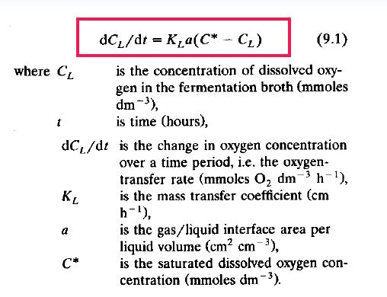
OXYGEN SUPPLY
•
Transfer of
oxygen from air bubble
to
cell
Notes:
The rate of oxygen transfer from air bubble to the liquid phase may be described by the equation

Slide 21
KL may be considered as the sum of the reciprocals of the resistances to the transfer of oxygen from gas to liquid and (C* - CL) may be considered as the 'driving force' across the resistances
It is extremely difficult to measure both KL and 'a' in a fermentation and, therefore, the two terms are generally combined in the term KLa, the volumetric mass-transfer coefficient, the units of which are reciprocal time (h⁻¹).
The larger the KLa, the higher the aeration capacity of the system.

Slide 22
The KLa value will depend upon the design and operating conditions of the fermenter and will be affected by such variables as:
- aeration rate,
- agitation rate and
- impeller design.
These variables affect 'KL' by reducing the resistances to transfer and affect 'a' by changing the number, size and residence time of air bubbles.

Slide 23
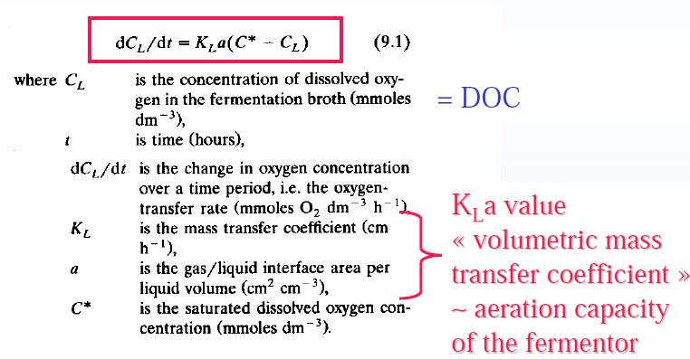
OXYGEN SUPPLY
•
Transfer of
oxygen from air bubble
to
cell

Slide 24
DETERMINATION of K_{L}a VALUES
Determination of KLa in a fermenter is important to establish its aeration efficiency and quantify effects of operating variables on oxygen supply.
It is important to remember that dissolved oxygen is usually monitored using a dissolved oxygen electrode which records dissolved oxygen activity or dissolved oxygen tension (DOT) while the equations describing oxygen transfer are based on dissolved oxygen concentration(DOC).
Thus, to translate DOT into concentration the solubility of oxygen in the fermentation medium must be known.
A number of different methods are available
Notes:
The solubility of oxygen is affected by dissolved solutes so that pure water and a fermentation medium saturated with oxygen would have different dissolved oxygen concentrations yet have the same DOT, i.e. an oxygen electrode would record 100% for both. Thus, to translate DOT into concentration the solubility of oxygen in the fermentation medium must be known and this can present difficulties.

Slide 25

DETERMINATION of K_{L}a VALUES
The sulphite oxidation technique
Gassing-out (static) techniques
Dynamic method of gassing out

Slide 26
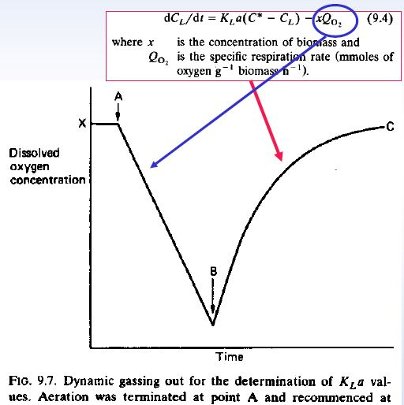
of
Dynamic method
gassing out
During a fermentation:
•
•
Stop supply of air
Linear decline in
DOC (zone AB) Start areation
(A)
•
again
(zone
BC)
Notes:
Over the period, BC, the observed increase in dissolved oxygen concentration is the difference between the transfer of oxygen into solution and the uptake of oxygen by the respiring culture as expressed by the equation

Slide 27

In Fig. 9.7 the slope of the line AB is a measure of the respiration rate of the culture.
At point B the aeration is resumed and the dissolved oxygen concentration increases until it reaches concentration X.
BC, the observed increase in dissolved oxygen concentration is the difference between the transfer of oxygen into solution and the uptake of oxygen by the respiring culture as expressed by the equation:
where x is the concentration of biomass
Qo₂ is the specific respiration rate (mmoles of oxygen g ⁻¹ biomass h⁻¹ ).
The term xQo₂ is given by the slope of the line AB in Fig. 9.7.

Slide 28

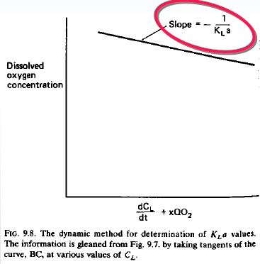
Dynamic Method of gassing out
This technique is convenient in that the equations may be applied using DOT rather than concentration because it is the rates of transfer and uptake that are being monitored so that the percentage saturation readings generated by the electrode may be used directly.
Notes:
Thus, from equation (9.5), a plot of CL versus dCL/dt + xQo2 will yield a straight line, the slope of which will equal -1/KLa, as shown in Fig. 9.8.

Slide 29
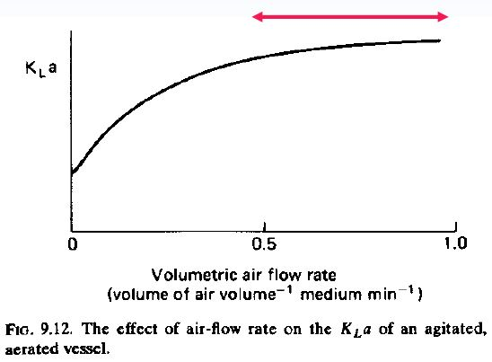
Factors affecting K_{L}a value in fermentation vessels
The effect of air flow rate on K_{L}a
Normally air flow rate used are 0.5 to 1.5 vvm
This air flow rate is maintained during scale up
If the impeller is unable to disperse the incoming air then OTR decreases extremely due to impeller flooding
Flooding is the phenomena where the air flow dominates the flow pattern
Notes:
Vvm =vessel volume per minute
When implere is flooded, bubbles will accumulate underneath the impeller and coalesce (come together and form one mass or whole)

Slide 30
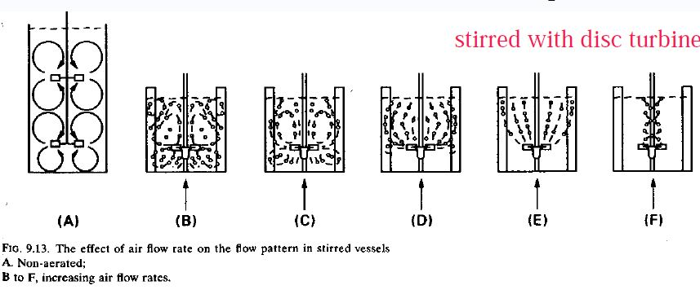
Factors affecting K_{L}a value in fermentation vessels
The effect of air flow rate on flow pattern
air-flow dominates flow pattern

Slide 31
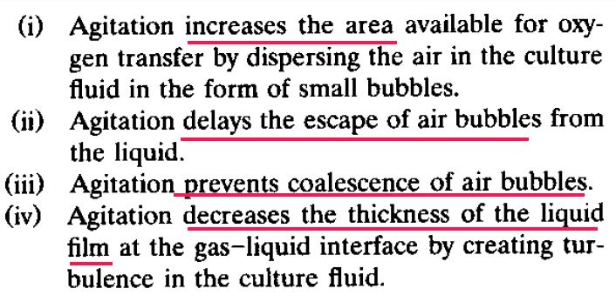
Factors affecting K_{L}a value in fermentation vessels
The effect of Agitation degree on K_{L}a

Slide 32
Factors affecting K_{L}a value in fermentation vessels
The effect of foam and antifoam on oxygen transfer
Presence of foam increases the residence time so air bubbles are depleted of oxygen
Foam in the impeller region prevents adequate mixing of
the fermentation broth
Antifoams are surfactants
- Collapse of bubbles in foam
- Decrease oxygen transfer rate
- Favours coalescence of bubbles (surface area increases)
Notes:
Surfactants: lower the surface tension between two liquids

Slide 33
Scale up
Study of problems associated with the transfer of experimental data from laboratory and pilot plant equipment to large scale industrial equipment
The fundamental requirement for scale up is that the model and the prototype should be the same to each other.
Two kinds of conditions must be satisfied to ensure similarity between the model and the prototype.
- similarity of the physical boundaries
- similarity of the flow fields

Slide 34
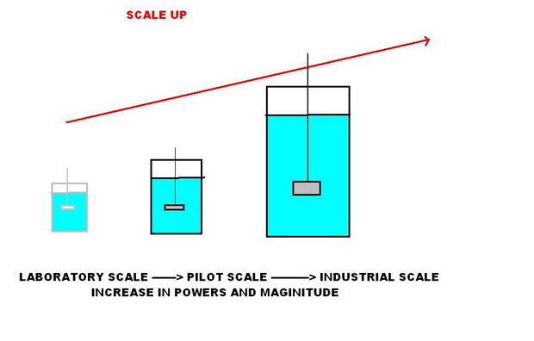

Slide 35
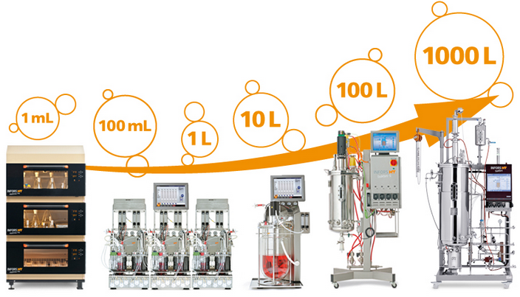
Scale Up

Slide 36
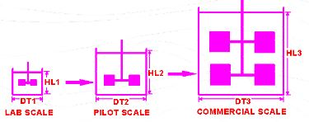

Physical boundaries
Preservation of geometric similarity of the physical boundaries
All linear dimensions of the model must be related to the corresponding dimensions of the prototype by diameter and height
i.e. Keep the ratio of the height H to diameter D t (tank) same in the model and prototype
Notes:
- Ratio of surface to volume decreases during scale-up.

Slide 37
Dynamic similarity of the flow fields
To achieve dynamic similarity in a stirred-tank reactor, scale-up can be based on the following criteria in addition to geometric similar boundaries:
- constant power input per volume(OTR)
- constant liquid circulation rate inside the reactor
- constant impeller tip speed (shear rate)
- constant Reynolds number( Heat transfer)
Notes:
Shear rate is the rate of change of velocity at which one layer of fluid passes over an adjacent layer.

Slide 38
Major factor in scale up
The cell/physiological state
The culture medium
Type of the bioreactor
Operational parameters

Slide 39
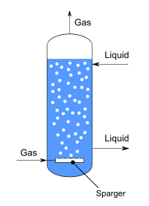
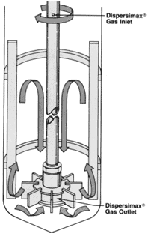
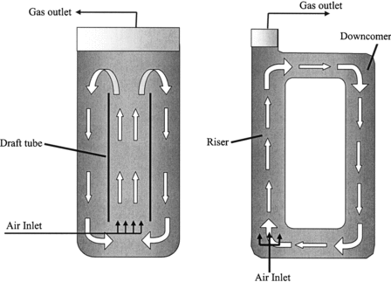
Type of bioreactor
Stirred tank reactor
Bubble column
Air lift column

Slide 40


Constant tip speed
N₁= Impeller speed of small bioreactor
N₂= Impeller speed of Large bioreactor
D_{i1}= Impeller diameter of small bioreactor
D_{i2}= Impeller diameter of large bioreactor
Notes:
It affects the Shear rate which is : The rate of change of velocity at which one layer of fluid passes over an adjacent layer.

Slide 41


Constant Reynolds number
N = Impeller speed
D = Impeller diameter
ρL= Density of the liquid
μL=Viscosity of the liquid
Notes:
Reynold number: inertial force over viscous force

Slide 42
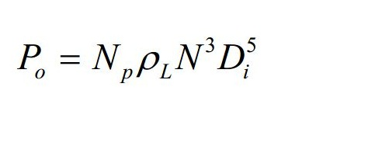
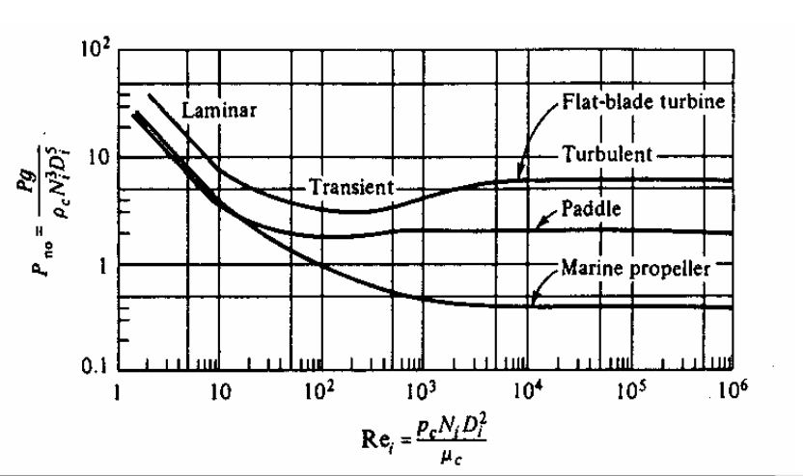
Constant Power consumption per unit volume
Ungassed power consumption ,
(Rushton’s equation)
N_{p}
Notes:
N=rotational speed
Np= power number
Di= impller diameter
Po=ungassed power

Slide 43
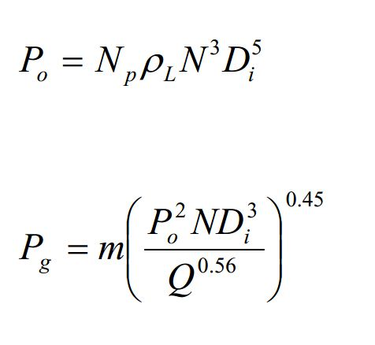
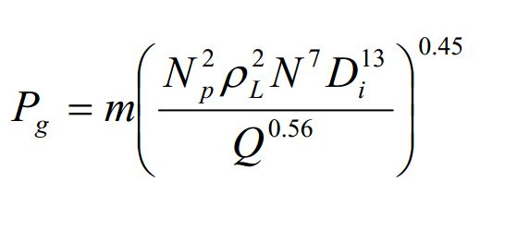
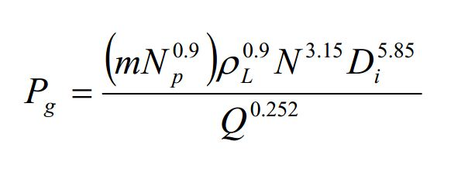
Constant Power consumption per unit volume
Ungassed power consumption ,
(Rushton’s equation)
Gassed power consumption ,
Notes:
Pg=gassed power

Slide 44
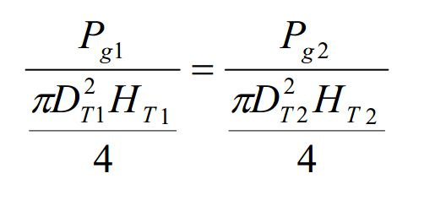
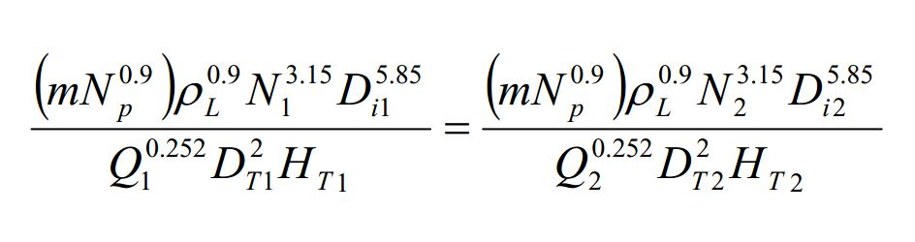
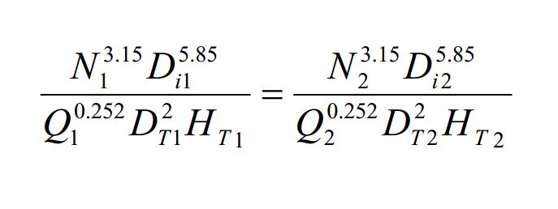
Constant Power consumption per unit volume

Slide 45
Steps in scale up
Identification of the principal environmental domain affected by the aeration and agitation
Identification of the process variable which affects the identified environmental domain
Calculation of the value of the process variable to be used on the large scale

Slide 46
Process Variable | Characteristics affected
Power consumption per unit volume | Oxygen Transfer Rate
Impeller tip speed | Shear Rate
Volumetric air flow rate | Oxygen Transfer Rate
Pumping rate | Mixing time
Reynolds number | Heat transfer

