Slide 1

Feed Additives
An Overview and Some Examples In Veterinary
Medicine & Toxicology
Takele Beyene, Assistant Professor
Addis Ababa University
College of Veterinary Medicine
VeLT4122

Slide 2
Objectives
Be familiar with the meaning of the Animal Medical Drug Use and Clarification Act (AMDUCA)
Issues in respect to using antibiotics in feed
Feed additives: In respect to the examples given in this lectures on feed additives, you should be able to recognize:
  Clinical signs
  Very general pathophysiology
  Specific animal species sensitivities
  What to sample for a diagnostic work up
  How it may be important to public health

Slide 3
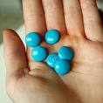
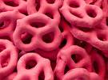
Food/Feed Additive
Definition
Food/feed additives
  Any substance that directly or indirectly becomes a component of food or that affects a food’s characteristic.
  May include grains, milling products, added vitamins, minerals, fats/oils, and other nutritional and energy sources
Pharmaceutical or nutritional substances that are added to processed or stored foods/feeds for various purposes
Dyes

Slide 4
Feed Additives
PHARMACEUTICAL OR NUTRITIONAL substances that
  ARE NOT natural feedstuffs,
  added to made-up or stored feeds for various purposes,
  to control infectious diseases or promote health and growth
IMPROPER use may cause:
  POISONING or
  result in undesirable RESIDUES in food intended for humans
If you (or someone else) add anything to feed, you must consider animal and public health!!!!

Slide 5
Examples of Feed Additives In Animal Feeds
Substance
  Buffers
    NaHCO3, MgO
  Yeast/Probiotics Cultures
  Minerals
    Zn, Se,
  Ionophores
  Chlortetracycline
Purpose
  Reduce Acidosis
  Beneficial “bugs”
  Address Deficiencies
  Coccidiostat/ Rumen Fxn
  Control Liver Abscess or
  Respiratory Disease Risk

Slide 6
Medicated Feed Applications
Veterinary feed directive (VFD)
  An important document if you prescribe antibiotics to be included in feed (but you must consider the same “issues” for use in water)
  Describes how medically important antibiotics may be used in feed and water
Medications mentioned in the VFD CANNOT be used extra label (ELDU; extra label drug use)
As of January 2017 all use of medically important antibiotics for production purposed (growth promotion) was prohibited
  Does not include ionophores (later)
  All water medications become prescription

Slide 7
AMDUCA Animal Medical Drug Use Clarification Act
About Extralabel Drug Use (ELDU) in animals
ELDU only by vets
ELDU only for FDA approved human and animal drugs
A valid VCPR (veterinarian-client-patient-relationship)
ELDU:
  Only for therapeutic use (not production)
  ELDU in feed is prohibited!
  Prohibited if it results in violative food residues (any residue)
  Specific prohibited drugs

Slide 8
Toxicology Cases Involving
Feed & Feed Additives

Slide 9
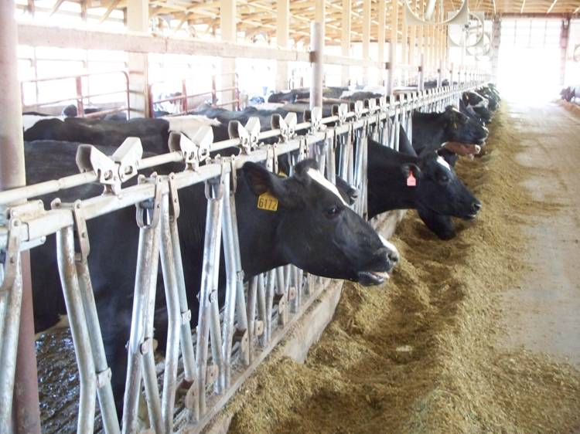
“Three rations” on any (dairy) farm
Actually, three potential rations for any animal
Calculated (on paper)
Mixed (In the feed)
What the animals eat (sorting)

Slide 10
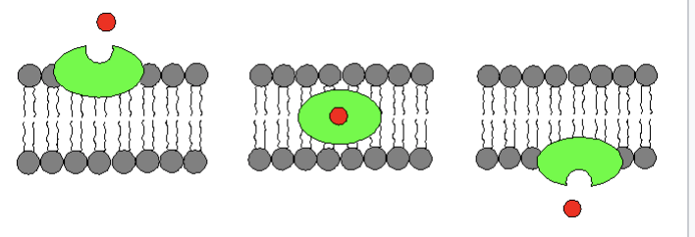
Approved Animal In-Feed Medications
An ionophore is a chemical species that reversibly binds ions
Ionophores
  Phore (Greek): To Carry
  Polyether fermentation compounds derived from Streptomyces sp. that facilitate transport across biologic membranes by forming
    Lipid Soluble
    Dynamically Reversible Complexes
    Mono or Divalent Cations
Licensed for cattle, chickens, goats,

Slide 11
Monensin (Rumensin®)
Forms complexes with monovalent cations, including sodium and potassium.
The complexes are transported in a nonpolar manner across the bacterial cell membrane.
As such, it acts as an Na⁺/H⁺ antiporter.
Greater affinity for Na⁺ than K⁺ or Ca²⁺

Slide 12
Antimicrobial Activity of Ionophores
Generally bacteriostatic
  changes the competitive rumen environment
High activity against Gram (+) bacteria
  Gram -ve organisms resistant (e.g., E. coli, Salmonella sp.)
  due to thick lipid membranes
Potency based on changes in rumen fermentation
  MIC: poor indicator of ionophore efficacy

Slide 13
Activity of Ionophores (cont.)
Antibacterial activity selects fermentation products
  Favors succinate and propionate production
    produced by Gram (-) bacteria
    fiber digesting organisms
  Reduces butyrate, acetate, ammonia, methane, hydrogen and lactate (lactic acid) production
    produced by Gram (+) bacteria
    sugar digesting organisms

Slide 14
Ionophore Influences on Metabolic Disease
Favors Propionic acid production
Acetate and ketones
Ketosis & hepatic lipidosis
Inhibits lactate producing (Strep. bovis & Lactobacillus; Gram +) & spares lactate utilizing bacteria (Gram -)
  Rumen lactic acidosis (grain overload)

Slide 15
Antimicrobial and Drug Residue Profile
For Ionophores/Monensin
  No genes that code for resistance – no transfer between bacteria possible
No meat or milk withholding
  No parent (un-metabolized) monensin in meat or milk
    metabolites (many) excreted entirely in bile (feces)
    Degrades in environment < 30 days

Slide 16
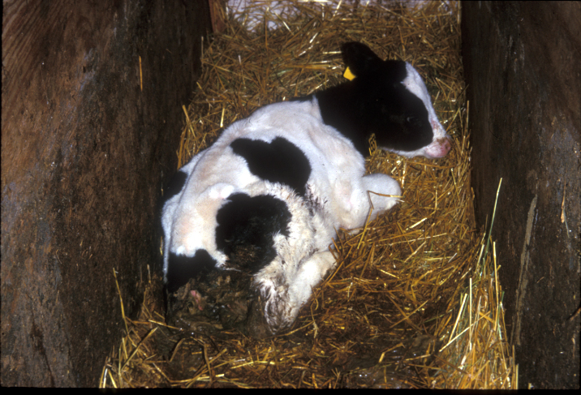
Ionophores Action on Protozoa
Disruption of protozoal electron transport system
  Control of:
    Coccidia
    Toxoplasmosis
    Sarcocystis
  Approved for use in ruminants (cattle sheep & goats) and poultry

Slide 17
It seems so safe….toxicity?
Overdose or Misuse in Target species (cattle)
Mixing errors
Livestock “break ins” into feed
  LD ₅₀ = 50 – 80 mg/kg
Packaged as Rumensin 90® – 90 gm/ lb
Rumensin® 80 – 80 gm/lb

Slide 18
Species Sensitivity for Ionophores
LD₅₀
Horses = 2 - 3 mg/kg
Sheep = 12 mg/ kg
Swine = 16 mg/kg
Dogs = 20 mg/ kg
Goats = 24 mg/kg
Cattle = 50 – 80 mg/ kg
Poultry = 200 mg/ kg

Slide 19
General Signs of Ionophore Toxicity
  Anorexia
  Hypoactivity
  Weakness (especially legs)
  Ataxia
  Depression
  Diarrhea (except horses = scant manure)
  Recumbent
  DEATH

Slide 20
Diagnostics for Ionophore Toxicity
  Retrieve and analyze stomach/rumen contents
  Retrieve and analyze feed for ionophore content and concentration
  Chronic Toxicity
    May die acutely (cardiac failure) from an exposure occurring some time ago
    Stomach/ Rumen contents may be negative at time of death
    Feed in question is usually no longer available

Slide 21
Treatment for Ionophore Toxicity
  Fluids to correct electrolyte abnormalities & maintain renal perfusion
  Vitamin E/ Se – May protect cells by stabilizing cell membranes (Lipid peroxidation)
  Activated Charcoal to absorb and mineral oil to protect gut (decrease absorption of active ingredient)
  ~ 99% of ionophores are eliminated in feces, poor GI absorption, very low tissues levels for assay
    Hence, testing tissues is not effective in detecting ionophores

Slide 22
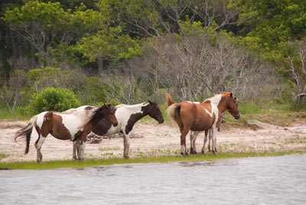
Salt Poisoning/ Sodium Toxicity
Common CNS signs in livestock populations
  Water deprivation,
    Plumbing issue, Loss of electricity, frozen water pipes
  Salinity in water/Grass
    Chincoteague Ponies have adapted
  Imbalanced rations
  Accidental gluttony

Slide 23
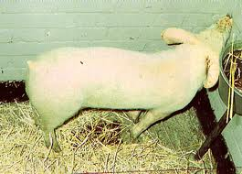
Salt Poisoning/ Sodium Toxicity
Clinical signs
  Diarrhea
  Ataxia
  Hyperexcitability
  Seizures
  Head pressing
  Constant chewing
  Muscle twitching
  Coma
  Death respiratory failure

Slide 24
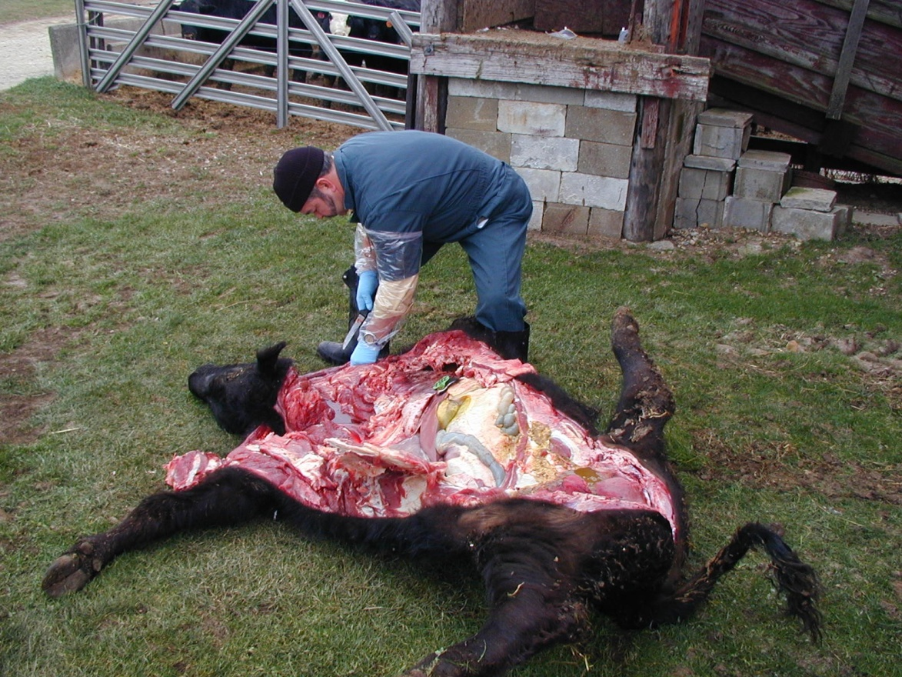
Salt Poisoning/ Sodium Toxicity
Pathophysiology
  Accumulation of Na ions in CSF, and tissue
  Interferes with sodium transport of cells
  Water engorgement
  Extracellular fluid becomes relatively (CSF)hypotonic
  Water into brain-edema

Slide 25
Salt Poisoning/ Sodium Toxicity
Clinical Pathology
  Hypernatremic > 145 meq/L
  Normonatremic if recently drank water
  CSF : > 200 meq/L
  Brain tissue > 1800 ppm
  These tissues can be used for diagnosis

Slide 26
Why Livestock Feed–Associated Investigations Are Intricate?
There are THREE rations on the farm:
Calculated
Mixed
What the cows eat

Slide 27
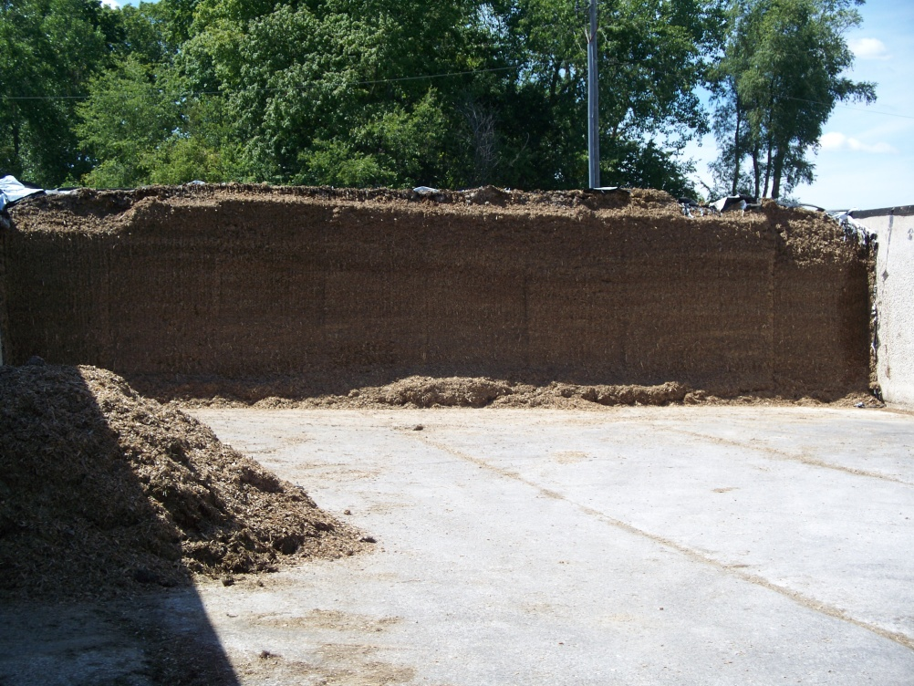
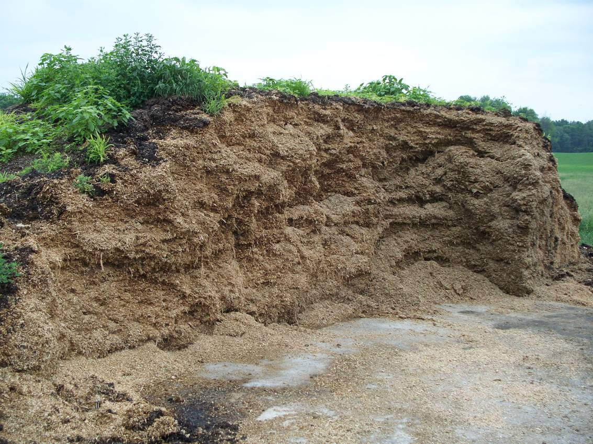
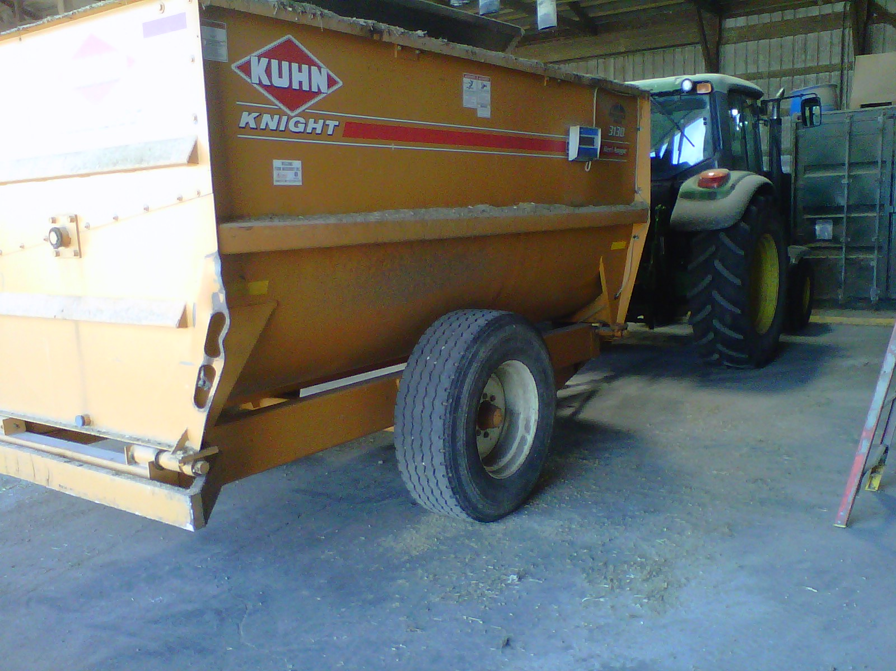
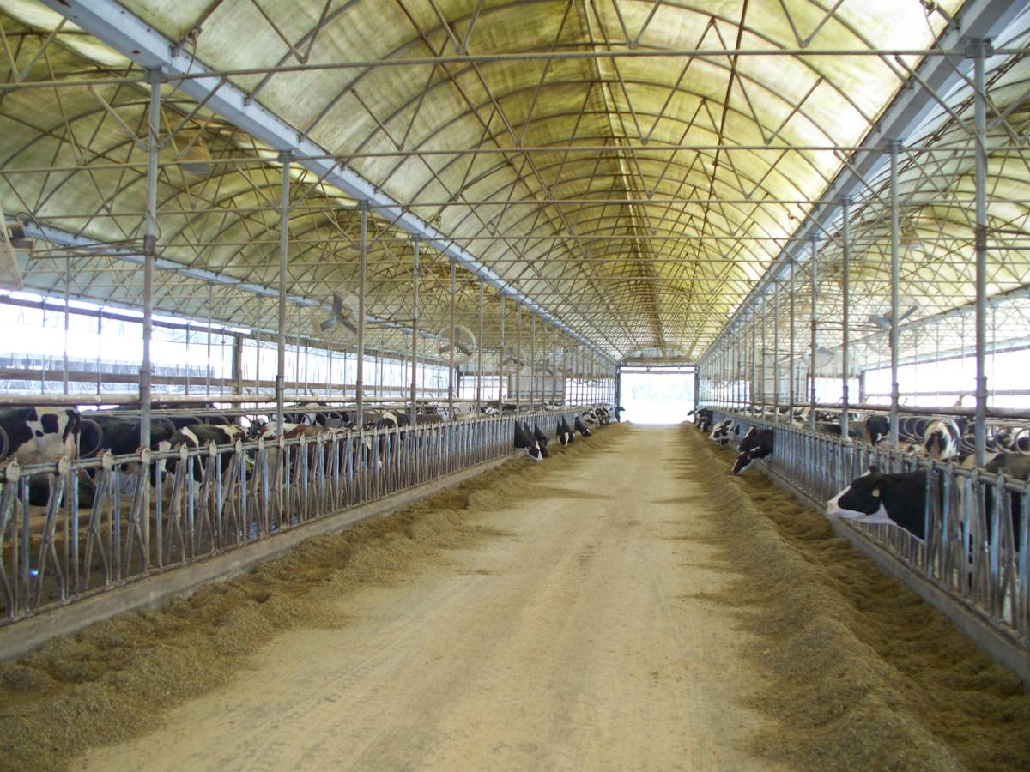
Variability in forages = Variability in rations
Total Mixed Ration
Cow Casserole

Slide 28
Toxic Contaminants In Livestock Feed
Loss or treatment costs of the animals
Losses to the farm
Risk to farm families consuming products directly from their farm
  Can be a concentrated “dose” in eggs, milk or meat
Also THINK PUBLIC HEALTH!
  Greater risk of contamination throughout the human food chain

Slide 29
Overall Conclusions
  Although intended as feed additives, they can be toxic!
  Large groups of animals affected should make you think of feed contamination with a toxic or potentially toxic substance
  Toxic substances in food animals may result in contaminated products: Meat, milk, eggs
    You have an obligation to protect public health

