Slide 1
Chapter 8
Downstream processing

Slide 2
Outline
Introduction
Cell disruption
Removal of insoluble
Product isolation
Product purification
Product polishing

Slide 3
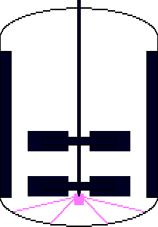
Typical Bioprocessing
Stock Culture
Raw Materials
Shake Flasks
Medium Formulation
Seed fermenter
Sterilization
Air
Agitator
Recovery
Purification
Products
Notes:
A bioprocess is a specific process that uses complete living cells or their component to obtain desired products

Slide 4
Downstream processing
The various stages of processing that occur after the completion of the fermentation or bioconversion stage, including separation, purification, and packaging of the product.
is any treatment of culture broth after fermentation to concentrate and purify the products

Slide 5
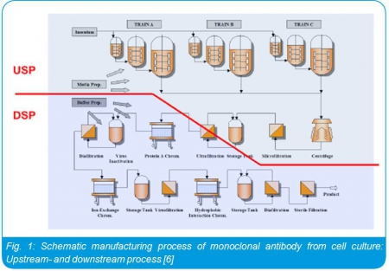

Slide 6
Stage in Downstream processing
Crude product
Product recovery
Removal of insoluble
Cell disruption
Purify the product
Finished product
market
Notes:
Crude product: is the product initially isolated from the reaction mixture prior to purification step.

Slide 7
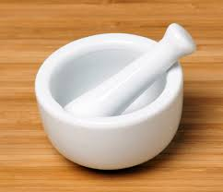
Cell disruption
Some product are intercellular including many enzymes and products required to disrupt the cells and release these products e.g. Yeast
Cell disruption can be achieved by both mechanical and non mechanical methods
Mechanical – sonication and liquid shear homogenization etc.
Non mechanical – autolysis, osmosis shock etc.
Notes:
Intercellular: located or occurring between cells.

Slide 8
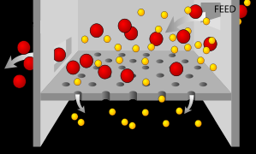
Removal of Insoluble
Separation of cells, cell debris or other particulate matter from fermentation broth culture
Typical operations to achieve this:
Filtration
Centrifugation
Sedimentation
Flocculation a process where a solute comes out of solution in the form of floc or flakes.
Gravity settling

Slide 9
Filtration
A mechanical operation used for the separation of solids from fluids (liquids or gases) by interposing a medium to porous membrane through which the fluid can pass, but the solids in the fluid are retained.

Slide 10
Filtration
Separation of particles from liquid by applying a pressure to the solution to force the solution through a filter. Filter are materials with pores
Particles larger than the pore size of the filter are retained by filter.
Particles smaller than the pore size of the filter pass through the filter along with the liquid

Slide 11
Filtration
The solid particles deposited on the filter form a layer, which is known as filter cake.
All the solid particles from the feed are stopped by the cake ,and the cake grows at the rate at which particles are bought to its surface.
All of the fluid goes through the cake and filter medium.

Slide 12
Continuous Rotary Vacuum filter
It is one of the most commonly used type of filter in fermentation.
The drum is pre coated prior to filtration.
A small agent of coagulating is added to the broth before it is pumped into the filter.
The drum rotates under vacuum and a thin layer of cells sticks to the drum.
The thickness of the layer increases in the section designed for forming the cake.

Slide 13
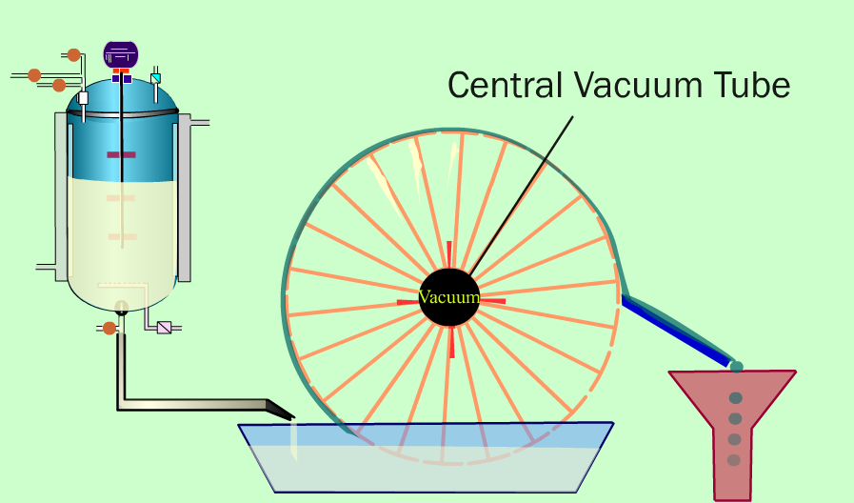
Continuous Rotary filter
Liquid filtrate
Filter
Hollow spokes
Cell mass
Perforated drum
Knife

Slide 14
Points to be considered while selecting the filter medium:
Ability to build the solid.
Minimum resistance to flow the filtrate.
Resistance to chemical attack.
Minimum cost.
Long life

Slide 15
Centrifugation
Centrifugation is used to separate particles of 100 – 0.1 micrometer from liquid by gravitational forces.
It depends on particles size, density difference between the cells and the broth and broth viscosity.
Use of the centrifugal force for the separation of mixtures
More-dense components migrate away from the axis of the centrifuge
Less-dense components migrate towards the axis.
Types of centrifuges used are Tubular bowl centrifuge, multi-chamber centrifuge, disc bowl centrifuge etc.

Slide 16
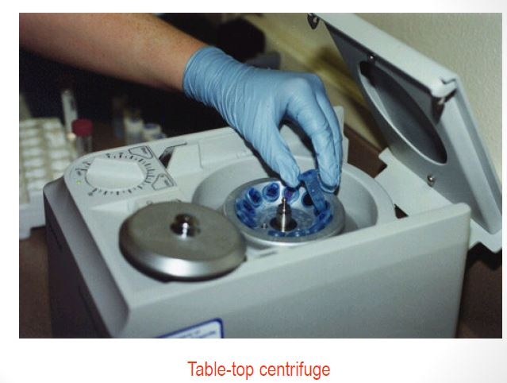

Slide 17
Sedimentation
It is applicable only for large particles greater than 100 micrometer flocs.
It is a slow process and takes ~3 hours.
It is used in process like activated sludge effluent treatment.
It’s a free settling process depends only on gravity.

Slide 18
Flocculation
Process where a solute comes out of solution in the form of flocs or flakes.
Particles finer than 0.1 µm in water remain continuously in motion due to electrostatic charge which causes them to repel each other
Once their electrostatic charge is neutralized (use of coagulant) the finer particles start to collide and combine together .
These larger and heavier particles are called flocs.

Slide 19
Product Isolation
Removal of those components whose properties vary markedly from that of the desired product.
Water is the chief impurity
Isolation steps are designed to remove it (i.e.dialysis)
Reducing the volume
Concentrating the product.
Liquid –liquid extraction, adsorption, ultrafiltration, and precipitation are some of the unit operations involved.
Notes:
Dialysis: is the separation of particle in a li

Slide 20
Liquid -Liquid extraction
It is a separation process that takes the advantage of the relative solubilities of solute in immiscible solvents.
Solute is dissolved more readily and becomes more concentrated in the solvent in which it has a higher solubility.
A partial separation occurs when a number of solutes have different relative solubilities in the two solvents used.
Solvent should be non toxic, selective, inexpensive and immiscible with broth and should have a high distribution coefficient for the product.
Notes:
Distribution coefficient: measure of the difference in solubility of the compound in the two phase

Slide 21
Adsorption
is a surface phenomenon
It is the binding of molecules to the surface and different from absorption.
The binding to the surface is weak and reversible.
Compounds containing chromogenic group are usually strongly adsorbed on activated carbon.
Common adsorbent used are activated carbon, silica gel ,alumina becoz they present enormous surface areas per unit weight.
Notes:
Absorption: is the process in which a fluid is dissolved by a liquid or a solid (absorbent)
Adsorption: is the process in which atoms, ions or molecules from a substance adhere to a surface of the adsorbent
Chromogenic: production of color or pigments

Slide 22
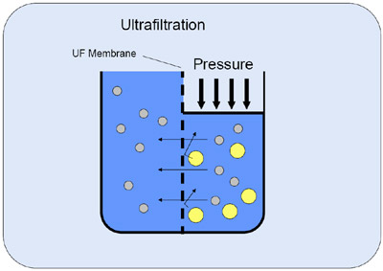
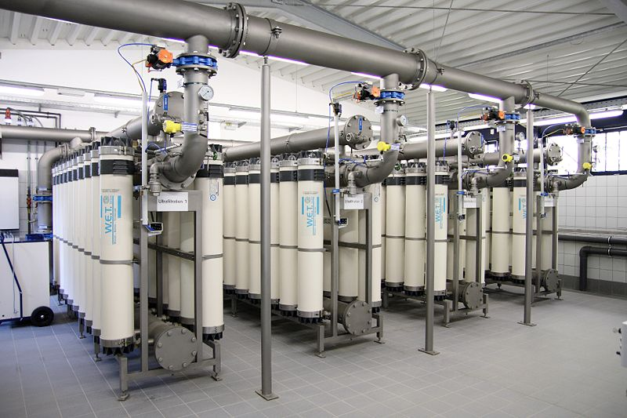
Ultrafiltration
UF is basically a pressure-driven separation process.
The operating pressure is usually between 0.1 and 1 MPa.

Slide 23
Ultrafiltration
UF is governed by a screening principle and dependent on particle size.
UF membranes have a pore size between 1 nm and 100 nm (10 and 2000 Å), thus allowing retention of compounds with a molecular weight of 300 to 500 000 Dalton.
Typically, the process is suitable for retaining biomolecules, bacteria, viruses, polymers, colloidal particles and sugar molecules.

Slide 24
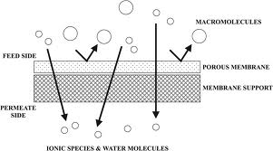
Ultrafiltration

Slide 25
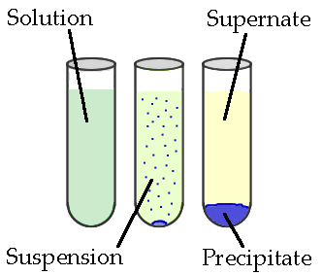
Precipitation
Formation of a solid in a solution during a chemical reaction.
Solid formed is called the precipitate and the liquid remaining above the solid is called the supernate.

Slide 26
Precipitation
Salts such as ammonium & sodium sulphate are used for proteins to precipitate.
Organic solvents methanol used to precipitate dextrans.
Chilled ethanol and acetone used for protein precipitation.
Non ionic polymer such as polyethylene glycol used in precipitation.

Slide 27
Product Purification
Done to separate those contaminants that resemble the product very closely in physical and chemical properties.
Expensive to carry out
Require sensitive and sophisticated equipment
Significant fraction of the entire downstream processing expenditure.
Examples of operations include affinity, size exclusion, reversed phase chromatography, crystallization and fractional precipitation.

Slide 28
Product purification
Removing components with properties similar to those of the products
Chromatography
Separates molecules by their chemical and physical difference
e.g.
Adsorption chromatography
Affinity chromatography
Ion exchange chromatography

Slide 29
Components
- Solute: molecule of interest
- Mobile phase( solvent, gas)MF
- Stationary phase( solid, liquid)SF
Principle
- The solute partion between the two phase
- The interaction with the solute phase determines how fast the solute migrate in the mobile phase
- Solute that interact differently with the stationary phase can be separated

Slide 30
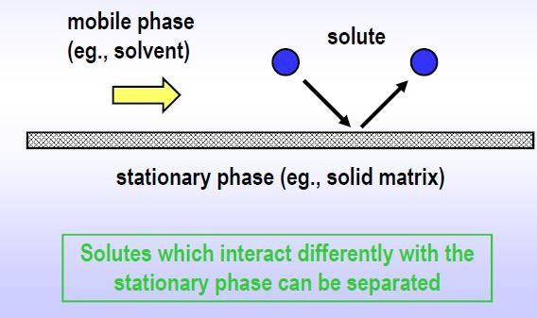
Chromatography components and principle

Slide 31
Liquid Chromatography
Mobile phase is a liquid.
Carried out either in a column or a plane.
HPLC
In the HPLC technique, the sample is forced through a column that is packed with irregularly or spherically shaped particles or a porous monolithic layer (stationary phase) by a liquid (mobile phase) at high pressure.

Slide 32
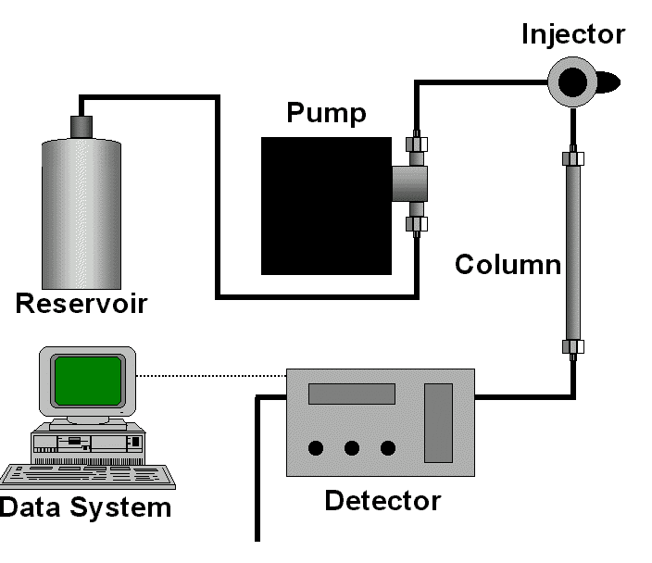
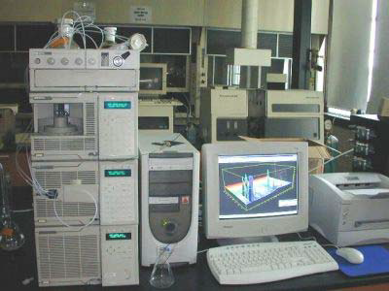
HPLC Configuration

Slide 33
Product Polishing
Final processing steps which end with packaging of the product in a form that is stable and easily transportable
Crystallization, concentration and drying are typical unit operations

Slide 34
Crystallization
process of formation of solid crystals precipitating from a solution, melt or more rarely deposited directly from a gas.
chemical solid-liquid separation technique, in which mass transfer of a solute from the liquid solution to a pure solid crystalline phase occurs.

Slide 35
Crystallization process
Liquid mixer
Generation of supersaturation: driving force
Nucleation: birth of
solid phase
Final product
Crystal growth

Slide 36
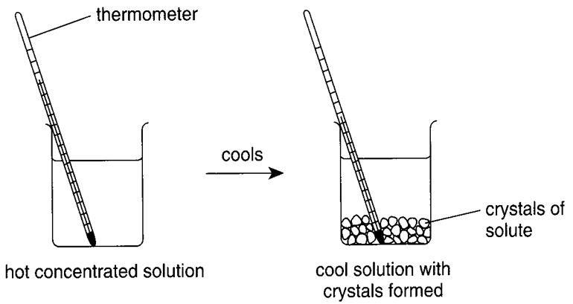
Crystallization
• By cooling saturated solution

Slide 37
Drying
• It involves the transfer of heat to the wet material
and the removal of the moisture as water
vapor
• Drying Methods
（1） Atmospheric drying
（2）Vacuum drying
(Decompression )
（3） Freeze-drying (lyophilization)
（4） Spray drying

Slide 38
lyophilization
Freeze drying
Process in which water is removed from a product after it is frozen.
It is placed under vacuum allowing the ice to change directly from the solid to vapor without passing through a liquid phase

