Slide 1
Introduction to Biochemical Eng.
CBEg 4192
AAiT, 2020

Slide 2
Outline
Biotechnology
Typical biological process
Overview of microorganisms
Microbial growth
The development of pure culture
Disinfection and sterilization

Slide 3
BIOTECNOLOGY: DEFINITIONS
It is the integrated use of biological Sciences, microbiology, genetics and chemical engineering, to utilize from the technological level the properties and possibilities of microorganisms and cell cultures (Fed. European biotechnology, Feb. 1978)
Is The scientific and engineering application of principles in order to processes where biological agents transform a material into a product having a utility. (A. T. Bull, 1989)
Is the use of living organisms or substances obtained from living organisms, to produce products of value to man. (J. L. Marx, 1989)
Is the application of science and engineering principles to the processing of materials by biological agents or direct treatment of biological materials for the production of goods and services (ocde: Organization for cooperation and development)

Slide 4
TYPES OF BIOTECNOLOGIES
INDUSTRIAL
AGRICULTURE
MEDICAL
ANIMAL
ENVIROMENTAL

Slide 5
Applications of biotechnology
Biotechnology - the use of techniques based on living things
(plants, animals, microbes) to make products or improve
other species
Area | Products or Applications
Pharmaceuticals | - Antibiotics, insulin, antigens, interferon …
Agriculture | Improve yield, quality, flavour of food, increase shelf life Development of biological control agents and their products - Improvement of animal feeds
Environmental | - Bioremediation - Biofuel production - Biofertilizer & biopesticides production
Chemicals | Acetic acid, acetone, ethanol…
Bioelectronics | Biosensors, biochips

Slide 6
Modular representation of any technological process
Concepts and definitions

Slide 7
TECHNOLOGY (definition)
“ Is the set of scientists knowledge, engineering, managerial and/or empirical that contribute to the creation, production, distribution and marketing from the point of view of the scope of technology, or, from the obtaining of the product to the end user,”
The technologies can be classified as: process technology: technological schemes, material balance, flow diagram and description of the technological equipment product technology: Composition, configuration, properties or mechanical design of the product. Marketing, packaging

Slide 8
MODULAR REPRESENTATION OF ANY TECNOLOGICAL PROCESS
Raw material
Technological Modules:
Set of process and/or units operations required in order to get a product or a given objective.
MODULE
A
MODULE
B
MODULE
C
MODULE
D

Slide 9
Unit operations or process
Grinding
Filtration
Centrifugation
Mixing
Drying
Sedimentation
Chemical and/or biological reactions
Distillation
Others

Slide 10
Cont..
MODULE A: PREPARATION OF RAW MATERIAL AND MATERIALS
MODULE B: CHEMICAL AND/OR BIOLOGICAL TRANSFORMATIONS
MODULE C: SEPARATION, PURIFICATION AND/OR FORMULATION
MODULE D: STORAGE, PACKING, DISTRIBUTION AND TRADING

Slide 11
Module B:
Chemical and/or biologicals reactions
It is developed in bioreactors, known also as fermenter or biological reactor
Fermentation or biotransformation process takes place

Slide 12
Components present in any biotransformation process
Cell or component of them
Culture media
Parameter of fermentation
Type of bioreactors
All of this components are the main part of this course

Slide 13
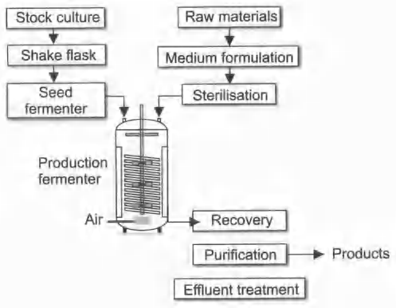
Typical biological process

Slide 14
Biological Process
Industrial applications of biological processes are to use living cells or their components to effect desired physical or chemical changes.
Biological processes have advantages and disadvantages over traditional chemical processes.

Slide 15
Biological Process
Advantages | Disadvantages
Mild reaction conditions | Complex product mixtures
Specificity | Dilute aqueous environments
Renewable resources | Contamination
Recombinant DNA technology | Variability

Slide 16
Overview of microorganisms
Microbiology- is the science that deals with tiny organisms or microbes (microorganisms)
Microorganisms are organisms that can not be seen with the naked eye
It includes- bacteria, viruses, fungi, and parasites
Microorganisms exist virtually everywhere (cosmopolitan) in the biosphere
    In soil, water, food, in the air, on the surface and inside our body
    Can also survive in most unlikely environment, like in cold air, in hot spring at temperature of 90 ⁰C

Slide 17
Overview of microorganisms cont…
Microbes directly benefit or harm human beings – some of the economic importance of micro organisms are
    cause diseases both in plants and animals
    most of antimicrobial drugs are produced by microbes
    e.g. Streptomycin – Streptomycetes, Penicilin – Penicillium
    play key role in nutrient recycling- carbon and nitrogen
        Increase soil fertility
    involved in food production and processing
    e.g. making of yogurt, cheese, wine, beer, bread
    some microorganisms (oceanic algae) contribute to the atmosphere by producing oxygen – photosynthesis
    biotechnology e.g. insulin
    biological weapons

Slide 18
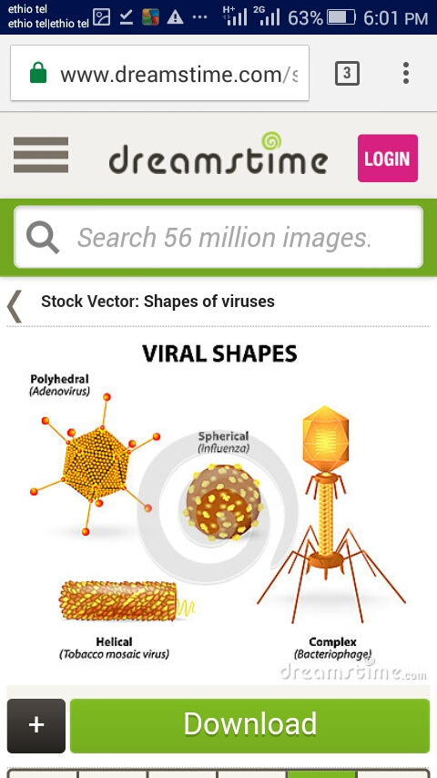
Overview of microorganisms cont…
Viruses
  Are obligate intracellular parasites of other living cells
  Have a protein coat over their nucleic acid and sometimes a lipid surface membrane
  Carry genetic information in either DNA or RNA molecules, but never both
  Do not have their own metabolism, use host metabolism

Slide 19
Overview of microorganisms cont…
Bacteria
  Are prokaryotes
  Unlike viruses bacteria possess both DNA and RNA
  Vary in size and different genera have different shape (rod, spherical and spiral)
  Reproduce by binary fission
  Many bacteria are capable of independent growth and they can be cultured in artificial media
  Some bacteria are obligate intracellular parasite e.g. Chlamydia trachomatis

Slide 20
Overview of microorganisms cont…
Classification of Bacteria:
Taxonomy – the science that deals with identification, nomenclature and classification of organisms
Classification – is the arrangements of organisms into taxonomic groups (taxa) on the basis of differences and similarities
Nomenclature- is the assignment of names to the taxonomic groups according to international rules
Identification – the process of determining that a new isolates belongs to one of the established, named taxa

Slide 21
Overview of microorganisms cont…
Classical methods of taxonomy
1. Morphological characters
Concern cell shape and size, staining reactions, presence or absence of spores, type of motility etc
e. g. Cocci: These are spherical bacteria
Diplococcus - Binary fission occurs in one plane,
e.g. Pneumococcus
Streptococcus - Cocci arranged in chains,
e.g. Streptococcus pyogenes.
Staphylococcus - Cocci arranged in clusters,
e.g. Staphylococcus aureus.

Slide 22
Overview of microorganisms cont…
Fig. Shapes of some different bacteria

Slide 23
Overview of microorganisms cont…
Bacilli
Rod-shaped: e.g. Enterobacteria, Bacillus species
Comma shape - e.g. Vibrio
Coccobacilli- e.g. Brucella
Spirochetes: these are slender, refractile and spiral filaments
e.g. Treponema, Borrelia and Leptospira
Based on staining properties
Gram-positive bacteria: e.g. Gram-positive cocci (Staphylococcus); Gram-positive bacilli (Bacillus)
Gram-negative bacteria: e.g. Gram-negative cocci (Neisseria) Gram-negative bacilli (Salmonella)

Slide 24
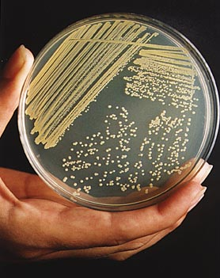
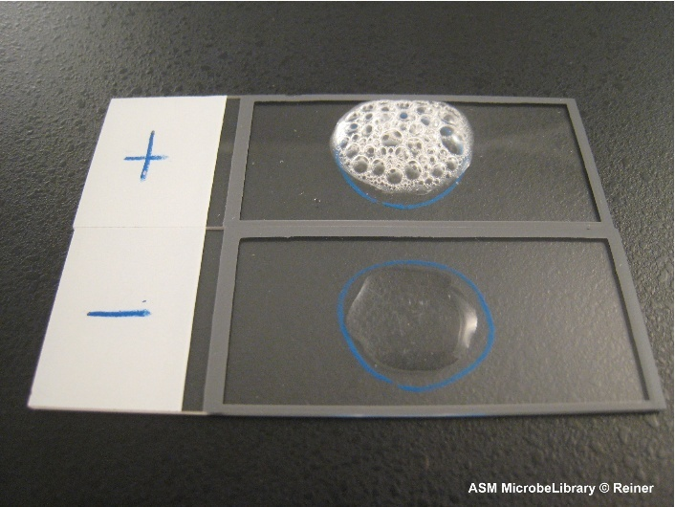
Overview of microorganisms cont…
2. Cultural characters
Include the cultural requirements for multiplication e. g. nutrients, oxygen , temperature, liquid media , solid media
3. Biochemical characters
Include the metabolic end products and the presence or absence of particular enzyme
4. Molecular characters
Include the sequences of bases in the DNA

Slide 25
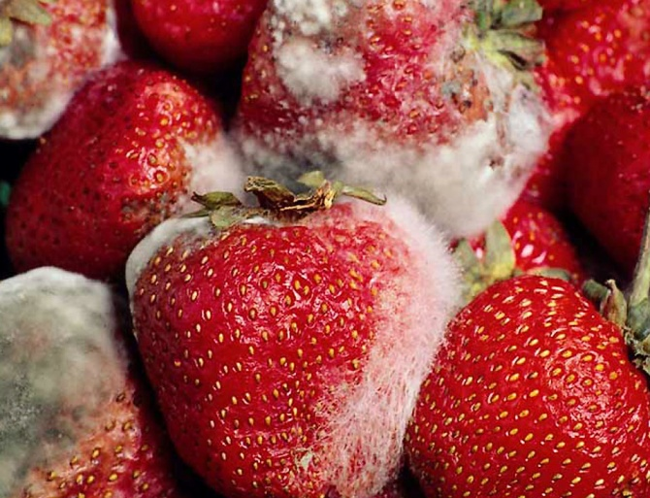
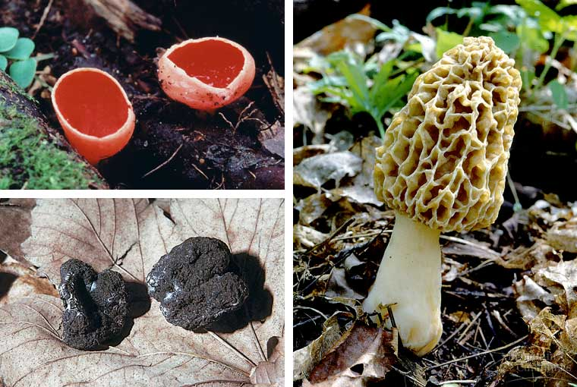
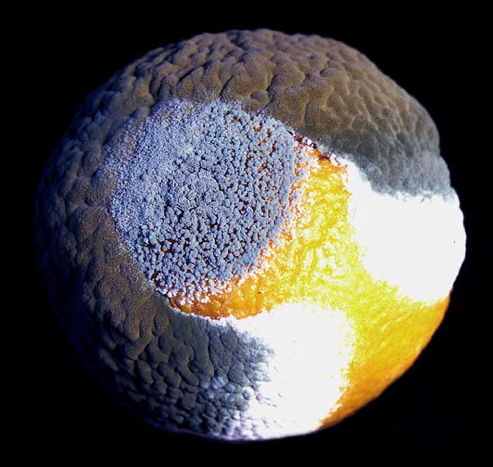
Overview of microorganisms cont…
Fungi
  Eukaryotes
  Exist either in yeast or mold forms
  Larger than bacteria and have a well advanced structure
  e.g. Saccromyces cerevisiae (yeast) , Cryptococcus, Candida, Penicillium

Slide 26
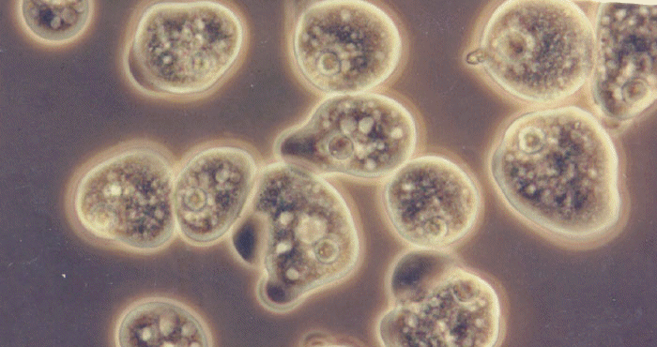
Overview of microorganisms cont…
Parasites
  Eukaryotes
  The most diverse of all microorganisms
  Range from unicellular amoebas to multicellular tapeworms

Slide 27
Microbial Growth
It is an increase in all the cell components, which ends in multiplication of cell leading to an increase in population.
It involves - an increase in the size of the cell & an increase in the number of individual cells.
Bacteria divide by binary fission.

Slide 28
Microbial Growth cont…
Binary Fission
Division exactly in half
Most common means of bacterial reproduction
  forming two equal size progeny
  genetically identical offspring
  cells divide in a geometric progression doubling cell number
28

Slide 29
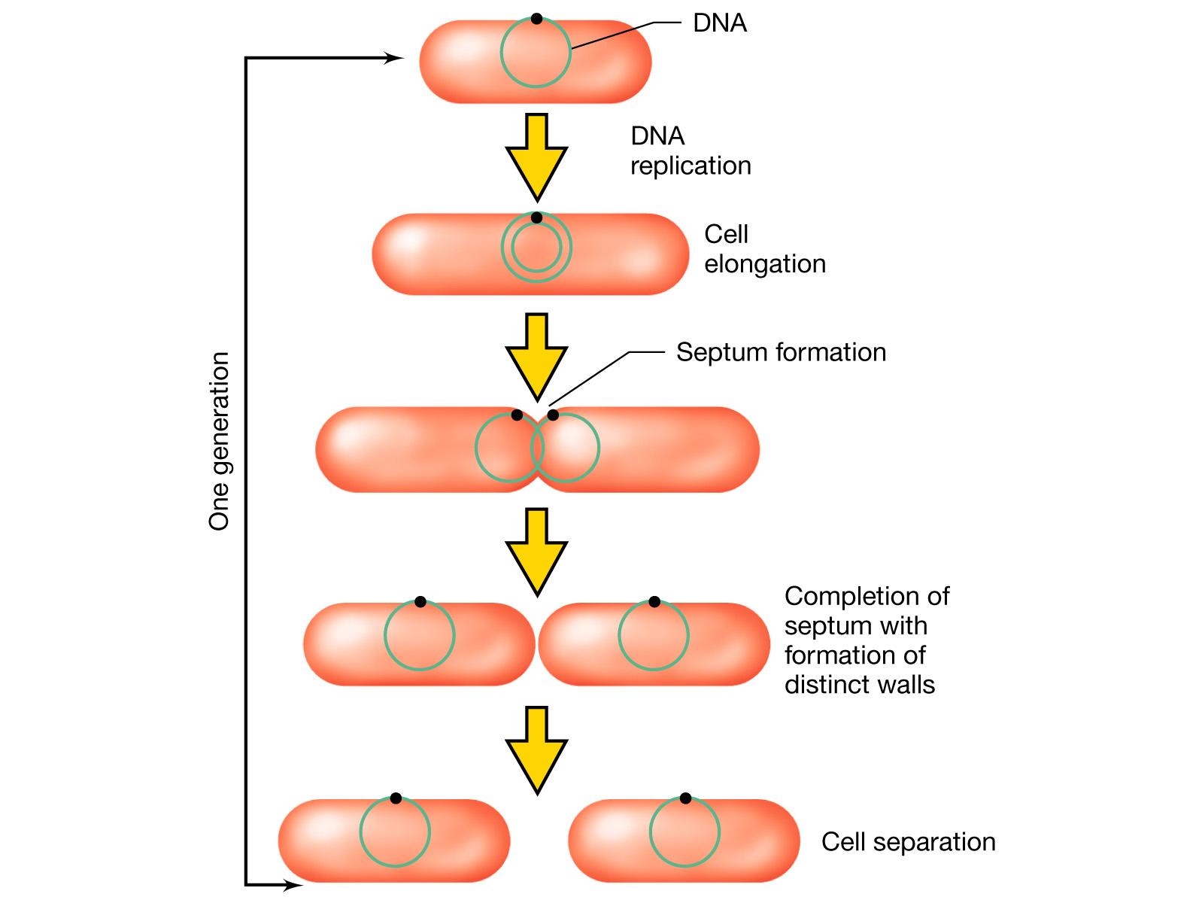
Bacterial Growth – binary fission
Microbial Growth cont…
Notes:
Figure: 06-01
Caption:
The general process of binary fission in a rod-shaped prokaryote. For simplicity, the nucleoid is depicted as a single circle in green.

Slide 30
Microbial Growth cont…
Generation time
Interval of time between two cell divisions
OR
The time required for a bacterium to give rise to 2 daughter cells under optimum conditions
Also called population doubling time.
e.g. E.coli – 20 mins
Tubercle bacilli – 20 hrs
Lepra bacilli – 20 days

Slide 31
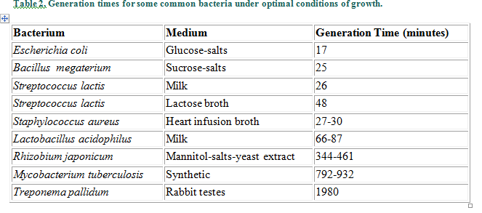

Slide 32
Enumeration of Microorganisms
Microbial Growth cont…
1. Viable plate count
2. Total direct count
3. Turbidometric measurements
4
1
5
9
10
3
6
8
2
7
32

Slide 33
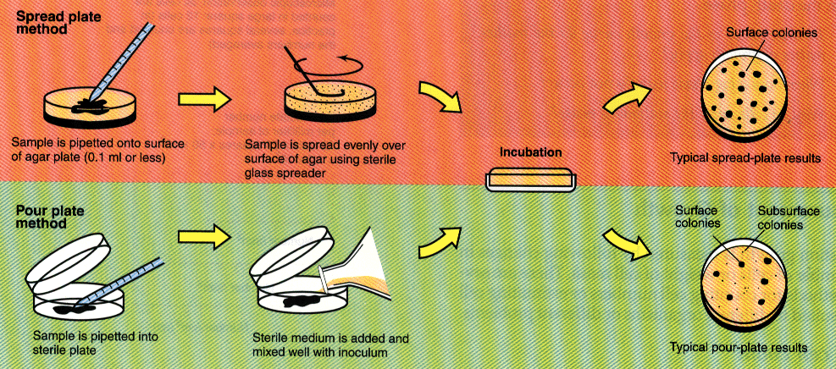
Microbial Growth cont…
Viable Plate Count
The most common procedure for assessing microbial numbers
1) serial dilutions of a suspension of microbes are plated and incubated

Slide 34
Viable Plate Count
Microbial Growth cont…
  2) the number of colonies developing are then counted
    it is assumed that each colony arises from an individual microbial cell
  3) by counting the colonies and taking into account the dilution factors the concentration of microbes in original sample can be determined
  4) only plates having between 30 and 300 colonies are used in the calculations
34

Slide 35
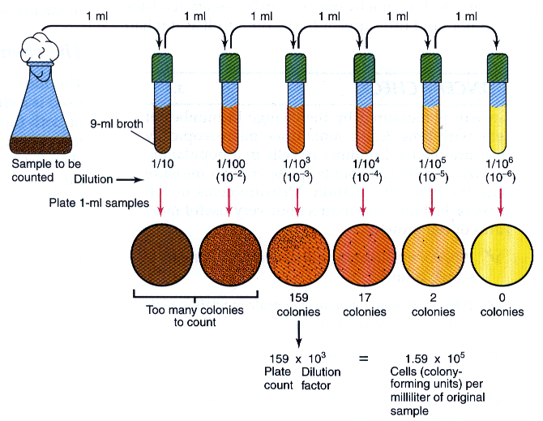
Viable Plate Count
Microbial Growth cont…

Slide 36
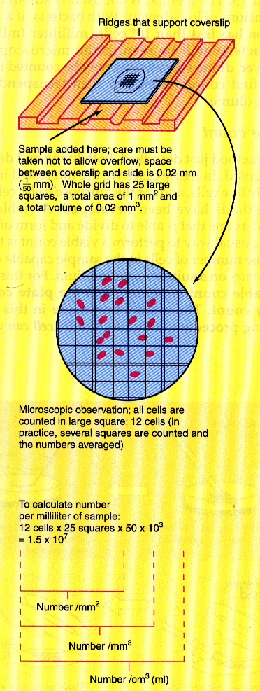
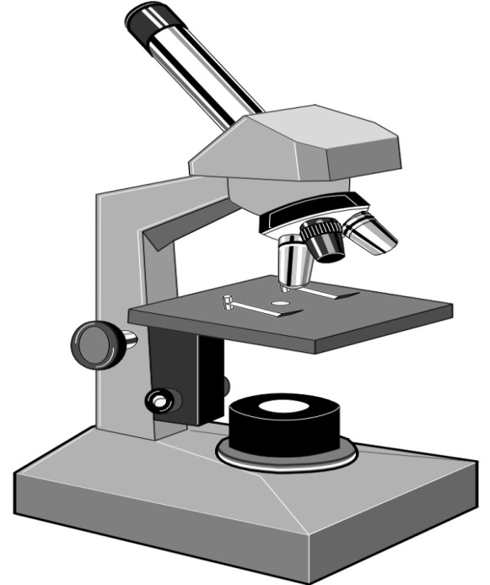
Direct Count
Microbial Growth cont…
Dilutions of samples are observed under a microscope
the number of bacterial cells from a given volume of sample are counted
  dead cells are also counted
automated particle counters can be used
36

Slide 37
Turbidometric measurements
Microbial Growth cont…
Turbidity or optical density is the cloudeness of a suspension
Can be detected by spectrophotometer
As microbial growth increase the more turbid a suspension the less light will be transmitted through it
Adv. Rapid
Disadv. Counts all light scattering
Application estimation of cell number in broth culture

Slide 38
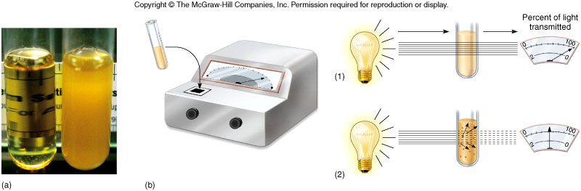
Turbidometric measurements as indicators of microbial growth.
The greater the turbidity the larger the population density.

Slide 39
Microbial Growth Curve
Microbial Growth cont…
When a microbe is added to a suitable liquid medium & incubated, its growth follows a definite course.
If microbes counts are made at intervals after inoculation & plotted in relation to time, a growth curve is obtained.

Slide 40
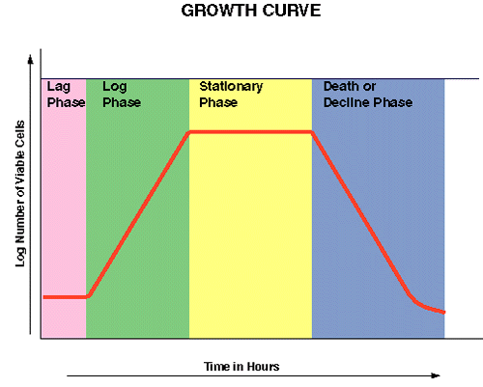
Microbial Growth Curve
Microbial Growth cont…
Growth of culture goes through four phases with time
1. Lag phase
2. Log or Logarithmic phase
3. Stationary phase
4. Death or Decline phase

Slide 41
Microbial Growth cont…
Lag (preparatory) phase
Adjustment period to the new environment
High cellular metabolism
Rapid biosynthesis of macromolecules and enzymes
Primary metabolites are essential for growth
Maximum cell size towards the end of lag phase.
The length of lag phase depends upon:
  Type of microbe and medium used.
  The phase of the culture from which inoculation is taken.
  Size of inoculums
  Environmental factors like temperature

Slide 42
Microbial Growth cont…
    Logarithmic (exponential) phase
    Growth rate  death rate
    Cell grow exponentially
    Maximum rate of cell division takes place
    Are more sensitive to antibiotics
    Smaller cells, stain uniformly

Slide 43
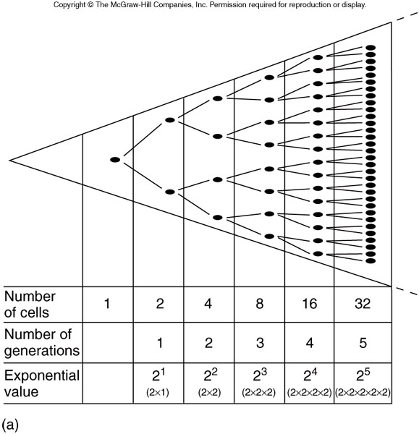
Exponential Growth
Microbial Growth cont…

Slide 44
Microbial Growth cont…
Stationary Phase
Dying and dividing organisms are at an equilibrium (death rate = growth rate)
Death is due to reduced nutrients, pH changes, toxic waste and reduced oxygen
In some cases cells do not die but they are not multiplying
Irregular staining, sporulation and production of exotoxins & antibiotics (secondary metabolites)

Slide 45
Microbial Growth cont…
Death Phase
The population is dying in a geometric fashion so there are more deaths than new cells
Involution forms (with ageing)
Deaths are due to
  1. factors in stationary phase
  2. lytic enzymes that are released when bacteria lyse

Slide 46
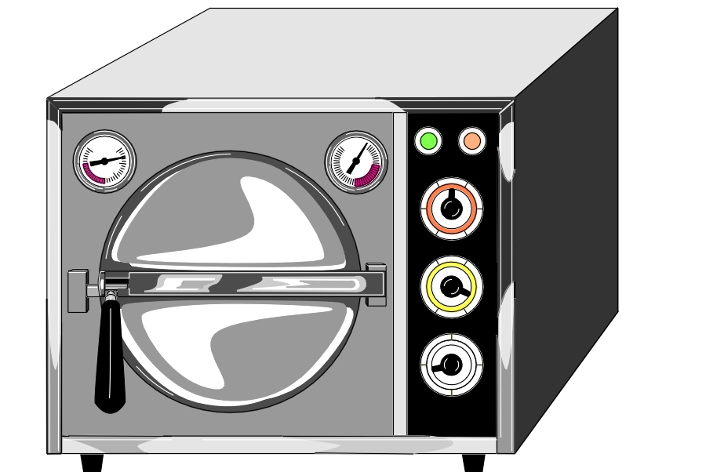
Factors Influencing Microbial Growth
Microbial Growth cont…
1. Nutrition
2. Temperature
3. Oxygen
4. Salinity
5. pH
6. Pressure
7. Radiation
46

Slide 47
The Development of Pure Culture
Pure culture (axenic culture) – a culture which contains one and only one species of microorganism
Why pure culture is needed?
To study the morphological, physiological, nutritional, genetic characteristic and environmental requirements etc of a given spp.
How pure culture is obtained?
Two important procedures
Isolation – separation of a microbe of concern from mixed population
Microorganisms in nature exist in a mixed population
For isolation several methods can be used- streak, spread and pour plate methods, etc…

Slide 48
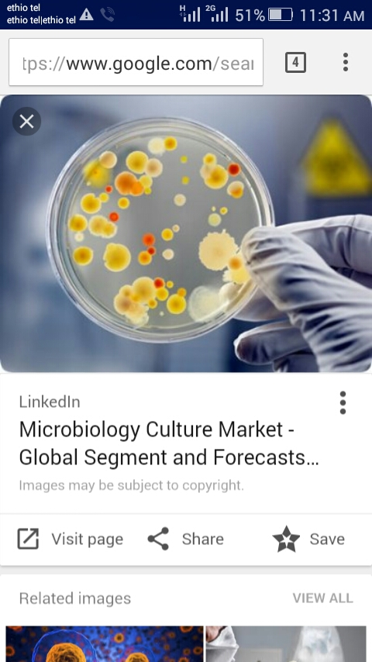
The Development of Pure Culture cont…
Pure culture
Mixed culture

Slide 49
Streak Plate Isolation Principle
The Development of Pure Culture cont…
An original inoculum containing a mixture of bacteria is spread into triple quadrants on solid media.
The goal is to reduce the number of bacteria in each subsequent quadrant.
Colonies are masses of offspring from an individual cell therefore streaking attempts to separate individual cells.
Discrete colonies form as the individual cells are separated and then multiply to form isolated colonies in the later quadrants.

Slide 50
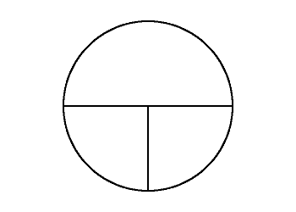
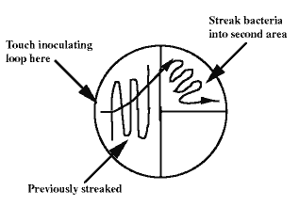
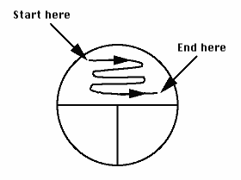
Triple streak
The Development of Pure Culture cont…

Slide 51
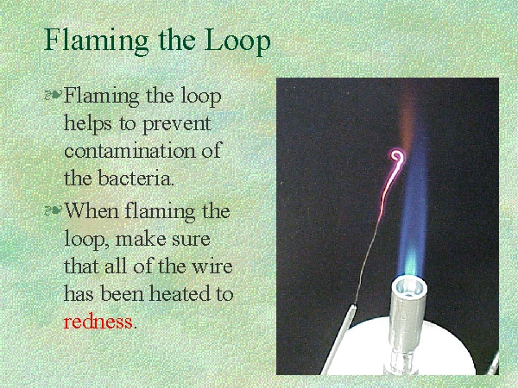
Incinerate and cool the loop between the quadrants
The Development of Pure Culture cont…

Slide 52
The Development of Pure Culture cont…
Pour plate method
1ml sample will be prepared serially
15ml sterile broth is added into test tube and kept at 45 ⁰C in water bath
The serial diluted sample and broth is mixed at 45 ⁰C and poured in empty sterile plate and incubated for observation

Slide 53
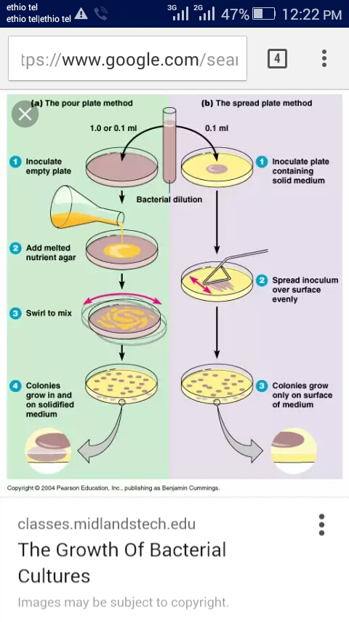

Slide 54
The Development of Pure Culture cont…
Spread Plate Method
Inoculums is prepared by serial dilution
An agar plate medium is prepared and set to solidify
1 ml of the serially diluted inoculums is poured onto the agar medium and spreaded using glass rod
Then incubated for observation

Slide 55
The Development of Pure Culture cont…
Culturing (cultivation)- is the growing of the isolated microbe on a specific media into large number
Culture media – is a growth media which support the growth of microorganisms or cells in the laboratory
Culture media can be classified based on
    physical states,
    functional properties,
    chemical composition etc
Physical state
I . Liquid media
Do not contain any solidifying agent
Used for propagation of large number of organisms, fermentation studies
e..g. nutrient broth, citrate broth, glucose broth, litmus milk etc

Slide 56
The Development of Pure Culture cont…
I I . Solid media
Contain solidifying agent such as agar, silica gel or gelatin
e. g. Nutrient agar, Blood agar and Sabouraud’s agar
- used for developing surface colony growth of bacteria and molds
Gelatin as solidifying agent
Koch used gelatin as a solidifying agent to grow Bacillus anthracis
  Drawbacks – it melts at 25 ⁰C
- some microbes used as a source of protein

Slide 57
The Development of Pure Culture cont…
Agar as a solidifying agent – produced from sea weed
has a number of Advantages
    Has melting point above 100 ⁰C
    Solidify at 45 ⁰C
    It is totally inert with no nutritive value and indigestible by most microorganisms
    Allow clear observation of microbial colony
III . Semisolid media
Fall between liquid and solid media
Useful in determining weather certain bacteria are motile or not

Slide 58
The Development of Pure Culture cont…
B . Culture media classification based on chemical compositions
I . Synthetic media
Type of media in which all constituents are chemically defined e. g. Nutrient agar
Used to study specific nutritional requirements of micro organisms
e. g. E. coli can grow on minimal media since it can synthesize the remaining nutrients

Slide 59
The Development of Pure Culture cont…
II . Complex media
Type of media in which there is one or more nutrients that is chemically undefined
Usually extracted from biological materials e. g. Beef extract, peptone (casein) extract, yeast extract
Satisfy the growth of most microorganisms
III . Natural media
Naturally available and used as growth media with out modification e.g. milk

Slide 60
The Development of Pure Culture cont…
C. Culture media classification based on their functional property
I . Simple media
Allow the growth of all microorganisms e. g. nutrient agar
II . Differential media
Used to differentiate a specific microorganisms from a given mixed population
e .g. - Blood agar serve as a substrate for some microbes – S. pyogens which lyses blood
- Eosin methylene blue (EMB) agar differentiate lactose fermenters from non lactose fermenters of enteric bacteria
III . Selective media
Allow the growth of some bacteria and inhibit others
e .g. Bismuth sulfite agar, bile salt etc

Slide 61
The Development of Pure Culture cont…
IV. Selective - differential media
Differentiate and select a specific microorganism from a given mixed population
e. g. mac Ckoneky’s agar
Selectively grow gram negative bacteria and inhibit gram positive bacteria
Differentiate lactose fermenters from non lactose fermenters
V . Enrichment medium
Unlike the above types of media, this medium may involve chemical, physiological, nutritional and environmental factors
Is used to enrich the required microbe
e.g. suppose you want to grow thermopiles, then incubate the culture at high temperature

Slide 62
Disinfection and Sterilization
Sterilization- Killing or removing all forms of microbial life (including endospores) in a material or an object
Disinfection- Reducing the number of pathogenic microorganisms to the point where they no longer cause diseases e.g. vegetative cell
May use physical or chemical methods
  Disinfectant: Applied to inanimate objects.
  Antiseptic: Applied to living tissue (antisepsis).

Slide 63
References
Stuart Hogg. 2005. Essential Microbiology. John Wiley and Sons, Ltd.
2. Benson: Microbiological Applications Lab Manual. 8th ed. The McGraw−Hill Companies, 2001.

