Slide 1
Flow of fluid through granular beds

Slide 2
GRANULAR AND PACKED BEDS
Flow through granular and packed beds occurs in reactors with solid catalysts, adsorbers, ion exchangers, filters, and mass transfer equipment. Therefore expressions are needed to predict pressure drop across beds due to the resistance caused by the presence of the particles.
Natural porous media may be consolidated (solids with holes in them), or they may consist of unconsolidated, discrete particles.
Passages through the beds may be characterized by the properties of porosity, permeability, tortuosity, and connectivity.
Granular beds may consist of mixtures of particles of several sizes. In flow problems, the mean surface diameter is the appropriate mean, given in terms of the weight fraction distribution.

Slide 3
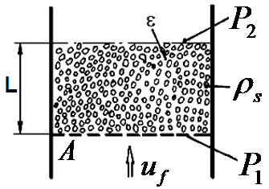
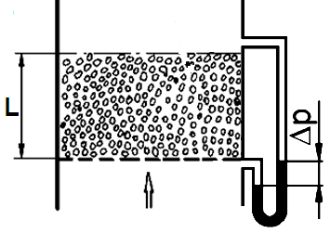
Porosity
Pressure drop calculation:
Filtration
Adsorption
Catalytic reactors
Ion exchangers
Mass transfer equipments

Slide 4
A long-established correlation of the friction factor is that of Ergun (Chew. Eng. Prog. 48, 89-94, 1952). The average deviation from his line is said to be 20%. The friction factor is:
The pressure gradient accordingly is given by:

Slide 5
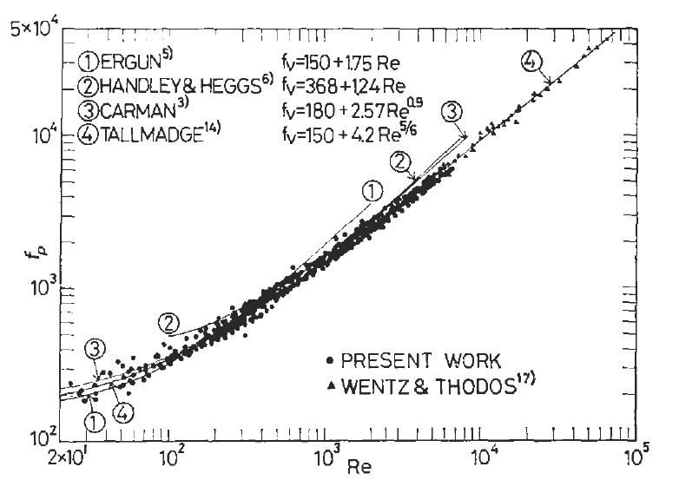
Friction factors in flow of single phase fluids in granular beds.
Correlation of the friction factor vs the Reynolds number

Slide 6
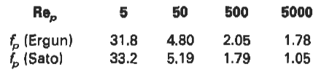
An improved correlation is that of Sato (1973) and Tallmadge (AIChE J. 16, 1092 (1970)] shown on the Figure. The friction factor is
with the definitions of Eqs. (1) and (3). A comparison of Eqs. (2) and (4) is
In the highly turbulent range the disagreement is substantial.

Slide 7
FLUIDIZATION OF BEDS OF PARTICLES
As the flow of fluid through a bed of solid particles increases, it eventually reaches a condition at which the particles are lifted out of permanent contact with each other. The onset of that condition is called minimum fluidization.
Uniformity of temperature, rapid mass transfer, and rapid mixing of solids account for the great utility of fluidized beds in process applications.
As the gas flow rate increases beyond the minimum fluidization, the bed may continue to expand and remain homogeneous for a time. At a fairly definite velocity, however, bubbles begin to form. Further increases in flow rate distribute themselves between the dense and bubble phases in some ways that are not well correlated.
Extensive bubbling is undesirable when intimate contacting between phases is desired, as in drying processes or solid catalytic reactions.

Slide 8
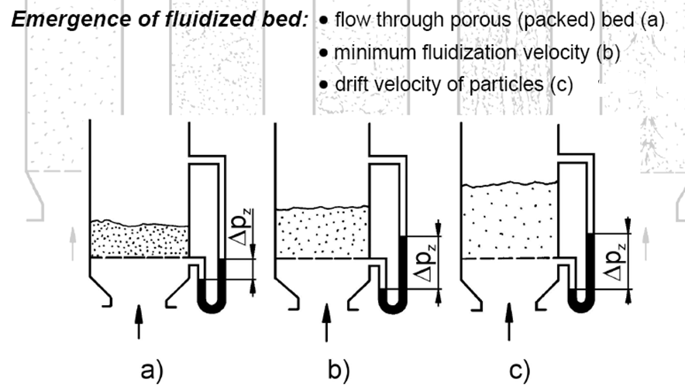

Slide 9
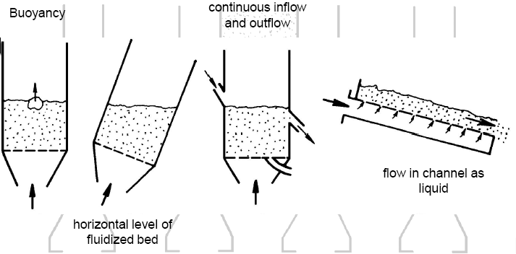
Behavior of fluidized bed

Slide 10
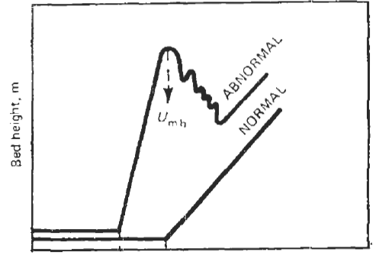
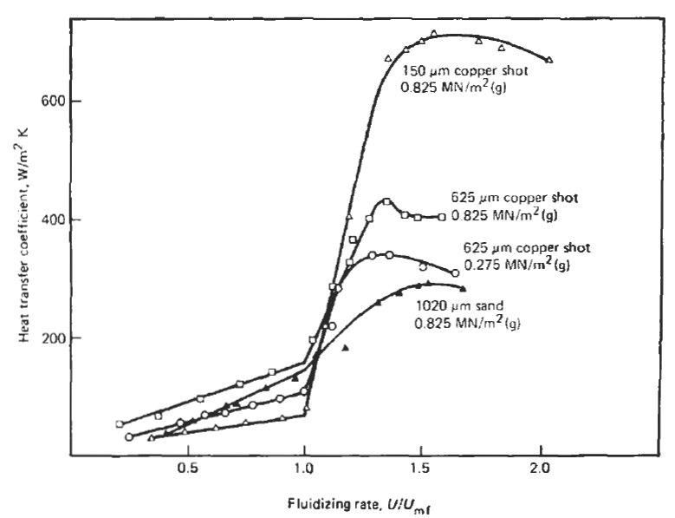
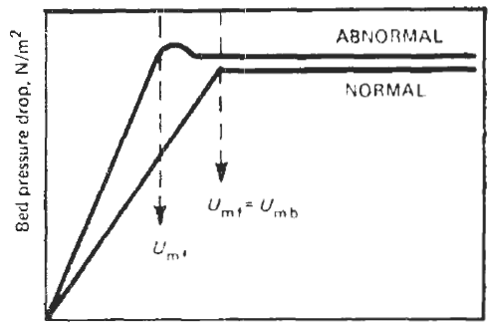
Behavior of heat transfer coefficient with gas flow rate
Gas velocity, mls
Schematic of the progress of pressure drop and bed height with increasing velocity, for “normal” and “abnormal” behavior.
The peak depends on the density and diameter of the particle

Slide 11
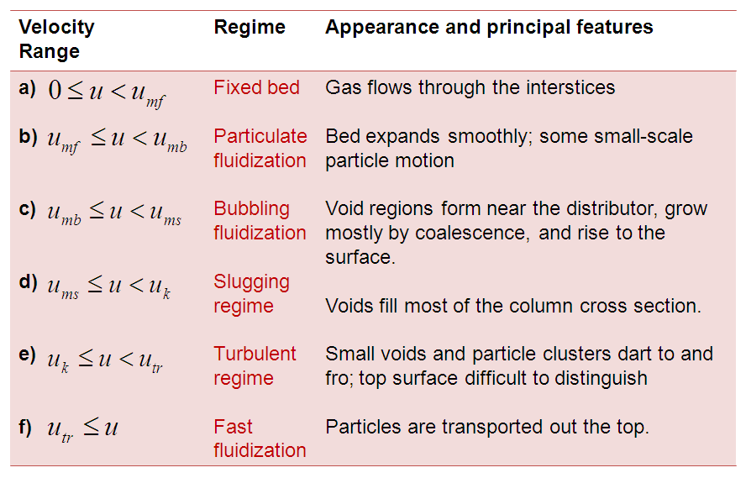
CHARACTERISTICS OF FLUIDIZATION
Six different regimes of fluidization are identified:

Slide 12
CHARACTERISTICS OF FLUIDIZATION
Particulate fluidization, class (b) , is desirable for most processing since it affords intimate contacting of phases.
Fluidization depends primarily on:
  Size of the particles
  Density of the particles,
  (to some extent also) Particles roughness, temperature, pressure, and humidity of the gas. Especially small particles are subject to electrostatic and inter-particle forces.
Especially small particles are subject to electrostatic and inter-particle forces.

Slide 13
CHARACTERISTICS OF FLUIDIZATION
Onset of fluidization commonly is detected by noting a break in the plot of flow against pressure drop.
For a range beyond the minimum fluidizing velocity, the pressure drop remains constant and equal to the weight of the bed but the bed level rises gradually and bubbles are generated at an increasing rate. Not in all cases, however, is the fluidization behavior entirely smooth.
Among the reasons for abnormality are aggregation of particles because of stickiness or attractive forces between small particles and interlocking of rough surfaces. It is even possible for bubbling to occur before the onset of fluidization by formation of channels in the bed.

Slide 14
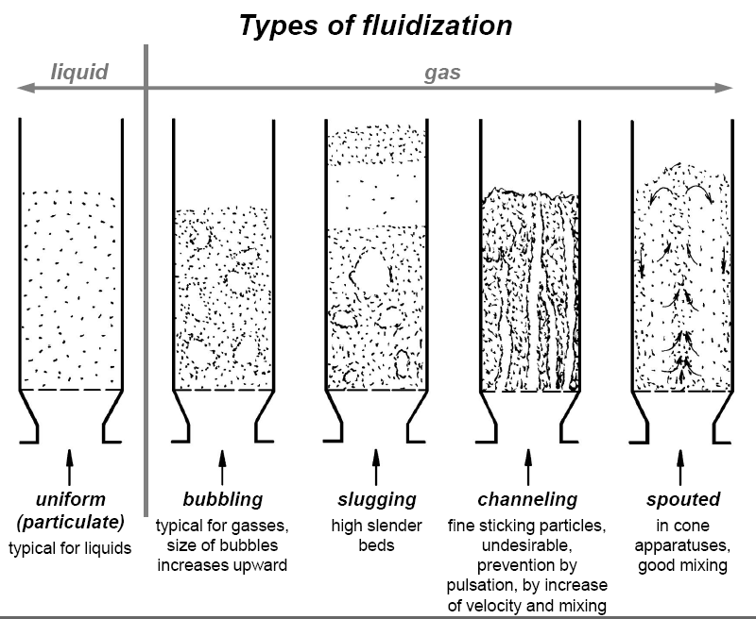

Slide 15

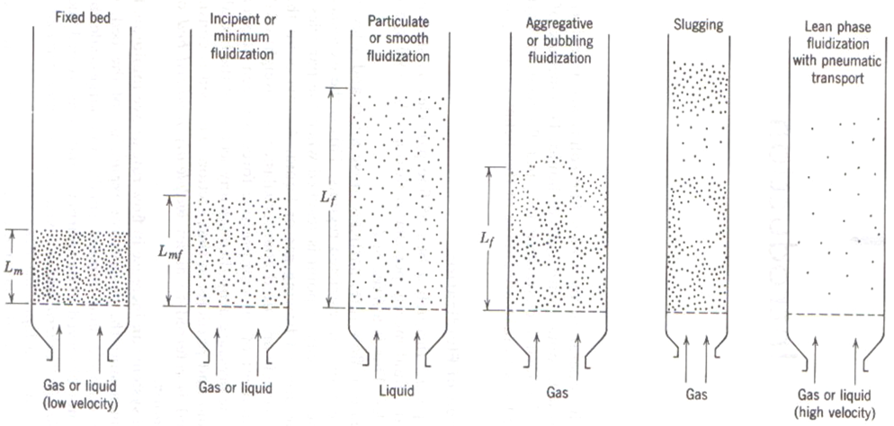

Slide 16

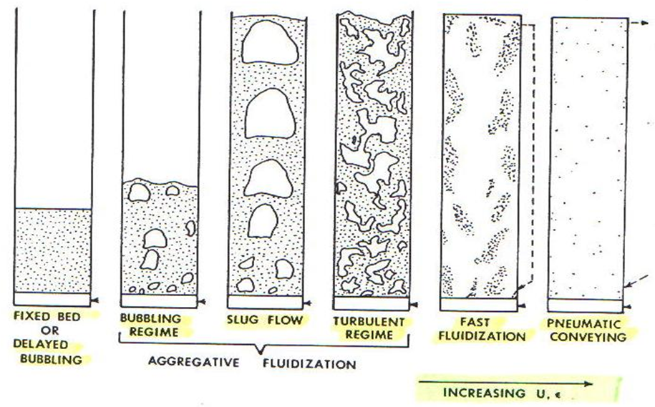

Slide 17
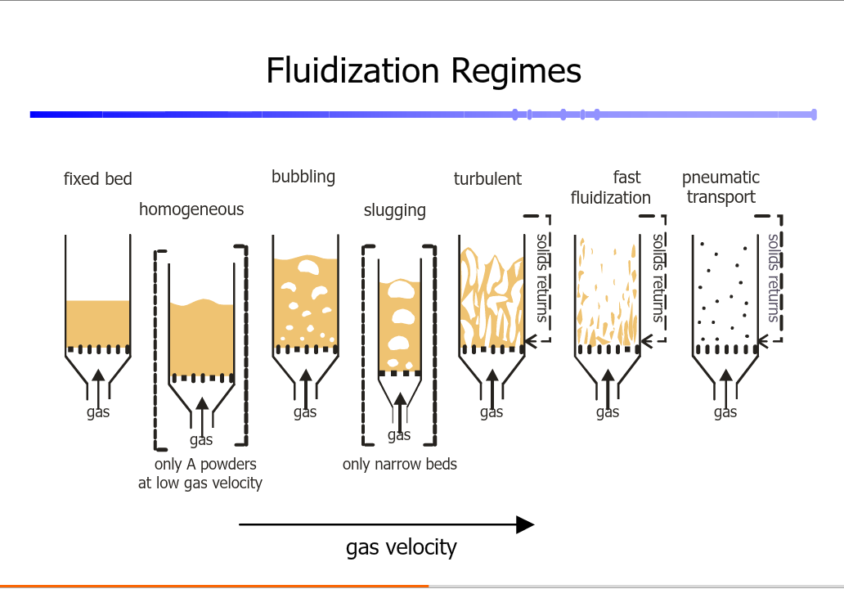

Slide 18
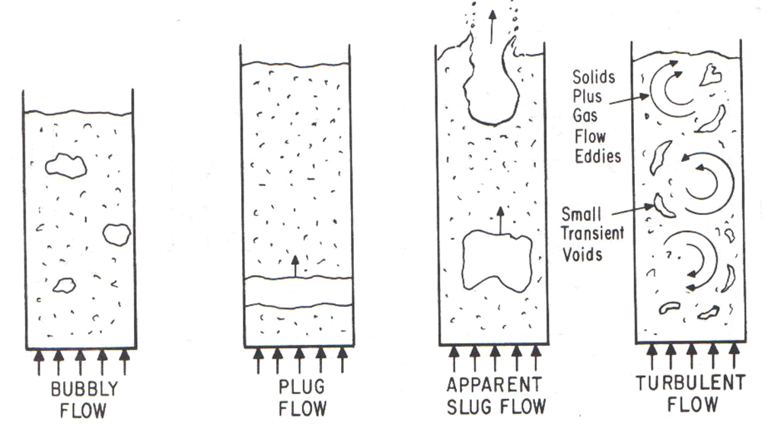

Slide 19
Classification of Powders
Geldart (1973) classified powders into four groups according to their fluidization properties at ambient conditions
The Geldart classification of powders is now used widely in all fields of powder technology
Group A – powders which when fluidized by air at ambient conditions give a region of non-bubbling fluidization beginning at U_{mf}, followed by bubbling fluidization as fluidizing velocity increases
Group B – powders which under these conditions give only bubbling fluidization
Group C – powders which are very fine, cohesive and are incapable of fluidization
Group D – large particles distinguished by their ability to produce deep spouting beds
In Group C powders, the inter-particle forces are large compared with the inertial forces on the particles
Particles are unable to achieve the separation required to be totally supported by drag and buoyancy forces
True fluidization does not occur
Bubbles do not appear, instead the gas flow forms channels through the powder
Since the particles are not fully supported by the gas, pressure loss across the bed is always less than apparent weight of the bed per unit cross-sectional area

Slide 20
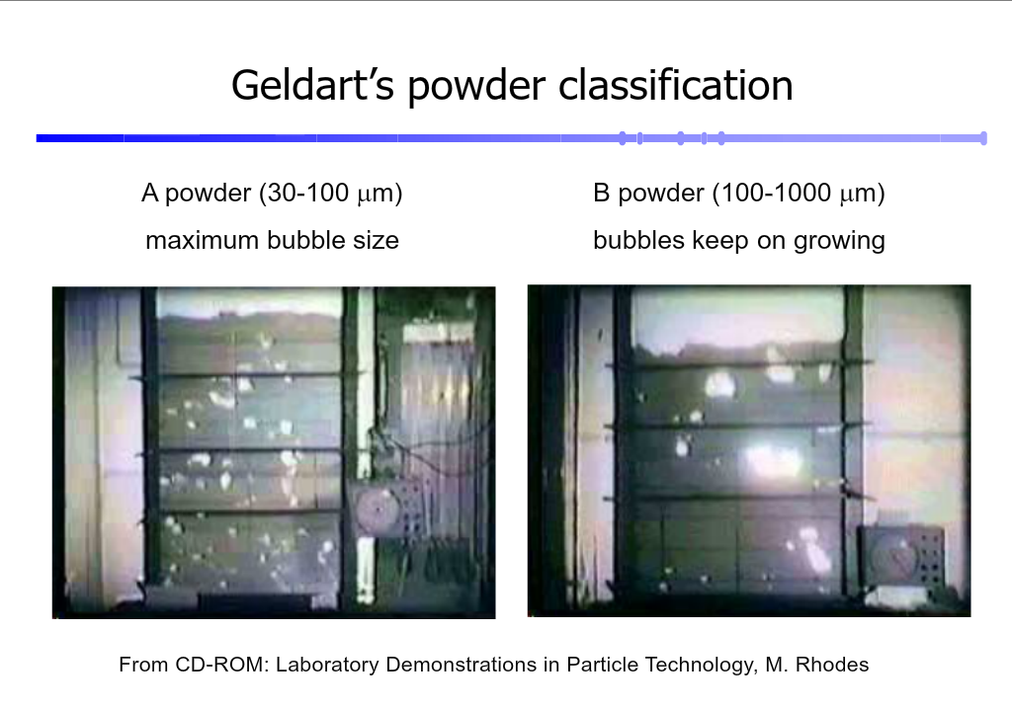

Slide 21
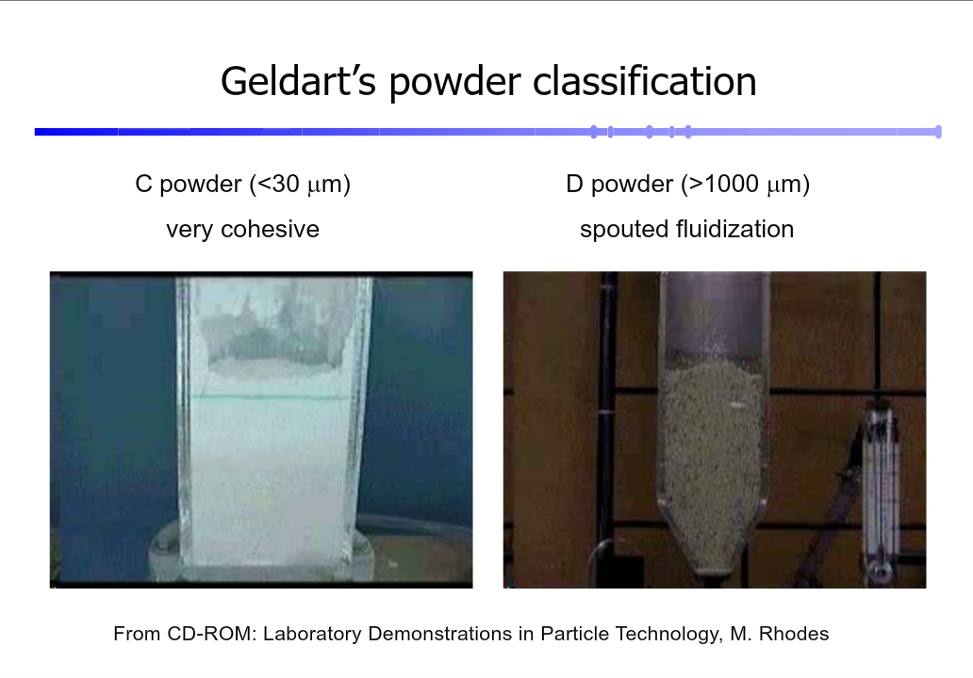

Slide 22
C
D

Slide 23
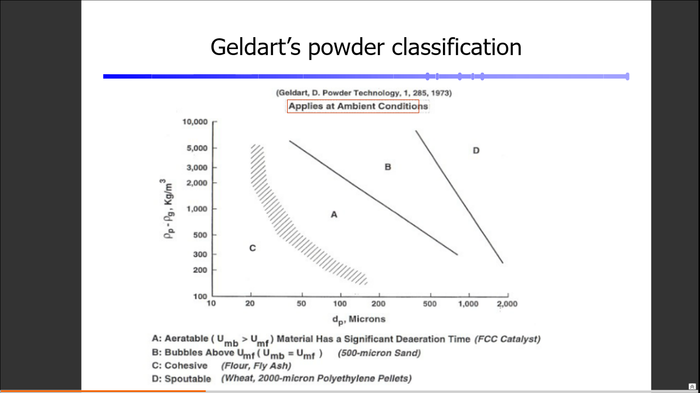

Slide 24
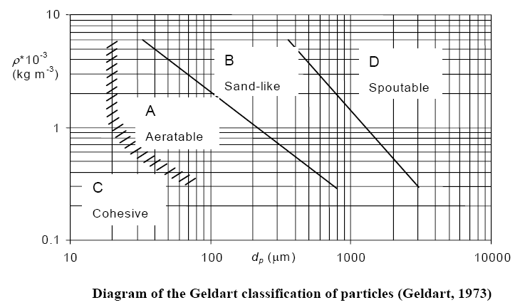
Geldart’s powder classification

Slide 25
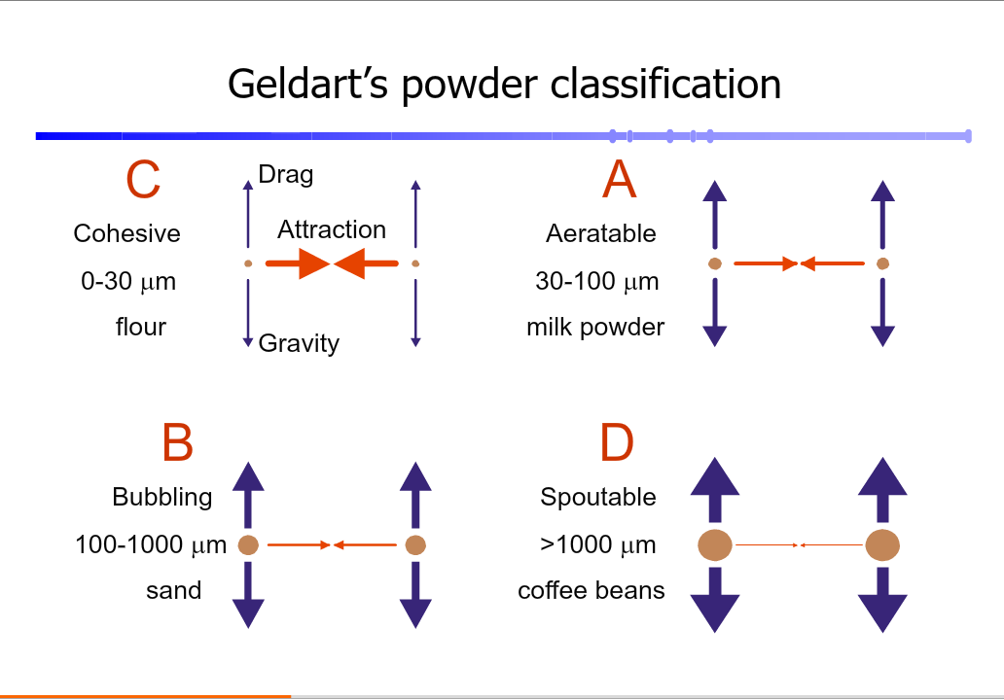

Slide 26
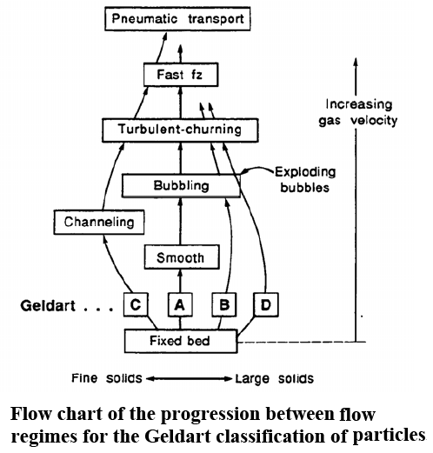

Slide 27
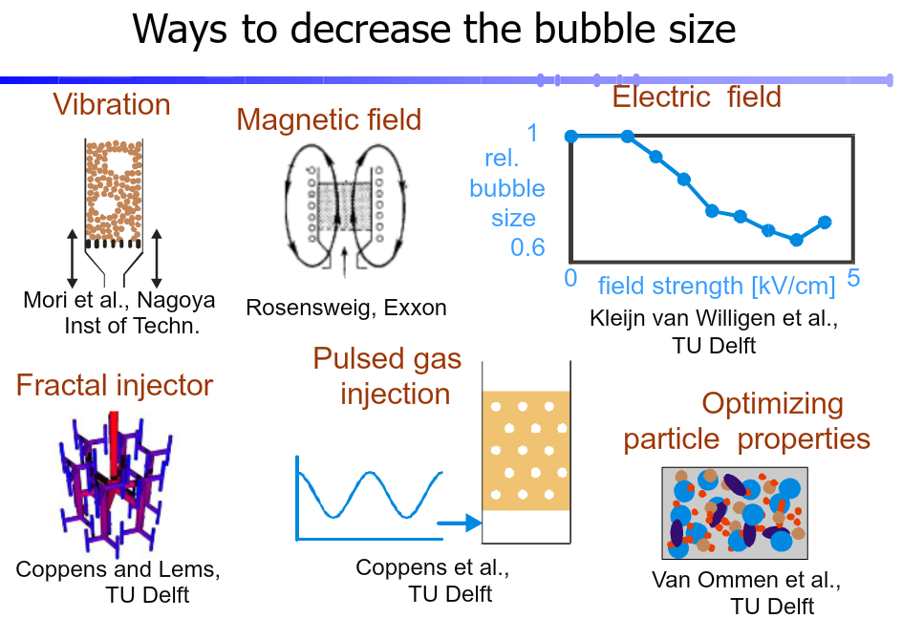

Slide 28
Minimum Fluidization
In an ideal fluidized bed the pressure drop corresponding to minimum fluidization is equal to the buoyant weight of particles per unit area. In practice, it may deviate appreciably from this value as a result of channeling and the effect of particle-wall friction.
The minimum fluidizing velocity, u_{mf} , may be determined experimentally by measuring the pressure drop across the bed for both increasing and decreasing velocities and plotting the results vs. velocity. The two ‘best’ straight lines are then drawn through the experimental points and the velocity at their point of intersection is taken as the minimum fluidizing velocity. Linear rather than logarithmic plots are generally used, although it is necessary to use logarithmic plots if the plot of pressure gradient against velocity in the fixed bed is not linear.

Slide 29
Minimum Fluidization
The theoretical value of the minimum fluidizing velocity may be calculated from the equations given for the relation between pressure drop and velocity in a fixed packed bed, with the pressure drop through the bed put equal to the apparent weight of particles per unit area, and the porosity set at the maximum value that can be attained in the fixed bed.
Particles become fluidized when the frictional force of the air on the particles equals or exceeds the weight of the bed. The minimum velocity required for fluidization can be determined by equating the weight per unit area of the bed to the pressure drop of air through the bed. At this minimum fluidization velocity, all of the powder particles become suspended and the bed exhibits liquid like behavior.

Slide 30
Minimum Fluidization
This state of incipient fluidization can be described by an equation giving the pressure drop in a gas flowing through a packed bed, such as the so-called Ergun equation:
in which ΔP is equal to the bed weight per unit cross-sectional area

Slide 31
Minimum Fluidization
When applying the Ergun equation, one has to know the minimum fluidization voidage, ε_{mf}, although it is frequently an unknown. Wen and Yu (1966) developed an expression for the minimum fluidization velocity for a range of particle types and sizes by assuming the following approximations to hold based on experimental data:
They combined these with the Ergun equation and obtained the relation:
For gas fluidization, the Wen and Yu correlation is often taken as most suitable for particles larger than 100 μm

Slide 32
Minimum Fluidization
The correlation of Baeyens and Geldart (1974) is best for particles less than 100 μm
Where:
In SI units it is

Slide 33
Minimum Fluidization
An equation more recently recommended by Grace (1982) covers Reynolds numbers up to 1000:
Leva (1959) obtained empirically another widely used expression:

Slide 34
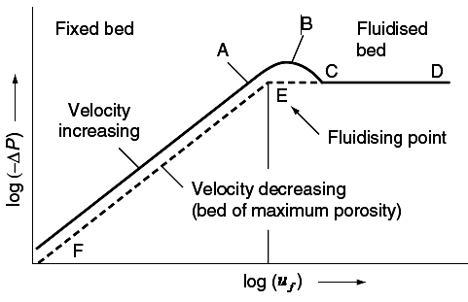
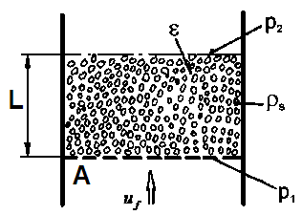
Force balance
Bernoulli equation

Slide 36
Minimum Fluidization
Minimum bubbling velocities for Group B substances are about the same as the minimum fluidization velocities, but those of Group A substances are substantially greater. The superficial gas velocity at which bubbles first appear is known as the minimum bubbling velocity U_{mb.}
For Group A materials the correlation of Geldart and Abrahamsen [Powder Technol 19, 133 (1978)l for minimum bubbling velocity is
For air at STP this reduces to
Harriott and Simone (1983) present an equation for the ratio of the two kinds of velocities as
The units of this equation are SI

Slide 37
Minimum Fluidization
Voidage at minimum bubbling is correlated by an equation of Cheremisinoff and Cheremisinoff (1984, p. 163):
Ordinarily under practical conditions the flow rate is at most a few multiples of the minimum fluidizing velocity so the local maximum bed level at the minimum bubbling velocity is the one that determines the required vessel size. The simplest adequate equation that has been proposed for the ratio of voidages at minimum bubbling and fluidization is
The last equation results from substitution of Eq. (Δ) into (Ο).

Slide 38
Minimum Fluidization
The relative bed level can be found from:

Slide 39


Slide 40
Physical Processes
Drying of particles
Coating of surfaces
Granulation
Heat treatment
Filtration
Blending
classification
Chemical Processes
Coal combustion
Solid waste incineration
Gas phase polymerization
Fluid catalytic reaction

Slide 41
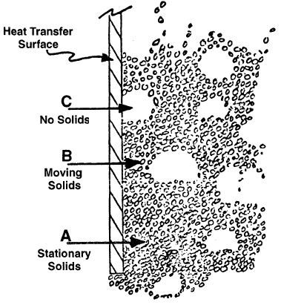
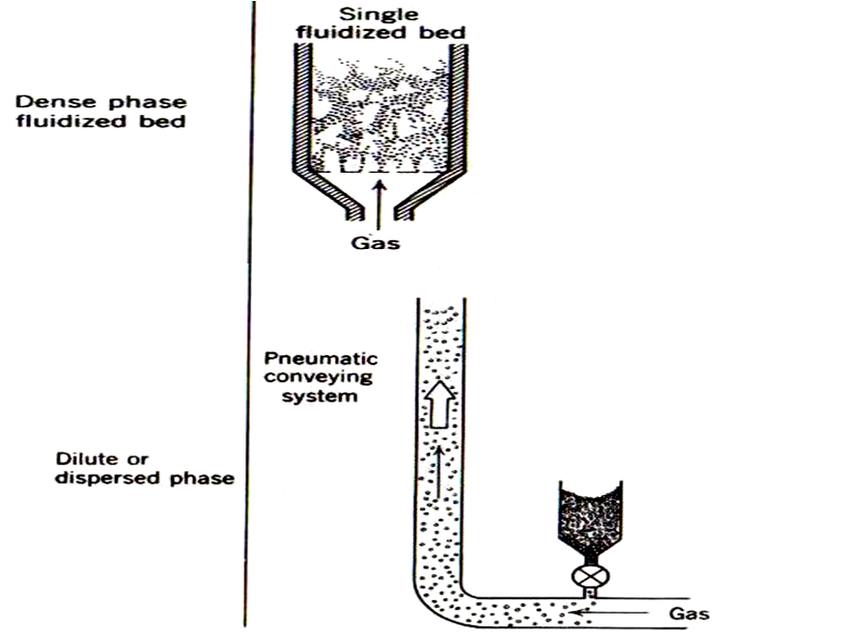

Slide 42
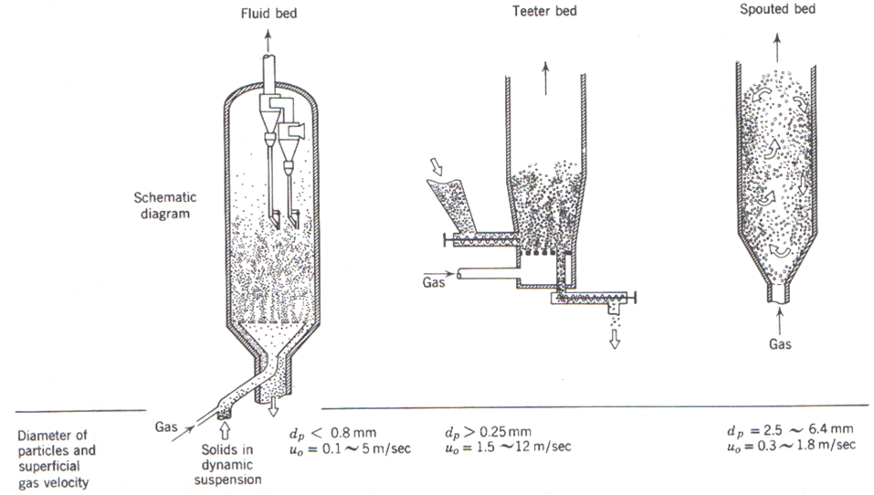
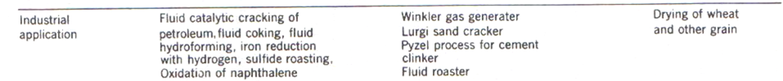

Slide 43

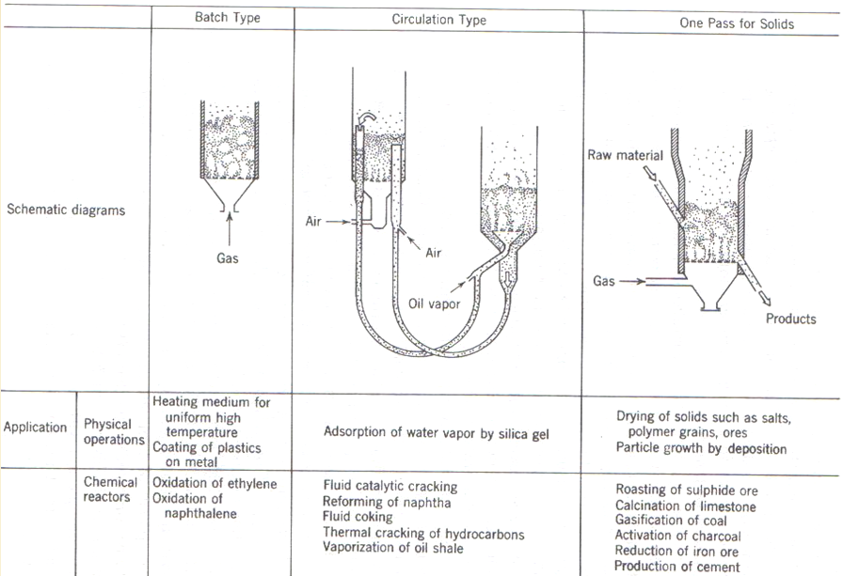

Slide 44
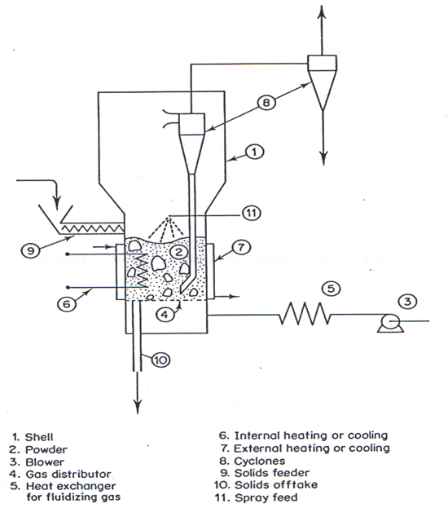

Slide 45

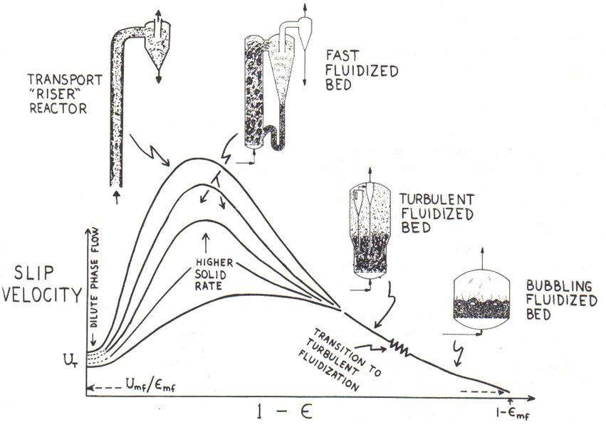

Slide 46

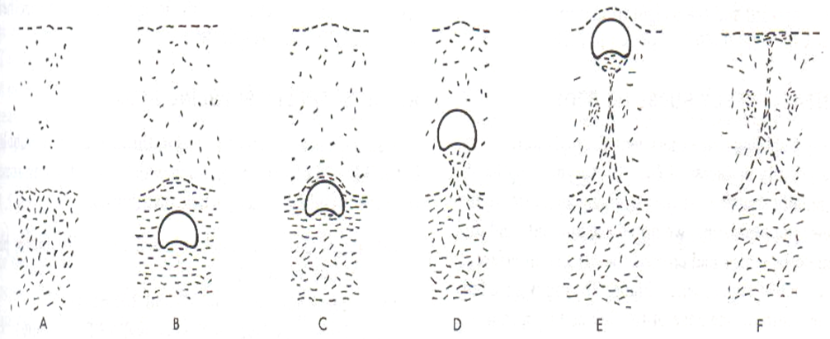

Slide 47

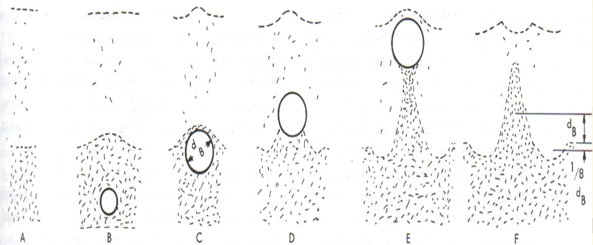

Slide 48
Physical processes include drying, mixing, granulation, coating, heating and cooling
Fluidized beds are often used to cool particulate solids following a reaction
Cooling may be by fluidizing air alone or by use of cooling water passing through tubes immersed in the bed

Slide 49
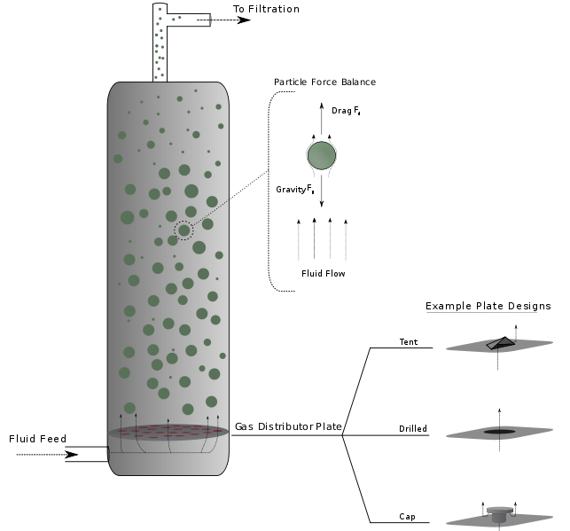
PRINCIPLE OF FBC

Slide 50
MECHANISM OF FLUIDIZED BED COMBUSTION
Temperature of bed should be at least equal to ignition
temperature of coal.
Bed temperature must not increase melting point of Ash.
Equilibrium temperature achieved through transfer
tubes immersed in bed and walls of combustor.
Gas velocity must be maintained between fluidization
velocity and the particle entrainment velocity.

Slide 51
Gas fluidized bed is also a good medium to carry out a chemical reaction involving a gas and a solid
Gas-solid contacting is generally good
Excellent solids circulation within the bed promotes good heat transfer between bed particles and fluidizing gas and between the bed and heat transfer surfaces immersed in the bed
Gives rise to near isothermal conditions even when reactions are strongly exothermic or endothermic
Good heat transfer gives rise to ease of control of the reaction
Fluidity of the bed makes for ease of removal of solids from reactor

Slide 52
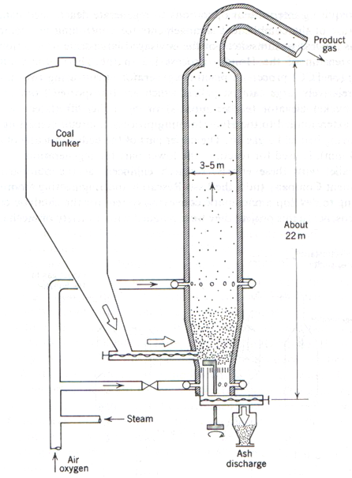

Slide 53

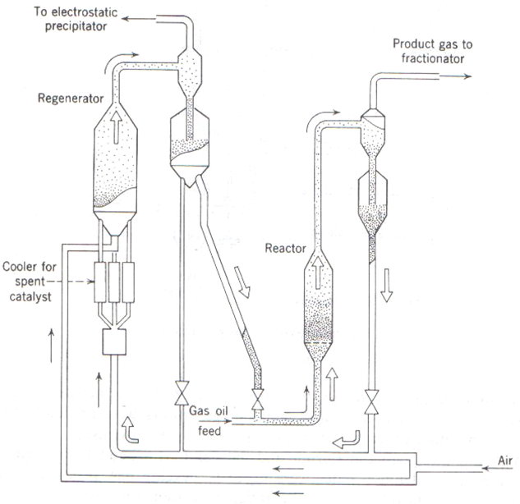

Slide 54
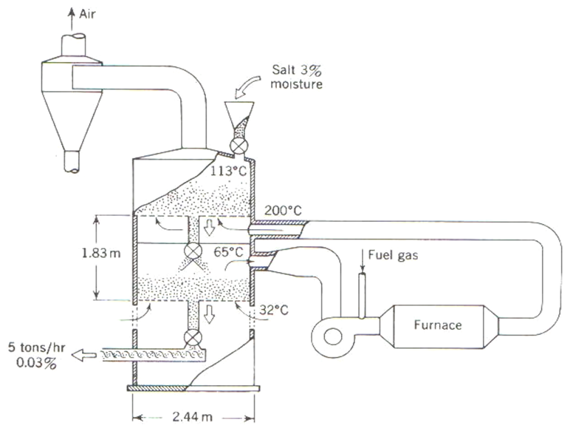

Slide 55

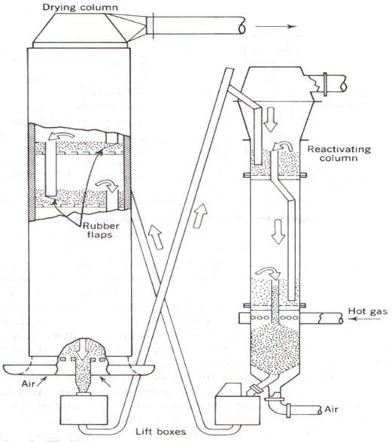
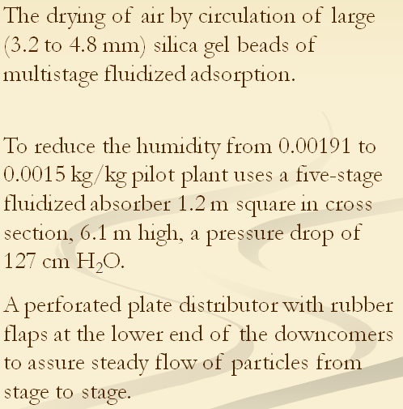

Slide 56
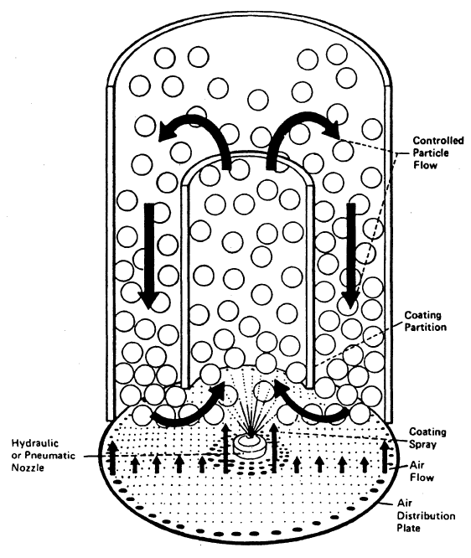
Fluidized bed coating

Slide 57
Example 1: Solid particles having a size of 0.14mm and a density of
900 kg/m³ are to be fluidized using air at 2.0atm and 25ºC. The voidage
at minimum fluidizing (ε_{mf}) condition is 0.38. if the cross-section of the
empty bed is 0.42m² and the bed contains 380kg of solid, calculate
  L_{mf}
  ΔP_{mf}
  u_{mf}
  (μ_{f} =1.845x10⁻⁵ Pa.s, ρ_{f} = 2.374 kg/m³ at P = 2.02x10⁵Pa and T = 25ºC)

Slide 59
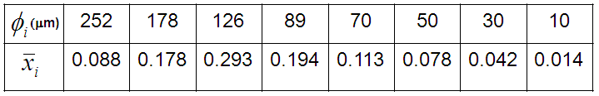
Example 2: A fluidized bed is to hold 10,000kg of a mixture of particles
whose true density is 1700kg/m³. The fluidizing gas fed at 0.3m³/sec, has a
viscosity of 0.017cP and a density of 1.2kg/m³. The size distribution of the
particles is
Calculate:
Average particle size
Which group the material belongs to
Minimum fluidization
Operating gas velocity
Dimensions of the bed and vessel
Porosity at minimum bubbling
Minimum bubbling velocity

Slide 60
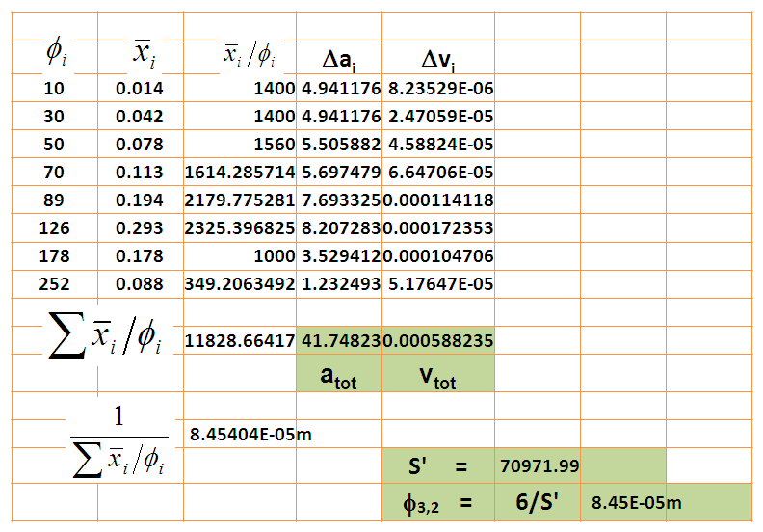
Average particle size

Slide 61
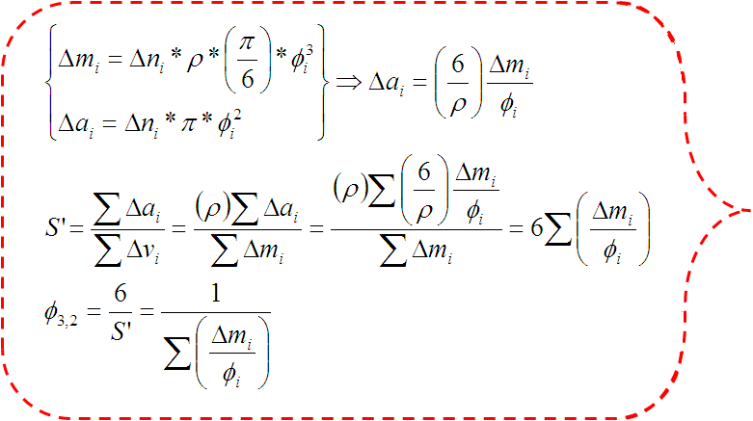
Two alternative
approaches to calculate φ_{3,2}

Slide 62
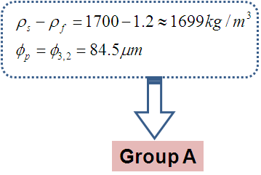
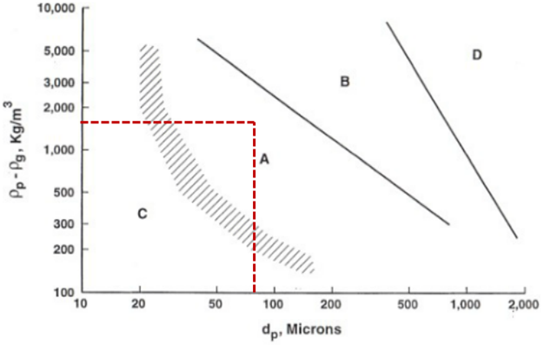
Group of the material

Slide 63
Minimum fluidization
Use the larger value;
as the conservative one

Slide 64
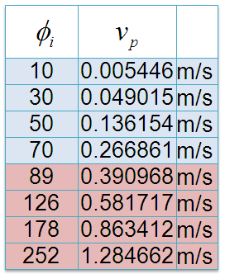
Operating gas velocity

Slide 65
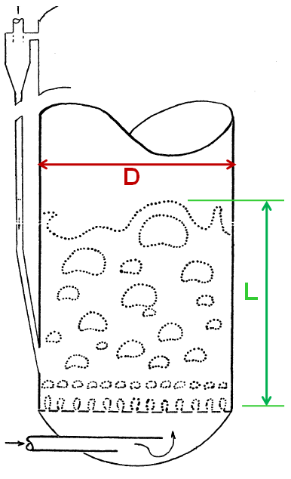
The entrainment velocity for particles with size 10μm is less than the minimum
fluidization. That means 10μm size particles will be entrained if you set the
operating gas velocity at the minimum fluidization velocity.
Entrainment of the smallest particles cannot be avoided, but an appreciable
multiple of the minimum fluidizing velocity can be used for operation; say a
multiple of 5, so that
Dimensions of the bed and vessel

Slide 66
With a charge of 10,000kg of solids and porosity at minimum bubbling of 0.469, the height of the minimum bubbling bed is:

Slide 67
Porosity at minimum bubbling velocity
Minimum bubbling velocity

Slide 68
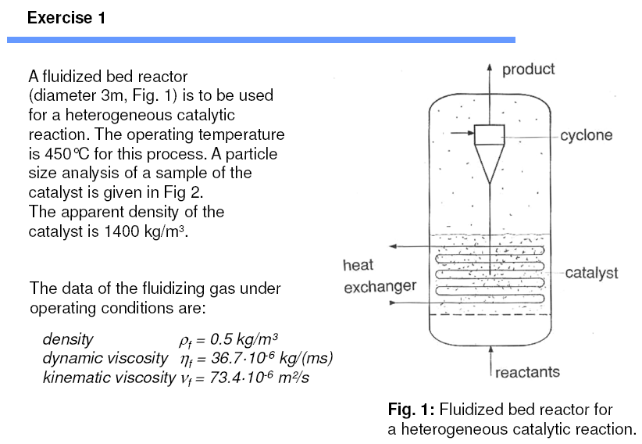

Slide 69
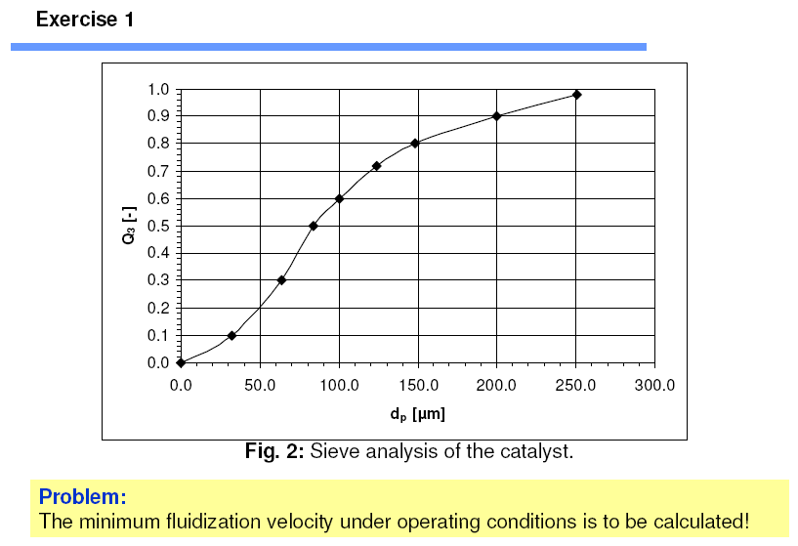

Slide 70
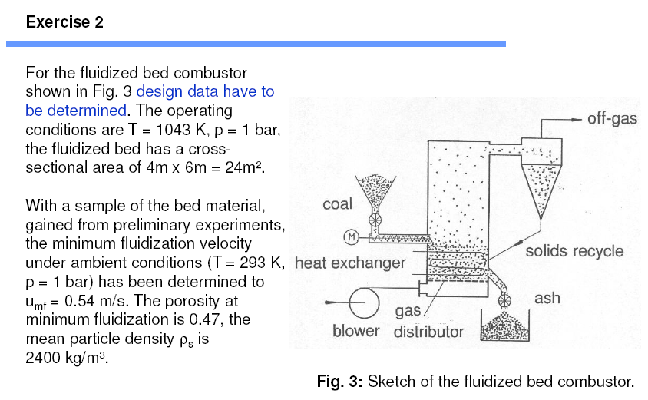

Slide 71


Slide 72


Slide 73
A fluidized bed combustor
The following data is given (see as well exercise 2):
• cross-section of the fluidized bed: A_{t} = 4 m x 6m
• operating temperature: T_{op} = 860 °C
• fluid density: ρ_{f} = 0.32 kg/m3
• porosity at minimum fluidization: ε_{mf} = 0.47
• solid density: ρ_{s} = 2400 kg/m3
• Sauter diameter: d_{p}= 0.8 mm
• minimum fluidization velocity under operating conditions: u_{mf} = 0.324 m/s
The combustor is equipped with a nozzle plate distributor. The plate contains 1600
openings per m² ground area. The height of the openings above the ground plate is
70 mm. The combustor contains a heat exchanger within the fluidized bed consisting
of a bundle of horizontal tubes. The distance between the lowest tube row and the
nozzle plate openings amounts to 515 mm. The last tube row is at a height of 1015 mm above the nozzle plate openings. The outer diameter of the tube is 50 mm, the
horizontal spacing s_{h} between the tubes is 150 mm and the vertical spacing s_{v} is
150 mm as well. The tube bundle contains as total number 160 tubes each having a
length of 4 m.

Slide 74
The following questions have to be responded:
• Calculate the bed height H_{mf} at minimum fluidization, if the fluidized bed at
expanded state is to just cover the tube bundle ?
• How great are the bubble size and the bubble rise velocity being decisive for
elutriation at the surface of the fluidized bed ?
• How great is local bubble gas holdup which is needed to calculate the local heat
exchange within the tube bundle ?
• How will change the state parameter, if the (comparably high) superficial fluid
velocity is reduced from 2.4 m/s to 1.5 m/s ?
• How much bed material has to be added to the fluidized bed when reducing the
velocity so that the tube bundle is just covered by the fluidized bed ?

Slide 79



Slide 80
Ex-1: Water at 24°C is flowing by gravity through a filter bed of small particles having an equivalent diameter of 0.0060 m. the void fraction of the bed is measured as 0.42. The packed bed has a depth of 1.50 m. The liquid level of water above the bed is held constant at 0.40 m. What is the water velocity v’ based on the empty cross section of the bed?
Ex-2: Particles having a size of 0.10 mm, a shape factor of 0.86, and a density of 1200 kg/m3 are to be fluidized using air at 25°C and 202.65 kPa abs pressure. The void fraction at minimum fluidizing conditions is 0.43. The bed diameter is 0.60 m and the bed contains 350 kg of solids.
a. Calculate the minimum height of the fluidized bed,
b. Calculate the pressure drop at minimum fluidizing conditions,
c. Calculate the minimum velocity for fluidization,
d. Using 4.0 times the minimum velocity, estimate the porosity of the bed.

Slide 81
EXERCISE 7.1:
A packed bed of solid particles of density 2500 kg/m3, occupies a depth of 1 m in a vessel of cross-sectional area 0.04 m2. The mass of solids in the bed is 50 kg and the surface-volume mean diameter of the particles is 1 mm. A liquid of density 800 kg/m3 and viscosity 0.002 Pas flows upwards through the bed.
(a) Calculate the voidage (volume fraction occupied by voids) of the bed.
(b) Calculate the pressure drop across the bed when the volume flow rate of liquid is 1.44 m3/h.
(c) Calculate the pressure drop across the bed when it becomes fluidized.
EXERCISE 7.2:
130 kg of uniform spherical particles with a diameter of 50 μm and particle density 1500 kg/m3 are fluidized by water (density 1000 kg/m3, viscosity 0.001 Pas.) in a circular bed of cross-sectional area 0.2 m2. The single particle terminal velocity of the particles is 0.68 mm/s and the voidage at incipient fluidization is known to be 0.47.
(a) Calculate the bed height at incipient fluidization.
(b) Calculate the mean bed voidage when the liquid flow rate is 2 x 10-5 m3/s.

Slide 82

EXERCISE 7.3:
130 kg of uniform spherical particles with a diameter of 60 μm and particle density 1500 kg/m3 are fluidized by water (density 1000 kg/m3, viscosity 0.001 Pas.) in a circular bed of cross-sectional area 0.2 m2. The single particle terminal velocity of the particles is 0.98 mm/s and the voidage at incipient fluidization is known to be 0.47.
(a) Calculate the bed height at incipient fluidization.
(b) Calculate the mean fluidized bed voidage when the liquid flow rate is
2 x 10-5 m3/s.
EXERCISE 7.10:
A batch fluidized bed process has an initial charge of 2000 kg of solids of particle density 1800 kg/m3 and with the size distribution shown below:

Slide 83
The bed is fluidized by a gas of density 1.2 kg/m3 and viscosity 18.4 x 10-5 Pas at a superficial gas velocity of 0.4 m/s.
The fluid bed vessel has a cross-sectional area of 1 m2.
Using a discrete time interval calculation with a time increment of 5 minutes, calculate:
(a) the size distribution of the bed after 50 minutes
(b) the total mass of solids lost from the bed in that time
(c) the maximum solids loading at the process exit
(d) the entrainment flux above the transport disengagement height of solids in size range 1 (15 - 30 μm) after 50 minutes.
Assume that the process exit is positioned above TDH and that none of the entrained solids are returned to the bed.
EXERCISE 6.6: The reactor of a catalytic reformer contains spherical catalyst particles of diameter 1.46 mm. The packed volume of the reactor is to be 3.4 m3 and the void fraction is 0.25. The reactor feed is a gas of density 30 kg/m3 and viscosity 2 x 10-5 Pas flowing at a rate of 11,320 m3/h. The gas properties may be assumed constant. The pressure loss through the reactor is restricted to 68.95 kPa. Calculate the cross-sectional area for flow and the bed depth required.

Slide 84




Slide 85



