Slide 1
Agitation/Mixing
Agitation refers to forcing a fluid by mechanical means to flow in a circulatory or other pattern inside a vessel.
Mixing usually implies the taking of two or more separate phases, such as a fluid and a powdered solid or two fluids, and causing them to be randomly distributed through one another.

Slide 2
Mixing Process design
For design or consideration of mixing process one should understand:
mechanism of mixing
flow patterns
types of equipment available
power consumption
scale-up criteria
mixing time/rates

Slide 3
Mixing equipments:
Mixers for liquid-liquid, gas and/or solid in liquid (referred as fluid mixing)
Mixers for solid-solid (powders)
Mixers for semisolids or pastes

Slide 4
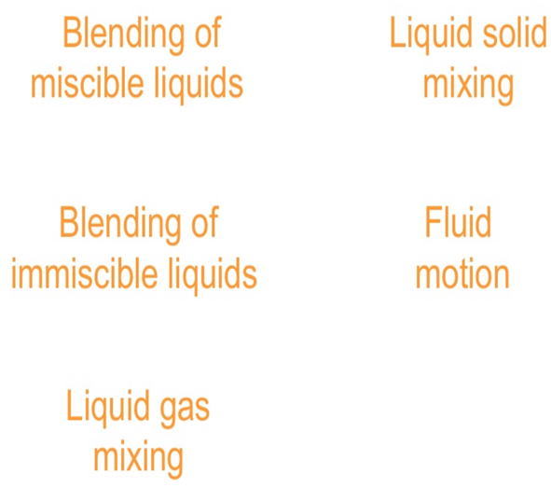
I Fluid mixing

Slide 5
Fluid mixing applications
1. Blending of two miscible liquids, such as ethyl alcohol and water.
2. Dissolving solids in liquids, such as salt in water.
3. Dispersing a gas in a liquid as fine bubbles,
- such as oxygen from air in a suspension of microorganisms for fermentation or for the activated sludge process in waste treatment.
4. Suspending of fine solid particles in a liquid,
- in the catalytic hydrogenation of a liquid, solid catalyst particles and hydrogen bubbles are dispersed in the liquid.
5. Agitation of the fluid to increase heat transfer between the fluid and a coil or jacket in the vessel wall.

Slide 6
Blending of miscible liquids

Slide 7
Blending of immiscible liquids

Slide 8
Blending of immiscible liquids

Slide 9
Liquid-gas mixing

Slide 10
Liquid-solid mixing

Slide 11
Fluid motion

Slide 12
Fluid Mixing Processes
Mechanical Agitation
Jet Mixing
Gas Sparging
In-line Mixing

Slide 13
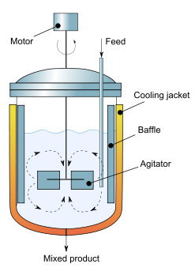
Agitation Tank
The impeller is the most important part
The motor rotates the shaft; impeller
Baffles are many times added to improve mixing
Circular tip
A level indicator
Inlet/Outlet pipe
Notes:
Unbaffled mixing tanks often used:
in transition region
for sticky materials
where perfect cleaning is required
in large tanks where baffle effects are small
processes where it is not clear baffles have an effect on mixing performance

Slide 14
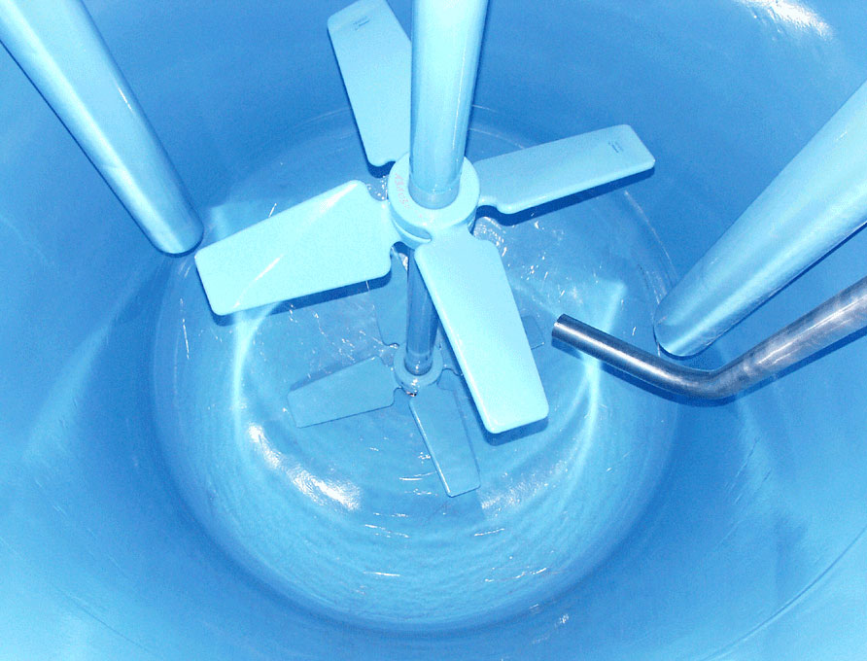

Slide 15
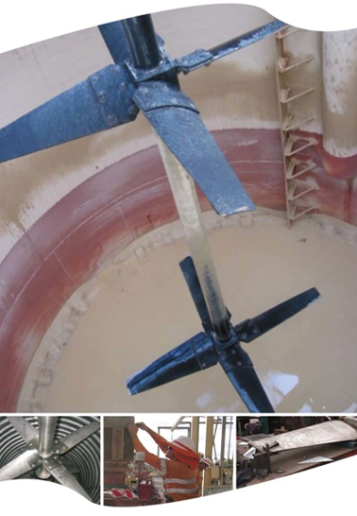

Slide 16
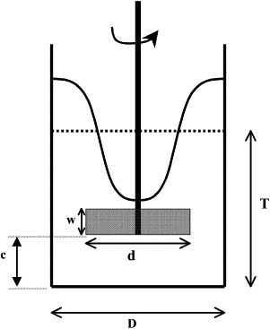
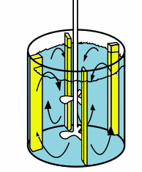
Baffles
Unbaffled mixing tanks often used:
in transition region
for sticky materials
where perfect cleaning is required
in large tanks where baffle effects are small
processes where it is not clear baffles have an effect on mixing performance

Slide 17
Baffles

Slide 18
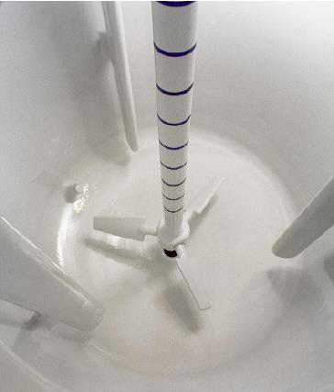

Slide 19
Agitation in an unbaffled vessel (left) leads to swirling flow with surface vortex formation and poor solids distribution, while standard baffling (right) with a pitched-blade turbine promotes axial flow that results in good solids distribution.

Slide 20
Devices to produce agitation
IMPELLERS
Three-blade propeller agitator
Paddle (Turbine) agitators
Helical-ribbon agitators
The performance for impeller mixer depends on:
Creation of a current or stream of liquid which penetrate to all point of mixing vessel or tank.
Turbulence movement to carry the current in all places of the tank.
Notes:
Paddle Agitators
Often used at low speeds, between about 20 and 200 rpm.
Two-bladed and four-bladed flat paddles are often used.
The paddle agitator is ineffective for suspending solids
- since good radial flow is present but little vertical or axial flow.
An anchor or gate paddle is often used.
Turbine Agitator
Turbines resemble of multi bladed paddle agitators with shorter blades
used at high speeds for liquids with a very wide range of viscosities.
The turbines usually have four or six blades.
They are also useful for good gas dispersion;
- the gas is introduced just below the impeller at its axis and is drawn up to the blades and chopped into fine bubbles.
Often a pitched-blade turbine with only four blades is used in suspension of solids.

Slide 21
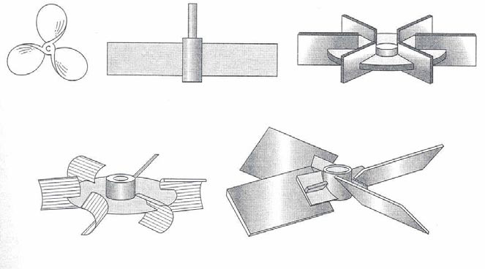
Impellers to produce agitation
Three-blade
Marine propeller
Straight-blade
turbine
Disk turbine
Concave-blade CD-6 impeller
Pitched-blade turbine

Slide 22
Impellers

Slide 23
Axial Flow Impellers

Slide 24
Marine Propellers

Slide 25
Pitched Blade Turbine

Slide 26
Hydrofoil Impellers

Slide 27
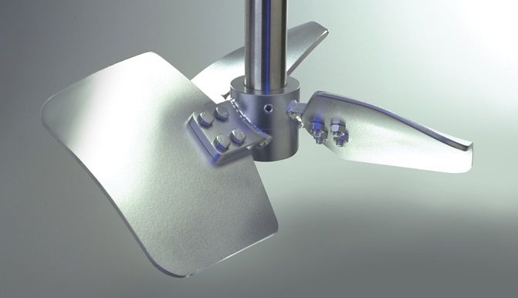

Slide 28
Radial Flow Impellers

Slide 29
Rushton Turbine, Smith Impeller

Slide 30
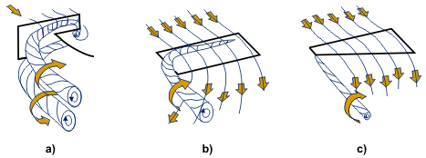
Fluid flow around the blades
Details of the flow around turbine blades a) a Rushton turbine, b) a pitched blade impeller, c) a hydrofoil.
Notes:
The detail of the flow behind the blades is interesting. Flow around the blade of a Rushton turbine separates with a pair of trailing vortices from the tips of each blade. These vortices, which are rather less developed in a turbine without a disc, are the locations of the greatest shear rates and most intense turbulence in the vessel (van'tRiet and Smith). In the fully developed turbulence region (Re > ~ 10⁵) the power number of a radial flow turbine is about 5. Much of the energy is small scale turbulence associated with the vortices; this decays rapidly in the outflowing stream so that about 80% of the energy transmitted from the shaft is dissipated in about 20% of the vessel volume.

Slide 31
Open Blade Turbine, Coil Impeller

Slide 32
Low Clearance Impellers
Notes:
Helical-Ribbon Agitator
used in highly viscous solutions
operates at a low rpm in the laminar region.
The ribbon is formed in a helical path and is attached to a central shaft.
The liquid moves in a tortuous flow path down the center and up along the sides in a twisting motion.
Similar types are the double-helical-ribbon agitator and the helical-screw impeller

Slide 33
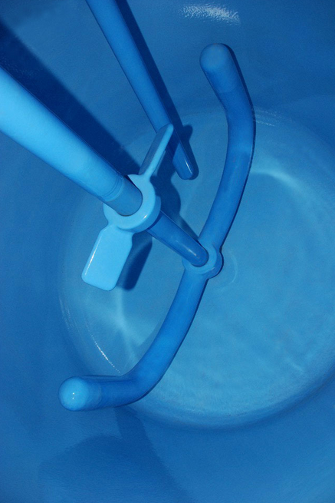
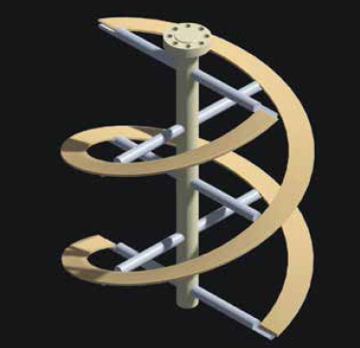

Slide 34
High Shear Impellers

Slide 35
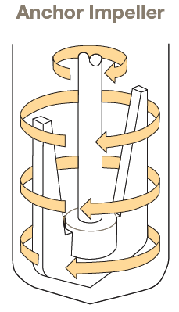
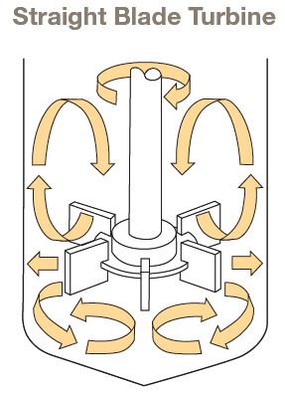
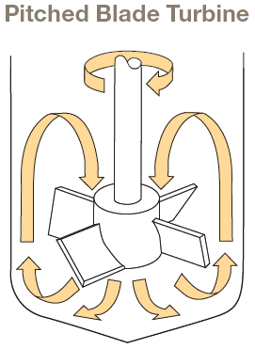
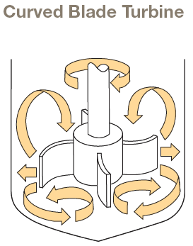
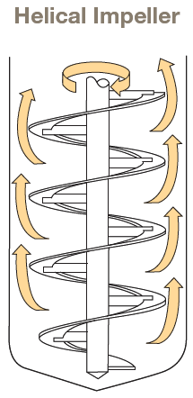
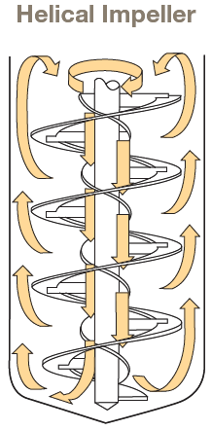
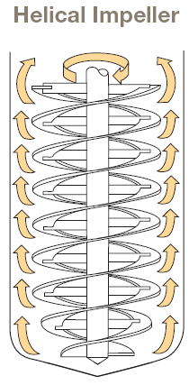
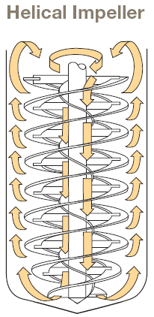
(1 Outer Flight)
(1 Inner Flight, 1 Outer Flight)
(1 Inner Flight , 2 Outer Flights )
(2 Outer Flights)

Slide 36
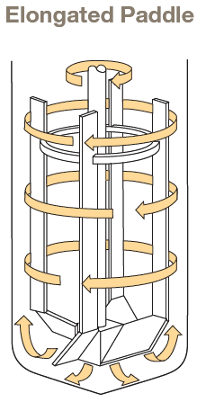
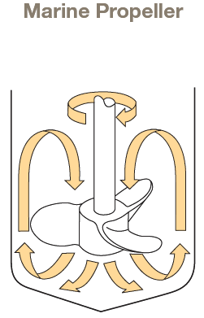
The Marine Propeller is an axial flow impeller generally pitched for downward pumping action, however, upward pumping is also available. This impeller provides a high, uniform discharge and therefore is best suited for low viscosity liquid blending applications. *Vessel baffling may be required for optimum performance.
The Elongated Paddle impeller provides a combination of axial upward and radial fluid flow. It, like the Anchor and Helical Impellers, operates in close proximity to the vessel wall.

Slide 37
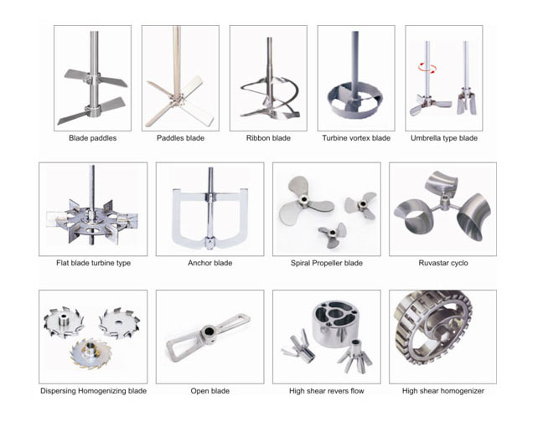

Slide 38
Impeller Selection

Slide 39
Impeller Selection

Slide 40
Side Entering Mixers

Slide 41
Side Entering Mixers
Flow patterns for side-entering propeller

Slide 42
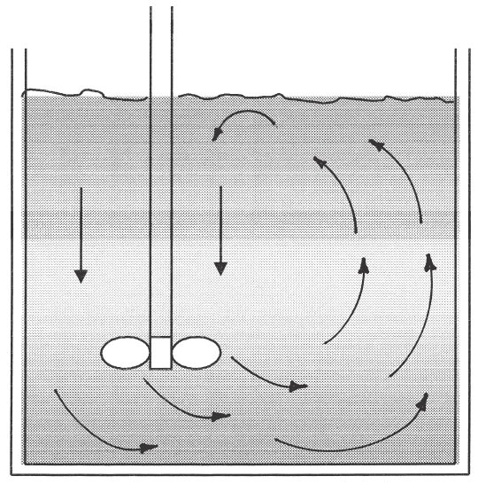
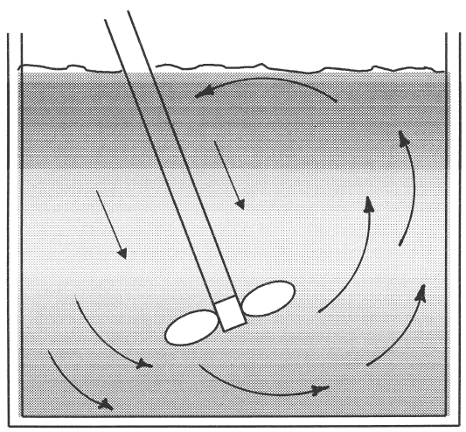
Impeller position
Flow pattern of propellers in an eccentric angle and off-centered position

Slide 43
Off-center agitator mounting (left) reduces swirl in unbaffled vessels, while angled, off-center mounting (right) approximates the flow in fully-baffled vessels

Slide 44
Portable Mixers

Slide 45
Jet Mixers

Slide 46
Motionless Mixers

Slide 47
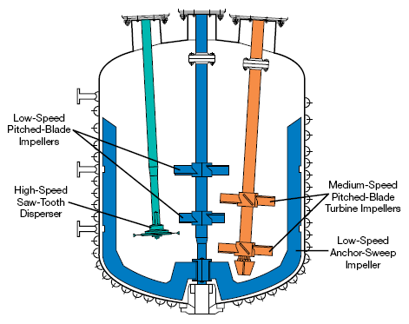

Slide 48
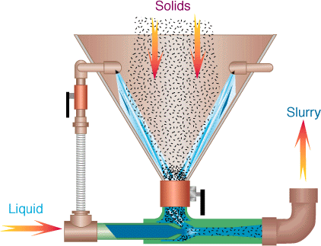

Slide 49
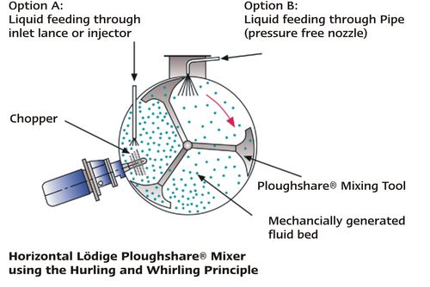
Lödige systems enable therefore the gentle mixing of sensitive products and the concerted shear introduction into the material

Slide 50
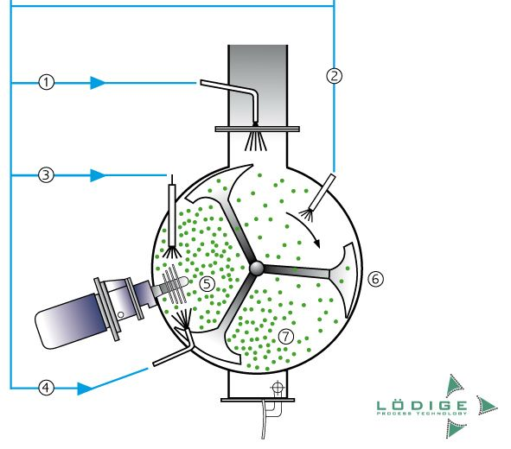

Slide 51
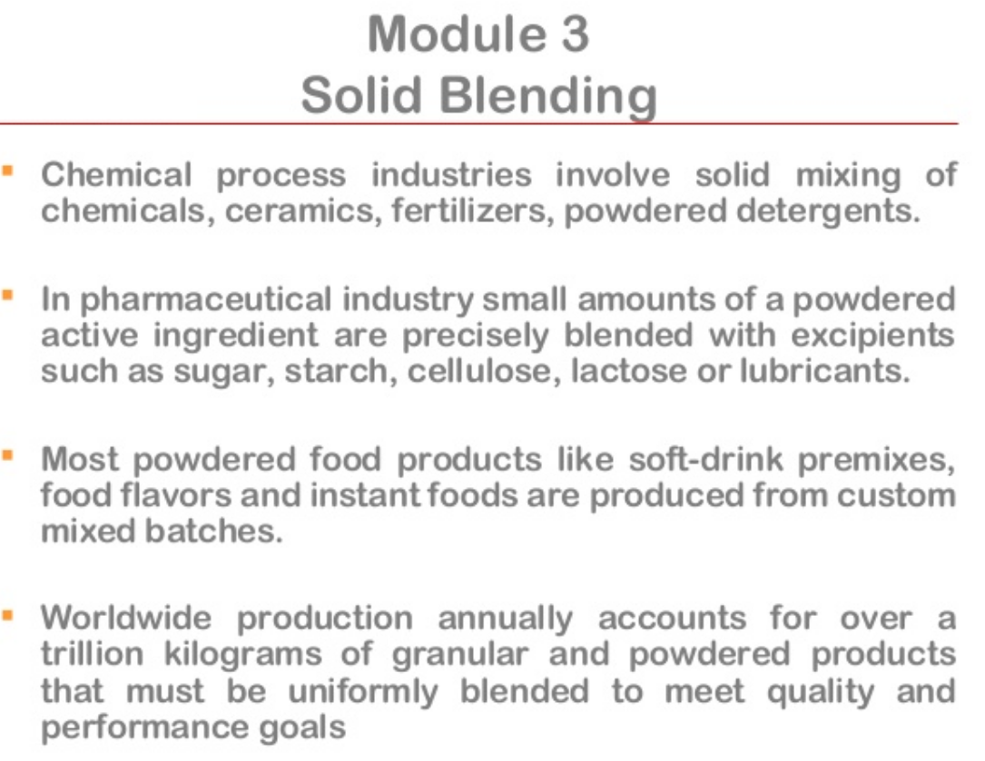
II Solid-Solid Mixing

Slide 52
Material Properties Affecting Solid Blending

Slide 53
Material Properties Affecting Solid Blending

Slide 54
Material Properties Affecting Solid Blending

Slide 55
Material Properties Affecting Solid Blending

Slide 56
Material Properties Affecting Solid Blending

Slide 57
Structured and Random Blend Structures

Slide 58
Mechanisms of Solid Blending

Slide 59
Mechanisms of Solid Blending

Slide 60
Diffusion Blending

Slide 61
Convection Blending

Slide 62
Shear Blending

Slide 63
Segregation (De-mixing)

Slide 64
Segregation Mechanisms

Slide 65
Sifting Segregation

Slide 66
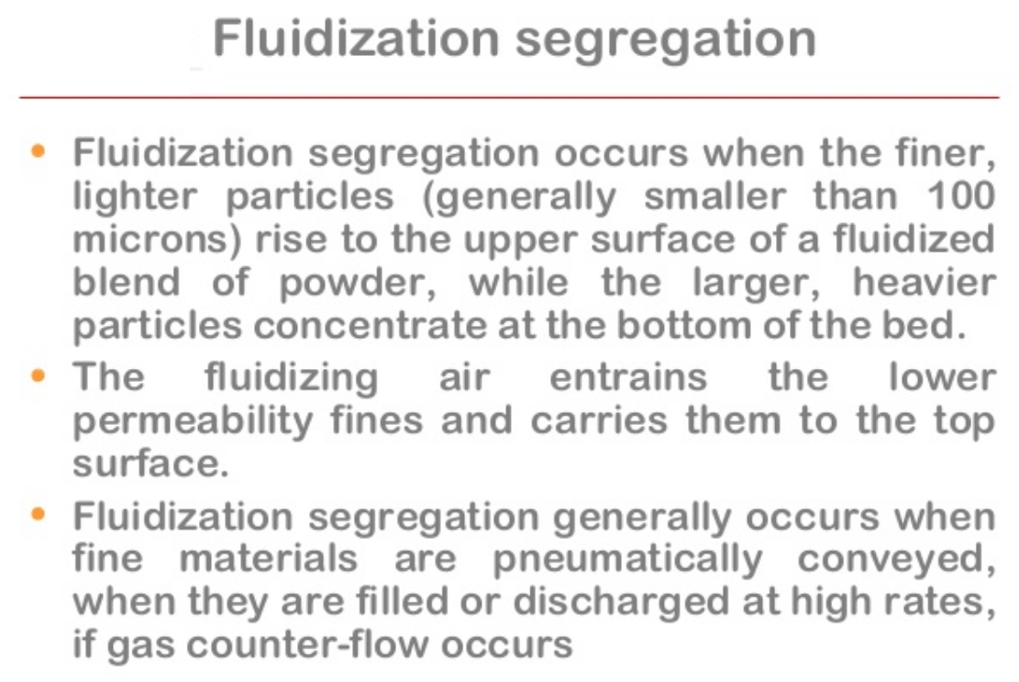
Fluidization Segregation

Slide 67
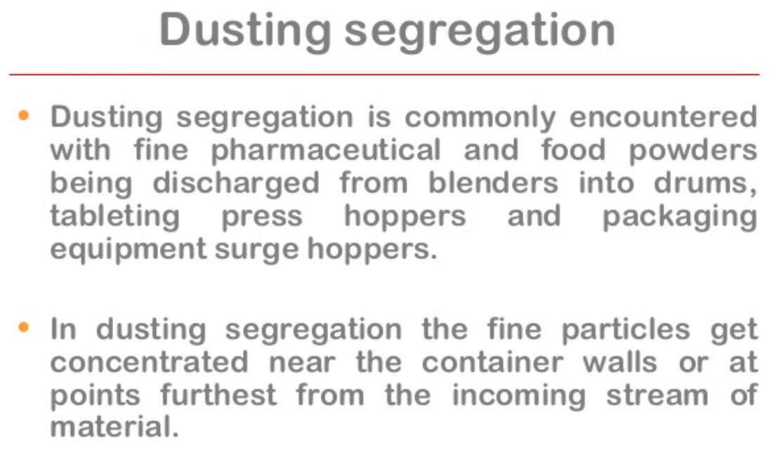
Dusting Segregation

Slide 68
Minimizing Segregation

Slide 69
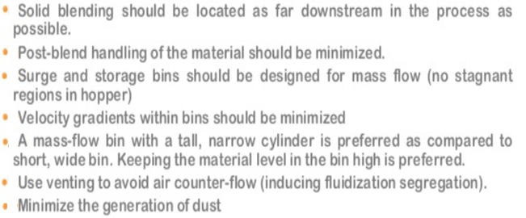
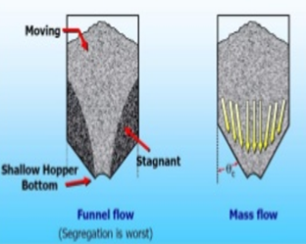
Design Practices for minimizing segregation

Slide 70
Solid Blending Equipment

Slide 71
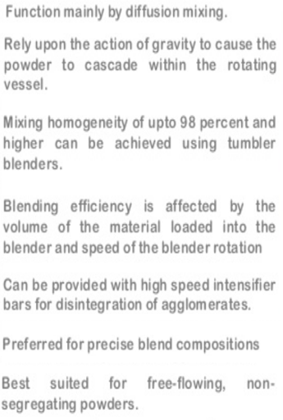
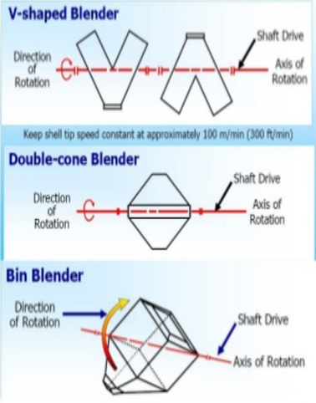
Tumbler Blenders

Slide 72
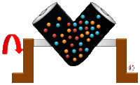
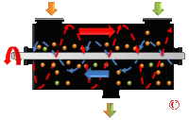
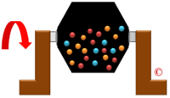
Industrial V Blender.
Industrial Ribbon Blender
Industrial Double Cone Blender.

Slide 73
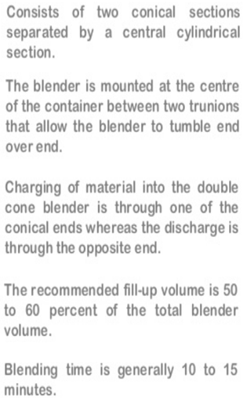
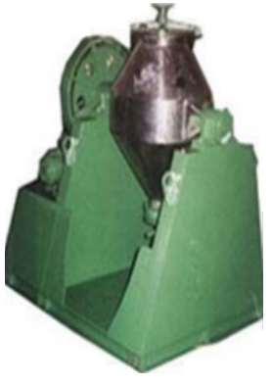
Double Cone Blenders

Slide 74
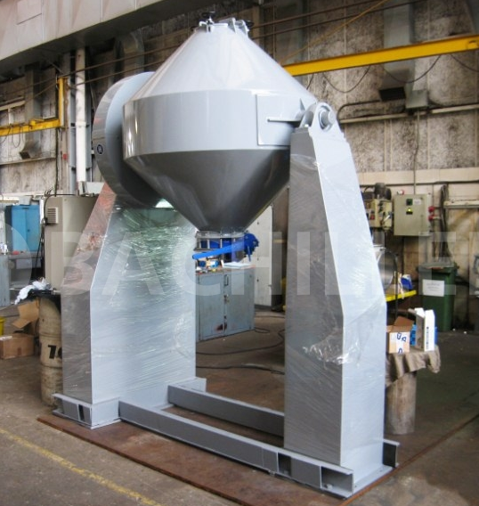

Slide 75
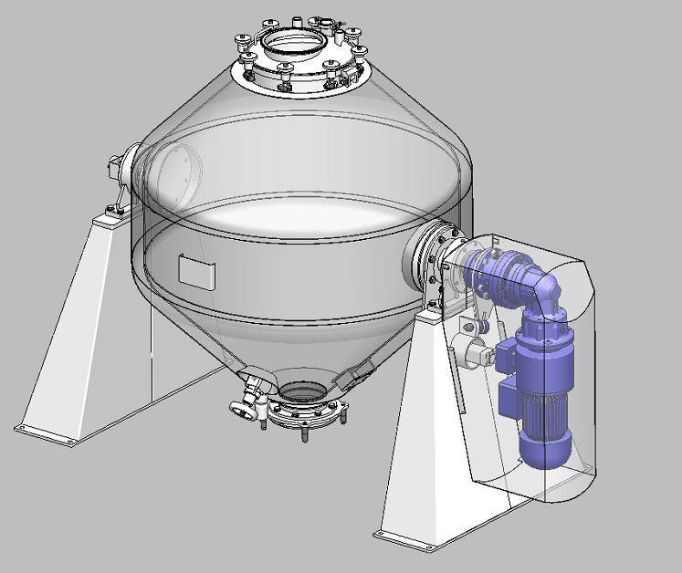

Slide 76
V Blender

Slide 77
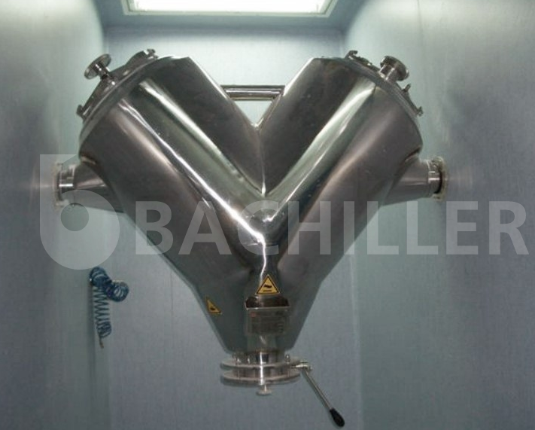

Slide 78
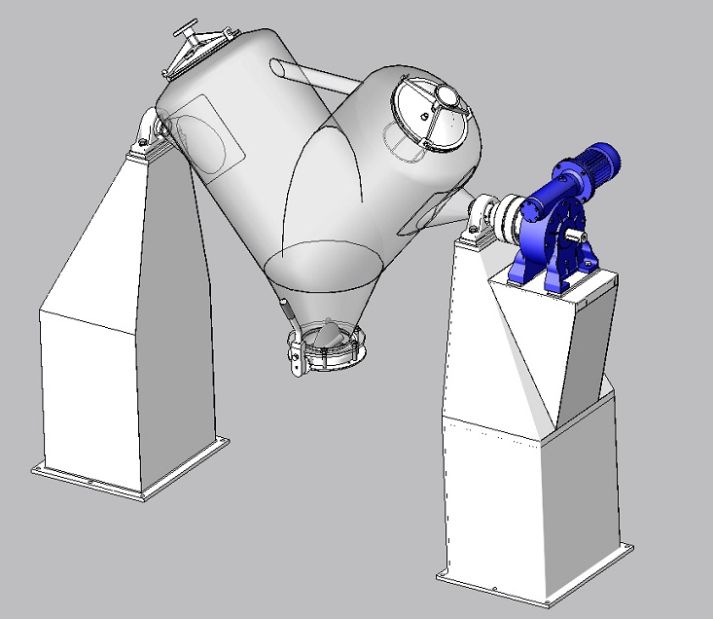

Slide 79
Advantages

Slide 80
Disadvantages

Slide 81
Convective Blenders

Slide 82
Convective Blenders

Slide 83
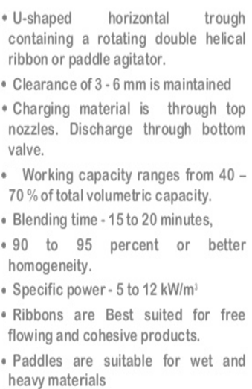
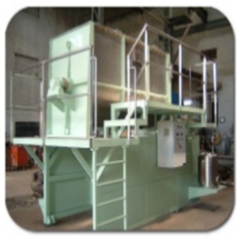
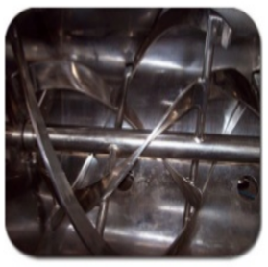
Horizontal Ribbon, Paddle Blender

Slide 84
Vertical Ribbon Blender

Slide 89
Vertical Cone Screw Blender

Slide 92
Single screw configuration
• Standard execution
• Variety of designs
Double screw configuration
• Reduced mixing times
• Improved heat transfer
Intensifier
• Provides additional mixing energy
• Can be combined with liquid spray devices
Cantilevered (no support)
Radial bottom locator
Ball head bearing

Slide 94
Plow Mixer

Slide 95
Plow Mixer

Slide 96
Twin Shaft Paddle Blender

Slide 97
Twin Shaft Paddle Blender

Slide 99
Selection of Solid Mixer

Slide 100
Silo Blenders

Slide 101
Gravity Silo Blender

Slide 102
Mechanical Silo Blender

Slide 103
Pneumatic Blender

Slide 104
III Mixing of High Viscosity Materials and Pastes

Slide 105
High Viscosity Mixing

Slide 106
Mixing Mechanisms

Slide 107
Mixing Challenges

Slide 108
Viscous Mixing Equipment

Slide 109
Mixer Design

Slide 110
Single Planetary Mixer

Slide 111
Double Planetary Mixer

Slide 112
Double Arm Kneader Mixer

Slide 113
Double Arm Kneader Mixer

Slide 114
Pan Muller Mixer

Slide 115
Single Screw Extruder

Slide 116
Twin Screw Extruder

Slide 117
Pug Mills

Slide 118
Design of fluid mixers

Slide 119
Experimental approach
Torque
(measured)
Lab scale mixer
(run at different rpm)
Power
(calculated)
VS
Power number
(calculated)
Reynolds number
(calculated)

Slide 120
Parameters

Slide 122
Scale up, Power & Time of mixing of the large mixer

Slide 126
Typical measurement profile with a stepwise increase in the agitator rotational speed (i.e. N₁ < N₂ < N₃) in 5 min intervals, as indicated by the vertical dashed lines.
Calculated power input in the bioreactor as a function of the Reynolds number for different model media.
Determined power numbers as a function of the Reynolds number in baffled tanks.

Slide 127
Dimensions of agitated fluid mixer
Notes:
F. PROCEDURE
Given a tank, impeller, baffles and liquid (water or corn syrup) we will vary the shaft speed and measure the torque. This will be done using a large and then a small tank, and with and without baffles. From these we will calculate N_{p} and N_{re}, and check N_{p} vs. the value taken from the plot. Then we will run corn syrup and use the plot to calculate the viscosity. We will also determine the effect of baffles vs. no baffles on the torque and mixing efficiency as determined by the tracer injection method.
1. Fill the 4 L tank with water and remove the baffles. Mount the 4-bladed, flat-bladed impeller on the mixer shaft. The mixer shaft position is a fixed reference point in the horizontal plane. Center the torque table directly beneath the shaft. Center the tank on the torque table. The impeller should be located vertically so that it is halfway between the tank bottom and the water surface. Set the rotation direction to clockwise (CW). Increase the stirring speed slowly until a vortex forms that pulls air into the tank. This is the maximum speed for this configuration. Set the speed at zero and record the torque reading (which may not be zero). Then run at 10 speeds evenly spaced between 0 and the maximum speed, and record the torque reading at each speed. Repeat using other impellers and rotation senses. Convert the torque reading to torque (in N m) using the calibration data below.
2. Repeat the procedure above with baffles inserted in the tank, using water.
3. Repeat steps 1 and 2 using corn syrup. The maximum speed may be limited by the power available.
4. Repeat steps 1 and 2 using the 20 L tank filled with water.
5. Mount the 4-bladed flat-bladed impeller and insert in middle of the 20 L tank filled to the mark with tap water. Mount the conductivity transducer 1 inch above the tank bottom and 1 inch from the tank wall, connect to the conductivity meter, connect the meter to the computer, and load and start the QuickBASIC program for agitation data acquisition. Remove the baffle(s) from the tank. Set the speed at 20% of the speed that produces air ingestion. Inject 10 ml of KCl solution onto the plate at the top of the tank, at the same time starting the data acquisition program. Make 5 additional injections under the same conditions. The tank will now contain a dilute solution of KCl. Empty the tank and refill with tap water. Set the speed at 80% of the maximum speed and make an additional 6 runs. For each run record the torque reading.
6. Repeat the 12 runs of step 5 with baffles inserted in the tank.
7. If time permits, repeat some of the runs of steps 5 and 6 using the propeller, driving fluid in the upward and then downward direction.
F. REPORT
The report should describe concisely the goals of the work, what was done, and the results and conclusions. The raw data should appear in an Appendix, and plots of torque and power vs. stirring speed should be presented and discussed in the body of the report. The effect of viscosity, baffles, impeller design should be discussed, and the power consumption should be compared with correlations from the literature (McCabe, Smith and Harriot).
Specifically, does the torque as a function of stirring speed follow the prediction of theory? And, how close is the observed power to that predicted by the correlation?
Plots of tracer concentration as a function of time should also be presented, and the effect of impeller type, baffles, and stirring speed on the tracer concentration vs. time curves should also be discussed.

Slide 128
Agitated Vessel
Power Used in Agitated Vessel
In the design of an agitated vessel, an important factor is the power required to drive the impeller.
Empirical correlations have been developed to predict the power required.
Reynolds number, is defined as:
Where:
D_{a} = impeller (agitator) diameter (m)
N = rotational speed (rev/s)
ρ = fluid density (kg/m³)
µ = fluid viscosity (kg/m.s)

Slide 129
Power consumption is related to fluid density ρ, fluid viscosity µ, rotational speed N and impeller diameter D_{a} by plots of power number N_{p} versus
The power number is defined as:
(SI)
(English)
Where P = power (J/s) or (W). In English units, P = ft.lb_{f}/s.

Slide 130
Power correlations for various impellers and baffles
(Geankoplis, 4th ed.)

Slide 131
Curve 1. Flat six-blade turbine with disk but six blades); D_{t}/W = 5; four baffles each D_{t}/J = 12.
Curve 2. Flat six-blade open turbine; D_{a}/W = 8;four baffles each D_{t}/J = 12.
Curve 3. Six-blade open turbine (pitched-blade) but blades at 45⁰; D_{a}/W = 8; four baffles each D_{t} /J = 12.
Curve 4. Propeller; pitch 2D_{t} four baffles each D_{t} /J = 10; also holds for same propeller in angular off-center position with no baffles.
Curve 5. Propeller; pitch = D_{a} four baffles each D_{t} /J = 10; also holds for same propeller in angular off-center position with no baffles.
Curve 6. High-efficiency impeller; four baffles each D_{t} /J = 12.

Slide 133
Example 1: Power Consumption in an Agitator
A flat blade turbine agitator with disk having six blades is installed in a tank similar to Fig. 3.4-3. The tank diameter D_{t} is 1.83 m, the turbine diameter D_{a} is 0.61 m, D_{t} = H, and the width W is 0.122 m. The tank contains four baffles, each having a width J of 0.15 m. The turbine is operated at 90 rpm and the liquid in the tank has a viscosity of 10 cp and a density of 929 kg/m³.
a) Calculate the required power of the mixer in kW.
b) For the same conditions, except for the solution having a viscosity of 100,000 cp, calculate the required power in kW.

Slide 134
Solution
For part (a) the following data are given:
Reynolds number is:
Using Curve 1 in the Figure, since
Solving for P and substituting known values

Slide 135
For part (b)
This is the laminar flow region. From Figure, N_{p} = 14.
Hence, a 10,000-fold increase in viscosity only increases the power from 1.324 to 3.71 kW.

Slide 136
AGITATOR SCALE UP
Scale-up the laboratory-size or pilot-size agitation system to a full-scale unit.
Maintain
constant power per unit volume
geometric similarity

Slide 137
Agitator Scale-Up
Scale-up procedure:
Calculate the scale-up ratio R. Assuming that the original vessel is a standard cylinder with D_{T1} = H₁, the volume is:
The ratio of the volume is
The scale-up ratio is then

Slide 138
Using this value of R, apply it to all of the dimensions to calculate the new dimensions. For Example,
D_{a2} = RD_{a1}, J₂ = RJ₁…
Determine the agitator speed N₂, to be used to duplicate the small scale results using N₁. The equation is:
Where n = 1 for equal liquid motion, n = ¾ for equal suspension solids and n = 2/3 for equal rates of mass transfer (which is equivalent to equal power per unit volume, P₁/V₁ = P₂/V₂ ). This value of n is based on empirical and theoretical considerations.
4. Knowing N₂, the power required can be determined.

Slide 139
Example 2: Scale up of Turbine Agitator
An existing agitation system is the same as given in Example 1a for a flat-blade turbine with a disk and six blades. The given conditions and sizes are D_{T1} = 1.83 m, D_{a1} = 0.61 m, W₁ = 0.122 m, J₁ = 0.15 m, N₁ = 90/60 = 1.50 rev/s, ρ = 929 kg/m³ and µ = 0.01 Pa.s. It is desired to scale up these results for a vessel whose volume is 3.0 times as large. Do this for the following two process objectives:
a) Where equal rate of mass transfer is desired.
b) Where equal liquid motion is needed.

Slide 140
Solution:
Since H₁ = D_{T1} = 1.83 m,
the original tank volume,
Volume V₂ = 3.0 (4.813) = 14.44 m³.
Following the steps in the scale-up procedure:
The dimensions of the larger agitation system are as follows:
D_{T2} = RD_{T1} = 1.442 (1.83) = 2.64 m, D_{a2} = 1.442 (0.61) = 0.880 m, W₂ = 1.442 (0.122) = 0.176 m and J₂ = 1.442 (0.15) = 0.216 m.
For part (a), for equal mass transfer, n = 2/3 :

Slide 141
Reynolds number
Referring to Figure, Curve 1 and N_{Re} = 8.453 x 10⁴, gives N_{p} = 5.0
Using N_{p} = 5.0

Slide 142
The power per unit volume is
The value of 0.2752 kW/m³ is somewhat lower than the approximate guidelines of 0.8 to 2.0 for mass transfer.
For part (b), for equal liquid motion, n = 1.0

Slide 143
Time of mixing

Slide 144
Mixing Times of Miscible Liquids
Figure 3.4-6 shows a Correlation of mixing time for miscible liquid using a turbine in a baffled tank.
Mixing factor f_{t} is defined as:
where t_{T} is the mixing time in seconds.
For , f_{t} is approximately constant, then t_{T} N^{2/3} is constant.
For scaling up from vessel 1 to another vessel 2 with similar geometry and with same power/unit volume in the turbulent region, the mixing times are related by:

Slide 146
The mixing time increases for the larger vessel.
For scaling up while keeping the same mixing time, the power/unit volume (P/V) increases markedly:
Usually, in scaling up to large-size vessels, a somewhat larger mixing time is used so that the power/unit volume does not increase markedly.

Slide 147
Example 3: Scale-up of Mixing Time in a Turbine Agitator
Using the existing conditions for the turbine with a disk as in Example 1 part (a), do as follows:
Calculate the mixing time
Calculate the mixing time for a smaller vessel with a similar geometric ratio, where D_{t} is 0.30 m instead of 1.83 m. Do this for the same power per unit volume as used in part (a).
Using the same mixing time calculated for the smaller vessel in part (b), calculate the new power per unit volume for the larger vessel in part (a).

Slide 148
Solution
In part (a), D_{t} = 1.83 m, D_{a} = 0.61 m, D_{t} = H, N = 90/60 = 1.50 rev/s, ρ = 929 kg/m³, µ = 10 cp = 0.01 Pa.s. From example 1,
, N_{p} = 5, P₁ = 1.324 kW. For the tank volume,
The power per unit volume is
From the Figure 3.4-6 , , f_{t} = 4.0. Substituting in Eq.

Slide 149
For part (b)
* Mixing time decrease for smaller vessel from 17.30 to 5.73 s.

Slide 150
For part (c)
t_{T2} = 5.73 s for smaller vessel
Calculate the P / V for the larger vessel

Slide 151
Turbulent blending
The dimensionless blend time characteristic (Nt_{m}) is constant for geometrically
similar, agitated, baffled vessels that operate in the turbulent-flow regime.
The value of Nt_{m} depends mainly on the type of impeller and the diameter ratio. Mersmann [1] evaluated the measurement results of various authors and determined a simple correlation that characterized the performance of many mixers, with H/D_{t} = 1 and a single-stage impeller, in terms of the impeller power number and ratio of impeller to vessel diameter. In dimensionless form his equation becomes:

Slide 152
Blend time (estimation to within 5% desired concentration):
where:
Notes:
Q = discharge flowrate, or pumping capacity.
For “square-pitched” propellers in turbulent region, take N_{Q} = 0.5
W=J/s = N-m/s = kg-m^2/s^3
http://www.em.doe.gov/PDFS/Slurry%20Handling%20Workshop/2-Short%20Course%20Art%20Etchells/2-2%20DOEM4M5%20Slurry%20Handling%20Course_Part%202_Art%20Etchells_Dec31'07.pdf

Slide 153
Mixing Time
Blend time (estimation to within 10% desired concentration):
P.M. Doran, Bioprocess Engineering Principles, 2nd Ed., Academic Press 2012
Notes:
N_{i} t_{m} = dimensionless mixing time or the number of stirrer rotations to mix the solution to homogenization.

Slide 154
Mixing Time
Doran suggests that for turbulent mixing conditions, irrespective of the impeller type, that (baffled vessel, single impeller, H=T):
Verified under aerated conditions also (impeller not flooded) and for:
P.M. Doran, Bioprocess Engineering Principles, 2nd Ed., Academic Press 2012

Slide 155
Pumping Capacity: discharge flow rate from an impeller:
Tip Speed of an impeller:
Torque: “twist” force acting on
agitator shaft:
Power per unit volume:
Notes:
Q = discharge flowrate, or pumping capacity.
For “square-pitched” propellers in turbulent region, take N_{Q} = 0.5
W=J/s = N-m/s = kg-m^2/s^3
http://www.em.doe.gov/PDFS/Slurry%20Handling%20Workshop/2-Short%20Course%20Art%20Etchells/2-2%20DOEM4M5%20Slurry%20Handling%20Course_Part%202_Art%20Etchells_Dec31'07.pdf

Slide 156
Power Consumption in Agitated Vessels

Slide 162
Typical Dimensions for Mixing Equipment
G.B. Tatterson., Fluid Mixing and Gas Dispersion in Agitated Tanks, McGraw-Hill, 1991

Slide 163
Typical Dimensions for Mixing Equipment
G.B. Tatterson., Fluid Mixing and Gas Dispersion in Agitated Tanks, McGraw-Hill, 1991

Slide 164
Power Consumption and Scale-up in Mixing
Consider geometry, fluid properties, flow patterns, power, and so on. Has been considered through dimensional analysis.
With:
For geometrically similar vessels, ratios of all terms to right of the Froude number are negligible.
The Froude number is only important when significant vortex develops (in unbaffled tanks); for baffled tanks the N_{P} does not depend on the Froude number.
Tatterson & Colson and Richardson.
Notes:
P = power dissipation to the fluid. W=J/s = N-m/s = kg-m^2/s^3
Power rating of the driver must exceed P, i.e. has to overcome losses of driver, seals, bearing, etc.
As R.O.T., estimate losses as 25 % of calculated P
Therefore: P_{driver} = 1.25 * P Use 1.75 factor when solids might settle on propeller before it is started.
(info from Cheremisinoff)

Slide 165
Power Consumption and Scale-up in Mixing
Consider low viscosity, unbaffled systems.
Colson and Richardson.

Slide 166
In-Class PS Exercise
Consider a solution of sodium hydroxide with the properties listed below. It is agitated by a propeller mixer that is 0.5m in diameter in a 2.28m diameter unbaffled tank. The liquid depth is 2.28m. The impeller is located 0.5m above the bottom of the tank. If the propeller is rotated at 2 Hz, what power is required?
Notes:
Colson and Richardson

Slide 167
Power Consumption and Scale-up in Mixing
Consider low viscosity, baffled systems.
Colson and Richardson.

Slide 168
Power Consumption and Scale-up in Mixing
Consider low viscosity, baffled systems (wall baffles).
Figure 10.59 Power correlations for turbine impellers in a tank with 4 baffles. [w, D, impeller width and diameter, respectively.]
Colson and Richardson.
Notes:
Curve 1 = Rushton impeller
Curves 2 & 4, open, flat blade impellers
Curve 5 is Backswept open impeller
Curve 6 is PBT (pitched blade turbine)

Slide 169
In-Class PS Exercise
Assume you are mixing a small amount of material into water in a standard configuration baffled tank. The diameter of the pitched blade turbine is 1 m and it is desired to operate at 84 RPM. Estimate the power required.
Notes:
http://www.em.doe.gov/PDFS/Slurry%20Handling%20Workshop/2-Short%20Course%20Art%20Etchells/2-2%20DOEM4M5%20Slurry%20Handling%20Course_Part%202_Art%20Etchells_Dec31'07.pdf

Slide 170
Power Consumption and Scale-up in Mixing
Consider low viscosity, baffled systems (wall baffles).
N.P. Cheremisinoff, Handbook of Chemical Processing Equipment, B-H, 2000

Slide 171
Power Consumption and Scale-up in Mixing
Propeller pitch:
Notes:
Propeller pitch = (distance fluid (or propeller) travels in one full revolution) / (propeller diameter)

Slide 172
Discharge Coefficient
N.P. Cheremisinoff, Handbook of Chemical Processing Equipment, B-H, 2000

Slide 173
In-Class PS Exercise
A fermentation broth with properties as given below, is agitated in a 2.7 m³ baffled tank using a Rushton turbine with a diameter of 0.5 m and a stirred speed of 1 Hz. Estimate the mixing time.

Slide 174
Additional Plots for Non-Standard Mixing
N.P. Cheremisinoff, Handbook of Chemical Processing Equipment, B-H, 2000

Slide 175
Additional Plots for Non-Standard Mixing
N.P. Cheremisinoff, Handbook of Chemical Processing Equipment, B-H, 2000

Slide 176
Additional Plots for Non-Standard Mixing
N.P. Cheremisinoff, Handbook of Chemical Processing Equipment, B-H, 2000

Slide 177
Additional Plots for Non-Standard Mixing
N.P. Cheremisinoff, Handbook of Chemical Processing Equipment, B-H, 2000

Slide 178
Heat Transfer in Agitated Vessel
Often it is necessary to cool or heat the contents of the vessel during agitation.
This is usually done by heat-transfer surfaces, which may be in the form of:
1) cooling or heating jackets in the wall of the vessel
2) coils of pipe immersed in the liquid.

Slide 180
Vessel with heating jacket
When heating, the fluid entering is often steam, which condenses inside the jacket and leaves at the bottom.
The vessel is equipped with an agitator and in most cases also with baffles (not shown).
Correlations for the heat-transfer coefficient from the agitated Newtonian liquid inside the vessel to the jacket walls of the vessel have the following form:

Slide 181
where:
h is the heat-transfer coefficient for the agitated liquid to the inner wall in W/m².K,
D_{t} is the inside diameter of the tank in m,
k is thermal conductivity in W/m.K,
D_{a} is diameter of agitator in m,
N is rotational speed in revolutions per sec,
ρ is fluid density in kg/m³,
µ is liquid viscosity in Pa.s

Slide 184
EXAMPLE 4.13-1. Heat-Transfer Coefficient in Agitated Vessel with Jacket
A jacketed 1.83-m-diameter agitated vessel with baffles is being used to heat a liquid which is at 300 K. The agitator is 0.61 m in diameter and is a flat-blade turbine rotating at 100 rpm. Hot water is in the heating jacket. The wall surface temperature is constant at 355.4 K. The liquid has the following bulk physical properties: ρ = 961 kg/m³, c_{p} = 2500 J/kg.K, k = 0.173 W/m.K, and µ = 1.00 Pa.s at 300 K and 0.084 Pa.s at 355.4 K. Calculate the heat-transfer coefficient to the wall of the jacket.

Slide 187
Vessel with heating coil
Correlations for the heat-transfer coefficient to the outside surface of the coils in agitated vessel have the following form:
a) for a paddle agitator
b) for vertical baffle tube with a flat-blade turbine:
D_{o} is outside diameter of the coil tube (in m), n_{b} is number of vertical baffle tubes and µ_{f} is the viscosity of the mean film temperature

Slide 190
Solution
1a
D_{a1} | 5.00E-02 | m
J₁ | 1.50E-02 | m
H₁ | 1.50E-01 | m
D_{T1} | 1.50E-01 | m
E₁ | 5.00E-02 | m
D_{a2} | 2.92E-01 | m
J₂ | 8.77E-02 | m
H₂ | 8.77E-01 | m
D_{T2} | 8.77E-01 | m
E₂ | 2.92E-01 | m

Slide 191
1b
N (rev/s) | P (J/s) | N_{Re} | N_{P}
4.00E-03 | 1.00E-09 | 1.00E+00 | 50
8.00E-03 | 5.12E-09 | 2.00E+00 | 32
2.00E-02 | 4.25E-08 | 5.00E+00 | 17
4.00E-02 | 1.60E-07 | 1.00E+01 | 8
4.00E-01 | 4.00E-05 | 1.00E+02 | 2
1.60E+00 | 1.28E-03 | 4.00E+02 | 1
4.00E+00 | 1.60E-02 | 1.00E+03 | 0.8
1.20E+01 | 2.70E-01 | 3.00E+03 | 0.5
6.00E+01 | 2.03E+01 | 1.50E+04 | 0.3
4.00E+02 | 4.00E+03 | 1.00E+05 | 0.2
4.00E+03 | 3.20E+06 | 1.00E+06 | 0.16
From the graph

Slide 193
1c
From the graph

Slide 194
Advances in Mixing Technology

