Slide 1
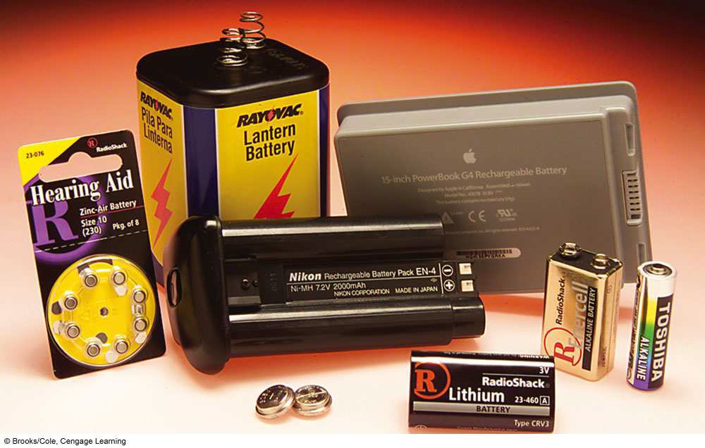

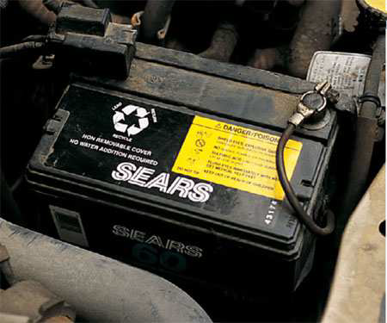


BATTERY TECHNOLOGY
Girma M.

Slide 2
Exercise
Can we store copper sulphate in (i)Zinc vessel (ii) Silver vessel? Give reasons.
Given E⁰ Cu²⁺/Cu = +0.34V, E⁰Zn²⁺/Zn= -0.76V) , E⁰Ag⁺/Ag = +0.80V

Slide 3
Chapter 2
Battery technology

Slide 4
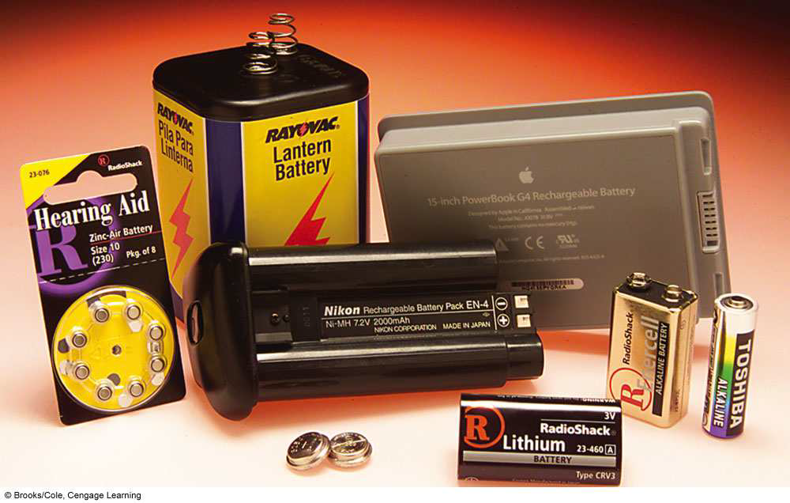

Slide 5
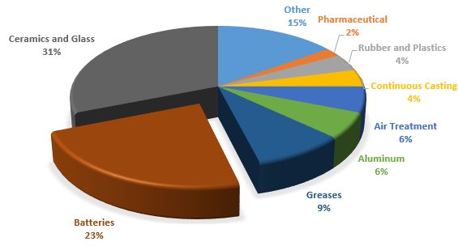


Why is this important?

Slide 6
Battery
A battery is a source of electrical energy, which is provided by one or more electrochemical cells
In today’s life, batteries play an important part as many household and industrial appliances use batteries as their power source.

Slide 7
Battery components
Cathode
  Positive terminal
  Chemical reduction occurs (gain electrons)
Anode
  Negative terminal
  Chemical oxidation occurs (lose electrons)
Electrolytes allow:
  Separation of ionic transport and electrical transport
  Ions to move between electrodes and terminals
  Current to flow out of the battery to perform work

Slide 8
types of Batteries
Batteries can be divided into two major categories, primary batteries and secondary batteries.
A primary battery is a disposable kind of battery. Once used, it cannot be recharged. Alkaline batteries, Mercury batteries, Silver-Oxide batteries, and Zinc carbon batteries are examples of primary batteries
Secondary batteries are rechargeable batteries. Once empty, it can be recharged again. This charging and discharging can happen many times depending on the battery type. Lead-Acid batteries and Lithium batteries fall into secondary battery's category.

Slide 9
Primary Cell
Alkaline Battery
Zinc-Carbon Battery
Zinc powered, basic electrolyte
Higher energy density
Functioning with a more stable chemistry
Shelf-life: 8 years because of zinc powder
Long lifetime both on the shelf and better performance
Can power all devices high and low drains
Use:
  Digital camera, game console, remotes
Zinc body, acidic electrolyte
Case is part of the anode
Zinc casing slowly eaten away by the acidic electrolyte
Cheaper than Alkaline
Shelf-life: 1-3 years because of metal body
Intended for low-drain devices
Use:
  Kid toys, radios, alarm clocks

Slide 10

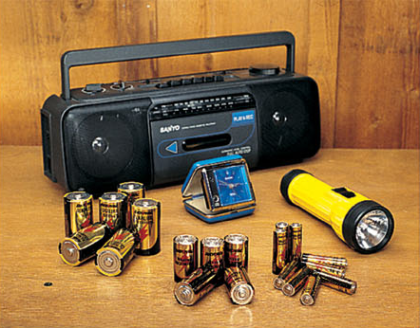

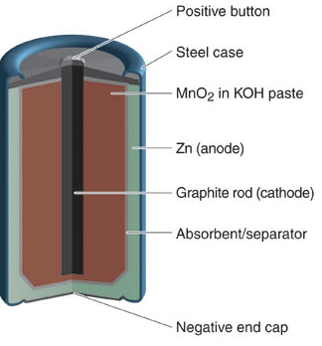
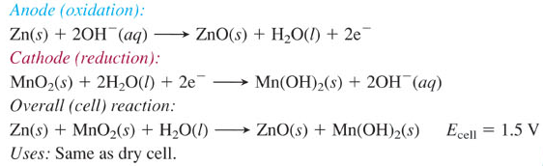

alkaline battery

Slide 11
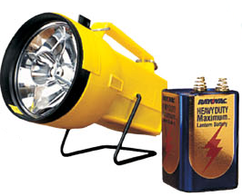
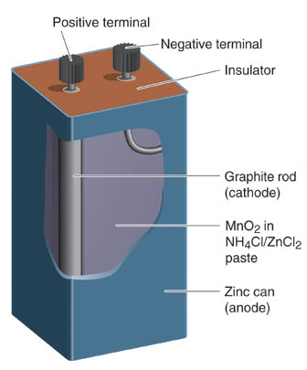
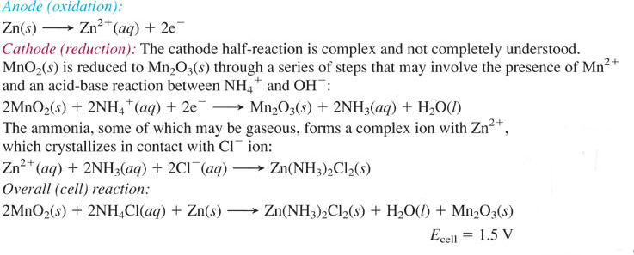
dry cell

Slide 12

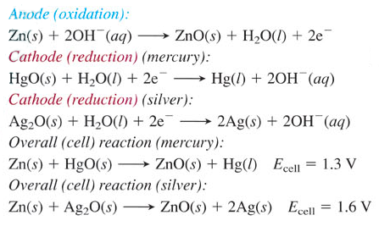
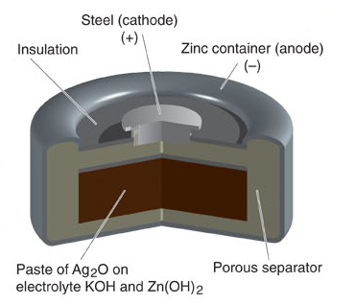
mercury and silver (button) batteries

Slide 13
Secondary (Rechargeable) Batteries
Lead acid
Nickel cadmium
Nickel metal hydride
Lithium ion
Lithium ion polymer

Slide 14
Construction of Lead Acid Battery
The container and the plates are the main part of the lead acid battery. The container stores chemical energy which is converted into electrical energy by the help of the plates.
Active Material Lead peroxide (PbO₂) ,Sponge lead ,Dilute Sulfuric Acid (H₂SO₄)
Separators –thin sheets of non-conducting material made up of chemically treated leadwood, porous rubbers, or mats of glass fibre and are placed between the positive and negative to insulate them from each other.
Battery Terminals battery has two terminals the positive and the negative.

Slide 15
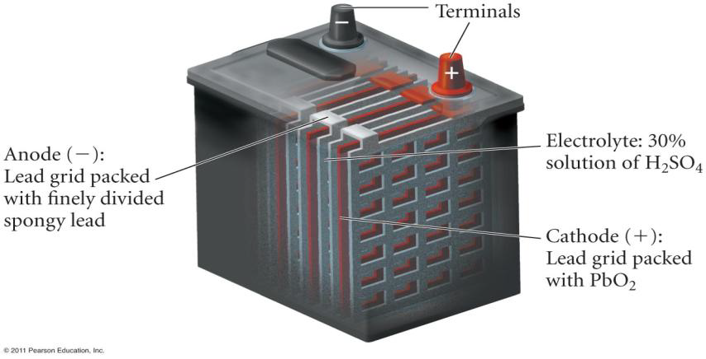
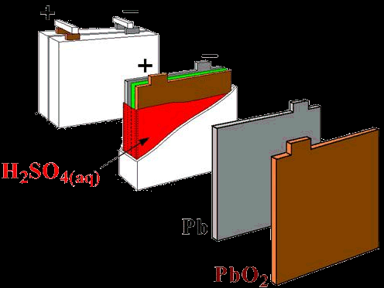
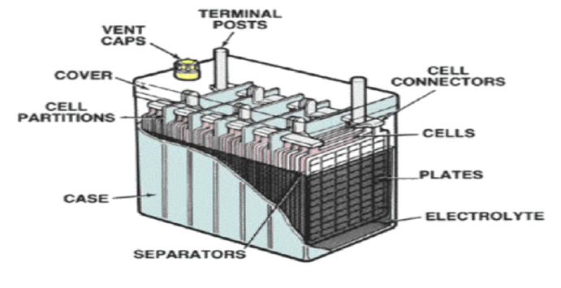
Typical lead acid battery schematic

Slide 16
Lead Acid Battery
The following reactions occur during discharge...
Anode:
Pb Pb+2 + 2 e- E°ox = 0.356 V
Pb+2 + SO4 -2 PbSO4
Cathode:
PbO2 + 4 H+ + 2 e- Pb+2 + H2O E°red = 1.685 V
Pb+2 + SO4-2 PbSO4
Overall:
Pb + PbO2 + 2 H2SO4 2 PbSO4 + H2O E°cell = 2.041 V
This is set up in a series of 6 cells in order to make a 12V battery.

Slide 17
Ethiopia locally produced batteries
Awash Batteries Plc, a local battery manufacturing plant owned and managed by an Indian businessman, Shyam Agarwal,
Located on the outskirts of Dukem, a town 35 km east of Addis Ababa, the manufacturing plant is established with an initial investment outlay of over 25 million birr, according to Agarwal, proprietor and managing director of the company.
Established in January 2008, Awash Batteries is the second battery manufacturer locally next to a Chinese firm manufacturing similar products. Prior to both Awash Batteries and the Chinese company, an Italian businessman established what was the first battery manufacturing plant in the country only to go out of it in a year's time.

Slide 18
Lead/acid battery recycling

Slide 19
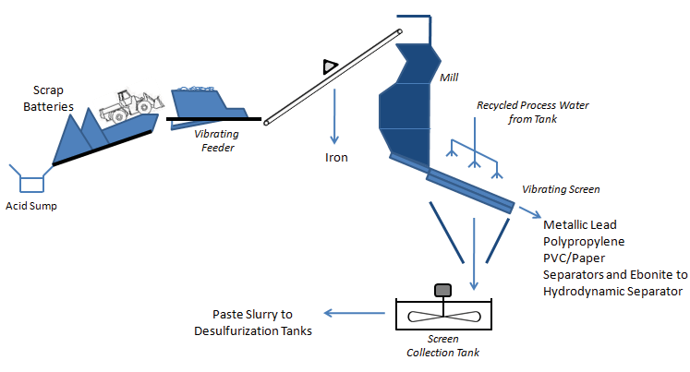
Battery c rushing and screenings
Batterybreaking
The hammer mill reduces the feed size to a maximum of 50mm And deposits it on to a vibrating washing screen.
The latter has a 0.8mm mesh aperture that allows the fine lead paste to pass through and be collected in a stirred tank prior to desulfurization.

Slide 20
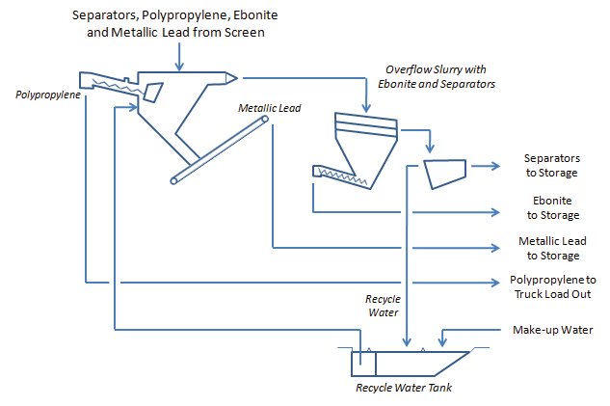
Hydrodynamic separation system
Over side from the screen is fed to a hydrodynamic classification system that separates the component part, namely: polypropylene, metallic grids And poles, ebonite,andseparator

Slide 21
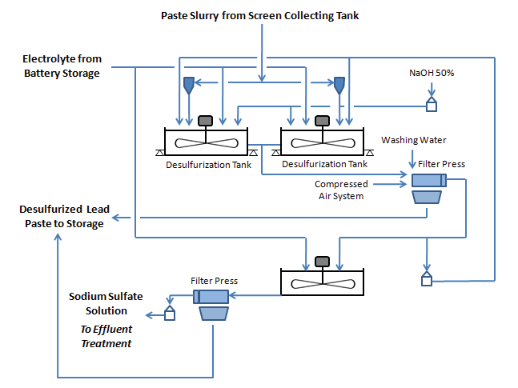
Paste desulfurization
The paste slurry that contains lead oxide and lead sulfate is partially dewatered and pumped into the reaction vessels with collected battery acid and Liquid caustic soda.

Slide 22
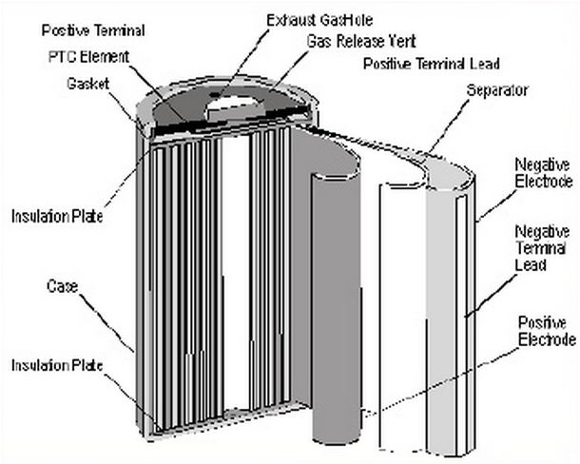
Nickel-Cadmium Battery
Anode: Cadmium hydroxide, Cd(OH)₂
Cathode: Nickel hydroxide, Ni(OH)₂
Electrolyte: Potassium hydroxide, KOH
The half-reactions are:
  Cd+2OH⁻ → Cd(OH)₂+2e⁻
  2NiO(OH)+Cd+2e⁻ →2Ni(OH)₂+2OH⁻
Overall reaction:
  2NiO(OH) + Cd+2H₂O→2Ni(OH)₂+Cd(OH)₂

Slide 23
Nickel-Cadmium Battery
Maintain a steady voltage of 1.2v per cell until completely depleted
Have ability to deliver full power output until end of cycle
Have consistent powerful delivery throughout the entire application
Very low internal resistance
Lower voltage per cell
Notes:
http://www.batterystuff.com/kb/articles/battery-articles/what-the-heck-is-a-nicd-battery.html
http://www.ehow.com/list_6943868_uses-nickel-cadmium-battery.html
http://www.puremobile.com/cell-phone-batteries

Slide 24
Nickel-Cadmium Battery
Advantages:
  Operate in a range of temperatures
  Tolerates abuse well and performs well after long periods of storage
Disadvantages:
  It is three to five times more expensive than lead-acid
  Its materials are toxic and the recycling infrastructure for larger nickel-cadmium batteries is very limited

Slide 25
Lithium Batteries
Because lithium metal has a very low density, and because lithium can yield high voltages in batteries, lithium batteries have very high energy to mass ratios (or energy to volume ratios), making them ideal for powering electronic devices.

Slide 26
Lithium Ion Batteries
Chemistry
  Graphite (-), cobalt or manganese (+)
  Non aqueous electrolyte
Features
  40% more capacity than NiCd
  Self-discharge 50% less than NiCd
  Expensive
Cathode (+): Lithium Cobalt Oxide (LiCoO2)
Anode (-): Lithium graphite (LiC6)
Electrolyte: Lithium hexafluorophosphate (LiPF6)

Slide 27
Lithium Ion Polymer Batteries
Chemistry
  Graphite (-), cobalt or manganese (+)
  Non aqueous electrolyte
Features
  Slim geometry, flexible shape, light weight
  Potentially lower cost (but currently expensive)
  Lower energy density, fewer cycles than Li-ion

Slide 28
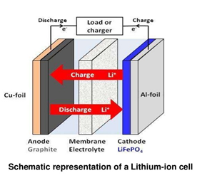

Slide 29
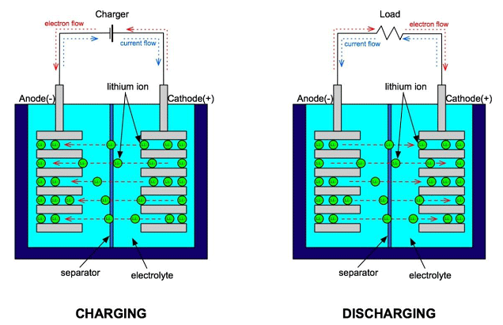

Slide 30
Battery Characteristics
Further Characteristics
Size
  Physical: button, AAA, AA, C, D, ...
  Energy density (watts per kg or cm³)
Longevity
  Capacity (Ah, for drain of C/10 at 20°C)
  Number of recharge cycles
Discharge characteristics (voltage drop)
Cost
Behavioral factors
  Temperature range (storage, operation)
  Self discharge
  Memory effect
Environmental factors
  Leakage, gassing, toxicity
  Shock resistance

Slide 31
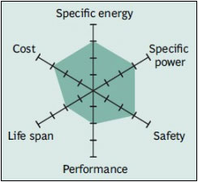
Battery performance

Slide 32
Battery Technical Specifications
Specific Energy (Wh/kg) –
The nominal battery energy per unit mass, sometimes referred to as the gravimetric energy density. Specific energy is a characteristic of the battery chemistry and packaging. Along with the energy consumption of the vehicle, it determines the battery weight required to achieve a given electric range.
Specific Power (W/kg)
The maximum available power per unit mass. Specific power is a characteristic of the battery chemistry and packaging. It determines the battery weight required to achieve a given performance target.
Energy Density (Wh/L)
The nominal battery energy per unit volume, sometimes referred to as the volumetric energy density.

Slide 33
Battery capacity
"Battery capacity" is a measure (typically in Amp-hr) of the charge stored by the battery, and is determined by the mass of active material contained in the battery.
The battery capacity represents the maximum amount of energy that can be extracted from the battery under certain specified conditions
However, the actual energy storage capabilities of the battery can vary significantly from the "nominal" rated capacity, as the battery capacity depends strongly on the age and past history of the battery, the charging or discharging regimes of the battery and the temperature.

Slide 34
Exercises
A circuit connected with 600mAh current rating and related to the load of 30mA, calculate for how long do you use the battery?
Sony lithium NP-FT1 battery pack is a 3.6 V 2.4 Wh battery .On the other hand kyocera manufactured a 3.6 V 1.55Ah battery TXBAT091. which battery has a larger capacity?

Slide 35
Peukert’s Law
Peukert’s Law describes how battery capacity is affected by the rate at which the battery is discharged. As the discharge rate increases, the battery’s usable capacity decreases.
A typical battery’s capacity is measured by the current that is required to fully discharge in 20 hours

Slide 36
Formula:
Actual Battery Capacity = (C x I) / I^{n}
Peukert's Formula, T = C / I^{n} Where,
C = Rated Battery Capacity the amp-hour capacity
I = Rate of Discharge, discharge current in Amperes
n = Peukert's Number typically 1.1 to 1.3
T = Full Discharge Time in hours
Example :
The rated battery charge capacity is 250 amp-hours, discharge rate is 20 amps and peukert's number is 1.3, what is the actual battery capacity and discharge time.

Slide 37
Solution :
Substitute the given values in the formula,
Actual Battery Capacity Calculation
Actual Battery Capacity= (C x I) / I^{n}= (250 x 20) / 20^{1.3}= 5000 / 49.129121045= 101.772632884
Full Discharge Time Calculation
Full Discharge Time (T)= C / I^{n}= 250 / 20^{1.3}= 250 / 49.129121045= 5.088631644

Slide 38
Sample Calculation
Consider an electric car with ten (12 volt, 75 Ah theoretical capacity, 1.1 Peukert) batteries and a 20 hp electric motor that draws 155 amps at 5000 rpm at 120 volts.
The 100% discharge time
80% discharge time

Slide 39
As the ten batteries are in series, the current draw is not distributed among the batteries: each battery must provide the full 155 amps to feed the motor. the capacity of a battery at 155 amps, we get 45.2 Ah.
The 100% discharge time will be 45.2 Ah ÷ 155 amps = 0.29 hours, or 17 minutes, so the 80% discharge time will be 14 minutes.
If the car is geared to travel at 60 mph at 5000 rpm (and assuming it can reach 60 mph on only 20 hp, which it probably can), it's range will be 14 miles.

Slide 40
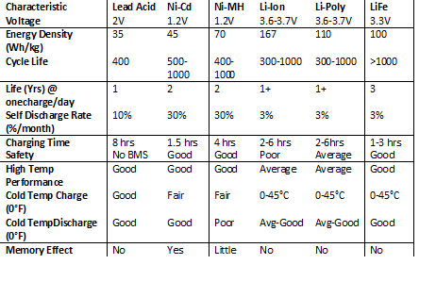
Battery performance characteristics comparison

Slide 41
Battery Capacity
Type | Capacity (mAh) | Density (Wh/kg)
Alkaline AA | 2850 | 124
Rechargeable | 1600 | 80
NiCd AA | 750 | 41
NiMH AA | 1100 | 51
Lithium ion | 1200 | 100
Lead acid | 2000 | 30
Notes:
Sources differ as to exact numbers
Density should take packaging into account, not just chemistry
Consult product specification sheets

Slide 42
Recharging
Type | Cycles (to 80%) | Charge time | Discharge per month | Cost per kWh
Alkaline | 50 (50%) | 3-10h | 0.3% | $95.00
NiCd | 1500 | 1h | 20% | $7.50
NiMH | 300-500 | 2-4h | 30% | $18.50
Li-ion | 500-1000 | 2-4h | 10% | $24.00
Polymer | 300-500 | 2-4h | 10%
Lead acid | 200-2000 | 8-16h | 5% | $8.50

Slide 43

Fuel Cell
Ph.D. Materials Science and Engineering, Massachusetts Institute of Technology, Cambridge, MA
SOSSINA M. HAILE
Chemical Pioneer Award (AIC) 2010, for “establishing new classes of fuel cells…”

Slide 45
What are Fuel Cells?
Fuel cells are devices that are able to continuously convert chemical energy into electrical energy through an electrochemical reaction.
The system inputs are a fuel, which is usually hydrogen, and an oxidant, typically oxygen (that is in the air).
The outputs from the system are DC electricity, water vapour and heat.
Fuel cells will generate electricity continuously provided there is sufficient fuel and available oxidant.
Fuel cells are able to utilise a number of different fuels depending on the fuel cell technology used. Typical fuels are:
          Hydrogen
          Methanol
          Natural gas
          Diesel or petrol

Slide 46
The Need for Fuel Cells
Interest in fuel cells has been strengthened by the need for sustainable energy sources.
Fuel cells are able to produce power without the high rates of emissions that are associated with traditional power sources.
Modern fuel cells are able to produce sufficient electricity for remote areas where the normal electricity grid may not be available.
World energy consumption from transport will continue to rise (particularly in the Developing World) and it is expected that oil production will plateau and then decline in the decades to come. This will create a need for a new energy source for transport, with fuel cells being one attractive option.

Slide 47
Why Fuel Cells?
A conventional combustion-based power plant typically generates electricity at efficiencies of 33 to 35 percent, while fuel cell systems can generate electricity at efficiencies up to 60 percent (and even higher with cogeneration).
The gasoline engine in a conventional car is less than 20% efficient in converting the chemical energy in gasoline into power that moves the vehicle, under normal driving conditions. Hydrogen fuel cell vehicles, which use electric motors, are much more energy efficient and use 40-60 percent of the fuel’s energy — corresponding to more than a 50% reduction in fuel consumption, compared to a conventional vehicle with a gasoline internal combustion engine.

Slide 48
Fuel Cell Types
There are many fuel cell types available and they are usually described by the electrolyte that is used. However the six most widely used at present are the:
    Alkaline Fuel Cell (AFC)
    Proton Exchange Membrane or (Polymer Electrolyte Membrane) Fuel Cell (PEMFC)
    Direct Methanol Fuel Cell (DMFC)
    Phosphoric Acid Fuel Cell (PAFC)
    Molten Carbonate Fuel Cell (MCFC)
    Solid Oxide Fuel Cell (SOFC)

Slide 49
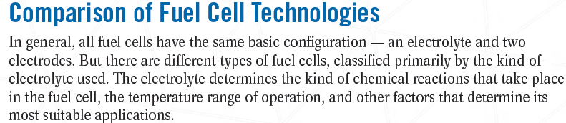
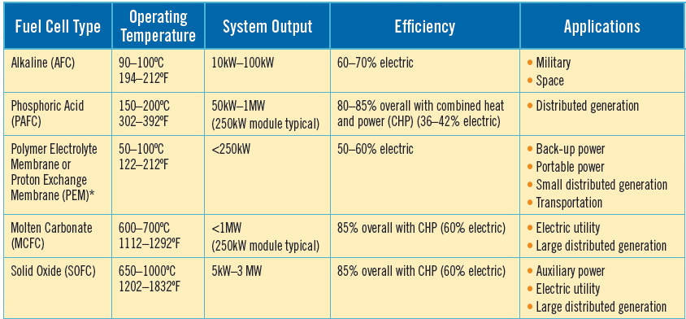

Slide 50
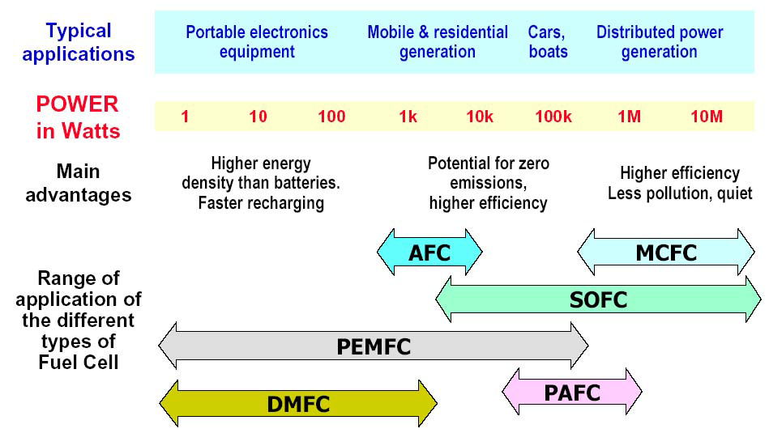
Potential Applications

Slide 51
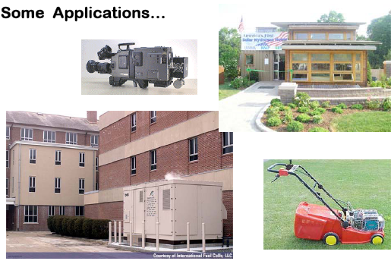

Slide 52
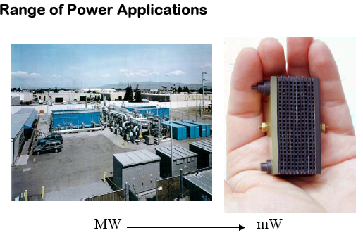



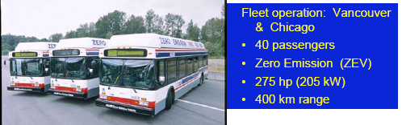

Slide 53
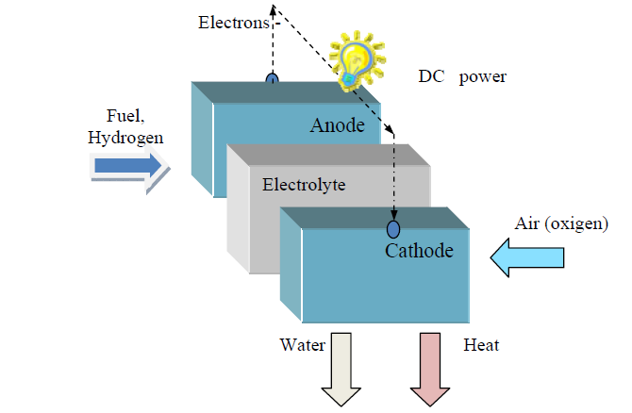
Types of Fuel Cells
Proton Exchange Membrane (PEM):
These cells use a perfluorinated ionomer polymer membrane electrolyte which passes protons from the anode to the cathode
They operate at a relatively low temperature (70 to 85C), and are especially notable for their rapid start-up time.
These are being developed for use in transportation applications and for portable and small fuel cells.

Slide 54
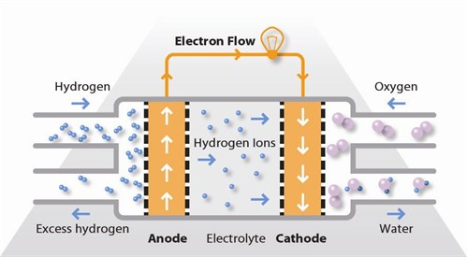
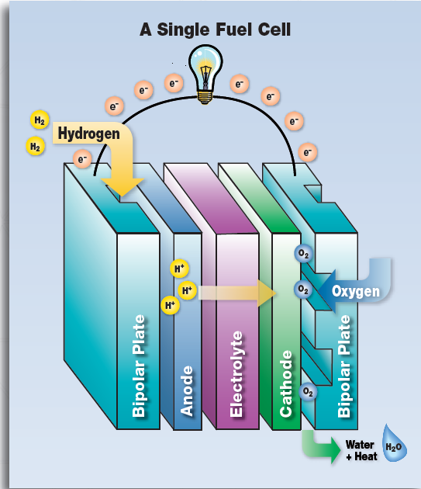
Proton-Exchange Membrane Cell
Anode:
2 H2(g) → 4 H+(aq) + 4 e−
Cathode:
O2(g) + 4 H+(aq) + 4 e− → 2 H2O(l)
Overall
2 H2(g) + O2(g) → 2 H2O(l)

Slide 55
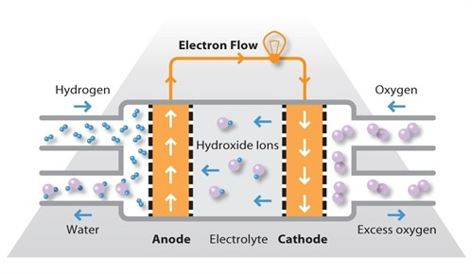
Alkaline fuel cell (AFC)
The cathode reaction is the reduction
O2(g) + 2 H2O(l) + 4e− → 4 OH−(aq)
the anode reaction is the oxidation
H2(g) + 2 OH−(aq) → 2 H2O(l) + 2 e−
overall
2 H2(g) + O2(g) → 2 H2O(l)
This is one of the oldest designs. It has been used in the U.S. space program since the 1960s.
The AFC is very susceptible to contamination, so it requires pure hydrogen and oxygen.
It is also very expensive, so this type of fuel cell is unlikely to be commercialized.

Slide 56
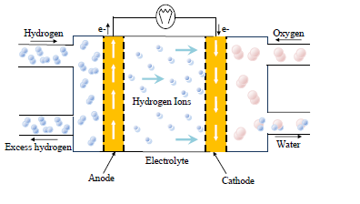
Phosphoric-acid fuel cell (PAFC)
The phosphoric-acid fuel cell has potential for use in small stationary power-generation systems.
It operates at a higher temperature than PEM fuel cells, so it has a longer warm-up time. This makes it unsuitable for use in cars.
Anode:
2 H2(g) → 4 H+(aq) + 4 e−
Cathode:
O2(g) + 4 H+(aq) + 4 e− → 2 H2O(l)

Slide 57
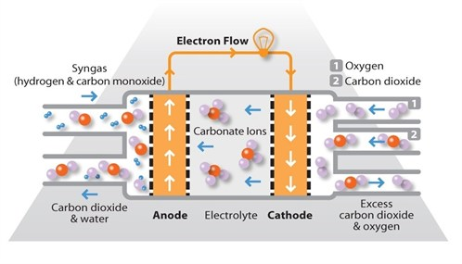
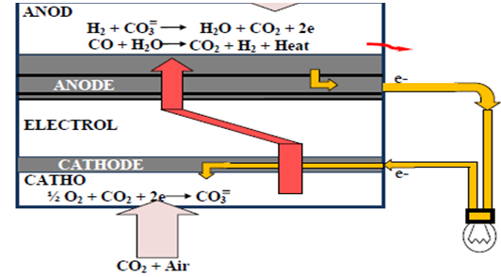
Molten carbonate fuel cell (MCFC)
These fuel cells are also best suited for large stationary power generators.
They operate at 1,112 F (600 C), so they also generate steam that can be used to generate more power.
They have a lower operating temperature than the SOFC, which means they don't need such exotic materials.
This makes the design a little less expensive.

Slide 58
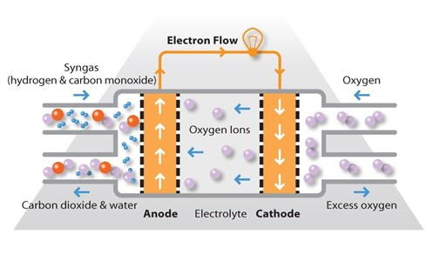
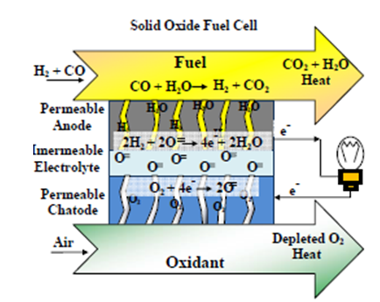
Solid oxide fuel cell (SOFC)
These fuel cells are best suited for large-scale stationary power generators that could provide electricity for factories or towns.
This type of fuel cell operates at very high temperatures (1,000 C).
The steam produced by the fuel cell can be channeled into turbines to generate more electricity. This improves the overall efficiency of the system.

Slide 59
Challenges and Research Directions
Reducing cost and improving durability are the two most significant challenges to fuel cell commercialization. Fuel cell systems must be cost-competitive with, and perform as well or better than, traditional power technologies over the life of the system.
Ongoing research is focused on identifying and developing new materials that will reduce the cost and extend the life of fuel cell stack components including membranes, catalysts, bipolar plates, and membrane-electrode assemblies. Low cost, high volume manufacturing processes will also help to make fuel cell systems cost competitive with traditional technologies.

