Slide 1
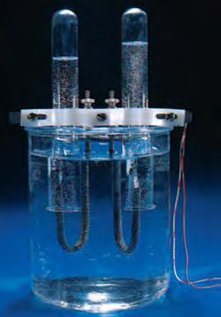
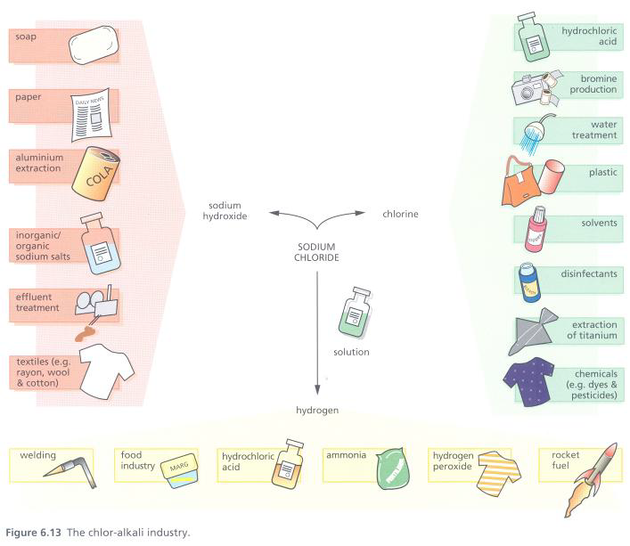
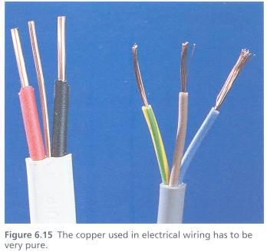
Industrial Application of Electrolysis Chapter 3
Paul Heroult
Girma M.

Slide 2
Outline
Electrolytic cell
Application electrolysis
elecrosynthesis (Chloroalkali manufacturing )
Faraday law
Aluminium refining
Copper refining
Electro plating

Slide 3
Outline
Electrolytic cell
Faraday law
Application electrolysis
elecrosynthesis (Chloroalkali manufacturing )
Aluminium refining
Copper refining
Electro plating

Slide 4
Electrolysis
Electrolysis is an electrochemical process in which electrical energy is the driving force of chemical reactions.
Substances are decomposed, by passing a current through them.

Slide 5
Electrolytic cells
Use an applied voltage to carry out nonspontaneous chemical reaction ⇒ ΔG > 0
Electric current supplied by an external source
Power
Supply
Cathode
e.g. inert Ti
Anode
e.g. inert Ti
+
-
← Cl⁻
Na⁺ →
External source must provide a greater potential than that for the spontaneous reverse reaction
Electrolyte, e.g. NaCl
Electrolysis = process in which electrical energy is used to cause a non-spontaneous chemical reaction to occur

Slide 6
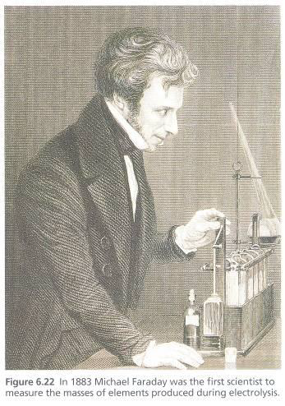
Faraday’s law
Faraday’s first law states that the mass of metal deposited at the electrode of an electrolytic cell is directly proportional to the electrical charge passed through the cell.
Charge (coulombs) = current (amps) X time (seconds) => Q = I X t.)
The mass of element produced is proportional to the equivalent weight of the element.
E = M/n.
To produce w grams or (w/E) equivalents of an element by electrolysis, we need
(w/E) × F Coulombs of charge to pass through the solution. Mathematically,
Q = It = (w/E)F.
equivalent weights E
number of moles of electrons n
w grams

Slide 7
Faraday’s second law of electrolysis

Slide 8
Example 1
At the cathode of an electrolytic cell silver metal is deposited according to the half equation Ag+(aq) + e => Ag(s). A steady current of 20.0 Amps was applied for 30.0 minutes. What mass of silver was deposited?

Slide 9
Example
A 100 W, 110 V incandescent lamp is connected in series with an electrolyte cell containing cadmium sulphate solution. What mass of cadmium will be deposited by the current flowing for 10 hr? (atomic mass of Cd = 112.4 g)

Slide 10
Example
Watt = Volt × Current
100 = 110 × Current
Mass of cadmium deposited
But we know, Q = i × t
= 19.06 g
Number of equivalent =
= 0.339

Slide 11
Example
How long will it take to deposit 0.0047 mol of gold by electrolysis of KAuCl₄ using a constant current of 0.214 A?
Answer: 106 minutes

Slide 12
Example
How much Ca will be produced in an electrolytic cell of molten CaCl₂ if a current of 0.452 A is passed through the cell for 1.5 hours?
Answer: 0.5 g Ca

Slide 13
Quiz 5%
Elemental calcium is produced by the electrolysis of molten CaCl2. What mass of calcium can be produced by this process if a current of 750 A is applied for 48 h? Assume that the electrolytic cell is 68% efficient.
GIVEN
F = 96,500 C/mol
Molecular mass Calcium= 40g/mol

Slide 14
A particular lead-acid battery delivers a current of 3.50 A for 2.00 minutes at a potential difference of 12.0 V.
What amount, in mole, of PbO₂ will be used up within the whole battery of six cells?
What mass, in gram, of PbSO₄ will be deposited in each one of the six cells?
How much energy, in joule, could be obtained in this situation?
Pb=207.2g/mol

Slide 15
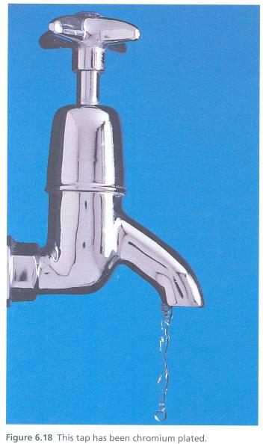
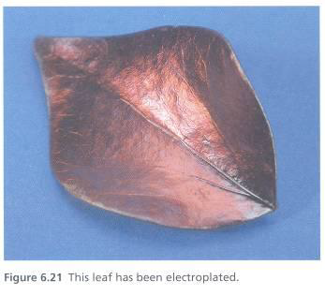
APPLICATION OF ELECTROLYSIS
Electro- metallurgy
The metal like sodium ,potassium, magnesium, calcium aluminium are obtained by electrolytes of fused electrolyte
Manufacture of non metals
Non metals like hydrogen,fluorine,chlorine are obtained by electrolysis
Electrorefining of metals
The metals like copper ,silver, gold , aluminum
Manufactures of compounds like NaOH,KOH,NaCO3,KClO3
ELECTROPLATING

Slide 19
Downs cell the electrolysis of molten NaCl
Inlet for
NaCl
Cl2 outlet
Molten NaCl
Cathode
Na outlet
e–
Power
source
Anode

Slide 20
Downs cell the electrolysis of molten NaCl

Slide 21
Manufacture of NaOH
Electrolysis of Brine
Chlorine at Anode; Hydrogen along with alkali hydroxide at cathode
Three types of cell exist:
Mercury Cell
Diaphragm Cell
Membrane Cell
Raw Materials
1. Brine (NaCl)
2. Electricity

Slide 22
Diaphragm Cells
Contain a diaphragm made of asbestos fibers to separate anode from cathode
Allows ions to pass through by migration
Graphite anode and cast iron cathode

Slide 23
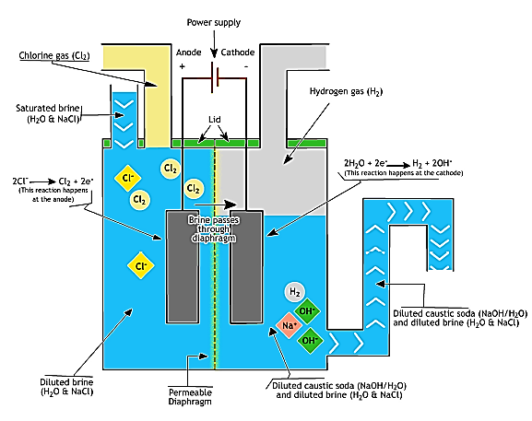
Diaphragm cell

Slide 24
Diaphragm Cells– Advantages & Disadvantages
Major Advantage – Can run on dilute (20%), fairly impure brine
Dilute brine produces NaOH 11% (NaCl 15%)
Consumes lot of energy for evaporation
For 1 ton of 50% caustic need 2600 kg of water to be evaporated.
Some amount of Chloride ion remains and is highly objectionable to some industries (Rayon)

Slide 25
Mercury Cells
Mercury Cell
Operate differently than the other two
Cathode is a flowing pool of mercury; graphite anode
Electrolysis produces a mercury-sodium alloy (amalgam)
Amalgams is decomposed in a separate vessel as:
2Na.Hg + 2H₂O → 2 NaOH + H₂ + Hg

Slide 26
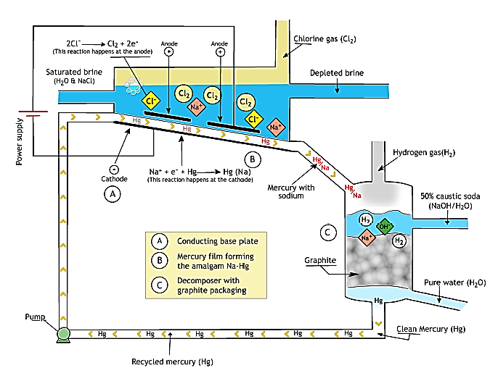

Slide 27
Advantages and Disadvantages of Mercury
50% NaOH is produced with very low salt content (30 ppm)
No evaporation needed
Small loss of mercury to environment poses severe problems.

Slide 28
Membrane Cells
Use semipermeable membrane to separate anode and cathode compartments.
Separate compartments by porous chemically active plastic sheets; that allows sodium ions to pass but reject hydroxyl ions.

Slide 29
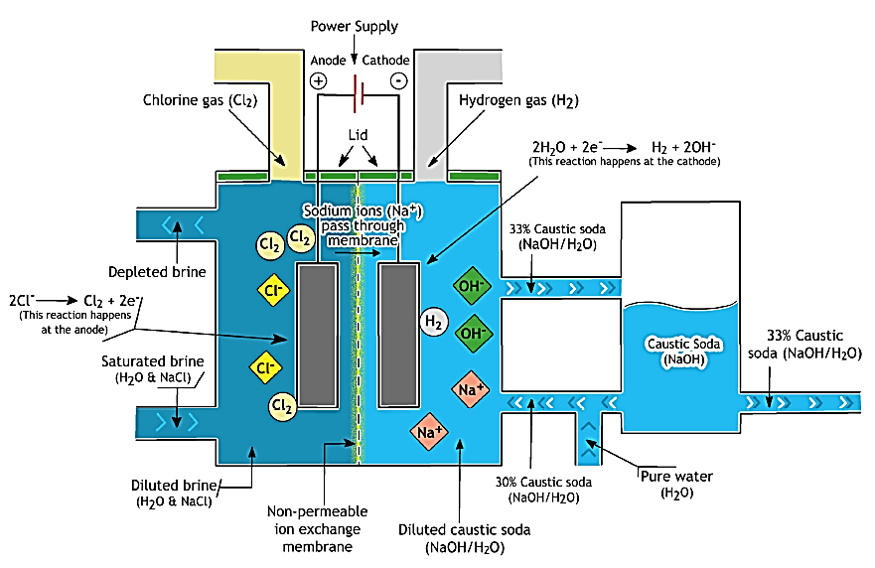
Membrane cell

Slide 30
Membrane Cell
Advantages of Membrane Cell
Disadvantage of Membrane Cells
Because of difficulty and expense of concentration and purification, only large diaphragm cells are feasible
Membrane cells produce conc NaOH
considerable saving in energy (Evaporation)
and saving in freight (operate to the point of caustic use)
Small, efficient units may cause a revolution in the distribution of the chlor-alkali industry, particularly if efficiencies remain high
Membranes are more readily clogged than diaphragms, so some of savings are lost, bcos of necessity to pretreat the brine fed in order to remove Ca and Mg before electrolysis

Slide 31
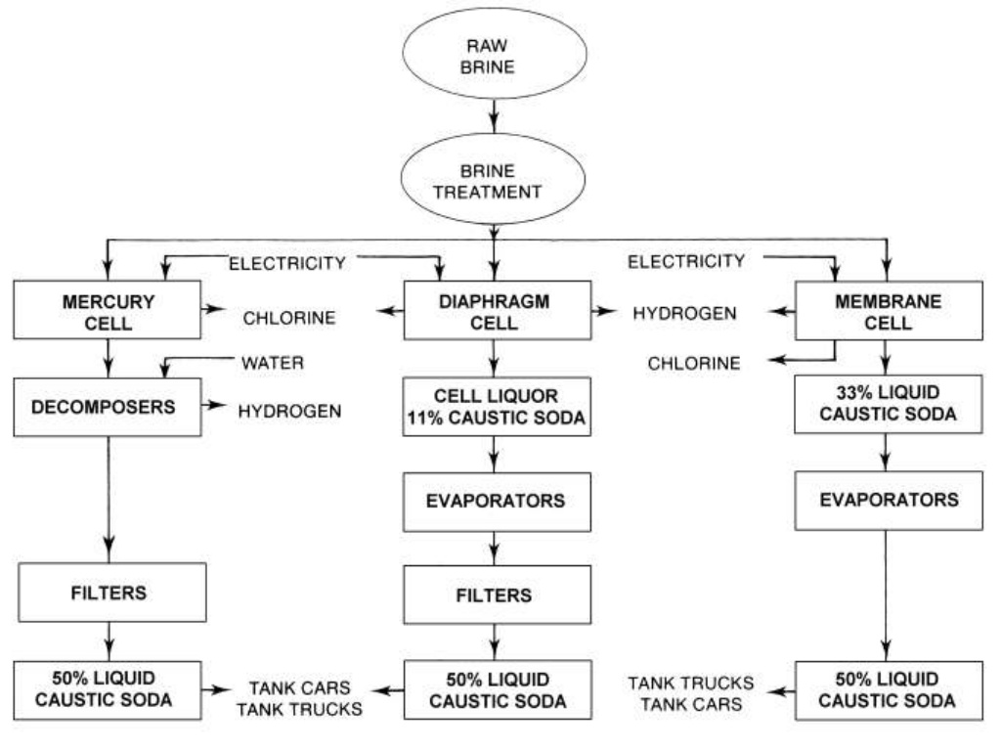

Slide 32
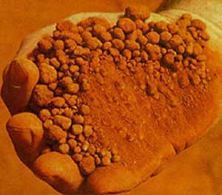
Aluminium
Aluminium is a reactive metal that is found in the ore bauxite combined with oxygen as aluminium oxide (Al₂O₃). Electrolysis breaks down the Al₂O₃ into aluminium and oxygen. As the aluminium loses oxygen, reduction takes place.
Ore – bauxite – aluminium oxide
The ore is dissolved in cryolite to
lower the melting point.
Bauxite contains SiO₂, iron oxides and titanium (IV) oxide as impurities.Bauxite is digested with a hot concentrated (45%) solution of sodium hydroxide at about 473-523 K and 35-36 bar pressure.

Slide 33
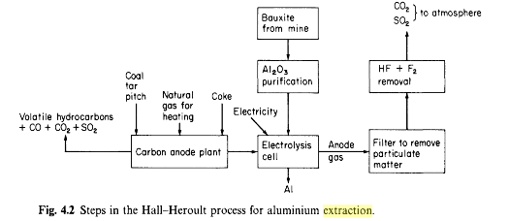

Slide 34
Extracting aluminium
Aluminium is one of the most useful metals in the world.
Electrolysis is used to extract aluminium from its ore. Why is it not possible to extract aluminium by heating its ore with carbon?
Aluminium ore (bauxite) is more reactive than carbon and has a very high melting point (2050 °C). In electrolysis, the ore is dissolved in a compound called cryolite (Na₃AlF₆), which effectively lowers the melting point to 1,000 °C.

Slide 35
The Hall-Héroult process is used to make aluminum by the electrolysis of dissolved alumina, Al2O3.
e–
Carbon anode
Power
source
e–
Solution of
alumina, Al2O3, in
cryolite, Na3AlF6
Carbon cathode
Molten
aluminum, Al

Slide 36
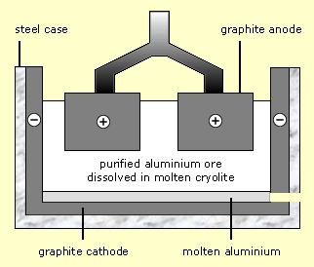
Redox equations – aluminium
overall equation for this extraction by electrolysis?
What processes occur at the electrodes during the electrolysis of aluminium oxide (Al₂O₃)?
At the negative electrode:Cathode
Al³⁺ + 3e⁻ Al (reduction)
At the positive electrode:anode:
C(s) + 2 O2-(l) CO2(g) + 4 e-(oxidation)
aluminium oxide aluminium + oxygen
2 Al₂O₃ (l) 4 Al (l) + 3 O₂ (g)
Diagram of electrolysis

Slide 37
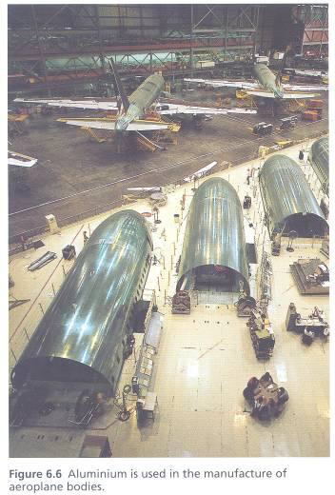

Slide 38
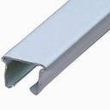
Uses of Aluminium
Low density and strength make it ideal for
construction of aircraft, lightweight vehicles, and ladders.
An alloy of aluminium called duralumin is often used instead of pure aluminium because of its improved properties.
Easy shaping and corrosion resistance make it a good material for drink cans and roofing materials.
Corrosion resistance and low density leads to its use for greenhouses and window frames.
Good conduction of heat leads to its use for boilers, cookers and cookware.
Good conduction of electricity leads to its use for overhead power cables hung from pylons (low density gives it an advantage over copper).

Slide 39
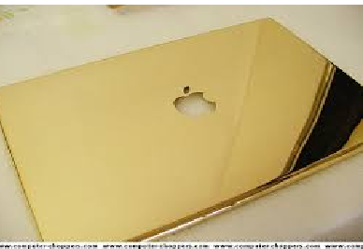
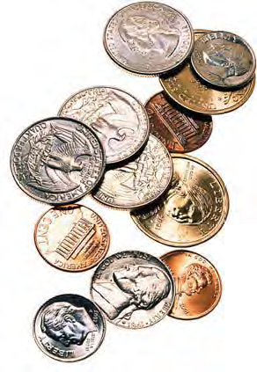
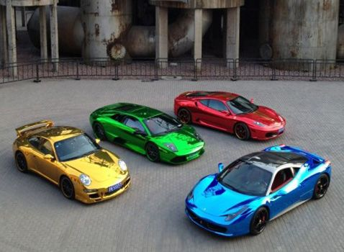
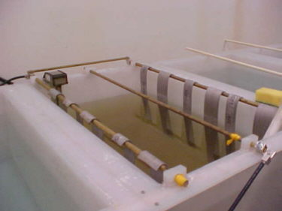
Chapter 3 part 2
Electro refining Electroplating
Girma M.

Slide 40
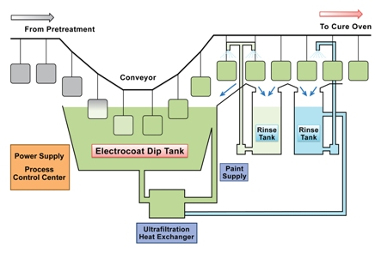
Outline
Water electrolysis
Electro-refining of copper
What is electroplating
Uses of electroplating
How is electroplating done?
Types of electroplating
Plating Thickness

Slide 41
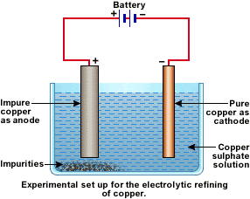
Electro refining
It is the electrolytic purification of a metal.
The metal of an impure anode is oxidized and then the ions migrate to the pure cathode where they are reduced back to the metal.
Impurities are left behind
(anode mud or slime)

Slide 42
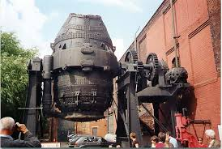
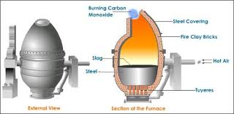
bessemer converter

Slide 43
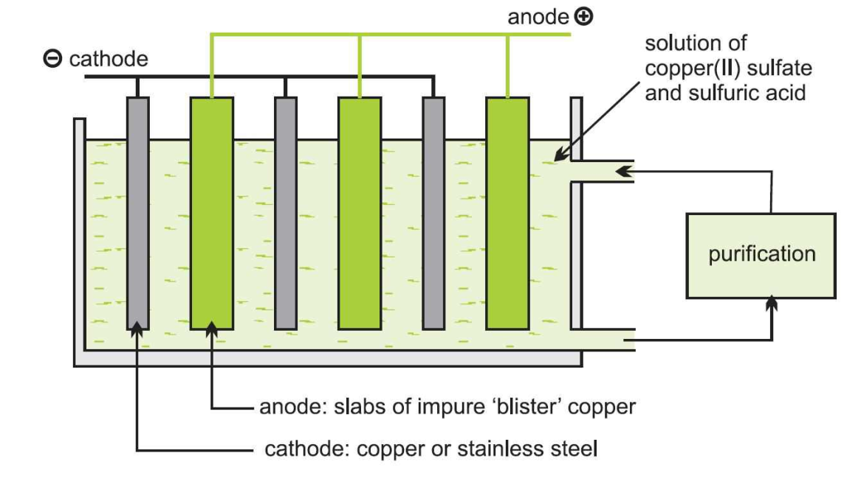
Purification of impure copper

Slide 44
Purification of impure copper

Slide 45
Purification of impure copper

Slide 47
Electroplating
Electroplating is the process of applying one or more layers of a metal to a part by passing a positively charged electrical current through a solution containing dissolved metal ions (anode) and a negatively charged electrical current through your part to be plated (cathode).

Slide 48
Uses of electroplating
Improving the appearance of the substrate
Improving the work piece’s resistance to corrosion.
Building the thickness of a metal surface
Increasing wear resistance
Improving electrical conductivity such as when plating a copper layer onto an electrical component
Preparing surfaces for enhanced adhesion prior to painting or e-coating
Reducing friction
Protecting against surface abrasions
Improving surface uniformity

Slide 50
Setup for electro plating process

Slide 51
How is electroplating done?
Electroplating is done in a liquid solution called an electrolyte (fig.a), also known as a "plating bath". The plating bath is a specially designed chemical bath that has the desired metal (i.e. silver, gold) dissolved as microscopic atoms (positive charged ions) suspended in solution.
The plating bath solution serves as a conductive medium and utilizes a low d.c. voltage (direct current). The object that is to be plated is submerged into the plating bath and a low voltage d. c. current is applied to the bath.
Generally located at the center of the plating bath, the object that is to be plated acts as a negatively charged cathode (fig. b). The positively charged anodes (fig. c) that will complete the d.c. circuit are carefully positioned at the edges of the plating tank.
A power source known as a rectifier (fig. d.) is used to convert a.c. power to a carefully regulated low voltage d.c. current.

Slide 52
Diagram electroplating process

Slide 53
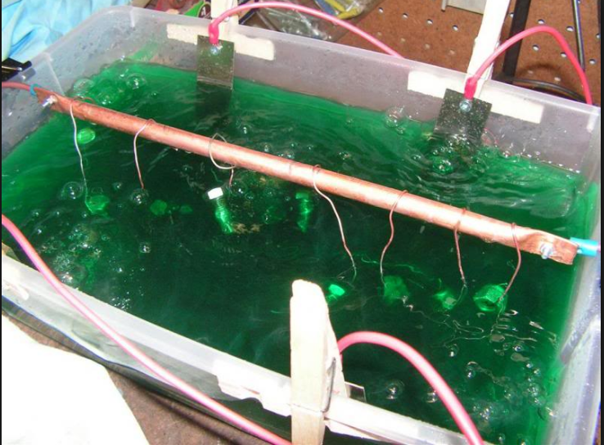
Electroplating Bath

Slide 54
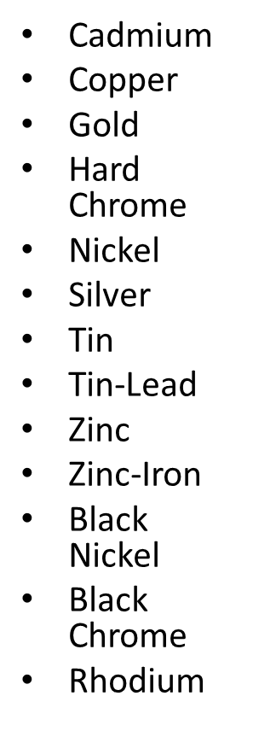
Which materials are used in the electroplating process?
Metals commonly used in electroplating include zinc, copper and tin, as well as precious metals such as gold, silver and palladium.
Plating can occur with individual metals or in various combinations (alloys) that can provide additional value to the electroplating process.
Price, substrate composition and desired result are key factors when determining the most appropriate electroplating process.
Even though any material can be electroplated, the applications are normally limited to metals and some specific plastics.
Commonly used electroplated plastics are acrylonitrile butadiene styrene (ABS), chlorinated polyethylene (PEC), ABS/polycarbonate, Polyphenylene oxide, polysulfone, polypropylene, nylon, polyester, polyacetal, polystyrene and polycarbonate.

Slide 55
Examples of Electroplating
Copper electroplating

Slide 56
Copper electroplating
Electroplating copper can be extremely valuable in applications such as the manufacturing of electronic parts and components, as well as products used in the aerospace and defense industries.
Copper is also widely used for plating on plastics and other non-metallic surfaces.
Key copper electroplating benefits include excellent corrosion protection, high thickness build and heat treatment stop-off.

Slide 57
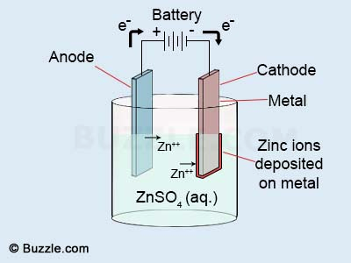
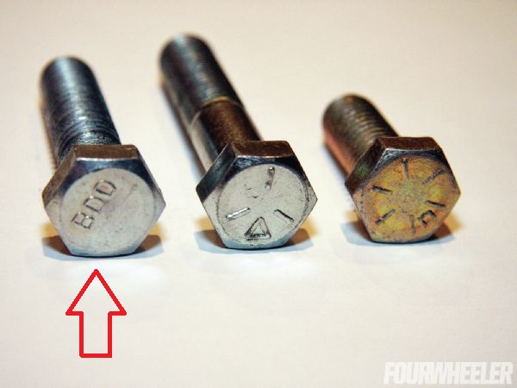
Zinc electroplating
cost-effective
a protective coating to metallic substances such as nuts, bolts, fasteners, automotive parts, and many other hardware items.
the use of zinc also improves the overall appearance of the metals, by giving them a variety of colors, a clean look, brightness, and a nice glowing shine.
Grade 8 Bolt

Slide 58
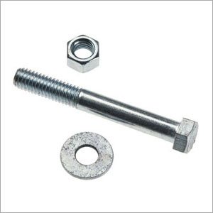
How Zinc Electroplating Is Applied
Zinc electroplating is a method of depositing zinc metal on the surface of another metal, such as steel, by immersing the fasteners in an appropriate plating bath and applying electrical current.
Zinc travels through the electrolytic bath from the zinc anodes and attaches to the surface of the fastener.
The thickness of zinc plating depends on the time spent in the plating bath, the amount of current, and the chemical composition of the bath.
Zinc Electroplating provides corrosion resistance by acting as a barrier and sacrificial coating.
Zinc is more electrochemically reactive than steel, so when exposed to a corrosive environment, the zinc plating corrodes sacrificially, delaying rust formation even after portions of bare steel are exposed.

Slide 59
Silver plating
In silver plating, the object to be plated (e.g., a spoon) is made from the cathode of an electrolytic cell.
The anode is a bar of silver metal, and the electrolyte (the liquid in between the electrodes) is a solution of silver cyanide, AgCN, in water.
When a direct current is passed through the cell, positive silver ions (Ag⁺) from the silver cyanide migrate to the negative anode (the spoon), where they are neutralized by electrons and stick to the spoon as silver metal. Meanwhile, the silver anode bar gives up electrons to become silver ions:
Thus, the anode bar gradually dissolves to replenish the silver ions in the solution. The net result is that silver metal has been transferred from the anode to the cathode, in this case the spoon. This process continues until the desired coating thickness is built up on the spoon-usually only a few thousandths of an inch-or until the silver bar has completely dissolved.

Slide 60
Siliver Plating
Cathode = object to be plated.
Anode is made of metal that you want to plate on object.
Solution contains ions of plating metal.

Slide 61
Silver plating
Silver is another precious metal that can be used in a wide range of plating applications. Silver offers the advantage of being somewhat less expensive than gold or platinum, while still offering important benefits. Because of its remarkable ability to conduct electricity and heat, implementing a silver electroplating solution has gained widespread use in the manufacturing of solar panels.

Slide 62
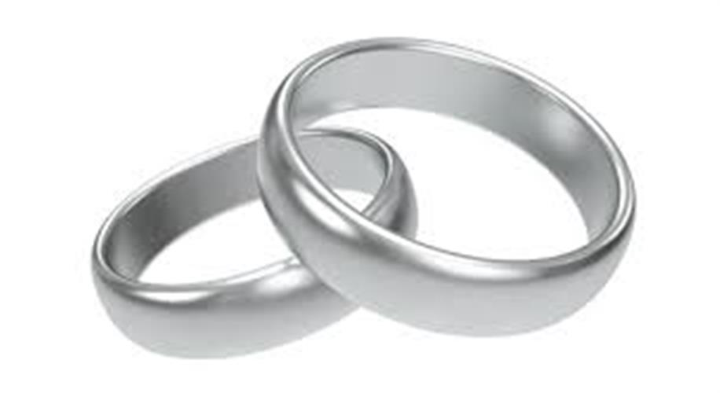
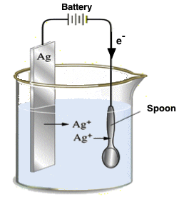
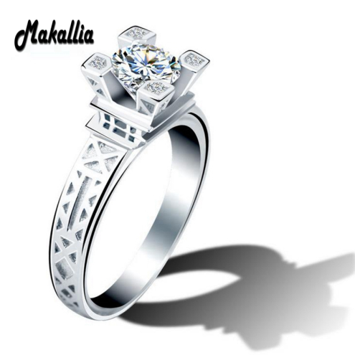
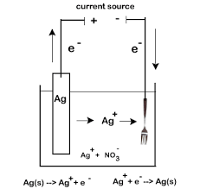
Silver plating

Slide 63
Siliver Plating

Slide 64
Factors that impact the final plating

Slide 65
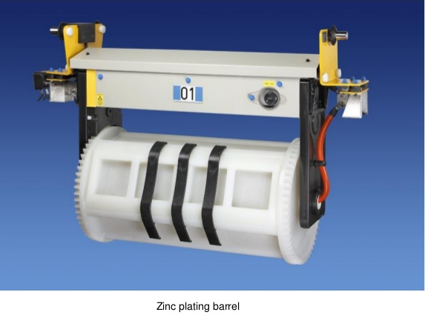
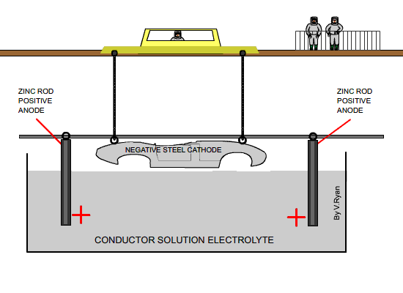
Types of plating
1. Barrel plating: This is performed in rotating barrels that are oriented either horizontally or at an oblique angle (35degree). Many small parts are processed in a batch.
2. Rack plating: This is used for parts which are large, heavy and complex enough for barrel plating. Racks are fabricated into suitable shapes for holding the parts and conducting the current to them.
3. Strip plating: This method is preferred when high production is required. The work consists of a continuous strip that is pulled through the plating solution by means of a take-up reel.

Slide 66
Amount of Deposition (cont.)
I
# moles of atoms = It/Fz
2e⁻
ammeter
m = mass = (It/Fz)(gram atomic weight)
Cu²⁺
e.g., AW_{Cu} = 63.55 g/mole
t = film thickness = (mass)/(density • area) = m/(ρA)
Note that these equations assume 100% current efficiency (CE) - that is, assuming that all of the electrons are used for converting metal ions.

Slide 67
Example
You work for a company and your boss asks you to mass produce Zinc metal from Zn(NO₃)₂. While running the reaction at a current of 3.4 amps, you bump your head and fall into a coma. When you wake up, you return to your job and realize that your reaction never stopped running (no one at your job likes you so they didn’t even notice you were gone).
You measure 4.2 x 10⁸ kg Zinc metal. For how long were you in a coma?
Use electroplating formula:

Slide 68
Use electroplating formula:
It/nF = moles plated.
Ans: 11.56 million years

Slide 69
Example
A metal cup of surface area 200 cm² needs to be electroplated with silver to a thickness of 0.200 mm. The density of silver is 1.05 x 10⁴ kg m¯³. How long does the cup need to be in the electrolytic tank if a current of 12.5 A is being used?
Ag 107.8 g/mol

Slide 70
Solution:
Determine the volume of silver that gets electroplated:
First, convert values to m:(200. cm²) (1 m² / 100² cm²) = 0.0200 m² (0.200 mm) (1 m / 1000 mm) = 0.000200 m
(0.0200 m²) (0.000200 m) = 0.000004m³
Determine the mass, then the moles of silver:
Mass= (0.000004 m³) (1.05 x 10⁴ kg m¯³) = 0.0420 g
Mole=0.0420 g / 107.8682 g/mol = 0.00039 mol

Slide 71
Solution
(1.79 x 10¯²⁵ kg) (1000 g / kg) (6.022 x 10²³ mol¯¹) = 107.79 g/mol) Moles of electrons required:
Ag⁺(aq) + e¯ ---> Ag(s)0.00039 mol of Ag⁺ plated out requires 0.000389364 mol of electrons
Determine Coulombs of charge that was transfered:
(0.000389364 mol) (96485 C/mol) = 37.56778 C
Determine time required to transfer charge:
12.5 A = 12.5 C/s37.56778 C / 12.5 C/s = 3.00 s

Slide 72
Exercise
Calculate the time required for plating 1 μm (micron meter)thickness of nickel on an area of 1 dm2. (The current density applied is 5 A / dm2).
Density of the nickel is 8.907g/cm3
Molecular mass nickel 58.69 g/mol

Slide 73
Container used has volume of 400L.Rectifier input was 440V and rectifier output was 0-30V (DC), 0-300A. Electroplating was performed for cylindrical and plate work-pieces placed at center for 10 minutes. Electroplated work-pieces were washed with water and dipped in Nitric Acid and later dried to neutralize the acidic zinc on the surface and to give a shiny surface.
Initial dimensions (all in mm) of plate are L=50.44, W=24.33, T=4 and of cylinder are L=69.38 and D=22.36
Calculate coating thickness (μm) and coating weight (g) for plate and cylinder
Information about electrolyte
Electrolyte Acidic Zinc Sulphate
Ph of electrolyte 5
Conductivity 6.5σ /m
Temperature 30oC
Current 100A
Density 7.13g/m3 molecular mass 65.38 g/mol

Slide 74
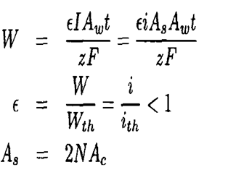
Production Rate
Actual electrochemical cells do not operate at 100% efficiency because of imperfections in the wiring system and possible contaminants or impurities in the electrolyte.
where E= Current efficiency
I = Current (A)
Aw= Atomic weight or molar mass (g/mol)
t= Time (s)
Z= Valence
F = 96, 500 C/mol (= A.s/mol = J/mol.V)
As= Total cathode surface area
N = Number of cathodes
Ac= Cathode surface area
Conventional

Slide 75
Production Rate
Another important parameter for assessing the performance of an electrowinning cell is the production rate, which is defined by
In order to analyze an electrowinning cells from economical point of view, the power and the energy consumption needed to operate the cell are, respectively

Slide 76
Examples
An electrowinning cell produces 10 Kg/h of nickel at a current efficiency of 80%. The cell contains 20 cathodes and operates at a current of 215 A/m2and a potential of 2 V.
Determine the energy consumption.

Slide 77
Production Rate
energy consumption

Slide 78
Project content
Introduction
Raw materials availability
Annual world production
Ethiopia production
Processing technology/technologies
Process description /process flow sheet
Unit Operations and Chemical Conversions
Material /energy balance
Conclusion
References

