Slide 1

Process integration and optimization
Lecture one: Introduction to Optimization

Slide 2
OPTIMIZATION
Optimization is a mathematical process of obtaining the minimum (or maximum) value of a function subject to some given constraints.
Or A mathematical technique to find out the best possible solution
You have a process that can be represented by a mathematical model.
You also have a performance criterion such as minimum cost. The goal of optimisation is to find the values of the variables in the process that yield the best value of the performance criterion.
Optimization involves searching for either the minimum or the maximum

Slide 3
WHY OPTIMIZE?
Improved yields, reduced pollutants
Reduced energy consumption
Higher processing rates
Reduced maintenance, fewer shutdowns
Better understanding of process (simulation)
But there are always positive and negative factors to be weighed

Slide 4
INGREDIENTS OF AN OPTIMISATION PROBLEM
The following are the requirements for the application of optimization problems:-
  The design or decision variables
    the variables within a model that one can control
  The constraints (Performance criterion)
    The limit of any variable
  The objective function (cost function)
    the mathematical expression that we need to optimize
  Process model
    Process Mathematical presentation

Slide 5
Performance criterion (constraints)
Constraints are limitations on the values of decision variables. These may be linear or nonlinear, and they may involve more than one decision variable.
When a constraint is written as an equality involving two or more decision variables, it is called an equality constraint.
  For example, a reaction may require a specific oxygen concentration in the combined feed to the reactor. The mole balance on the oxygen in the reactor feed is an equality constraint.

Slide 6
Performance criterion (constraints)
When a constraint is written as an inequality involving one or more decision variables, it is called an inequality constraint.
  For example, the catalyst may operate effectively only below 400°C, or below 20 MPa.

Slide 7
Performance criterion (constraints)
An equality constraint effectively reduces the dimensionality (the number of truly independent decision variables) of the optimization problem.
Inequality constraints reduce (and often bound) the search space of the decision variables.

Slide 8
Process or model (The objective function) (cost function)
An objective function is a mathematical function that, for the best values of the decision variables, reaches a minimum (or a maximum). Thus, the objective function is the measure of value or goodness for the optimization problem.
If it is a profit, one searches for its maximum.
If it is a cost, one searches for its minimum.
There may be more than one objective function for a given optimization problem.

Slide 9
Some typical performance criteria:
Maximum profit
Minimum cost
Minimum effort
Minimum error
Minimum waste
Maximum throughput
Best product quality
Note the need to express the performance criterion in mathematical form.

Slide 10
Optimisation
Static optimisation: variables have numerical values, fixed with respect to time.
Dynamic optimisation: variables are functions of time.

Slide 11
Essential Features
Every optimisation problem contains three essential categories:
1. At least one objective function to be optimised
2. Equality constraints
3. Inequality constraints

Slide 12
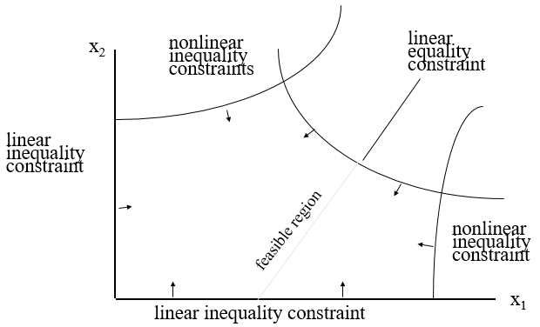
Cont…
By a feasible solution we mean a set of variables which satisfy categories 2 and 3. The region of feasible solutions is called the feasible region.

Slide 13

Cont…
An optimal solution is a set of values of the variables that are contained in the feasible region and also provide the best value of the objective function in category 1.
For a meaningful optimisation problem the model needs to be underdetermined.

Slide 14
Optimization and Chemical Engineering
Optimization is important for process modelling, synthesis, design, operation and retroﬁtting of chemical, petrochemical, pharmaceutical, energy and related processes.
Chemical engineers need to optimize the design and operating conditions of industrial process systems to improve their performance, costs, proﬁtability, safety and reliability.

Slide 15
Optimization and Chemical Engineering
Process system optimization is challenging because chemical engineering application problems are often complex, nonlinear and large, have both equality and inequality constraints and/or involve both continuous and discrete decision variables.
The mathematical relationships among the objective to be optimized and constraints and decision variables establish the difﬁculty and complexity of the optimization problem , as well as the optimization method that should be used for its solution.

Slide 16
Optimization Applications
Examples of optimization in a chemical plant:
  At what temperature to run a reactor?
  When to regenerate/change reactor catalyst?
  What distillation reflux ratio for desired purity?
  What pipe diameter for a piping network?
Optimization can be used to determine the best answer to each of these questions

Slide 17
Benefits of Optimization
Able to systematically determine the best solution
Model created for optimization can be used for other applications
Insights gained during optimization process may identify changes that can be made to improve performance

Slide 18
Optimization Requirements
A clear understanding of what is needed to be optimized.
  Ex: minimize cost or maximize product quality?
A clear understanding of the constraints on the optimization.
  Ex: safety concerns, customer requirements, budget limits, etc.
A way to represent these mathematically (i.e. a model)

Slide 19
More Definitions
Minimum: A point where the objective function does not decrease when the variable(s) are changed some amount.
Maximum: A point where the objective function does not increase when the variable(s) are changed some amount.
Minimum
Strict minimum:

Slide 20
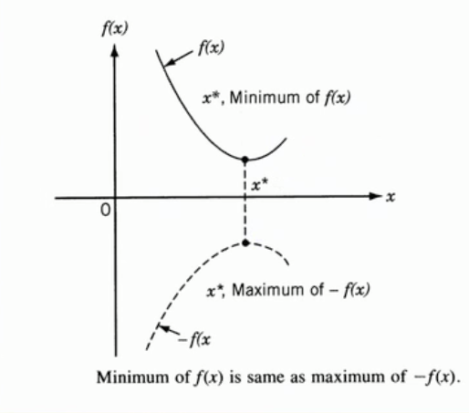
Minimization Vs Maximization

Slide 21
Mathematical Description

Slide 22
Steps Used To Solve Optimisation Problems
Analyse the process in order to make a list of all the variables.
Determine the optimisation criterion and specify the objective function.
Develop the mathematical model of the process to define the equality and inequality constraints. Identify the independent and dependent variables to obtain the number of degrees of freedom.

Slide 23
Steps Used To Solve Optimisation Problems
If the problem formulation is too large or complex simplify it if possible.
Apply a suitable optimisation technique.
Check the result and examine it’s sensitivity to changes in model parameters and assumptions.

Slide 24
Modeling Example 1
A chemical plant makes urea and ammonium nitrate. The net profits are $1000 and $1500/ton produced respectively. Both chemicals are made in two steps – reaction and drying. The number of hours necessary for each product is given below:
Step/Chemical | Urea | Ammonium Nitrate
Reaction | 4 | 2
Drying | 2 | 5

Slide 25
Cont…
The reaction step is available for a total of 80 hours per week and the drying step is available for 60 hours per week.
There are 75 tons of raw material available. Each ton produced of either product requires 4 tons of raw material.
What is the production rate of each chemical that will maximize the net profit of the plant?

Slide 26
Cont…
Objective Function:
We want to maximize the net profit. Net Profit = Revenue – Cost. Let x₁ = tons of urea produced per week & x₂ = tons of ammonium nitrate produced per week. Revenue = 1000x₁ + 1500x₂. There is no data given for costs, so assume Cost = 0.
So the objective function is:
Maximize 1000x₁ + 1500x₂

Slide 27
Cont…
Constraints:
We are given that the reaction step is available for 80 hrs/week. So, the combined reaction times required for each product cannot exceed this amount.
The table says the each ton of urea produced requires 4 hours of reaction and each ton of ammonium nitrate produced requires 2 hours of reaction. This gives the constraint:
4x₁ + 2x₂ ≤ 80

Slide 28
Cont…
We are also given that the drying step is available for 60 hrs/wk. The table says that urea requires 2 hrs/ton produced and ammonium nitrate requires 5 hrs/ton produced. So, we end up with the following constraint:
2x₁ + 5x₂ ≤ 60

Slide 29
Cont…
We are given that the supply of raw material is 75 tons/week and each ton of urea or ammonium nitrate produced requires 4 tons of raw material. This gives our final constraint:
4x₁ + 4x₂ ≤ 75

Slide 30
Cont…
Finally, to ensure a realistic result, it is always prudent to include non-negativity constraints for the variables where applicable.
Here, we should not have negative production rates, so we include the two constraints
x₁ ≥ 0 & x₂ ≥ 0

Slide 31
Cont…
So, we have the following problem:
Maximize 1000x₁ + 1500x₂
Subject to: 4x₁ + 2x₂ ≤ 80
2x₁ + 5x₂ ≤ 60
4x₁ + 4x₂ ≤ 75
x₁, x₂ ≥ 0
When solved, this has an optimal answer of x₁ = 11.25 tons/wk & x₂ = 7.5 tons/wk
Constraint 1
Constraint 2
Constraint 3

Slide 32
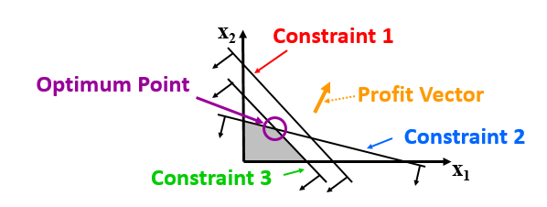
Graph of Example 1
The grey area is called the feasible region and you can see that the optimum point is at the intersections of constraints 2 & 3.
Since we are maximizing, we went in the direction of the profit vector

Slide 33
Modeling Example 2
A company has three plants that produce ethanol and four customers they must deliver ethanol to. The following table gives the delivery costs per ton of ethanol from the plants to the customers.
(A dash in the table indicates that a certain plant cannot deliver to a certain customer.)
Plant/Customer | C₁ | C₂ | C₃ | C₄
P₁ | 132 | - | 97 | 103
P₂ | 84 | 91 | - | -
P₃ | 106 | 89 | 100 | 98

Slide 34
Cont..
The three plants P1, P2, & P3 produce 135, 56, and 93 tons/year, respectively. The four customers, C1, C2, C3, & C4 require 62, 83, 39, and 91 tons/year, respectively.
Determine the transportation scheme that will result in the lowest cost.

Slide 35
Cont..
Objective Function:
We want to get the lowest cost, so we want to minimize the cost. The cost will be the costs given in the table times the amount transferred from each plant to each customer. Many of the amounts will be zero, but we must include them all because we don’t know which ones we will use.

Slide 36
Cont..
Let xij be the amount (tons/year) of ethanol transferred from plant Pi to customer Cj. So, x21 is the amount of ethanol sent from plant P2 to customer C1. We will leave out combinations the table says is impossible (like x12). So, the objective function is:
Minimize 132 x₁₁ + 97 x₁₃ + 103 x₁₄ + 84 x₂₁ + 91 x₂₂ + 106 x₃₁ + 89 x₃₂ + 100 x₃₃ + 98 x₃₄.

Slide 37
Cont..
Constraints:
The ethanol plants cannot produce more ethanol than their capacity limitations. The ethanol each plant produces is the sum of the ethanol it sends to the customers. So, for plant P1, the limit is 135 tons/year and the constraint is:
x₁₁ + x₁₃ + x₁₄ ≤ 135
Since it can send ethanol to customers C₁, C₂, & C₄.

Slide 38
Cont..
For plants P₂ & P₃, the limits are 56 and 93 tons/year, so their constraints are:
x₂₁ + x₂₂ ≤ 56
x₃₁ + x₃₂ + x₃₃ + x₃₄ ≤ 93
The ≤ sign is used because the plants may produce less than or even up to their limits, but they cannot produce more than the limit.

Slide 39
Cont..
Also, each of the customers have ethanol requirements that must be met. For example, customer C₁ must receive at least 62 tons/year from either plant P₁, P₂, P₃, or a combination of the three. So, the customer constraint for C₁ is:
x₁₁ + x₂₁ + x₃₁ ≥ 62
Since it can receive ethanol from plants P₁, P₂, & P₃.

Slide 40
Cont..
The requirements for customers C₂, C₃, & C₄ are 83, 39, & 91 tons/year so their constraints are:
x₂₂ + x₃₂ ≥ 83
x₁₃ + x₃₃ ≥ 39
x₁₄ + x₃₄ ≥ 91
The ≥ sign is used because it’s alright if the customers receive extra ethanol, but they must receive at least their minimum requirements.

Slide 41
Cont..
If the customers had to receive exactly their specified amount of ethanol, we would use equality constraints
However, that is not stated for this problem, so we will leave them as inequality constraints

Slide 42
Cont..
As in the last example, non-negativity constraints are needed because we cannot have a negative amount of ethanol transferred.
x₁₁, x₁₃, x₁₄, x₂₁, x₂₂, x₃₁, x₃₂, x₃₃, x₃₄ ≥ 0

Slide 43
Cont..
The problem is:
Minimize 132 x₁₁ + 97 x₁₃ + 103 x₁₄ + 84 x₂₁ + 91 x₂₂ + 106 x₃₁ + 89 x₃₂ + 100 x₃₃ + 98 x₃₄
Subject to: x₁₁+ x₁₃ + x₁₄ ≤ 135
x₂₁ + x₂₂ ≤ 56
x₃₁ + x₃₂ + x₃₃ + x₃₄ ≤ 93

Slide 44
Cont..
x₁₁ + x₂₁ + x₃₁ ≥ 62
x₂₂ + x₃₂ ≥ 83
x₁₃+ x₃₃ ≥ 39
x₁₄ + x₃₄ ≥ 91
And: x₁₁, x₁₃, x₁₄, x₂₁, x₂₂, x₃₁, x₃₂, x₃₃, x₃₄ ≥ 0
The optimum result is:
x₁₁ | x₁₃ | x₁₄ | x₂₁ | x₂₂ | x₃₁ | x₃₂ | x₃₃ | x₃₄
0 | 39 | 87 | 56 | 0 | 6 | 83 | 0 | 4

Slide 45
Cont..
Unlike the previous example, we cannot find the optimum point graphically because we have more than 2 variables
This illustrates the power of mathematical optimization

Slide 46
Classification of optimization techniques
Classification based on presence/absence of constraint
Constraint optimization problems: which are subjected to one or more constraint.
Unconstraint optimization: in which no constraint exist

Slide 47
Classification based on the nature of the equation involved:
Linear programing (LP)
Nonlinear programing (NLP)
Quadratic programing (QP)

Slide 48
Classification based on the nature of decision variables:
Continuous optimization
Integer programing (IP)
Mixed integer linear programing (MILP)
Mixed integer nonlinear programing (MINLP)

Slide 49
Classification based on search space:
Local search methods
Global search methods

Slide 50
Classification based on the number of objective function:
Single objective optimization
Multi-objective optimization

Slide 51
Another classification
Deterministic optimization
Stochastic optimization

Slide 52
Question?
End Lecture one

