Slide 1
Process integration and optimization
Lecture Two: Application of optimization in Chemical Engineering Problems

Slide 2
Beyond previous lecture
Definition of optimization
Purpose of optimization
Components of optimization (Objective function and constraints)
Types of optimization (static and dynamic)
Essential feature of optimization
Optimization and Chemical Engineering (process modeling, synthesis, design, operation and retroﬁtting of chemical process)
Benefits of Optimization
Steps Used To Solve Optimisation Problems
Modeling Example
Classification of optimization techniques

Slide 3
Application of optimization in Engineering
Theory of optimization finds application of all branches of Engineering. The areas of application may be broadly divided as follow:
Design of system components or entire system
Planning and analysis of existing operations
Engineering analysis and data reduction
Control of dynamic system: optimal control/dynamic optimization

Slide 4
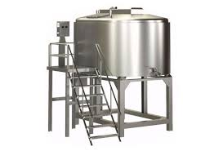
Optimal design of process tank
Design a tank which will hold 500 L of liquid. Height=[7 12]m, Radius =[3 7]m.
h
r

Slide 5
Optimal design of process tank
What dimensions for the cylindrical tank will use the least amount of material?
We can minimize the material by minimizing the area, A

Slide 6
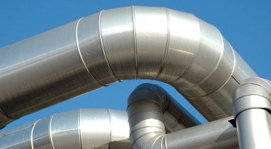
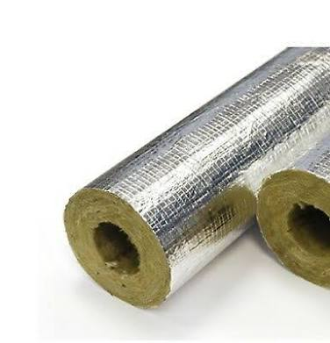
Optimal insulation thickness
Economic Criteria
The addition of insulation should save money thorough reduction of heat losses
But insulation material can be expensive
The optimal amount of insulation needed can be determined by an optimization Techniques.

Slide 7
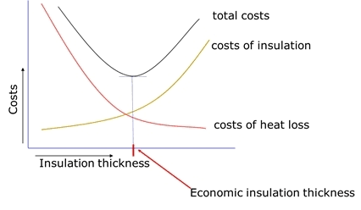
Optimal insulation thickness

Slide 8
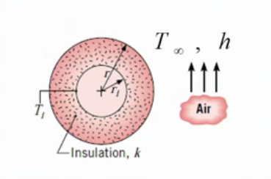
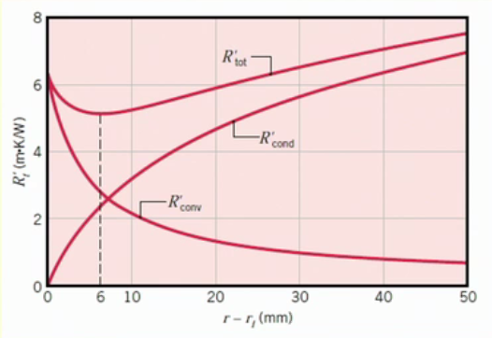
The critical insulation thickness
Technical Criteria

Slide 9
The critical insulation thickness
The conduction resistance (first term) increases with the addition of insulation. But the convection resistance (second term) decreases due to increasing outer surface area.

Slide 10
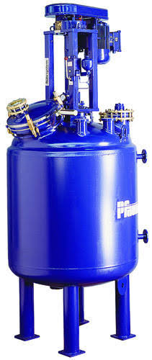
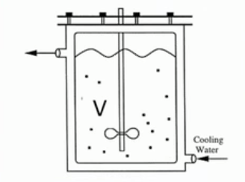

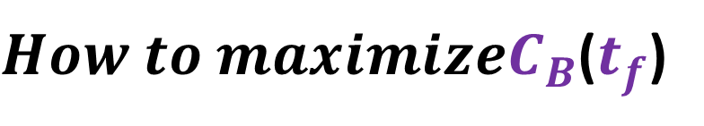



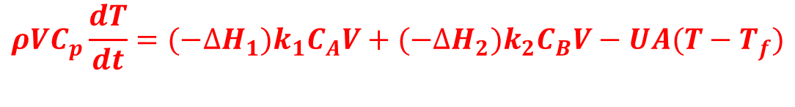




Chemical Reactor Design: Series Reaction
$How to maximizeC_{B}$($t_{f}$)
$$A→B→C$$
$$k_{1}=k_{10}e^{{−E}_{1}/RT}$$
$$k_{2}=k_{20}e^{{−E}_{2}/RT}$$
$$\frac{dC_{B}}{dt}=k_{2}C_{B}$$
$$\frac{dC_{A}}{dt}=k_{1}C_{A}−k_{2}C_{B}$$
$$Material Balance$$
$$\frac{dC_{C}}{dt}=k_{2}C_{B}$$
$$ρVC_{p}\frac{dT}{dt}={(−∆H}_{1})k_{1}C_{A}V+{(−∆H}_{2})k_{2}C_{B}V−UA(T−T_{f})$$
$$Energy Balance$$

Slide 11
Chemical Reactor: Parallel Reaction
Lets look at a reactant, which can form a desire product D, and an undesired side-product U in parallel reactions.
Undesired side-product usually needed to be separated
Higher conversion to D will reduce separation cost, but increase the cost of reactor. What is the optimal conversion?
D
A
U

Slide 12
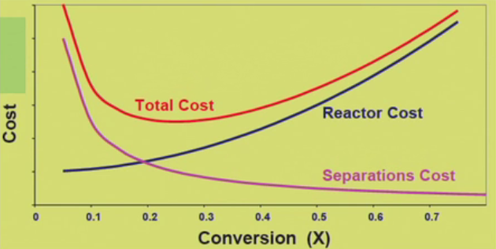
Chemical Reactor: Parallel Reaction

Slide 13

Refinery Blending Problem
Petrol Type | Octane Number | Price ($/liter)
Premium | 93 | 85
Regular | 85 | 80
Raw Oil | Octane Number | Price ($/liter) | Availability (Kilo Liter)
1 | 70 | 40 | 200
2 | 80 | 50 | 450
3 | 85 | 60 | 450
4 | 90 | 70 | 500
5 | 99 | 75 | 350
How much of “Premium Petrol” and how much of “”Regular Petrol”
should be produced to maximize the profit?

Slide 14
Diet Problem
Prepare a food mix so that daily requirement is satisfied
How much gm of Oat and Corn should be fed to minimize the cost?
Feed | Calories (per 100 g) | Minerals (unit per 100g) | Vitamin (unit per 100g) | Cost ($per 100g)
Oat | 400 | 50 | 50 | 10
Corn | 100 | 100 | 25 | 20
Daily Minimum requirement | 2000 | 1000 | 5000

Slide 15
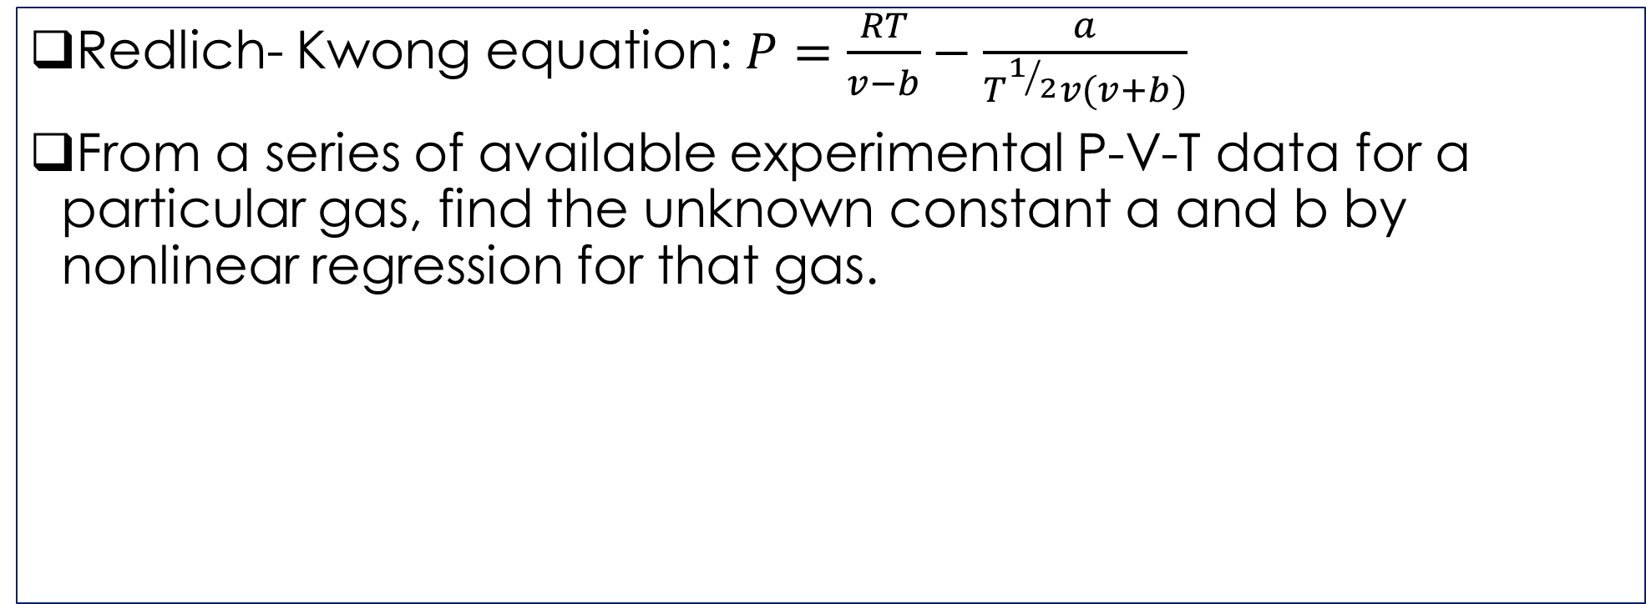
Nonlinear Regression
Redlich- Kwong equation: $P=\frac{RT}{v−b}−\frac{a}{T^{1/2}v(v+b)}$
From a series of available experimental P-V-T data for a particular gas, find the unknown constant a and b by nonlinear regression for that gas.
Expt.No | T (K) | v (cc/g mol) | P (atm)
1 | 273 | 500 | 32
2 | 325 | 500 | 42
3 | 373 | 600 | 45
N | 370 | 700 | 40

Slide 16
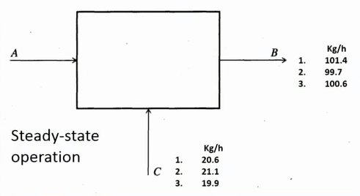
The Material Balance Reconciliation
Suppose the flow rates entering and leaving a process are measured periodically.
Determine the best value for stream A in kg/h from the three hourly measurements of B and C

Slide 17
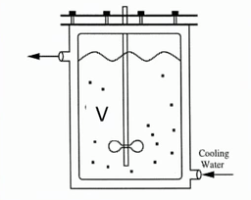

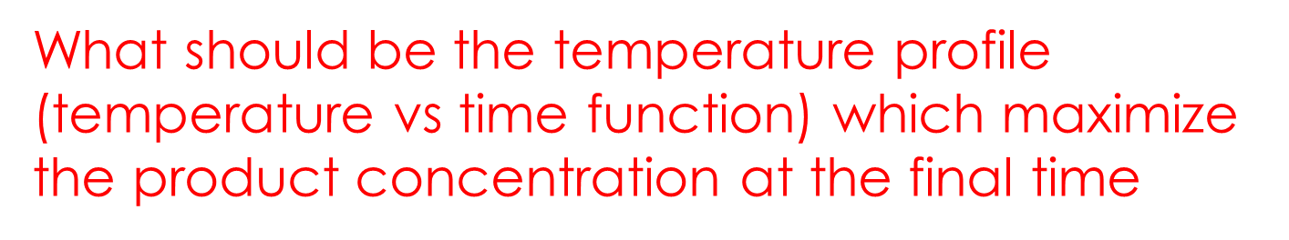
Control of Dynamic Systems: Optimal Control Problem/Dynamic Optimization: Optimal Reactor Temperature
Consider a well-mixed batch reactor where species A and B react to form a product C.
The reaction is depends on the reactor temperature which can be varied with time.
What should be the temperature profile (temperature vs time function) which maximize the product concentration at the final time
$$aA+bB→cC$$

Slide 18
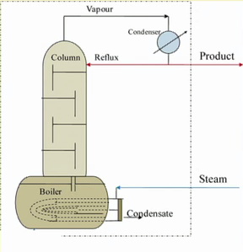
Control of Dynamic Systems: Optimal Control Problem/Dynamic Optimization: Batch Distillation Column
Maximize the production of distillate of a desired purity over a fixed time duration by controlling the distillate production arte with time.

Slide 19
Question?
End Lecture Two

