Slide 1
Process integration and optimization
Lecture three: Optimization Problem Formulation

Slide 2
Beyond previous lecture
Application of optimization in Engineering
Optimal design of process tank
Optimal insulation thickness
The critical insulation thickness
Chemical Reactor Design: Series Reaction
Chemical Reactor: Parallel Reaction
Refinery Blending Problem
Diet Problem

Slide 3
Beyond previous lecture
Nonlinear Regression
The Material Balance Reconciliation
Control of Dynamic Systems: Optimal Control Problem/Dynamic Optimization: Optimal Reactor Temperature
Control of Dynamic Systems: Optimal Control Problem/Dynamic Optimization: Batch Distillation Column

Slide 4
Process Models for Optimization
Optimization requires use of mathematical techniques for maximizing or minimizing of objective function.
With advent of computers, optimization have become part of computer-aided design activities
Getting a valid, accurate model of the process is an important step in optimization

Slide 5
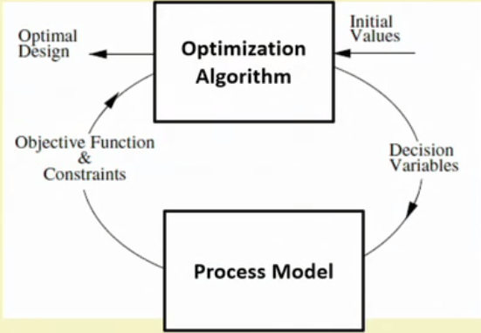
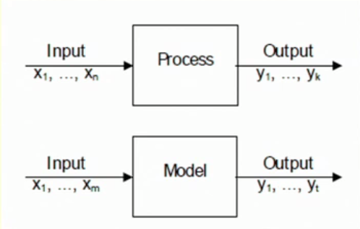
Process Models for Optimization

Slide 6
Process Models for Optimization
In an optimization problem, constraints arises because the process must describe the physical bounds on the design variables, empirical relations among design variables, and physical laws that apply to a specific problem.
To optimize a process, we need a process model to formulate the objective function, equality constraints, and inequality constraints.

Slide 7
Process Models for Optimization
A process model is a set of equations that imitates reality and cannot incorporate all features of the real process. However, reasonably accurate model saves us time and money as we can avoid repetitive experimentation and measurements.
Remember: Quality of optimal solution depends on accuracy of the process model used.

Slide 8
Classification of Process Models
Broadly two types
Model based on physical theory (Uses physical, chemical laws .First principle based model)
Model based on strictly empirical description (Black box models, data based models)

Slide 9
Classification of Process Models
There are many additional ways to classify mathematical models
For our purposes it is most satisfactory to first consider grouping the models into opposite pairs:
deterministic vs. probabilistic
linear vs. nonlinear
steady state vs. non-steady state
lumped parameter vs. distributed

Slide 10
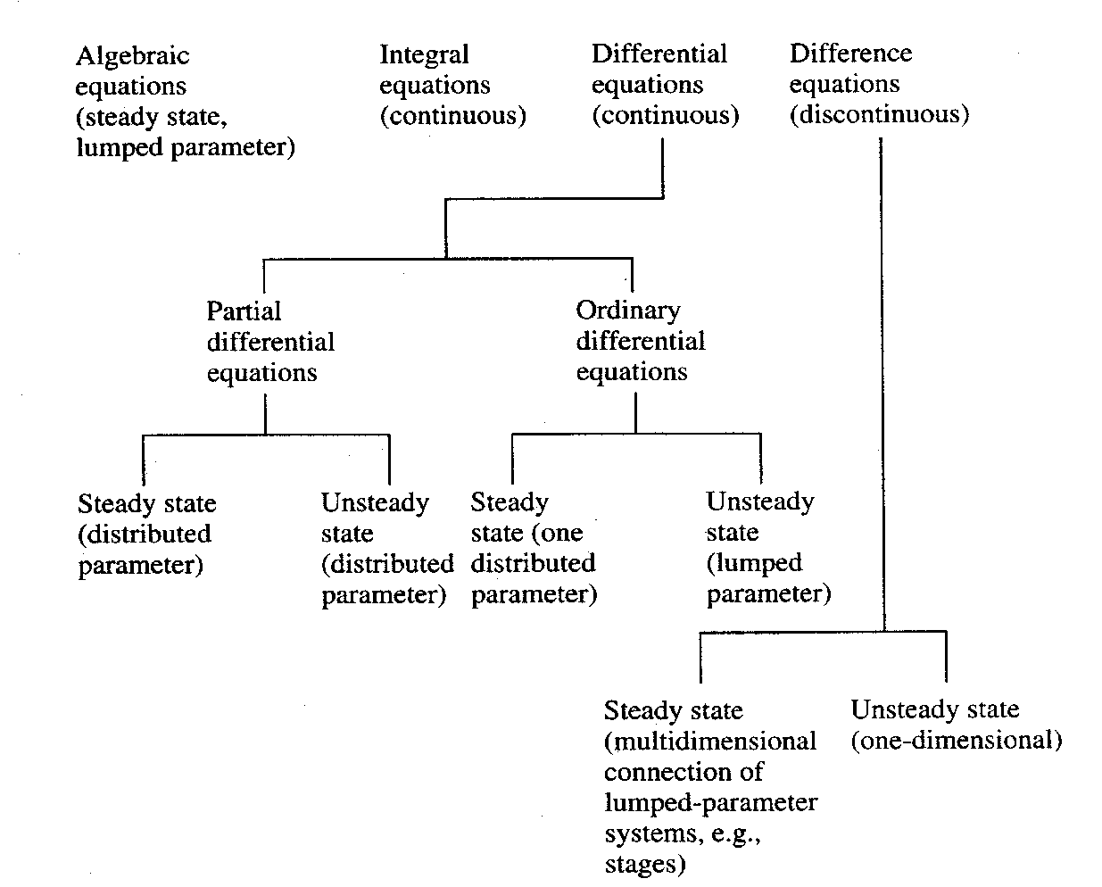
Classification of Process Models

Slide 11





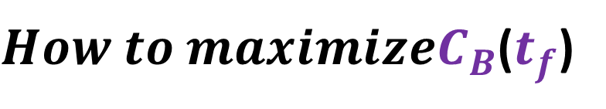

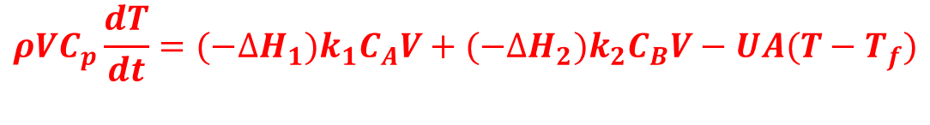


Series Reaction Optimization: Theoretical Mode
$How to maximizeC_{B}$($t_{f}$)
$$A→B→C$$
$$k_{1}=k_{10}e^{{−E}_{1}/RT}$$
$$k_{2}=k_{20}e^{{−E}_{2}/RT}$$
$$\frac{dC_{A}}{dt}={−k}_{2}C_{A}$$
$$\frac{dC_{A}}{dt}=k_{1}C_{A}−k_{2}C_{B}$$
$$Material Balance$$
$$\frac{dC_{C}}{dt}=k_{2}C_{B}$$
$$ρVC_{p}\frac{dT}{dt}={(−∆H}_{1})k_{1}C_{A}V+{(−∆H}_{2})k_{2}C_{B}V−UA(T−T_{f})$$
$$Energy Balance$$

Slide 12
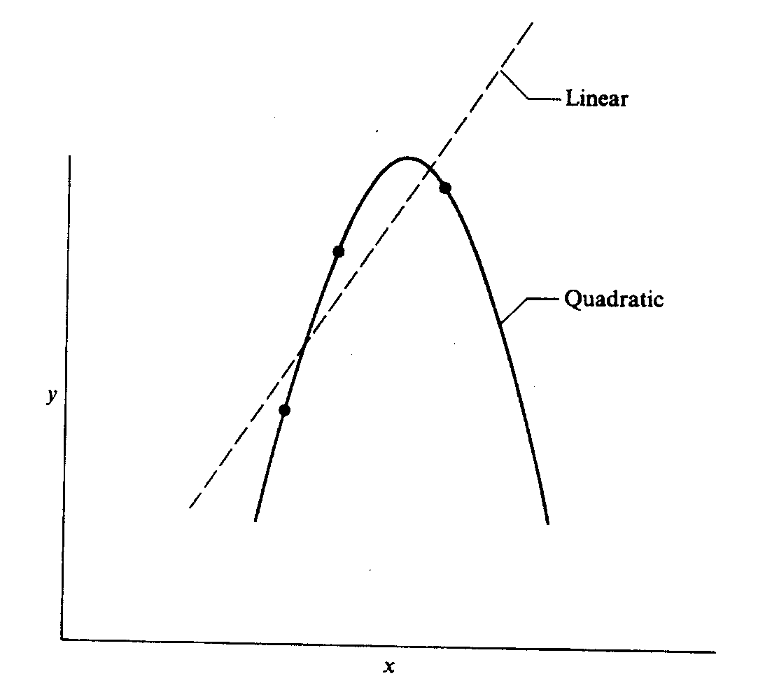
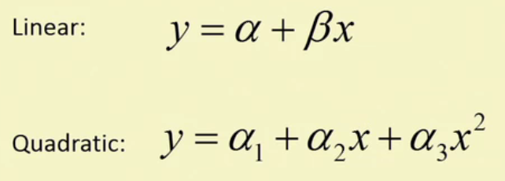
Empirical Model: Regression

Slide 13
The Degrees of Freedom Analysis
The degree of freedom analysis gives us the number of decision variables that can be changed during optimization process to obtain the optimal solution.
Degrees of freedom, DOF=(No. of variables)-(No. of linearly independent Variables)
  If DOF=0,unique solution exists. No optimization is possible.
  If DOF>0,under-determined system. Infinite solutions exists. Optimization possible
  If DOC<0,over-determined system. No solution exists. Least square analysis possible

Slide 14
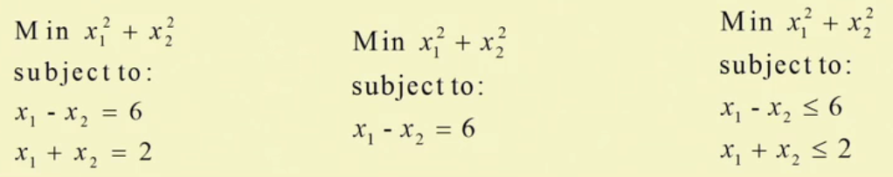
The Degrees of Freedom Analysis: Example
How many variables are there?
How many independent variables are there?
What are the DOF?

Slide 15
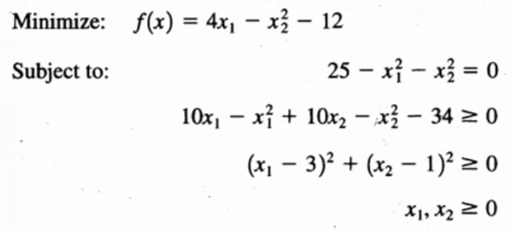
The Degrees of Freedom Analysis: Example
How many variables are there?
How many independent variables are there?
What are the DOF?

Slide 16
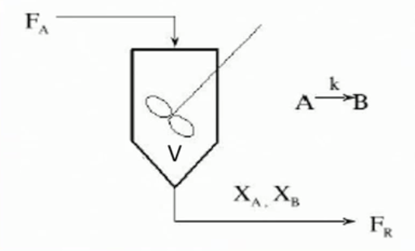
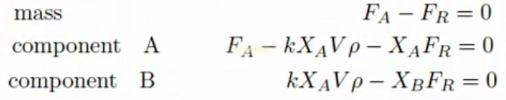

The Degrees of Freedom Analysis: Example
A Product Mix Problem
If we specify: F_{A},V,ρ,k we have
three variables (X_{A},X_{B},F_{A}) and
4 equation are all linearly independent.

Slide 17
Continuity of functions
Optimization (Analytical or Numerical)
it preferable and more convenient to work with continuous functions of one or more variables than with functions containing discontinuities.
Functions having continuous derivatives are also preferred.

Slide 18
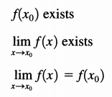
Cont..
The property of continuity. A function of a single variable x is continuous at a point x_{o} if
If f(x) is continuous at every point in region R, then f(x) is said to be continuous throughout R.

Slide 19
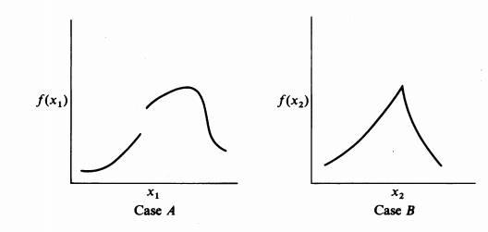
Cases

Slide 20
Cont..
Case A shows a discontinuous function
For case B, the function of x has a "kink" in it, but f(x) does satisfy the property of continuity. However, f'(x) = df(x)/dx does not.
Therefore, the function in case B is continuous but not continuously differentiable.

Slide 21
Analysis of functions for continuity
Are the following functions continuous?
f(x)=1/x;
f(x)=lnx
In each case specify the range of x for which f(x) and f’(x) are continuous.

Slide 22
Summery
A discontinuity in a function may or may not cause difficulty in optimization.
In case A, the maximum occurs reasonably far from the discontinuity which may or may not be encountered in the search for the optimum.

Slide 23
Summery
In case B, if a method of optimization that does not use derivatives is employed, then the "kink“ in f(x) is probably unimportant, but methods employing derivatives might fail, because the derivative becomes undefined at the discontinuity and has different signs on each side of it.

Slide 24
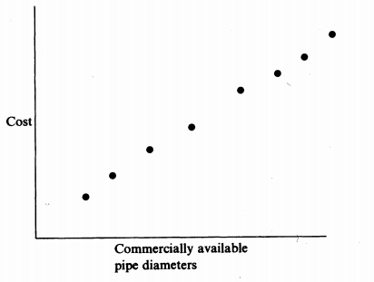
Objective functions
discrete (cost per unit diameter of pipe, the cost per unit area for heat exchanger surface or or the insulation cost considered as installed cost as a function of the pipe diameter )

Slide 25
Cont…
Can be approximated as a continuous function
because of the relatively small differences in available pipe diameters (by interpolation).
If linear interpolation is used, then the extended function usually has discontinuous derivatives at each of the original diameters (can cause problems for derivative-based optimizers )

Slide 26
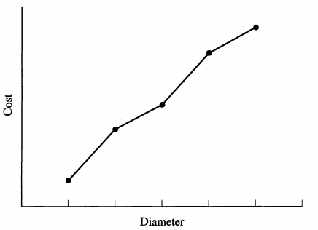
Cont…

Slide 27
Cont…
A remedy is to interpolate with quadratic or cubic functions chosen so that their first derivatives are continuous at the break points.
Once the optimum value of the diameter is obtained for the continuous function, the discretely valued diameter nearest to the optimum that is commercially available can be selected

Slide 28
Question?
End Lecture Three

