Slide 1
Process integration and optimization
Lecture Four: Optimization Problem Formation

Slide 2
Beyond previous lecture
Process Model for Optimization
Classification of Process Models
Series Reaction Optimization: Theoretical Mode
Empirical Model: Regression
The Degrees of Freedom Analysis
The Degrees of Freedom Analysis: Example
Continuity of functions
Analysis of functions for continuity
Objective functions (discrete)

Slide 3
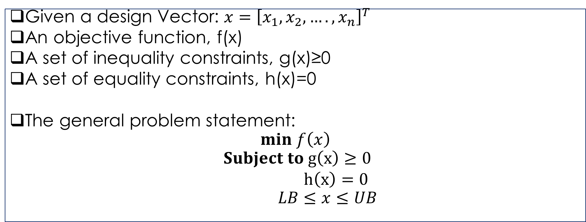
General Problem Formation
Given a design Vector: $x={\left[x_{1},x_{2},….,x_{n}\right]}^{T}$
An objective function, f(x)
A set of inequality constraints, g(x)≥0
A set of equality constraints, h(x)=0
The general problem statement:
$$min f\left(x\right)$$
$$Subject to g\left(x\right)≥0$$
$h\left(x\right)=0$
$$LB≤x≤UB$$

Slide 4
Understand the Problem: Example
A manufacturer produces the chemical Q from two raw material:R₁ and R₂. cost of R₁ is $100/kg and cost of R₂ is $50/kg. Determine the amount of each raw material required to minimize the cost of product Q/kg.

Slide 5
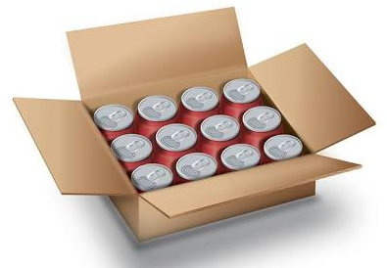
Optimal Design of a Can: The Problem
A cylindrical can with volume at least Vo is to be designed in such a way as to minimize the total cost of the material in box of 12 cans, arranged in a way 3x4 pattern.
The cost is proportional to surface area of cans and box. It is given as
Cost=c₁S₁+c₂S₂
Where S₁ is the surface area of the 12 cans and S₂ is the surface area of the box.
The constant coefficient c₁ and c₂ are positive.
Another constraint is that no dimension of the
box can exceed a given value D_{o}.

Slide 6
Product Mix
A food company decides to produce two new soft-drinks: Drink-1 and Drink-2. The Company has three plants.
Unit profit for Drink-1 is $ 3 and unit profit for Drink-2 is $ 5. How many of each item should be produced to maximize the profit.
 | Production time needed for each unit produced
Plant | Drink-1 | Drink-2 | Availability /week
1 | 1 hour | 0 | 4 hour
2 | 0 | 2 hour | 12 hour
3 | 3 hour | 2 hour | 18 hour

Slide 7
Another Example on Product Mix
A fertilizer manufacturing company produces two types of fertilizer: Type A:has high phosphorus content, Type B:having low phosphorous content.
What should be the daily production schedule (tons of A and B produced) to maximized the profit?
Raw Material | Tons required per ton of fertilizer |  | Maximum availability per day, ton
 | Type-A | Type-B
Urea | 2 | 1 | 3000
Potash | 1 | 1 | 2400
Rock Phosphate | 1 | 0 | 1000
Net Profit per ton | 30 | 20

Slide 8
The transportation problem
In a transportation problem, we wish to find the minimum cost distribution of a given commodity from a group (i=1,…,m) of supply centers (sources) to a group (j=1,….,n) of receiving centers (destinations).
Each source has a certain supply (s_{j}).Each destination has a certain demand (d_{j}).
The cost of shipping from a source to a destination is directly proportional to the number of units shipped.

Slide 9
A simple transport network representation
Sources
Destination
1
1
Supply s₁
Demand d1
2
2
Supply s₂
Demand D₂
.
.
.
.
.
.
X_{ij}
m
n
Demand D_{n}
Supply s_{m}
Costs_{ij}

Slide 10
The Transportation Problem
Minimize the total shipping cost
Factory | Warehouse
 | A | B | C | D | Supply | Total supply
1 | 4 | 7 | 7 | 1 | 100
2 | 12 | 3 | 8 | 8 | 200
3 | 8 | 10 | 16 | 5 | 150
Demand | 80 | 90 | 120 | 160 |  | 450
Total Demand |  |  |  |  | 450

Slide 11
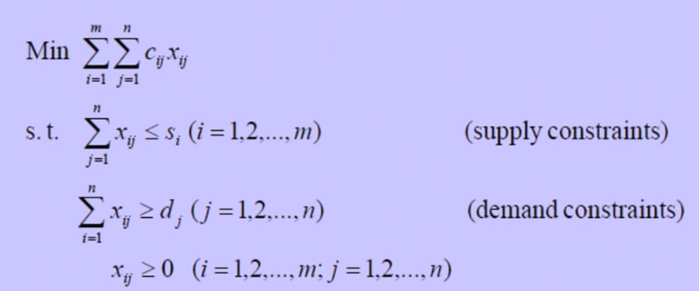
The transportation problem: Matrix Notation

Slide 12
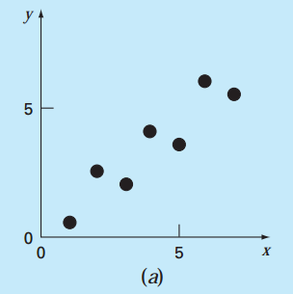
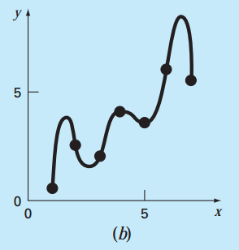
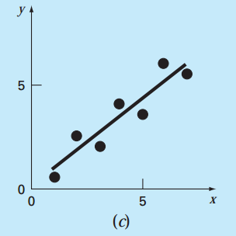
Optimization Problem Formulation: Least square Regression
Consider two Cases
Experimental data exhibited a significant degree of scatter. How to drive a single curve (or line) that represents the general trend of data?
Experiment data may be very precise. How to pass a curve or a series of curves through each of the point?

Slide 13
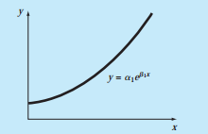
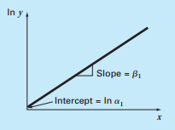


Linearization of Nonlinear Relationship
The exponential equation
$$lny=lna_{1}+b_{1}x$$
$$y^{∗}=a_{o}+a_{1}x$$

