Slide 1
Process integration and optimization
Lecture six: Non-linear Programming

Slide 2

Introduction
problems involving minimization (or maximization) of a nonlinear objective function subject to linear or nonlinear constraints:
If a model has one or more nonlinear equations (objective or constraint) then the model is nonlinear
The inequality constraints can be transformed into equality constraints, so we focus first on problems involving only equality constraints.

Slide 3
Characteristics of Nonlinear Programming (NLP) Models
Difficult to solve
Optimal solutions are not necessarily at corner points
There are both local and global optimal solutions
Solution may depend on starting point
Starting point is usually arbitrary

Slide 4
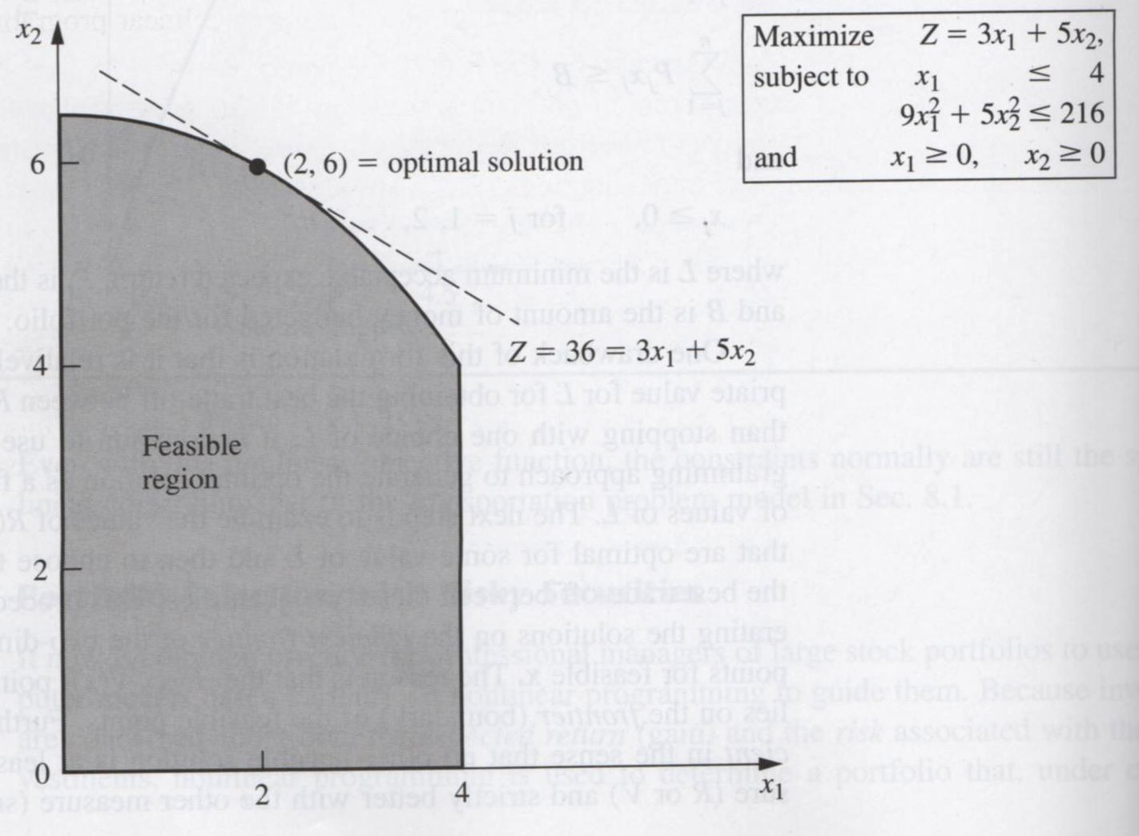
Graphical illustration of nonlinear programs
An example with nonlinear constraints when the optimal solution is not a corner point feasible solution.

Slide 5
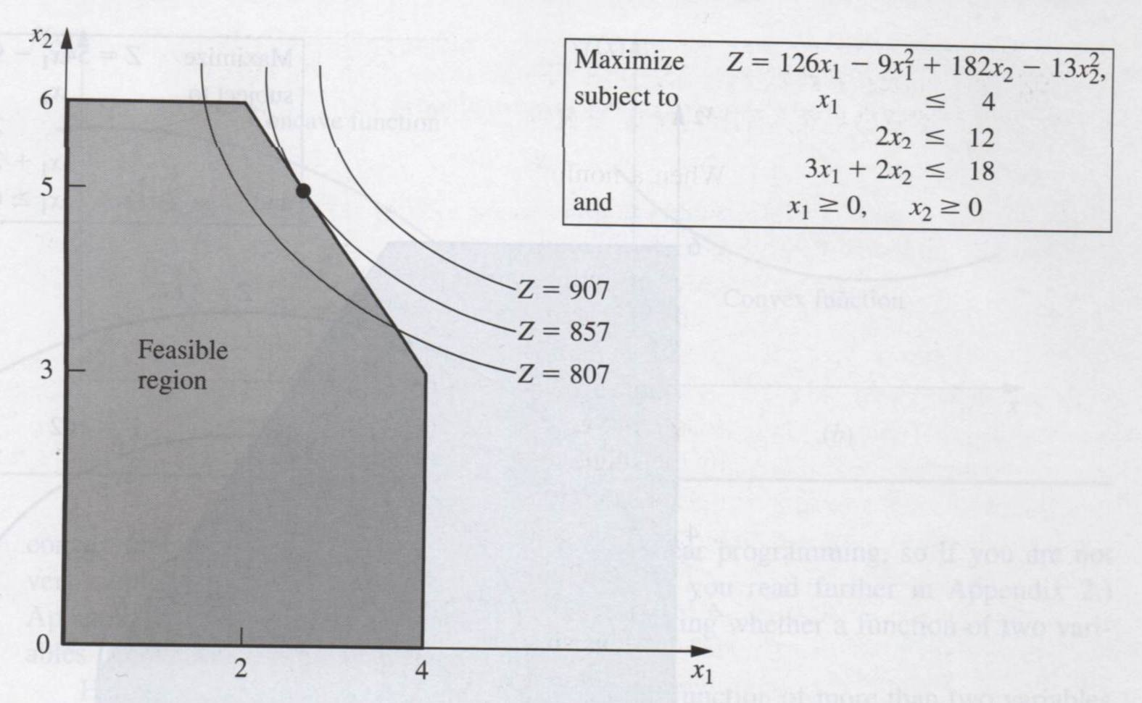
Graphical illustration of nonlinear programs
An example with linear constraints but nonlinear objective function when the optimal solution is not a corner point feasible solution.

Slide 6
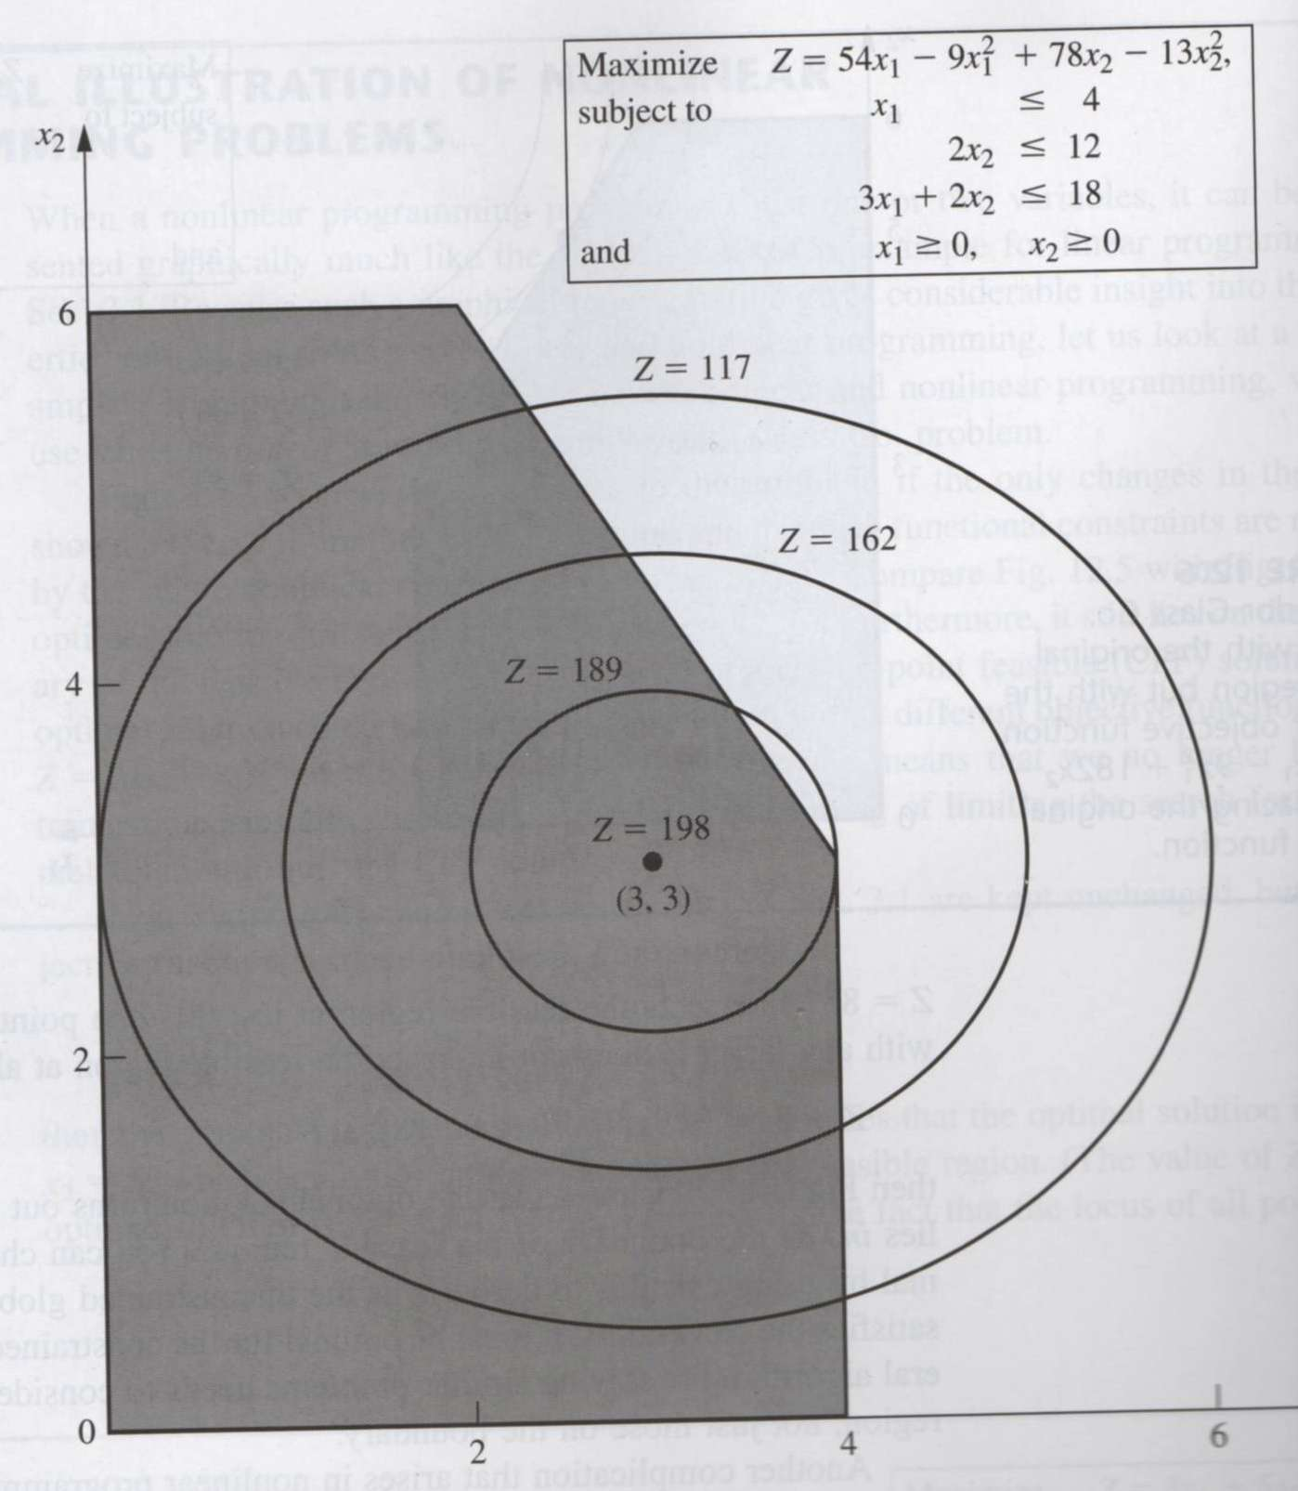
Graphical illustration of nonlinear programs
An example when the optimal solution is inside the boundary of the feasible region.

Slide 7
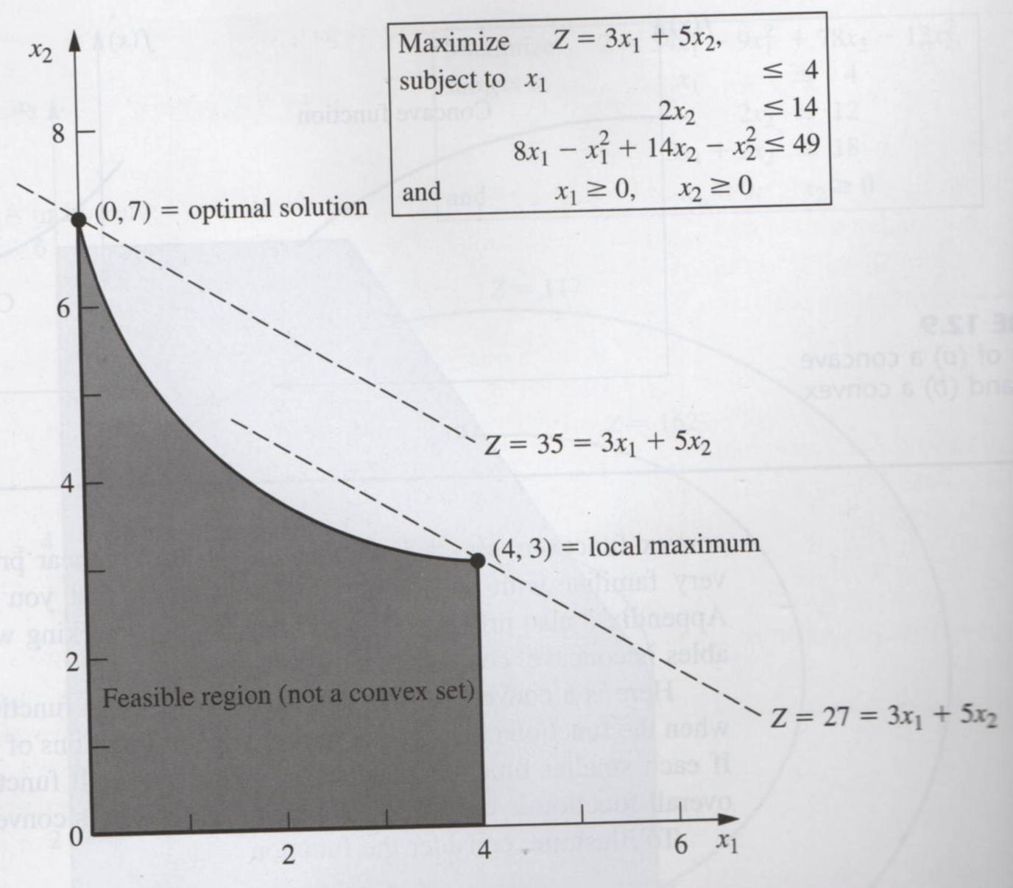
Graphical illustration of nonlinear programs
An example when a local maximum is not a global maximum (the feasible region is not a convex set).

Slide 8
Types of Nonlinear Programming problems
Unconstrained optimization
min or max f(x₁,…,x_{n})
No functional constraints.
Linearly constrained optimization
  Objective function nonlinear
  Functional constraints linear
  Extensions of simplex method can be applied.
Quadratic programming
Special case of linearly constrained optimization when the objective function is quadratic.

Slide 9
Types of Nonlinear Programming problems
Convex programming
  Objective function f is concave
  Each g_{i} is convex
  Covers a broad class of problems.
  A local maximum is a global maximum.

Slide 10
Types of Nonlinear Programming problems
Separable programming
  A special case of convex programming when f and g_{i} are separable functions. In a separable function each term involves just a single variable.
  E.g., f(x₁, x₂) = x₁² + 2x₁- 4x₂² + 3x₂,
  Can be closely approximated by a linear programming problem.

Slide 11
Types of Nonlinear Programming problems
Nonconvex programming
  Even if we are successful in finding a local maximum, there is no assurance that it also will be a global maximum.
  In some special cases (Geometric programming, Fractional programming), the problem can be reduced to an equivalent convex programming problem.

Slide 12
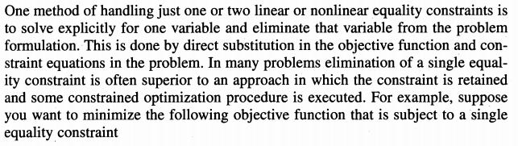
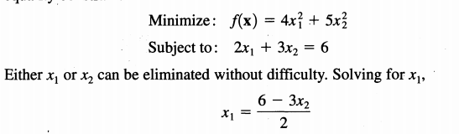
DIRECT SUBSTITUTION

Slide 13


Cont..
The constraint in the original problem has now been eliminated, and f(x₂) is an unconstrained function with 1 degree of freedom (one independent variable). Using constraints to eliminate variables is the main idea of the generalized reduced gradient method,
We can now minimize the objective function , by setting the first derivative off equal to zero, and solving for the optimal value of x₂:

Slide 14
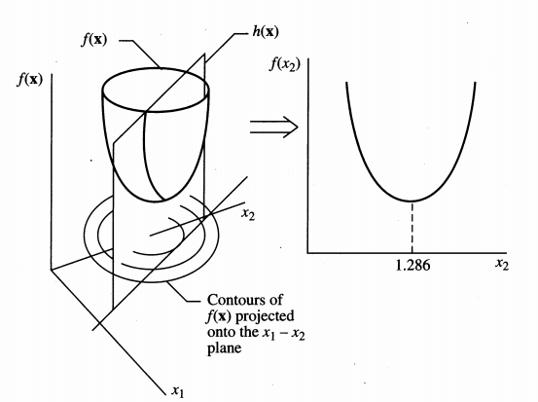

Graphical representation of a function of two variables reduced to a function of one variable by direct substitution. The unconstrained minimum is at (0,0), the center of the contours.
Once x₂* is obtained, then, x₁* can be directly obtained via the constraint

Slide 15

Example

Slide 16
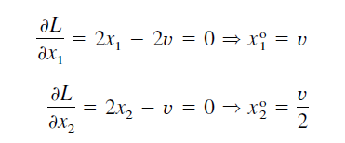




Slide 17

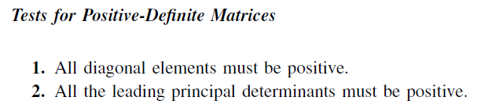
Test whether the stationary point corresponds to a minimum
positive definite

Slide 18






Slide 19


Example

Slide 20
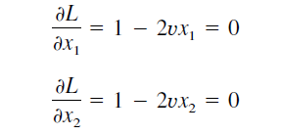


Slide 21
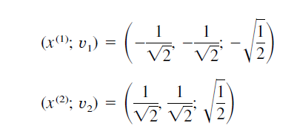

Slide 22



max
positive definite
negative definite

Slide 23
Karush–Kuhn–Tucker conditions
the Karush–Kuhn–Tucker (KKT) conditions, also known as the Kuhn–Tucker conditions, are first-order necessary conditions for a solution in nonlinear programming to be optimal, provided that some regularity conditions are satisfied.
Allowing inequality constraints, the KKT approach to nonlinear programming generalizes the method of Lagrange multipliers, which allows only equality constraints.

Slide 24
Karush–Kuhn–Tucker conditions
The system of equations and inequalities corresponding to the KKT conditions is usually not solved directly, except in the few special cases where a closed-form solution can be derived analytically. In general, many optimization algorithms can be interpreted as methods for numerically solving the KKT system of equations and inequalities.

