Slide 1
Introduction to Power Systems
Chapter 2: Representation of power system components

Slide 2
Introduction
Review of basic concepts
Phasors:
A sinusoidal voltage or current at constant frequency is characterized by two parameters:
    maximum value
    phase angle
A voltage
    has maximum value: V_{max}
    phase angle: δ when referenced to cosωt

Slide 3


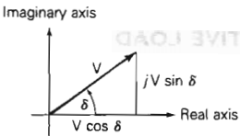
The root-mean-square (rms) value, also called effective value, of the sinusoidal voltage is
The rms phasor representation of the voltage is given in three forms: exponential, polar and rectangular.
Phasor diagram for converting from polar to rectangular form

Slide 4
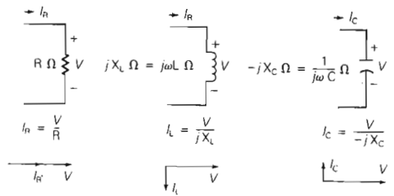
Summary of the relationships between voltage and current phasors for the three passive elements: resistor, inductor and capacitor.

Slide 5
Power in single phase ac circuits
Instantaneous power:
The instantaneous power in watts absorbed by an electrical load is the product of the instantaneous voltage across the load in volts and the instantaneous current into the load in amperes.
Assume that load voltage is

Slide 6
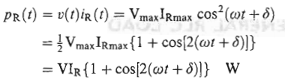
Purely resistive load
The current into the load is in phase with the load voltage.
Where
The instantaneous power absorbed by the resistor

Slide 7


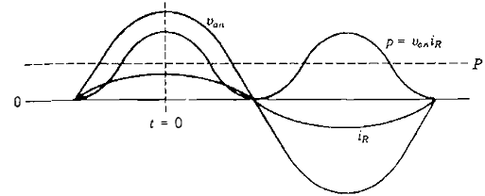
It has two parts: an average value and a double frequency term.
Average value
Double frequency term

Slide 8

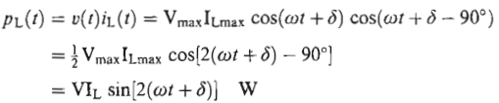
Purely inductive load
The current into the load lags the voltage by 90º.
Where
The instantaneous power absorbed by the inductor is
The instantaneous power is a double frequency sinusoid with zero average value.

Slide 9
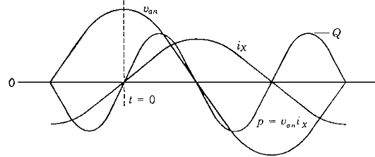

Slide 10
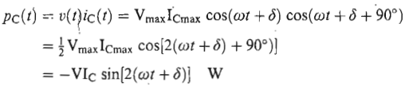
Purely capacitive load
The current into the load leads the voltage by 90º.
Where
The instantaneous power absorbed by the capacitor is
The instantaneous power is also a double frequency sinusoid with zero average value.

Slide 11
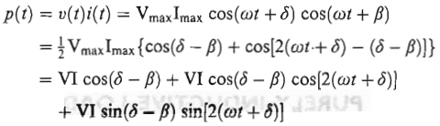
General RLC load
For a general load composed of RLC elements under sinusoidal steady state excitation, the load current is of the form
The instantaneous power absorbed by the load is

Slide 12

Letting
The instantaneous power has two components:
One can be associated with the power absorbed by the resistive component of the load, and the other can be associated with the reactive (inductive or capacitive) component.

Slide 13
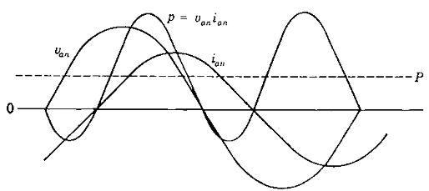

Slide 14

Real power
The average power P is also called real power or active power.
Power factor
The term cos (δ-β) is called the power factor.
The phase angle (δ-β), which is the angle between the voltage and current, is called the power factor angle.
Inductive load: Lagging power factor (δ>β)
Capacitive load: Leading power factor (δ<β)

Slide 15



Reactive power
The instantaneous power absorbed by the reactive part of the load is a double frequency sinusoid with zero average value with amplitude Q given by
The term Q is given the name reactive power.
Complex power
If the phasor expressions for voltage and current are known , the calculation of real and reactive power is accomplished conveniently in complex form.

Slide 16
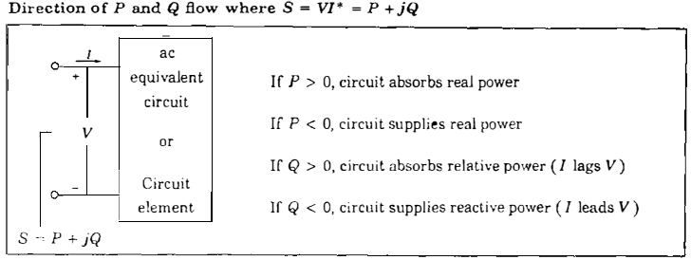

Slide 17
Single Phase Solution of Balanced Three Phase Systems
Balanced Three Phase Circuits
  Y Connections
  Line-to-Neutral Voltages
  Line-to-Line Voltages
  Line Currents
  Δ Loads
  Δ-Y conversion
  Equivalent Line-to-Neutral Diagrams

Slide 18
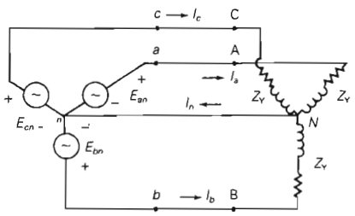
Balanced-Y Connections

Slide 19
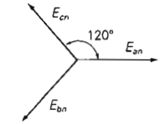
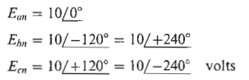
  Balanced Line-to-Neutral Voltages
  The source line-to-neutral voltages E_{an}, E_{bn} and E_{cn} are balanced when these voltages have equal magnitudes and an equal 120º phase difference between any two phases.
  Example: positive sequence (abc)

Slide 20
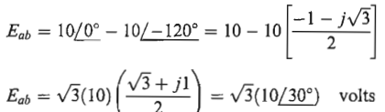
  Balanced Line-to-Line Voltages
The voltages E_{ab}, E_{bc} and E_{ca} between phases are called line-to-line

Slide 21
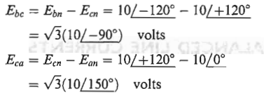
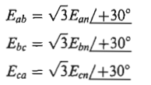
Similarly:
The line-to-line voltages are √3 times the line-to-neutral voltages and lead by 30º.

Slide 22
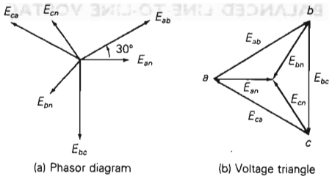
The sum of the three line-to-line voltages is zero, even if the system is unbalanced.
The sum of the three line-to-neutral voltages for a balanced system is zero.

Slide 23
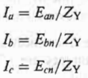
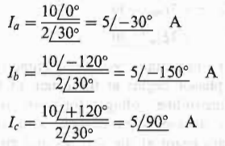
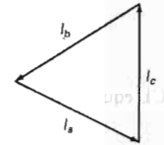

  Balanced Line Currents
Example:

Slide 24
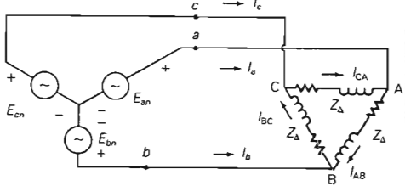
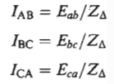
  Balanced Δ Loads

Slide 25
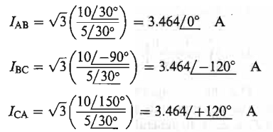
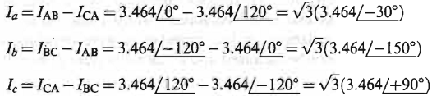
Example:
The line currents:

Slide 26
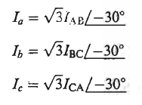
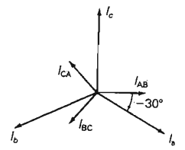

Slide 27
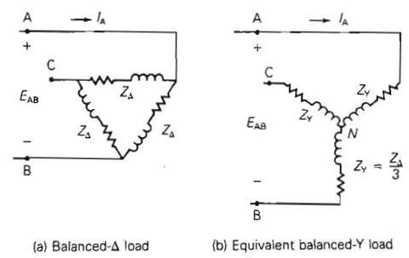
  Δ-Y Conversion for Balanced Loads

Slide 28
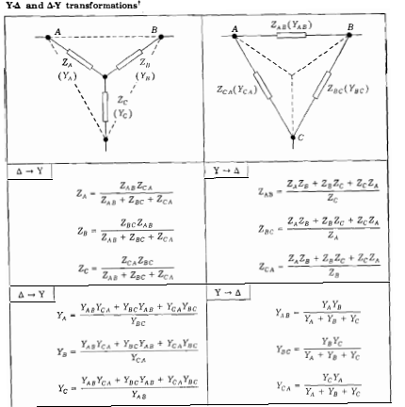


Slide 29
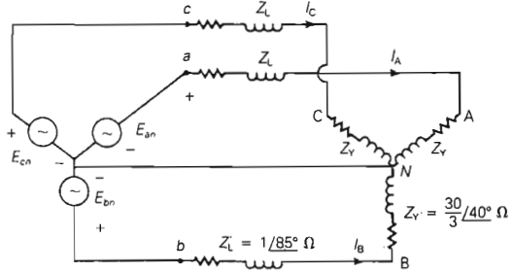
  Equivalent Line-to-Neutral Diagrams

Slide 30
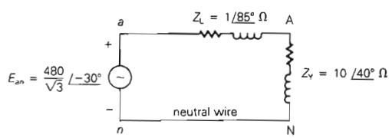

Slide 31
Power in Balanced Three Phase Circuits
  Instantaneous and Complex Power for Balanced Three Phase Generators
  Instantaneous and Complex Power for Balanced Three Phase Motors
  Instantaneous and Complex Power for Balanced Three Phase Y- and Δ-Impedance Loads

Slide 32
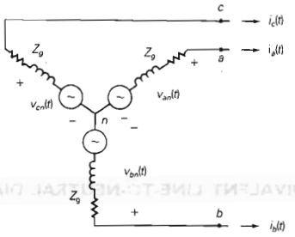
  Instantaneous and Complex Power for Balanced Three Phase Generators

Slide 33


Instantaneous voltage and current
The instantaneous power delivered by phase a

Slide 34


Similarly:

Slide 35
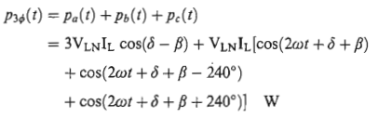

The total instantaneous power delivered by a three phase generator is the sum of the instantaneous powers delivered by each phase.

Slide 36
The total instantaneous power delivered by a three phase generator under balanced operating conditions is not a function of time, but a constant,
The equations for instantaneous powers delivered by phases of a generator are valid for instantaneous powers absorbed by phases of a balanced three phase motor and balanced three phase impedance loads.
Therefore, the equation for the total instantaneous power is valid for these loads.

Slide 37



Complex Power: Generators, Motors and Y-loads

Slide 38




In terms of the total real and reactive powers
Where
The total apparent power is:

Slide 39



Complex Power: Δ-loads

Slide 40
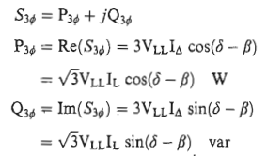


Slide 41
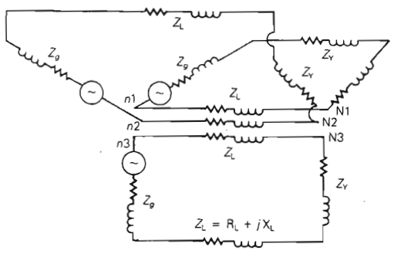
Advantages of Balanced Three phase versus Single Phase
Less capital and
operating cost
Avoids shaft vibration
and noise

Slide 42
The three neutral conductors can be removed in three phase systems.
The balanced three phase system, while delivering the same power, requires half the number of conductors required for the three separate single phase systems.
The total instantaneous power delivered by a three-phase generator under steady state conditions is constant. The input mechanical power will be constant.
The shaft mechanical torque is nearly constant.

Slide 43
The mechanical input power and the mechanical shaft torque in single-phase generators under steady state condition have double frequency components that create shaft vibration and noise, which could cause shaft failure in large machines.
Accordingly, most generators and motors rated 5KVA and higher are constructed as three-phase machines in order to produce nearly constant torque thereby minimize shaft vibration and noise.

Slide 44
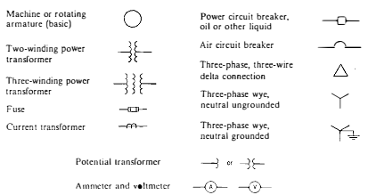
One-Line Diagram and Impedance or Reactance Diagram
One-Line Diagram

Slide 45
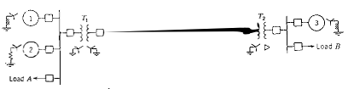
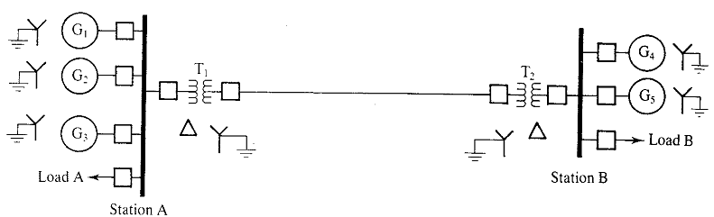

Slide 46
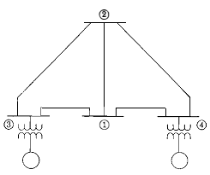

Slide 47
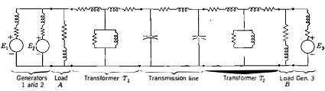
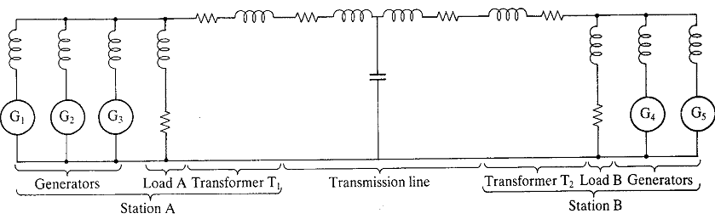
Impedance Diagram

Slide 48

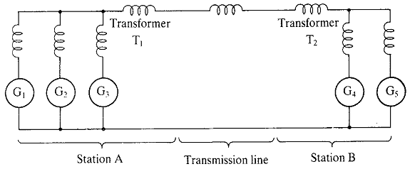
Reactance Diagram

Slide 49
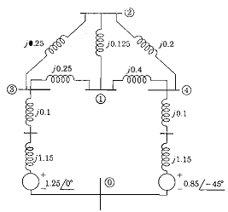

Slide 50
Per Unit Representation
A key problem in analyzing power systems is the large number of transformers.
  It would be very difficult to continually have to refer impedances to the different sides of the transformers
This problem is avoided by a normalization of all variables.
This normalization is known as per unit analysis.

Slide 51
Per Unit Conversion Procedure, 1φ
Pick a 1φ VA base for the entire system, S_{B}
Pick a voltage base for each different voltage level, V_{B}. Voltage bases are related by transformer turns ratios. Voltages are line to neutral.
Calculate the impedance base, Z_{B}= (V_{B})²/S_{B}
Calculate the current base, I_{B} = V_{B}/Z_{B}
Convert actual values to per unit
Note, per unit conversion affects magnitudes, not
the angles. Also, per unit quantities no longer have
units (i.e., a voltage is 1.0 p.u., not 1 p.u. volts)

Slide 52
Per Unit Solution Procedure
Convert to per unit (p.u.) (many problems are already in per unit)
Solve
Convert back to actual as necessary

Slide 53
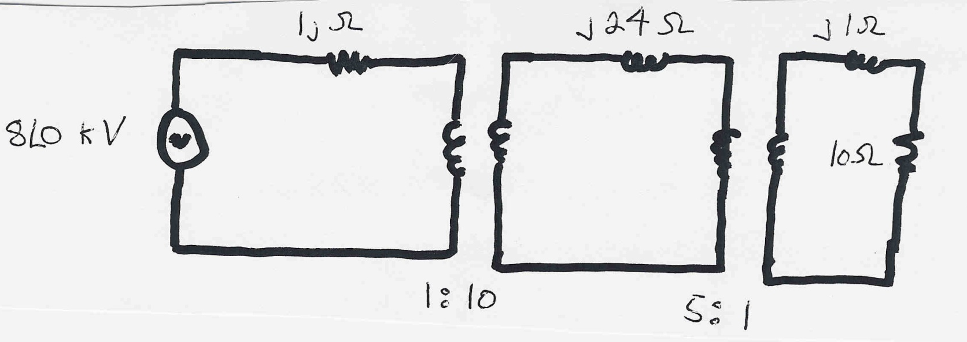
Per Unit Example
Solve for the current, load voltage and load power
in the circuit shown below using per unit analysis
with an S_{B} of 100 MVA, and voltage bases of 8 kV, 80 kV and 16 kV.
Original Circuit

Slide 54
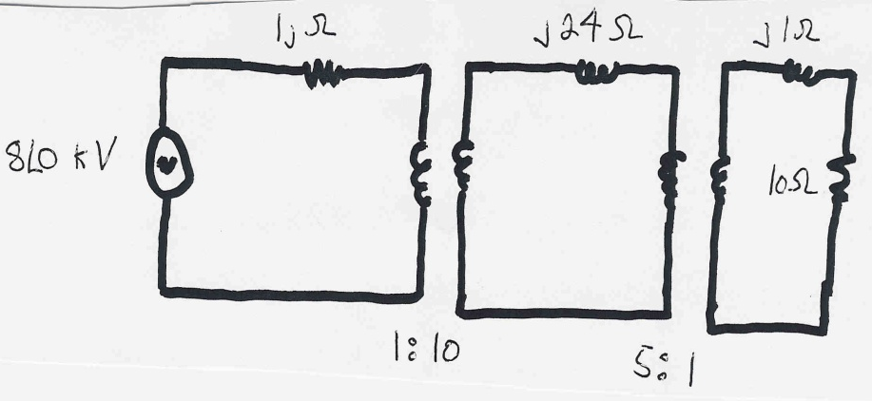
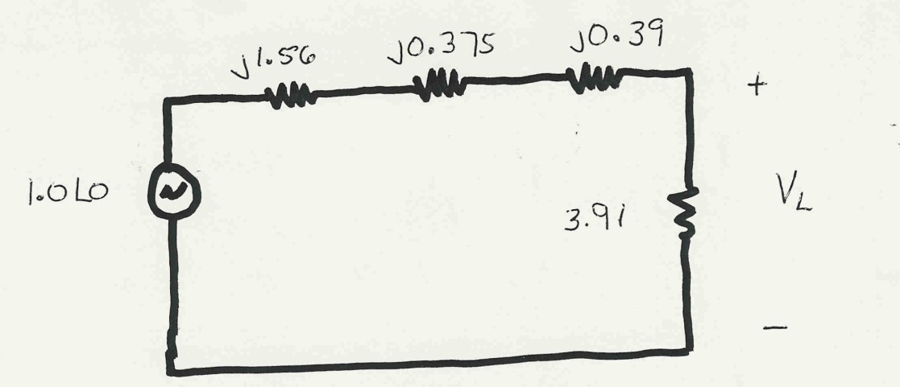
Same circuit, with
values expressed
in per unit.

Slide 55
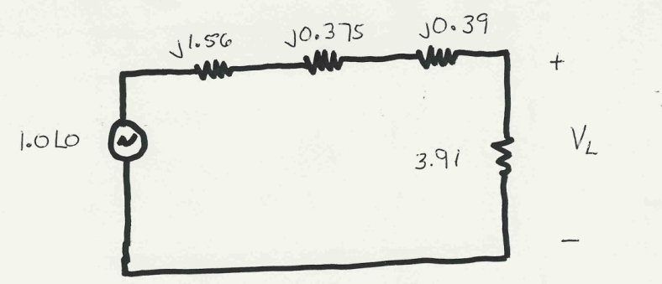

Slide 56
To convert back to actual values just multiply the
per unit values by their per unit base

Slide 57
Three Phase Per Unit
Procedure is very similar to 1φ except we use a 3φ
VA base, and use line to line voltage bases
Pick a 3φ VA base for the entire system,
Pick a voltage base for each different voltage level, V_{B}. Voltages are line to line.
Calculate the impedance base
Exactly the same impedance bases as with single phase!

Slide 58
Calculate the current base, I_{B}
Convert actual values to per unit
Exactly the same current bases as with single phase!

Slide 59
Three Phase Per Unit Example
Solve for the current, load voltage and load power
in the previous circuit, assuming a 3φ power base of
300 MVA, and line to line voltage bases of 13.8 kV,
138 kV and 27.6 kV (square root of 3 larger than the 1φ example voltages). Also assume the generator is Y-connected so its line to line voltage is 13.8 kV.
Convert to per unit
as before. Note the
system is exactly the
same!

Slide 60
Again, analysis is exactly the same!

Slide 61
Differences appear when we convert back to actual values

Slide 62
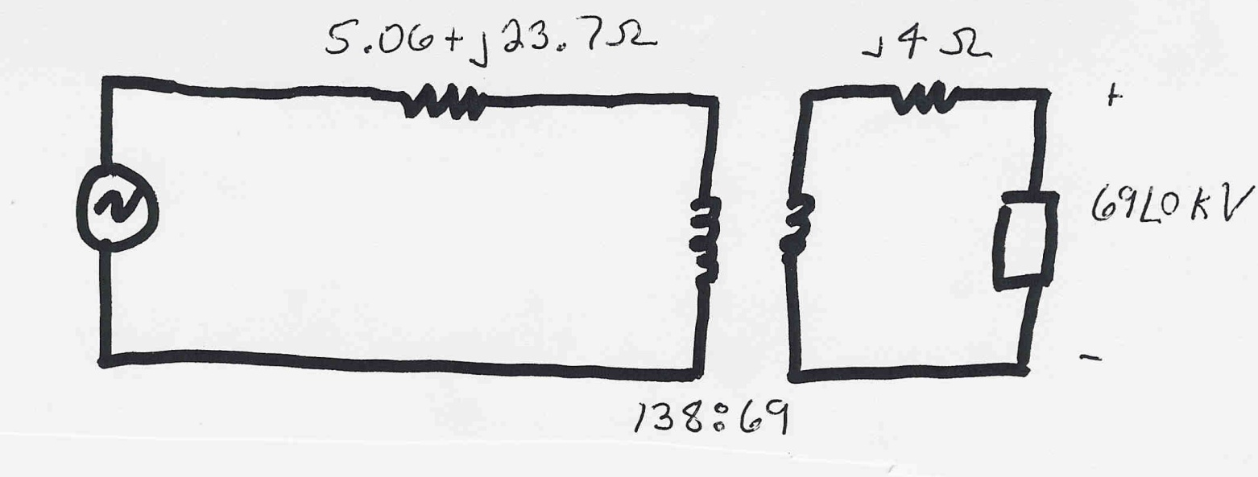
3φ Per Unit Example 2
Assume a 3φ load of 100+j50 MVA with V_{LL} of 69 kV is connected to a source through the below network:
What is the supply current and complex power?
Answer: I=467 amps, S = 103.3 + j76.0 MVA

Slide 63
Per Unit Change of MVA Base
Parameters for equipment are often given using power rating of equipment as the MVA base
To analyze a system all per unit data must be on a common power base

Slide 64
Per Unit Change of Base Example
A 54 MVA transformer has a leakage reactance of 3.69%. What is the reactance on a 100 MVA base?

Slide 65
Transformer Reactance
Transformer reactance is often specified as a percentage, say 10%. This is a per unit value (divide by 100) on the power base of the transformer.
Example: A 350 MVA, 230/20 kV transformer has leakage reactance of 10%. What is p.u. value on 100 MVA base? What is value in ohms (230 kV)?

Slide 66

Three Phase Transformers
There are 4 different ways to connect 3φ transformers
Y-Y
Δ−Δ

Slide 67

Δ-Y
Y-Δ

Slide 68
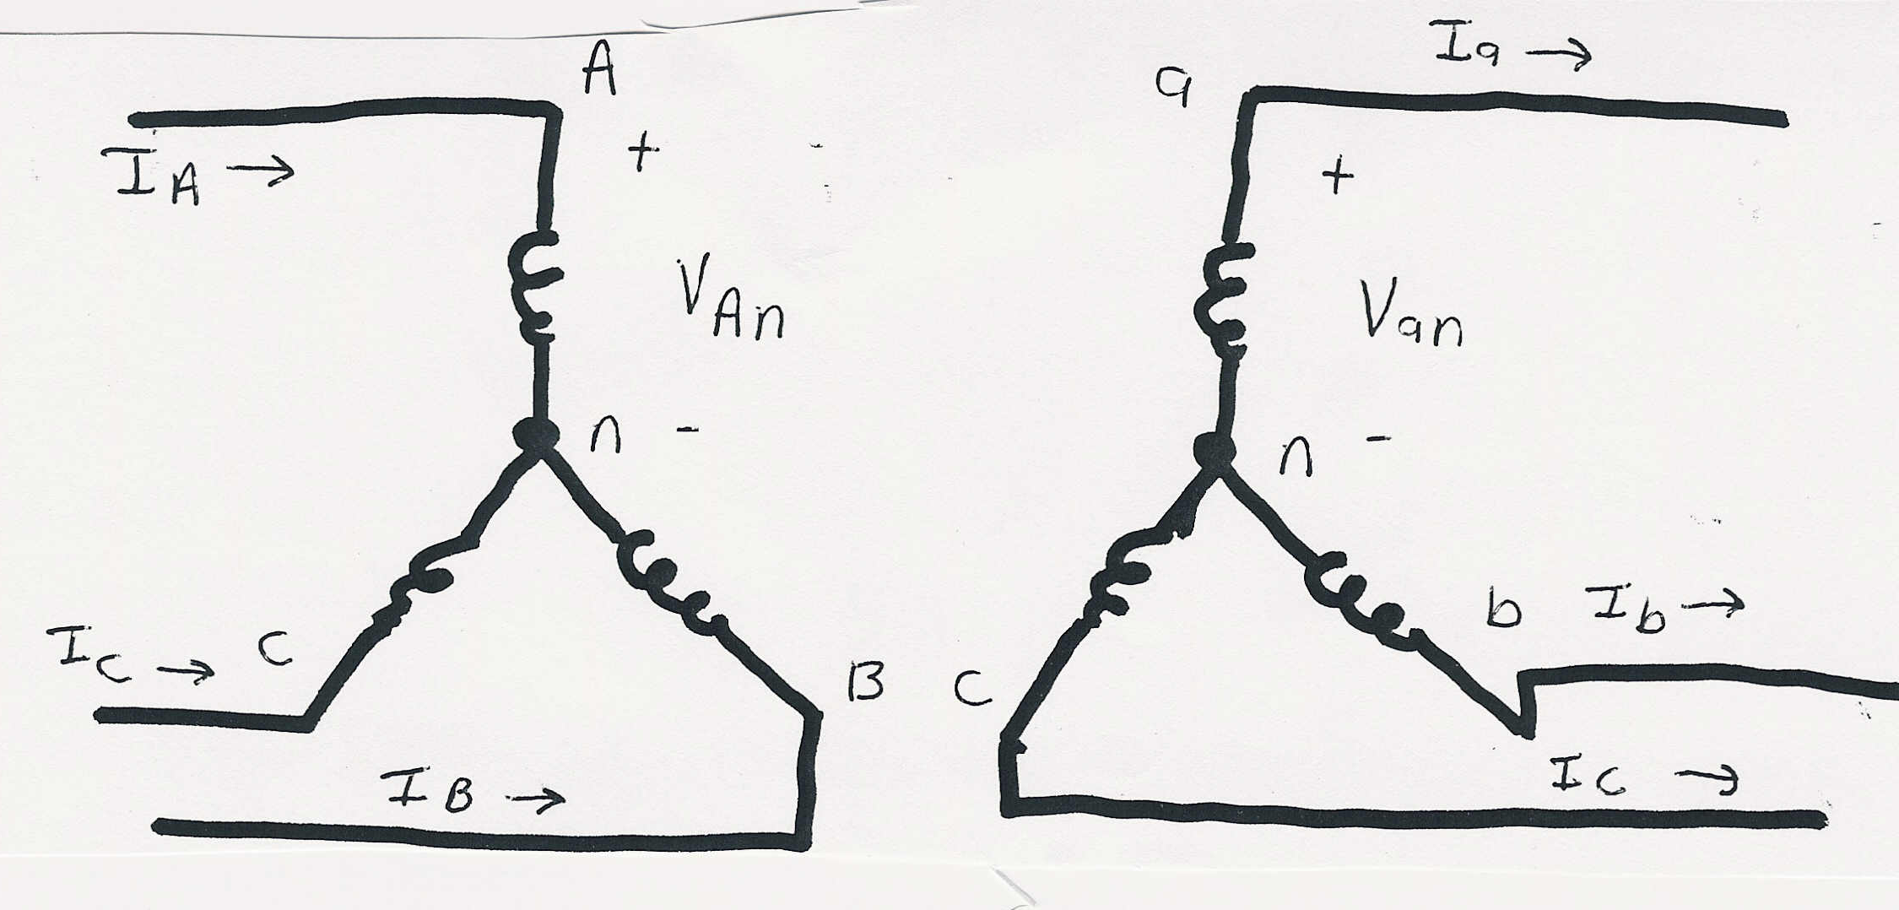
Y-Y Connection

Slide 69
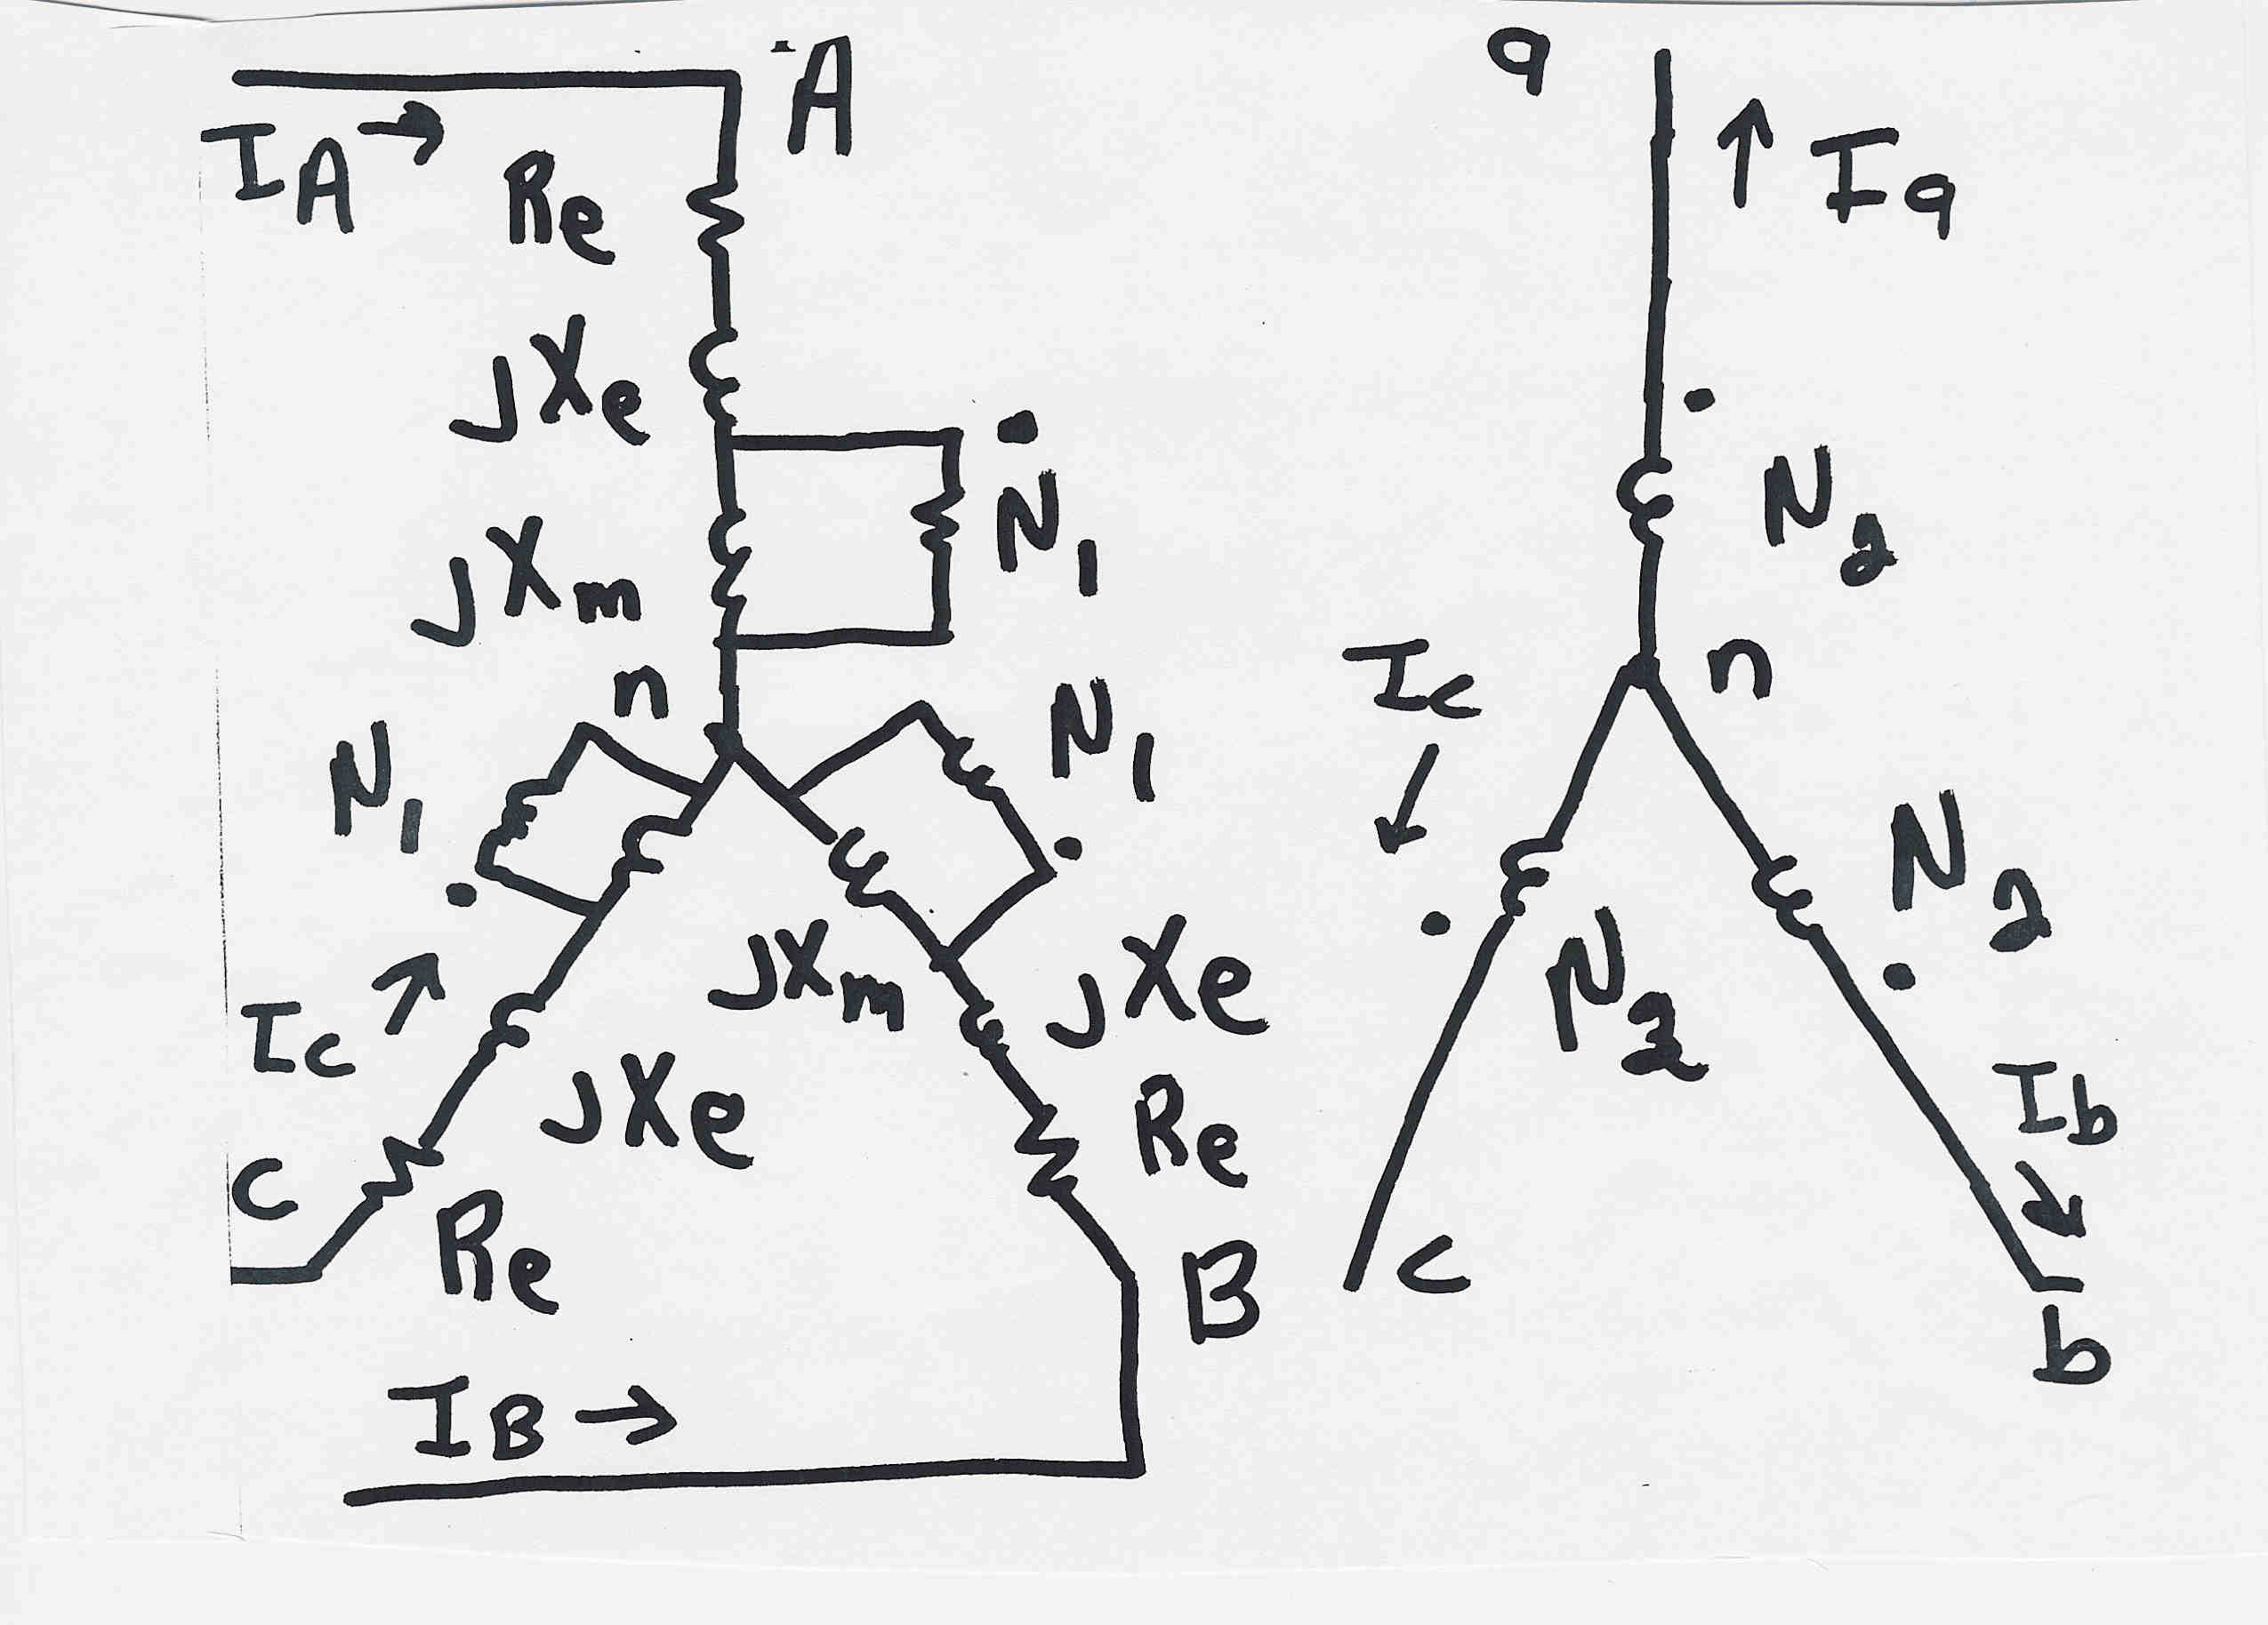
Y-Y Connection: 3φ Detailed Model

Slide 70
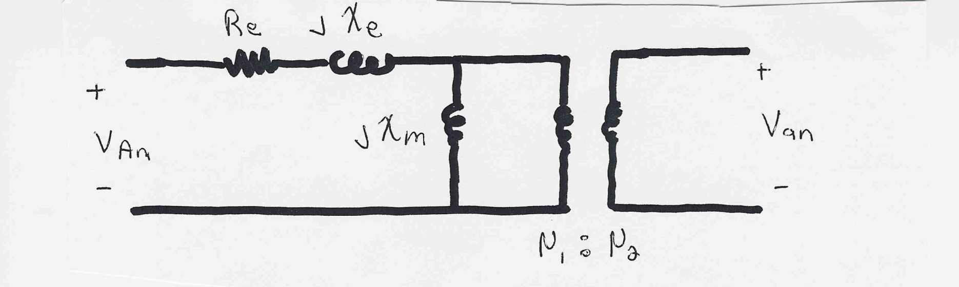
Y-Y Connection: Per Phase Model
Per phase analysis of Y-Y connections is exactly the
same as analysis of a single phase transformer.
Y-Y connections are common in transmission systems.
Key advantages are the ability to ground each side
and there is no phase shift is introduced.

Slide 71

Δ-Δ Connection

Slide 72

Δ-Δ Connection: 3φ Detailed Model
To use the per phase equivalent we need to use
the delta-wye load transformation

Slide 73

Δ-Δ Connection: Per Phase Model
Per phase analysis similar to Y-Y except impedances are decreased by a factor of 3.
Key disadvantage is Δ-Δ connections can not be grounded; not commonly used.

Slide 74

Δ-Y Connection

Slide 75
Δ-Y Connection V/I Relationships

Slide 76

Δ-Y Connection: Per Phase Model
Note: Connection introduces a 30 degree phase shift!
Common for transmission/distribution step-down since
there is a neutral on the low voltage side.
Even if a = 1 there is a sqrt(3) step-up ratio

Slide 77

Y-Δ Connection: Per Phase Model
Exact opposite of the Δ-Y connection, now with a
phase shift of -30 degrees.

