Slide 1
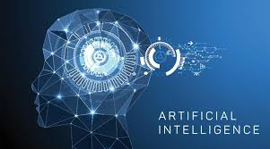
What is Artificial Intelligence?
“is it possible to build a machine that has intelligence, specifically a human level of intelligence?”
Artificial Intelligence is
  “The science and engineering of making intelligent machines, especially intelligent computer programs.”
  “About algorithms enabled by constraints exposed by representations that support models targeted at thinking, perception and action.”
  “The theory and development of computer systems able to perform tasks normally requiring human intelligence, such as visual perception, speech recognition, decision-making, and translation between languages. “

Slide 2
Cont’d
AI is the creation of a computer program that can learn to think and function on its own, kind of like robots that don’t need to be told what to do all the time.
Most advanced AI systems use machine learning technology to analyze current conditions and learn from experience.

Slide 3
Cont’d
Examples of technologies that uses AI
  Machine Learning
  Robotics
  Machine Automation
  Virtual Reality
  Cloud Computing
  Augmented Reality
  Neural Networks
  Big Data
  Internet of Things
  Computer Vision

Slide 4
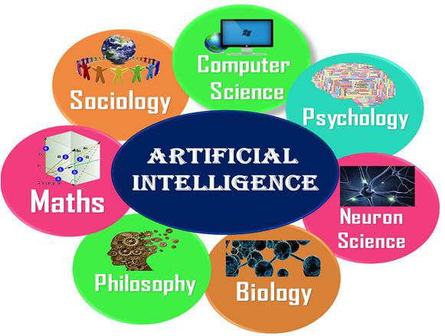
Artificial Intelligence is multidisciplinary

Slide 5
Components of AI system
Applications: Image recognition, Speech recognition, Chatbots, Natural language generation, and Sentiment analysis.
Types of Models: Deep learning, Machine learning, and Neural Networks.
Software/Hardware for training and running models: Graphic Processing Units (GPUs), Parallel processing tools (like Spark), Cloud data storage and computer platforms.
Programming languages for building models: Python, TensorFlow, Java, and C/C⁺⁺, etc.

Slide 6
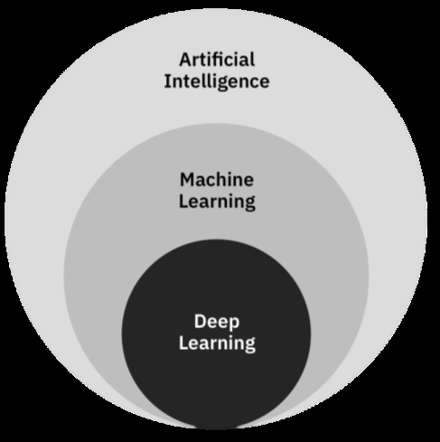
Artificial Intelligence (AI), Machine Learning (ML) and Deep Learning (DL)

Slide 7
History of Artificial Intelligence (AI)
Formally initiated in 1956 and the name AI was coined by John McCarthy.
The advent of general purpose computers provided a vehicle for creating artificially intelligent entities.
  Used for solving general-purpose problems
Which one is preferred?
  General purpose problem solving systems
  Domain specific systems

Slide 8
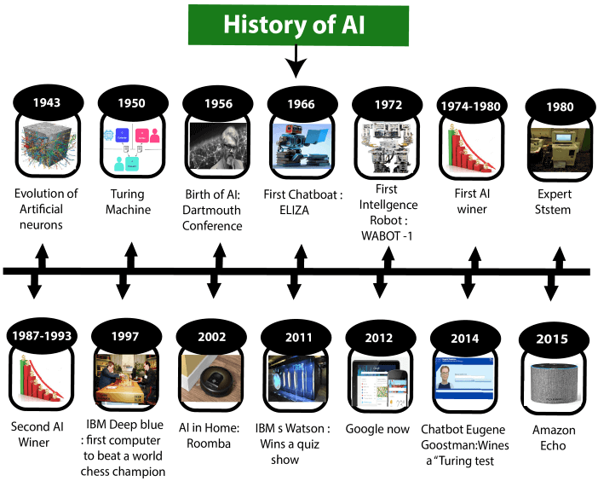

Slide 9
Cont’d
Year | Description
1956 | The term “artificial intelligence” is coined by John McCharty at a Dartmouth conference and AI is founded as an academic discipline
1956–1974 | The golden years of AI enjoy government funding in promising, logic-based problem-solving approaches.
1974–1980 | Overly high expectations coupled with the limited capacities of AI programs leads to the first “AI winter”, with reduced funding and interest in AI research.
1980–1987 | The rise of knowledge-based expert systems brings new successes and a change in the focus of research and funding toward this form of AI.
1987–1993 | The second “AI winter” starts with the sudden collapse of the specialized hardware industry in 1987. The AI hype brings with it negative perceptions by governments and investors, as expert systems show their limitations and prove expensive to update and maintain.

Slide 10
Cont’d
1993–2011 | Optimism about AI returns and increases. New successes are marked with the help of increased computational power and AI becomes data-driven.
 | In 1997, IBM’s DeepBlue beats world champion Gary Kasparov at chess.
 | In 2002, Amazon uses automated systems to provide recommendations.
 | In 2011, Apple releases Siri and IBM Watson beats two human champions at the TV quiz Jeopardy.
2012–today | Increased availability of data, connectedness and computational power allow for breakthroughs in machine learning, mainly in neural networks and deep learning, heralding a new era of increased funding and optimism about the AI potential.
 | In 2012, Google driverless cars navigate autonomously and in 2016 Google AlphaGo beats a world champion in the complicated board game Go.

Slide 11
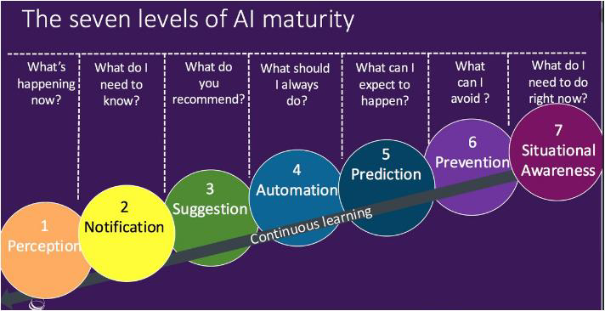

Slide 12
Types of Artificial Intelligence(AI)
Based on the level of intelligence embedded into a machine AI is divided into three.
Artificial Narrow Intelligence (Weak AI or Narrow AI
Artificial General Intelligence (General AI or Strong AI)
Artificial Super Intelligence (Super AI)

Slide 13
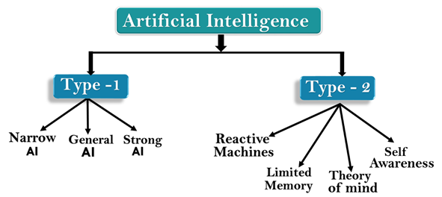

Slide 14
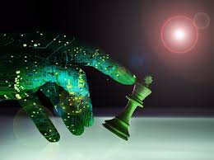
Cont’d
1. Artificial Narrow Intelligence (Weak AI or Narrow AI)
  A type of AI which is able to perform a dedicated task with intelligence.
  The most common and currently available.
  It is only trained for one specific task, cannot perform beyond its field or limitations
  Example of narrow AI
  Playing chess,
  Purchasing suggestions on e-commerce site,
  Self-driving cars,
  Speech recognition, and
  Image recognition.

Slide 15
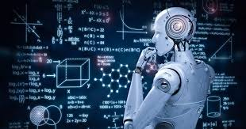
Cont’d
2. Artificial General Intelligence (General AI or Strong AI)
  a type of intelligence which could perform any intellectual task with efficiency like a human.
  The idea is to make a system which could be smarter and think like a human by its own.
  General AI systems are still under research.

Slide 16
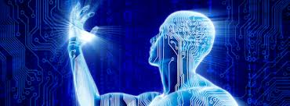
Cont’d
3. Artificial Super Intelligence (Super AI)
  a level of Intelligence of Systems at which machines could surpass human intelligence, and can perform any task better than human with cognitive properties.
  an outcome of general AI.
  Characteristics of strong AI include the ability to think, to reason, solve the puzzle, make judgments, plan, learn, and communicate by its own.
  Development of such systems in real is still world changing task.

Slide 17
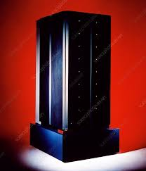
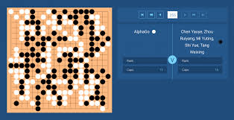
Cont’d
Based on capabilities
  Reactive Machines: Purely reactive machines are the most basic types of Artificial Intelligence. Such AI systems do not store memories or past experiences for future actions. These machines only focus on current scenarios and react on it as per possible best action.
  IBM's Deep Blue system and Google’s AlphaGo is an example of reactive machines.
IBM Deep Blue Super Computer
Google Alpha Go

Slide 18
Cont’d
  2. Limited Memory: Limited memory machines can store past experiences or some data for a short period of time. These machines can use stored data for a limited time period only.
  Self-driving cars are one of the best examples of Limited Memory systems. These cars can store recent speed of nearby cars, the distance of other cars, speed limit, and other information to navigate the road.

Slide 19
Cont’d
  3. Theory of Mind: Theory of Mind AI should understand the human emotions, people, beliefs, and be able to interact socially like humans. This type of AI machines are still not developed, but researchers are making lots of efforts and improvement for developing such AI machines.
  Sophia – the humanoid robot is one example of such effort where a number of young Ethiopians have contributed on the development.[

Slide 20
Cont’d
  4. Self–Awareness: Self-awareness AI is the future of Artificial Intelligence. These machines will be super intelligent, and will have their own consciousness, sentiments, and self-awareness. These machines will be smarter than human mind.
  Self-Awareness AI does not exist in reality still and it is a hypothetical concept.

Slide 21
  Applications of AI
Currently, AI is being applied across several industries. But we cannot say that AI is replacing humans but it is certainly making the work of human beings more efficient.
Agriculture
AI technologies are being used to yield healthier crops, control pests, monitor soil and growing conditions, organize data for farmers, help with workload, and improve a wide range of agriculture-related tasks in the entire food supply chain.

Slide 22

Cont’d
  Agricultural Robots
Companies are developing and programming autonomous robots to handle essential agricultural tasks such as harvesting crops at a higher volume and faster pace than human laborers.
Examples of AI applications in the agriculture sector.
  See & Spray Robot
  Harvest CROO Robotics
  Crop and Soil Monitoring

Slide 23

Cont’d
2. Health
AI applications are revolutionizing how the health sector works to reduce spending and improve patient outcomes.
Companies are applying machine learning to make better and faster diagnoses than humans.
  One of the best known healthcare technologies is IBM Watson.
  Other AI applications include chatbots.

Slide 24
Cont’d
Personal Health Virtual Assistant
Examples of AI applications in the health sector.
  Dip.io
  Apple Watch
  Medical Imaging Analysis
  IBM Watson analysis
  IDx software
  Precision Medicine
  Healthcare Bots
  Operational applications of AI

Slide 25
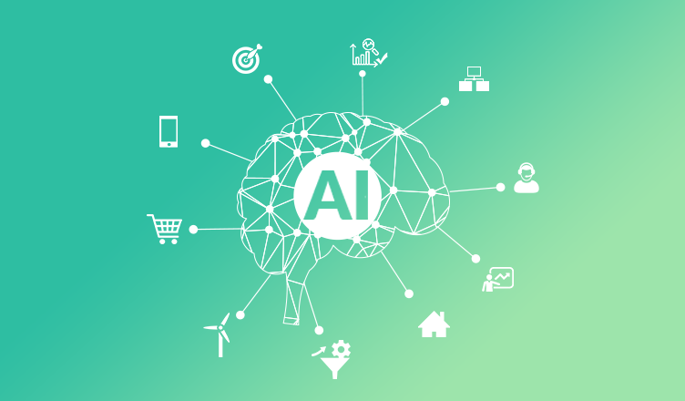
Cont’d
3. Business (Emerging market)
Artificial Intelligence has enormous potential to augment human intelligence and to radically alter how we access products and services, gather information, make products, and interact.
In emerging markets, AI offers an opportunity to lower costs and barriers to entry for businesses and deliver innovative business models that can leapfrog traditional solutions and reach the underserved.

Slide 26
Cont’d
Examples of AI applications in the Business sector.
Improve Customer Services
Automate Workloads
Optimize Logistics
Increase Manufacturing Output and Efficiency
Prevent Outages
Predict Performance
Predict Behavior
Manage and Analyze Data
Improve Marketing and Advertising

Slide 27
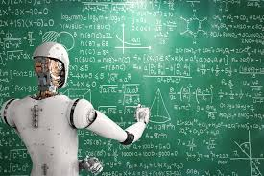
Cont’d
4. Education
The increasing adoption of the AI technology for various applications in the education sector.
AI can automate grading, giving educators more time, and can also assess students and adapt to their needs, helping them work at their own pace. AI tutors can provide additional support to students, ensuring they stay on track.

Slide 28
Cont’d
Examples of AI applications in the Education sector.
Administrative Tasks Automation
Smart Content
Smart Tutors and Personalization
Virtual Lectures and Learning Environment
Teachers’ Support
Students’ Communication

