Slide 1
Chapter Four
Internet of Things(IoT)

Slide 2
Learning outcomes
After completing this lesson you should be able to
Understand the idea of IoT
List advantages and challenges of IoT
Explain How IoT works
List the application of IoT Across different Application Domains
List IoT Tools and Application Development Platforms

Slide 3
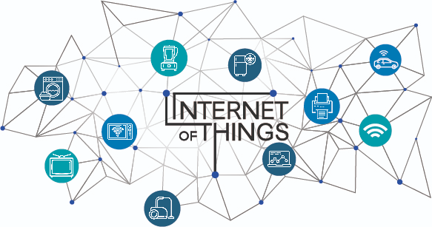
Overview of IoT
Internet of Things (IoT) is a network of devices which can sense, accumulate and transfer data over the internet without any human intervention.
IoT= Services + Data + Networks + Sensors
A thing in the internet of things can be
natural or man-made object
assigned a Unique IP address
able to transfer data over a network

Slide 4
Overview of IoT
According to the Gartner report, by 2020 connected devices across all technologies will reach 20.6 billion.
And by 2025, we will have 41.6 billion connected IoT devices
The number of IoT devices surpassed the global human population in 2010.

Slide 5
Definition from International Bodies
Internet Architecture Board (IAB): The networking of smart objects, meaning a huge number of devices intelligently communicating in the presence of internet protocol that cannot be directly operated by human beings but exist as components in buildings, vehicles or the environment
Internet Engineering Task Force (IETF): The networking of smart objects in which smart objects have some constraints such as limited bandwidth, power, and processing accessibility for achieving interoperability among smart objects

Slide 6
Definition from International Bodies
IEEE Communications: A framework of all things that have a representation in the presence of the internet in such a way that new applications and services enable the interaction in the physical and virtual world in the form of Machine-to-Machine (M2M) communication in the cloud

Slide 7
What IoT Include
IoT includes many different systems, including
Internet-connected cars
wearable devices including health and fitness monitoring devices, watches, and even human implanted devices;
Smartphones, smart meters and smart objects;
home automation systems and lighting controls;
wireless sensor networks that measure weather, flood defenses, tides and more

Slide 8
IoT Enablers
The IoT four key technological enablers are: -
RFID technology used for tagging the things
Sensor technology used for sensing the things
Smart technology used for thinking the things
Nanotechnology used for shrinking the things
Communication technologies: Wireless sensor networks, sensor networks , 2G/3G/4G,GSM,GPRS,RFID, WI-FI, GPS, etc.

Slide 9
Components of IoT
There are four main components of an IoT system
The Thing itself (that is, the device)
The local network (this can include a gateway, which translates proprietary communication protocols to Internet Protocol).
The Internet ( the Global Network)
Back-end services (enterprise data systems, or PCs and mobile devices).

Slide 10
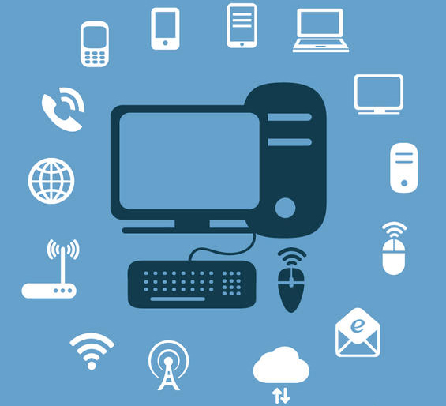
Communication Mode in IoT
Communication between devices and the Internet or to a gateway includes many different models
Direct Ethernet or Wi-Fi connectivity using TCP or UDP
Bluetooth Low Energy(BLE)
Near Field Communication (NFC)
Zigbee or other mesh radio networks
SRF and point-to-point radio links
UART or serial lines

Slide 11
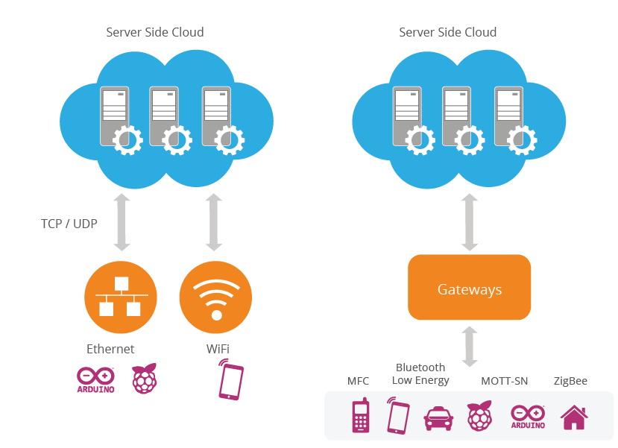
Two major modes of connectivity

Slide 12
IoT network requirements
The ability to connect large numbers of heterogeneous IoT elements
High reliability
Real-time awareness with low latency
Ability to secure all traffic flows
Programmability for application customization
Traffic monitoring and management at the device level
Low-cost connectivity for a large number of devices/sensors

Slide 13
History of IoT
The term “The Internet of Things” (IoT) was coined by Kevin Ashton in a presentation to Proctor & Gamble in 1999.
He is a co-founder of MIT’s Auto-ID Lab.
He pioneered RFID (used in bar code detector) for the supply-chain management domain.

Slide 14
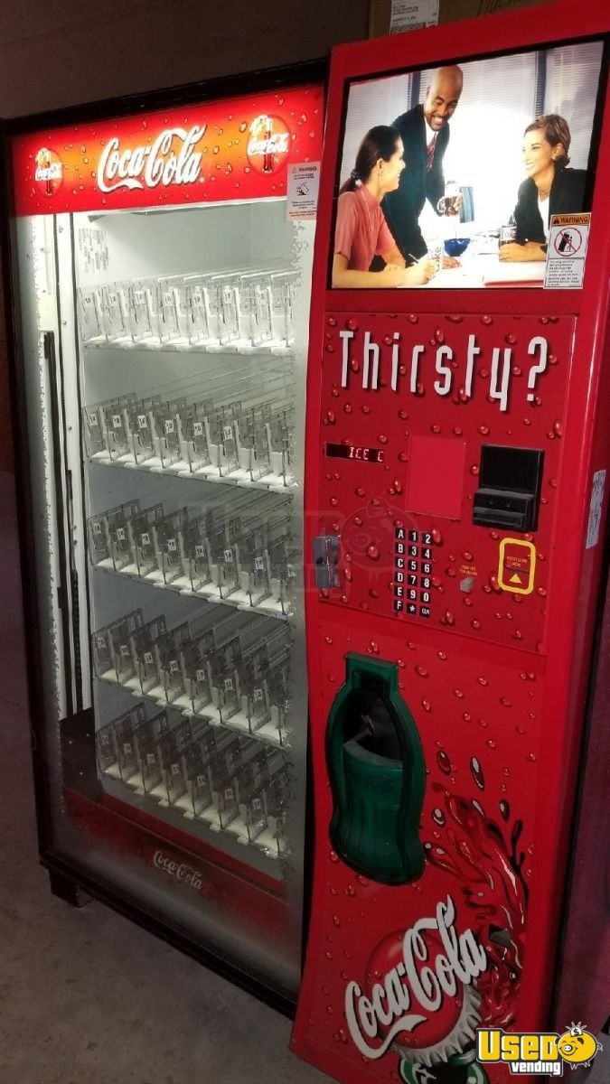
History of IoT
The first internet appliance, for example, was a Coke vending machine at Carnegie Mellon University in the early 1980s.
Using the web, programmers has determined whether there is cold drink or not

Slide 15
History of IoT
IoT has evolved from the convergence of
wireless technologies,
microelectromechanical systems (MEMS),
microservices and
the Internet.
The convergence has helped tear down the silos between operational technology (OT) and information technology (IT)
IoT evolved from machine-to-machine (M2M) communication

Slide 16
How does IoT Works
Stage 1 (Sensors/Actuators) : A thing in the context of “Internet of Things”, should be equipped with sensors and actuators thus giving the ability to emit, accept and process signals
Stage 2 (Data Acquisition Systems): The data from the sensors starts in analogue form which needs to be aggregated and converted into digital streams for further processing.
This stage performs these data aggregation and conversion functions

Slide 17
How does IoT Works
Stage 3 (Edge Analytics): Once IoT data has been digitized and aggregated, it may require further processing before it enters the data center, this is where Edge Analytics comes in
Stage 4 (Cloud Analytics):
Data that needs more in-depth processing gets forwarded to physical data centers or cloud-based systems.

Slide 18
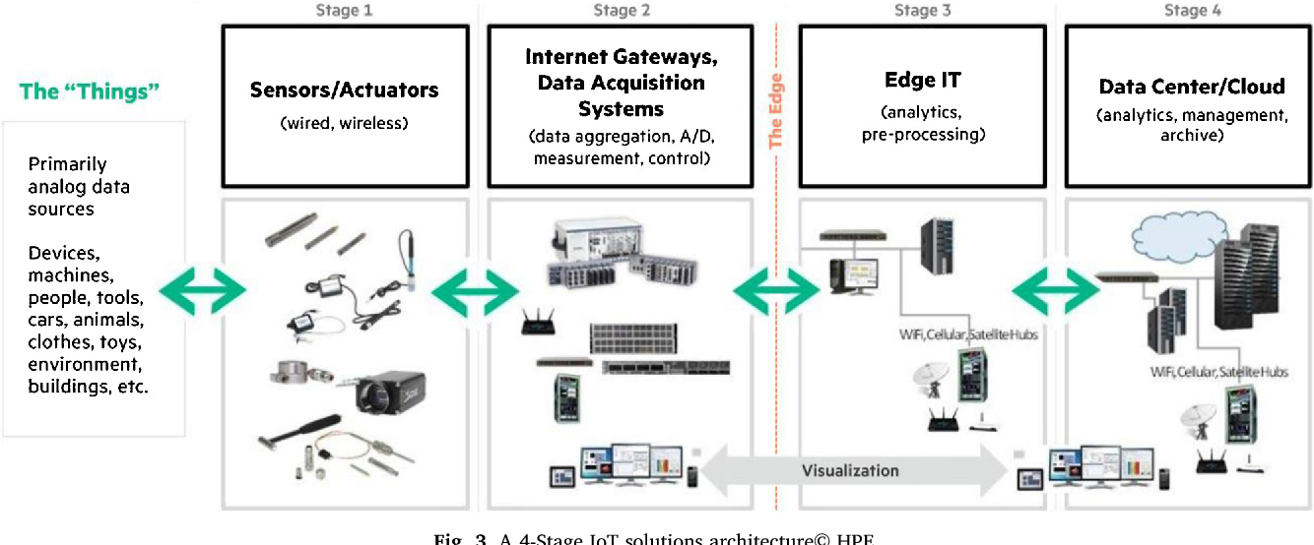
How does IoT Works

Slide 19
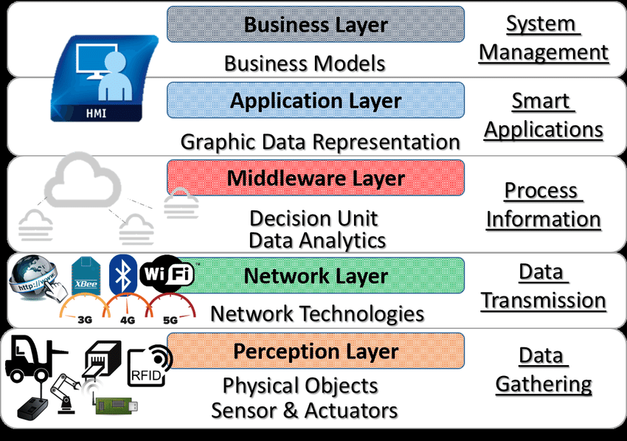
How does IoT Works(Layered Architecture)

Slide 20
Why is IoT important?
Touches every industry, including healthcare, finance, retail, and manufacturing
Helps people live and work smarter
Smart homes, smart, cities, smart kitchen…
Smart cities help citizens reduce waste and energy consumption

Slide 21
Why is IoT important?
Provides businesses with a real-time look into how their companies’ systems really work
Delivering insights into everything from the performance of machines to supply chain and logistics operations
Connected sensors are even used in farming to help monitor crop and cattle yields and predict growth patterns

Slide 22
IoT Across Application Domains
There are numerous real-world applications of the internet of things
Consumer IoT and Enterprise IoT
Manufacturing and Industrial IoT

Slide 23
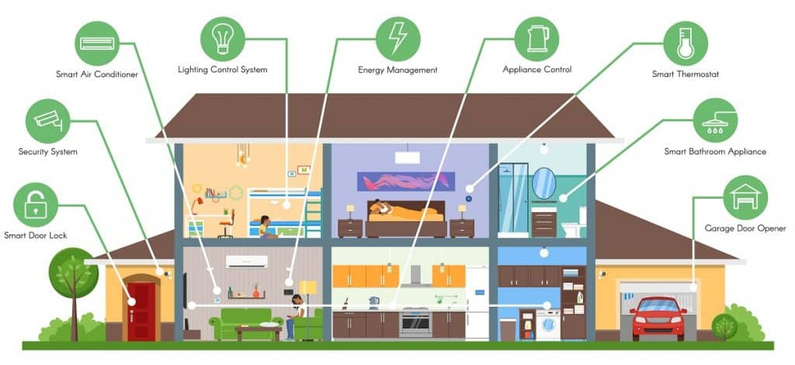
IoT Applications - Smart Homes

Slide 24
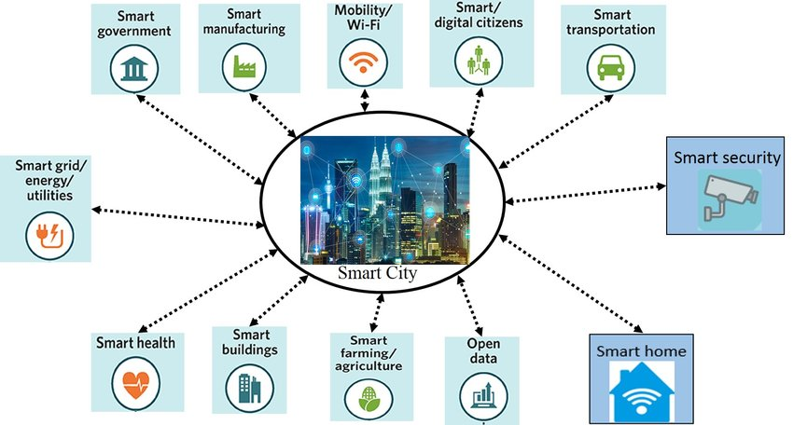
IoT Applications - Smart City

Slide 25
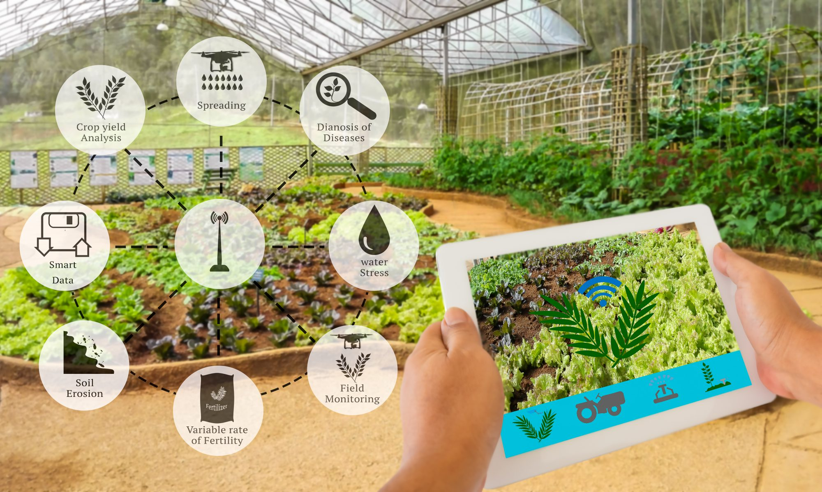
IoT Applications - Smart Farming

Slide 26
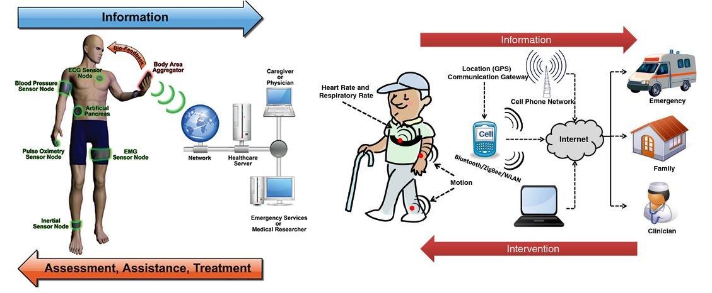
IoT Applications - Health Care

Slide 27
IoT Tools and Application Development Platforms
Cloud IoT Tools : Google Cloud IoT, Microsoft Azure IoT Suite, SAP, Salesforce IoT, Oracle Internet of Things, Cisco IoT Cloud Connect, Bosch IoT Suite, IBM Watson Internet of Things, ThingWorx IoT Platform, Huawei Cloud Core
IoT Development Platforms: Tessel 2, Eclipse IoT, Arduino, PlatformIO, Kimono Create, IBM Watson, Raspbian (Raspberry Pi), OpenSCADA, Node-RED, Device Hive

Slide 28
Key IoT Challenges
Privacy and Security ( refer to the security issues at different Layers of IOT)
Trust and quality of-information in shared information models
Secure exchange of data between IoT devices and consumers of their information
Protection mechanisms for vulnerable devices
Cost versus Usability: reduction in cost of devices and mechanism to use devices is expected

Slide 29
Key IoT Challenges
Interoperability : With numerous sources of data and heterogeneous devices, the use of standard interfaces between these diverse entities becomes important
Data Management: the volume of the generated data and the processes involved in the handling of those data become critical
Device Energy Consumption Level : How to interconnect “things” in an interoperable way while taking into account the energy constraints
Communication between devices takes the most energy

Slide 30
Pros and Cons of IoT
Advantage
Improved(active) Customer Engagement
Technology Optimization
Reduced Waste
Enhanced Data Collection(sensors do that)

Slide 31
Pros and Cons of IoT
Disadvantages
Increased Security Concern( more devices and more info created and shared)
Big Data Management issue( handling huge numbers)
The higher chance of system corruption (if there is a bug in any part of the system)
Device Interoperability( multiple, different device vendors with no accepted standard)

