Slide 1
Chapter Five
Augmented Reality (AR)

Slide 2
Learning outcomes
After completing this lesson you should be able to
Explain augmented reality
Explain the features of augmented reality
Explain the difference between AR, VR, and MR
Explain the architecture of augmented reality systems
Describe the application areas of augmented reality

Slide 3
Overview of AR
The fundamental idea of AR is to combine, or mix, the view of the real environment with additional, virtual content that is presented through computer graphics.
Augmented reality (AR) is a form of emerging technology that allows users to overlay computer-generated content in the real world. AR refers to a live view of a physical real-world environment whose elements are merged with augmented computer-generated images creating a mixed reality.
Augmented reality is the integration of digital information with the user's environment in real-time.

Slide 4
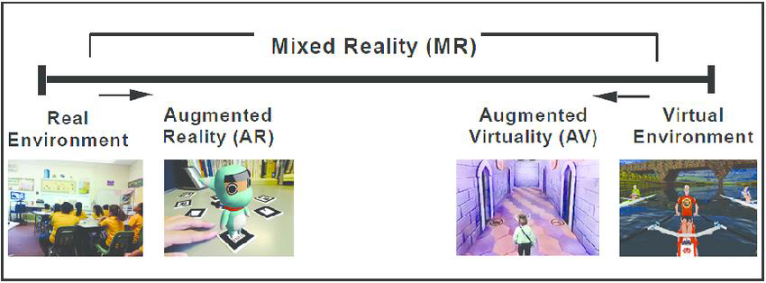
Virtual reality (VR), Augmented Reality (AR) vs Mixed reality (MR) verview of AR

Slide 5
Virtual Reality (VR)
VR is fully immersive, which tricks your senses into thinking you’re in a different environment or world apart from the real world.
Using a head-mounted display (HMD) or headset, you’ll experience a computer-generated world of imagery and sounds in which you can manipulate objects and move around using haptic controllers while tethered to a console or PC.
It is also called a computer-simulated reality.

Slide 6
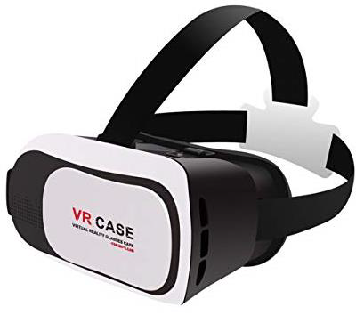
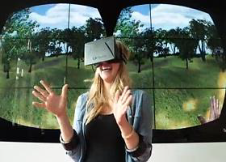
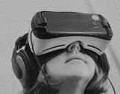
Example of Immersive Technology VR Case that Inserts a Smartphone

Slide 7
Augmented Reality (AR)
In AR, users see and interact with the real world while digital content is added to it. If you own a modern smart phone, you can easily download an AR app and try this technology.
There’s a different way to experience augmented reality, though – with special AR headsets, such as Google Glass, where digital content is displayed on a tiny screen in front of a user’s eye.
AR adds digital elements to a live view often by using the camera on a smart phone. Examples of augmented reality experiences include Snapchat lenses and the game Pokemon Go.

Slide 8
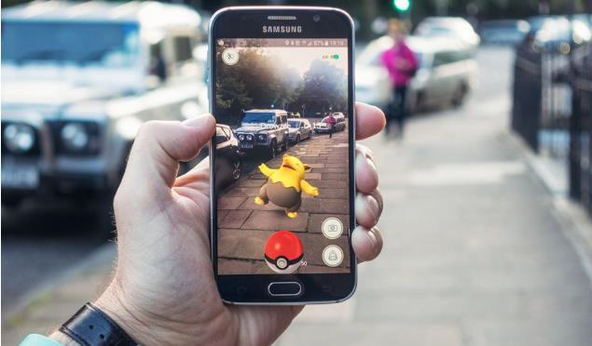
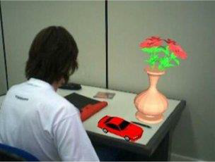
Direct and Indirect Augmentation of Objects

Slide 9
Mixed Reality (MR)
Mixed Reality (MR), sometimes referred to as hybrid reality, is the merging of real and virtual worlds to produce new environments and visualizations where physical and digital objects co-exist and interact in real-time.
In mixed reality, you interact with and manipulate both physical and virtual items and environments, using next-generation sensing and imaging technologies.

Slide 10
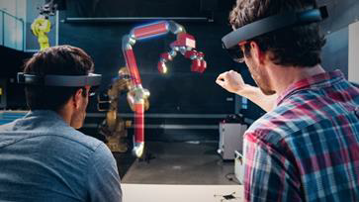
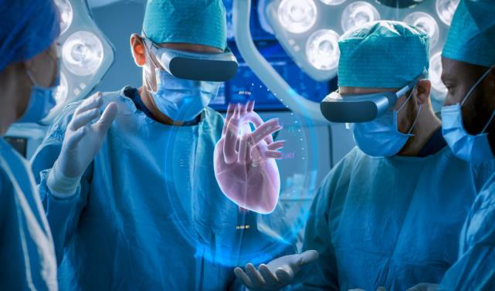
Mixed Reality in Engineering and Medicine

Slide 11

Mixed Reality in Entertainment

Slide 12
The architecture of AR Systems
The first Augmented Reality Systems (ARS) were usually designed with a basis on THREE main blocks:
(1) Infrastructure Tracker Unit
(2) Processing Unit
(3) Visual Unit.
Tracker Unit : Collecting data from the real world, sending them to the Processing Unit .
Processing Unit : Mix up the virtual content with the real content and sent the result to the Video Out module of the Visual Unit .
Visual Unit : Visualize the content.

Slide 13
Contd….
The Visual Unit can be classified into two types of system, depending on the followed visualization technology:
1. Video see-through: It uses a Head-Mounted Display (HMD) that employs a video-mixing and displays the merged images on a closed-view HMD.
2. Optical see-through: It uses an HMD that employs optical combiners to merge the images within an open-view HMD.
HMDs are currently the dominant display technology in the AR field.

Slide 14
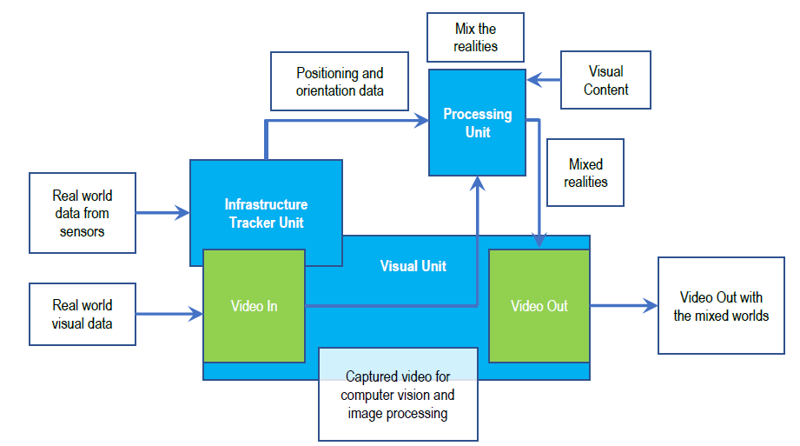
Augmented Reality Systems (ARS) standard architecture

Slide 15
Applications of AR Systems
AR In education :
Affordable learning materials
Posters, digital illustrations, physical models, prototypes are very expensive and impossible for schools to purchase.
AR technology allows for avoiding investments in physical materials.
Interactive lessons
when AR technology is used in classrooms, students can view models on their own smart phones and get a better idea of the concepts they are studying.
That increases engagements and reinforces the learning.

Slide 16
Applications of AR
Higher engagement
when teachers integrate augmented reality into their lectures, they attract the attention of their students and make lessons more effective.
When students are interested, it is much easier to make them work more productively.
Higher retention
Using the AR app, students can get access to augmented models that represent any real objects from a famous monument or work of art to a molecule.
with AR technology, students use different senses and retain more knowledge for a long time.

Slide 17
Applications of AR
Boost intellectual curiosity
Augmented reality makes students more excited about learning certain subjects.
Modern students were born in a digital era so they will always be excited with innovative technologies that can help them learn new ideas and develop their critical thinking skills.

Slide 18
Applications of AR
AR In Medicine :
Describing symptoms
when it was hard to describe to the doctor what was bothering you.
Medical app AyeDecide is using augmented reality to show the simulation of the vision, harmed by the different diseases.
It helps patients to understand their conditions and describe correctly their symptoms.

Slide 19
Applications of AR
Nursing care
About 40% of the first intravenous injections fail, and this ratio is even higher in the case of children and elderly patients.
The AccuVein uses augmented reality to cope with this negative statistic.
Surgery
In no sphere augmented reality does not have such practical application as in the medicine, especially in surgery, where it literally helps to save lives.
Three-dimensional reconstructions of organs or tumors will help surgeons become more efficient at surgery operations.

Slide 20
Applications of AR
Ultrasounds
A few AR software companies developed handy ultrasound scanner, which with the help of smart glasses works as a traditional one.
Diabetes management
In 2017, the number of people struggle with diabetes reached up to 425 million adults worldwide.
In 2014, Google revealed the plans for creating a smart contact lens (Google 92 Contact Lens), in which the main function will be to measure the glucose levels in the tears.

Slide 21
Applications of AR
Navigation
The using AR in navigation apps has already become a “traditional” way.
AR can be useful to provide information about the nearest hospitals.

Slide 22
Applications of AR
AR In Entertainment
AR in games
The AR games were praised for increasing physical activity in people – you actually have to move around to find your target, Ex: Pokémon Go.
AR in music
Augmented reality can providing complete information on the track or its performer including the performers’ bios, the lyrics of the song, the making of the recording or the music video.
.

Slide 23
Applications of AR
AR on TV
One way of integrating augmented reality in television is adding supplementary information to what is going on the TV screen – such as match scores, betting options, and the like.
AR in eSports
Augmented reality turns eSports shows into interactive experiences allowing the watchers to become participants.

Slide 24
Applications of AR
AR in the theater
Augmented reality can serve not only for entertainment purposes but also for the purposes of accessibility.
The possibility to overlay virtual objects over the real environment can be used, for example, for subtitling in various theater shows.
Now, many theaters use LED displays either to provide subtitles for translation or to assist hearing-impaired visitors.

