Slide 1
Addis Ababa University
Addis Ababa institute of Technology
SECE
By Teshome.H
Dec, 2018

Slide 2
Addis Ababa institute of Technology
School of electrical and computer engineering
Induction motor drives
3. Introduction,
AC electric motors are generally:
    more compact,
    have better efficiency than their DC counterparts.
Moreover; they are supplied from commercially available AC power while for DC motors, the AC must be converted to DC at point of use.

Slide 3
Cont’d…
Conventional AC machines are:
    either synchronous machines or
    asynchronous (induction) machines
Both machines have stator with armature winding and rotor with field winding.

Slide 4
However;
  there are permanent magnet synchronous motors which don’t have winding on the rotor;
  instead the required field winding coming from the permanent magnets.
  In asynchronous (induction) machines, power is supplied only to the armature circuit;
      the rotor circuit is excited through induction.
Cont’d…

Slide 5
Cont’d…
On the other hand for non permanent magnet synchronous motors,
      the excitation is generally from separate DC power supply.
What makes induction motors the most used in industry?
  average torque at zero speed,
  single power supply requirement and maintenance free operation

Slide 6
Induction motor types:
  Squirrel cage type:
    Rotor winding is composed of copper bars embedded in the rotor slots and shorted at both end by end rings
    Simple, low cost, robust, low maintenance

Slide 7
  Wound rotor type:
    Rotor winding is wound by wires. The winding terminals can be connected to external circuits through slip rings and brushes.
    Easy to control speed, more expensive.

Slide 8
3.1. Induction motor equivalent circuit and the torque-speed curve
The equivalent circuit development can be seen in two steps.
  The first step is looking the rotor not to rotate so that the induction machine is like a transformer with air-gap in the magnetic circuit.
  The second step is allowing the rotor to rotate.

Slide 9
Locked Rotor (Rotor does not rotate)
If the rotor of an induction motor is locked (not to rotate),
  its equivalent circuit is similar to that of a three phase balanced transformer as shown in figure 1.

Slide 10
Cont’d………
Fig. 1 Induction motor equivalent circuit when rotor is locked with rotor circuit referred to stator

Slide 11
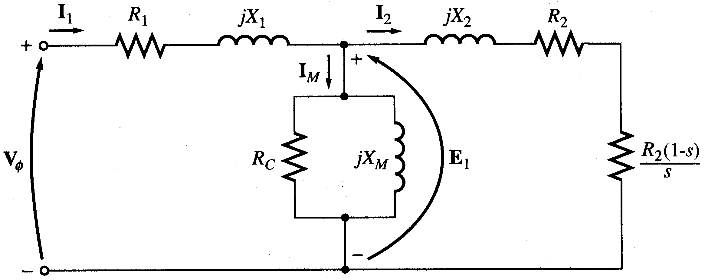
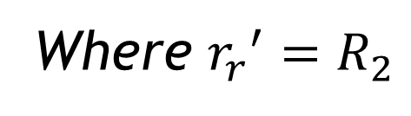
Where ${r_{r}}^{′}=R_{2}$
Resistance equivalent to mechanical load
Actual rotor resistance

Slide 12
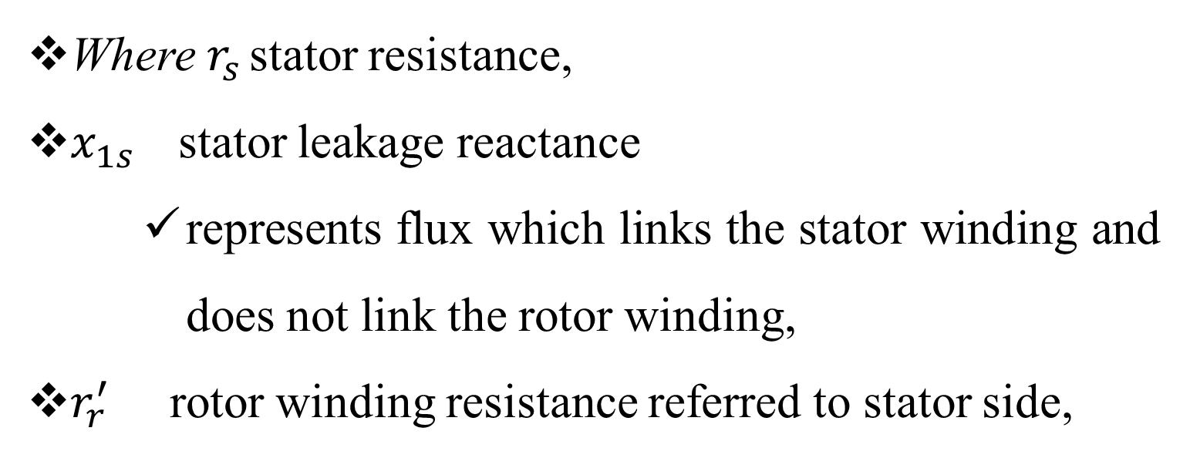
Cont’d…
Where $r_{s }$stator resistance,
$x_{1s }$ stator leakage reactance
    represents flux which links the stator winding and does not link the rotor winding,
$r_{r}^{′}$ rotor winding resistance referred to stator side,

Slide 13
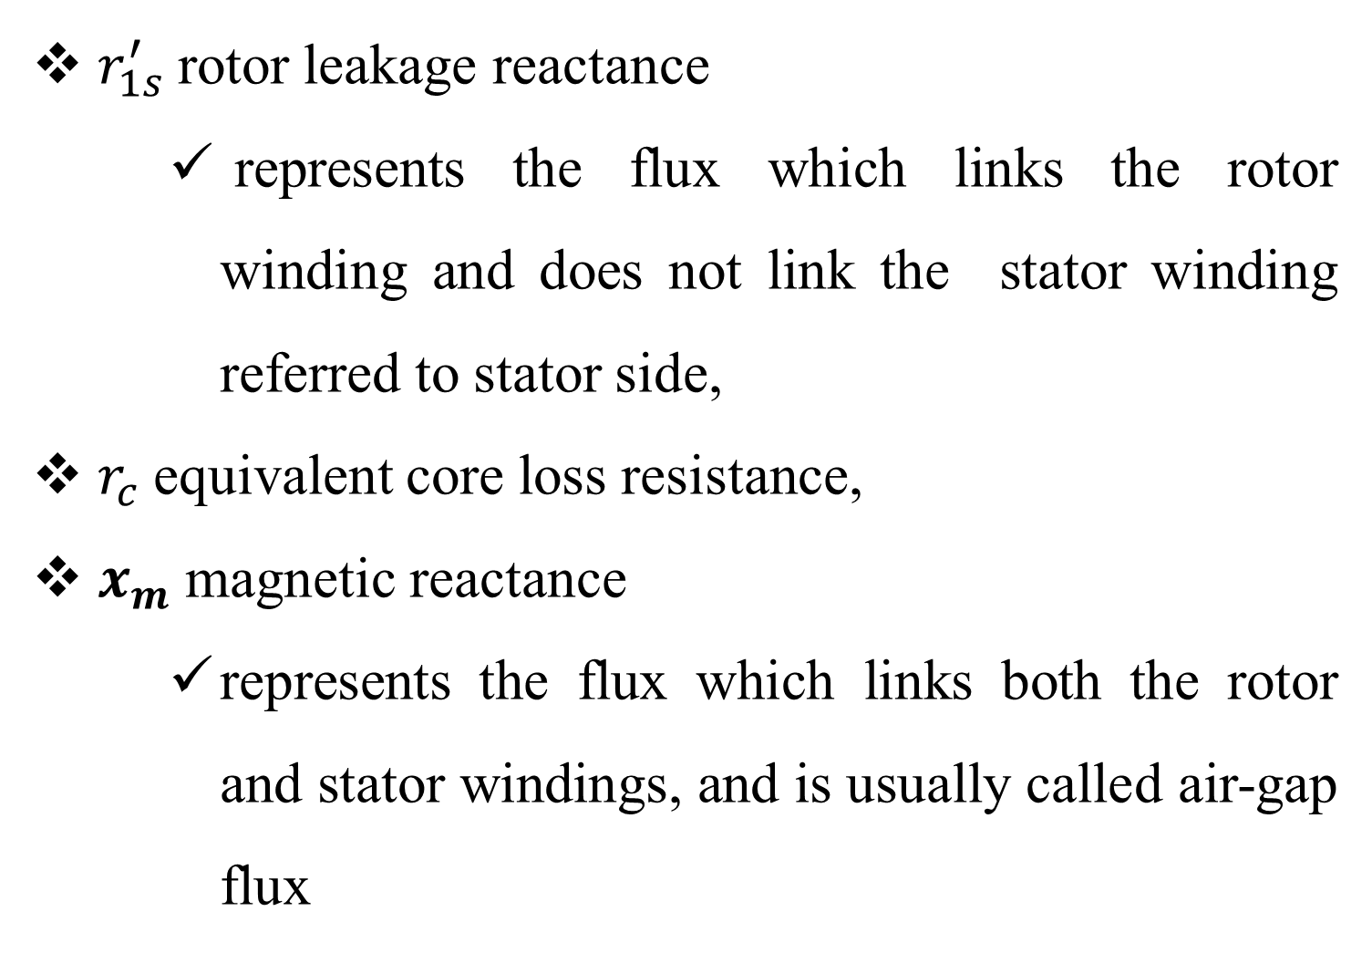
$r_{1s}^{′}$ rotor leakage reactance
    represents the flux which links the rotor winding and does not link the stator winding referred to stator side,
$r_{c}$ equivalent core loss resistance,
$x_{m}$ magnetic reactance
    represents the flux which links both the rotor and stator windings, and is usually called air-gap flux

Slide 14
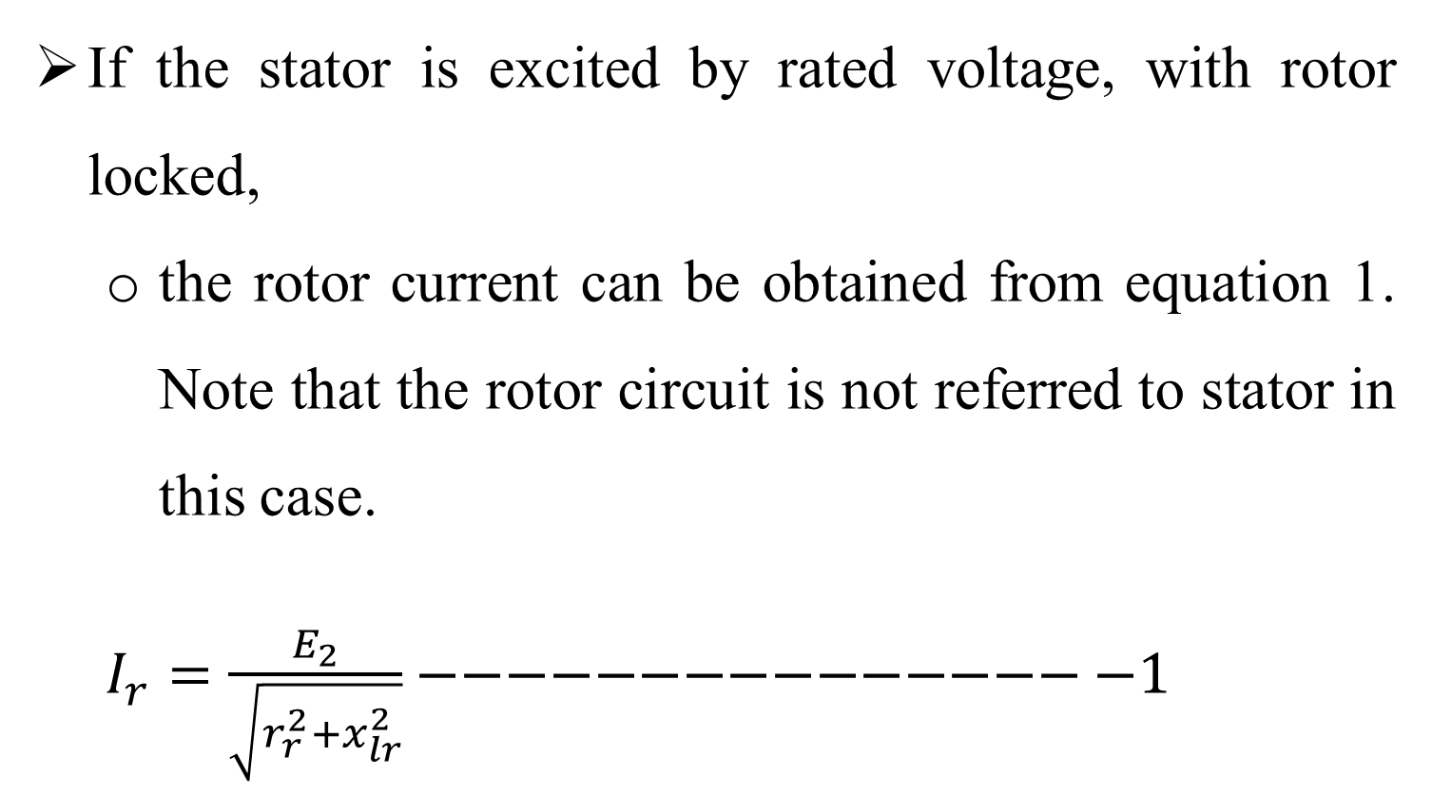

$V_{s}$ stator terminal phase voltage.
If the stator is excited by rated voltage, with rotor locked,
  the rotor current can be obtained from equation 1. Note that the rotor circuit is not referred to stator in this case.
  $I_{r}=\frac{E_{2}}{\sqrt{r_{r}^{2}+x_{lr}^{2}}}−−−−−−−−−−−−−−−−1$

Slide 15

Cont………
This is result from the vector summation of :
$$E_{2}=r_{r}+jx_{lr}$$
Where E₂ is induced e.m.f. in rotor,
    I_{r} is rotor current,
    r_{r} rotor winding resistance,
    x_{lr} is rotor leakage inductance.

Slide 16
Cont’d………
The rotor circuit parameters and variables can be referred to stator circuit as shown in figure 1b.
    The referred rotor current can also be expressed as in equation 1.
    The apostrophe indicating referred parameters to stator circuit (functions of turn’s ratio between stator and rotor)

Slide 17
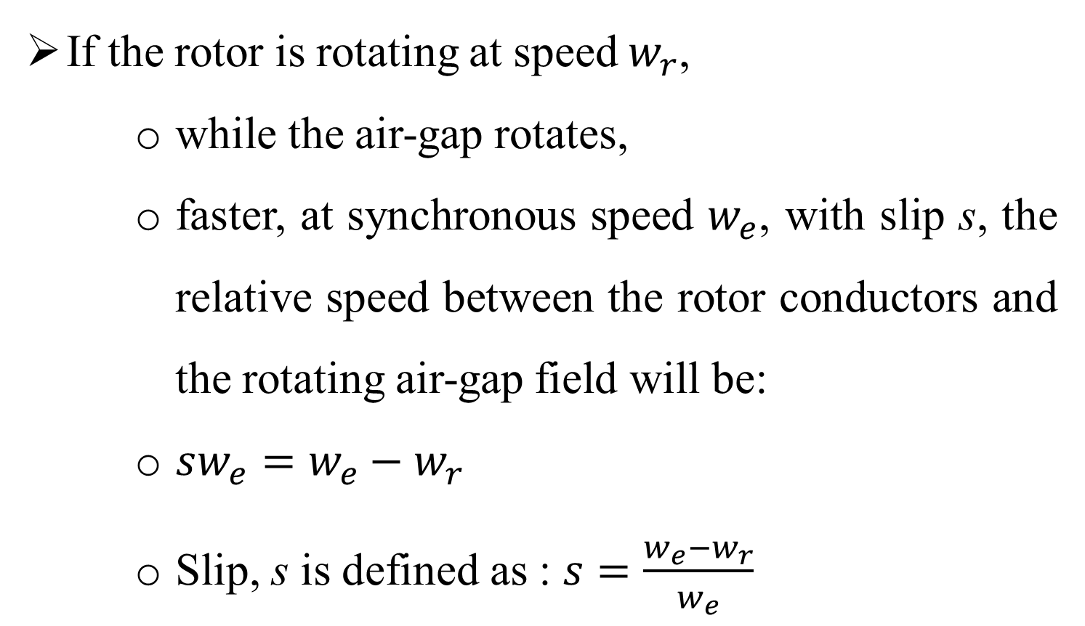
Rotor Rotating With Slip s
If the rotor is rotating at speed $w_{r}$,
    while the air-gap rotates,
    faster, at synchronous speed $w_{e}$, with slip s, the relative speed between the rotor conductors and the rotating air-gap field will be:
    $sw_{e}=w_{e}−w_{r}$
    Slip, s is defined as : $s=\frac{w_{e}−w_{r}}{w_{e}}$

Slide 18
Therefore, there will be induced voltage in the rotor winding whose frequency is only sf Hz,
    Hence, the induced voltage in the rotor will be sE₂ while the reactance is sx_{lr}.
  Equation 2, then, can be used to calculate rotor current assuming the induced voltage and reactance equal to the ones when the rotor is at stand still (similar to transformer), and only the rotor resistance changing with slip s.

Slide 19
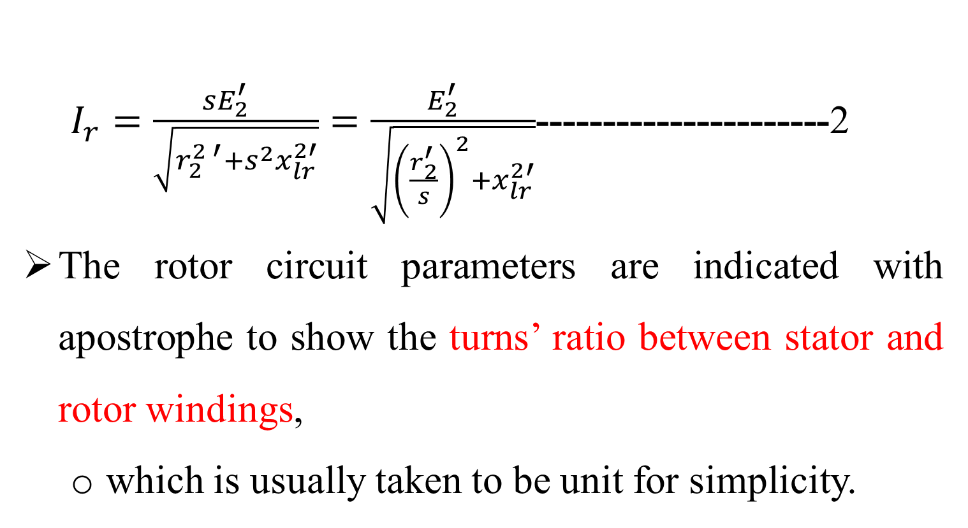
Cont………
  $I_{r}=\frac{sE_{2}^{′} }{\sqrt{r_{2}^{2 ′}+s^{2}x_{lr}^{2′}}}=\frac{E_{2}^{′} }{\sqrt{{\left(\frac{r_{2}^{′}}{s}\right)}^{2}+x_{lr}^{2′}}}$----------------------2
The rotor circuit parameters are indicated with apostrophe to show the turns’ ratio between stator and rotor windings,
  which is usually taken to be unit for simplicity.

Slide 20
Figure 2 Induction motor equivalent circuit when rotor is rotating at slip s

Slide 21
Cont’d…
Equivalent circuit of figure 2 can be approximated by figure 3:
  if the voltage drop across stator winding resistance is neglected.
Institute of Electrical and Electronics Engineers
Figure 3 Approximate (IEEE) equivalent circuit of
induction motor

Slide 22
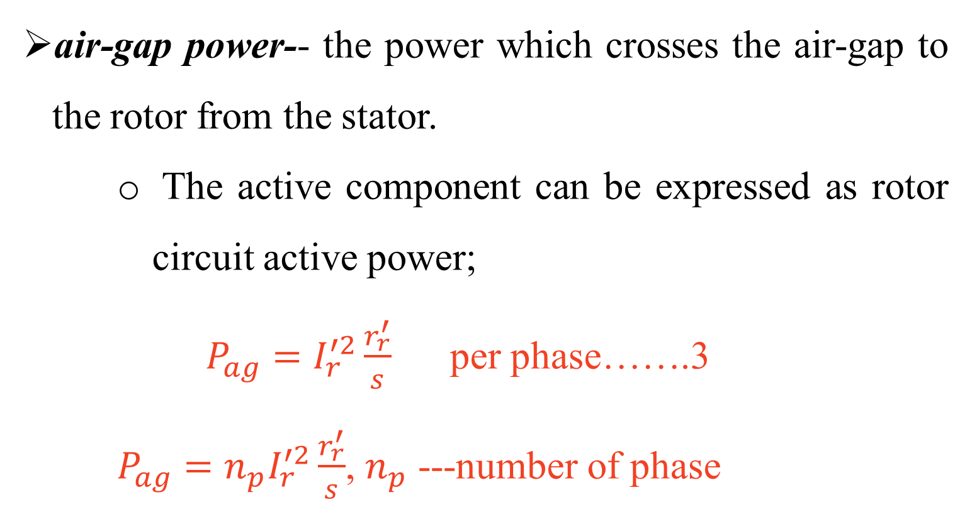
Power Flow in induction motor
air-gap power-- the power which crosses the air-gap to the rotor from the stator.
    The active component can be expressed as rotor circuit active power;
    $P_{ag}=I_{r}^{′2}\frac{r_{r}^{′}}{s}$ per phase…….3
    $P_{ag}=n_{p}I_{r}^{′2}\frac{r_{r}^{′}}{s}$, $n_{p}$ ---number of phase

Slide 23
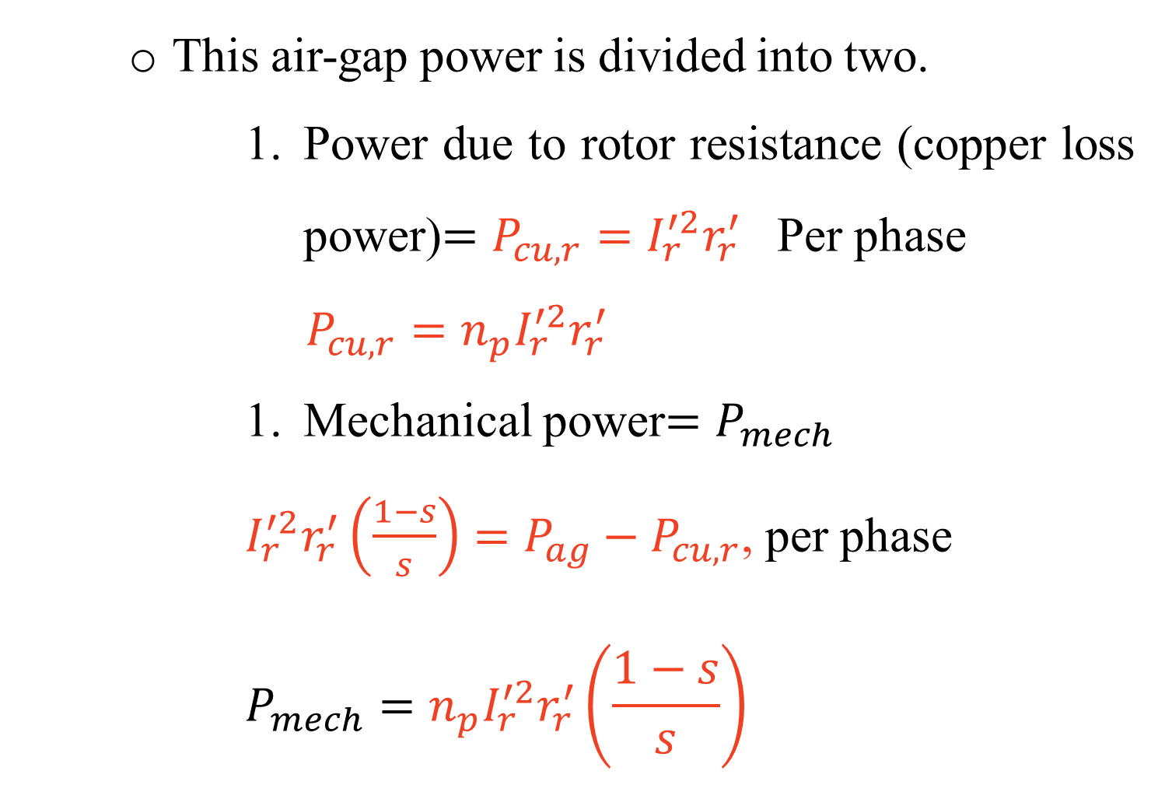
    This air-gap power is divided into two.
        Power due to rotor resistance (copper loss power)$=P_{cu,r}=I_{r}^{′2}r_{r}^{′}$ Per phase
        $$P_{cu,r}=n_{p}I_{r}^{′2}r_{r}^{′}$$
        Mechanical power$=P_{mech}$
        $I_{r}^{′2}r_{r}^{′}\left(\frac{1−s}{s}\right)=P_{ag}−P_{cu,r}$, per phase
        $$P_{mech}={n_{p}I}_{r}^{′2}r_{r}^{′}\left(\frac{1−s}{s}\right)$$

Slide 24
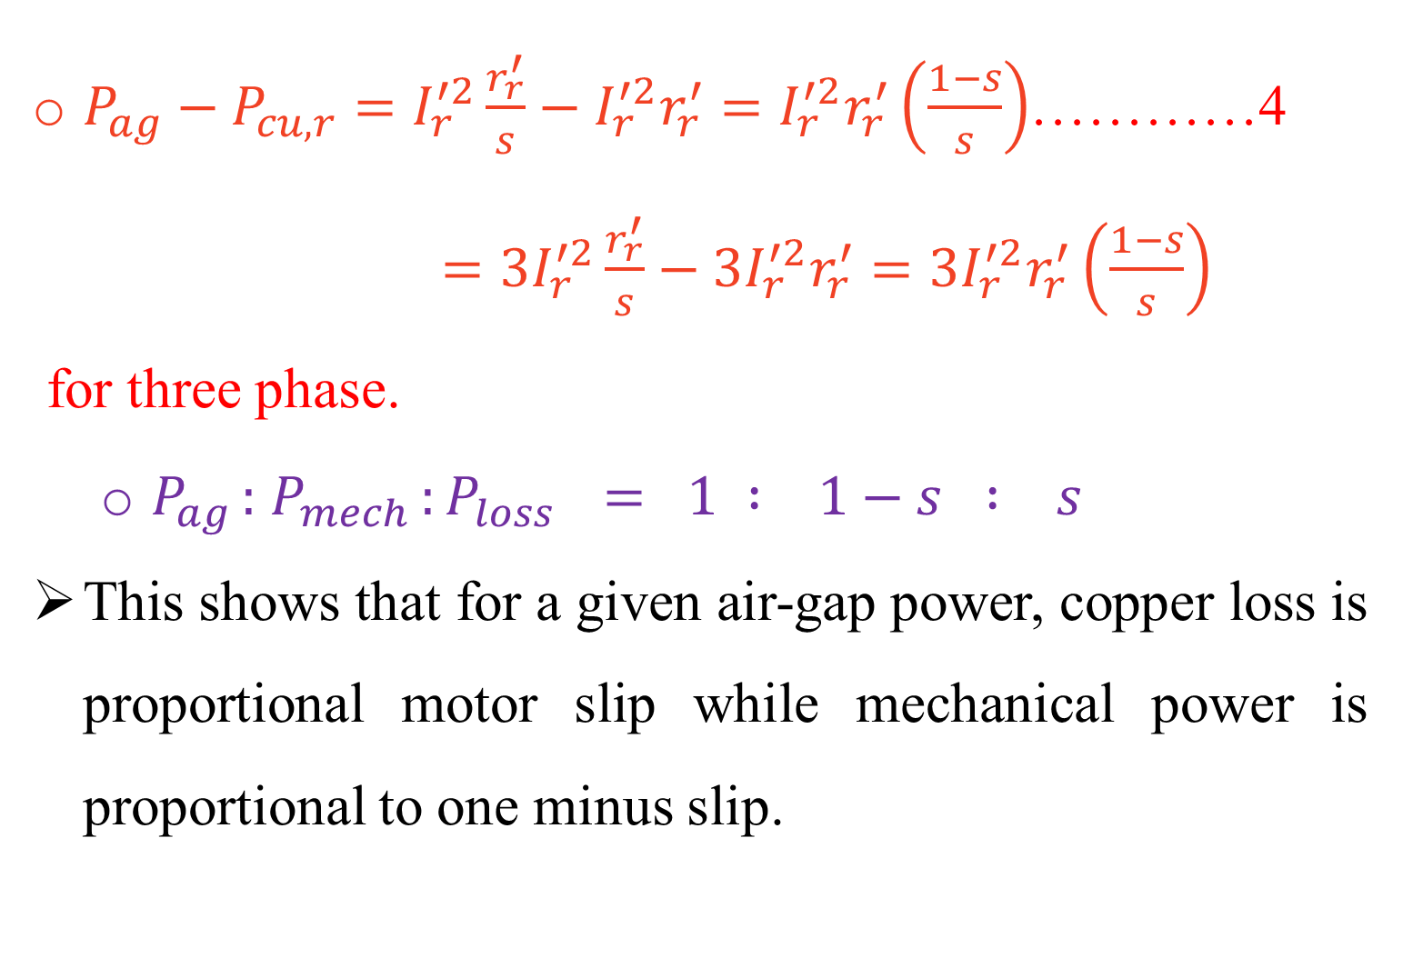
$P_{ag}−P_{cu,r}=I_{r}^{′2}\frac{r_{r}^{′}}{s}−I_{r}^{′2}r_{r}^{′}=I_{r}^{′2}r_{r}^{′}\left(\frac{1−s}{s}\right)$…………4
$=3I_{r}^{′2}\frac{r_{r}^{′}}{s}−{3I}_{r}^{′2}r_{r}^{′}=3I_{r}^{′2}r_{r}^{′}\left(\frac{1−s}{s}\right)$
for three phase.
  $P_{ag }:$ $P_{mech }:P_{loss } = 1 : 1−s : s$
This shows that for a given air-gap power, copper loss is proportional motor slip while mechanical power is proportional to one minus slip.

Slide 25
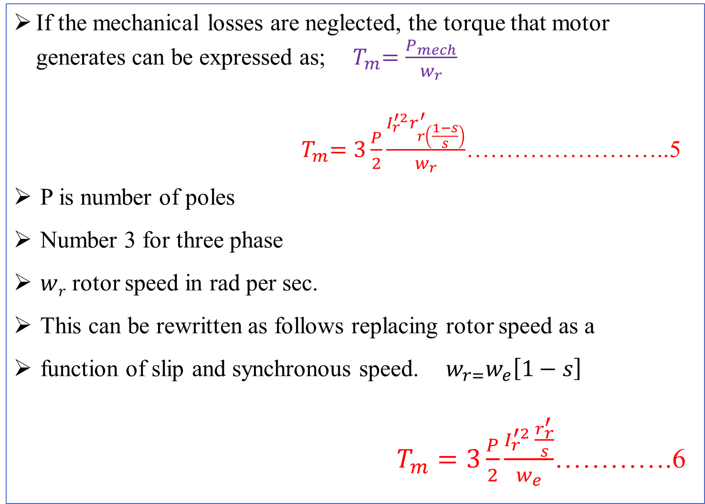
mechanical power = output shaft power + mechanical windage and frictional losses.
If the mechanical losses are neglected, the torque that motor generates can be expressed as; ${ T}_{m}=\frac{P_{mech}}{w_{r}}$
${ T}_{m}=3\frac{P}{2}\frac{I_{r}^{′2}r_{r\left(\frac{1−s}{s}\right)}^{′}}{w_{r}}$……………………..5
P is number of poles
Number 3 for three phase
$w﷮r$ rotor speed in rad per sec.
This can be rewritten as follows replacing rotor speed as a
function of slip and synchronous speed. $w_{r=}w_{e}\left[1−s\right]$
$T_{m}=3\frac{P}{2}\frac{I_{r}^{′2 }\frac{r_{r}^{′}}{s}}{w_{e}}$………….6

Slide 26
The torque-speed characteristics of a balanced three-phase induction motor can be derived from the equivalent circuit of the motor replacing the rotor current in equation 6 in terms of terminal voltage.
Consider the simplified equivalent circuit given in Fig. 3 for rotor current estimation
The phase voltage can be written as equation 7, from the simplified equivalent circuit neglecting the magnetization current.

Slide 27
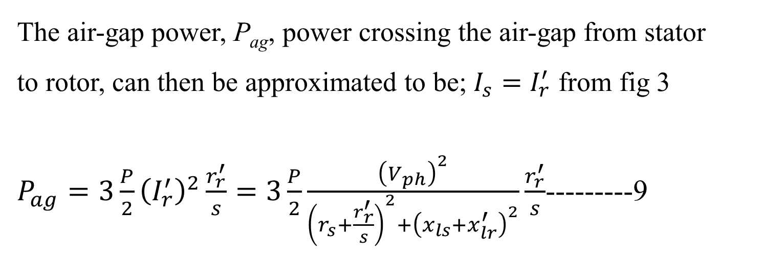
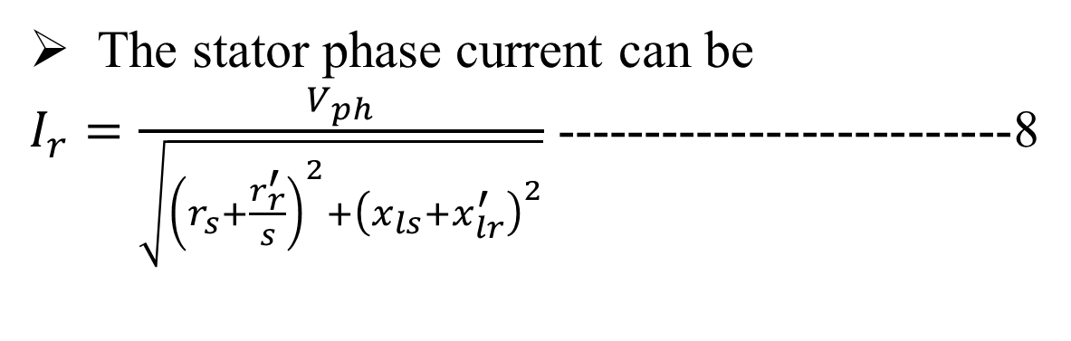

$$V_{ph}=(r_{s}I_{s}+\frac{r_{r}^{′}}{s}I_{s})+j{(x}_{ls}I_{s}+x_{lr}^{′})−−−−−7$$
The stator phase current can be
$I_{r}=\frac{V_{ph}}{\sqrt{{\left(r_{s}+\frac{r_{r}^{′}}{s}\right)}^{2}+{\left(x_{ls}+x_{lr}^{′}\right)}^{2}}}$ --------------------------8
The air-gap power, P_{ag}, power crossing the air-gap from stator
to rotor, can then be approximated to be; $I_{s}=I_{r}^{′}$ from fig 3
$P_{ag}=3\frac{P}{2}{\left(I_{r}^{′}\right)}^{2}\frac{r_{r}^{′}}{s}=3\frac{P}{2}\frac{{\left(V_{ph}\right)}^{2}}{{\left(r_{s}+\frac{r_{r}^{′}}{s}\right)}^{2}+{\left(x_{ls}+x_{lr}^{′}\right)}^{2}}\frac{r_{r}^{′}}{s}$---------9

Slide 28
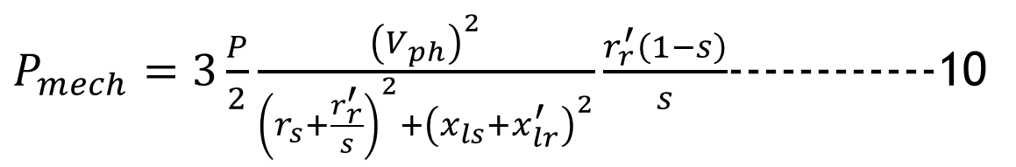
The mechanical power can be expressed as follows,
    with rotor current approximated by the terminal voltage divided by impedance.
$P_{mech}=3\frac{P}{2}\frac{{\left(V_{ph}\right)}^{2}}{{\left(r_{s}+\frac{r_{r}^{′}}{s}\right)}^{2}+{\left(x_{ls}+x_{lr}^{′}\right)}^{2}}\frac{r_{r}^{′}\left(1−s\right)}{s}$------------10
The torque the motor generates is the mechanical power divided by the rotor speed, w_{r},
    which can be written in terms of the electrical synchronous speed, w_{e}.

Slide 29
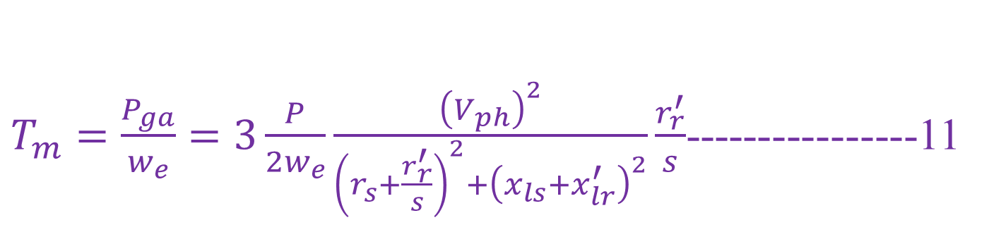
$T_{m}=\frac{P_{ga}}{w_{e}}=3\frac{P}{2w_{e}}\frac{{\left(V_{ph}\right)}^{2}}{{\left(r_{s}+\frac{r_{r}^{′}}{s}\right)}^{2}+{\left(x_{ls}+x_{lr}^{′}\right)}^{2}}\frac{r_{r}^{′}}{s}$----------------11

Slide 30
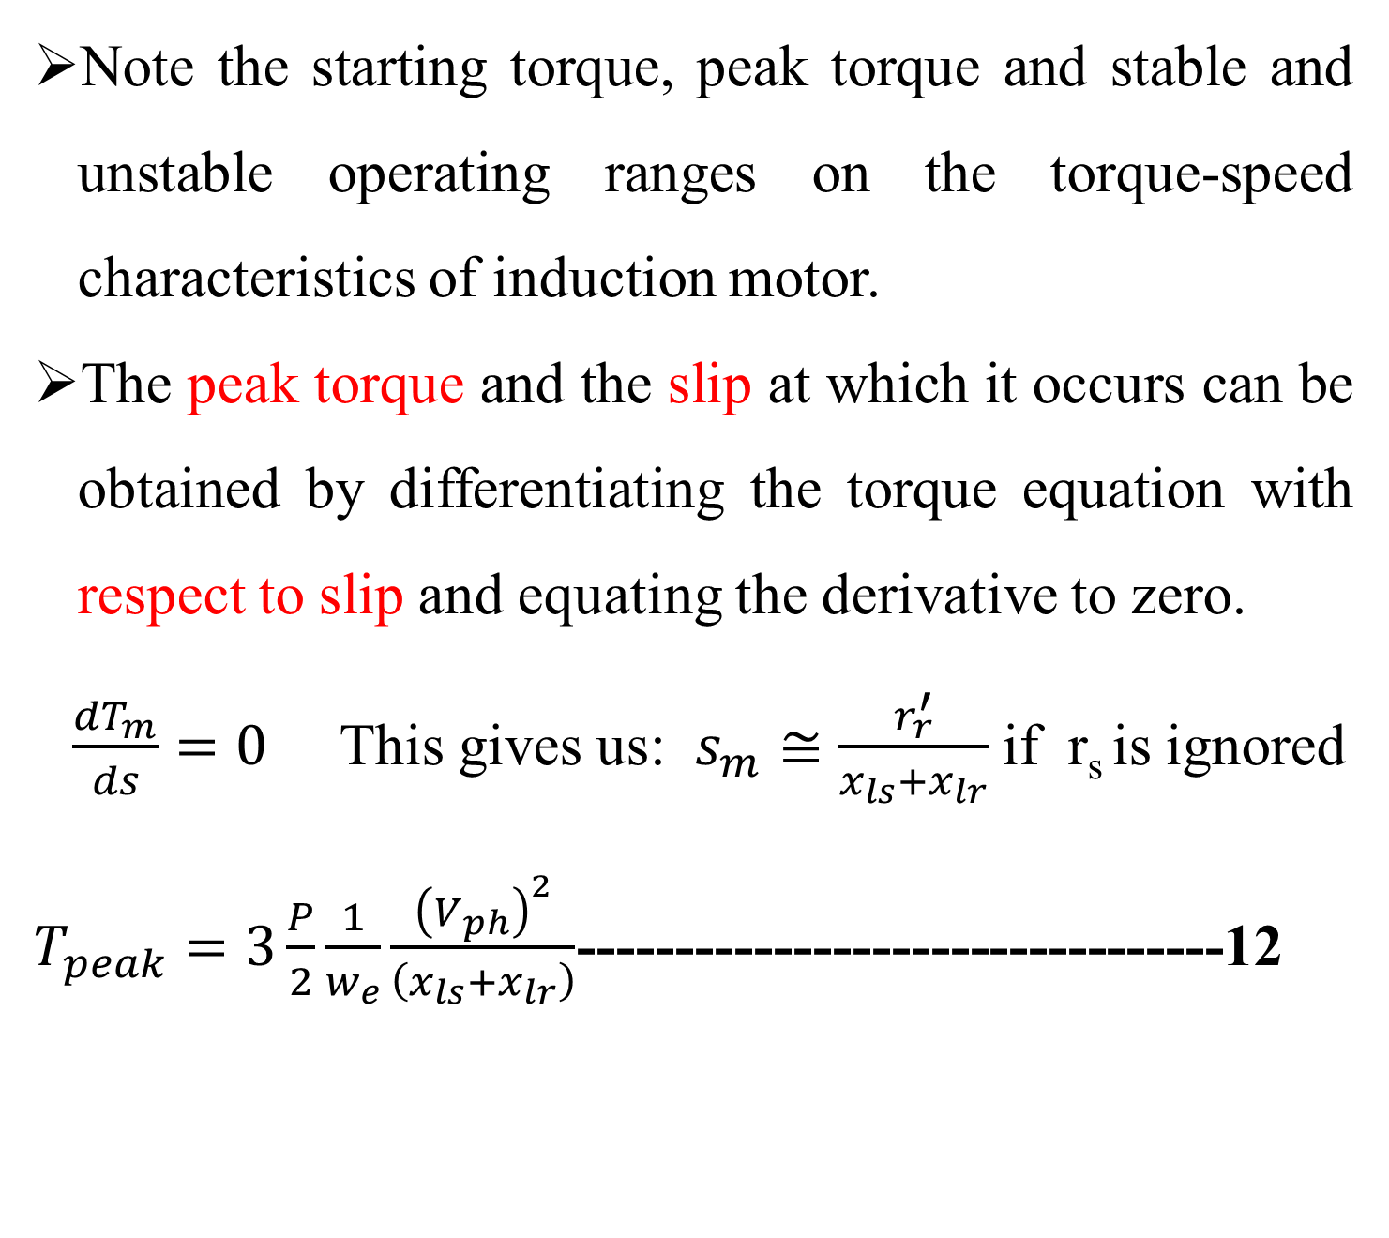
Note the starting torque, peak torque and stable and unstable operating ranges on the torque-speed characteristics of induction motor.
The peak torque and the slip at which it occurs can be obtained by differentiating the torque equation with respect to slip and equating the derivative to zero.
$\frac{dT_{m}}{ds}=0$ This gives us: $s_{m}≅\frac{r_{r}^{′}}{x_{ls}+x_{lr}}$ if r_{s} is ignored
$T_{peak}=3\frac{P}{2}\frac{1}{w_{e}}\frac{{\left(V_{ph}\right)}^{2}}{\left(x_{ls}+x_{lr}\right)}$---------------------------------12

Slide 31
Similarly, the starting torque can be determined by:
    equating the slip to be unity corresponding to zero speed.
Note in this equations that the peak torque is not function of rotor resistance while the slip at which the peak torque occurs is function of the rotor circuit resistance.

Slide 32
3.2. Induction motor Speed control
The speed of induction motor can be controlled by controlling:
    external resistor in the rotor circuit (wound type motor only),
    phase voltage,
    frequency of supply voltage,
    number of poles of the motor,
    simultaneous voltage and frequency control.
    Small variation of slip.

Slide 33
3.2.1. Supply Voltage Control
In equation for torque,
    if slip is kept constant,
    the torque becomes proportional to voltage squared.
    The supply voltage decrease results the torque-speed curve as shown in figure below

Slide 34
(where V_{n}>V₁>V₂>V₃)

Slide 35
As the voltage decreases the torque decreases as square of the voltage as shown in the figure.
Disadvantage of speed control by supply voltage control are:-
    Decrease in peak torque as the square function of the voltage
    Decrease in stability of the motor, for the same torque change the speed change is larger for low voltage than higher voltage.

Slide 36
    Decrease in starting torque as voltage decreases,
    Difficulty of varying AC supply voltage
    The speed adjustment range is limited to between rated and the speed at which the peak torque occurs.

Slide 37
3.2.2. External Rotor resistance variation
Motor speed variation by external rotor resistance variation :
    possible only for wound type induction motors,
    because the rotor winding terminals are brought out through slip rings for external resistor connection if required.

Slide 38
    In cage type rotors, there is no access to the rotor winding for external resistance connection.
As the peak torque is independent of rotor resistance, it will also independent of external resistor

Slide 39
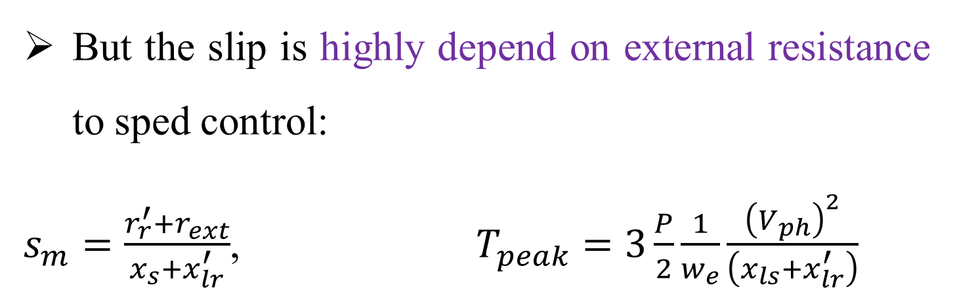
But the slip is highly depend on external resistance to sped control:
$s_{m}=\frac{r_{r}^{′}+r_{ext}}{x_{s}+x_{lr}^{′}}$, $T_{peak}=3\frac{P}{2}\frac{1}{w_{e}}\frac{{\left(V_{ph}\right)}^{2}}{\left(x_{ls}+x_{lr}^{′}\right)}$
The resulting torque-speed curve as the rotor circuit resistance varies is drawn

Slide 40
Advantage of induction motor speed control by external rotor resistance variation are:-
  The speed range can vary between zero speed and the rated speed
  The starting torque increase
  The peak torque remains constant
On the other hand, its main disadvantages are:-
  High power loss in the rotor circuit as the result of slip increase for low speeds
  Stability decrease as rotor external resistance increases

Slide 41
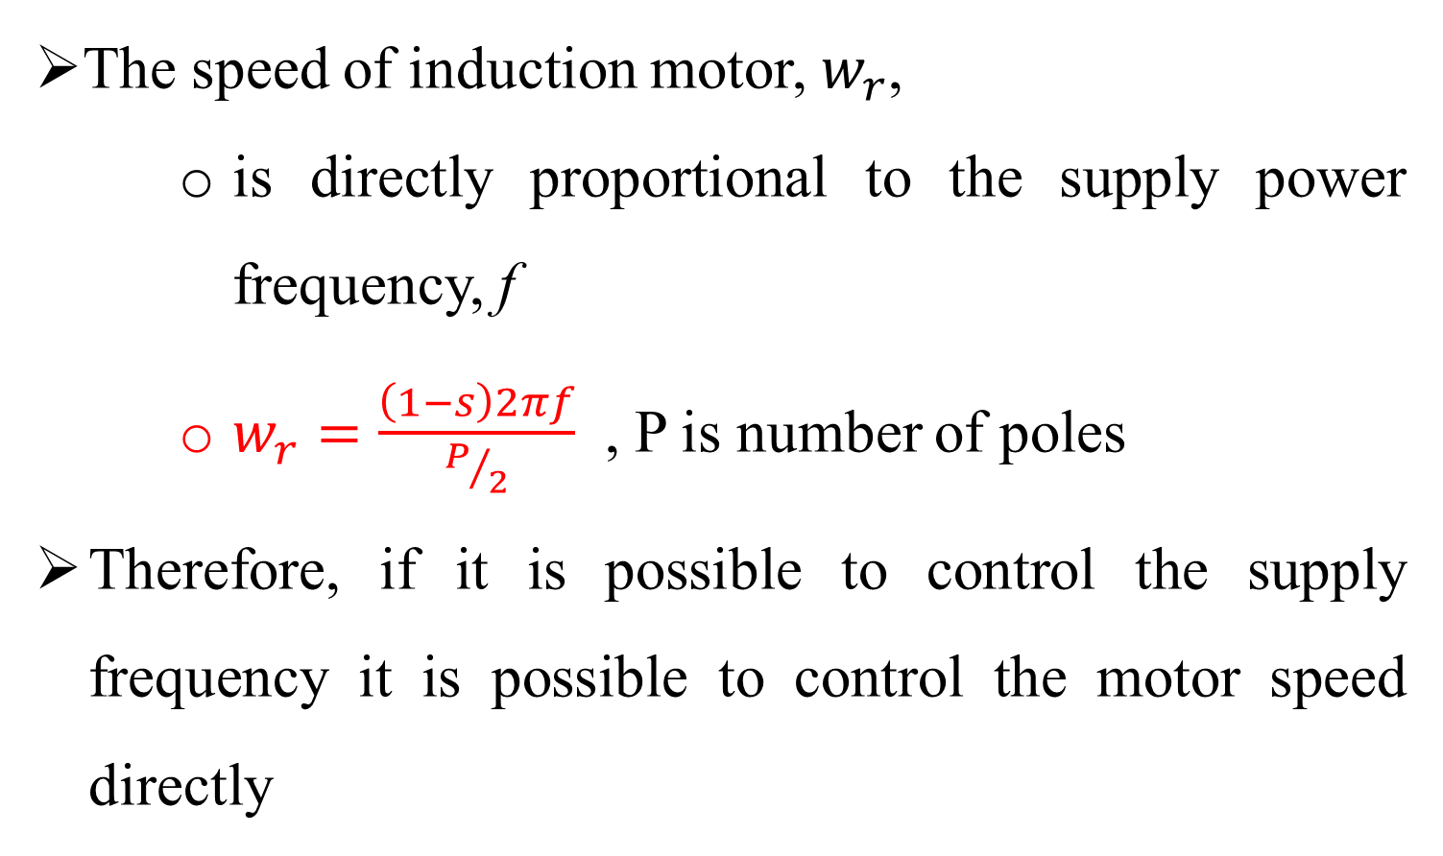
3.2.3.Supply Voltage Frequency Control
The speed of induction motor, $w_{r}$,
    is directly proportional to the supply power frequency, f
    $w_{r}=\frac{\left(1−s\right)2πf}{P/2}$ , P is number of poles
Therefore, if it is possible to control the supply frequency it is possible to control the motor speed directly

Slide 42
  This method is not widely used.
  This method is used where, only the induction motor is supplied by the generator (so that frequency can be easily changed by changing the speed of the prime mover)
  By changing the frequency, we can control the speed above and below the rated speed.
  It offers high range of speed control

Slide 43
speed control by supply frequency control (f_{n}>f₁>f₂)

Slide 44
Advantages speed controls by supply frequency control are:-
  The speed control range can extend from rated speed to zero speed
Main disadvantage of frequency control method:
  the stator current increases and results overloading as the frequency decreases.
  This is the result of reactive impedance decrease as the frequency decreases.

Slide 45
3.2.4. Changing number of poles
The terminals of all the windings have to be brought out for proper connection using magnetic contactors or circuit breakers.
Such pole adjustments are usually limited to two or three steps due to the complication and cost of switching.
The rotor is always cage type, which adjusts its self, automatically to stator number of poles.

Slide 46
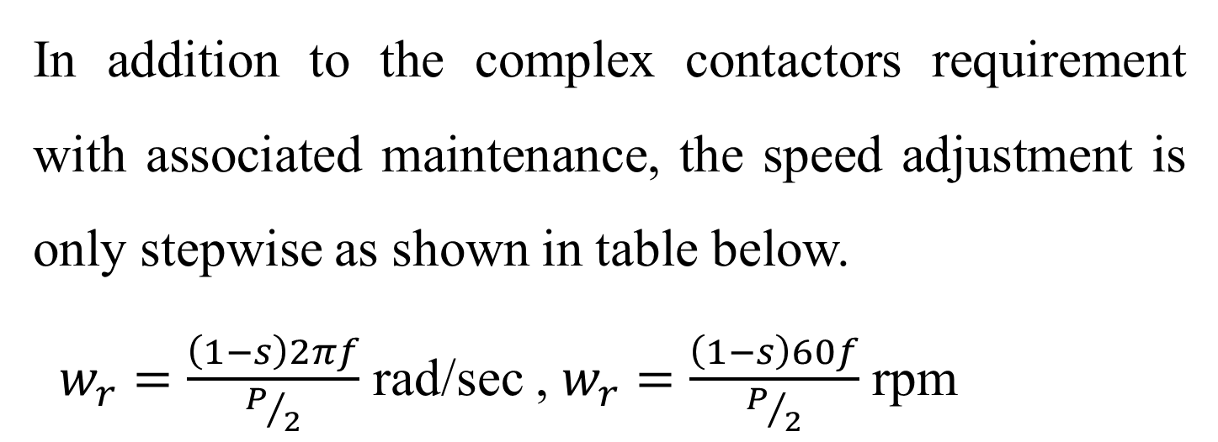
In addition to the complex contactors requirement with associated maintenance, the speed adjustment is only stepwise as shown in table below.
$w_{r}=\frac{\left(1−s\right)2πf}{P/2}$ rad/sec , $w_{r}=\frac{\left(1−s\right)60f}{P/2}$ rpm

Slide 47
3.2.5. Speed Control by varying frequency and voltage
voltage to frequency ratio is constant.
Simultaneous control of voltage and frequency for constant ratio of the two.
This method results :
    a constant peak torque,
    roughly constant stability level, and
    wide speed control range.

Slide 48
Maintain speed regulation
uses power electronics circuit for frequency and voltage controller

Slide 50
The induction motor speed control by simultaneous variation of voltage and frequency,
    keeping the ratio of voltage to frequency constant is possible:
    if the motor is to be supplied by an inverter which can control both the frequency and the magnitude of the voltage output to the motor.
    In this control the air gap flux is approximately kept constant.

Slide 51
    ASC represents the automatic speed controller which can be any controller like:
    Proportional-Integral (PI),
    Proportional-Integral-Derivative (PID) and the like.

Slide 52
    The hyperbolic function represents the torque voltage relation,
    Torque being proportional to voltage squared for a constant slip as shown in equation below.
Once the voltage is obtained from this relation, the frequency can be obtained from the constant voltage to frequency ratio at rated value.

Slide 53
Where, Vmn and fn are, respectively, rated voltage and rated frequency.
Characteristics of constant voltage to frequency ratio control are:
  Constant peak torque,
  Constant relative stability,
  Approximately constant copper loss
  Wide speed control range between zero and rated speed

Slide 54
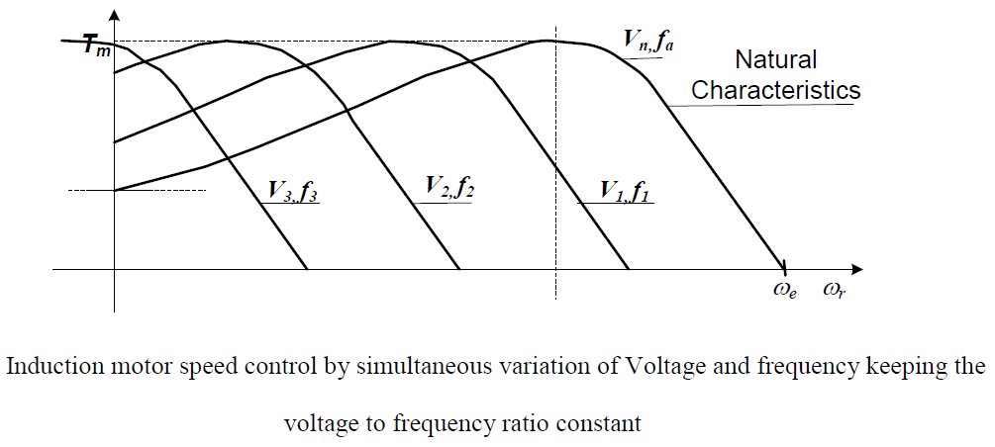

Slide 55
3.2.6. Small slip torque-speed relation
If load torque is proportional to speed squared as shown in figure below, the torque to slip ratio can be given as shown below.

Slide 57
Inverter supplied Induction motor
Variable Speed Drive (VSD)
A variable frequency drive converts incoming 50 Hz
utility power into DC, then converts to a simulated
variable voltage, variable frequency output.
Applies to devices that control the speed of :
    either the motor or
    the equipment driven by the motor
        (fan, pump, compressor, etc.)

Slide 58
AC
DC
AC
RECTIFIER
(AC - DC)
INVERTER
(DC - AC)
50 Hz
Zero - 100 Hz
VFD
50 Hz Power
^{ABB}
To
Motor
Zero - 100 Hz
Electrical Energy
VFD
VFD consists of the following stages:
    rectifier stage
    Inverter stages
    control

Slide 59
The differences between a variable frequency drive (VFD) and a variable speed drive (VSD)
  A variable frequency drive (VFD) refers to:
      AC drives only and
      vary the speed of an AC motor by varying the frequency to the motor.
  A variable speed drive (VSD) refers to:
      either AC Drives or DC Drives.
      VSDs referring to DC motors vary the speed by varying the voltage to the motor.

Slide 60
VFDs are of threes:
current source inverter (CSI)
Voltage source Inverter(VSI)
pulse width modulation (PWM)
current source inverter (CSI)
  Consists of large and expensive inductor so to gives smooth current
Voltage source Inverter(VSI)
  Have poor power factor
pulse width modulation (PWM)
  most widely used, because of good power factor and less cost

Slide 61
+
Positive
DC Bus
-
Negative
DC Bus
RECTIFIER
INVERTER

Slide 62
+
Positive
DC Bus
-
Negative
DC Bus
RECTIFIER
INVERTER

Slide 63
+
Positive
DC Bus
-
Negative
DC Bus
RECTIFIER
INVERTER

Slide 64
+
Positive
DC Bus
-
Negative
DC Bus
RECTIFIER
INVERTER

Slide 65
+
Positive
DC Bus
-
Negative
DC Bus
RECTIFIER
INVERTER

Slide 66
+
Positive
DC Bus
-
Negative
DC Bus
RECTIFIER
INVERTER

Slide 67
+
Positive
DC Bus
-
Negative
DC Bus
RECTIFIER
INVERTER

Slide 68
+
Positive
DC Bus
-
Negative
DC Bus
RECTIFIER
INVERTER

Slide 69
+
Positive
DC Bus
-
Negative
DC Bus
RECTIFIER
INVERTER

Slide 70
+
Positive
DC Bus
-
Negative
DC Bus
RECTIFIER
INVERTER

Slide 71
+
Positive
DC Bus
-
Negative
DC Bus
RECTIFIER
INVERTER

Slide 72
+
Positive
DC Bus
-
Negative
DC Bus
RECTIFIER
INVERTER

Slide 73
+
Positive
DC Bus
-
Negative
DC Bus
RECTIFIER
INVERTER

Slide 74
+
Positive
DC Bus
-
Negative
DC Bus
RECTIFIER
INVERTER

Slide 75
+
Positive
DC Bus
-
Negative
DC Bus
RECTIFIER
INVERTER

Slide 76
+
Positive
DC Bus
-
Negative
DC Bus
RECTIFIER
INVERTER

Slide 77
+
Positive
DC Bus
-
Negative
DC Bus
RECTIFIER
INVERTER

Slide 78
+
Positive
DC Bus
-
Negative
DC Bus
RECTIFIER
INVERTER

Slide 79
+
Positive
DC Bus
-
Negative
DC Bus
RECTIFIER
INVERTER

Slide 80
+
Positive
DC Bus
-
Negative
DC Bus
RECTIFIER
INVERTER

Slide 81
+
Positive
DC Bus
-
Negative
DC Bus
RECTIFIER
INVERTER

Slide 82
+
Positive
DC Bus
-
Negative
DC Bus
RECTIFIER
INVERTER

Slide 83
+
Positive
DC Bus
-
Negative
DC Bus
RECTIFIER
INVERTER

Slide 84
+
Positive
DC Bus
-
Negative
DC Bus
RECTIFIER
INVERTER

Slide 85
+
Positive
DC Bus
-
Negative
DC Bus
RECTIFIER
INVERTER

Slide 86
+
Positive
DC Bus
-
Negative
DC Bus
RECTIFIER
INVERTER

Slide 87
+
Positive
DC Bus
-
Negative
DC Bus
RECTIFIER
INVERTER

Slide 88
+
Positive
DC Bus
-
Negative
DC Bus
RECTIFIER
INVERTER

Slide 89
Area Under The Square-Wave Pulses
Approximates The Area Under A Sine Wave
+
Positive
DC Bus
Voltage
-
Negative
DC Bus
RECTIFIER
INVERTER
Frequency

Slide 90
Frequency = 30Hz
Frequency = 60Hz

Slide 91
RECTIFIER
INVERTER
+
Positive
DC Bus
-
Negative
DC Bus
Motor

Slide 92
RECTIFIER
INVERTER
+
Positive
DC Bus
-
Negative
DC Bus
Motor

Slide 93
RECTIFIER
INVERTER
+
Positive
DC Bus
-
Negative
DC Bus
Motor

Slide 94
RECTIFIER
INVERTER
+
Positive
DC Bus
-
Negative
DC Bus
Motor

Slide 95
RECTIFIER
INVERTER
+
Positive
DC Bus
-
Negative
DC Bus
Motor

Slide 96
RECTIFIER
INVERTER
+
Positive
DC Bus
-
Negative
DC Bus
Motor

Slide 97
RECTIFIER
INVERTER
+
Positive
DC Bus
-
Negative
DC Bus
Motor

Slide 98
BLOCK DIAGRAM OF VARIABLE FREQUENCY DRIVE
VARIABLE
FREQUENCY
AC VOLTAGE
AC LINE
POWER
DC LINK
Converter
Inverter
Control
CONVERTS 50/60 HZ
LINE POWER
INTO DC
INVERTS DC POWER
INTO ADJUSTABLE
FREQUENCY AC POWER

Slide 99
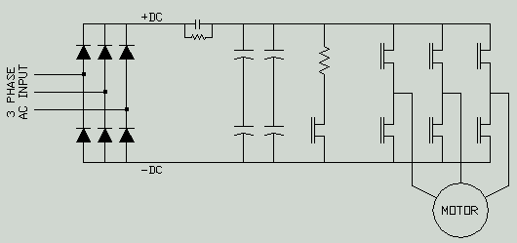
INVERTER
CONVERTER
Dc capacitors

Slide 100
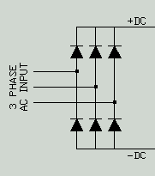
converter
Converts AC power to DC power
DC Bus = RMS x 1.414

Slide 101

VFC Sections
DC Bus
FILTERS THE VOLTAGE
STORES POWER FOR LOAD

Slide 102
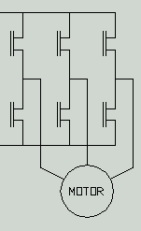
Cont’d…
Inverter
Inverts the DC Bus Voltage into a PWM AC sine wave
Monitors the motor Back EMF to determine the load
Is six set of IGBT or GTO or SCR which converts the dc to variable AC with control system.
The control system maintain the constant ratio of voltage to frequency

Slide 103
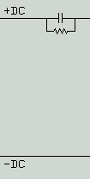
Cont’d…
Soft Charge Circuit
At start up the discharged caps look as a dead short to the AC line.
The resistor allows the caps to charge softly and prevent fuse faults.
Soft charge circuit

