Slide 1
CHAPTER-IV
CURVE FITTING
CURVE FITTING
CURVE FITTING

Slide 2
Introduction
Data is often given for discrete values along a continuum. However estimates of points between these discrete values may be required.
One way to do this is to formulate a function to fit these values approximately. This application is called curve fitting. There are two general approaches to curve fitting.

Slide 3
The first is to derive a single curve that represents the general trend of the data. One method of this nature is the least-squares regression.
The second approach is interpolation which is a more precise one. The basic idea is to fit a curve or a series of curves that pass directly through each of the points.

Slide 4
Least squares regression
Simple Linear regression
The simplest example of the least squares approximation is fitting a straight line to a set of paired observations: (x₁,y₁),(x₂,y₂)……( x_{n} ,y_{n}). The mathematical expression for the straight line is
y = a_{o} + a₁x+ e

Slide 5
where a_{o} and a₁ are coefficients representing the y-intercept and the slope of the line respectively while e is the error or residual between the model and the observations, which can be represented as
e = y - a_{o} - a₁x
Thus the error is the discrepancy between the true value of y(observed value) and the approximate value a_{o} + a₁x, predicted by the linear equation.

Slide 6
Any strategy of approximating a set of data by a linear equation (best fit) should minimize the sum of residuals. The least squares fit of straight line minimizes the sum of the squares of the residuals.
To determine the values of a_{o} and a₁, differentiate the above eqn with respect to each coefficient

Slide 7
Setting the derivatives equal to zero will result in a minimum S_{r}. The equations can then be expressed as
Solving for a_{o} and a₁ simultaneously

Slide 8
where and are the means of y and x, respectively
Test of goodness of fit
Any line other than the one derived above gives larger sum of the squares of the residuals.
The standard deviation of the regression line can be determined by the standard error of the estimate

Slide 9
r is the correlation coefficient for linear regression r is given by
For a perfect fit r =1 and r should be close to 1 for good fit

Slide 10
Example Find the standard "least squares line for the data points
Solution

Slide 11
The normal eqns for finding the coefficients a and b are:
The solution is

Slide 12
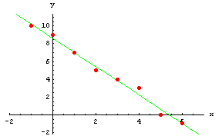
The least square line is
And the graph will look like:

Slide 13
Linearization of non-linear relationships
Linear regression provides a powerful technique for fitting a “best” line to a data.
However it is predicated on the fact that the relationship between the independent and dependent variables is linear.
But usually this is not the case. Visual inspection of the plot of the data will provide useful information whether linear regression is acceptable.

Slide 14
In situations where linear regression is inadequate other methods such as polynomial regression are appropriate.
For others, transformations can be used to express the data in a form that is compatible with linear regression.
The followings are examples of functions which can be linearized
i Exponential functions
where a₁ and b₁ are constants

Slide 15
This function can be linearized by taking the natural logarithm of both sides of the equation
the plot of ln y versus x will yield a straight line with a slope of b₁ and an intercept of ln a₁.
ii Power functions
where a₂ and b₂ are constant coefficients.
This equation can be linearized by taking its base 10 logarithm to give

Slide 16
the plot of logy versus logx will yield a straight line with a slope of b₂ and an intercept of log a_{2.}
iii Saturation growth rate equation
this equation can be linearized by inverting to give
the plot of 1/y versus 1/x will be linear, with a slope of b₃/a₃ and an intercept of 1/a_{3.}

Slide 17
In their transformed forms, these models are fit using linear regression in order to evaluate the constant coefficients.
Then they can be transformed back to their original state and used for predictive purposes.

Slide 18
Polynomial regression
Some engineering data, although exhibiting marked pattern, is poorly represented by straight line.
For these cases a curve would be better suited to fit the data. One of the possible ways of solving this kind of problems is to fit the data by a polynomial function.
This is called polynomial regression. The least squares method can be extended to fit data to a higher-order polynomial.

Slide 19
Suppose we want to fit a second order polynomial:
For this case the sum of the squares of the residuals is
Taking the derivative of the above equation with respect to each unknown coefficients of the polynomial gives

Slide 20
Setting these equations equal to zero and rearranging to develop the following set of equations

Slide 21
Solving for the coefficients of the quadratic regression is equivalent to solving three simultaneous linear equations. The techniques for solving these problems are discussed in chapter three.

Slide 22
This discussion can easily be extended to an m ^{th} order polynomial as
Thus determination of the coefficients of an m^{th} order polynomial is equivalent to solving a system of m+1 simultaneous linear equations. For this case the standard error is formulated as

Slide 23
Example Find the standard "least squares parabola “ ” for the data points .
The normal equations for finding the coefficients a and b are:

Slide 24
The solution is

Slide 25
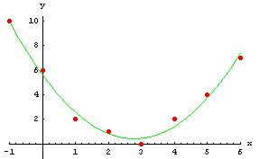
And the graph will look like:

Slide 26
Multiple linear regression
A useful extension of linear regression is the case where y is a linear function of more than one variable, say x₁ and x₂,
Such an equation is useful when fitting experimental data where the variable being studied is a function of two other variables.
In the same manner as the previous cases the best values of the coefficients are determined by setting the sum of the squares of the residuals to a minimum.

Slide 27
Differentiating with respect to the unknown coefficients, we have

Slide 28
The coefficients yielding the minimum sum of the residuals are obtained by setting the partial derivatives equal to zero and expressing the result in a matrix form as
The above case can be extended to m dimension,

Slide 29
General linear least squares
In the preceding discussions we have seen three types of regression: linear, polynomial and multiple linear.
All these belong to the general linear least squares model given by
where z_{o}, z₁, z₂, .....,z_{m} are m+1 different functions. For multiple linear regression z_{o} = 1, z₁ =x₁, z₂ = x₂, ...., z_{m} = x_{m}.

Slide 30
For polynomial regression, the z's are simple monomials as in z_{o}= 1, z₁ = x, z₂ = x² , ..., z_{m} = x^{m}.
The terminology linear refers only to the model's dependence on its parameters i.e., the a's. As in the case of polynomial regression. the functions themselves can be highly nonlinear.
the general linear least squares model can be expressed in a matrix form as

Slide 31
where [z] is a matrix of calculated values of the z functions at the measured values of the independent variables.
where m is the number of variables in the model and n is the number of data points. Because n ≥m+1 , most of the time [z] is not a square matrix.

Slide 32
The column vector {y} contains the observed values of the dependent variable.
The column vector {A} contains the unknown coefficients
The column vector {E} contains the residuals
The sum of the squares of the residuals can be defined as

Slide 33
This quantity can be minimized by taking its partial derivative with respect to each of the coefficients and setting the resulting equation equal to zero. The outcome of this process can be expressed in matrix form as

Slide 34
Interpolation
In many engineering applications it is required to estimate intermediate values between precise data points.
The most common method used is the polynomial interpolation.
For n+1 data points, there is a unique polynomial of order n that passes through all the points.
f(x) = a_{o} + a₁ x + a₂ x² + ... +a_{n} x^{n}

Slide 35
Polynomial interpolation involves the determination of that unique n^{th} order polynomial that fits n+1 data points.
This formula can then be used to estimate intermediate values.
Although there is only one n^{th} order polynomial that fits n+ 1 points, there are a variety of mathematical formats in which this polynomial can be expressed.
The most widely used alternatives are the Newton and Lagrange interpolating polynomials.

Slide 36
Newton's Divided Difference Interpolating Polynomials
The simplest form of interpolation is to connect two data points with a straight line. This technique is called linear interpolation. Using the concept of similar triangles,
This can be rearranged to yield

Slide 37
This is the linear interpolation formula. The notation f₁(x) indicates that this is a first order polynomial.
The term [f(x₁)-f(x_{o})]/(x₁-x₀) is the finite difference approximation of the first derivative.
The smaller the interval between the data points, the better the approximation.
Approximation of a curve with a straight line can result in significant errors. A better approximation can be achieved if some curvature is introduced into the line connecting the points.

Slide 38
If three points are available, a second order polynomial can be plotted through the data points. This is called a quadratic interpolating polynomial. A convenient form for this purpose is
f₂(x) = b_{o} + b₁(x-x_{o}) + b₂(x-x₀) (x-x₁)
b_{o} can be solved for f₂(x) by setting x=x₀, in which case b_{o} = f₂(x_{o})
then f₂(x) can be evaluated at x=x₁ to solve for b₁

Slide 39
Evaluating f₂(x) at x=x₂ gives
Note that b₁ represents the slope of the line between x_{o} and x₁ and b₂ is similar to the finite difference approximation of the second derivative.

Slide 40
General form of Newton's Interpolating Polynomials
The preceding analysis can be generalized to fit an n^{th} order polynomial to n+1 data points. The n^{th} order polynomial is
f_{n}(x) = b₀ + b₁(x-x_{o}) + b₂(x-x_{o})(x-x₁)+ .... + b_{n}(x-x_{o})(x-x₁)....(x-x_{n-1})
The data points can be used to evaluate the coefficients b_{o}, b₁, b₂, ...., b_{n}.

Slide 41
b₀ = f(x_{o})
b₁ = f[x₁,x_{o}]
b₂ = f[x₂,x₁,x_{o}]
.
.
.
b_{n} = f[x_{n},x_{n-1}, ..., x₁,x_{o}]
Where the bracketed function evaluations are finite divided differences. For example the first finite divided difference is given by

Slide 42
The second finite divided difference is expressed by
Similarly the n-th finite divided difference is

Slide 43
These differences can be used to evaluate the coefficients and then can be substituted to yield the interpolating polynomial
f_{n}(x) = f(x_{o})+(x-x_{o})f[x₁,x_{o}]+(x-x_{o})(x-x₁)f[x₂,x₁,x_{o}]+... + (x-x_{o})(x-x₁)...(x-x_{n-1})f[x_{n},x_{n-1},..., x_{o}]
This is called the Newton’s divided difference interpolating polynomial.
It does not require that the data be put in ascending order or the interval between data points to be equal.

Slide 44
Example1 Form the Newton polynomials of degree n = 1, 2, 3, 4, and 5 for the function over the interval using equally spaced nodes selected from the following list
a.

Slide 45
b.
c.

Slide 46
d.
e.
After simplification

Slide 47
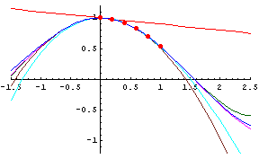

Slide 48
Errors in Newton's Interpolating polynomials
The structure of Newton's polynomial is similar to the Taylor series expansion in the sense that terms are added sequentially to capture the higher order behavior of the underlying function.
These terms are finite difference approximations of the higher order derivatives. Thus if the true underlying function is n^{th} order polynomial, the n^{th} order interpolating polynomial based on n+1 data points will yield exact results.

Slide 49
Recall that the truncation error in Taylor series is generally expressed as
where ξ is somewhere in the interval x_{i} to x_{i+1}
For the n^{th} order interpolating polynomial, an analogous relationship for error is

Slide 50
An alternative formulation which uses a finite difference to approximate the (n+1)^{th} derivative is
R_{n} = f[x_{n+1},x_{n},x_{n-1},....,x_{o}](x-x_{o})(x-x₁)...(x-x_{n})
The error estimate for the n^{th} order polynomial is equivalent to the difference between the (n+1)^{th} order and the n-th order prediction.
R_{n} = f_{n+1} (x) - f_{n}(x)
The validity of this approach lies on the fact that the series is strongly convergent. For such situations the (n+1) ^{th} order prediction would be closer to the true value than the n^{th} order prediction.

Slide 51
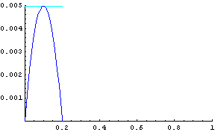
Investigate the error for the Newton polynomial approximations in Example1.
a)

Slide 52
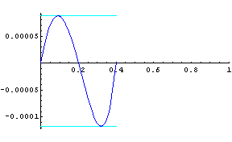
b)

Slide 53
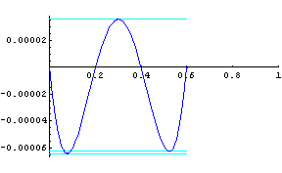
c)

Slide 54
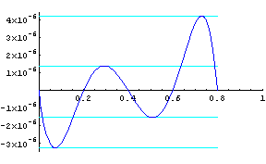
d)

Slide 55
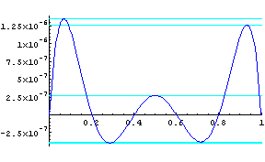
e)

Slide 56
ii. Lagrange Interpolation Polynomials
The Lagrange interpolating polynomial is a reformulation of the Newton polynomial that avoids the computation of divided differences. It can be represented as
Where
Where Π designates the "product of"

Slide 57
For linear interpolation
For second order interpolating polynomials
As in the Newton's method the Lagrange version has an estimated error of
Thus if an additional point at x=x+1 is available an error estimate can be obtained.

Slide 58
Example Construct three interpolating polynomials of degree n=1 for the function over [0,1]. Use the following sets of interpolation nodes.
.
(a). Use the nodes
. (b). Use the nodes
. (c). Use the nodes

Slide 59
a.
b.
c.
Note that the three polynomials of degree n = 1 are different. The error in approximating f[x] will also be different.

Slide 60
Exercise 1 Form several Lagrange polynomials of degree n = 2, 3, 4, and 5 for the function over the interval [0,1] using n+1 equally spaced nodes. Then compare the four Lagrange polynomials.
Exercise 2. Investigate the error for the Lagrange polynomial approximations of degree n = 2, 3, 4, and 5 in Exercise 1.

Slide 61
iii. Spline Interpolation
Employing high-order polynomial functions can lead to erroneous results because of round-off error and overshoot.
An alternative to this approach is to apply lower order polynomials to subsets of data points.
Such connecting polynomials are called spline functions.
The functions are so constructed that the connections between adjacent equations are visually smooth.

Slide 62
Linear splines
The simplest connection between two points is a straight line. The first order splines for a group of ordered data points can be defined as a set of linear functions,
f(x) = f(x_{o}) + m_{o}(x-x₀) x₀≤ x ≤ x₁
f(x) = f(x₁) + m₁(x-x₁) x₁≤ x ≤ x₂
.
.
.
f(x) = f(x_{n-1}) + m_{n-1}(x-x_{n-1}) x_{n-1}≤ x ≤ x_{n}

Slide 63
where m_{i} is the slope of the straight line connecting the points:
The disadvantage of first order splines is that they are not smooth. The slope changes abruptly at the knots i.e., the first derivative of the function is discontinuous at these points.

Slide 64
ii Quadratic Splines
To ensure the m^{th} order derivatives are continuous at the knots, a spline of at least m+1 order must be used.
cubic splines ensure that the first and second derivatives are continuous at the knots. Third and higher derivatives may be discontinuous but cannot be detected visually and consequently are ignored.

Slide 65
The objective in quadratic splines is to derive a second order polynomial for each interval between the data points. The polynomial for each interval can be represented generally as
f_{i}(x) = a_{i}x² +b_{i}x + c_{i}
for n+1 data points there are n intervals and consequently 3n unknown coefficients to evaluate.
Therefore, 3n equations are required to solve the problem. These equations are obtained from:

Slide 66
1. The function values of adjacent polynomials must be equal at the interior knots:
for i= 2 to n. Because only interior points are used, this provides 2n-2 conditions
2. The first and last functions must pass through the end points. This gives two additional equations:

Slide 67
The first derivatives at the interior knots must be equal
for i = 2 to n this provides n-1 conditions.
Assume that the second derivative is zero at the first point. Because the second derivative the quadratic equation is 2a_{i} this condition is mathematically expressed as
a₁ = 0
This means that the first two points are connected by a straight line.

Slide 68
iii Cubic Splines
The objective in cubic splines is to derive a third order polynomial for each interval between knots, as in
For n+1 data points there are n intervals and therefore 4n unknowns. The required 4n conditions are obtained from:

Slide 69
the function values at the interior knots must be equal (2n-2 conditions)
the first and last functions must pass through the end points ( 2 conditions)
The first derivatives at the interior knots must be equal (n-1 conditions)
the second derivatives at the interior knots must be equal ( n-1 conditions)
The second derivatives at the end knots are zero ( 2 conditions)

Slide 70
Example Construct the natural cubic spline for the points
that has the endpoint constraints

Slide 71
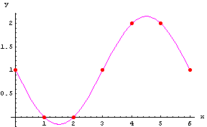
Solution

