Slide 1
CHAPTER-V
NUMERICAL DIFFERENTIATION
& INTEGRATION

Slide 2
CONTENTS:
INTRODUCTION
FORWARD DIFFERENCE FORMULA
CENTRAL DIFFERENCE FORMULA
NUMERICAL INTEGRATION
TRAPEZOIDAL RULE
SIMPSON’S RULE

Slide 3
5.1 Introduction:
Calculus is mathematics of change. Because engineers must continuously deal with systems and processes that change, calculus is an essential tool of the engineering profession.
Standing at the heart of calculus are the related mathematical concepts of differentiation and integration.
Mathematically, the derivative represents the rate of change of a dependent variable with respect to an independent variable. If y is the dependent variable and x is the independent variable, the first derivative of y = f(x) w.r.t. to x, represented by dy/dx, is given by

Slide 4
The inverse process to differentiation in calculus is integration. Mathematically, integration is represented by
which stands for the integral of the function f(x) w.r.t. the independent variable x, evaluated between the limits x = a to x = b. The function f(x) is referred to as the integrand.

Slide 5
Non-Computer Methods for Differentiation and Integration
The function to be differentiated or integrated will typically be in one of the following three forms:
A simple continuous function such as a polynomial, an exponential, or a trigonometric function.
A complicated continuous function that is difficult or impossible to differentiate or integrate directly.
A tabulated function where the values of x and f(x) are given at a number of discrete points, as is often the case with experimental or field data.

Slide 6
In the first case, the derivative or integral of a simple function may be evaluated analytically using calculus.
For the second case, analytical solutions are often impractical, and sometimes impossible, to obtain. In these instances, as well as in the third case of discrete data, approximate methods must be employed.
In the non-computer method for determining derivatives from data, the (x, y) data are tabulated and, for each interval, a simple divided difference Δy/Δx is employed to estimate the slope.

Slide 7
Then these values are plotted as a stepped curve versus x. Next a smooth curve is drawn that attempts to approximate the area under the stepped curve.
That is, it is drawn so that visually, the positive and the negative areas are balanced. The rates at given values of x can then be read from the curve.
In the same spirit, visually oriented approaches were employed to integrate tabulated data and complicated functions in the pre-computer era.
A simple intuitive approach is to plot the function on a grid and count the number of boxes that approximate the area. This number multiplied by the area of each box provides a rough estimate of the total area under the curve.

Slide 8
This estimate can be refined, at the expense of additional effort, by using a finer grid.
Another commonsense approach is to divide the area into vertical segments, or strips, with a height equal to the function value at the midpoint of each strip.
The area of the rectangles can be then calculated and summed to estimate the total area.
In this approach, it is assumed that the value at the midpoint provides a valid approximation of the average height of the function for each strip.
As with the grid method, refined estimates are possible by using more (and thinner) strips to approximate the integral.

Slide 9
5.2 Numerical Differentiation :
An effective tool for Numerical Differentiation is the Taylor series expansion of f (x) about the point xi. It has the advantage of providing us with information about the error involved in the approximation.
Numerical differentiation is not a particularly accurate process. It suffers from a conflict between round off errors (due to limited machine precision) and errors inherent in interpolation. For this reason, a derivative of a function can never be computed with the same precision as the function itself

Slide 10
5.2.1 Lower Order Methods
By truncating the second- and higher-derivatives in the Taylor series
the following formula for approximating the first derivative, called the first forward difference, is obtained
Where is referred to as the first forward difference and h is called the step size. The entire term is referred to as a first finite divided difference.

Slide 11
Similarly, by truncating the Taylor series between x_{i-1} and x_{i},
the following formula for approximating the first derivative is obtained
Where is referred to as the first backward difference.

Slide 12
A third way to approximate the first derivative is to subtract backward Taylor series expansions (between x_{i-1} and x_{i} ) from the forward Taylor series expansion (between x_{i-1} and x_{i} ) resulting in
from which we obtain
The above equation is a centered difference representation of the first derivative.

Slide 13
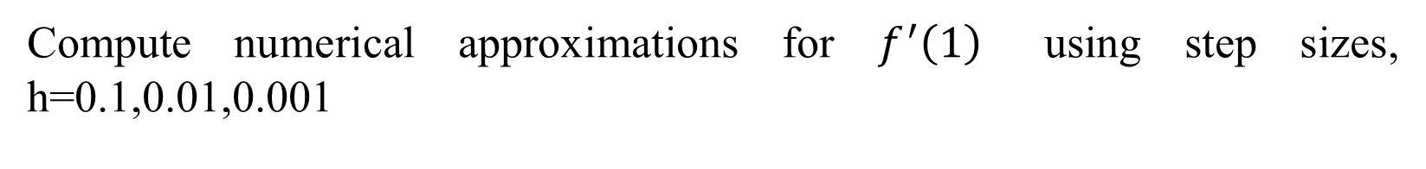
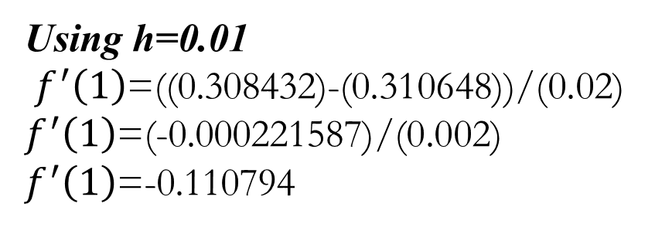
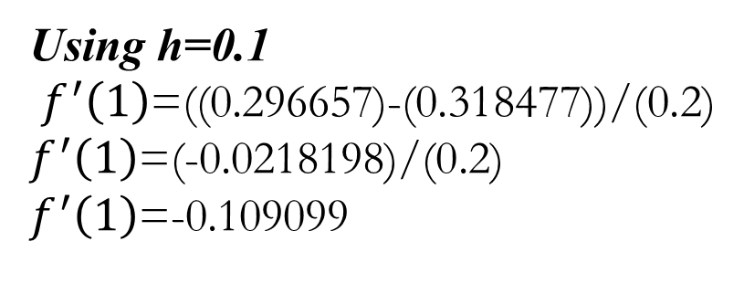

Example Consider the function$f\left(x\right)=e^{−x}sin⁡(x)$
Compute numerical approximations for $f^{′}\left(1\right)$using step sizes, h=0.1,0.01,0.001
$$f\left(x\right)=e^{−x}sin⁡(x)$$
Using h=0.1
$f^{′}\left(1\right)$=((0.296657)-(0.318477))/(0.2)
$f^{′}\left(1\right)$=(-0.0218198)/(0.2)
$f^{′}\left(1\right)$=-0.109099
Using h=0.01
$f^{′}\left(1\right)$=((0.308432)-(0.310648))/(0.02)
$f^{′}\left(1\right)$=(-0.000221587)/(0.002)
$f^{′}\left(1\right)$=-0.110794

Slide 14
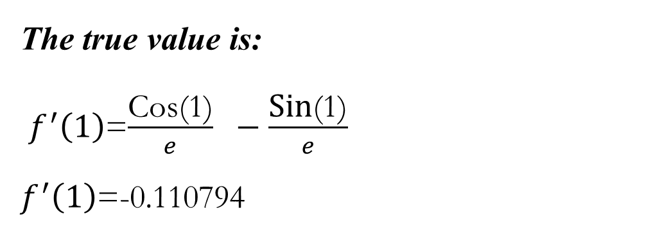
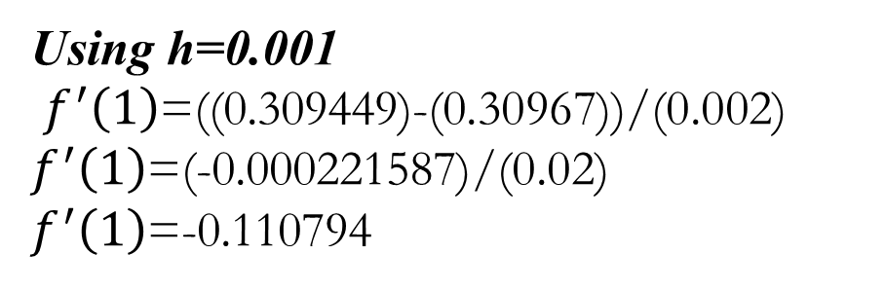
Using h=0.001
$f^{′}\left(1\right)$=((0.309449)-(0.30967))/(0.002)
$f^{′}\left(1\right)$=(-0.000221587)/(0.02)
$f^{′}\left(1\right)$=-0.110794
The true value is:
$f^{′}\left(1\right)$=$\frac{\text{Cos}\text{(1)}}{e} −\frac{\text{Sin}\text{(1)}}{e}$
$f^{′}\left(1\right)$=-0.110794

Slide 15
5.2.2 High-Accuracy Differentiation Formulas
High-accuracy divided difference formulas can be generated by including additional terms from the Taylor series expansion. For example, the forward Taylor series expansion can be written as
which can be solved for
The result can be truncated by excluding the second- and higher-derivative terms and were thus left with a final result

Slide 16
We can retain the second-derivative term by substituting the following approximation of the second derivative
into Eq. 2 to yield

Slide 17
collecting terms
Notice that the inclusion of the second-derivative term has improved the accuracy to O (h²).
Similar improved versions can be developed for the backward and centered formulas as well as for the approximations of the higher derivatives. The formulas are given below.

Slide 18
Forward Finite-divided Difference Formulas
First Derivative Error
Second Derivative

Slide 19
Third Derivative
Fourth Derivative

Slide 20
Look on the handout for
Backward Finite-divided Difference Formulas
Centered Finite-divided Difference Formulas

Slide 21
5.3 Newton-Cotes integration formulas
The Newton-Cotes formulas are the most common numerical integration schemes. They are based on the strategy of replacing a complicated function or tabulated data with an approximating function that is easy to integrate:
where f_{n}(x) = a polynomial of the form
where n is the order of the polynomial.

Slide 22
The integral can be approximated by one polynomial or using a series of polynomials applied piecewise to the function or date over segments of constant length.
Closed and open forms of the Newton-Cotes formulas are available. The closed forms are those where the data points at the beginning and end of the limits of integration are known. The open forms have integration limits that extend beyond the range of the data.

Slide 23
    The Trapezoidal Rule
The trapezoidal rule is the first of the Newton-Cotes closed integration formulas. It corresponds to the case where the polynomial in Eq. is first-order:
The straight line passing through the two points (a, f(a)) and (b, f(b)) is given by

Slide 24
The area under this straight line is an estimate of the integral of f(x) between the limits a and b:
The result of the integration is
which is called the trapezoidal rule.

Slide 25
Error of the Trapezoidal Rule
When we employ the integral under a straight line to approximate the integral under the curve, we obviously can incur an error that may be substantial. An estimate of the local truncation error of a single application of the trapezoidal rule is
where ξ lies somewhere in the interval from a to b.

Slide 26
Multiple-Application of Trapezoidal Rule
One way to improve the accuracy of the trapezoidal rule is to divide the integration interval from a to b into a number of segments and apply the method to each segment. The areas of the individual segments can then be added to yield the integral for the entire interval. The resulting equations are called multiple-application, or composite, integration formulas.
Considering n + 1 equally spaced base points (x₀, x₁, x₂, ..., x_{n}), and n segments of equal width:

Slide 27
If a and b are designated as x₀ and x_{n}, respectively, the total integral can be represented as
Substituting the trapezoidal rule for each interval yields

Slide 28
or, grouping terms,
or, It can be expressed in the following form,

Slide 29
An error for the multiple-application trapezoidal rule can be obtained by summing the individual errors for each segment to give
where f"(ξ_{i}) is the second derivative at a point ξ_{i} located in segment i. This result can be simplified by estimating the mean or the average value of the second derivative for the entire interval as

Slide 30
Therefore
and Eq. 5.25 can be rewritten as
Thus, if the number of segment is doubled, the truncation error will be quartered.

Slide 31
Example Numerically approximate the integral
by using the trapezoidal rule with m = 1, 2, 4, 8, and 16 subintervals.
For m = 1

Slide 32
For m = 2
For m = 4
follow the same procedure for m = 8 and 16

Slide 33
5.3.2 Simpson's Rules
Aside from applying the trapezoidal rule with finer segmentation, another way to obtain a more accurate estimate of an integral is to use higher-order polynomial to connect the points.
For example, if there is an extra point midway between f(a) and f(b), the three points can be connected with a parabola. If there are two points equally spaced between f(a) and f(b), the four points can be connected with a third-order polynomial.

Slide 34
The formulas that result from taking the integrals under these polynomials are called Simpson's rules.
i) Simpson's 1/3 Rule
Simpson's 1/3 rule results when a second-order interpolating polynomial is substituted into Eq. 5.13:
If a and b are designated as x₀ and x₂ and f₂(x) is represented by a second-order Lagrange polynomial, the integral becomes

Slide 35
After integration and algebraic manipulation, the following formula results
where, for this case, . This equation is known as Simpson's 1/3 rule.

Slide 36
Simpson's 1/3 rule can also be expressed in the following format
Where a=x₀, b=x₂ and x₁= the point midway between a and b, which is given by (b+a)/2.
Notice that, according to the above equation, the middle point is weighted two-thirds and the two end points by one-sixth.

Slide 37
It can be shown that a single-segment application of Simpson's 1/3 rule has a truncation error of
because
where ξ lies somewhere in the interval from a to b. Thus, Simpson's 1/3 rule is more accurate that the trapezoidal rule.

Slide 38
Multiple Application of Simpson's 1/3 Rule
Just as with the trapezoidal rule, Simpson's rule can be improved by dividing the integration interval into a number of segments of equal width:
The total integration can be represented as

Slide 39
Substituting Simpson's 1/3 rule for the individual integral yields
combining terms,

Slide 40
An error estimate for the multiple-application Simpson's rule is obtained in the same fashion as for the trapezoidal rule by summing the individual errors for the segments and averaging the derivative to yield
Where is the average fourth derivative for the interval.

Slide 41
Example Numerically approximate the integral
by using Simpson's rule with m = 1, 2, 4, and 8.
For m = 1

Slide 42
For m = 2
For m = 4

Slide 43
For m = 8

Slide 44
Simpson's 3/8 Rule
In a similar manner to the derivation of the trapezoidal and Simpson's 1/3 rule, a third-order Lagrange polynomial can be fit to four points and integrated:
to yield

Slide 45
Where
This equation is called Simpson's 3/8 rule because h is multiplied by 3/8. It is the third Newton-Cotes closed integration formula.
The 3/8 rule can also be expressed in the following form:

Slide 46
Thus, the two interior points are given weight's are given weights of three-eighths, whereas the end points are weighted with one-eighth.
Simpson's 3/8 rule has an error of

Slide 47
Simpson's 1/3 rule is usually the method of preference because it attains third-order accuracy with three points rather than the four points required for the 3/8 version.
However, the 3/8 rule has utility when the number of segments is odd.

Slide 48

Example Numerically approximate the integral
by using Simpson's 3/8 rule with m = 1, 2, 4.
For m = 1
For m = 2

Slide 49

For m = 3

