Slide 1

Addis Ababa University
Addis Ababa Institute of Technology
School of Mechanical & Industrial Engineering
Fluid Flow Theory
Prepared by: Dawit M.
Office: 314 - C
E-mail: dwtmus@gmail.com

Slide 2
Outline
  Introduction
  Objectives
  Fluid Flow Theory
  Force Balance and Velocity Distribution
    External Flow – Over a Flat Plate
    Internal Flow – In a Circular Cylinder
  Laminar and Turbulent Flows
  Reynolds Number
  Governing Equations of Fluid Flow
  Basic Laws
  The Integral Approach
  The Differential Approach
AAiT
School of Mechanical and Industrial Engineering - SMiE

Slide 3
Introduction
Fluid Mechanics is the study of fluids either in motion (Fluid Dynamics) or at rest (Fluid Statics) and the subsequent effect of the fluid up on the boundaries, which may be either solid surfaces or interfaces with other fluids.
Both gases and liquids are classified as fluids, and the number of fluids engineering application is enormous; breathing, pumping, flaying bodies (air crafts, missiles …), ships, piping, windmills … are few.
The essence of the subject – Fluid Flow is a judicious compromise between theory and experiment.
Fluid Mechanics - II devotes for Fluid Dynamics more importantly, Aerodynamics.
AAiT
School of Mechanical and Industrial Engineering - SMiE

Slide 4
Objectives
By the end of this lecture, students will be able to:
Have a deeper understanding about fluid flow theory
Determine the velocity profiles of various flow conditions from a simple force balances
Distinguish various flow types
Understand the basic laws and governing equations of fluid flow
Employ differential and integral approaches to formulate/solve a flow phenomena
AAiT
School of Mechanical and Industrial Engineering - SMiE

Slide 5
Reflective Activity
From point of view of Fluid Mechanics, all matter consists of only two states; Fluid and Solid.
Discuss the difference between solid and fluid.
Simple!
A solid can resist shear stress by static deformation, a fluid can not.
AAiT
School of Mechanical and Industrial Engineering - SMiE

Slide 6
Fluid Flow Theory
A Fluid
Molecules of fluids exert forces of attraction on each other. In liquids this is strong enough to keep the mass together but not strong enough to keep it rigid. In gases these forces are very weak and cannot hold the mass together.
When a fluid flows over a surface, the layer next to the surface may become attached to it (it wets the surface). The layers of fluid above the surface are moving so there must be shearing taking place between the layers of the fluid.
AAiT
School of Mechanical and Industrial Engineering - SMiE

Slide 7
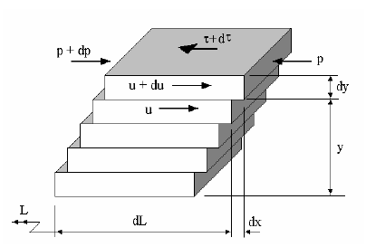
Cont’d …
Let us suppose that the fluid is flowing over a flat surface in laminated layers from left to right as shown in figure:
y is the distance above the solid surface (no slip surface)
L is an arbitrary distance from a point upstream.
dy is the thickness of each layer.
dL is the length of the layer.
dx is the distance moved by each layer relative to the one below in a corresponding time dt.
u is the velocity of any layer.
du is the increase in velocity between two adjacent layers.
AAiT
School of Mechanical and Industrial Engineering - SMiE

Slide 8
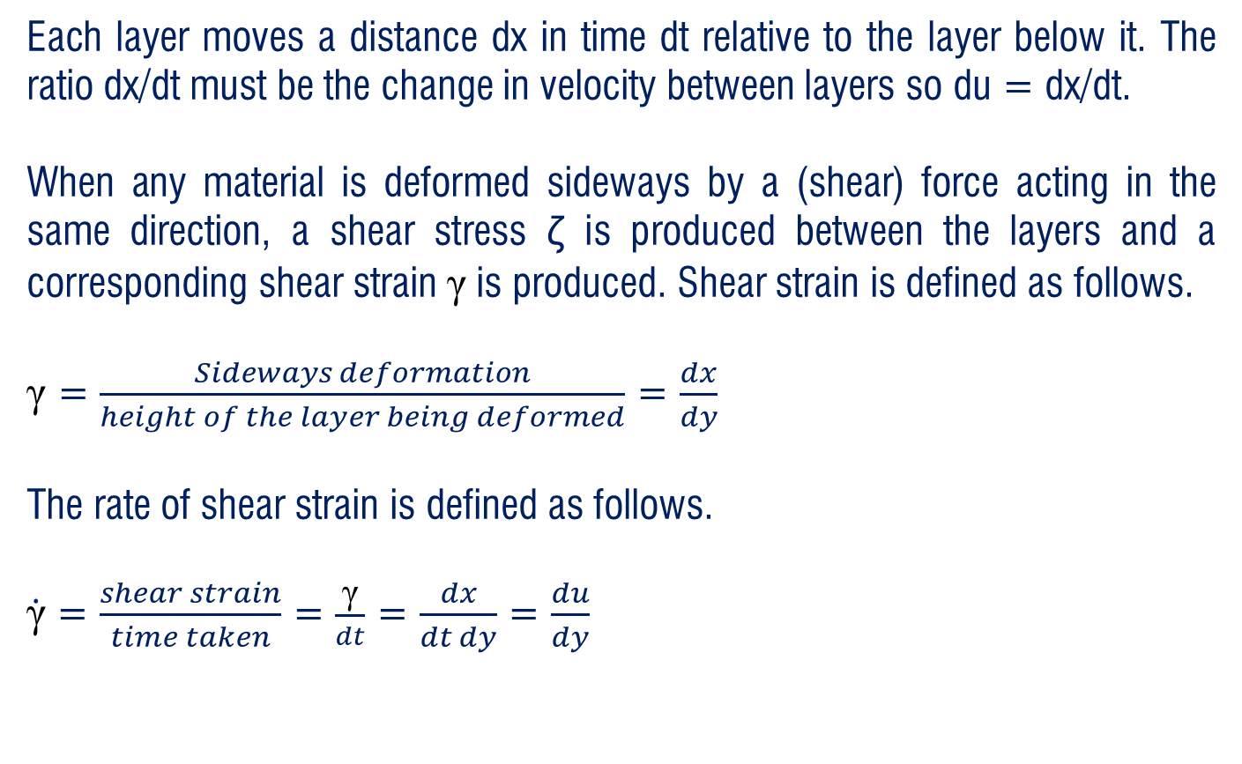
Cont’d …
Each layer moves a distance dx in time dt relative to the layer below it. The ratio dx/dt must be the change in velocity between layers so du = dx/dt.
When any material is deformed sideways by a (shear) force acting in the same direction, a shear stress ζ is produced between the layers and a corresponding shear strain γ is produced. Shear strain is defined as follows.
γ = $\frac{Sideways deformation}{height of the layer being deformed}$ = $\frac{dx}{dy}$
The rate of shear strain is defined as follows.
$\dot{\text{γ}}$ = $\frac{shear strain}{time taken}$ = $\frac{\text{γ}}{dt}$ = $\frac{dx}{dt dy}$ = $\frac{du}{dy}$
AAiT
School of Mechanical and Industrial Engineering - SMiE

Slide 9
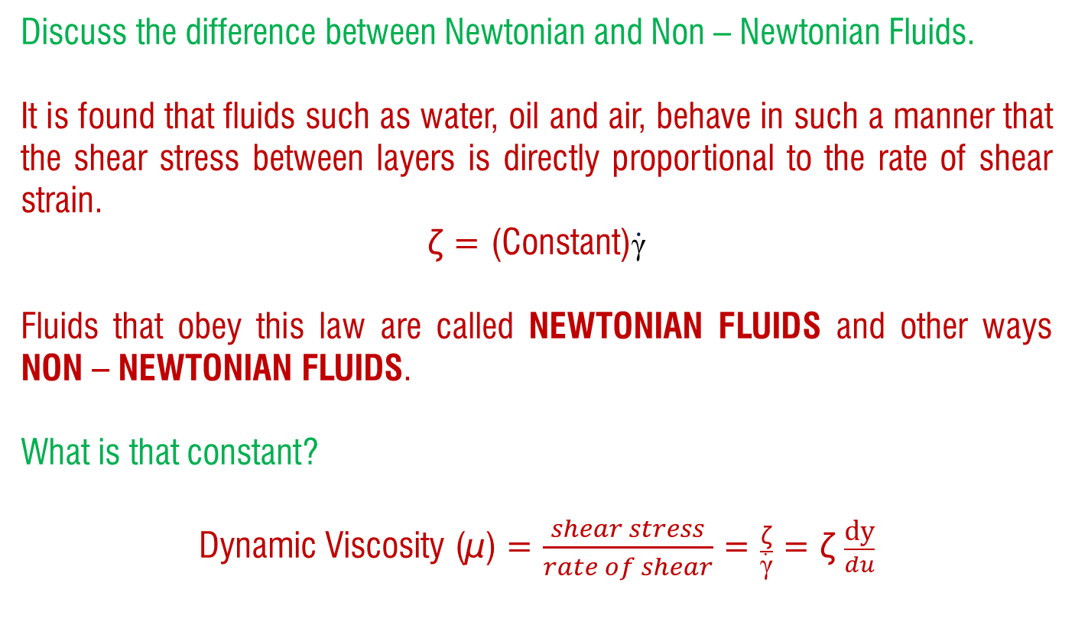
Reflective Activity
Discuss the difference between Newtonian and Non – Newtonian Fluids.
It is found that fluids such as water, oil and air, behave in such a manner that the shear stress between layers is directly proportional to the rate of shear strain.
ζ = (Constant)$\dot{\text{γ}}$
Fluids that obey this law are called NEWTONIAN FLUIDS and other ways NON – NEWTONIAN FLUIDS.
What is that constant?
Dynamic Viscosity (µ) = $\frac{shear stress}{rate of shear}$ = $\frac{\text{ζ}}{\dot{\text{γ}}}$ = ζ $\frac{\text{dy}}{du}$
AAiT
School of Mechanical and Industrial Engineering - SMiE

Slide 10
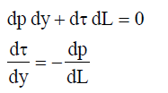
Force Balance and Velocity Distribution – External Flow
A shear stress ζ exists between each layer and this increases by dζ over each layer. The pressure difference between the downstream end and the upstream end is dp.
The pressure change is needed to overcome the shear stress. The total force on a layer must be zero so balancing forces on one layer (assumed 1 m wide) we get the following.
NB: This is for a flow on flat plate
AAiT
School of Mechanical and Industrial Engineering - SMiE

Slide 11
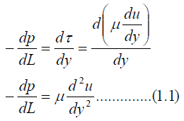
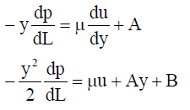
Cont’d …
It is normally assumed that the pressure declines uniformly with distance downstream so the pressure gradient dp/dL is assumed constant. The minus sign indicates that the pressure falls with distance. Integrating between the no slip surface (y = 0) and any height y we get:
Integrating twice to solve u we get the following:
AAiT
School of Mechanical and Industrial Engineering - SMiE

Slide 12
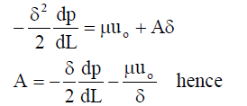
Cont’d …
A and B are constants of integration that should be solved based on the known conditions (boundary conditions). For the flat surface considered in figure 1.1 one boundary condition is that u = 0 when y = 0 (the no slip surface). Substitution reveals the following:
0 = 0 +0 +B hence B = 0
At some height δ above the surface, the velocity will reach the mainstream velocity u_{o}. This gives us the second boundary condition u = u_{o} when y = δ.
Substituting we find the following:
AAiT
School of Mechanical and Industrial Engineering - SMiE

Slide 13
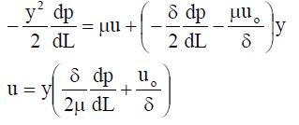
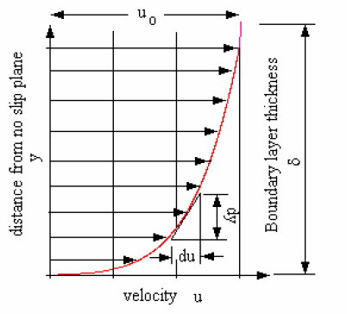
Cont’d …
The velocity distribution
Plotting u against y gives:
Boundary Layer
The velocity grows from zero at the surface to a maximum at height δ. In theory, the value of δ is infinity but in practice it is taken as the height needed to obtain 99% of the mainstream velocity. This layer is called the boundary layer and δ is the boundary layer thickness. The inverse gradient of the boundary layer is du/dy is the rate of shear strain γ.
AAiT
School of Mechanical and Industrial Engineering - SMiE

Slide 14
Force Balance and Velocity Distribution – Internal Flow
We consider steady, laminar, incompressible flow of a fluid with constant properties in the fully developed region of a straight circular pipe.
Free-body diagram of a ring-shaped differential fluid element of radius r, thickness dr, and length dx oriented coaxially with a horizontal pipe in fully developed laminar flow.
AAiT
School of Mechanical and Industrial Engineering - SMiE

Slide 15




Cont’d …
Boundary conditions
Average velocity
Velocity profile
Free-body diagram of a fluid disk element of radius R and length dx in fully developed laminar flow in a horizontal pipe.
Maximim velocity at centerline
AAiT
School of Mechanical and Industrial Engineering - SMiE

Slide 16
Laminar and Turbulent Flows
Laminar Flow:
A stream line is an imaginary line with no flow normal to it, only along it. When the flow is laminar, the streamlines are parallel and for flow between two parallel surfaces we may consider the flow as made up of parallel laminar layers. In a pipe these laminar layers are cylindrical and may be called stream tubes. In laminar flow, no mixing occurs between adjacent layers and it occurs at low average velocities.
Turbulent Flow:
The shearing process causes energy loss and heating of the fluid. This increases with mean velocity. When a certain critical velocity is exceeded, the streamlines break up and mixing of the fluid occurs. The diagram illustrates Reynolds colored ribbon experiment. Colored dye is injected into a horizontal flow. When the flow is laminar the dye passes along without mixing with the water. When the speed of the flow is increased turbulence sets in and the dye mixes with the surrounding water. One explanation of this transition is that it is necessary to change the pressure loss into other forms of energy such as angular kinetic energy as indicated by small eddies in the flow.
AAiT
School of Mechanical and Industrial Engineering - SMiE

Slide 17
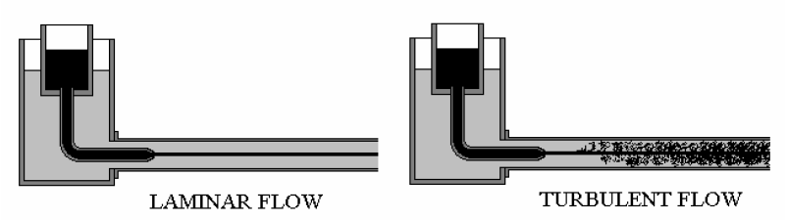
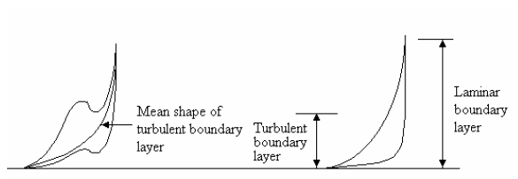
Cont’d …
It was explained that a boundary layer is the layer in which the velocity grows from zero at the wall (no slip surface) to 99% of the maximum and the thickness of the layer is denoted δ. When the flow within the boundary layer becomes turbulent, the shape of the boundary layers waivers and when diagrams are drawn of turbulent boundary layers, the mean shape is usually shown. Comparing a laminar and turbulent boundary layer reveals that the turbulent layer is thinner than the laminar layer. (Why do you think is that?)
AAiT
School of Mechanical and Industrial Engineering - SMiE

Slide 18
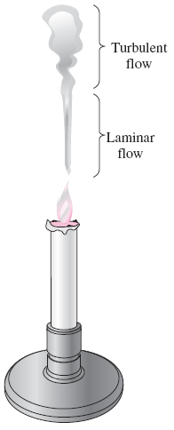
Cont’d …
Turbulent: Velocity fluctuations and highly disordered motion.
Transition: The flow fluctuates between laminar and turbulent flows.
Laminar: smooth streamlines and highly ordered motion.
Most flows encountered in practice are turbulent.
Laminar flow is encountered when highly viscous fluids such as oils flow in small pipes or narrow passages.
Laminar and turbulent flow regimes of candle smoke.
AAiT
School of Mechanical and Industrial Engineering - SMiE

Slide 19
Reynolds Number
The transition from laminar to turbulent flow depends on the geometry, surface roughness, flow velocity, surface temperature, and type of fluid.
The flow regime depends mainly on the ratio of inertial forces to viscous forces (Reynolds number).
At large Reynolds numbers, the inertial forces, which are proportional to the fluid density and the square of the fluid velocity, are large relative to the viscous forces, and thus the viscous forces cannot prevent the random and rapid fluctuations of the fluid (turbulent).
At small or moderate Reynolds numbers, the viscous forces are large enough to suppress these fluctuations and to keep the fluid “in line” (laminar).
Critical Reynolds number, Re_{cr}: The Reynolds number at which the flow becomes turbulent.
The value of the critical Reynolds number is different for different geometries and flow conditions.
AAiT
School of Mechanical and Industrial Engineering - SMiE

Slide 20
Governing Equations of Fluid Flow

Slide 21
Introduction
To formulate/model/solve a fluid flow problem, basic laws will be introduced.
To do so, we might take one of the paths:
Path 1: Seeking to describe the detailed flow pattern at every point (x,y,z) in the field. ➔ Differential Approach
Path 2: Working with finite regions, seeking a balance of flow in versus flow out and determining the gross effects such as force, or torque on a body or total energy exchange. ➔ Integral Approach
This section has outlined three basic approaches to analysis of arbitrary flow problems:
Integral Approach: Control volume is finite
Differential (Control volume) Approach: Control volume is infinitesimally small
Experimental/Dimensional Analysis
AAiT
School of Mechanical and Industrial Engineering - SMiE

Slide 22
System Vs Control Volume
All the laws of fluid mechanics are written for a system, which is defined as an arbitrary quantity of mass of fixed identity. Everything external to this system is denoted by a term surroundings, and the system is separated from its surroundings by its boundaries.
The laws of mechanics then state what happens when there is an interaction between a system and its surroundings.
Control volume is a finite space in the fluid domain where energy and mass enters/leaves/stores.
Individual masses can be considered as a system where as a control volume must be a specific region.
AAiT
School of Mechanical and Industrial Engineering - SMiE

Slide 23
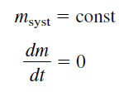

Basic Laws of Fluid Mechanics
Law 1: First the system is a fixed quantity of mass, demoted by m. Then the mass of a system is conserved and not change.
This law of mechanics has a very simple form, called conservation of mass.
Law 2: If the surrounding exert a net force F on the system, Newton’s 2nd law states that the mass begin to accelerate.
This law is applied to a differential control volume of viscous incompressible fluid
AAiT
School of Mechanical and Industrial Engineering - SMiE

Slide 24

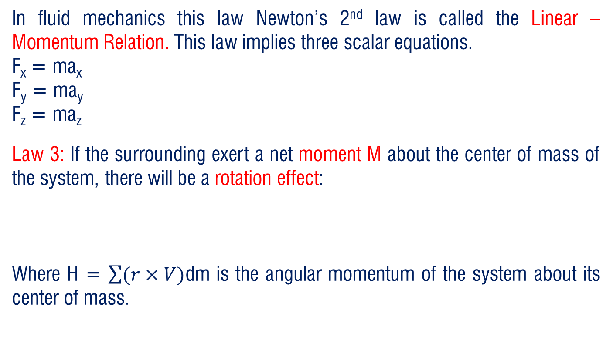
Cont’d …
In fluid mechanics this law Newton’s 2nd law is called the Linear – Momentum Relation. This law implies three scalar equations.
F_{x} = ma_{x}
F_{y} = ma_{y}
F_{z} = ma_{z}
Law 3: If the surrounding exert a net moment M about the center of mass of the system, there will be a rotation effect:
Where H = $\sum{(r×V)}$dm is the angular momentum of the system about its center of mass.
AAiT
School of Mechanical and Industrial Engineering - SMiE

Slide 25
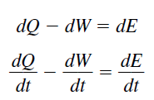

Cont’d …
Law 4: If heat dQ is added to the system and work is done by the system the system energy dE must change according to the relation of first law of thermodynamics.
Law 5: 2nd law of thermodynamics relates entropy change dS to heat added dQ and absolute temperature T.
This law is of less practical importance in incompressible fluid mechanics applications
AAiT
School of Mechanical and Industrial Engineering - SMiE

Slide 26
The Integral Approach
The previous laws or relations are ideal for solid mechanics, where we follow the same system forever because it represents the product we are designing or building.
For example:
We follow a beam as it deflects under load
We follow a piston as it oscillates
We follow a rocket system all its way
But fluid systems do not demand this attention. It is rare that we wish to follow the ultimate path of specific particle of fluid. Instead it is likely that the fluid forms the environment whose effect on the product is needed to be known.
AAiT
School of Mechanical and Industrial Engineering - SMiE

Slide 27
Cont’d …
We wish to know:
Wind load on the beam
(In other words, fluid particles in the wind go after they leave the beam is of little interest to the beam designer)
Fluid pressure on the piston
Drag and lift load on the rocket
This requires that the basic laws be written to apply to a specific region in the neighborhood of product.
In analyzing control volume, we convert the system laws to apply to a specific region which the system may occupy at any instant of time.
By using integral approach, the basic laws are formulated to apply for this local region called control volume and the flow conditions away from the control volume are irrelevant.
AAiT
School of Mechanical and Industrial Engineering - SMiE

Slide 28



Integral Relations for Control Volume
Conservation of Mass
The Linear Momentum Equation
The Energy Equation
AAiT
School of Mechanical and Industrial Engineering - SMiE

Slide 29
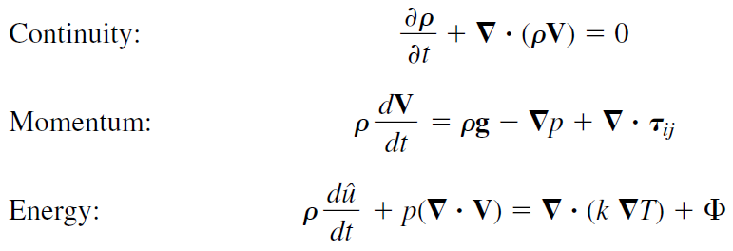
Differential Relations for a Fluid Particle
AAiT
School of Mechanical and Industrial Engineering - SMiE

Slide 30
Thank You
Questions are Welcome!

