Slide 1

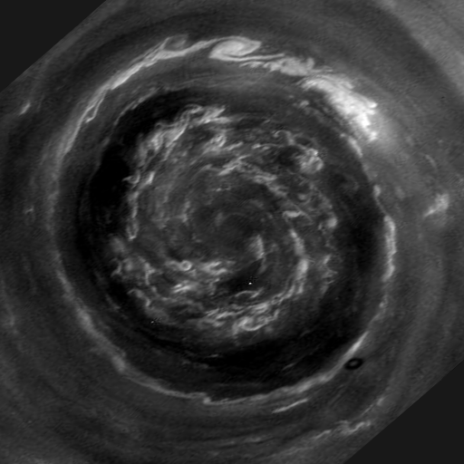
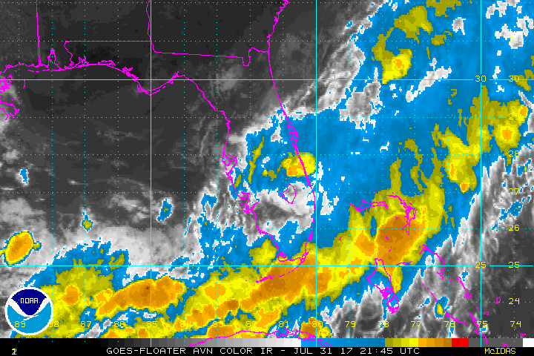
Addis Ababa University
Addis Ababa Institute of Technology
School of Mechanical & Industrial Engineering
Vorticity and Circulation
Fluid Mechanics II - Aerodynamics
Prepared by: Dawit M. (M.Sc.)
Office: 314 - C
E-mail: dwtmus@gmail.com

Slide 2
Outline
  Introduction
  Applications
  Vorticity and Strain Rate
  Side Tilting Analysis
  Irrotationality
  Rotation
  Circulation
AAiT
School of Mechanical and Industrial Engineering - SMiE

Slide 3
Introduction
When previously examining fluid motion, we considered only the changing position and velocity of a fluid element. Now we will take a closer look, and examine the element’s changing shape and orientation.
This will lead us to the discussion of vorticity and circulation.
Circulation and vorticity are the two primary measures of rotation in a fluid.
Vorticity, is a vector field that gives a microscopic measure of the rotation at any point in the fluid.
Circulation, however, is a scalar integral quantity, is a macroscopic measure of rotation for a finite area of the fluid.
AAiT
School of Mechanical and Industrial Engineering - SMiE

Slide 4
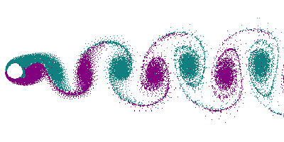
Applications
AAiT
School of Mechanical and Industrial Engineering - SMiE

Slide 5
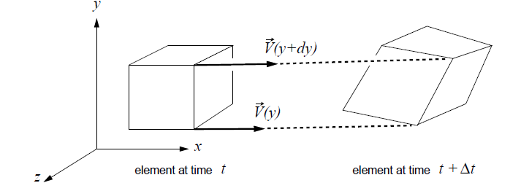
Vorticity and Strain Rate
Consider a moving fluid element which is initially rectangular, as shown in the figure. If the velocity varies significantly across the extent of the element, its corners will not move in unison, and the element will rotate and become distorted.
AAiT
School of Mechanical and Industrial Engineering - SMiE

Slide 6
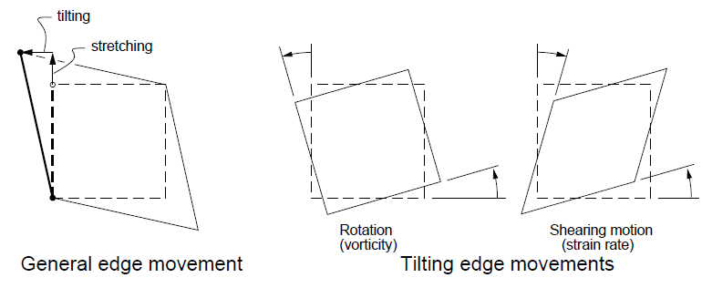
Cont’d …
In general, the edges of the element can undergo some combination of tilting and stretching. For now we will consider only the tilting motions, because this has by far the greatest implications for aerodynamics.
The figure below on the right shows two particular types of element-side tilting motions. If adjacent sides tilt equally and in the same direction, we have pure rotation. If the adjacent sides tilt equally and in opposite directions, we have pure shearing motion.
AAiT
School of Mechanical and Industrial Engineering - SMiE

Slide 7
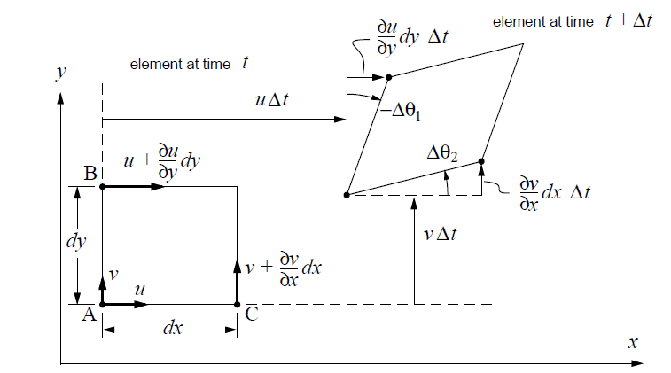
Side Tilting Analysis
Consider the 2-D element in the xy plane, at time t, and again at time t + ∆t.
AAiT
School of Mechanical and Industrial Engineering - SMiE

Slide 8



Cont’d …
Points A and B have an x-velocity which differs by ∂u/∂y dy. Over the time interval ∆t they will then have a difference in x displacements equal to:
and the associated angle change of side AB is:
assuming small angles. A positive angle is defined counterclockwise. We now define a time rate of change of this angle as follows.
AAiT
School of Mechanical and Industrial Engineering - SMiE

Slide 9



Cont’d …
Similar analysis of the angle rate of side AC gives:
Vorticity
The angular velocity of the element, about the z axis in this case, is defined as the average angular velocity of sides AB and AC.
The same analysis in the xz and yz planes will give a 3-D element’s angular velocities ω_{y} and ω_{x}.
AAiT
School of Mechanical and Industrial Engineering - SMiE

Slide 10



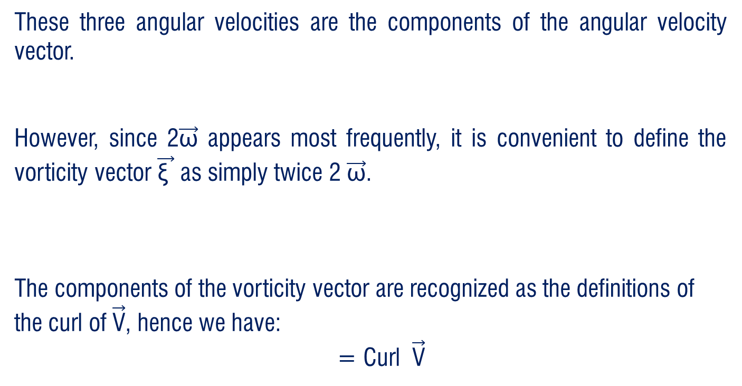
Cont’d …
These three angular velocities are the components of the angular velocity vector.
However, since 2$\vec{\text{ω}}$ appears most frequently, it is convenient to define the vorticity vector $\vec{\text{ξ} }$ as simply twice 2 $\vec{\text{ω}}$.
The components of the vorticity vector are recognized as the definitions of the curl of $\vec{\text{V}}$, hence we have:
= Curl $\vec{\text{V}}$
AAiT
School of Mechanical and Industrial Engineering - SMiE

Slide 11


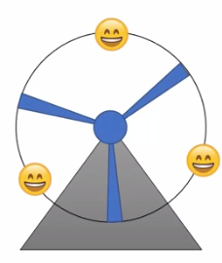
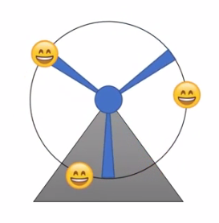
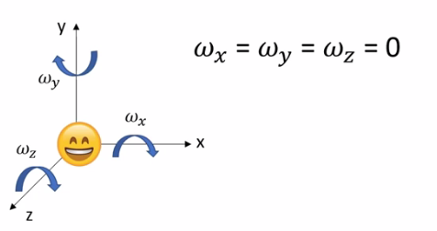
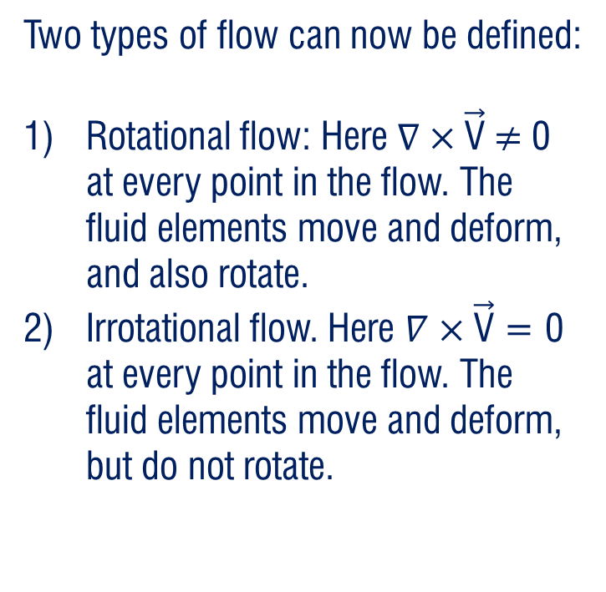
Irrotationality
Irrotational
Two types of flow can now be defined:
Rotational flow: Here $∇×\vec{\text{V}}$ $≠$ 0 at every point in the flow. The fluid elements move and deform, and also rotate.
Irrotational flow. Here $∇×\vec{\text{V}}$ = 0 at every point in the flow. The fluid elements move and deform, but do not rotate.
AAiT
School of Mechanical and Industrial Engineering - SMiE

Slide 12


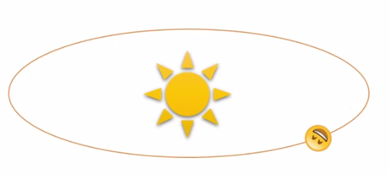

Rotational Flow
Many flows have negligible or zero vorticity and are called Irrotational.
Irrotationality:
Curl $\vec{\text{V}}$ = 0
Rotationality:
$∇×\vec{\text{V}}$ $≠$ 0
AAiT
School of Mechanical and Industrial Engineering - SMiE

Slide 13

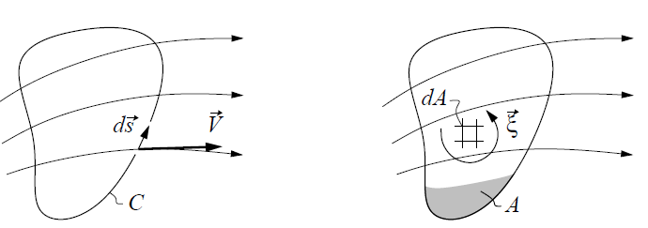
Circulation
Consider a closed curve C in a velocity field as shown in the figure on the left. The instantaneous circulation around curve C is defined by:
In 2-D, a line integral is counterclockwise by convention. But aerodynamicists like to define circulation as positive clockwise, hence the minus sign.
AAiT
School of Mechanical and Industrial Engineering - SMiE

Slide 14



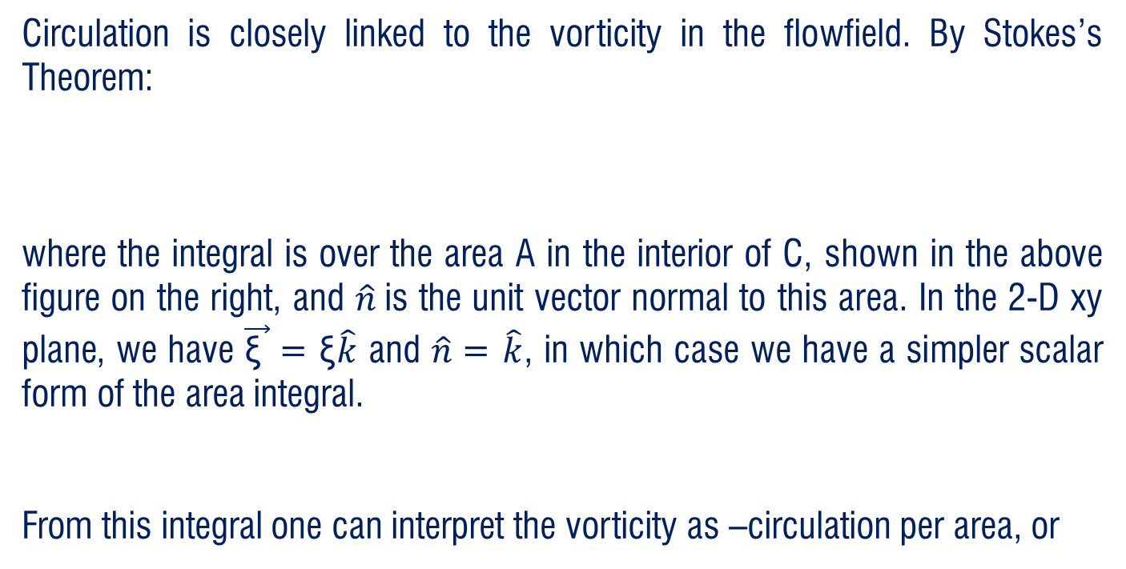
Cont’d …
Circulation is closely linked to the vorticity in the flowfield. By Stokes’s Theorem:
where the integral is over the area A in the interior of C, shown in the above figure on the right, and $\hat{n}$is the unit vector normal to this area. In the 2-D xy plane, we have $\vec{\text{ξ} }$= ξ$\hat{k}$ and $\hat{n}$= $\hat{k}$, in which case we have a simpler scalar form of the area integral.
From this integral one can interpret the vorticity as –circulation per area, or
AAiT
School of Mechanical and Industrial Engineering - SMiE

Slide 15
Thank You
Questions are Welcome!

