Slide 1
Structured cabling and Installation
Lecture Three
By: Eyob Gebretinsae

Slide 2
Cable End to End Accessories
  Contents
Standards
CABINETS, RACKS & ENCLOSURES
Faceplates and Keystone jacks
Floor Boxes
Data and Voice Patch panels
Fiber Patch panels and its accessories

Slide 3
Standards
Network cabling standards are used internationally and are published by ISO/IEC, CENELEC and the Telecommunications Industry Association (TIA).
Most European countries use CENELEC, International Electro technical Commission (IEC) or International Organization for Standardization (ISO) standards
The Telecommunications Industry Association (USA)

Slide 4
CABINETS, RACKS & ENCLOSURES
House IT equipment in a variety of wall mount and freestanding racks.
19” cabinets are typically used in commercial or advanced home installations where either a high number of cabling system connections are required or where there will be a lot of equipment installed in the cabinet.
Servers come in a wide variety of depths.
Not all server racks are made equal, and one size does not fit all applications.
Ranging from 4U to 45U, fixed depth to adjustable depth, 24" to 30"W and 24"D to 48"D with different accessory option.
A standard server rack is often quite a bit cheaper than more robust versions
E.g. Standard 42u 19" rack to fit an HP, Dell, IBM or other top brand

Slide 5
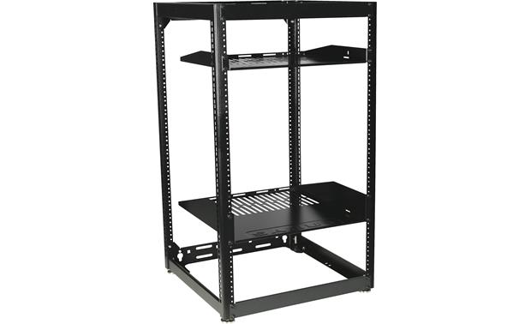
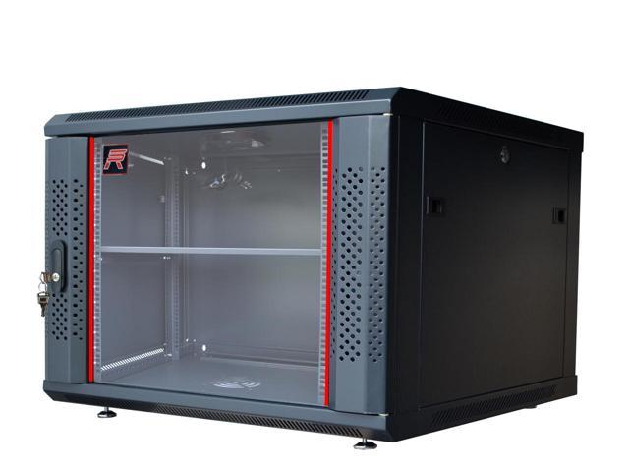
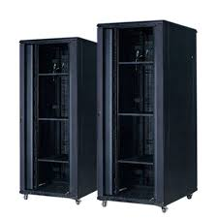
Cabinet height is measured in cabinet Units (U) with one 24 port patch panel typically requiring 1U(1U = 44mm).
Customers often choose these server racks because they are standard heights ranging from 18u to 48u and standard 19" and 23" widths with traditional options like removable side panels and basic locking front and rear doors.
Depth 450mm, 600mm,800mm,1000mm and 1200mm

Slide 6
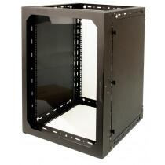
Rack Types
Wall Mount Rack:-
4U-15U of Rack Space (4U,6U,9U,12U,15U)
It Includes side panels and doors
Used for Small, peripheral devices like Patch panels & network devices
Installations requiring moderate security
Easy cable access & tie points

Slide 7
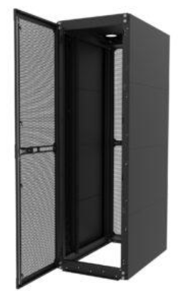
Server Rack Cabinet
Floor standing cabinets are used where lots of space is required for cabling system hardware or heavy equipment.
Server cabinet is typically enclosed. Meaning it has doors in the front and rear of the rack;
These doors are usually perforated in order increase ventilation within the enclosure.
A server rack cabinet offers additional security due to its ability to be locked.
Server rack is used to mount server mounted racks, UPS and Swithces
A rack-mounted server is a server specifically made to be housed in a server rack.

Slide 8

Data Center Server Racks
Fully integrated solutions provide an optimized environment for critical hardware.
Data center server rack cabinets combine strength, airflow management and customizability.
Numerous power mounting and cable management options make cabinets extremely configurable.

Slide 9
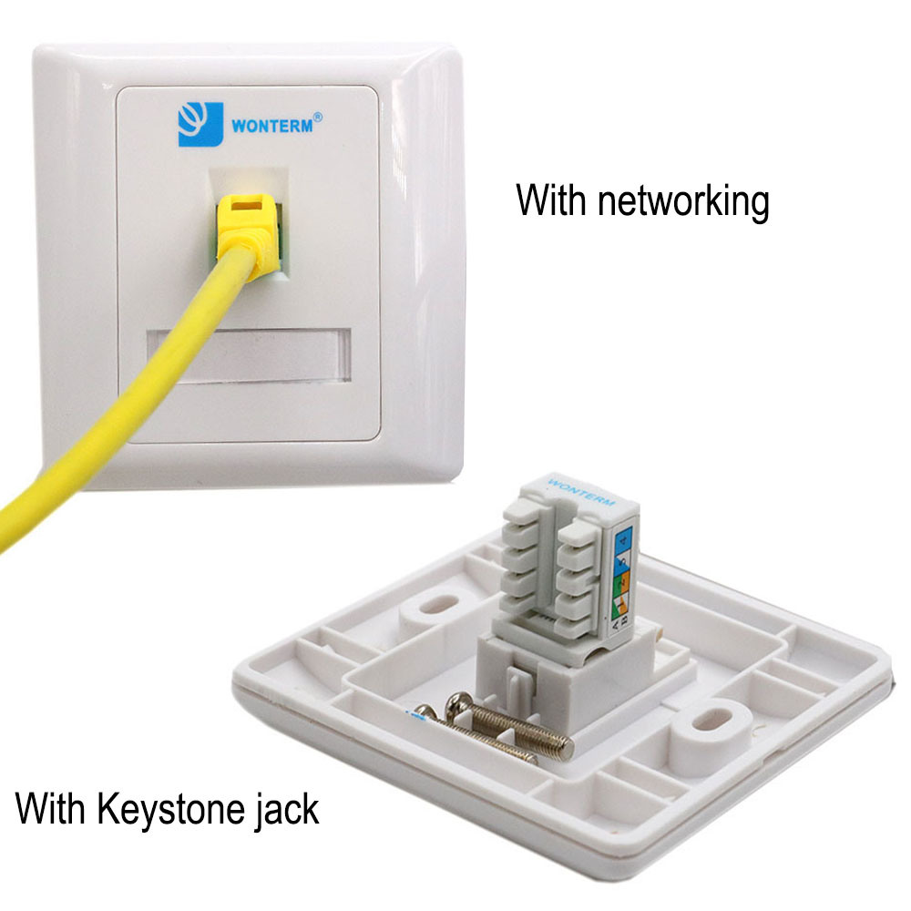
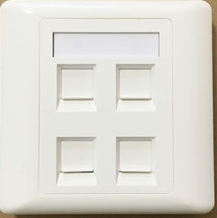
Faceplates and Keystone jacks
Faceplate
Also known as wall plates or outlet covers, networking faceplates are plastic or metal plates used for Cat5 cable, Cat5e or Cat6 Ethernet cable installation.
The standard household outlet is a single-gang duplex receptacle, but two-gang duplex outlets are also common.

Slide 10
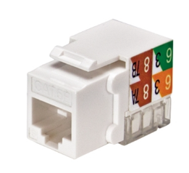
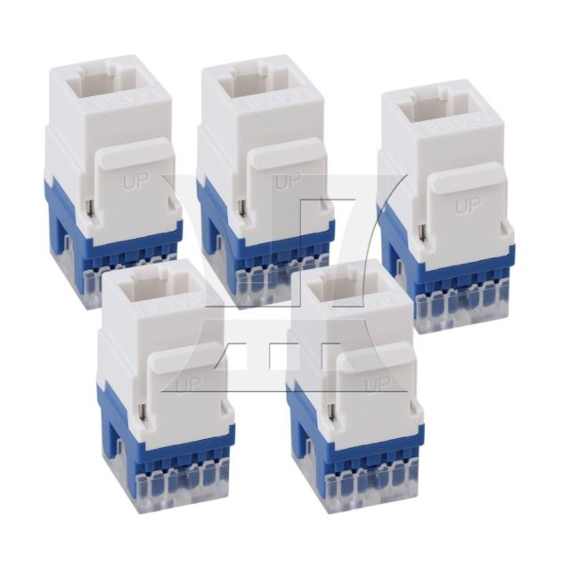
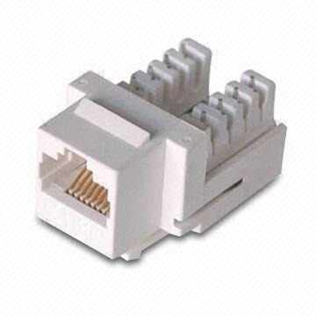
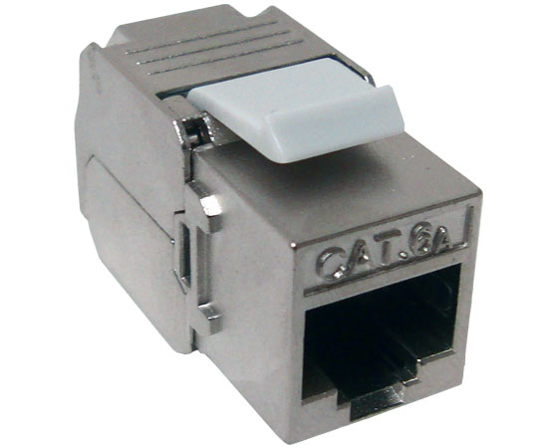
Keystone Jacks
A keystone jack is a standardized snap-in package for mounting a variety of low-voltage electrical jacks or optical connectors into a keystone wall plate, faceplate, surface-mount box, or a patch panel.
Keystone jacks have a rectangular face of 14.5mm wide by 16.0mm high and are held in place with flexible tabs.
All keystones, regardless of the type of jack they carry, are interchangeable and replaceable.
This provides much flexibility in arranging and mounting many different types of electrical jacks in one plate or panel without requiring customized manufacturing.

Slide 11
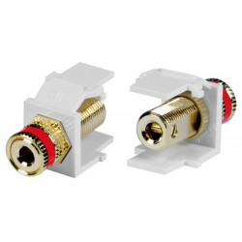
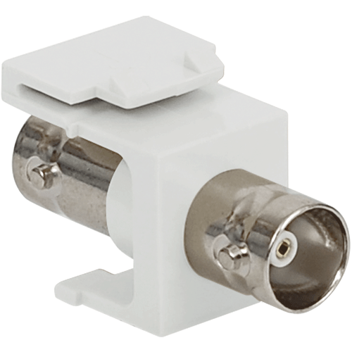
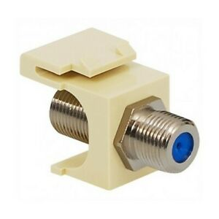
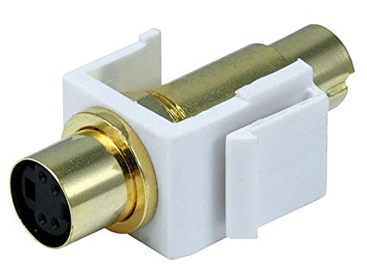
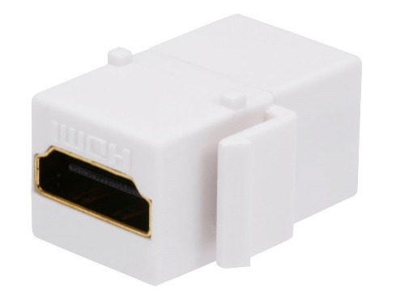
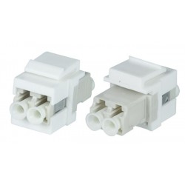
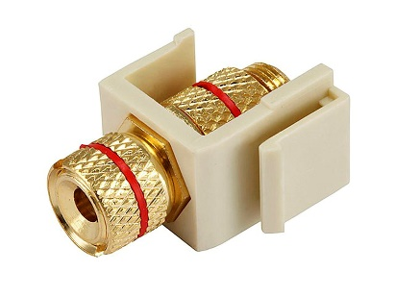
Types of jacks
6P6C (RJ-11) modular jacks (telephone)
8P8C modular jacks (computer networking)
F connector (TV antenna/cable/satellite)
RCA jacks (audio/video)
4-pin mini-DIN (S-Video jacks)
HDMI jacks (high-definition video and audio)
Optical fiber connectors
BNC connector
USB jacks
Speaker terminals
Banana connectors

Slide 12
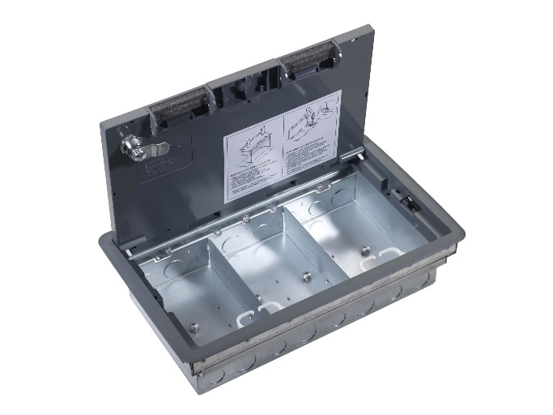
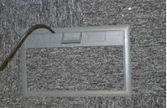
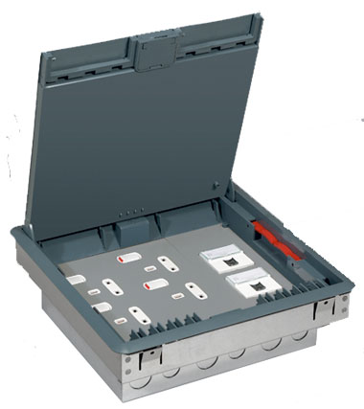
Floor Boxes
A floor box is an electrical box that is placed into the floor.
There are many reasons that floor boxes may be required in a commercial premises.
Floor boxes can be used to provide data and electrical supplies for desks situated away from walls.
There are several different types of floor boxes; plastic, carpet tile, concrete, wooden floor, brass covered, metal covered, data ports, electrical ports, pop up, slide and flip over.

Slide 13
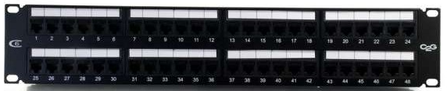
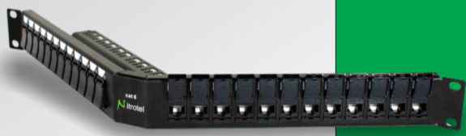
Data and Voice Patch panels
Ethernet Patch Panel
Patch panel plays a very important role in Network cabling.
Patch panel can be described as a patch bay having multiple units of Network jacks stacked together in row to connect and route network data.
Patch panel comes usually in the following count of ports
  12 port
  24 port
  48 port
  96 port
  Feed through Patch panels
Based on the wire management and Server rack, they are also defined by U’s
1U Blank Patch Panels
2U Blank Patch Panels
3U Blank Patch Panels

Slide 14
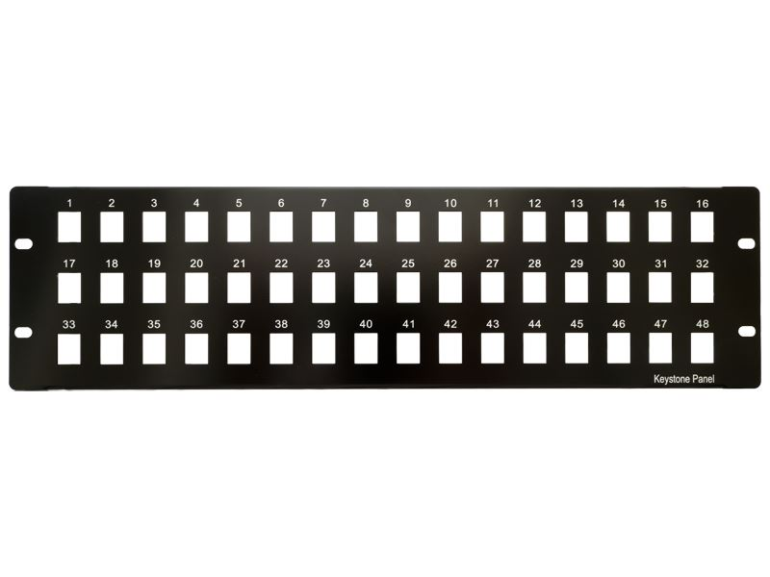
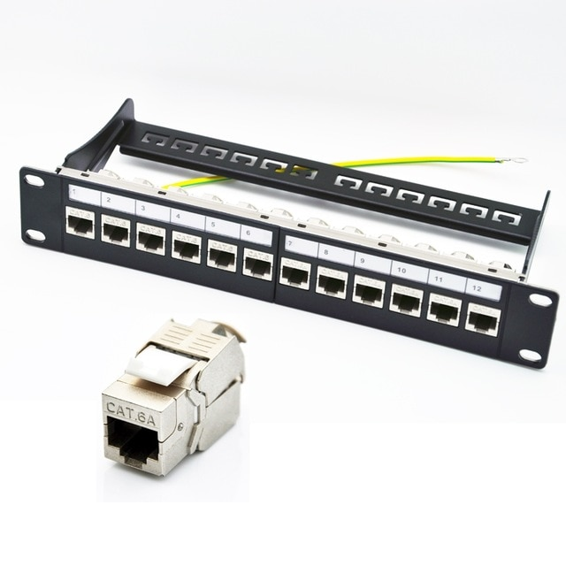
Ethernet Blank Patch Panel
The keystone blank patch panel offers unlimited flexibility for customization of different applications.
The port openings will accommodate all keystone jacks, including RJ45 Ethernet, HDMI audio/video, voice and USB applications.

Slide 15
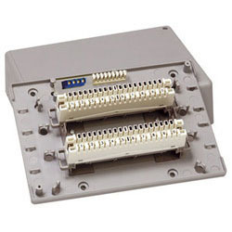
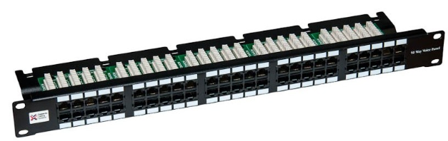
Voice Patch panels and Tele MDF
19” rack mounted voice patch panels are available in 1U 25 & 50 port versions to ensure maximum utilization of cabinet space
4 and 6 pin versions available
Each 8 way RJ45 socket has three pairs connected.
This ensures that the panels can be used with analogue, digital and ISDN systems Features:

Slide 16
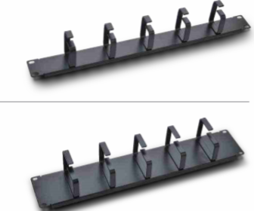

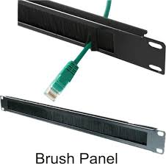
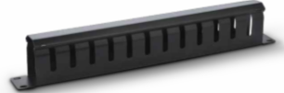
Cable Organizer panel, Blank Patch panels and Brush Patch panels
The 1U blank panel fits all 19 inch standard server rack and cabinets.
The panel uses metal material which helps ensure superior thermal insulation performance.
It’s an ideal tool for improving airflow within the rack by covering the unused spaces.

Slide 17


Fiber Patch panels and its accessories
There are two kinds of fiber optic patch panels: the rack mounted, and the wall mounted wherein both are usually placed near the terminating equipment.
Fiber optic patch panels are used in fiber optic management.
These patch panels fix and manage the fiber optic cables inside the box and provide protection at the same time.
Often times, two ports stand together on a panel are prepared to connect a pair of wires. One port acts as the transmitting end while the other is the receiving end.
Different Fiber patch panels designed with different number of ports(6,12,24,48) and connector types like SC, LC

Slide 18
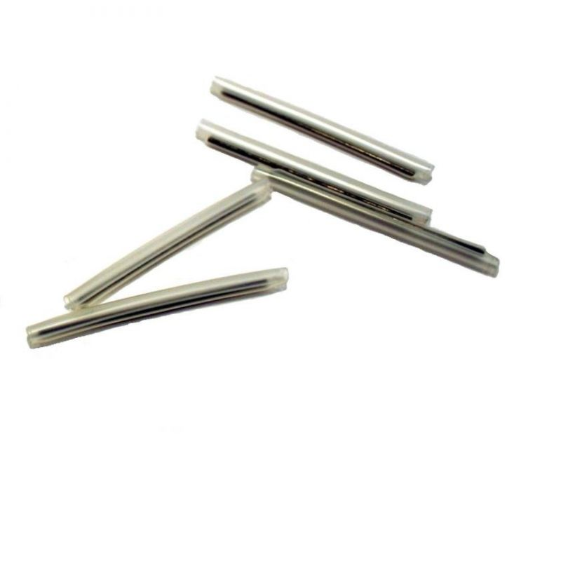
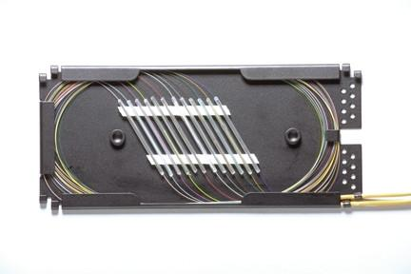
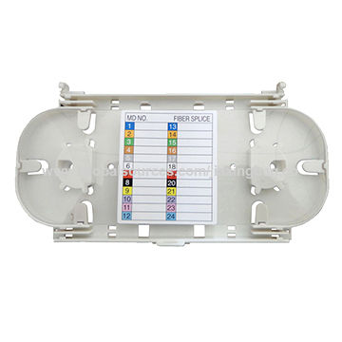
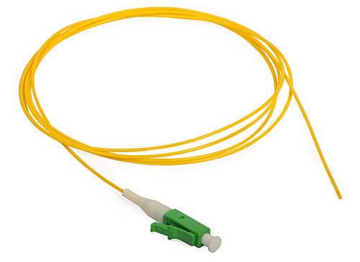
Fiber optic pigtails, Connectors, Trays and Splice Protectors
Fiber optic pigtails are basically used to splice with the fiber so that they can be connected to the patch panel or equipment.
Fiber optic splice trays provide physical security, and organization for fusion splices
splice protectors used to protect fusion splices, they are available in various lengths for either single fibre or ribbon fibre splices.

Slide 19
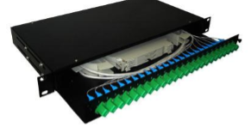
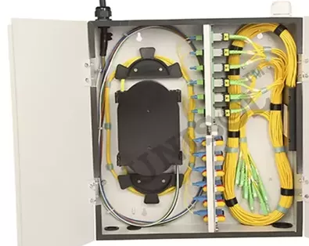
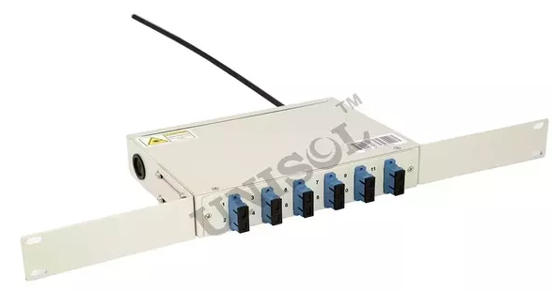
Components of the typical fiber optic patch panel
Enclosed chamber houses the cable units and cable links.
It can be wall mounted or an equipment rack.
Coupler panels or adapter panels are used to hold the connector couplers, also known as connector adapters
Splice tray is used to organize and secure splice modules

Slide 20
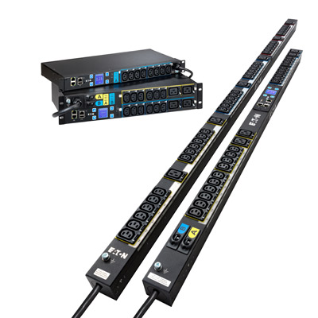
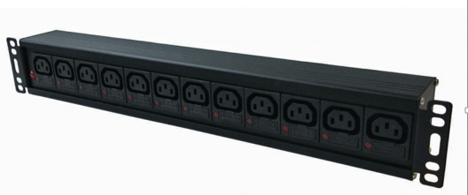
PDUs and Intelligent PDU
Basic PDUs are power strips used in data center environments. They distribute voltage and current to supply power to racked IT equipment.
An Intelligent Power Distribution Unit (iPDU) is a networked power distribution unit that increases the efficiencies of data centers with real-time remote power monitoring, environmental monitoring, and data center infrastructure integration.
Intelligent rack PDUs deliver technologies which
enables a smarter IT infrastructure so you can stay
ahead of problems before they occur.

