Slide 1
Chapter One: Architectural Styles| Design Patterns and Objects: Preliminaries
Sem. II - 2020
Department of Software Engineering
ITSC-AAIT
Dr. V Sunkari
Software Engineering II (Design, Verification and Validation)

Slide 2
Architectural Design
Architectural design is concerned with understanding how a software system should be organized and designing the overall structure of that system.
Architectural design is the critical link between design and requirements engineering, as it identifies the main structural components in a system and the relationships between them.
The output of the architectural design process is an architectural model that describes how the system is organized as a set of communicating components.
An early stage of agile processes is to design an overall systems architecture.
Refactoring the system architecture – expensive.
Software Engineering II (Design, Verification and Validation)
Notes:
Expensive – because it affects many other components

Slide 3
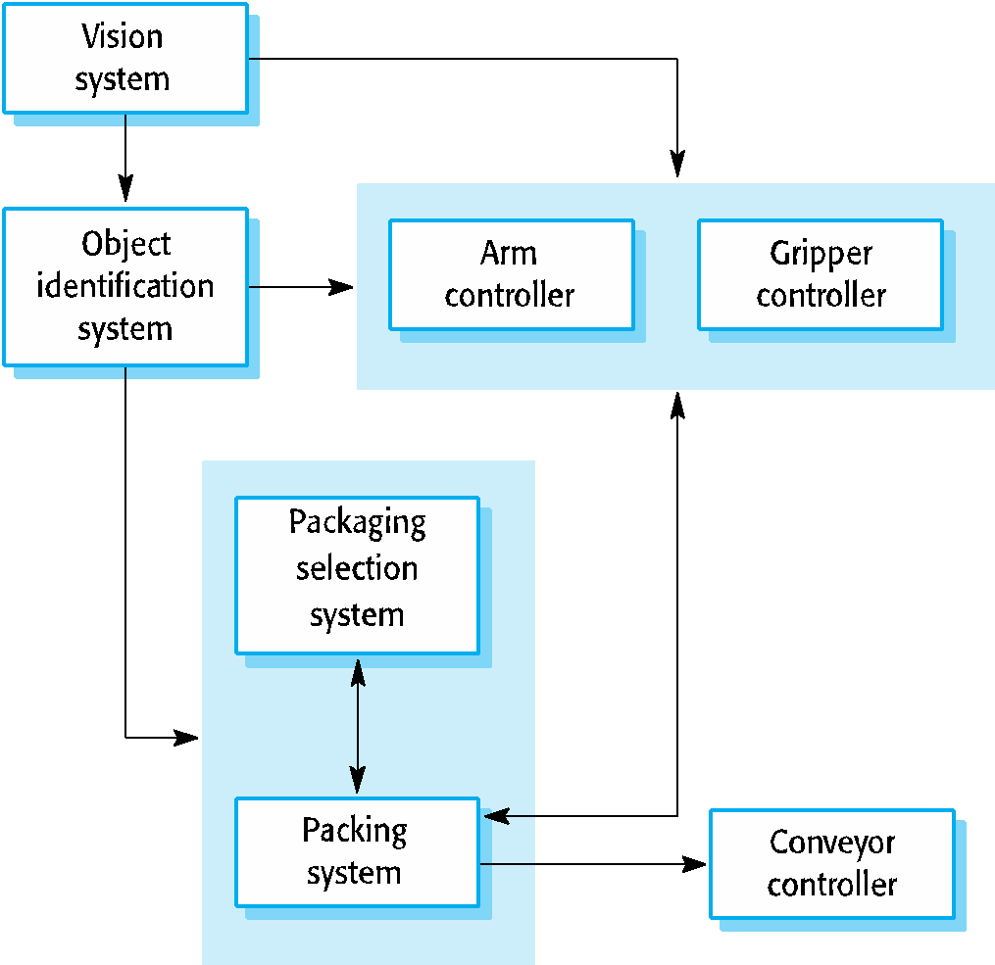
Architecture - Example
Software Engineering II (Design, Verification and Validation)
Notes:
Gripper
Conveyor

Slide 4
Architectural Abstraction
Program Level Architecture - concerned with the way that an individual program is decomposed into components.
System Level Architecture - concerned with the architecture of complex enterprise systems that include other systems, programs, and program components. These enterprise systems are distributed over different computers, which may be owned and managed by different companies.
Software Engineering II (Design, Verification and Validation)

Slide 5
Advantages of Explicit Architecture
Stakeholder Communication
Architecture may be used as a focus of discussion by system stakeholders.
System Analysis
Analysis of whether the system can meet its non-functional requirements.
Large-Scale Reuse
The architecture may be reusable across a range of systems
Product-line architectures may be developed.
Software Engineering II (Design, Verification and Validation)
Notes:
A software product line architecture is one that could be used for software-intensive systems that share a common, managed set of features satisfying the specific needs of a particular market segment or mission and that are developed from a common set of core assets in a prescribed way.

Slide 6
Architectural Representations
Simple, informal block diagrams showing entities and relationships are the most frequently used method for documenting software architectures.
But these have been criticized because, they lack semantics, do not show the types of relationships between entities nor the visible properties of entities in the architecture.
The requirements for model semantics depends on how the models are used.
Software Engineering II (Design, Verification and Validation)

Slide 7
Box and Line Diagrams
Very Abstract - they do not show the nature of component relationships nor the externally visible properties of the sub-systems.
However, useful for communication with stakeholders and for project planning.
Software Engineering II (Design, Verification and Validation)

Slide 8
Use of Architectural Models
As a way of facilitating discussion about the system design
A high-level architectural view of a system is useful for communication with system stakeholders and project planning because it is not cluttered with detail. Stakeholders can relate to it and understand an abstract view of the system. They can then discuss the system as a whole without being confused by detail.
As a way of documenting an architecture that has been designed
The aim here is to produce a complete system model that shows the different components in a system, their interfaces and their connections.
Software Engineering II (Design, Verification and Validation)

Slide 9
Architectural Design Decisions
Architectural design is a creative process so the process differs depending on the type of system being developed.
However, a number of common decisions span all design processes and these decisions affect the non-functional characteristics of the system.
Software Engineering II (Design, Verification and Validation)

Slide 10
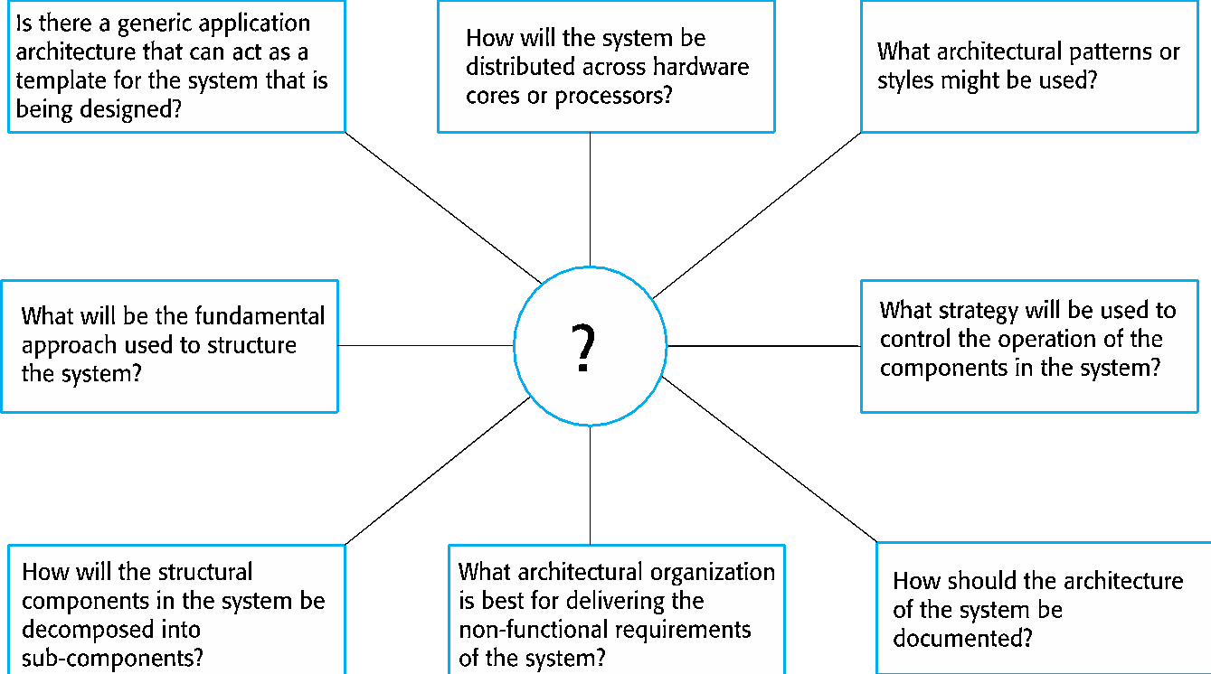
Architectural Design Decisions
Software Engineering II (Design, Verification and Validation)

Slide 11
Architecture Reuse
Systems in the same domain often have similar architectures that reflect domain concepts.
Application product-lines are built around a core architecture with variants that satisfy particular customer requirements.
The architecture of a system may be designed around one of more architectural patterns or ‘styles’.
These capture the essence of an architecture and can be instantiated in different ways.
Software Engineering II (Design, Verification and Validation)

Slide 12
Architecture and System Characteristics
Performance
Localize critical operations and minimize communications. Use large rather than fine-grain components.
Security
Use a layered architecture with critical assets in the inner layers.
Safety
Localize safety-critical features in a small number of sub-systems.
Availability
Include redundant components and mechanisms for fault tolerance.
Maintainability
Use fine-grain, replaceable components.
Software Engineering II (Design, Verification and Validation)

Slide 13
Architectural Views
What views or perspectives are useful when designing and documenting a system’s architecture?
What notations should be used for describing architectural models?
Each architectural model only shows one view or perspective of the system.
It might show how a system is decomposed into modules, how the run-time processes interact or the different ways in which system components are distributed across a network. For both design and documentation, you usually need to present multiple views of the software architecture.
Software Engineering II (Design, Verification and Validation)

Slide 14
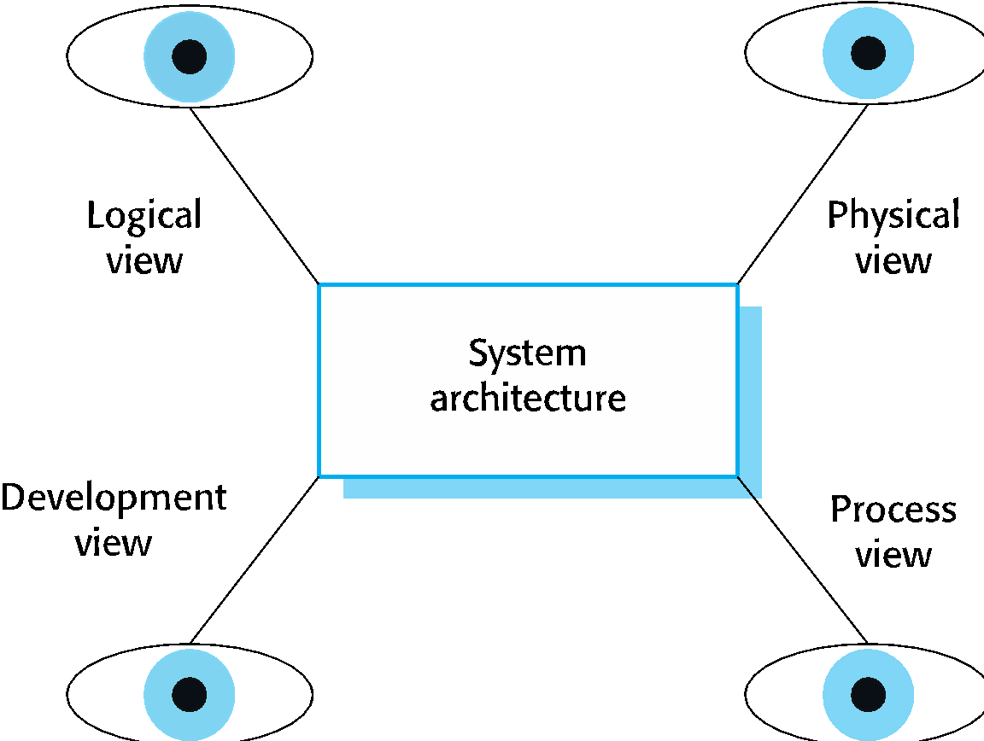
Architectural Views
Software Engineering II (Design, Verification and Validation)

Slide 15
4 + 1 View Model of Software Architecture
A logical view, which shows the key abstractions in the system as objects or object classes.
A process view, which shows how, at run-time, the system is composed of interacting processes.
A development view, which shows how the software is decomposed for development.
A physical view, which shows the system hardware and how software components are distributed across the processors in the system.
Related using use cases or scenarios (+1)
Software Engineering II (Design, Verification and Validation)

Slide 16
Representing Architectural Views
Some people argue that the Unified Modeling Language (UML) is an appropriate notation for describing and documenting system architectures.
Architectural description languages (ADLs) have been developed but are not widely used.
Software Engineering II (Design, Verification and Validation)

Slide 17
Architectural Patterns
Patterns are a means of representing, sharing and reusing knowledge.
An architectural pattern is a stylized description of good design practice, which has been tried and tested in different environments.
Patterns should include information about when they are and when they are not useful.
Patterns may be represented using tabular and graphical descriptions.
Software Engineering II (Design, Verification and Validation)

Slide 18
The Model-View-Controller (MVC) Pattern
Name | MVC (Model-View-Controller)
Description | Separates presentation and interaction from the system data. The system is structured into three logical components that interact with each other. The Model component manages the system data and associated operations on that data. The View component defines and manages how the data is presented to the user. The Controller component manages user interaction (e.g., key presses, mouse clicks, etc.) and passes these interactions to the View and the Model.
Example | The architecture of a web-based application system organized using the MVC pattern.
When used | Used when there are multiple ways to view and interact with data. Also used when the future requirements for interaction and presentation of data are unknown.
Advantages | Allows the data to change independently of its representation and vice versa. Supports presentation of the same data in different ways with changes made in one representation shown in all of them.
Disadvantages | Can involve additional code and code complexity when the data model and interactions are simple.
Software Engineering II (Design, Verification and Validation)

Slide 19
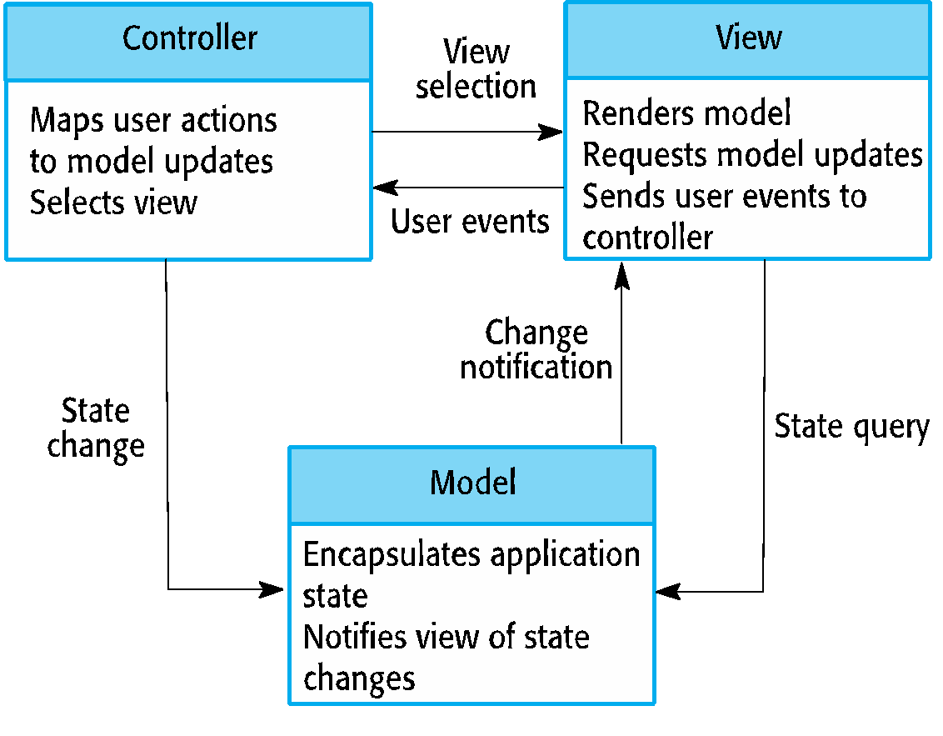
The organization of the Model-View-Controller
Software Engineering II (Design, Verification and Validation)

Slide 20
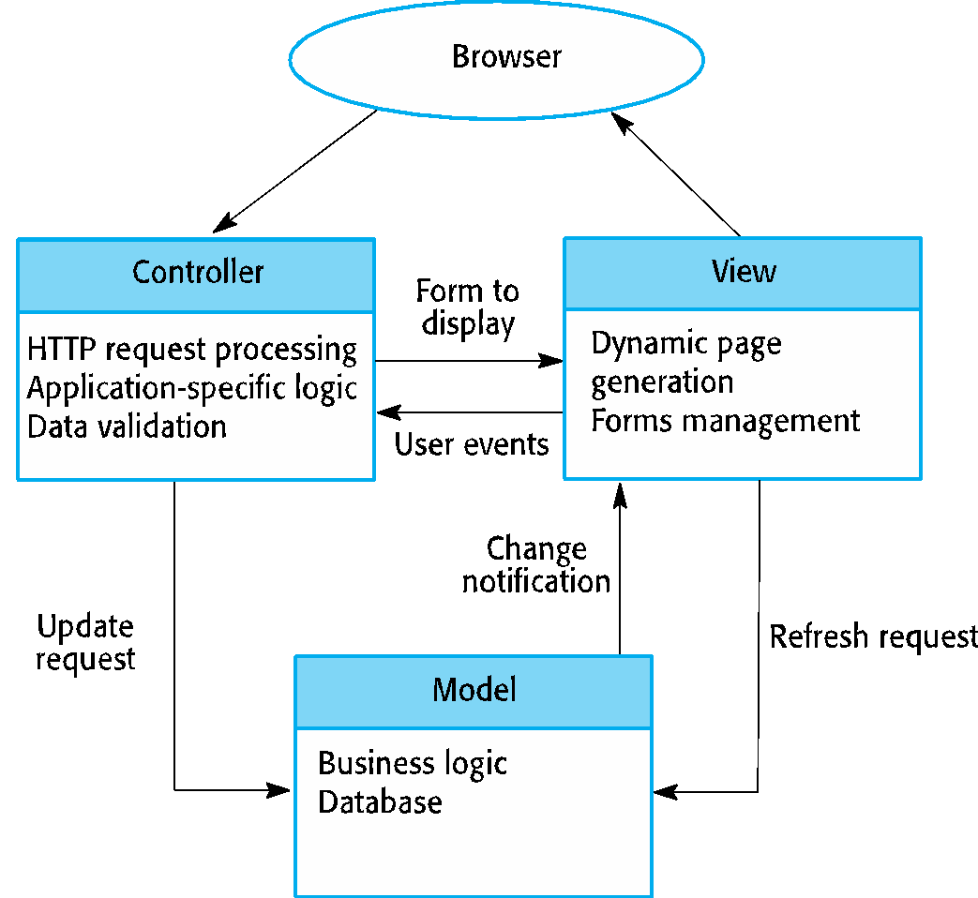
Web Application Architecture using the MVC Pattern
Software Engineering II (Design, Verification and Validation)

Slide 21
Layered Architecture
Used to model the interfacing of sub-systems.
Organizes the system into a set of layers (or abstract machines) each of which provide a set of services.
Supports the incremental development of sub-systems in different layers. When a layer interface changes, only the adjacent layer is affected.
However, often artificial to structure systems in this way.
Software Engineering II (Design, Verification and Validation)

Slide 22
The Layered Architecture Pattern
Name | Layered architecture
Description | Organizes the system into layers with related functionality associated with each layer. A layer provides services to the layer above it so the lowest-level layers represent core services that are likely to be used throughout the system.
Example | A layered model of a system for sharing copyright documents held in different libraries.
When used | Used when building new facilities on top of existing systems; when the development is spread across several teams with each team responsibility for a layer of functionality; when there is a requirement for multi-level security.
Advantages | Allows replacement of entire layers so long as the interface is maintained. Redundant facilities (e.g., authentication) can be provided in each layer to increase the dependability of the system.
Disadvantages | In practice, providing a clean separation between layers is often difficult and a high-level layer may have to interact directly with lower-level layers rather than through the layer immediately below it. Performance can be a problem because of multiple levels of interpretation of a service request as it is processed at each layer.
Software Engineering II (Design, Verification and Validation)

Slide 23
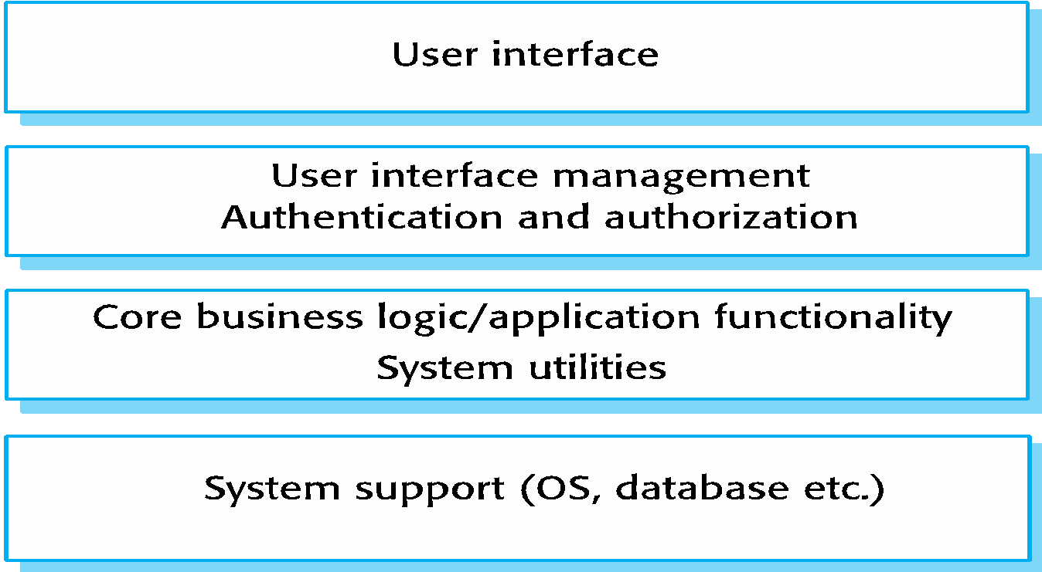
A Generic Layered Architecture
Software Engineering II (Design, Verification and Validation)

Slide 24
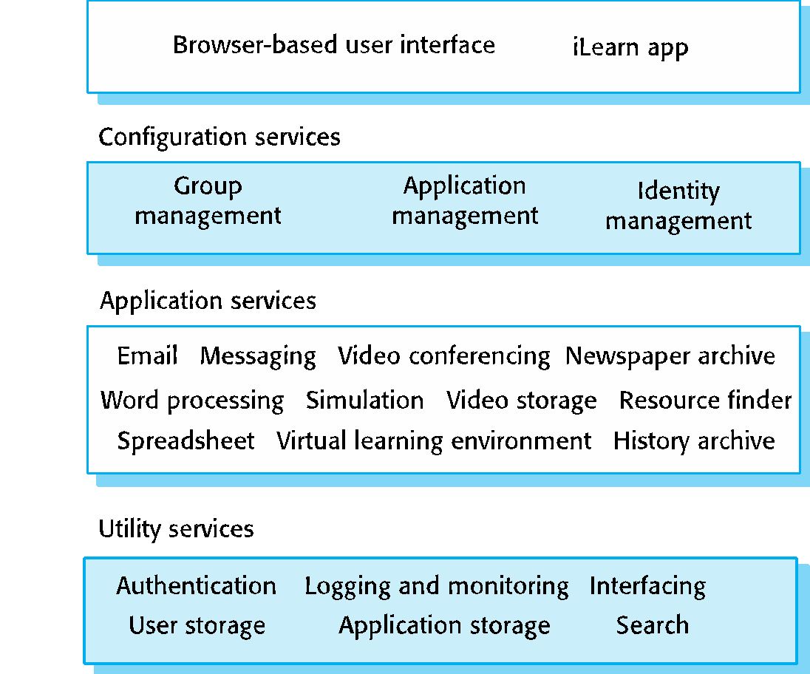
The Architecture of the iLearn System
Software Engineering II (Design, Verification and Validation)

Slide 25
Repository Architecture
Sub-systems must exchange data. This may be done in two ways:
Shared data is held in a central database or repository and may be accessed by all sub-systems;
Each sub-system maintains its own database and passes data explicitly to other sub-systems.
When large amounts of data are to be shared, the repository model of sharing is most commonly used as an efficient data sharing mechanism.
Software Engineering II (Design, Verification and Validation)

Slide 26
The Repository Pattern
Name | Repository
Description | All data in a system is managed in a central repository that is accessible to all system components. Components do not interact directly, only through the repository.
Example | an IDE where the components use a repository of system design information. Each software tool generates information which is then available for use by other tools.
When used | You should use this pattern when you have a system in which large volumes of information are generated that has to be stored for a long time. You may also use it in data-driven systems where the inclusion of data in the repository triggers an action or tool.
Advantages | Components can be independent—they do not need to know of the existence of other components. Changes made by one component can be propagated to all components. All data can be managed consistently (e.g., backups done at the same time) as it is all in one place.
Disadvantages | The repository is a single point of failure so problems in the repository affect the whole system. May be inefficiencies in organizing all communication through the repository. Distributing the repository across several computers may be difficult.
Software Engineering II (Design, Verification and Validation)

Slide 27
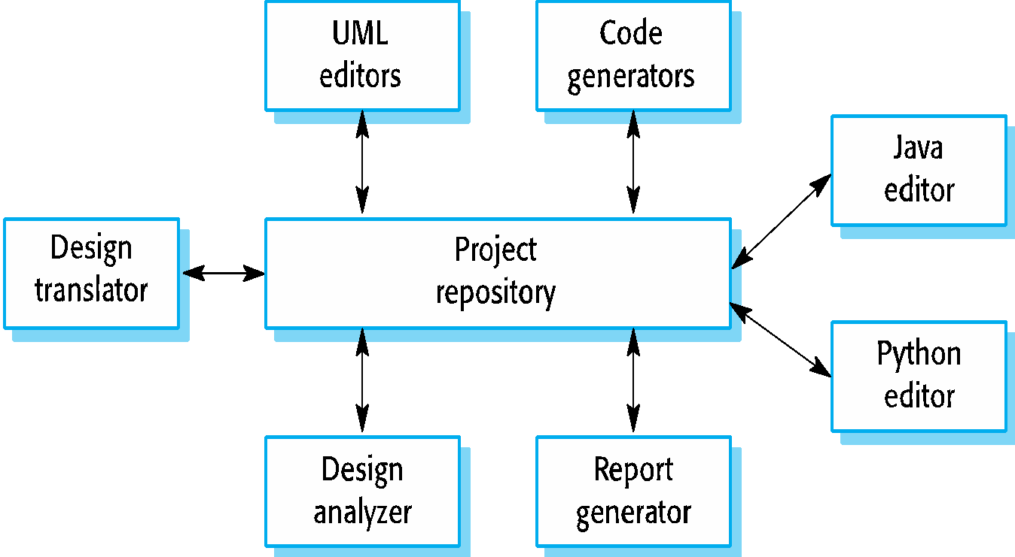
A Repository Architecture for an IDE
Software Engineering II (Design, Verification and Validation)

Slide 28
Client-Server Architecture
Distributed system model which shows how data and processing is distributed across a range of components.
Can be implemented on a single computer.
Set of stand-alone servers which provide specific services such as printing, data management, etc.
Set of clients which call on these services.
Network which allows clients to access servers.
Software Engineering II (Design, Verification and Validation)

Slide 29
The Client - Server Pattern
Name | Client-server
Description | In a client–server architecture, the functionality of the system is organized into services, with each service delivered from a separate server. Clients are users of these services and access servers to make use of them.
Example | a film and video/DVD library organized as a client–server system.
When used | Used when data in a shared database has to be accessed from a range of locations. Because servers can be replicated, may also be used when the load on a system is variable.
Advantages | The principal advantage of this model is that servers can be distributed across a network. General functionality (e.g., a printing service) can be available to all clients and does not need to be implemented by all services.
Disadvantages | Each service is a single point of failure so susceptible to denial of service attacks or server failure. Performance may be unpredictable because it depends on the network as well as the system. May be management problems if servers are owned by different organizations.
Software Engineering II (Design, Verification and Validation)

Slide 30
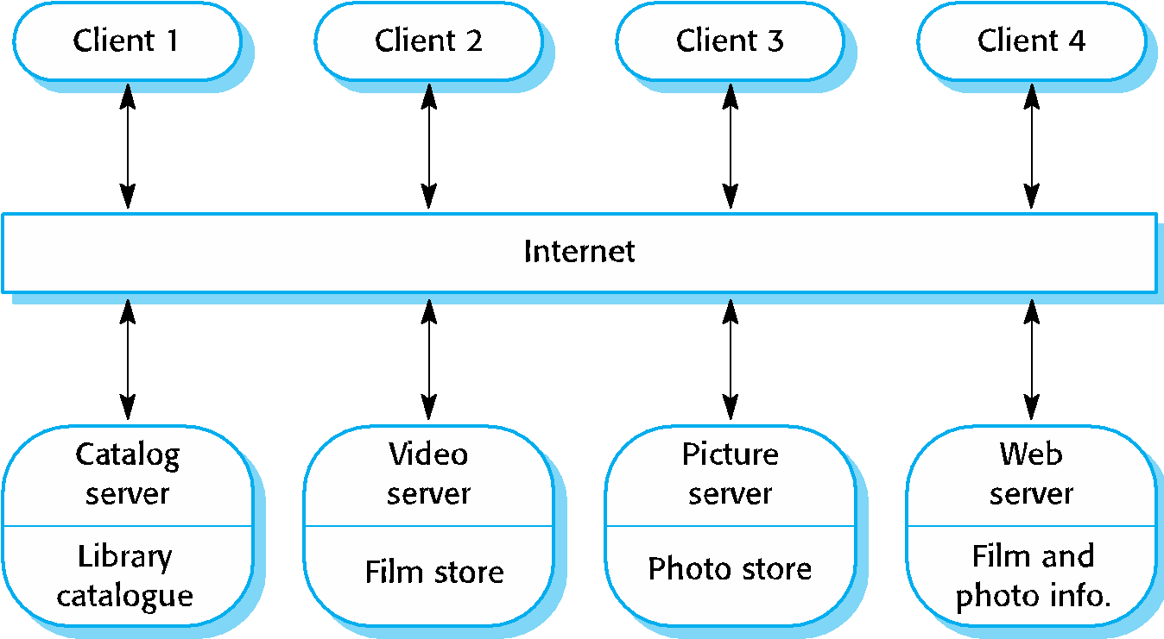
A Client - Server Architecture for a Film Library
Software Engineering II (Design, Verification and Validation)

Slide 31
Pipe and Filter Architecture
Functional transformations process their inputs to produce outputs.
May be referred to as a pipe and filter model (as in UNIX shell).
Variants of this approach are very common. When transformations are sequential, this is a batch sequential model which is extensively used in data processing systems.
Not really suitable for interactive systems.
Software Engineering II (Design, Verification and Validation)

Slide 32
The Pipe and Filter Pattern
Name | Pipe and filter
Description | The processing of the data in a system is organized so that each processing component (filter) is discrete and carries out one type of data transformation. The data flows (as in a pipe) from one component to another for processing.
Example | A pipe and filter system used for processing invoices.
When used | Commonly used in data processing applications (both batch and transaction-based) where inputs are processed in separate stages to generate related outputs.
Advantages | Easy to understand and supports transformation reuse. Workflow style matches the structure of many business processes. Evolution by adding transformations is straightforward. Can be implemented as either a sequential or concurrent system.
Disadvantages | The format for data transfer has to be agreed upon between communicating transformations. Each transformation must parse its input and unparse its output to the agreed form. This increases system overhead and may mean that it is impossible to reuse functional transformations that use incompatible data structures.
Software Engineering II (Design, Verification and Validation)
Notes:
Batch processing is the execution of a series of jobs in a program on a computer without manual intervention (non-interactive).
A Transaction Processing System (TPS) is a type of information system that collects, stores, modifies and retrieves the data transactions of an enterprise. Transaction processing systems also attempt to provide predictable response times to requests, although this is not as critical as for real-time systems. Rather than allowing the user to run arbitrary programs as time-sharing, transaction processing allows only predefined, structured transactions

Slide 33
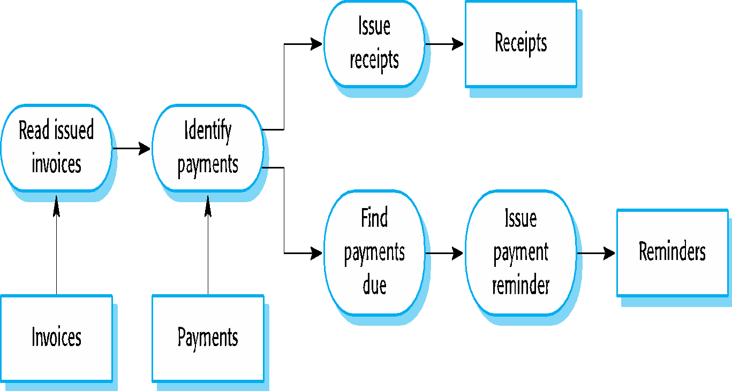
An example of the pipe and filter architecture used in a payments system
Software Engineering II (Design, Verification and Validation)

Slide 34
Reading
Ian Sommerville, “Software Engineering”, Pearson Education, 9th Ed., 2011.
Page [147 – 176]
And read other online references
Software Engineering II (Design, Verification and Validation)

