Slide 1
ONE-DIMENSIONAL, STEADY-STATE CONDUCTION

Slide 2
Temperature gradient exists along only a single coordinate direction, and heat transfer occurs exclusively in that direction.
T=T(x,t)
Steady-state implies that at any given location, the temperature does not change with time.
The two conditions above will make T=T(x). Initially heat generation will not be considered.

Slide 3
3.1 The Plane Wall
3.1.1 Temperature Distribution
The two surfaces of the plane wall are at temperatures T_{s,1} and T_{s,2}, where due to the existing temperature gradient conduction heat transfer will occur as shown in fig-chp3\fig.3.1.pptx. At the surfaces convective heat transfer will also occur.
The appropriate equation to be used for one-dimensional steady-state conduction with no heat generation will be

Slide 4
For constant k, the general solution is
T(x) = C₁x +C₂
Two boundary conditions will be required to determine the two constants.
T(0) = T_{s,1}, and T(L) = T_{s,2}
The above will give
Substitution will give

Slide 5
The above shows T varying linearly with x.
Heat transfer rate or flux can be determined as:
3.1.2 Thermal Resistance
Thermal Ohm’s law can be formed as

Slide 6
ρ = σ⁻¹ = resistivity of material (Ω.m)
For convection heat transfer
q = hA(T_{s} - T∞)
Corresponding thermal resistance
Since q_{x} is constant, the thermal circuit diagram will fig-chp3\fig.3.1.pptx give

Slide 7
For an overall temperature difference, (T_{∞,1}-T_{∞,2} )
i.e. thermal potential difference
Also for radiation
q_{rad} = h_{r}A(T_{s} – T_{sur}) and

Slide 8
3.1.3 The Composite Wall
Composite walls can be analyzed as series and parallel thermal network. The schematic is seen in fig-chp3\fig.3.2.pptx where the series thermal circuit is also shown for both conduction and convection heat transfer.

Slide 9
For constant q_{x}
An overall heat transfer coefficient U is defined as
q_{x} = UA ΔT_{overall} and R_{tot} = 1/UA

Slide 10
In general
Series-parallel arrangement can also be analyzed as shown in fig-chp3\fig.3.3.pptx. Although the heat flow is now multidimensional, it is often reasonable to assume one-dimensional conditions. Two equivalent thermal circuits are presented. In (a) surfaces normal to the x direction are isothermal and in (b) being symmetric to the x-axis, the surfaces can be considered adiabatic.

Slide 11
3.1.4 Contact Resistance
At the interface of composite materials, due to surface roughness, there is what is called thermal contact resistance. This results in a temperature drop across the interface as shown in fig-chp3\fig.3.4.pptx. This thermal contact resistance is designated by R_{t,c} and expressed by
The contact resistance may be viewed as two parallel resistances:
Due to contact spots
Due to gaps

Slide 12
For rough surfaces, the contact area is typically small and the major contribution is from the gaps.
By increasing the joint pressure the contact area can be increased thus decreasing the contribution from the gap.
Example 3.1
To reduce the heat loss rate, a person wears special sporting clothes (insulation, k=0.014 W/m.K) against an environment of air or water at 10ºC. The emissivity of the cloth is 0.95. What thickness of insulation is needed to reduce the heat loss rate to 100 W ( a typical metabolic heat generation rate) in air and water? What are the resulting skin

Slide 13
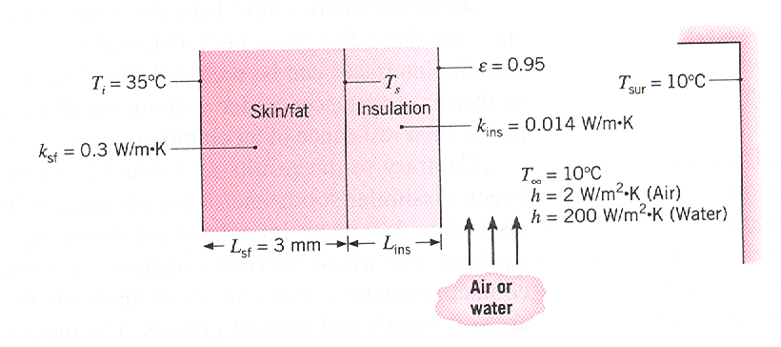
temperatures? Take surface area as 1.8 m².

Slide 14
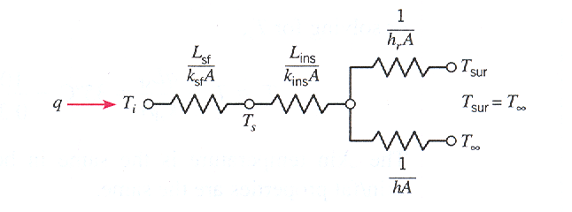
Solution
The thermal circuit showing conduction through the skin fat and insulation, and convection and radiation from the insulation surface

Slide 15
The total thermal resistance will be
From the thermal circuit diagram
Air
To determine h_{r}, iteration will be required. Assume of T_{o}=291K (T_{ins}) and use

Slide 16
Substitution of the values will give
h_{r} = 0.95 x 5.67 x 10⁻⁸ (291 +283)(291²+283²) = 5.09
To check on the heat transfer from the outer surface, we will use
It can further be refined to give q = 100 W.
Using

Slide 17
L_{ins} = 0.0042 m = 4.2 mm
This will give a temperature of 34.6ºC on the skin which will be comfortable.
Water
The convection resistance is much lower than the radiation resistance. So it will be assumed that all the heat transfer from the skin will be by convection.
This will give

Slide 18
This will give a skin temperature of 34.6ºC which is about the same as that due to the air stream the air.
Had it not been for the insulation the temperatures on the skin surface would have been 18ºC and almost 10ºC for the air and water respectively. You can imagine how cold you can feel in the case of water!
Example 3.2
The thermal conductivity of a D=14-nm carbon nanotube is measured with an instrument that is fabricated of a wafer of silicon nitride at a temperature of T∞=300K. The 20-μm-long nanotube rests on two 0.5-μm-thick, 10 μm x 10 μm square islands that are separated by a distance
s=5 μm. A thin layer of platinum is used as an

Slide 19
electrical resistor on the heated island (at temperature T_{h}) to dissipate q=11.3 μW of electrical power. On the sensing island, a similar layer of platinum is used to determine its temperature T_{s}. The platinum’s electrical resistance, R(T_{s}) = E/I, is found by measuring the voltage drop and electrical current across the platinum layer. The temperature of the sensing island, T_{s}, is then determined from the relationship of the platinum electrical resistance to its temperature. Each island is suspended by two L_{sn}=250-μm-long silicon nitride

Slide 20
beams that are w_{sn}=3 μm wide and t_{sn}=0.5 μm thick. A platinum line of width w_{pt}=1 μm and thickness t_{pt}=0.2 μm is deposited within each silicon nitride beam to power the heated island. The entire experiment is performed in a vacuum at a steady-state temperature of T_{s}=308.4 K. Estimate the thermal conductivity of the carbon nanotube.
k_{pt}=71.6 W/m.K k_{sn}=15.5 W/m.K

Slide 21
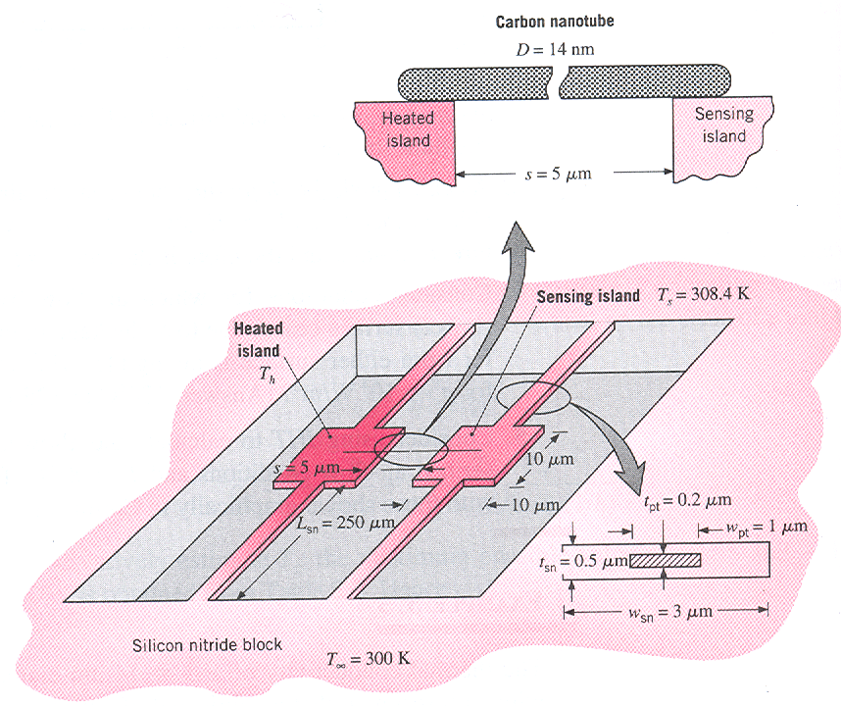
Figure for example 3.2

Slide 22
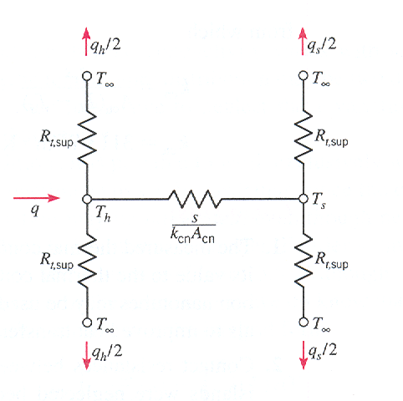
Solution
The thermal circuit diagram is shown below.

Slide 23
The cross-sectional areas of the materials in the support beams are
A_{pt}=w_{pt} t_{pt} = (1x10⁻⁶) x (0.2x10⁻⁶) =2 x 10⁻¹³m²
A_{sn}=w_{sn} t_{sn} – A_{pt} = (3x10⁻⁶) x (0.5x10⁻⁶)⁻ ² x 10⁻¹³=
= 1.3 x 10⁻¹² m²
Cross-sectional area of the carbon nanotube is
A_{cn} = πD²/4 = π(14x10⁻⁹)²/4=1.54 x 10⁻¹⁶ m²
The thermal resistance of each support is
= 7.25 x 10⁶ K/W

Slide 24
The combined heat loss through both sensing island supports is
q_{s} = 2 (T_{s}-T∞)/R_{t,sup} = 2 x (308.4 – 300) / (7.25 x 10⁶)
= 2.32 x 10⁻⁶ W = 2.32 μW
q_{h} = q – q_{s} = 11.3 – 2.32 = 8.98 μW
And from
T_{h} = 332.6 K

Slide 25
Using the circuit connecting T_{h} and T_{s}
Approximate heat transfer due to radiation shows a value of 0.047 μW which is negligible on a comparative basis.

Slide 26
3.2 ALTERNATIVE CONDUCTION ANALYSIS
For steady-state, no heat generation and no heat loss from the sides ( fig-chp3\fig.3.5.pptx) q_{x} is constant and independent of x while A(x),dT/dx, and k(T) may vary.
T may be T(x,y), but the y-coordinate effect may be neglected. This makes it a one dimensional analysis.
Starting with Fourier’s law

Slide 27
For A(x) and k(T) known, the integration results in a functional form of T(x).
3.3 RADIAL SYSTEMS
Cylindrical and spherical systems can be analyzed by using the standard method and alternative method.
For the one dimensional case T=T(r)
3.3.1 The cylinder (standard method)
The appropriate equation for steady-state with no generation is

Slide 28
Also
which shows q_{r} to be constant (independent of r).
The cylindrical configuration is shown in fig-chp3\fig.3.6.pptx
Integrating for constant k gives
T(r) = C₁ ln r + C₂
Two boundary conditions
T(r₁)=T_{s,1} and T(r₂) = T_{s,2}

Slide 29
The final solution becomes
This gives
The thermal circuit is also shown in the figure.
For composite cylinders shown in fig-chp3\fig.3.7.pptx

Slide 30
Using the thermal circuits
Using the overall heat transfer coefficient U
where U is defined based on arbitrary area A.
It could also be defined on the basis of other areas such that
U₁A₁= U₂A₂ = U₃A₃ = U₄A₄ = (∑R_{t})⁻¹

Slide 31
If U is defined on A₁=2πr₁L, then
Example 3.3
A thin-walled copper tube of radius r_{i} is used to transport a low-temperature refrigerant and is at a temperature T_{i} that is less than that of the ambient air at T∞ around the tube. Is there an optimum thickness associated with application of insulation to the tube? Use graph for justification.

Slide 32
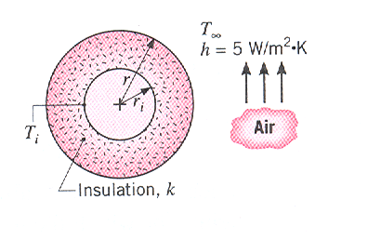
Solution
The arrangement is shown in the figure below. Use cellular glass for insulation k=0.055 W/m.K and h= 5 W/m².K and r_{i}=5 mm.

Slide 33
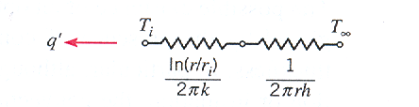
Thermal circuit for example 3.3

Slide 34
Using the thermal circuit per unit length of the tube
The above equation shows that with increase in r the conduction resistance increases while that of convection decreases. This indicates that there may be an optimum thickness of insulation that will minimize the heat transfer. This can be achieved by using

Slide 35
The above gives
Checking the second derivative gives
which suggests that the resistance determined is the minimum or gives maximum heat transfer. However this benchmark (r=r_{c}) which is the indicator of maximum heat transfer, can still be used to get information on the heat transfer characteristics with increase of insulation thickness.

Slide 36
The figure shows a plot of against insulation thickness (r-r_{i}).
r_{c}=k/h=0.055/5=0.011m r_{c}-r_{i}=(0.011-0.005)=0.006m
The graph shows that insulation thicknesses below this critical radius results in increased heat transfer with increase in insulation thickness. This is desirable for electrical wire insulation (good cooling effect).
For insulation thicknesses above the critical radius, heat transfer decreases with increase in thickness of insulation. (But make a note that the bare tube has the same resistance up to a certain insulation thickness) This is the usual setup in practical insulation. The thickness of the insulation will be optimized with respect to the cost of the insulation material and the saved energy cost.

Slide 37
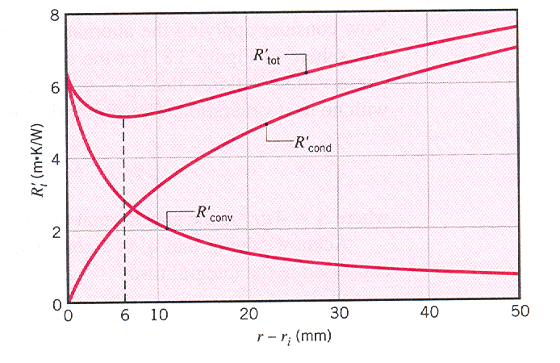
Thermal resistance vs. insulation thickness

Slide 38
3.3.2 The Sphere
To diversify our approach, here we will use the alternative method.
Considering fig-chp3\fig.3.8.pptx, steady-state conduction with no generation gives q_{r}=constant.
For constant k

Slide 39
The thermal resistance will be

Slide 40
Example 3.4
A spherical, thin-walled metallic container is used to store liquid nitrogen at 77 K. The container has a diameter of 0.5 m and is covered with an evacuated, reflective insulation composed of silica powder. The insulation is 25 mm thick, and its outer surface is exposed to ambient air at 300 K. The convection coefficient is known to be 20 W/m².K. The latent heat of vaporization and the density of liquid nitrogen are 2 x 10⁵ J/kg and 804 kg/m³, respectively. (1) What is the rate of heat transfer to the liquid nitrogen? (b) What is the rate of liquid boil-off?

Slide 41
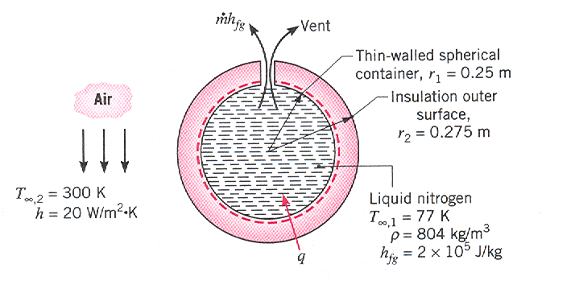
Figure for example

Slide 42
Solution
(1) The thermal circuit is shown below
Hence

Slide 43
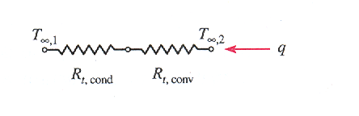
Thermal circuit for example 3.4

Slide 44
which gives
Energy balance on the control volume (liquid N₂)

Slide 45
3.4 CONDUCTION WITH THERMAL ENERGY GENERATION
Internal energy generation could be from current, nuclear, or exothermic chemical reaction where the generation will be assumed to be uniform. Typical for electric current is
and the energy generation per unit volume will be

Slide 46
3.4.1 The Plane Wall
The applicable equation for constant k is
And the surfaces are maintained at T_{s,1} and T_{s,2} as shown in fig-chp3\fig.3.9.pptx
The general solution is
The boundary conditions to determine C₁ and C₂ are
T(-L)=T_{s,1} and T(L)=T_{s,2}

Slide 47
Applying the boundary conditions will give
Substitution will give the temperature distribution as
Unlike the previous equations, heat transfer is no more independent of x as the derivative dT/dx shows.
For symmetric boundary conditions T_{s,1}=T_{s,2}=T_{s}

Slide 48
Maximum temperature exists at the midplane (x=0) with a magnitude of
This will give the dimensionless temperature distribution as
The midplane temperature distribution has (dT/dx)=0 at x = 0. This acts like an adiabatic surface. Implication is that same equation applies to plane

Slide 49
walls that are perfectly insulated on one side (x=0) and maintained at a fixed temperature T_{s} on the other side (x=L).
It is better to relate to the adjoining fluid, since it may not be convenient to measure T_{s}.
Neglecting radiation, energy balance at the surface, x=L

Slide 50
This will give
The same can be derived from
The temperature distribution, then, becomes

Slide 51
Example 3.5
A plane wall is a composite of two materials, A and B. The wall of material A has uniform heat generation of 1.5 x 10⁶ W/m³, k_{A} = 75 W/m.K, and thickness L_{A} = 50 mm. The wall material B has no generation with k_{B}=150 W/m.K and thickness L_{B}=20 mm. The inner surface of material A is well insulated, while the outer surface of material B is cooled by a water stream with T∞ =30ºC and h = 1000W/m².K.
Sketch the temperature distribution that exists in the composite under steady-state conditions.
Determine the temperature T_{o} of the insulated surface and the temperature T₂ of the cooled surface.

Slide 52
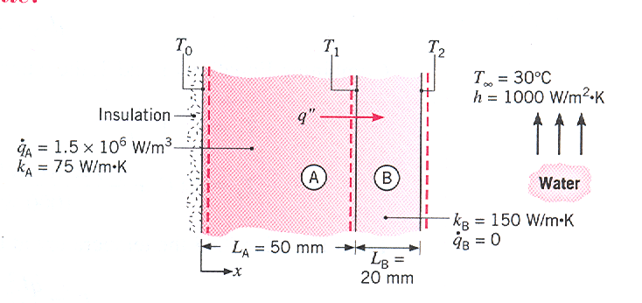
Figure for the example

Slide 53
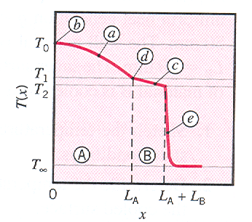
Solution
Features of temperature distribution
Parabolic in material A ; Zero slope at insulated boundary; Linear in material B; Slope change = k_{B}/k_{A} = 2 at interface; Large gradients near the surface (water).

Slide 54
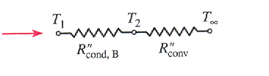
2. At the outer surface, x=L_{A} +L_{B}
h (T₂ - T∞)
Also Equating the two gives
Since T_{o} is given in terms of T₁, using the circuit diagram shown below

Slide 55
Using

Slide 56
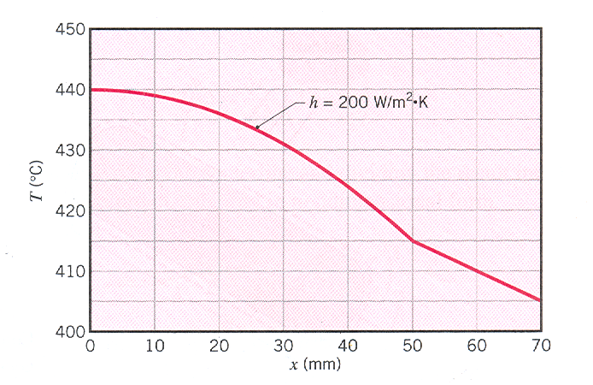
Thermal circuit for example 3.4
Temperature distribution for h = 200 W/m².K

Slide 57
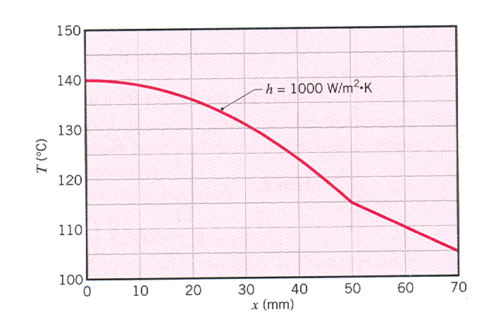
Thermal circuit for example 3.4
Temperatur distribution for h = 1000 W/m².K

Slide 58
3.4.2 Radial Systems
For the cylinder shown in fig-chp3\fig.3.10.pptx , the heat generated is convected from the surface of the cylinder.
The appropriate equation for analysis is (constant k)
Integrating twice gives

Slide 59
Boundary conditions are
The first gives C₁ = 0 and the second gives
This gives the temperature distribution as
Using the centerline temperature T(0) = T_{o}

Slide 60
To relate T_{s} to T∞, use is made of the equality of heat generated and heat convected from surface
One needs to make a note that the thermal resistance approach has not been used as the heat transfer rate with heat generation is not constant.

Slide 61
Example 3.6
Consider a long solid tube, insulated at the outer radius r₂ ( adiabatic surface with a prescribed temperature T_{s,2})and cooled at the inner radius r₁, with uniform heat generation within the solid.
Obtain the general and particular solution for the temperature distribution in the tube.
Determine the heat removal rate per unit length of tube.
If the coolant is available at a temperature T∞, obtain an expression for the convection coefficient that would have to be maintained at the inner surface to allow for operation at prescribed

Slide 62
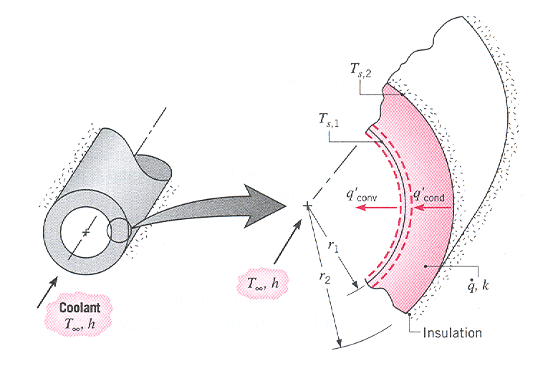
values of

Slide 63
Solution
(1) The general solution is
Boundary conditions
T(r₂) = T_{s,2} and
These give
And the temperature distribution after substitution

Slide 64
(2) Heat removal rate is the conduction heat rate at r=r₁
Alternatively, the same result could be found by equating the heat generated with the removal at r₁.
(3) At the inner surface

Slide 65
Hence
3.5 HEAT TRANSFER FROM EXTENDED SURFACES
The characteristics of an extended surface is shown in fig-chp3\fig.3.11.pptx . For T₁>T₂, heat transfer by conduction occurs in the strut. For T₁>T₂>T∞, in addition to heat conduction there will be convection heat transfer from the surfaces of the strut thus decreasing q_{x} continuously and hence . When compared with pure conduction the slope at the base is increased thus increasing the conduction rate.

Slide 66
Thus extended surfaces are used to enhance the heat transfer rate by increasing the surface area. The term fin is used for extended surfaces.
Consider the heat transfer from surface given in fig-chp3\fig.3.12.pptx (a). For fixed T_{s}, T∞ and A, heat transfer can be maximized by increasing h, which will require a higher velocity of fluid (need of blower or pump)-becomes costly. The other option is to increase the surface area for convection as shown (b) where fins or extended surfaces are used.
k has pronounced effect on the heat transfer effect
Infinite k-no temperature gradient, max q
fig-chp3\fig.3.13.pptx and fig-chp3\fig.3.14.pptx

Slide 67
Selection depends on space, weight, manufacturing and cost reduction as well as the reduction of h and increase of ∆P.
3.5.1 A General Conduction Analysis
Temperature distribution along the fin is to be obtained. This will allow the heat transfer rate to be determined from the surface and tip of fin shown in fig-chp3\fig.3.15.pptx.
The heat transfer originates from the base and finally transferred through the surface and tip of the fin. Since the fins involved are very thin it can safely be assumed the heat transfer is one-dimensional.

Slide 68
Energy balance on the differential CV gives
q_{x} = q_{x+dx} + dq _{conv}
Substitution in the energy balance equation gives

Slide 69
After performing the differentiation, the final general fin equation becomes
This equation will be used on specific fin geometries to get the particular fin equations.
3.5.2 Fins of Uniform Cross-Sectional Area
The rectangular and the pin fin are shown in fig-chp3\fig.3.16.pptx .
A_{c}=constant, dA_{c}/dx =0 A_{s}=Px dA_{s}/dx=P

Slide 70
Substitution in the general equation gives
The above equation can be further simplified if we define θ(x) = T(x) – T∞
dθ/dx=dT/dx θ is also called excess temperature
This will give
The above is a linear, homogeneous, second order differential equation with constant coefficients

Slide 71
General solution
Boundary Conditions
Common θ(0) = T_{b} – T∞ = θ_{b}
There are four possible cases
Convection heat transfer from the tip (T_{L}=T(L))
fig-chp3\fig.3.17.pptx

Slide 72
0
Substitution will give
Final solution ( details.docx )
Particular interest is the heat transfer rate from such fins. (a) from base (b) from surface of fins
is easier

Slide 73
This will give
Convection heat transfer from the tip is negligible in which case the tip may be treated as adiabatic.
(dT/dx)_{x=L}=0 or (dθ/dx)_{x=L}=0
This will give the second equation as
C₁e^{mL} – C₂e^{-mL} =0 C₁ +C₂ = θ_{b} (common)
The above will give the solution as

Slide 74
The heat transfer in this case is determined as
This is the most popular form
Temperature is prescribed at the tip,
θ(L)=θ_{L}=T_{L}-T∞
Solution will be

Slide 75
The fin is very long such that as
L→∞, T→T∞ or θ_{L}→0
The solution
table3.1.docx summarizes the solutions for different BC.
Example 3.7
A very long rod 5 mm in diameter has one end maintained at 100ºC. The surface of the rod is exposed to ambient air at 25ºC with a convection heat transfer coefficient of 100 W/m².K.

Slide 76
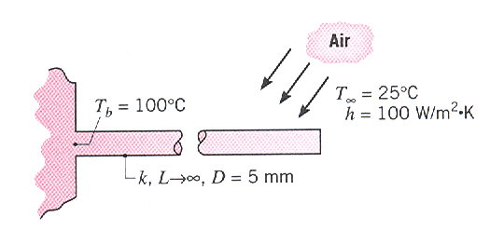
Determine the temperature distributions along rods constructed from Cu, Al and SS with k=398, 180, 14 W/m.K, respectively. What are the corresponding heat losses from the rods?
Estimate how long the rods must be for the assumption of infinite length to yield an accurate estimate of the heat loss.

Slide 77
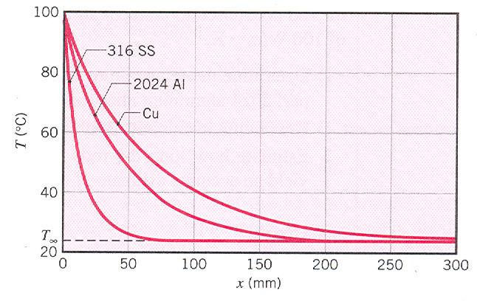
Solution
θ/θ_{b}=e^{-mx} or T=T∞+(T_{b} – T∞)e^{-mx}
where m=(hP/kA_{c})^{1/2} = (4h/kD)^{1/2}= 14.2, 21.2,
75.6 m⁻¹. T(x) shown below

Slide 78
q_{f} = (hPkA_{c})^{1/2}θ_{b} =(100π x 0.005 x 398 x (π/4) x 0.005²)^{1/2} (75)= 8.3W
For Al and SS q_{f} = 5.6 W and 1.6 W respectively.
Since no heat transfer at the tip, comparing cases II and IV one can approximate with
Hence a rod may be assumed to be infinitely long if
For copper

Slide 79
Corresponding values for Al and SS are 0.13 and 0.04 m respectively.
If the approximation is to accurately predict the temperature distribution one may use
θ(L)/θ_{b} = exp(-mL)<0.01
This gives mL>4.6 in which case L∞ ≈ 0.33, 0.23, and 0.07 for the copper, aluminum, and stainless steel. This is consistent with the graphical representation

Slide 80
3.5.3 Fin Performance
As the fin itself does have conduction resistance, there may be no assurance that the heat transfer will be increased by using fins. The evaluation uses fin effectiveness, ε_{f} defined by
where A_{c,b} is the fin cross-sectional area at the base. Usage of fins may not be justified unless .
As an example for case IV

Slide 81
since A_{c} = A_{c,b} for uniform cross-section. The above relation gives sufficient information for the important parameters
ε_{f} increases with k-with respect to Al and Cu, Al preferred due to low weight and low cost
ε_{f} increases with P/A_{c}- Use of thin fins recommended
ε_{f} increases with small h-the need for fins is stronger on the gas side than on the liquid side or the natural convection side than the forced convection side.

Slide 82
Fin performance may also be quantified in terms of thermal resistance.
Thermal resistance due to convection at the exposed base
The conduction/convection resistance of a fin is given by
Performing division gives

Slide 83
Need low R_{t,f} to increase ε_{f}. Also R_{t,f} < R_{t,b} ( a must)
A commonly used measure of fin performance is by using fin efficiency, η_{f}. This compares q_{f} with the maximum possible heat transfer (when all the fin surface is at base temperature
T = T_{b} or θ = θ_{b} = (T_{b}-T∞)
Based on this
For a straight fin of uniform cross-section and adiabatic tip

Slide 84
η_{f}: 1 → 0 as L: 0 → ∞
For a fin with an active tip, the length can be slightly increased (corrected) so that we have an adiabatic tip, and use the simplified relation of case II. The corrected lengths are given as
L_{c} = L + (t/2) - rectangular fin
L_{c} = L + (D/4) - pin fin
Errors associated with these approximations are negligible if

Slide 85
For w >> t which is usually the case P ≈ 2w
And (P/A_{c}) = (2w/wt) = 2/t
Multiplying numerator and denominator by (L_{c})^{1/2} and introducing a corrected fin profile area A_{p}=L_{c}t, it follows that
η_{f} is plotted as a function of in

Slide 86
fig-chp3\fig.3.18.pptx for rectangular, triangular, and parabolic profiles.
3.5.4 Fins of Nonuniform Cross-Sectional Area
Consider the annular fin shown in fig-chp3\fig.3.19.pptx . While the thickness is constant, the cross-sectional area A_{c} varies with r.
A_{c} = 2πrt and A_{s} = 2π(r² - r₁²)
Substituting in the general fin equation will give
With m² = (2h/kt) and θ =T - T∞

Slide 87
The equation becomes
This is a modified Bessel equation of order zero whose general solution is given by (Hyperbolic Functions Error Function.docx
θ(r) = C₁I_{o}(mr) + C₂K_{o}(mr)
Where I_{o} and K_{o} are modified, zero order Bessel functions of the first and second kind respectively.
B.C. used are

Slide 88
will finally give the solution for the temperature distribution as
Where I₁(mr) and K₁(mr) are modified first order Bessel functions of the first and second kinds.
The heat transfer by conduction from the base
gives

Slide 89
The fin efficiency is given by
For an active convection tip, use r_{2c} = r₂ + t/2
The fin efficiency is given graphically in fig-chp3\fig.3.20.pptx .
For determination of fin effectiveness, ε_{f} , the conduction/convection fin resistance is given by
R_{t,f} = 1/(hA_{f}η_{f})

Slide 90
For equivalent heat transfer the triangular fin requires much less volume than a rectangular profile. Slightly larger (q/V) is parabolic. But when considering the manufacturing cost triangular is the more preferred one. The annular fin of rectangular profile is commonly used to enhance heat transfer in circular tubes.
Expressions for the efficiency and surface area of several common fin geometries are summarized in table3.2.docx

Slide 91
3.5.5 Overall Surface Efficiency
Unlike η_{f} which considers a single fin, the overall surface efficiency, η_{o} considers the array of fins and the base surface. fig-chp3\fig.3.21.pptx shows typical arrays of fins.
In each case the overall efficiency is defined as
q_{t} = total heat transfer rate = q_{f} + q_{b}
A_{t} = total surface area = NA_{f} + A_{b}

Slide 92
The total heat transfer rate from fins and bare surface by convection is given by and then substitution of
A_{b} =A_{t} - NA_{f}
q_{t} = N η_{f} h A_{f} θ_{b} + h A_{b} θ_{b}
Substitution in the expression for η_{o} gives

Slide 93
Using thermal fin resistance, the overall thermal resistance can be expressed as
For fins machined as an integral part of the wall, the total resistance can be seen to be one of parallel circuit shown in fig-chp3\fig.3.22(a).pptx . This circuit will give the same overall efficiency as determined earlier.
But if the fins are manufactured separately and are attached (metallurgical, adhesive joint) or press fit to the wall, ( fig-chp3\fig.3.22(b).pptx ) there will be a thermal resistance, R_{t,c}, to be considered.

Slide 94
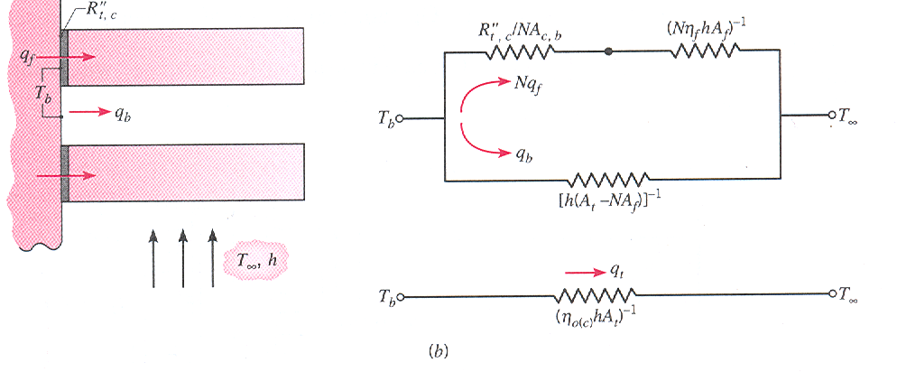
Fig.3.22(b) Fin array and thermal circuit-fins attached to base

Slide 95
The effective circuit resistance will be
Using the parallel/series circuit shown the effective overall efficiency can be determined as
where
While manufacturing make sure R_{tc}<<R_{tf}

Slide 96
Example 3.8
The engine cylinder of a motor cycle is constructed of 2024-T6 aluminum alloy and is of height H = 0.15 m and outside diameter D = 50 mm. Under typical operating conditions the outer surface of the cylinder is at a temperature of 500 K and is exposed to ambient air at 300 K, with a convection coefficient of 50 W/m².K. Annular fins are integrally cast with the cylinder to increase heat transfer to the surroundings. Consider five such fins, which are of thickness t = 6 mm. length L = 20 mm, and equally spaced. What is the increase in heat transfer due to use of the fins?

Slide 97
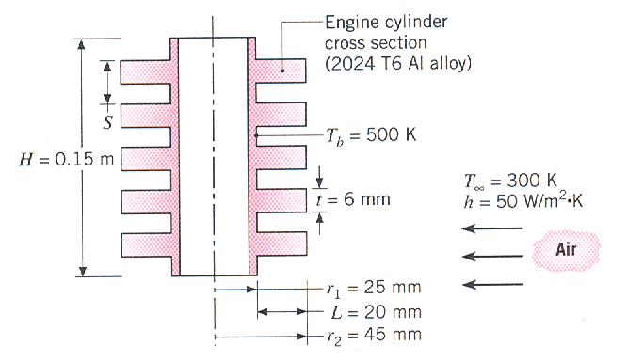
Solution
Figure for example 3.8

Slide 98
From Fig.3.19, η_{f} ≈ 0.95

Slide 99
With the fins the total heat transfer rate becomes
Without fins
q_{wo} = h(2πr₁H)θ_{b} = 50(2π x 0.025 x 0.15)(200)
=236W
Increase
Δq = q_{t} – q_{wo} = 454 W (nearly 300% increase)
The increase could even be much higher if number of fins are increased for the same fin thickness or fin thicknesses are decreased to accommodate more number of fins in a given space. (see figures)

Slide 100
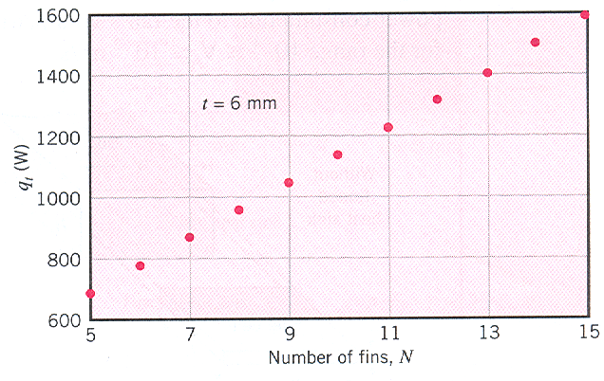
t = 6 mm No of fins are increased

Slide 101
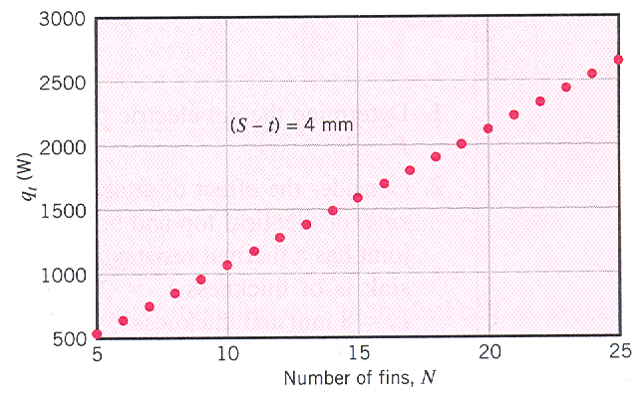
In the given H for a fin thickness of 2mm, 25 fins could be accommodated

Slide 102
Example 3.9
In the example on PEM on chapter 1, we saw that to generate an electrical power P = 9 W, the temperature of the PEM fuel cell had to be maintained at T_{c}≈56.4ºC, which required total removal of 11.25 W from the fuel cell and a cooling air velocity of V = 9.4 m/s for T∞=25ºC. To provide these convective conditions, the fuel cell is centered in a 50 mm x 26 mm rectangular duct, with 10 mm gaps between the exterior of the 50 mm x 50 mm x 6 mm fuel cell and the top and bottom of the well-insulated duct wall. A small fan, powered by the fuel cell, is used to circulate the cooling air. Inspection of a particular fan vendor’s data

Slide 103
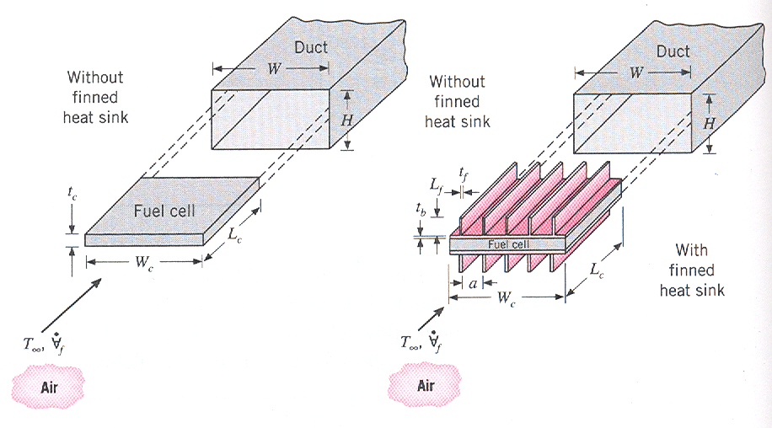
Figure for example 3.9

Slide 104
sheets suggest that the ratio of the fan power consumption to the fan’s volumetric flow rate is
P_{f}/ = C =1000 W/(m³/s) for the range
.
Determine the net electric power produced by the fuel-cell-fan system, P_{net} = P-P_{f}.
Consider the effect of attaching an aluminum (k=200 W/m.K) finned heat sink, of identical top and bottom sections, onto the fuel cell body. The contact joint has a thermal resistance of
and the base of the heat sink is of thickness t_{b} = 2 mm. Each of the N rectangular fins is of length L_{f} = 8 mm and thickness

Slide 105
of 1 mm, and spans the entire length of the fuel cell,
L_{c} = 50 mm. With the heat sink in place, the radiation losses are negligible and the convective heat transfer coefficient may be related to the size and geometry of a typical air channel by an expression of the form
h = 1.78 k_{air} (L_{f} + a )/(L_{f} . a)
where a is the distance between fins. Draw an equivalent thermal circuit for part 2 and determine the total number of fins needed to reduce the fan power consumption to half the value found in part 1.

Slide 106
Solution
Volumetric flow rate air for cooling
Substitution gives
This enables us to use the formula for power consumption by the fan

Slide 107
As the fan consumes more power than is generated, the system cannot produce net power.
2. To reduce the fan power by 50%, the volumetric flow rate of air must be reduced to
If we consider half of the fins the thermal resistances can be written as follows:
Contact resistance of the fin base:-
Fin base resistance:-

Slide 108
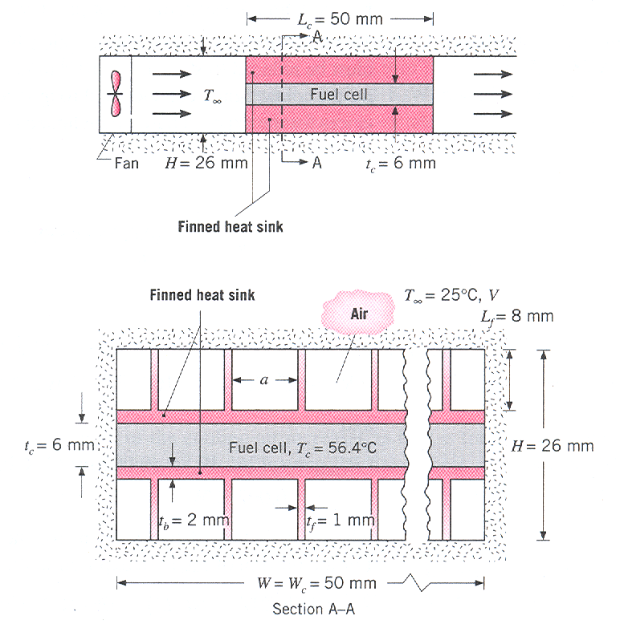

Slide 109
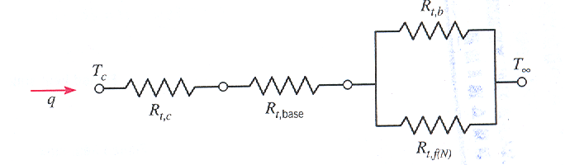
Thermal circuit for example 3.9

Slide 110
Bare surface of the base:-
The above cannot be evaluated until N and h are determined
Fin resistance:-
For a single fin (insulated tip)
P = 2(L_{c} +t_{f}) =2(0.05+0.001)=0.102 m
A_{c} = L_{c}t_{f} = 0.05x0.001=0.00005 m²

Slide 111
Substitution will give
And for N fins, q_{f(N)} =Nq_{f} this will give
R_{t,f(N)} = θ_{b}/Nq_{f} = R_{t,f}/N
a = (W_{c} – Nt_{f})/N = (0.05 – Nx0.001)/N
R_{equiv} can be determined from

Slide 112
In which case
=(56.4-25)/5.625-(0.4+0.004)=5.2 K/W
The solution requires iteration which can be initiated by assuming N. Let N=11
Then this will give a=0.0035 m, h=19.1 W/m².K, m=13.9 m⁻¹, R_{t,f(N)}=5.88 K/W, R_{t,b}=26.8 K/W
This will give R_{equiv} = 4.82 K/W and R_{tot}= 5.224 resulting in a fuel cell temperature of 54.4ºC.
N=10 and N=12 give fuel cell temperatures of 58.9ºC and 50.7ºC which are far from the given fuel cell

Slide 113
temperature.
So the total number of fins required will be 22.
P_{net} = P – P_{f} = 9.0 - 4.7 = 4.3 W
In actual cases h is not sensitive to the velocity of the air when the flow is confined to passages. This will be seen in detail in convection heat transfer topic.

