Slide 1
Examples (Part I)
Chapter Three – One Dimensional Steady State Conduction
By Dawit M.

Slide 2
Outline
Revision
Examples
Example 1: Plane Wall Heat Loss ( with Convection + Radiation)
Exercise 2: Plane Wall Heat Loss ( with Convection)
Example 3: Composite Plane Wall Heat Loss

Slide 3
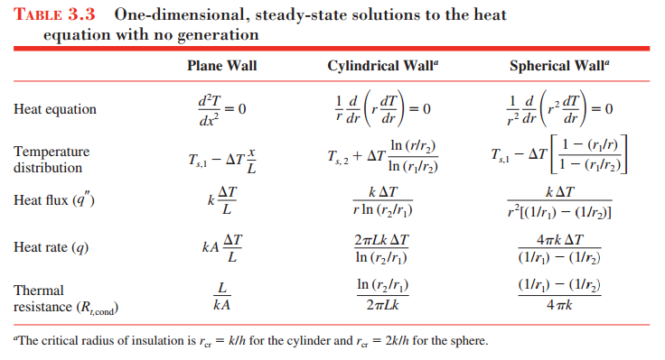
Revision

Slide 4
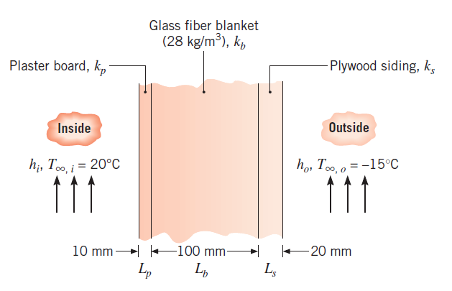
Example 1: Plane Wall Heat Loss (with Conv.)
1. A house has a composite wall of wood, fiberglass insulation, and plaster board, as indicated in the sketch. On a cold winter day, the convection heat transfer coefficients are h_{o} = 60 W/m²K and h_{i} = 30 W/m²K. The total wall surface area is 350 m².
k_{b}= 0.038 W/m⋅K
k_{s}= 0.12 W/m⋅K
k_{p}=0.17 W/m⋅K.
(Table A-3, Incropera)
Determine a symbolic expression for the total thermal resistance of the wall, including inside and outside convection effects for the prescribed conditions.
Determine the total heat loss through the wall.

Slide 5
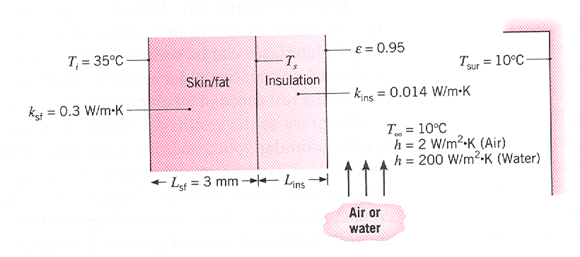
Example 2: Plane Wall Heat Loss (with Conv. + Rad.)
2. To reduce the heat loss rate, a person wears special sporting clothes (insulation, k=0.014 W/m.K) against an environment of air or water at 10ºC. The emissivity of the cloth is 0.95. What thickness of insulation is needed to reduce the heat loss rate to 100 W ( a typical metabolic heat generation rate) in air and water? What are the resulting skin temperatures? Take: surface area as 1.8 m² , h_{r} = 5.09 W/m²K.

Slide 6
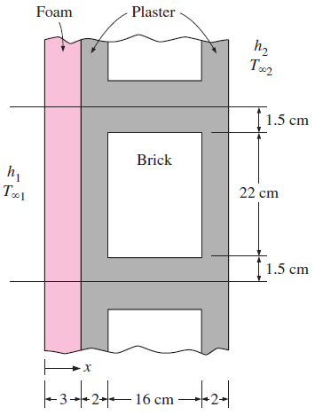
Exercise
3. A 3-m-high and 5-m-wide wall consists of long 16-cm x 22-cm cross section horizontal bricks (k = 0.72 W/m · °C) separated by 3-cm-thick plaster layers (k = 0.22 W/m · °C). There are also 2-cm-thick plaster layers on each side of the brick and a 3-cm-thick rigid foam (k =0.026 W/m · °C) on the inner side of the wall, as shown in Fig. 2. The indoor and the outdoor temperatures are 20°C and -10°C, and the convection heat transfer coefficients on the inner and the outer sides are h₁ = 10 W/m2 · °C and h₂ = 25 W/m2 · °C, respectively. Assuming one-dimensional heat transfer and disregarding radiation, determine the rate of heat transfer through the wall.

Slide 7
Thank You!
Any Questions?

