Slide 1
Examples (Part II)
Chapter Three – One Dimensional Steady State Conduction
By Dawit M.

Slide 2
Outline
Revision
Examples
Example 1: Cylindrical Wall Heat Loss (with Conv. + Rad.) Example 2: Cylindrical Heat Loss (With Internal Heat Generation)
Example 3: Oil Tank Heat Loss (Cylindrical + Spherical)

Slide 3
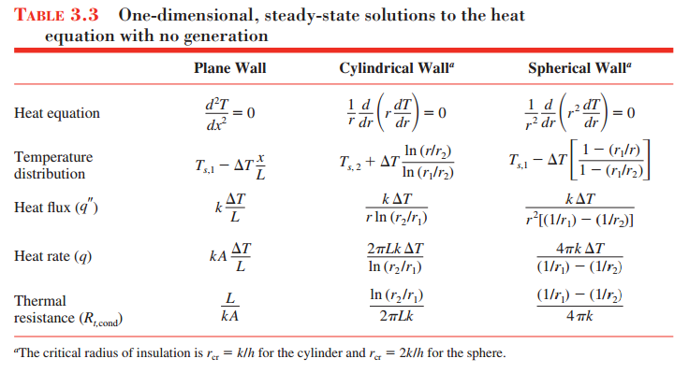
Revision

Slide 4
Example 1: Cylindrical Wall Heat Loss (with Conv. + Rad.)
1. Steam at T_{∞,1} = 320 °C flows in a cast iron pipe [k = 80 W/ m. °C] whose inner and outer diameter are D₁ = 5 cm and D₂ = 5.5 cm, respectively. The pipe is covered with a 3‐cm thick glass wool insulation [k = 0.05 W/ m. °C]. Heat is lost to the surroundings at T_{∞, 2} = 5°C by natural convection and radiation, with a combined heat transfer coefficient of h₂ = 18 W/m². °C. Taking the heat transfer coefficient inside the pipe to be h₁ = 60 W/m². °C, determine the rate of heat loss from the steam per unit length of the pipe. Also determine the temperature drop across the pipe shell and the insulation.

Slide 5
Example 2: Heat Loss from Cylindrical Wall (With Internal Heat Generation)
2. An electrical current of 700 A flows through a stainless steel cable having a diameter of 5 mm and an electrical resistance of 6 (10)⁻⁴ Ω/m (i.e., per meter of cable length). The cable is in an environment having a temperature of 30⁰C, and the total coefficient associated with convection and radiation between the cable and the environment is approximately 25 W/m² _ K.
a. If the cable is bare, what is its surface temperature?
b. If a coating of electrical insulation is applied to the cable, with a contact resistance of 0.02 m² _ K/W, what is the cable surface temperature?

Slide 6
Example 3: Oil Tank Heat Loss (Cylindrical + Spherical)
3. A storage tank consists of a cylindrical section that has a length and inner diameter of L = 2 m and D_{i} = 1m, respectively, and two hemispherical end sections. The tank is constructed from 20-mm-thick glass (Pyrex) and is exposed to ambient air for which the temperature is 300 K and the convection coefficient is 10 W/m² _ K. The tank is used to store heated oil, which maintains the inner surface at a temperature of 400 K. Determine the electrical power that must be supplied to a heater submerged in the oil if the prescribed conditions are to be maintained. Radiation effects may be neglected, and the Pyrex may be assumed to have a thermal conductivity of 1.4 W/m_ K.

Slide 7
Thank You. Any Question?

