Slide 1
Chapter Four: Unit Testing
Sem. II - 2020
Department of Software Engineering
ITSC-AAIT
Dr. Sunkari

Slide 2
Concept of Unit Testing
A unit test generally exercises the functionality of the smallest possible unit of code (which could be a method, class, or component) in a repeatable way.
Static Unit Testing
  Code is examined over all possible behaviors that might arise during run time
  Code of each unit is validated against requirements of the unit by reviewing the code
Dynamic Unit Testing
  A program unit is actually executed and its outcomes are observed.
  One observe some representative program behavior, and reach conclusion about the quality of the system
Static unit testing is not an alternative to dynamic unit testing. Both are complementary in nature.
Notes:
In practice, partial dynamic unit testing is performed concurrently with static unit testing. It is recommended that static unit testing be performed prior to the dynamic unit testing.

Slide 3
Static Unit Testing
Static Testing techniques are quite effective in finding errors - so much so that every programming project should use one or more of these techniques.
How these testing techniques contribute to productivity and reliability
  the earlier errors are found, the lower the costs of correcting the errors and the higher the probability of correcting the errors correctly.
  programmers seem to experience a psychological change when computer-based testing commences.
The two primary static testing methods are code inspections and walkthroughs.
Notes:
2. Because of these pressures, programmers tend to make more mistakes when correcting an error found during computer-based testing than they make when correcting an error found earlier.
Divide and Conquer
An examiner inspect small parts of the unit in isolation
nothing is overlooked
the correctness of all examined parts of the module implies the correctness of the whole module

Slide 4
Inspections and Walkthroughs
Involve a team of people reading or visually inspecting a program
Requires subsequent meeting to find errors but not to find solutions to the errors (to test rather than to debug).
Is an improvement over the desk-checking process.
Review is conducted by three or four experts, only one is the author who revises his/her code based on test standards.
lower debugging (error-correction) costs.
In Contrast, Computer based testing
  Uncovers 30 - 70 percent of logical and coding errors but not higher level design errors.
Notes:
desk-checking process (the process of a programmer reading his or her own program before testing it).
lower debugging (error-correction) costs, is the fact that when an error is found it is usually precisely located in the code.
PS: these methods are effective in finding up to 70 percent of all errors found by the end of the testing process.
Divide and Conquer
An examiner inspect small parts of the unit in isolation
nothing is overlooked
the correctness of all examined parts of the module implies the correctness of the whole module

Slide 5
Code Inspections
A code inspection is a set of procedures and error-detection techniques for group code reading.
Inspection team is composed of three-four members; one as a moderator.
moderator
  Distributes materials for (several days in advance), and scheduling, the inspection session, Leading the session, Recording all errors found, and ensuring that the errors are subsequently corrected.
Activities during inspection session
  Narrating the code – programmer is responsible
  Analyzing the program based on a checklist which is composed of historically common programming errors.
Notes:
The moderator is responsible for ensuring that the discussions proceed along productive lines and that the participants focus their attention on finding errors, not correcting them. (The programmer corrects errors after the inspection session.)

Slide 6
Code Inspections
Benefits
  The programmer usually receives feedback concerning programming style, choice of algorithms, and programming techniques. The same is true for other members.
  Guides computer based testing by narrowing the domain to be tested (get the flash point).

Slide 7
Error Checklist for Inspections
The checklist is largely language independent, meaning that most of the errors can occur with any programming language.
The following categories of checklists are recommended based on a through research on the domain [read ref. book to know Qs. Under each category]
  Data Reference Errors
  Data-Declaration Errors
  Computation Errors
  Comparison Errors
  Control-Flow Errors
  Interface Errors
  Input/output Errors

Slide 8
Walkthroughs
Similar to Inspections process but different
  In the procedure of the meeting and error-detection technique.
  The team should have a tester, moderator, secretary and experienced programmer/s.
Procedure
  The tester comes to the meeting armed with a small set of paper test cases.
  Each test case is mentally executed (the test data are walked through the logic of the program)
  State of the program is monitored on a paper/ white board.
Test Cases here are not a way to uncover error but as a vehicle for getting started and for questioning the programmer about his or her logic and assumptions.

Slide 9
Desk Checking
can be viewed as a one-person inspection or walkthrough
A person reads a program, checks it with respect to an error list, and/or walks test data through it.
Less Effective
  completely undisciplined process.
  people are generally ineffective in testing their own programs.
Swapping programs between programmers and let other check your unit.
  Still ineffective
    Synergetic effect of the walkthrough or inspection team

Slide 10
Dynamic Unit Testing
Dynamic unit testing is a term used to describe the testing of dynamic behavior of code based on specific test cases by execution of the test object or running programs.
The environment of a unit is emulated and tested in isolation
The caller unit is known as test driver
  A test driver is a program that invokes the unit under test (UUT)
  It provides input data to unit under test and report the test result
The emulation of the units called by the UUT are called stubs
  It is a dummy program
The test driver and the stubs are together called scaffolding
The low-level design document provides guidance for selection of input test data.

Slide 11
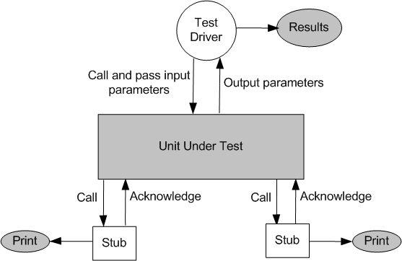
Dynamic Unit Testing

Slide 12
Test Case Design
Selection of test data is broadly based on the following techniques:
Control Flow Testing
  Draw a control flow graph (CFG) from a program unit
  Select a few control flow testing criteria
  Identify a path in the CFG to satisfy the selection criteria
  Derive the path predicate expression from the selected paths
  By solving the path predicate expression for a path, one can generate the data

Slide 13
Test Case Design
Data Flow Testing
  Draw a data flow graph (DFG) from a program unit and then follow the procedure described in control flow testing.
Domain Testing
  Domain errors are defined and then test data are selected to catch those faults.
Functional program Testing
  Input/output domains are defined to compute the input values that will cause the unit to produce expected output values

Slide 14
Mutation Testing
Modify a program by introducing a single small change to the code
A modified program is called mutant
A mutant is said to be killed when the execution of test case cause it to fail. The mutant is considered to be dead.
A mutant is an equivalent to the given program if it always produce the same output as the original program.
A mutant is called stubborn, if the existing set of test cases is insufficient to kill it.
A mutation score for a set of test cases is the percentage of non-equivalent mutants killed by the test suite.
The test suite is said to be mutation-adequate if its mutation score is 100%.
Notes:
Mutation Testing (White Box Testing)
A mutation of a program is a modification of the program created by introducing a single, small, legal syntactic change in the code.

Slide 15
Mutation Testing
Mutation analysis is a two step process
  The adequacy of an existing test suite is determined to distinguish the given program from its mutants. Stubborn Mutants are identified.
  Additional test cases will be added to kill stubborn mutants.
Mutation testing makes two major assumptions:
  Competent Programmer hypothesis
    Programmers are generally competent and they do not create random programs
  Coupling effects
    Complex faults are coupled to simple faults in such a way that a test suite detecting simple faults in a program will detect most of the complex faults

Slide 16
Debugging
Debugging is a two-step process that begins when you find an error as a result of a successful test case.
  Step 1 is the determination of the exact nature and location of the suspected error within the program.
  Step 2 consists of fixing the error.
It is less enjoyable phase in software product development
  Your ego may get in the way.
  You may run out of steam.
  You may lose your way.
  You may be on your own.
Notes:
- debugging confirms that programmers are not perfect.

Slide 17
Debugging by Brute Force
Is the least mentally taxing, but inefficient and generally unsuccessful method.
Brute force methods can be partitioned into at least three categories:
  Debugging with a storage dump.
    a crude display of all storage locations in hexadecimal or octal format)
    The most inefficient form of debugging
  Debugging according to the common suggestion to “scatter print statements throughout your program” (hit-or-miss method.).
  Debugging with automated debugging tools.
    has the ability to set breakpoints that cause the program to be suspended when a particular statement is executed.
Notes:
Brute force - The most common and least effective method of program debugging is by "brute force". It requires little thought and is the least mentally taxing of all the methods.
Storage Dumb is inefficient because,
- It is difficult to establish a correspondence between memory locations and the variables in a source program.
- With any program of reasonable complexity, such a memory dump will produce a massive amount of data, most of which is irrelevant.
- A memory dump is a static picture of the program, showing the state of the program at only one instant in time; to find errors, you have to study the dynamics of a program (state changes over time).
- A memory dump is rarely produced at the exact point of the error, so it doesn’t show the program’s state at the point of the error. Program actions between the time of the dump and the time of the error can mask the clues you need to find the error.
• There aren’t adequate methodologies for finding errors by analyzing a memory dump (so many programmers stare, with glazed eyes, wistfully expecting the error to expose itself magically from the program dump).

Slide 18
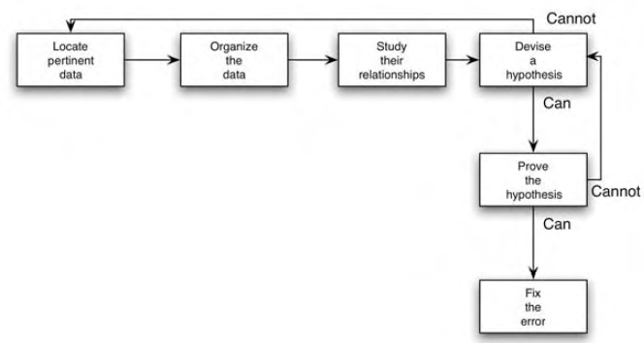
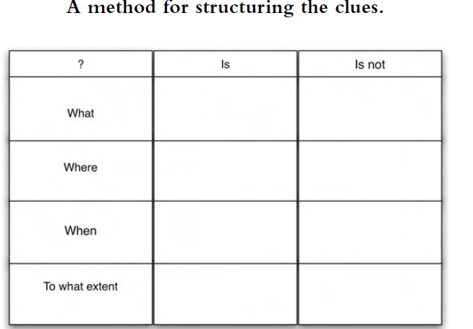
Debugging by Induction
a disciplined thought process without ever going near the computer.
start with the clues (the symptoms of the error, possibly the results of one or more test cases) and look for relationships among the clues.
Notes:
Induction = proceeds from a particular to the whole, By starting with the symptoms of the error, possibly in the result of one or more test cases, and looking for relationships among the symptoms, the error is often uncovered. Pertinent

Slide 19
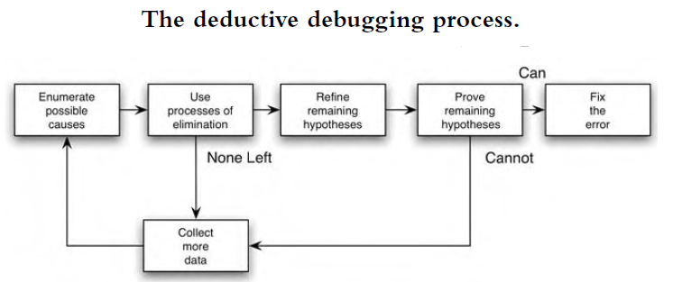
Debugging by Deduction
is a process of proceeding from some general theories or premises, using the processes of elimination and refinement, to arrive at a conclusion.
Notes:
Deduction

Slide 20
Debugging by Backtracking
Start at the point where the program gives the incorrect result such as where incorrect data were printed.
At this point you deduce from the observed output what the values of the program's variables must have been.
By performing a mental reverse execution of the program from this point and repeatedly using the process of "if this was the state of the program at this point, then this must have been the state of the program up here," you can quickly pinpoint the error.
Notes:
Backtracking. With this process you're looking for the location in the program between the point where the state of the program was what was expected and the first point where the state of the program was what was not expected.
It is a quite popular approach of debugging which is used effectively in case of small applications. The process starts from the site where a particular symptom gets detected, from there on backward tracing is done across the entire source code till we are able to lay our hands on the site being the cause. Unfortunately, as the number of source lines increases, the number of potential backward paths may become unmanageably large.

Slide 21
Debugging by Testing
Test Cases for Debugging vs Test Cases for Testing
  while debugging, the purpose is to provide information useful in locating a suspected error
Fat Vs Slim Test Case
  Test Cases for debugging should be slim where you want to cover only a single condition or a few conditions in each test case.
Can be used with induction method (to collect information to collect data) and deduction method (to eliminate suspected causes).
Read Debugging Principles …

Slide 22
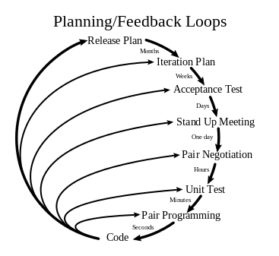
Extreme Testing
XP is a software development methodology which is intended to improve the software quality and responsiveness to the level of customers requirement and it encourages frequent releases in short development cycles.
XP was likely developed to support the adoption
of programming languages such as Java,
Visual Basic, and C#.
XP differs from traditional development processes
  it avoids the large-scale project syndrome
  it avoids coding unneeded functionality ( helps required functionality)
  it focuses on testing – write test then code to satisfy the test.
Notes:
XP has lots of practices specifically for programming such as TDD, continuous integration, pair programming.
Pair programming is an agile software development technique in which two programmers work together at one workstation. One, the driver, writes code while the other, the observer or navigator,[1] reviews each line of code as it is typed in. The two programmers switch roles frequently.

Slide 23
Extreme Testing
XP concepts/practices
  Listening to the customer and other programmers.
  Collaborating with the customer to develop the application’s specification and test cases.
  Pair Programming
  Testing the code base (XT).
    Different from Unit Testing – (Test Written Before Coding)
Notes:
XP has lots of practices specifically for programming such as TDD, continuous integration, pair programming.
Pair programming is an agile software development technique in which two programmers work together at one workstation. One, the driver, writes code while the other, the observer or navigator,[1] reviews each line of code as it is typed in. The two programmers switch roles frequently.

Slide 24
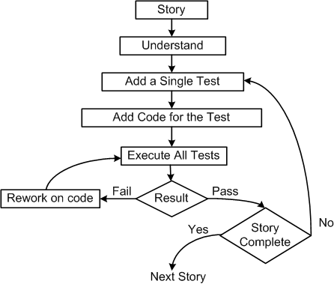
Extreme Unit Testing
Unit Testing and Acceptance Testing are the two extreme testing techniques.
Pick a requirement, i.e., a story
Write a test case that will verify a small part of the story and assign a fail verdict to it
Write the code that implement particular part of the story to pass the test
Execute all test
Rework on the code, and test
the code until all tests pass
Repeat step 2 to step 5 until
the story is fully implemented
Notes:
XP has lots of practices specifically for programming such as TDD, continuous integration, pair programming.
Pair programming is an agile software development technique in which two programmers work together at one workstation. One, the driver, writes code while the other, the observer or navigator,[1] reviews each line of code as it is typed in. The two programmers switch roles frequently.

Slide 25
Extreme Unit Testing
Three laws of Test Driven Development (TDD)
  One may not write production code unless the first failing unit test is written
  One may not write more of a unit test than is sufficient to fail.
  One may not write more production code than is sufficient to make the failing unit test pass.
Pair programming:
  In XP, code is being developed by two programmers working side by side
  One person develops the code tactically and the other one inspects it methodically by keeping in mind the story they are implementing.
Notes:
XP has lots of practices specifically for programming such as TDD, continuous integration, pair programming.
Pair programming is an agile software development technique in which two programmers work together at one workstation. One, the driver, writes code while the other, the observer or navigator,[1] reviews each line of code as it is typed in. The two programmers switch roles frequently.

Slide 26
JUnit – A Framework for Unit Testing
JUnit: It is a framework for performing unit testing of Java programs.
  Other frameworks: NUnit (C#), CPPUnit (C++), fUnit (Fortran)
Intuitive steps to test a method in Java (Ex. Move() method of PlanetClass)
  Create an object instance of PlanetClass. Call it Mars.
  Select values of all input parameters of Move().
  Compute the expected value to be returned by Move(). Let it be y.
  Execute method Move() on Mars with the selected input values.
    Let Move() return a value called z.
  Compare the actual output (z) returned by Move() with the expected value (y).
    If (z == y), Move() passes the test; otherwise it fails. 🡪 Report the result.

Slide 27
Reading
Software Testing and Quality Assurance: Theory and Practice
Page [83-120]
Glenford J. Myers, “The Art of Software Testing”, John Wiley & Sons, Inc., 2nd Ed., 2004.
Page [21-43, 91-105, 157-193]
And read other related sites

