Slide 1
Examples and Exercises
[Part III – Heat Transfer through Fins (Extended Surfaces)]
Chapter Three – One Dimensional -Steady State Conduction
By Dawit M.
Nov, 2016G.C

Slide 2
Outline
Important Tables and Diagrams
Examples
Example 1: Performance of Pin Finned Plate
Example 2: Engine Cylinder Cooling Assisted by Fins
Example 3: Performance of Pin Finned Plate

Slide 3
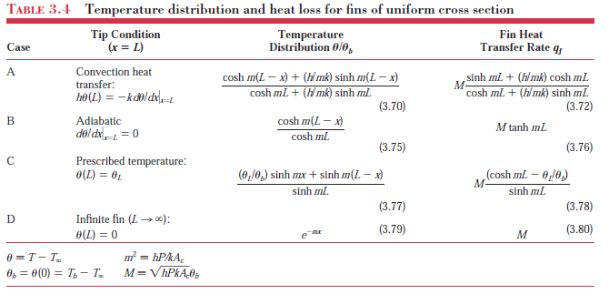
Important Tables and Diagrams

Slide 4
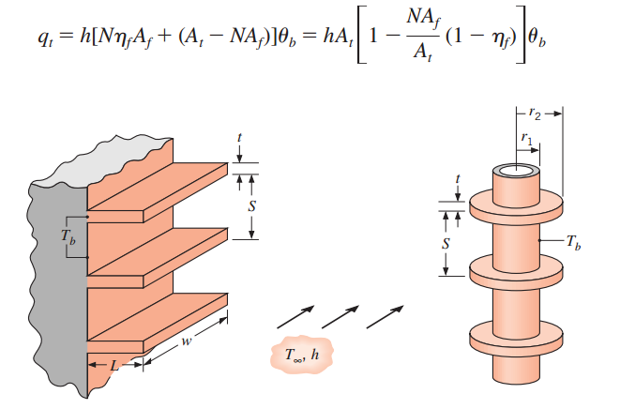
Cont’d …

Slide 5


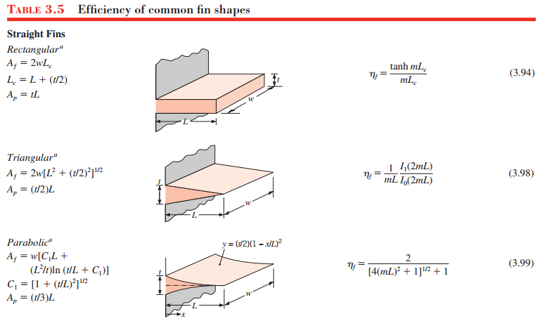
Cont’d …

Slide 6
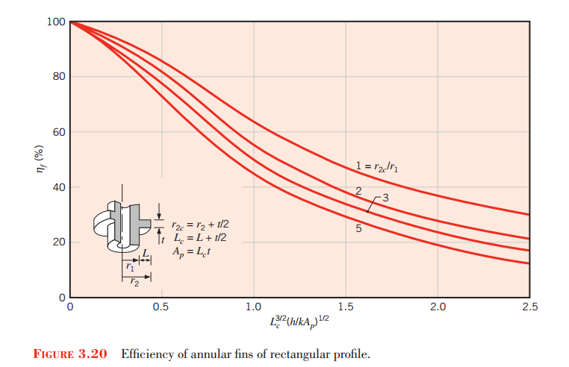
Cont’d …

Slide 7

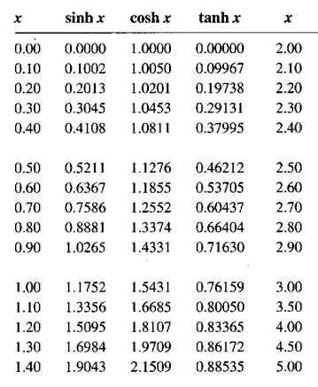
Cont’d …

Slide 8
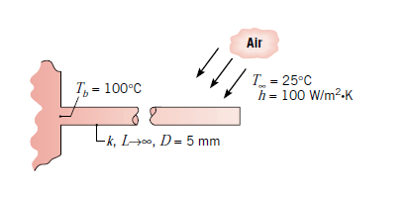
Exercise 1: Fin Heat Rate
A very long rod 5 mm in diameter has one end maintained at 100°C. The surface of the rod is exposed to ambient air at 25°C with a convection heat transfer coefficient of 100 W/m² K.
Determine the temperature distributions along rod constructed from pure copper, Table A.1, for copper, k = 398 W/mK. What is the corresponding heat loss from the rod?
Estimate how long the rods must be for the assumption of infinite length to yield an accurate estimate of the heat loss.

Slide 9
Example 2: Engine Cylinder Cooling Assisted by Fins
2. The engine cylinder of a motor cycle is constructed of 2024-T6 aluminum alloy (K = 186W/mK) and is of height H = 0.15 m and outside diameter D = 50 mm. Under typical operating conditions the outer surface of the cylinder is at a temperature of 500 K and is exposed to ambient air at 300 K, with a convection coefficient of 50 W/m².K. Annular fins are integrally cast with the cylinder to increase heat transfer to the surroundings. Consider five such fins, which are of thickness t = 6 mm. length L = 20 mm, and equally spaced. What is the increase in heat transfer due to use of the fins?

Slide 10
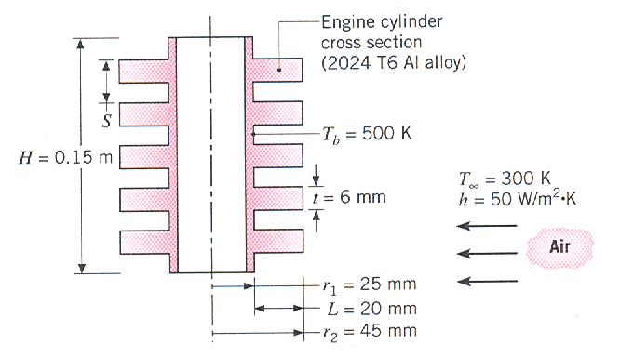
Cont’d …

Slide 11
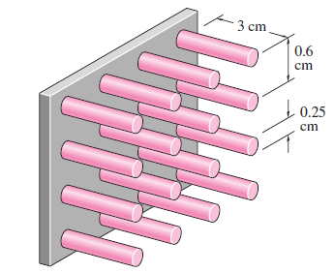
Example 3: Performance of Pin Finned Plate
3. A hot surface at 100°C is to be cooled by attaching 3-cm-long, 0.25-cm-diameter aluminum pin fins (k = 237 W/m · °C) to it, with a center-to-center distance of 0.6 cm. The temperature of the surrounding medium is 30°C, and the heat transfer coefficient on the surfaces is 35 W/m² · °C. Determine the rate of heat transfer from the surface for a 1-m x 1-m section of the plate. Also determine the overall Effectiveness of the fins.

Slide 12
Thank You!
Any Question?

