Slide 1
Chapter Five: Test Case Design Techniques
Control Flow Testing
Sem. II - 2020
Department of Software Engineering
ITSC-AAIT

Slide 2
Basic Idea
Two kinds of basic program statements
  Assignment statements (Ex. x = 2*y; )
  Program Conditions (Ex. if(), for(), while(), …)
Control flow
  Successive execution of program statements is viewed as flow of control.
  Conditional statements alter the default flow.
Program path is the execution instance of program unit.
  It Is the execution of a sequence of instructions from the entry point to the exit point of a program unit. There can be a large number of paths in a program.
  Program path could be characterized by a pair of (input, expected output).
  Executing a path requires invoking the program unit with the right test input.

Slide 3
Basic Idea
Mere execution of large number of paths is costly and ineffective in revealing defects.
Paths are chosen by using the concepts of path selection criteria.
Often tools are used to automatically generate test inputs from program paths.
Control Flow Testing
  Control flow testing is a kind of structural testing, which is performed by programmers to test code written by them (even the smaller units, functions)
  Test cases for control flow testing are derived from the source code, such as a program unit (e.g., a function or method), rather than from the entire program.
  The main idea in control flow testing is to appropriately select a few paths in a program unit and observe whether or not the selected paths produce the expected outcome. Executing few paths in a program unit could show the behavior of entire unit.

Slide 4
Outline of Control Flow Testing
Inputs: The source code of a program unit and a set of path selection criteria
Example of Path Selection Criteria
  Select paths such that every statement is executed at least once.
  Select paths such that every conditional statement, for example, an if() statement, evaluates to true and false at least once on different occasions.
Path selection should follow generation of a control flow graph .(in which visual representation of all paths in a program unit is performed).
In automated test generation, a compiler can be modified to produce a CFG.

Slide 5
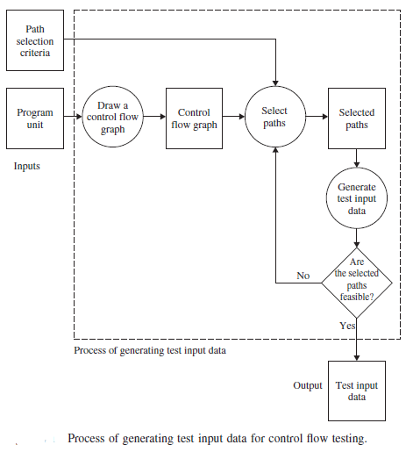
Outline of Control Flow Testing
Notes:
Selection of Paths: Paths are selected from the CFG to satisfy the path selection criteria, and it is done by considering the structure of the CFG.
Generation of Test Input Data: A path can be executed if and only if a certain instance of the inputs to the program unit causes all the conditional statements along the path to evaluate to true or false as dictated by the control flow(feasible paths).

Slide 6
Outline of Control Flow Testing
Selection of paths
  Enough entry/exit paths are selected to satisfy path selection criteria.
Generation of test input data
  Two kinds of paths
    Executable path: There exists input so that the path is executed.
    Infeasible path: There is no input to execute the path.
  Solve the path conditions to produce test input for each path.

Slide 7
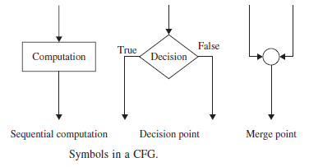
Control Flow Graph
Three symbols are used to construct a CFG.
Each computation and decision box should be labeled with a unique integer.
The two branches of a decision box are labeled with T and F.

Slide 8
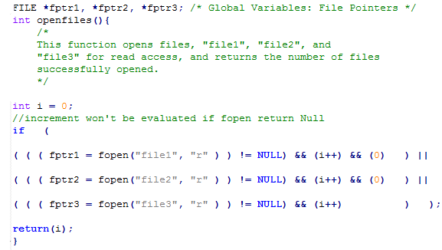
Control Flow Graph
Notes:
The above condition is executed as follows:
• Execute the assignment statement fptr1 = fopen(“file1”, “r”).
• Execute the relational operation fptr1! = NULL.
• If the above relational operator evaluates to false, skip the evaluation of
the subsequent condition components (i++) && (0).
• If the relational operator evaluates to true, then first (i) is evaluated to true
or false. Irrespective of the outcome of this evaluation, the next statement
executed is (i++).
• If (i) has evaluated to true, then the condition (0) is evaluated. Otherwise,
evaluation of (0) is skipped.

Slide 9
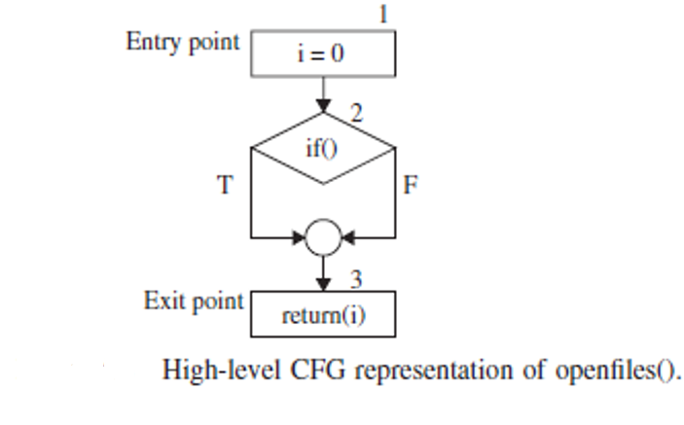
Control Flow Graph

Slide 10
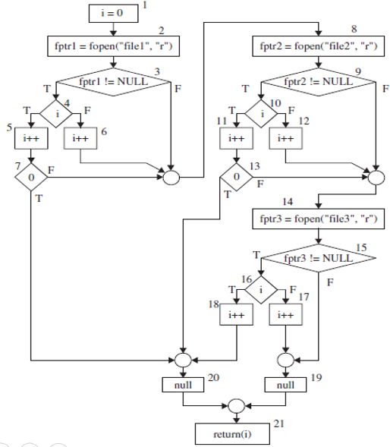
Control Flow Graph
Detail CFG

Slide 11
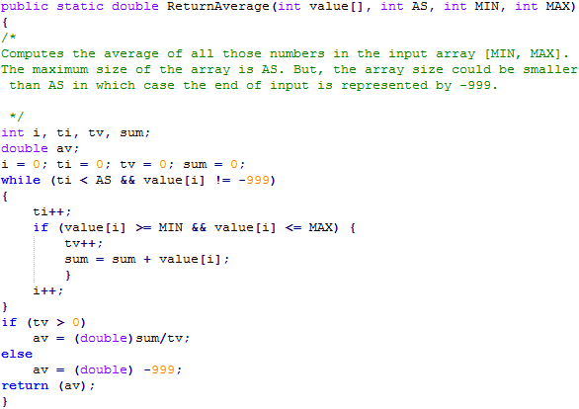
Control Flow Graph

Slide 12
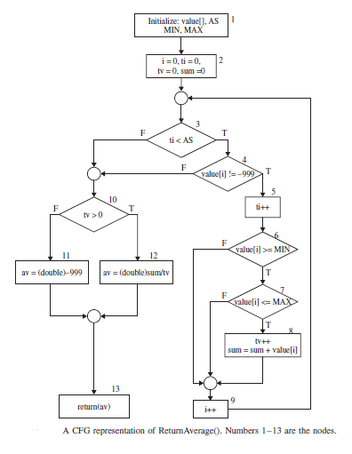
Control Flow Graph

Slide 13
Paths in a Control Flow Graph
A few paths from average calculator
  Path 1: 1-2-3(F)-10(T)-12-13
  Path 2: 1-2-3(F)-10(F)-11-13
  Path 3: 1-2-3(T)-4(T)-5-6(T)-7(T)-8-9-3(F)-10(T)-12-13
  Path 4: 1-2-3(T)-4(T)-5-6-7(T)-8-9-3(T)-4(T)-5-6(T)-7(T)-8-9-3(F)-10(T)-12- 13

Slide 14
Path Selection Criteria
Program paths are selectively executed.
The concept of path selection criteria is used to answer this question.
  What paths do I select for testing?
Advantages of selecting paths based on defined criteria:
  Ensure that all program constructs are executed at least once.
  Repeated selection of the same path is avoided.
  One can easily identify what features have been tested and what not.
Path selection criteria
  Select all paths.
  Select paths to achieve complete statement coverage.
  Select paths to achieve complete branch coverage.
  Select paths to achieve predicate coverage.

Slide 15
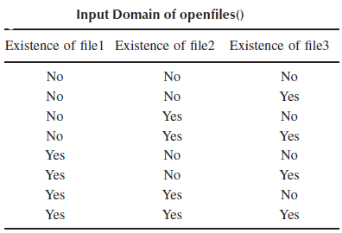
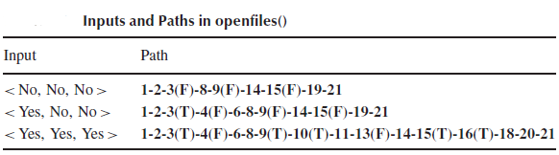
Path Selection Criteria
All-Path Coverage Criterion
  All-path coverage criterion: Select all the paths in the program unit under consideration.
  The openfiles() unit has 25+ paths. Selecting all the inputs will exercise all the program paths.

Slide 16
Path Selection Criteria
Statement Coverage Criterion
  Statement coverage means executing individual program statements and observing the output.
  100% statement coverage means all the statements have been executed at least once.
  Cover all assignment statements.
  Cover all conditional statements.
  Less than 100% statement coverage is unacceptable.
  The basic problem is to select a few feasible paths to cover all the nodes of a CFG in order to achieve the complete statement coverage criterion.

Slide 17
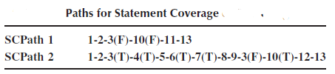
Path Selection Criteria
Statement Coverage Criterion

Slide 18
Path Selection Criteria
Branch Coverage Criterion
  A branch is an outgoing edge from a node in a CFG.
  A condition node has two outgoing branches – corresponding to the True and False values of the condition.
  Covering a branch means executing a path that contains the branch.
  100% branch coverage means selecting a set of paths such that each branch is included on some path.

Slide 19
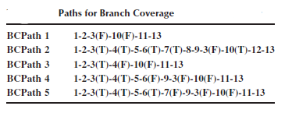
Path Selection Criteria
Branch coverage criterion

Slide 20
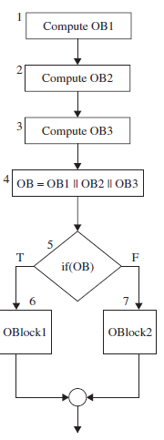
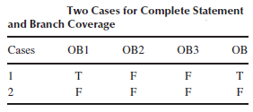
Path Selection Criteria
Predicate coverage criterion
    Achieve both statement coverage and branch coverage.
    If all possible combinations of truth values of the conditions affecting a path have been explored under some tests, then we say that predicate coverage has been achieved.
                We need to design just two test cases to achieve both statement coverage and branch coverage.

Slide 21
Generating Test Input
Having identified a path, a key question is how to make the path execute, if possible.
  i.e Generate input data that satisfy all the conditions on the path.
Key concepts in generating test input data
  Input vector - is a collection of all data entities read by the routine whose values must be fixed prior to entering the routine. E.g Arguments, Global variables and constants, Files, Contents of registers in assembly language programming, network connections and Timers
    Example: An input vector for openfiles() consists of individual presence or absence of the files “files1,” “file2,” and “file3.”
    Example: The input vector of ReturnAverage() is <value[], AS, MIN, MAX>

Slide 22
Generating Test Input
Key concepts in generating test input data …
  Predicate
    A predicate is a logical function evaluated at a decision point.
      Example: ti < AS is a predicate in AverageCalculator
      Example: The construct OB is a predicate

Slide 23
Generating Test Input
Key concepts in generating test input data …
  Path Predicate
    A path predicate is the set of predicates associated with a path.
    E.g for ReturnAverage( .. )
      Path: 1-2-3(T)-4(T)-5-6(T)-7(T)-8-9-3(F)-10(T)-12-13.
        Path Predicate
            ti < AS ≡ True
            value[i] != -999 ≡ True
            value[i] >= MIN ≡ True
            value[i] <= MAX ≡ True
            ti < AS ≡ False
            tv > 0 ≡ True

Slide 24
Generating Test Input
Key concepts in generating test input data
  Predicate Interpretation
    A path predicate may contain local variables.
      Example: <i, ti, tv> in ReturnAverage()’s path are local variables.
    Local variables play no role in selecting inputs that force a path to execute.
    Local variables can be eliminated(replaced by the element of input vectors) by a process called symbolic execution.
    Hence, Predicate interpretation is defined as the process of symbolically substituting operations along a path in order to express the predicate solely in terms of the input vector and a constant vector.
    A predicate may have different interpretations depending on how control reaches the predicate.
Notes:
The local variables are not
visible outside a function but are used to
• hold intermediate results,
• point to array elements, and
• control loop iterations.

Slide 25
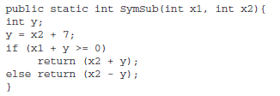
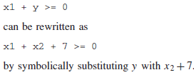
Generating Test Input
Key concepts in generating test input data
  Predicate Interpretation
    Example:
🡪🡪 🡪
This expression is defined over the input vector <x1, x2> and constant vector <0,7>

Slide 26
Generating Test Input
Key concepts in generating test input data
  Path Predicate Expression
  An interpreted path predicate is called a path predicate expression.
  A path predicate expression has the following attributes.
    It is void of local variables.
    It is a set of constraints in terms of the input vector, and, maybe, constants.
    Path forcing inputs can be generated by solving the constraints.
    If a path predicate expression has no solution, the path is infeasible.

Slide 27
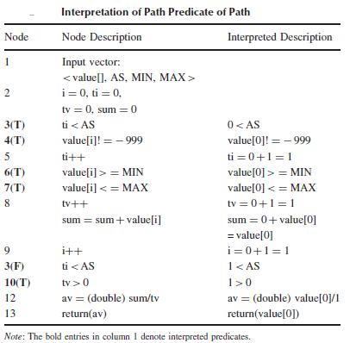
Generating Test Input
Key concepts in generating test input data
  Path predicate expression (Return Average())
  Path 🡪
  Predicate Expression 🡪

Slide 28
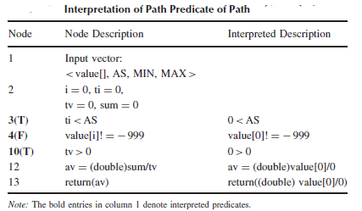
Generating Test Input
Key concepts in generating test input data
  Path predicate expression
    Infeasible Path of Return Average(…)
      Path: 1-2-3(T)-4(F)-10(T)-12-13
      Path Predicate Expression

Slide 29
Generating Test Input
Key concepts in generating test input data
  Generating input data from a path predicate expression
    Path: 1-2-3(T)-4(T)-5-6(T)-7(T)-8-9-3(F)-10(T)-12-13.
    Path Predicate Expression
      0 < AS ≡ True …… (1)
      value[0] != -999 ≡ True …… (2)
      value[0] >= MIN ≡ True …… (3)
      value[0] <= MAX ≡ True …… (4)
      1 < AS ≡ False …… (5)
      1 > 0 ≡ True …… (6)
  One can solve the above equations to obtain the following test input data
    AS = 1
    MIN = 25
    MAX = 35
    Value[0] = 30

Slide 30
Reading
Software Testing and Quality Assurance: Theory and Practice
Page [120-143]
The Art of Software Testing
Page [64 - 112 ]

