Slide 1
Chapter Seven: System Testing
Sem. II - 2020
Department of Software Engineering
ITSC-AAIT
Dr. Sunkari

Slide 2
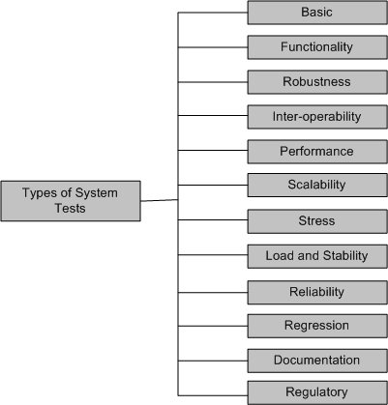
Types of System Tests

Slide 3
Types of System Tests
Basic tests provide an evidence that the system can be installed, configured and be brought to an operational state.
Functionality tests provide comprehensive testing over the full range of the requirements, within the capabilities of the system.
Robustness tests determine how well the system recovers from various input errors and other failure situations.
Inter-operability tests determine whether the system can inter-operate with other third party products.
Performance tests measure the performance characteristics of the system, e.g., throughput and response time, under various conditions.

Slide 4
Types of System Tests
Scalability tests determine the scaling limits of the system, in terms of user scaling, geographic scaling, and resource scaling
Stress tests put a system under stress in order to determine the limitations of a system and, when it fails, to determine the manner in which the failure occurs
Load and Stability tests provide evidence that the system remains stable for a long period of time under full load
Reliability tests measure the ability of the system to keep operating for a long time without developing failures.
Regression tests determine that the system remains stable as it cycles through the integration of other subsystems and through maintenance tasks.
Documentation tests ensure that the system’s user guides are accurate and usable

Slide 5
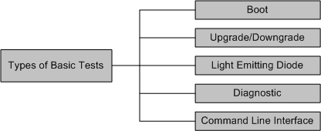
Basic Tests
Boot: Boot tests are designed to verify that the system can boot up its software image (or, build) from the supported boot options.
Upgrade/Downgrade: Upgrade/downgrade tests are designed to verify that the system software can be upgraded or downgraded (rollback) in a graceful manner.
Notes:
Booting – Initializing Software
Hard Booting – after supplying electric power to CPU(off 🡪 on) – to diagnose HW errors
Soft Booting – no power on self test(POST)
First POST 🡪 Boot loader(from HD to RAM)
Gracefull manner - No Hacks

Slide 6
Basic Tests
Light Emitting Diode: The LED (Light Emitting Diode) tests are designed to verify that the system LED status indicators functioning as desired.
Diagnostic: Diagnostic tests are designed to verify that the hardware components (or, modules) of the system are functioning as desired
  Power-On Self Test
  Ethernet Loop Back Test
  Bit Error Rate Test
Command line Interface: Command Line Interface (CLI) tests are designed to verify that the system can be configured.
Notes:
Multi Meter is used to Test this LED Test
Power on Self Test - undergone when the computer switches on and checks whether the keyboard the mouse. Ram disk drives and other hws are working properly. Boot Begins after POST
Loop Back Test – a test in which signal is sent from communication device and returned to it as a way to determine whether the device is working right or as a way to pin the failing node. Also used a special plug called wrap plug
Bit Error Rate Test (BERT) – the number of bits transmitted over the communication channel that have been altered because of noise, interference, distortion or bit synchronization errors.

Slide 7
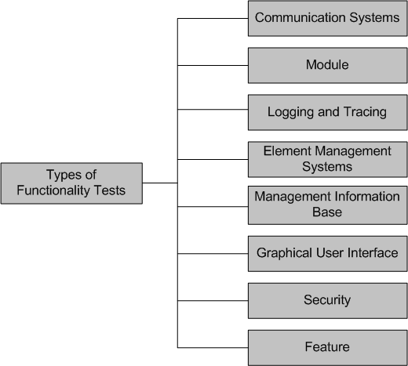
Functionality Tests

Slide 8
Functionality Tests
Communication Systems Tests
  These tests are designed to verify the implementation of the communication systems as specified in the customer requirements specification
  Four types of communication systems tests are recommended
    Basic interconnection tests
    Capability tests
    Behavior tests
    System resolution tests
Module Tests
  Module Tests are designed to verify that all the modules function individually as desired within the systems
  The idea here is to ensure that individual modules function correctly within the whole system.
    For example, an Internet router contains modules such as line cards, system controller, power supply, and fan tray. Tests are designed to verify each of the functionalities
Notes:
Basic Interconnection Testing - provide evidence that an implementation can
establish a basic connection before thorough testing is performed.
Capability tests check that an implementation provides the observable capabilities
based on the static communication systems requirements.
Behavior tests endeavor to verify the dynamic communication systems
requirements of an implementation. This define observable behavior of a protocol (external behavior of the program – Black Box Testing).
Systems resolution tests probe to provide definite “yes” or “no” answers to
specific requirements.

Slide 9
Functionality Tests
Logging and Tracing Tests
  Logging and Tracing Tests are designed to verify the configurations and operations of logging and tracing
  This also includes verification of “flight data recorder: non-volatile Flash memory” logs when the system crashes.
Element Management Systems (EMS) Tests
  EMS tests verifies the main functionalities, which are to manage, monitor and upgrade the communication systems network elements(NEs)
  It includes both EMS client and EMS servers functionalities
Management Information Base (MIB) Tests
  MIB tests are designed to verify
    Standard MIBs including MIB II
    Enterprise MIBs specific to the system
Notes:
Tracing – Requires a specialized form of logging to record program execution information. Used by programmers for debugging purpose. Functions of EMS Fault Management(alarm), Configuration Management(e.g backup) , Accounting Management(billing), Performance Management(data colletions and analysais report) and Security Management (control NE Access and Access logs).
SNMP - a given Ems may communicate with its NE using SNMP protocol and other.
MIB – is a database that is used to manage entities in the communication network (Like SNMP).
MIB II – Management Information Base
MIB Test - Tests may include verification of the agent within the system that implements the objects it claims to.
Every MIB object is
tested with the following primitives: Get, GetNext, GetBulk, and Set. It should
be verified that all the counters related to the MIBs are incremented correctly
and that the agent is capable of generating (i) well known traps (e.g., coldstart,
warmstart, linkdown, linkup) and (ii) application-specific traps (X.25 restart and
X.25 reset).

Slide 10
Functionality Tests
Graphical User Interface Tests
  Tests are designed to look-and-feel the interface to the users of an application system
  Tests are designed to verify different components such as icons, menu bars, dialog boxes, scroll bars, list boxes, and radio buttons.
  The GUI can be utilized to test the functionality behind the interface, such as accurate response to database queries
  Tests the usefulness of the on-line help, error messages, tutorials, and user manuals
  The usability characteristics of the GUI is tested, which includes the following
  Accessibility: Can users enter, navigate, and exit with relative ease?
  Responsiveness: Can users do what they want and when they want in a way that is clear?
  Efficiency: Can users do what they want to with minimum number of steps and time?
  Comprehensibility: Do users understand the product structure with a minimum amount of effort?

Slide 11
Functionality Tests
Security Tests
  Security tests are designed to verify that the system meets the security requirements
    Confidentiality
      It is the requirement that data and the processes be protected from unauthorized disclosure
    Integrity
      It is the requirement that data and process be protected from unauthorized modification
    Availability
      It is the requirement that data and processes be protected form the denial of service to authorized users
  Security test scenarios should include negative scenarios such as misuse and abuse of the software system

Slide 12
Functionality Tests
Security Test: Useful types of security tests includes the following:
  Verify that only authorized accesses to the system are permitted
  Verify the correctness of both encryption and decryption algorithms for systems where data/messages are encoded.
  Verify that illegal reading of files, to which the perpetrator is not authorized, is not allowed
  Ensure that virus checkers prevent or curtail entry of viruses into the system
  Ensure that the system is available to authorized users when a zero-day attack occurs
  Try to identify any “backdoors” in the system usually left open by the software developers
Feature Tests
  These tests are designed to verify any additional functionalities which are defined in requirement specification but not covered in the other functional Testing categories. Examples: Data conversion testing and Cross-functionality testing
Notes:
Data conversion testing is testing of programs or procedures that are used to convert data from an existing system to a replacement system. An example is testing of a migration tool that converts a Microsoft Access database to MySQL format.
Cross-functionality testing provides additional tests of the interdependencies among functions. For example, the verification of the interactions between NEs and an element management system in a 1xEV-DO wireless data network

Slide 13
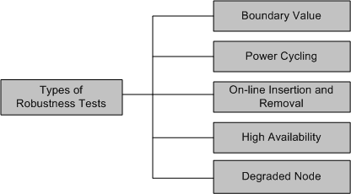
Robustness Tests
Robustness means how much sensitive a system is to erroneous input and changes its operational environment
Tests in this category are designed to verify how gracefully the system behaves in error situations and in a changed operational environment.

Slide 14
Robustness Tests
Boundary value
  Boundary value tests are designed to cover boundary conditions, special values, and system defaults
  The tests include providing invalid input data to the system and observing how the system reacts to the invalid input.
Power cycling
  Power cycling tests are executed to ensure that, when there is a power glitch in a deployment environment, the system can recover from the glitch to be back in normal operation after power is restored
On-line insertion and removal
  On-line Insertion and Removal (OIR) tests are designed to ensure that on-line insertion and removal of modules, incurred during both idle and heavy load operations, are gracefully handled and recovered.

Slide 15
Robustness Tests
High Availability
  The concept of high availability is also known as fault tolerance
  High availability tests are designed to verify the redundancy of individual modules, including the software that controls these modules.
  The goal is to verify that the system gracefully and quickly recovers from hardware and software failures without adversely impacting the operation of the system
  High availability is realized by means of proactive methods to maximize service up-time, and to minimize the downtime
Degraded Node
  Degraded node (also known as failure containment) tests verify the operation of a system after a portion of the system becomes non-operational
  It is a useful test for all mission-critical applications.

Slide 16
Interoperability Tests
Tests are designed to verify the ability of the system to inter-operate with third party products
The re-configuration activities during interoperability tests is known as configuration testing
Another kind of inter-operability tests is called (backward) compatibility tests
  Compatibility tests verify that the system works the same way across different platforms, operating systems, data base management systems
  Backward compatibility tests verify that the current software build flawlessly works with older version of platforms.

Slide 17
Performance Tests
Tests are designed to determine the performance of the actual system compared to the expected one.
Tests are designed to verify response time, execution time, throughput, resource utilization and traffic rate.
One needs to be clear about the specific data to be captured in order to evaluate performance metrics.
For example, if the objective is to evaluate the response time, then one needs to capture.
  End-to-end response time (as seen by external user)
  CPU time
  Network connection time
  Database access time
  Network connection time
  Waiting time

Slide 18
Scalability Tests
Tests are designed to verify that the system can scale up to its engineering limits
Scaling tests are conducted to ensure that the system response time remains the same, or increases by a small amount, as the number of users are increased.
There are three major causes of these limitations:
  data storage limitations
  network bandwidth limitations
  speed limit
Extrapolation is often used to predict the limit of scalability
Notes:
Extrapolation - Predicting the Limit based on the current Trend.

Slide 19
Stress Tests
The goal of stress testing is to evaluate and determine the behavior of a software component while the offered load is in excess of its designed capacity
The system is deliberately stressed by pushing it to and beyond its specified limits
It ensures that the system can perform acceptably under worst-case conditions, under an expected peak load. If the limit is exceeded and the system does fail, then the recovery mechanism should be invoked
Stress tests are targeted to bring out the problems associated with one or more of the following:
  Memory leak
  Buffer Allocation and Memory Carving
Notes:
Memory Carving – is an important to analyzing the Physical and Virtual memory dumps when the memory structures are unknown or have been overwritten.
Carving is a bit precise sequential search of the drive for various artifacts. While carving the product does not rely on the file system, and does not make use of files as they may have been deleted. It looks for a particular sequences of bytes or characteristic of signatures specific to certain types of evidence.
Memory Leak - causes when a computer program incorrectly manages memory allocations in such a way that memory which is not no longer needed is not released.

Slide 20
Load and Stability Tests
Tests are designed to ensure that the system remains stable for a long period of time under full load
When a large number of users are introduced and applications that run for months without restarting, a number of problems are likely to occur:
  the system slows down
  the system encounters functionality problems
  the system crashes altogether
Load and stability testing typically involves exercising the system with virtual users and measuring the performance to verify whether the system can support the anticipated load.
This kind of testing help one to understand the ways the system will work in real-life situations.

Slide 21
Reliability Tests
Reliability tests are designed to measure the ability of the system to remain operational for long periods of time.
The reliability of a system is typically expressed in terms of mean time to failure (MTTF)
The average of all the time intervals between successive failures is called the MTTF.
After a failure is observed, the developers analyze and fix the defects, which consumes some time – let us call this interval the repair time.
The average of all the repair times is known as the mean time to repair (MTTR)
Now we can calculate a value called mean time between failure (MTBF) as MTBF = MTTF + MTTR

Slide 22
Regression Tests
In this category, new tests are not designed, instead, test cases are selected from the existing pool and executed
The main idea in regression testing is to verify that no defect has been introduced into the unchanged portion of a system due to changes made elsewhere in the system
During system testing, many defects are revealed and the code is modified to fix those defects
One of four different scenarios can occur for each fix:
  The reported defect is fixed
  The reported defect could not be fixed inspite of making an effort
  The reported defect has been fixed, but something that used to work before has been failing
  The reported defect could not be fixed inspite of an effort, and something that used to work before has been failing

Slide 23
Regression Tests
One possibility is to re-execute every test case from version n − 1 to version n before testing anything new
A full test of a system may be prohibitively expensive.
A subset of the test cases is carefully selected from the existing test suite to
  maximize the likelihood of uncovering new defects
  reduce the cost of testing

Slide 24
Documentation Tests
Documentation testing means verifying the technical accuracy and readability of the user manuals, tutorials and the on-line help
Documentation testing is performed at three levels:
  Read test: In this test a documentation is reviewed for clarity, organization, flow, and accuracy without executing the documented instructions on the system
  Hands-on test: Exercise the on-line help and verify the error messages to evaluate their accuracy and usefulness.
  Functional test: Follow the instructions embodied in the documentation to verify that the system works as it has been documented.

Slide 25
Regulatory Tests
In this category, the final system is shipped to the regulatory bodies in those countries where the product is expected to be marketed
The idea is to obtain compliance marks on the product from various countries
Most of these regulatory bodies issue safety and EMC (electromagnetic compatibility)/ EMI (electromagnetic interference) compliance certificates (emission and immunity)
The regulatory agencies are interested in identifying flaws in software that have potential safety consequences
The safety requirements are primarily based on their own published standards

Slide 26
Software Safety
A hazard is a state of a system or a physical situation which when combined with certain environmental conditions, could lead to an accident or mishap
An accident or mishap is an unintended event or series of events that results in death, injury, illness, damage or loss of property, or harm to the environment
Software safety is defined in terms of hazards
A software in isolation cannot do physical damage. However, a software in the context of a system and an embedding environment could be vulnerable
Examples:
  A software module in a database application is not hazardous by itself, but when it is embedded in a missile navigation system, it could be hazardous
  If a missile takes a U-turn because of a software error in the navigation system, and destroys the submarine that launched it, then it is not a safe software

Slide 27
Safety Assurance
There are two basic tasks performed by a safety assurance engineering team:
  Provide methods for identifying, tracking, evaluating, and eliminating hazards associated with a system
  Ensure that safety is embedded into the design and implementation in a timely and cost effective manner, such that the risk created by the user/operator error is minimized

Slide 28
Reading
Software Testing and Quality Assurance: Theory and Practice
Page [224-253]
And read other online references

