Slide 1
MENG 3071
Chapter 2
Position Analysis
All figures taken from Design of Machinery, 3rd ed. Robert Norton 2003

Slide 2
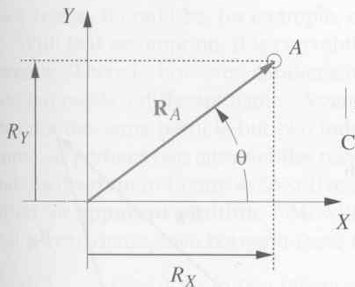
Coordinate Systems
Cartesian (R_{x}, R_{y})
Polar (R_{A}, θ)
Converting between the two
Position Difference, Relative position
  Difference (one point, two times)
  relative (two points, same time)
R_{BA}=R_{B}-R_{A}
Y
B
R_{BA}
A
R_{A}
R_{B}
X

Slide 3
4.3 Translation, Rotation, and Complex motion
Translation: keeps the same angle
Rotation: one point does not move
Complex motion: a combination of rotation and translation

Slide 4
Graphical Position Analysis of Linkages
Given the length of the links (a,b,c,d), the ground position, and θ₂. Find θ₃ and θ₄
b
B
c
b
A
θ₃
c
a
θ₂
θ₄
d
O₂
O₄

Slide 5
Graphical Linkage Analysis
b
Draw an arc of radius b, centered at A
Draw an arc of radius c, centered at O₄
The intersections are the two possible positions for the linkage, open and crossed
c
B₁
b
A
θ₃
c
a
d
θ₄
θ₂
O₂
O₄
B₂

Slide 6
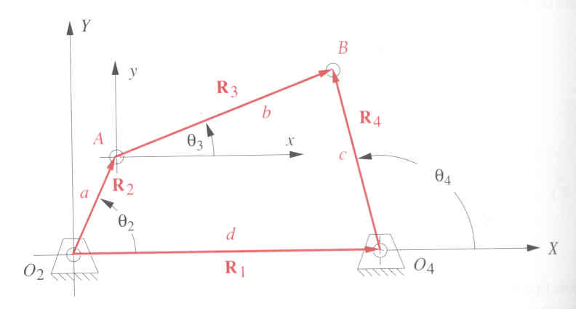
Algebraic Position Analysis
Obtain coordinates of point A:
Obtain coordinates of point B:
These are 2 equations in 2 unknowns: B_{x} and B_{y}
See solution in textbook pages 171, 172.

Slide 7
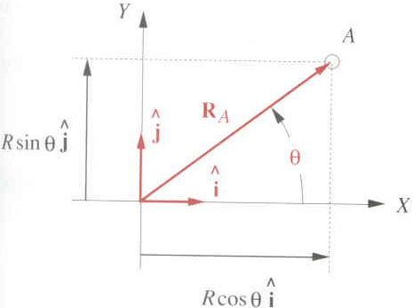
Complex Numbers as Vectors
We can plot complex numbers on the real-imaginary plane
Euler identity e^{±iθ}=cos θ ± i sin θ
Cartesian form: R_{A}cos θ + i R_{A}sin θ
Polar form: R_{A}e^{iθ}
Multiplying by e^{iθ} corresponds to rotating by θ
Imaginary
Real

Slide 8
Analytical Position Analysis
Given: link lengths a,b,c and d, θ₁, θ₂ (the motor position)
Find: the unknown angles θ₃ and θ₄

Slide 9
Analytical Position Analysis
Write the vector loop equation:
(Positive from tail to tip)
Substitute with complex vectors
Take knowns on one side, unknowns on the other.
Call the knowns Z
Unknowns
Knowns

Slide 10
Fourbar Linkage Analysis
Define:
Take conjugate to get a second equation:
For the conjugate of s we have (only true for e^{iθ})
So our second equation is
Note:

Slide 11
Fourbar Linkage Analysis
Use algebra to eliminate one of the unknowns
Multiplying the two gives:
Multiplying by t and collecting terms gives:
From the quadratic formula
Quadratic equation in t

Slide 12
Fourbar Linkage Analysis
In MATLAB,
Zc=conj(Z)
t=roots([Zc*c,Z*Zc+c^2-b^2,Z*c])
θ₄=angle(t), θ₃=angle(s)
Two solutions relate to the open and crossed positions
B₁
b
A
θ₃
c
a
d
θ₄
θ₂
O₂
O₄
B₂

Slide 13

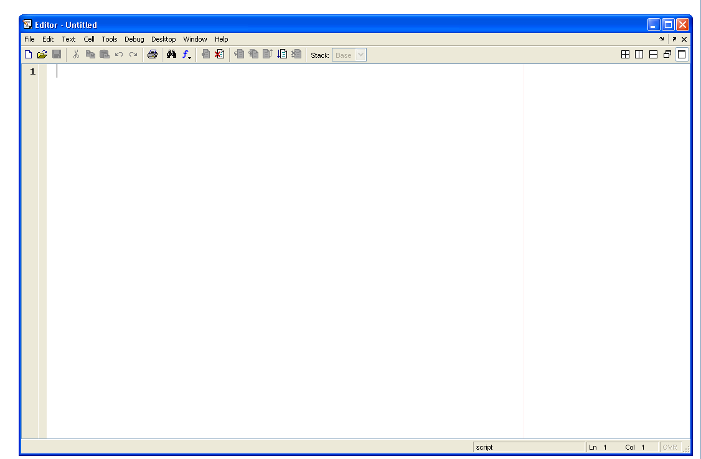
MATLAB
Change your current directory
Type in your commands here … or
Use a text editor

Slide 14
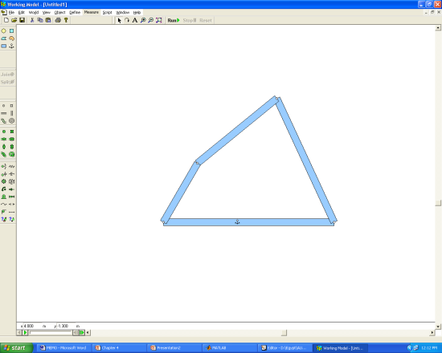
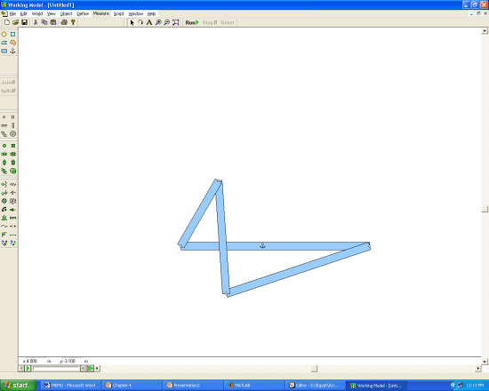
>> a=2; b=3; c=4; d=5;
>> th1=0; th2=60*pi/180;
>> z=-a*exp(i*th2)+d*exp(i*th1)
z =
4.0000 - 1.7321i
>> zc=conj(z)
zc =
4.0000 + 1.7321i
>> t=roots([zc*c,z*zc+c^2-b^2,z*c])
t =
-0.4194 + 0.9078i
-0.9490 - 0.3153i
>> s=(z+c*t)/b
s =
0.7741 + 0.6330i
0.0680 - 0.9977i
>> th4=angle(t)*180/pi
th4 =
114.7975
-161.6240
>> th3=angle(s)*180/pi
th3 =
39.2750
-86.1015
B
b
A
θ₃
c
a
θ₂
θ₄
d
O₂
O₄

Slide 15
Animation on MATLAB
% *******************************
% Animation of a four-bar linkage
clear; close all;
% Define parameters (link lengths)
a = 1; b = 3; c = 4; d = 5; th1 = 0;
% Now loop on the crank angle
for th2 = 0:0.05:2*pi
z = -a*exp(i*th2)+d*exp(i*th1);
zc = conj(z);
t = roots([zc*c,z*zc+c^2-b^2,z*c]);
s = (z+c*t)/b;
th3 = angle(s);
pA = a*exp(i*th2); % Position of point A
pB = pA+b*exp(i*max(th3)); % Be careful here!
% We took max(th3) because that will give the 'open' position.
% This may not work for all cases, so watch out!
% Now plot and animate. Fix the axis limits to see the animation.
plot([0 real(pA) real(pB) d 0],[0 imag(pA) imag(pB) 0 0],'linewidth',8);
axis([-1.2*a 1.2*d -c c]);%axis off
pause(0.01)
end

Slide 16
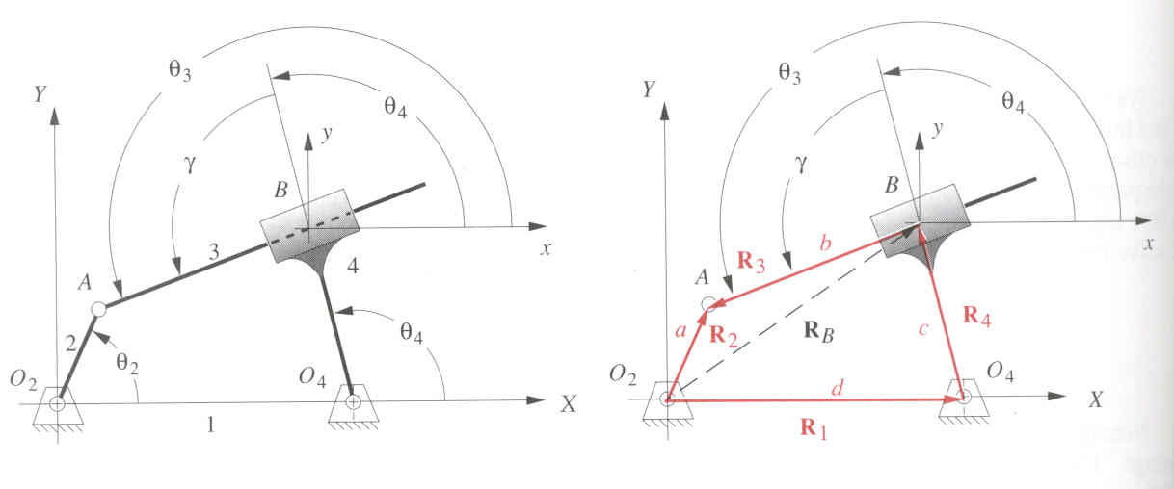
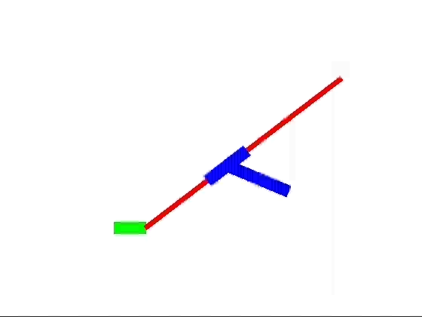
Inverted Crank Slider linkage
Given: link lengths a, c and d, θ₁, θ₂ (the motor position), and γ the angle between the slider and rod
Find: the unknown angles θ₃ and θ₄ and length b

Slide 17
Inverted Crank Slider linkage
Write the vector loop equation
Substitute with complex vectors
Geometry keeps
so

Slide 18
Inverted Crank Slider
Grouping knowns and unknowns
Calling
Gives
Taking the conjugate to get the second equation
Multiplying the two gives

Slide 19
Inverted Crank Slider
The solution is a quadratic equation in b
Which has a solution of
b=roots([1 c*(t+1/t),c^2-Z*Zc])
Once b is known, s can be found using

Slide 20
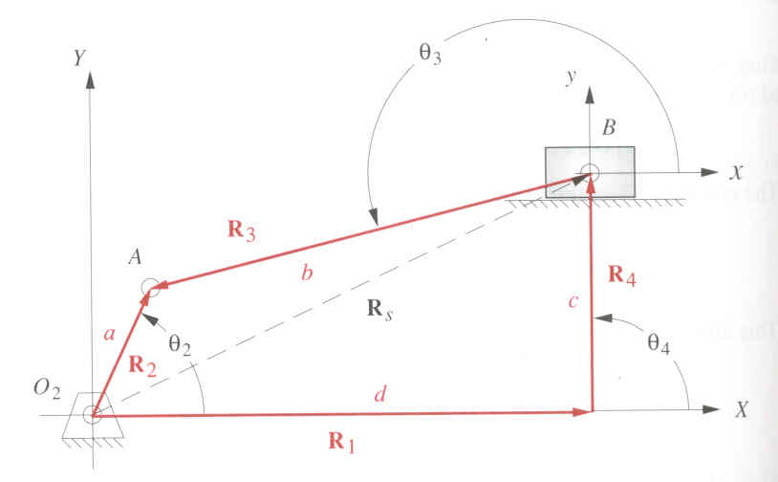
Crank Slider Mechanism
Given: link lengths a, b and c, θ₁, θ₂ (the motor position)
Find: the unknown angle θ₃ and length d

Slide 21
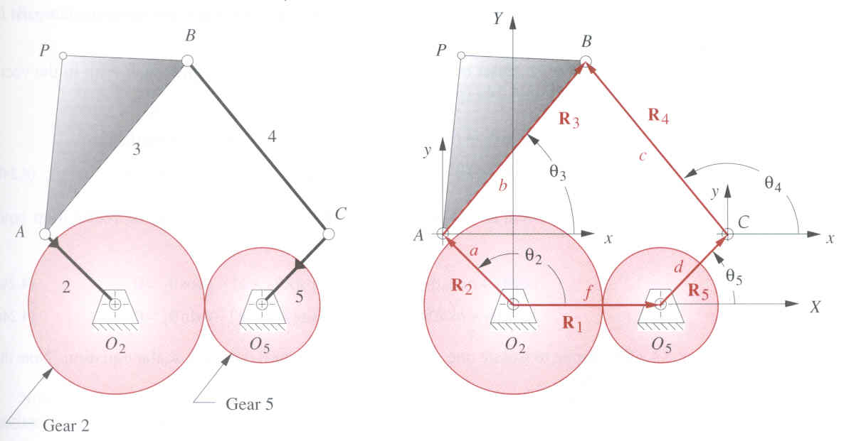
4.8 Linkages of More than Four Bars
Geared fivebar linkage
vector loop equation
Complex vectors
Separate unknowns and knowns (θ₅=λθ₂+φ)
(same eqn.
as 4bar)

Slide 22
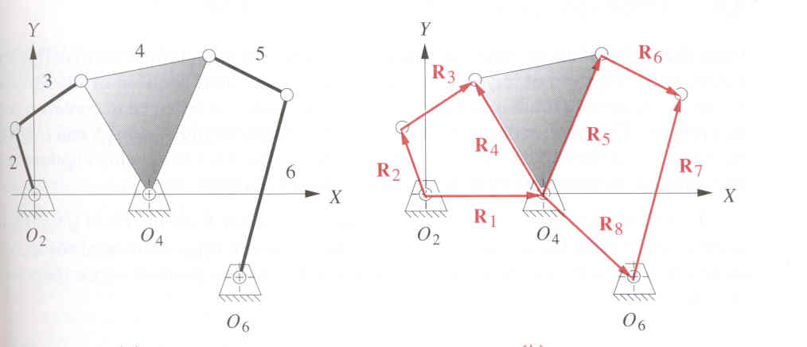
Sixbar Linkages
Watt’s sixbar can be solved as 2 fourbar linkages
R₁R₂R₃R₄, then R₅R₆R₇R₈
R₄ and R₅ have a constant angle between them

Slide 23
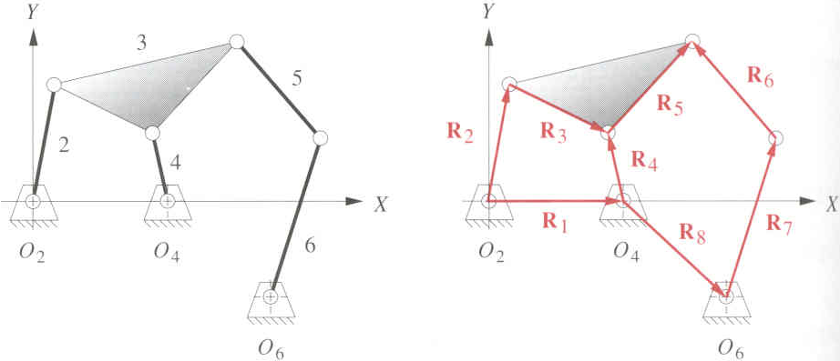
Sixbar Linkages
Stephenson’s sixbar can sometimes be solved as a fourbar and then a fivebar linkage
R₁R₂R₃R₄, then R₄R₅R₆R₇R₈
R₃ and R₅ have a constant angle between them
If motor is at O₆ you have to solve eqns. simultaneously

Slide 24
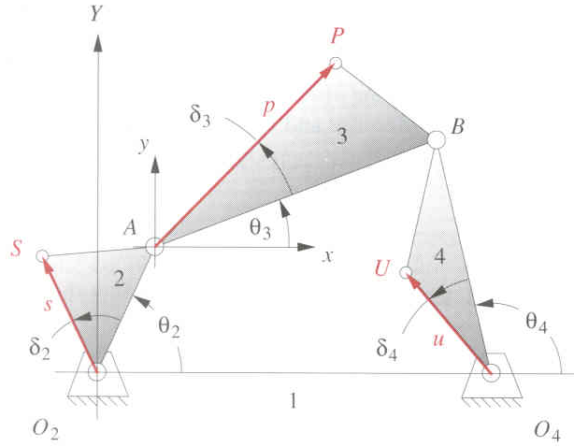
Position of any Point on a Linkage
Once the unknown angles have been found it is easy to find any position on the linkage
For point S
R_{s}=se^{i(θ2+δ2)}
For point P
R_{P}=ae^{i θ2} +pe^{i (θ3+δ3)}
For point U
R_{U}=d +ue^{i (θ4+δ4)}

Slide 25
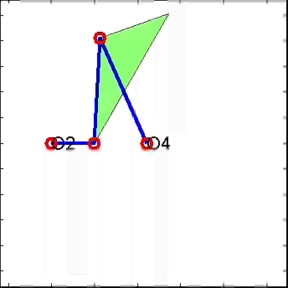
Using MATLAB (Spring 2007)

Slide 26
Example
Given: a,c,d,θ₂
Find: position of point P (coupler curve)
In MATLAB:
z = a*exp(i*th2)-d;
b = abs(z); th3 = angle(z);
b

Slide 27
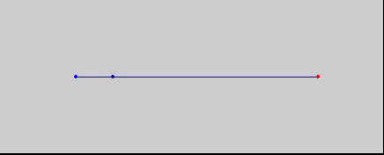
MATLAB m-file
clear; close all;
a = 2.4; c = 13.4; d = 8;
cupcur = [];
for th2 = 0:0.1:2*pi
z = a*exp(i*th2)-d;
b = abs(z); th3 = angle(z);
rp = a*exp(i*th2)-c*exp(i*th3);
cupcur = [cupcur rp];
X = [0 real(a*exp(i*th2)) real(rp)];
Y = [0 imag(a*exp(i*th2)) imag(rp)];
plot(X,Y,'.-'); axis equal; axis([-5 20 -5 5]); grid; hold on;
plot(real(cupcur),imag(cupcur),'.r');hold off;axis off
pause(0.1)
end
Mt1f13.avi
b

Slide 28
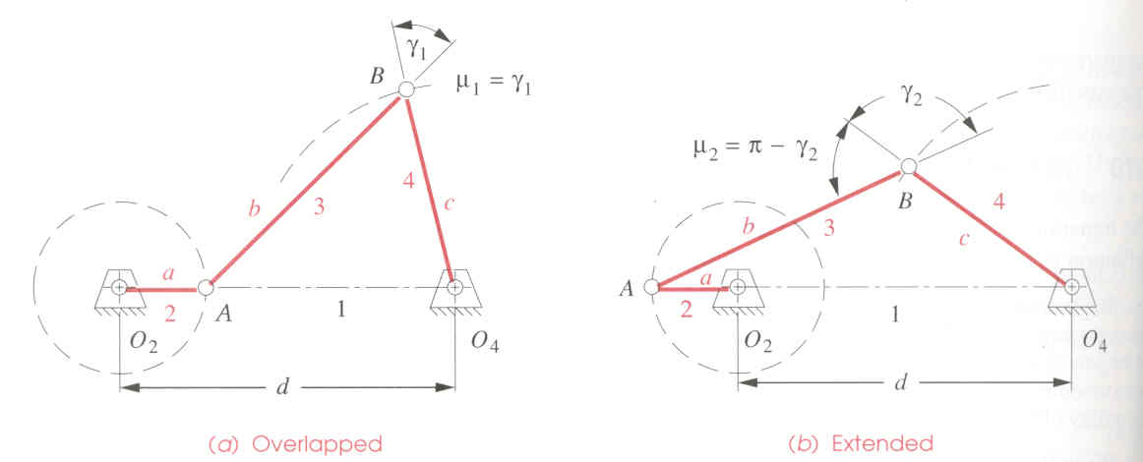
Transmission Angle
Extreme value of transmission angle when links 1 and 2 are aligned
Extended
Overlapped

Slide 29
Toggle Position
Caused by the colinearity of links 3 and 4.
For a non-Grashof linkage, only one of the values between the () will be between –1 and 1
3
3
4
Overlapped
2
2
4
θ₂
Extended
θ₂

