Slide 1
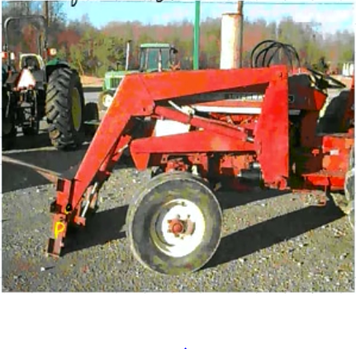

Slide 2
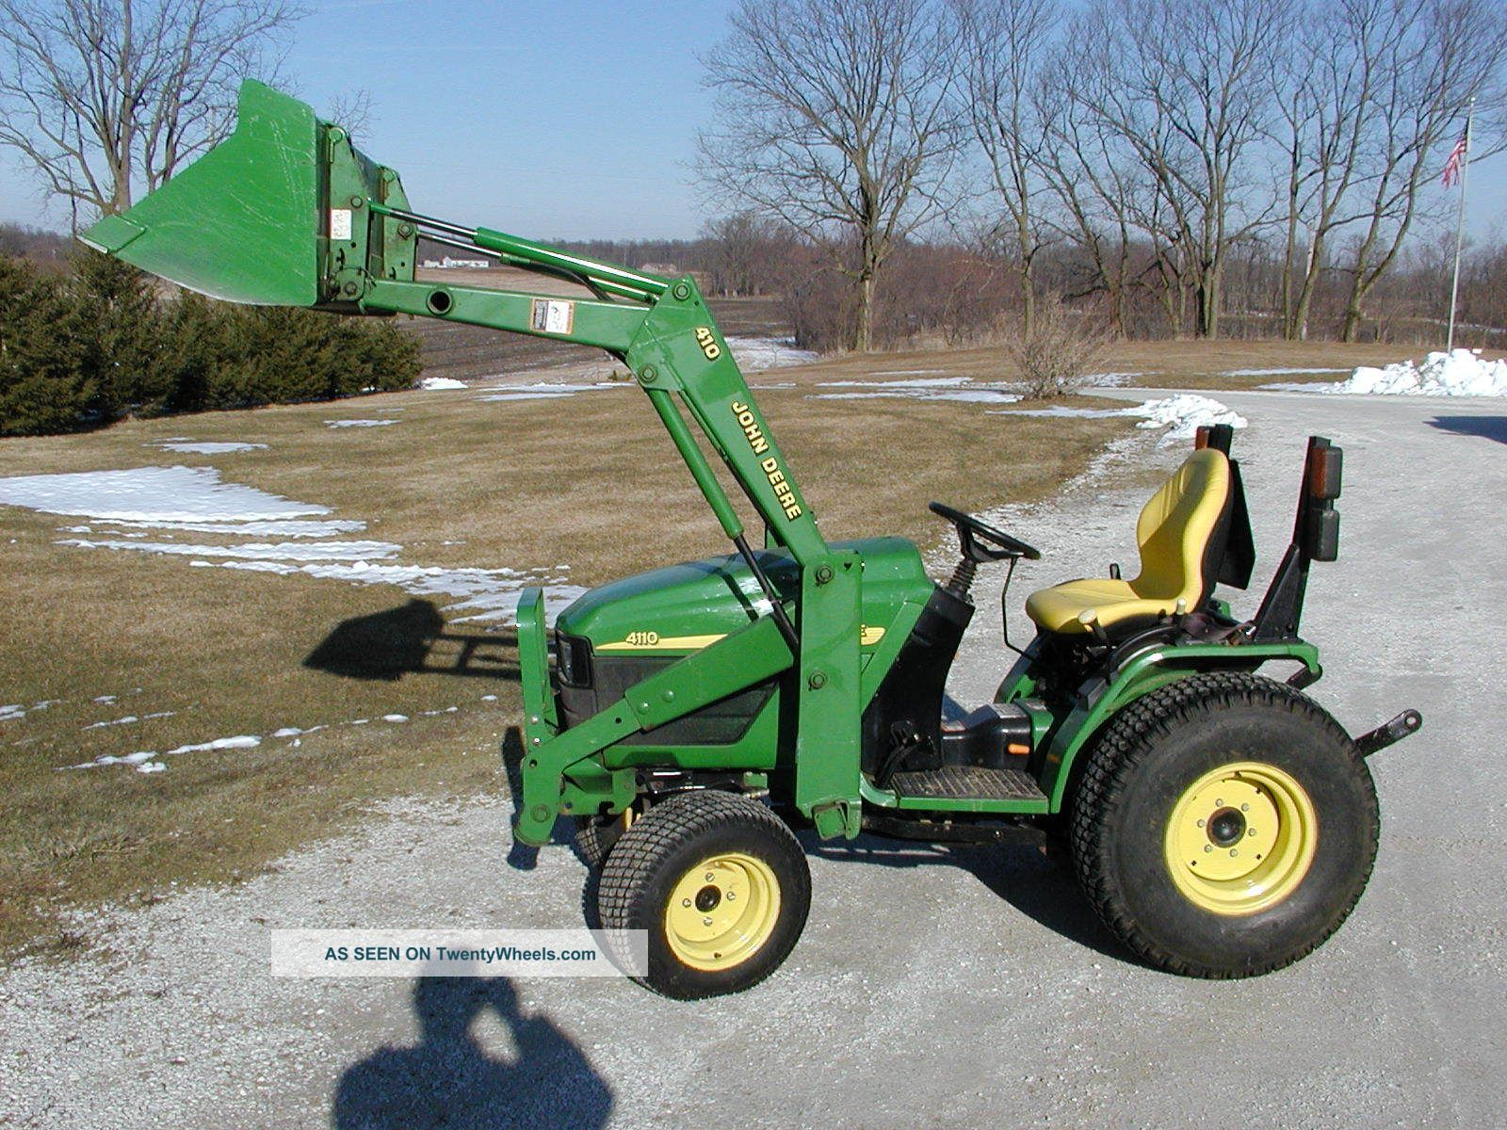

Slide 3
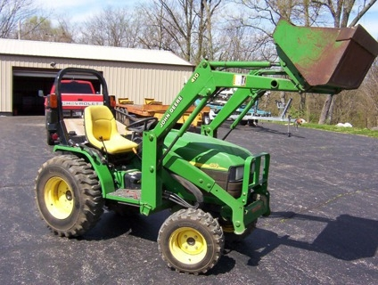

Slide 4
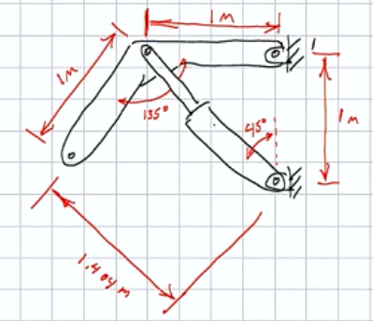

Slide 5
MENG 3071
Chapter 4
Acceleration Analysis
All figures taken from Design of Machinery, 3rd ed. Robert Norton 2003

Slide 6
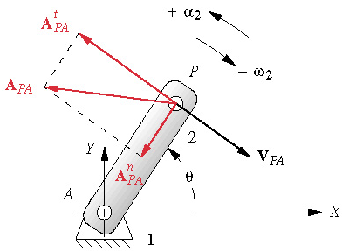
Acceleration Analysis
Linear acceleration
Angular acceleration
Acceleration of a point
Acceleration has 2 components: normal & tangential

Slide 7
Acceleration Analysis
Magnitudes of acceleration components
Magnitude of normal acceleration
Magnitude of tangential acceleration

Slide 8
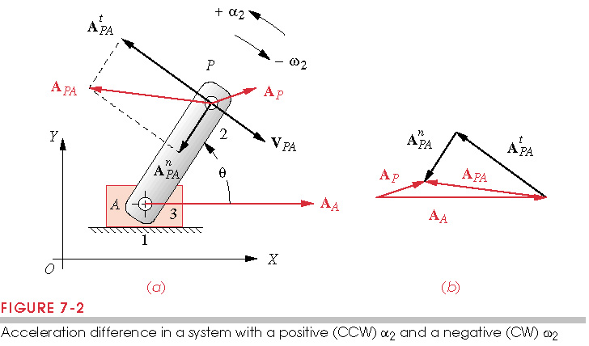
Acceleration Analysis
If point A is moving
Graphically:

Slide 9
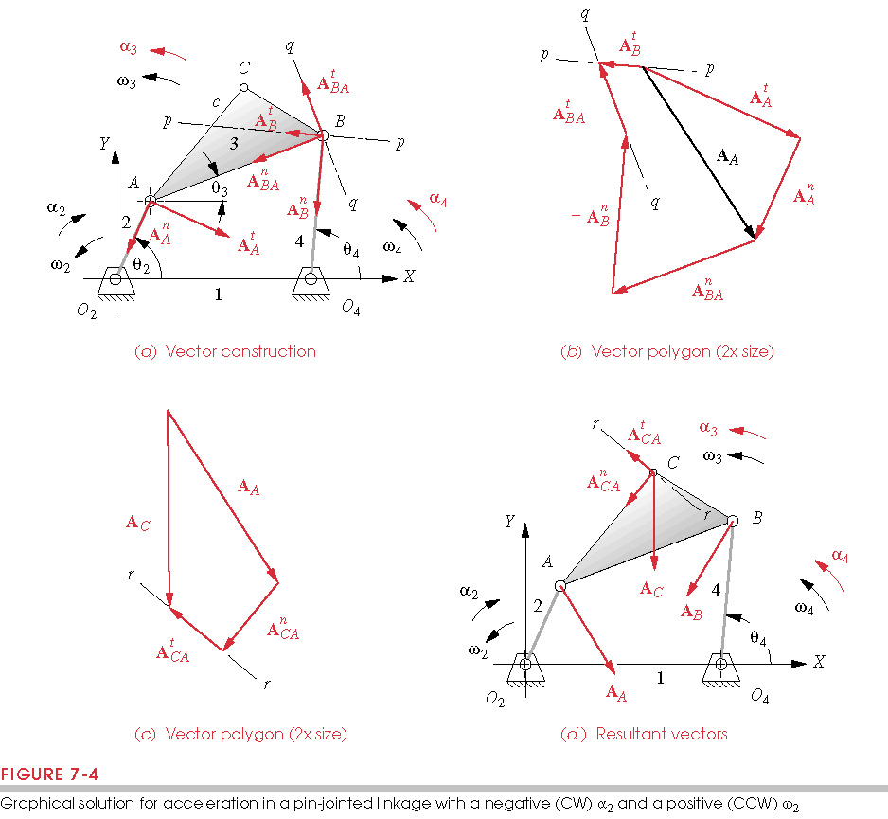
Graphical Acceleration Analysis (α₃&α₄)
Given linkage configuration, α₂. Find α₃ and α₄
Know A^{n}_{A},A^{t}_{A},A^{n}_{BA},A^{n}_{B}, and direction of A^{t}_{BA},A^{t}_{B}
A_{B}=A_{A}+A_{BA} A^{n}_{B}+A^{t}_{B}= A^{n}_{A}+A^{t}_{A}+A^{n}_{BA}+A^{t}_{BA}
A^{n}_{A}
A^{n}_{B}
A^{t}_{B}
A^{t}_{A}
A^{t}_{B} line
A^{t}_{BA}
A^{n}_{BA}
A^{t}_{BA} line

Slide 10
Acceleration of point C
Now we know α₃ from previous step
A_{C}=A_{A}+A_{C/A}=A^{n}_{A}+A^{t}_{A}+A^{n}_{C/A}+A^{t}_{C/A}
Enlarged scale
A^{n}_{A}
A_{C}
A^{t}_{A}
A^{t}_{C/A}
A^{n}_{C/A}

Slide 11
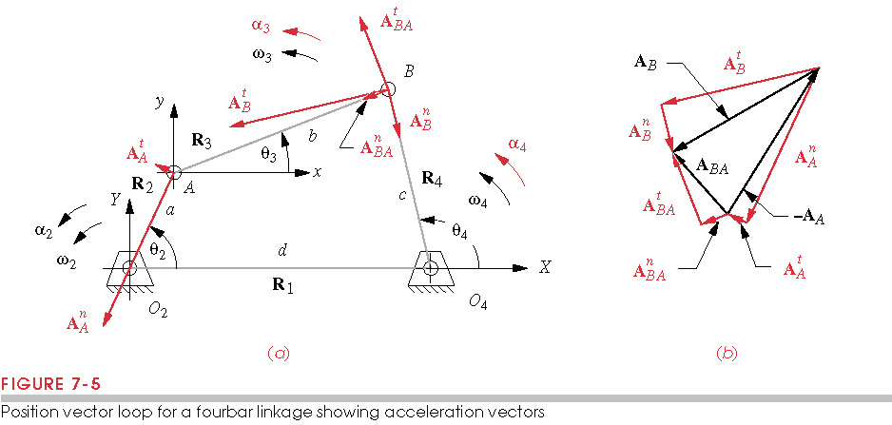
Analytical Acceleration Analysis (4bar)
Given α₂. Find α₃ and α₄

Slide 12
Analytical Acceleration Analysis (4bar)
Write vector loop equation:
Take two derivatives:

Slide 13
Analytical Acceleration Analysis (4bar)
Separate knowns and unknowns
Take conjugate
Put in matrix form
Solve

Slide 14
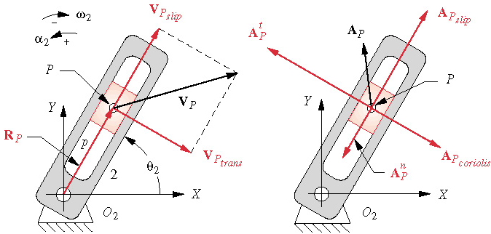
Coriolis Acceleration
Position of slider
.
Velocity of slider
Transmission velocity
Slip velocity
Acceleration: Use the product rule
Combining terms:
Coriolis acc. cccurs when a body has v_{slip} and w
Slip
Normal
Tangential
Coriolis

Slide 15
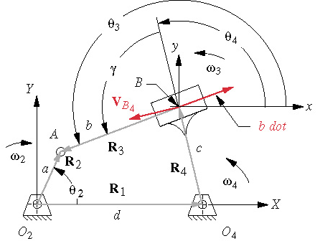
Inverted Crank Slider
Given α₂. Find , α₃ and α₄

Slide 16
Inverted Crank Slider
Write vector loop equation and take two derivatives
Recall
so
b varies with time

Slide 17
Inverted Crank Slider
Group into knowns and unknowns, α₃=α₄
Take conjugate
Put in matrix form
Solve

Slide 18
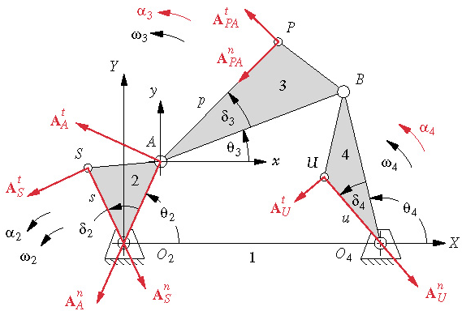
Acceleration of any point on the mechanism
Write the vector for R_{P}
Take derivative twice
Similarly
R_{P}

Slide 19
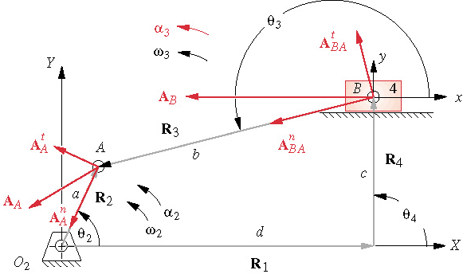
Inverted Crank Slider
..
Given α₂. Find α₃ and d

Slide 20
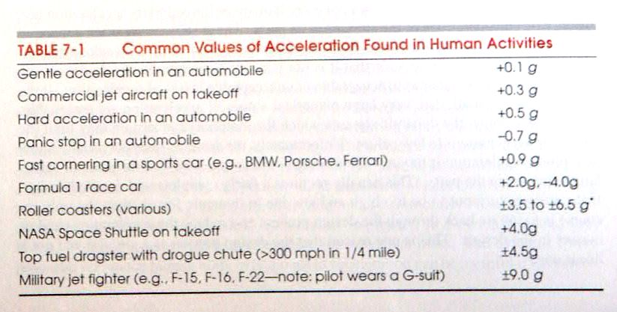
Common Values of Accelerations
A ‘g’ is the acceleration of gravity =9.81m/s²
Common values of acceleration:

Slide 21
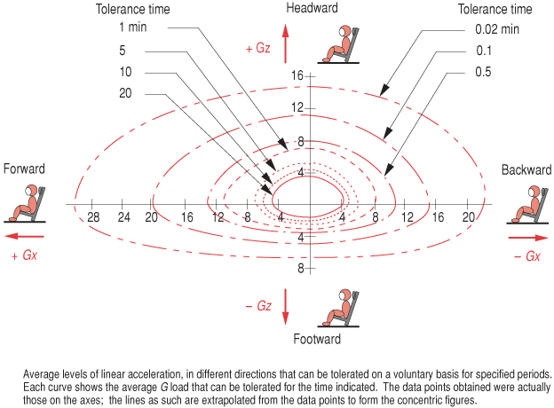
Human Tolerance for Acceleration
Humans are limited in the level of acceleration they can tolerate
Machines are limited
by the stresses in the
parts, e.g. automobile
piston 40g’s at
idle, 700g’s at
highway 2000g’s
peak

Slide 22
Jerk
Jerk is the derivative of acceleration
linear jerk
angular jerk
High value of jerk causes stomach to go funny in roller coaster or elevator starting to descend
High acceleration
High jerk

Slide 23
Jerk Analysis of 4-bar Linkage
Recall
Taking another derivative

