Slide 1


Addis Ababa University
Addis Ababa Institute of Technology
School of Mechanical & Industrial Engineering
Heat Exchangers
Prepared by: Dawit M.
Office: 314 - C
E-mail: dwtmus@gmail.com

Slide 2
Outline
  Introduction
  Objectives
  Applications
  Heat Exchanger Types
  Double Tube Heat Exchangers
  Cross – Flow Heat Exchangers
  Shell and Tube Heat Exchangers
  Compact Heat Exchangers
  Overall Heat Transfer Coefficient
  Heat Exchangers Analysis
  Principles of Heat Exchangers
  Temperature Gradient - Hot to Cold across Pipe Wall
  Overall Heat Transfer Coefficient
  The LMTD Method
  The ɛ – NTU Method
  ɛ – NTU Relations
  Special Operating Conditions
  Multi-pass and Cross-Flow Heat Exchangers: Use of a Correction Factor
  Heat Exchanger Design and Performance Checking Procedures
  Selection of Heat Exchangers
AAiT
School of Mechanical and Industrial Engineering - SMiE

Slide 3
Introduction
The process of heat exchange between two fluids that are at different temperatures and separated by a solid wall occurs in many engineering applications.
The device used to implement this exchange is termed a heat exchanger, and specific applications may be found in space heating and air conditioning, power production, waste heat recovery, and chemical processing.
AAiT
School of Mechanical and Industrial Engineering - SMiE

Slide 4
Objectives
After completion of this lecture and tutorials on heat exchangers, student will be able to:
  Understand what a heat exchanger is and its uses
  Differentiate various types of heat exchangers
  Use the methods available for analysis of exchangers
    The LMTD Method
    The ɛ – NTU Method
  Sizing of new heat exchanger
  Performance analysis of an existing heat exchanger.
AAiT
School of Mechanical and Industrial Engineering - SMiE

Slide 5
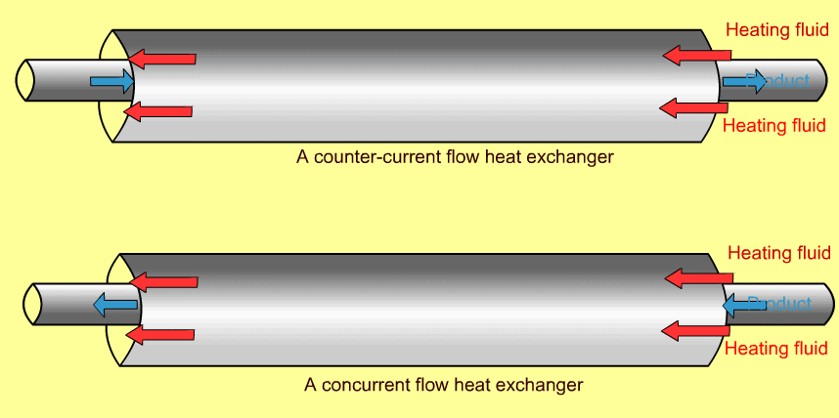
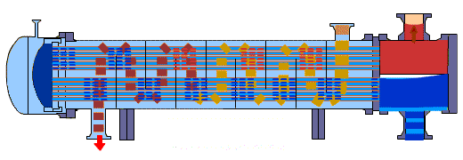
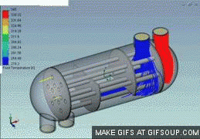
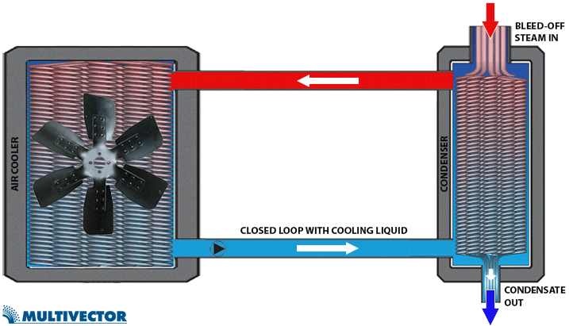
Applications
AAiT
School of Mechanical and Industrial Engineering - SMiE

Slide 6
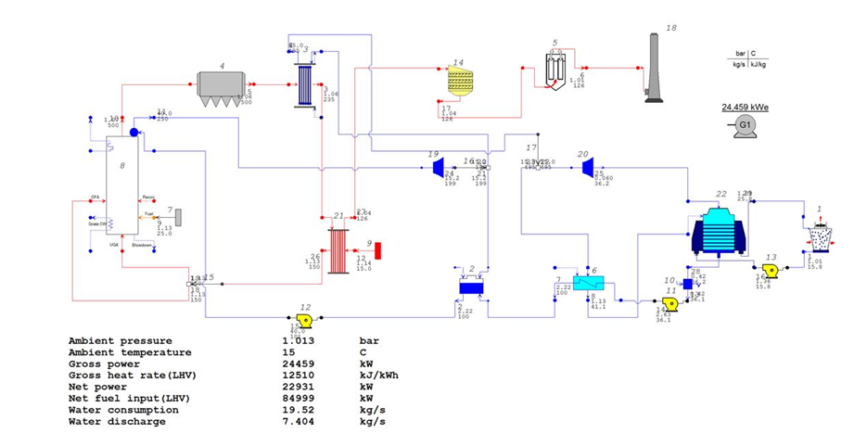
Applications
Super Heater
Air Cooled
Condenser
Boiler
Steam Drum
G. Furnace
Condenser
Air Pre- Heater
Feed Water Heater
AAiT
School of Mechanical and Industrial Engineering - SMiE

Slide 7
Heat Exchanger Types
Heat exchangers are typically classified according to:
  Flow arrangement and
  Type of construction.
Basic Heat Exchanger Types:
Double Tube Heat Exchangers (Parallel and Counter Types)
Cross – Flow Heat Exchangers
Shell and Tube Heat Exchangers
Compact Heat Exchangers
AAiT
School of Mechanical and Industrial Engineering - SMiE

Slide 8
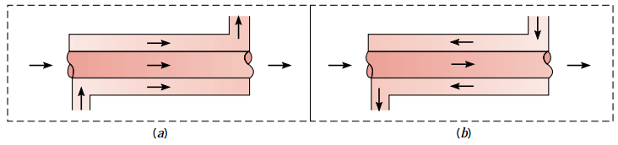
Double Tube Heat Exchangers
The simplest heat exchanger is one for which the hot and cold fluids move in the same or opposite directions in a concentric tube(or double-pipe) construction.
Concentric (double) tube heat exchangers. (a) Parallel flow. (b) Counter flow.
AAiT
School of Mechanical and Industrial Engineering - SMiE

Slide 9
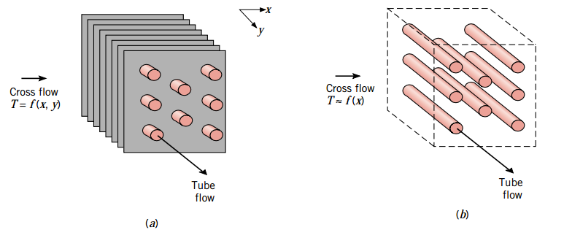
Cross - Flow Heat Exchangers
Alternatively, the fluids may move in cross flow(perpendicular to each other), as shown by the finned and unfinned tubular heat exchangers.
Cross-flow heat exchangers. (a) Finned with both fluids unmixed.
(b) Unfinned with one fluid mixed and the other unmixed.
AAiT
School of Mechanical and Industrial Engineering - SMiE

Slide 10
Cont’d …
The two configurations are typically differentiated by an idealization that treats fluid motion over the tubes as unmixed or mixed.
The fluid is said to be unmixed because the fins inhibit motion in a direction (y) that is transverse to the main-flow direction (x). In this case the fluid temperature varies with x and y. [Fig (a)]
In contrast, for the unfinned tube bundle of fluid motion, hence mixing, in the transverse direction is possible, and temperature variations are primarily in the main flow direction. [Fig (b)]
Since the tube flow is unmixed, both fluids are unmixed in the finned exchanger, while one fluid is mixed and the other unmixed in the unfinned exchanger.
The nature of the mixing condition can significantly influence heat exchanger performance.
AAiT
School of Mechanical and Industrial Engineering - SMiE

Slide 11
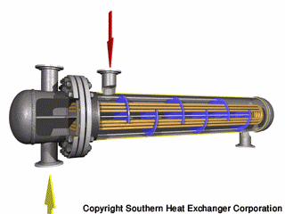
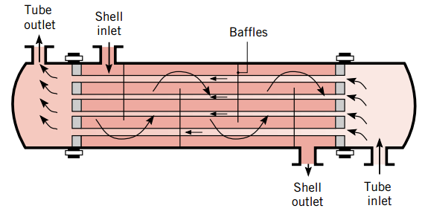
Shell and Tube Heat Exchangers
Another common configuration is the shell-and-tube heat exchanger. Specific forms differ according to the number of shell-and-tube passes, and the simplest form, which involves single tube and shell passes, is shown in Figure.
Shell-and-tube heat exchanger with one shell pass and one tube pass (cross-counter flow mode of operation).
AAiT
School of Mechanical and Industrial Engineering - SMiE

Slide 12
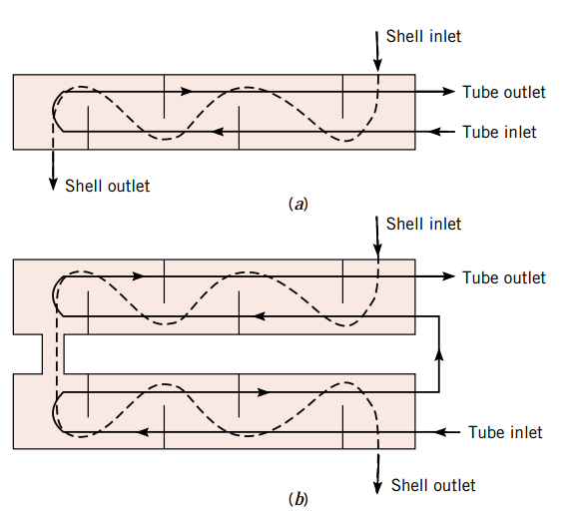
Cont’d …
Baffles are usually installed to increase the convection coefficient of the shell-side fluid by inducing turbulence and a cross-flow velocity component. In addition, the baffles physically support the tubes, reducing flow-induced tube vibration.
Shell-and-tube heat exchangers. (a) One shell pass and two tube passes. (b) Two shell passes and four tube passes.
AAiT
School of Mechanical and Industrial Engineering - SMiE

Slide 13
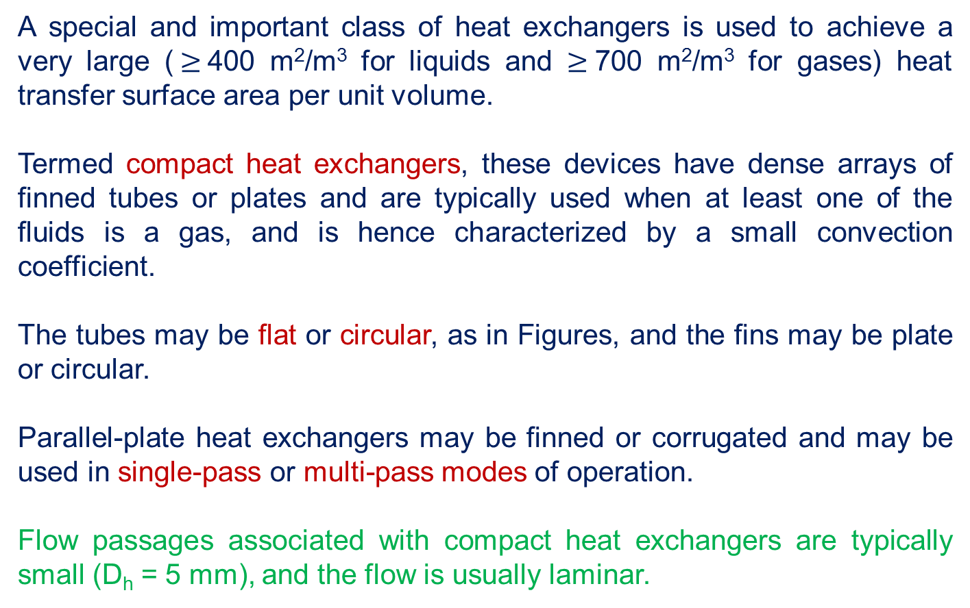
Compact Heat Exchangers
A special and important class of heat exchangers is used to achieve a very large ($≥$400 m²/m³ for liquids and $≥$700 m²/m³ for gases) heat transfer surface area per unit volume.
Termed compact heat exchangers, these devices have dense arrays of finned tubes or plates and are typically used when at least one of the fluids is a gas, and is hence characterized by a small convection coefficient.
The tubes may be flat or circular, as in Figures, and the fins may be plate or circular.
Parallel-plate heat exchangers may be finned or corrugated and may be used in single-pass or multi-pass modes of operation.
Flow passages associated with compact heat exchangers are typically small (D_{h} = 5 mm), and the flow is usually laminar.
AAiT
School of Mechanical and Industrial Engineering - SMiE

Slide 14
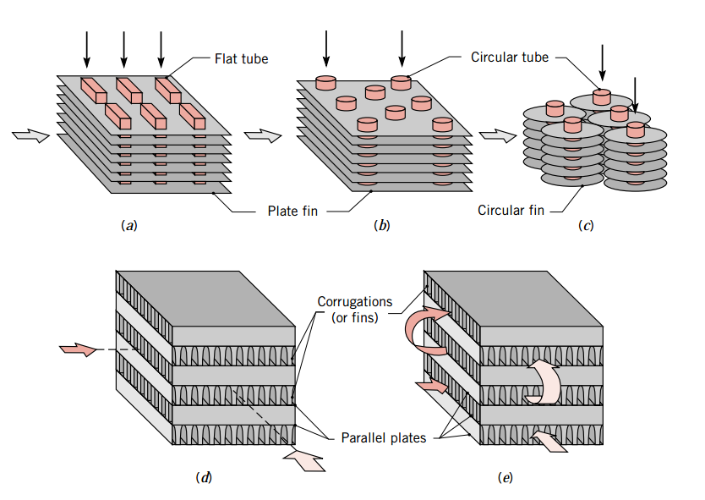
Cont’d …
Compact heat exchanger cores:
(a) Fin–tube (flat tubes, continuous plate fins). (b) Fin–tube (circular tubes, continuous plate fins). (c) Fin–tube (circular tubes, circular fins). (d) Plate–fin (single pass). (e) Plate–fin (multi-pass).
AAiT
School of Mechanical and Industrial Engineering - SMiE

Slide 15
Overall Heat Transfer Coefficient
An essential, and often the most uncertain, part of any heat exchanger analysis is determination of the overall heat transfer coefficient. that this coefficient is defined in terms of the total thermal resistance to heat transfer between two fluids.
The coefficient was determined by accounting for conduction and convection resistances between fluids separated by composite plane and cylindrical walls, respectively.
During normal heat exchanger operation, surfaces are often subject to fouling by fluid impurities, rust formation, or other reactions between the fluid and the wall material. The subsequent deposition of a film or scale on the surface can greatly increase the resistance to heat transfer between the fluids.
This effect can be treated by introducing an additional thermal resistance, termed the fouling factor, R_{ƒ}. Its value depends on the operating temperature, fluid velocity, and length of service of the heat exchanger.
AAiT
School of Mechanical and Industrial Engineering - SMiE

Slide 16
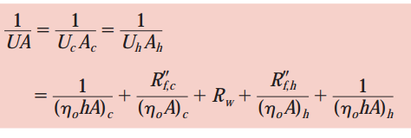
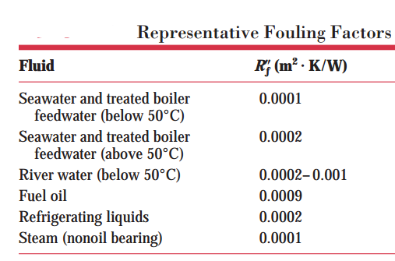
Cont’d …
Accordingly, with inclusion of surface fouling and fin (extended surface) effects, the overall heat transfer coefficient may be expressed as:
where c and h refer to the cold and hot fluids, respectively.
AAiT
School of Mechanical and Industrial Engineering - SMiE

Slide 17



Cont’d …
The quantity η_{o} is termed the overall surface efficiency or temperature effectiveness of a finned surface. It is defined such that, for the hot or cold surface without fouling, the heat transfer rate is:
AAiT
School of Mechanical and Industrial Engineering - SMiE

Slide 18
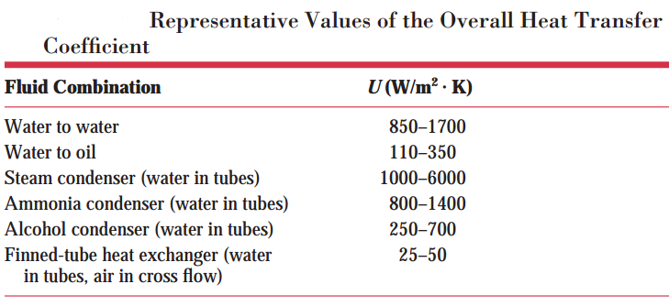
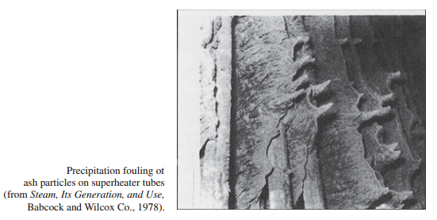
Cont’d …
The wall conduction term in the overall heat transfer coefficient equation may often be neglected, since a thin wall of large thermal conductivity is generally used. Also, one of the convection coefficients is often much smaller than the other and hence dominates determination of the overall coefficient.
AAiT
School of Mechanical and Industrial Engineering - SMiE

Slide 19
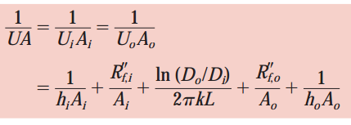
Cont’d …
For the unfinned, tubular heat exchangers:
The overall heat transfer coefficient may be determined from knowledge of the hot and cold fluid convection coefficients and fouling factors and from appropriate geometric parameters. For unfinned surfaces, the convection coefficients may be estimated from correlations presented for External Flow and Internal Flow. For standard fin configurations, the coefficients may be obtained from results compiled by Kays and London.
AAiT
School of Mechanical and Industrial Engineering - SMiE

Slide 20
Heat Exchanger Analysis
LMTD Method
It is a simple matter to use the log mean temperature difference (LMTD) method of heat exchanger analysis when the fluid inlet temperatures are known and the outlet temperatures are specified or readily determined from the energy balance expressions. The value of T_{lm} for the exchanger may then be determined.
ɛ – NTU Method
If only the inlet temperatures are known, use of the LMTD method requires a cumbersome iterative procedure. It is therefore preferable to use an alternative approach termed the effectiveness–NTU (or NTU) method.
AAiT
School of Mechanical and Industrial Engineering - SMiE

Slide 21
Principle of a Heat Exchanger
First Law of Thermodynamics: “Energy is conserved.”
0
0
0
0
Control Volume
COLD
Qh
HOT
Cross Section Area
Thermal Boundary Layer
AAiT
School of Mechanical and Industrial Engineering - SMiE

Slide 22
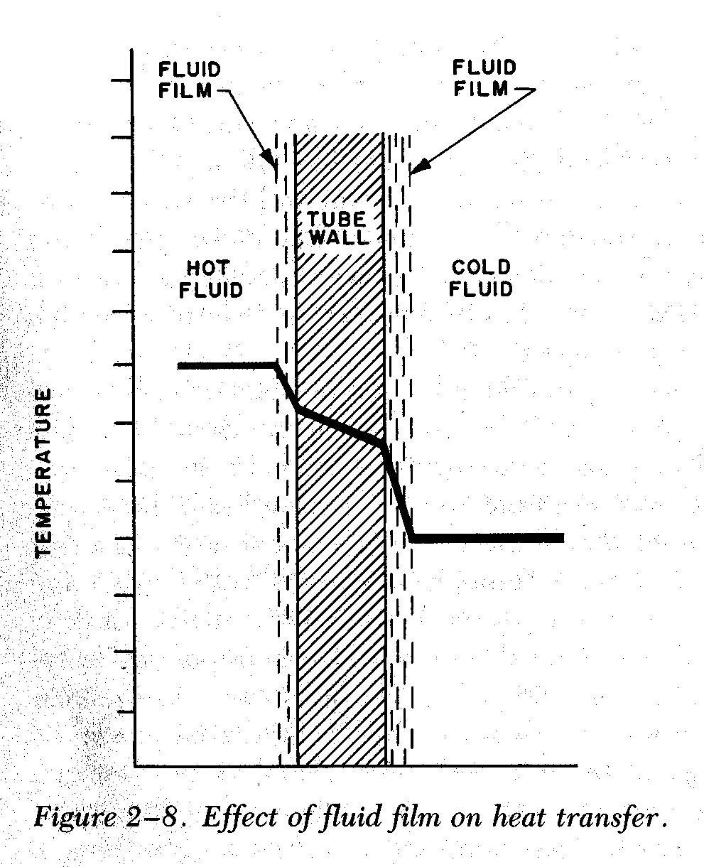
Temperature Gradient - Hot to Cold across Pipe Wall
Energy moves from hot fluid to a surface by convection, through the wall by conduction, and then by convection from the surface to the cold fluid.
Region III: Solid – Cold Liquid Convection
NEWTON’S LAW OF CCOLING
T_{h}
T_{i,wall}
T_{o,wall}
T_{c}
Region I : Hot Liquid-Solid Convection
NEWTON’S LAW OF CCOLING
Q hot
Q cold
Region II : Conduction Across Copper Wall FOURIER’S LAW
AAiT
School of Mechanical and Industrial Engineering - SMiE

Slide 23
Region I : Hot Liquid – Solid Convection
The Overall Heat Transfer Coefficient
Region II : Conduction Across Copper Wall
Region III : Solid – Cold Liquid Convection
+
r_{i}
r_{o}
AAiT
School of Mechanical and Industrial Engineering - SMiE

Slide 24
Use of The Log Mean Temperature Difference
Hot Stream :
Cold Stream:
Log Mean Temperature
AAiT
School of Mechanical and Industrial Engineering - SMiE

Slide 25
Cont’d …
COUNTER CURRENT FLOW
CONCURRENT FLOW
1
2
1
2
T₃
T₄
T₆
T₆
T₁
Wall
∆
T
1
T₇
T₂
∆
T
2
T₈
T₉
T₁₀
∆ A
A
A
T
10
T
10
T
1
T
4
T
5
T
2
T
1
T
4
T
5
T
2
T
3
T
6
T
3
T
6
T
8
T
9
T
7
T
8
T
9
T
7
P
ara
ll
e
l
Fl
ow
Co
un
t
e
r
- C
u
r
re
n
t
F
l
ow
AAiT
School of Mechanical and Industrial Engineering - SMiE

Slide 26
Cont’d ...
1
2
T₃
T₄
T₆
T₆
T₁
Wall
T₂
T₇
T₈
T₉
T₁₀
A
AAiT
School of Mechanical and Industrial Engineering - SMiE

Slide 27

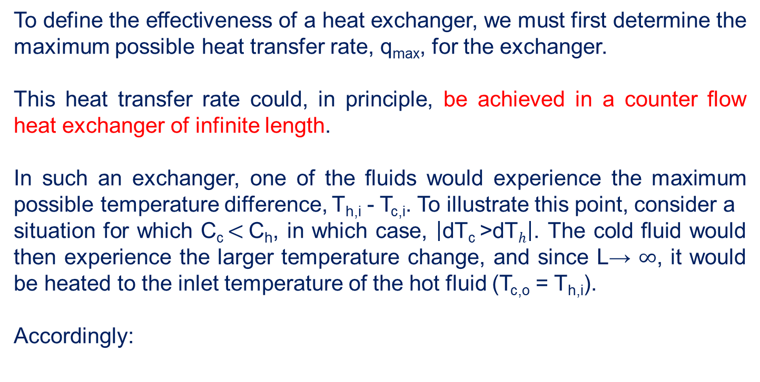
Effectiveness – NTU Method
To define the effectiveness of a heat exchanger, we must first determine the maximum possible heat transfer rate, q_{max}, for the exchanger.
This heat transfer rate could, in principle, be achieved in a counter flow heat exchanger of infinite length.
In such an exchanger, one of the fluids would experience the maximum possible temperature difference, T_{h,i} - T_{c,i}. To illustrate this point, consider a
situation for which C_{c} $<$C_{h}, in which case, $\left|\text{dT}\text{c} \text{>}\text{dT}h\right|$. The cold fluid would then experience the larger temperature change, and since L→ $∞$, it would be heated to the inlet temperature of the hot fluid (T_{c,o} = T_{h,i}).
Accordingly:
AAiT
School of Mechanical and Industrial Engineering - SMiE

Slide 28

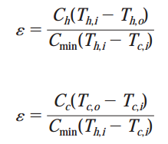

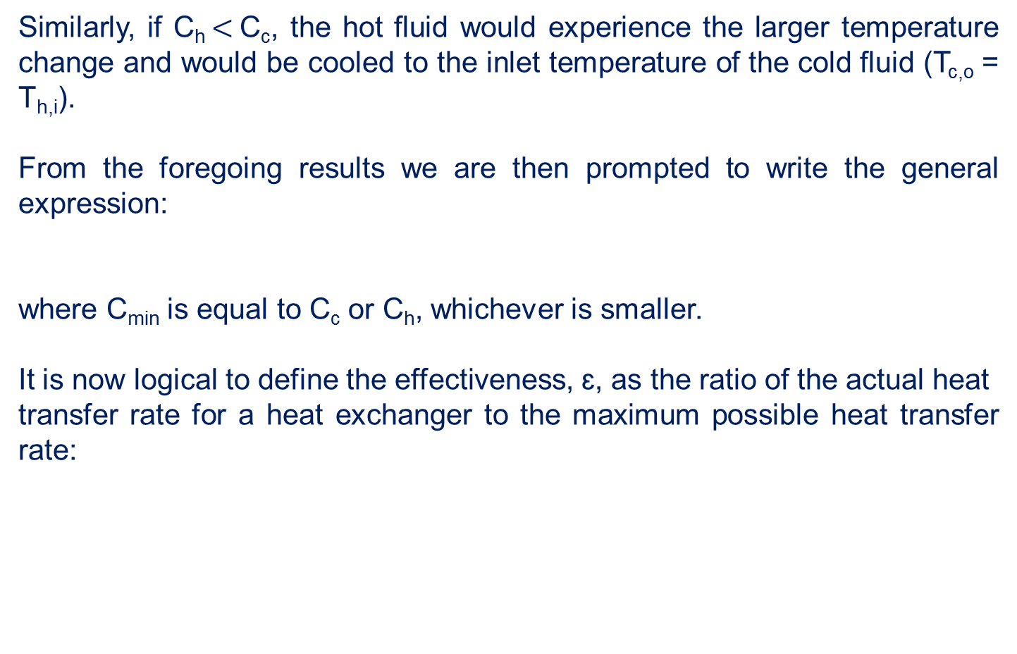
Cont’d …
Similarly, if C_{h} $<$C_{c}, the hot fluid would experience the larger temperature change and would be cooled to the inlet temperature of the cold fluid (T_{c,o} = T_{h,i}).
From the foregoing results we are then prompted to write the general expression:
where C_{min} is equal to C_{c} or C_{h}, whichever is smaller.
It is now logical to define the effectiveness, ɛ, as the ratio of the actual heat
transfer rate for a heat exchanger to the maximum possible heat transfer rate:
AAiT
School of Mechanical and Industrial Engineering - SMiE

Slide 29



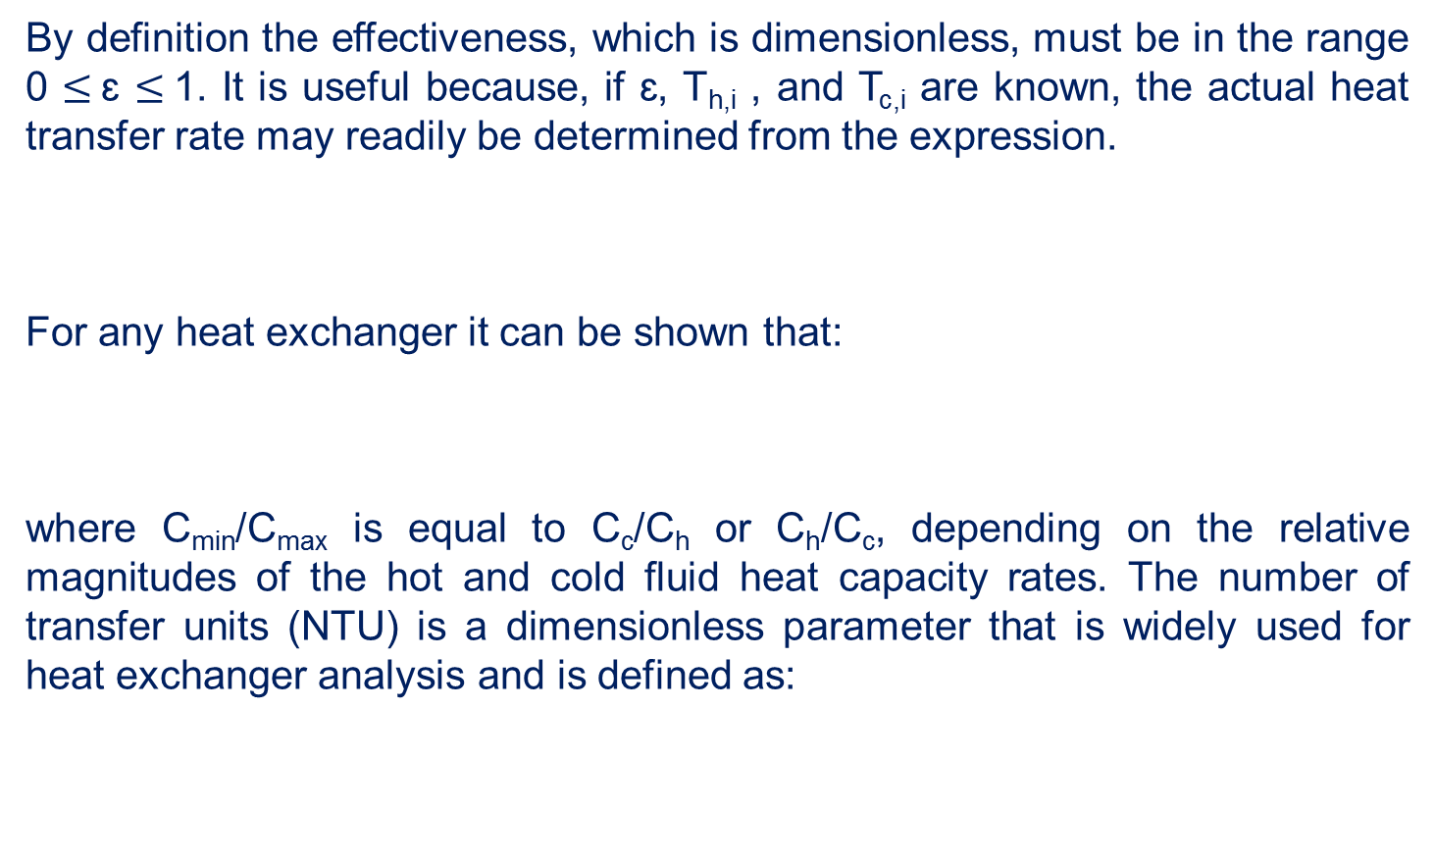
Cont’d …
By definition the effectiveness, which is dimensionless, must be in the range 0 $≤$ɛ $≤$1. It is useful because, if ɛ, T_{h,i} , and T_{c,i} are known, the actual heat transfer rate may readily be determined from the expression.
For any heat exchanger it can be shown that:
where C_{min}/C_{max} is equal to C_{c}/C_{h} or C_{h}/C_{c}, depending on the relative magnitudes of the hot and cold fluid heat capacity rates. The number of transfer units (NTU) is a dimensionless parameter that is widely used for heat exchanger analysis and is defined as:
AAiT
School of Mechanical and Industrial Engineering - SMiE

Slide 30





Effectiveness – NTU Relations
To determine a specific form of the effectiveness–NTU relation, consider a parallel-flow heat exchanger for which C_{min} = C_{h}. we then obtain:
… *
AAiT
School of Mechanical and Industrial Engineering - SMiE

Slide 31



Cont’d …
Substituting the above expression into Equation * and solving for ɛ, we obtain for the parallel-flow heat exchanger:
Since precisely the same result may be obtained for C_{min} = C_{c}, the above equation applies for any parallel-flow heat exchanger, irrespective of whether the minimum heat capacity rate is associated with the hot or cold fluid.
AAiT
School of Mechanical and Industrial Engineering - SMiE

Slide 32
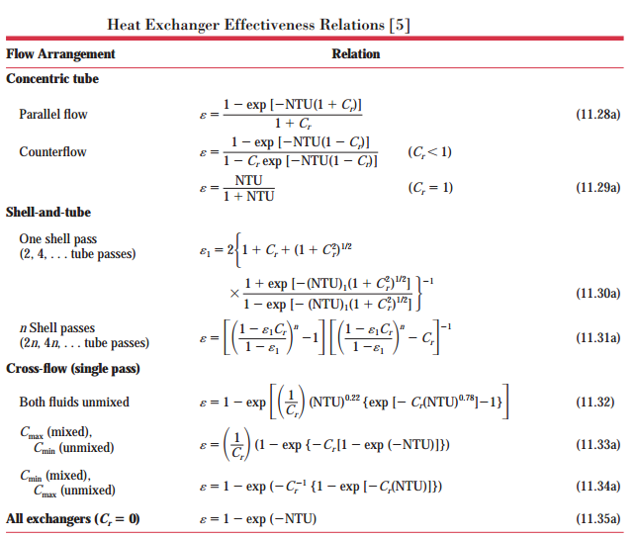
Cont’d …
Similar expressions have been developed for a variety of heat exchangers, and representative results are summarized in Table below: where Cr is the heat capacity ratio C_{r} = C_{min}/C_{max}.
AAiT
School of Mechanical and Industrial Engineering - SMiE

Slide 33

Cont’d …
In heat exchanger design calculations, it is more convenient to work with ɛ–NTU relations of the form:
For a shell-and-tube heat exchanger with multiple shell passes, it is assumed that the total NTU is equally distributed between shell passes of the same arrangement, NTU = n(NTU)₁.
Finally, this result would be multiplied by n to obtain the NTU for the entire exchanger, as indicated in Equation 11.31d in table below.
AAiT
School of Mechanical and Industrial Engineering - SMiE

Slide 34
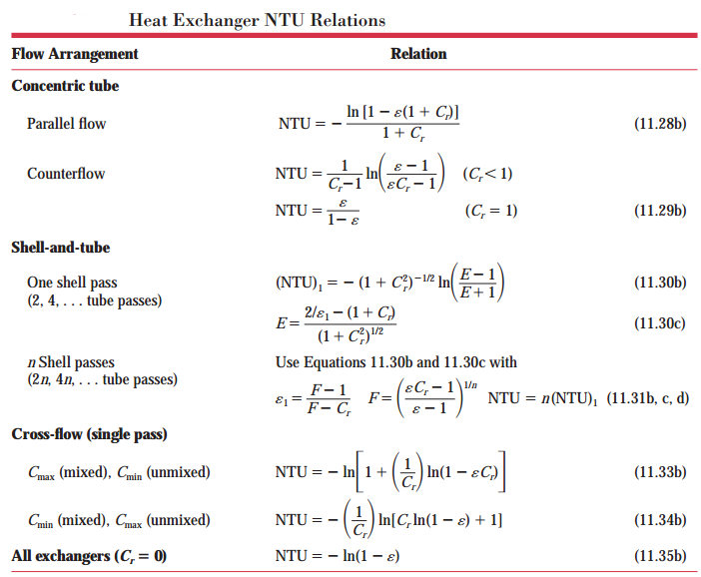
Cont’d …
AAiT
School of Mechanical and Industrial Engineering - SMiE

Slide 35
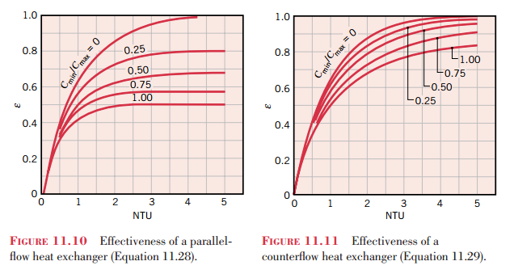
Cont’d …
The foregoing expressions are represented graphically in Figures 11.10 through 11.15. When using Figure 11.13, the abscissa corresponds to the total number of transfer units, NTU = n(NTU)₁.
AAiT
School of Mechanical and Industrial Engineering - SMiE

Slide 36
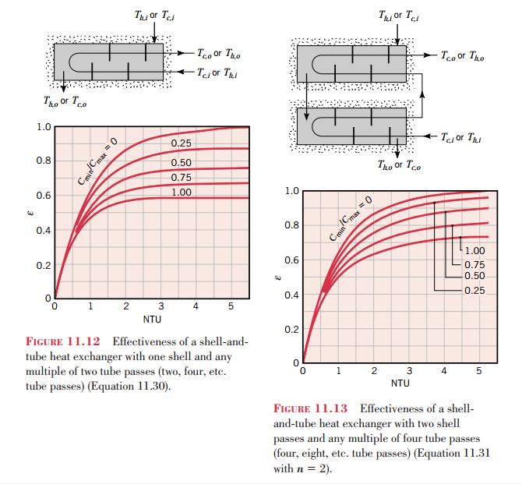
Cont’d …
AAiT
School of Mechanical and Industrial Engineering - SMiE

Slide 37
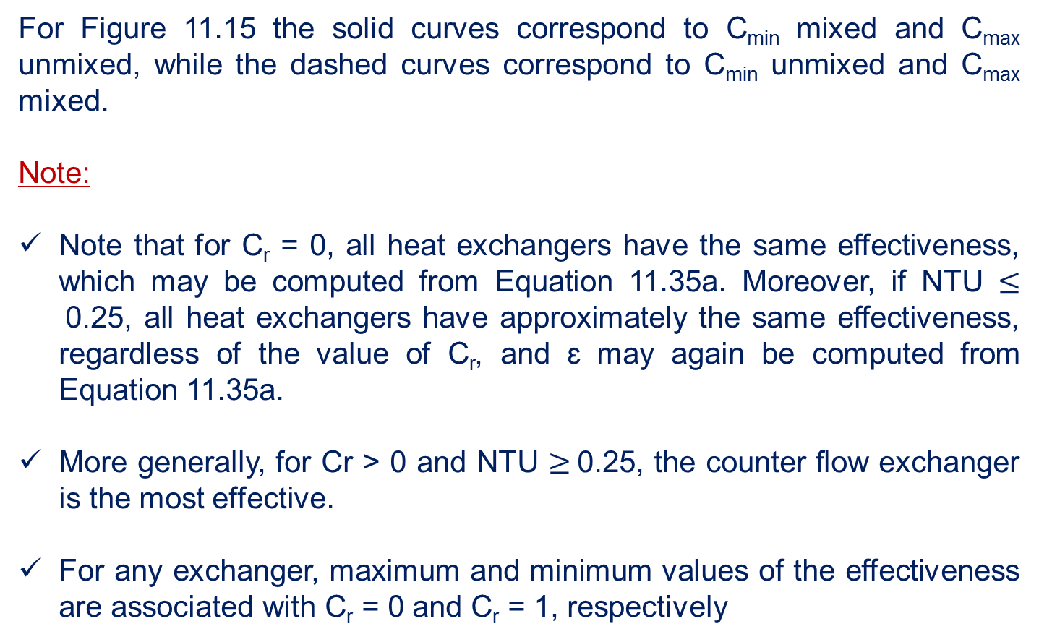
Cont’d …
For Figure 11.15 the solid curves correspond to C_{min} mixed and C_{max} unmixed, while the dashed curves correspond to C_{min} unmixed and C_{max} mixed.
Note:
Note that for C_{r} = 0, all heat exchangers have the same effectiveness, which may be computed from Equation 11.35a. Moreover, if NTU $≤$0.25, all heat exchangers have approximately the same effectiveness, regardless of the value of C_{r}, and ɛ may again be computed from Equation 11.35a.
More generally, for Cr > 0 and NTU $≥$0.25, the counter flow exchanger is the most effective.
For any exchanger, maximum and minimum values of the effectiveness are associated with C_{r} = 0 and C_{r} = 1, respectively
AAiT
School of Mechanical and Industrial Engineering - SMiE

Slide 38
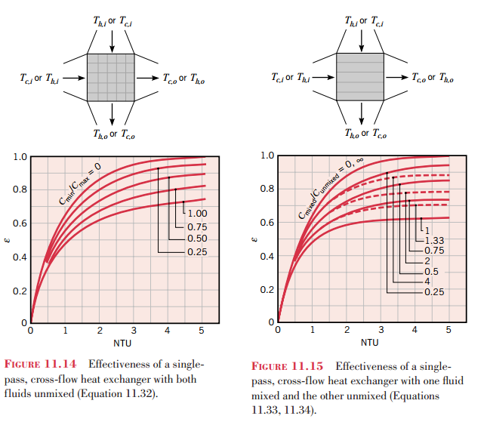
Cont’d …
AAiT
School of Mechanical and Industrial Engineering - SMiE

Slide 39
Cont’d …
We also note that both the LMTD and NTU methods approach heat exchanger analysis from a global perspective and provide no information concerning conditions within the exchanger. Although flow and temperature variations within a heat exchanger may be determined using commercial CFD (computational fluid dynamic) computer codes, simpler numerical procedures may be adopted.
AAiT
School of Mechanical and Industrial Engineering - SMiE

Slide 40
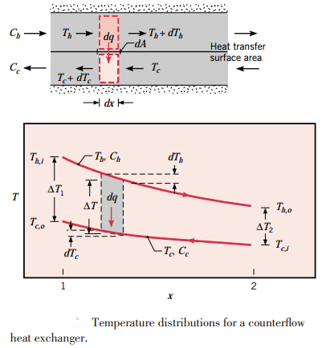
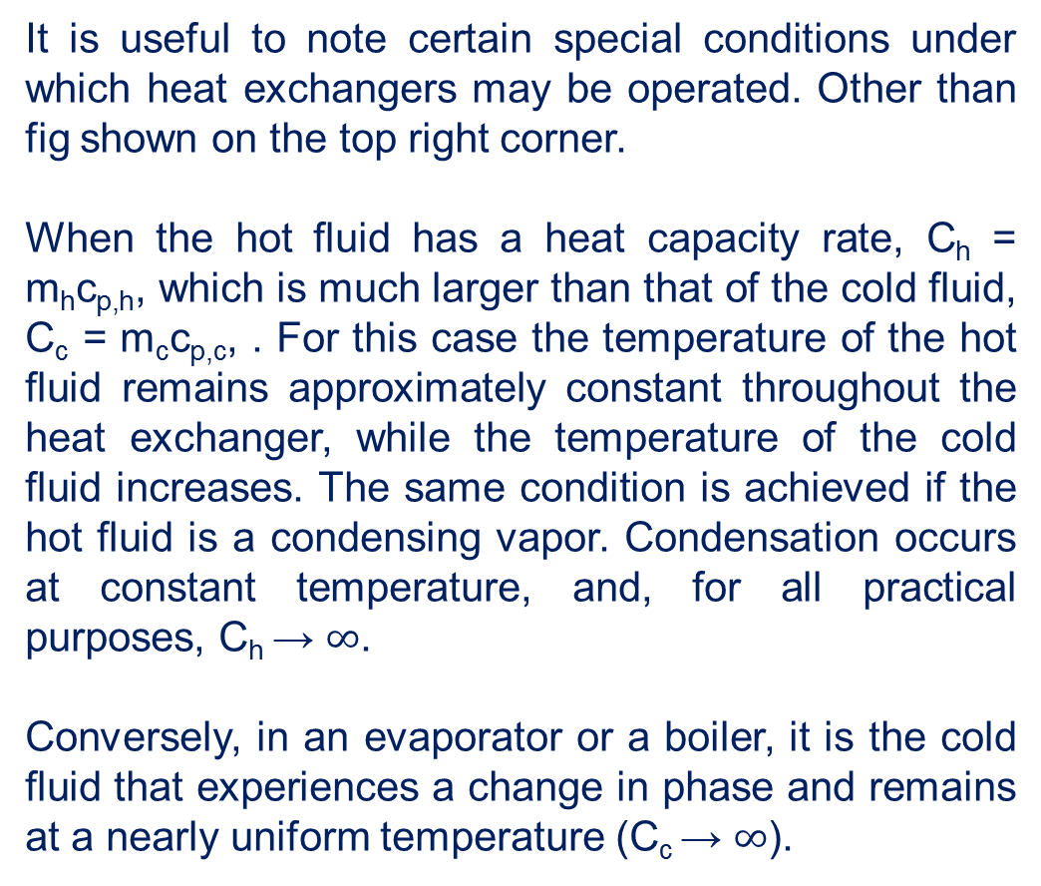
Special Operating Conditions
It is useful to note certain special conditions under which heat exchangers may be operated. Other than fig shown on the top right corner.
When the hot fluid has a heat capacity rate, C_{h} = m_{h}c_{p,h}, which is much larger than that of the cold fluid, C_{c} = m_{c}c_{p,c}, . For this case the temperature of the hot fluid remains approximately constant throughout the heat exchanger, while the temperature of the cold fluid increases. The same condition is achieved if the hot fluid is a condensing vapor. Condensation occurs at constant temperature, and, for all practical purposes, C_{h} → $∞$.
Conversely, in an evaporator or a boiler, it is the cold fluid that experiences a change in phase and remains at a nearly uniform temperature (C_{c} → $∞$).
AAiT
∞

Slide 41
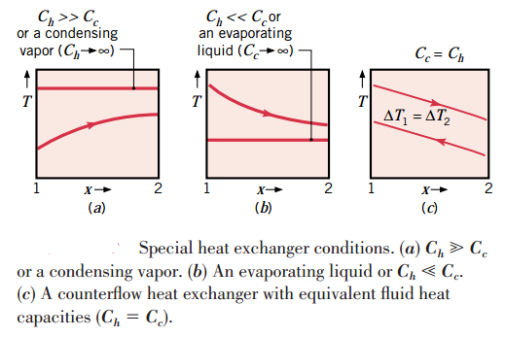

Cont’d …
The third special case involves a counter flow heat exchanger for which the heat capacity rates are equal (C_{h} = C_{c}). The temperature difference $∆$T must then be a constant throughout the exchanger, in which case $∆$T1 = $∆$T2 = $∆$T_{lm.}
Although flow conditions are more complicated in multi-pass and cross-flow heat exchangers, Equations may still be used if modifications are made to the definition of the log mean temperature difference.
AAiT
School of Mechanical and Industrial Engineering - SMiE

Slide 42

Multi-pass and Cross-Flow Heat Exchangers: Use of a Correction Factor
The log mean temperature difference T_{lm} relation developed earlier is limited to parallel-flow and counter-flow heat exchangers only. Similar relations are also developed for cross-flow and multi-pass shell-and-tube heat exchangers, but the resulting expressions are too complicated because of the complex flow conditions.
In such cases, it is convenient to relate the equivalent temperature difference to the log mean temperature difference relation for the counter-flow case as:
where F is the correction factor, which depends on the geometry of the heat exchanger and the inlet and outlet temperatures of the hot and cold fluid streams.
AAiT
School of Mechanical and Industrial Engineering - SMiE

Slide 43
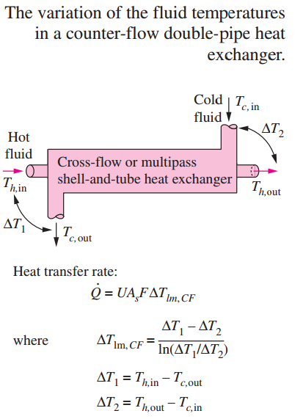


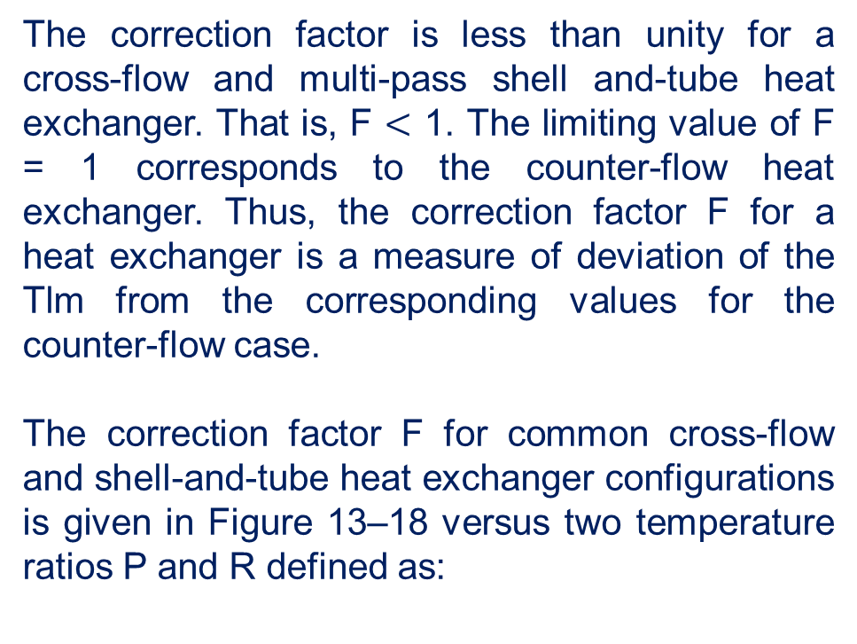
Cont’d …
The correction factor is less than unity for a cross-flow and multi-pass shell and-tube heat exchanger. That is, F $<$ 1. The limiting value of F = 1 corresponds to the counter-flow heat exchanger. Thus, the correction factor F for a heat exchanger is a measure of deviation of the Tlm from the corresponding values for the counter-flow case.
The correction factor F for common cross-flow and shell-and-tube heat exchanger configurations is given in Figure 13–18 versus two temperature ratios P and R defined as:
AAiT
School of Mechanical and Industrial Engineering - SMiE

Slide 44
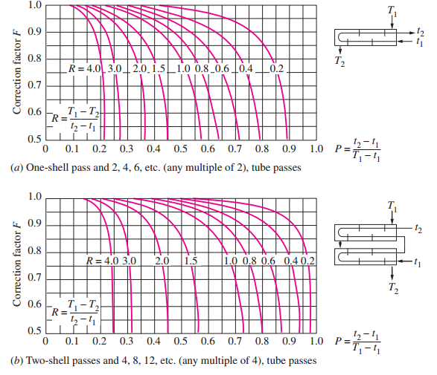
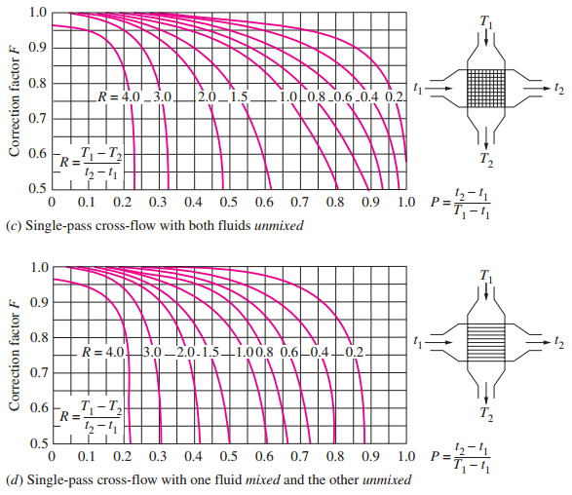
Cont’d …
AAiT
School of Mechanical and Industrial Engineering - SMiE

Slide 45
Heat Exchanger Design and Performance Checking Procedures
Two general types of heat exchanger problems are commonly encountered by the practicing engineer:
Heat Exchanger Design Problem
Specifications:
The fluid inlet temperatures and flow rates, as well as a desired hot or cold fluid outlet temperature, are prescribed.
Design Output:
The design problem is then one of specifying a specific heat exchanger type and determining its size—that is, the heat transfer surface area, A required to achieve the desired outlet temperature.
Note:
The design problem is commonly encountered when a heat exchanger is to be custom-built for a specific application.
AAiT
School of Mechanical and Industrial Engineering - SMiE

Slide 46
Performance Assessment of Heat Exchangers
2. Heat Exchanger Performance Problem
In a heat exchanger performance calculation, an existing heat exchanger is analyzed to determine the heat transfer rate and the fluid outlet temperatures for prescribed flow rates and inlet temperatures.
The performance calculation is commonly associated with the use of off-the-shelf heat exchanger types and sizes available from a vendor.
AAiT
School of Mechanical and Industrial Engineering - SMiE

Slide 47
Selection of Heat Exchangers
Heat transfer enhancement in heat exchangers is usually accompanied by increased pressure drop, and thus higher pumping power. Therefore, any gain from the enhancement in heat transfer should be weighed against the cost of the accompanying pressure drop.
Engineers in industry often find themselves in a position to select heat exchangers to accomplish certain heat transfer tasks. The parameters to be taken under consideration in selection are:
    Heat Transfer Rate
    Cost
    Pumping Power
    Size and Weight
    Type Materials
Other Considerations
Being leak-tight is an important consideration when toxic or expensive fluids
Ease of servicing, low maintenance cost, and safety and reliability
AAiT
School of Mechanical and Industrial Engineering - SMiE

Slide 48
Thank You
Questions please … ?

Slide 49
Problems

Slide 50
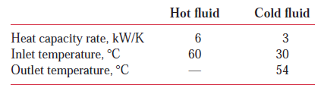
Problem 1 – Cooling by Double Pipe Heat Exchanger (LMTD App.)
Consider a concentric tube heat exchanger with an area of 50 m² operating under the following conditions:
Determine the outlet temperature of the hot fluid.
Is the heat exchanger operating in counter flow or parallel flow, or can’t you tell from the available information?
Calculate the overall heat transfer coefficient.
Calculate the effectiveness of this exchanger.
What would be the effectiveness of this exchanger if its length were made very large?
AAiT
School of Mechanical and Industrial Engineering - SMiE

Slide 51
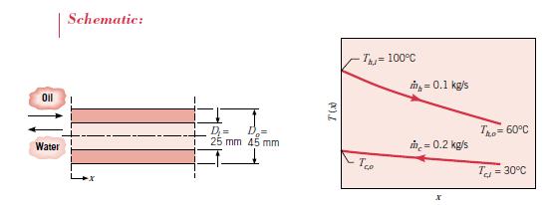

Problem 2 – Counter Flow, Double Pipe Heat Exchanger (LMTD App.)
A counter flow, concentric tube heat exchanger is used to cool the lubricating oil for a large industrial gas turbine engine. The flow rate of cooling water through the inner tube (D_{i} = 25 mm) is 0.2 kg/s, while the flow rate of oil through the outer annulus (D_{o} = 45 mm) is 0.1 kg/s. The oil and water enter at temperatures of 100 and 30°C, respectively. How long must the tube be made if the outlet temperature of the oil is to be 60°C?
AAiT
School of Mechanical and Industrial Engineering - SMiE

Slide 52
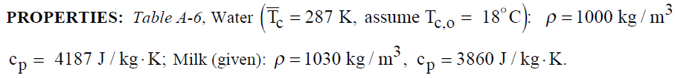
Problem 3 – Chilling of Milk (ε – NTU Approach)
In a dairy operation, milk at a flow rate of 250 liter/hour and a cow-body temperature of 38.6°C must be chilled to a safe-to-store temperature. Ground water at 10°C counter flow concentric tube heat exchanger is available at a flow rate of 0.72 m³/h. The density and specific heat of milk are 1030 kg/m³ and 3860 J/Kg K ,respectively.
(Safe-to-store temperature of milk is <= 13°C)
Determine the length of the exchanger if the inner pipe has a 50-mm diameter and the overall heat transfer coefficient is U = 1000 W/m² K .
Determine the outlet temperature of the water.
AAiT
School of Mechanical and Industrial Engineering - SMiE

Slide 53
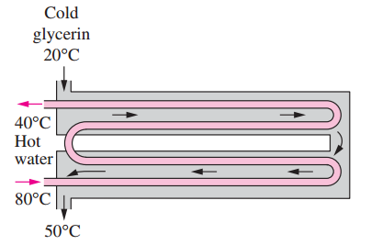
Problem 4 - Heating by Multi-Pass Heat Exchanger
A 2-shell passes and 4-tube passes heat exchanger is used to heat glycerin from 20°C to 50°C by hot water, which enters the thin-walled 2-cm-diameter tubes at 80°C and leaves at 40°C. The total length of the tubes in the heat exchanger is 60 m. The convection heat transfer coefficient is 25 W/m²·°C on the glycerin (shell) side and 160 W/m²· °C on the water (tube) side. Determine the rate of heat transfer in the heat exchanger.
AAiT
School of Mechanical and Industrial Engineering - SMiE

Slide 54
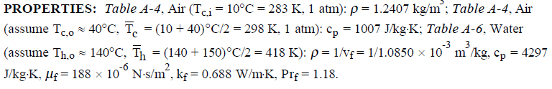
Problem 5 – Cooling by Cross-flow H.E (ε – NTU Approach)
A cross-flow heat exchanger consists of a bundle of 32 tubes in a 0.6 m² duct. Hot water at 150°C and a mean velocity of 0.5 m/s enters the tubes having inner and outer diameters of 10.2 and 12.5 mm. Atmospheric air at 10°C enters the exchanger with a volumetric flow rate of 1.0 m³/s. The convection heat transfer coefficient on the tube outer surfaces is 400 W/m² K. Estimate the fluid outlet temperatures.
AAiT
School of Mechanical and Industrial Engineering - SMiE

Slide 55
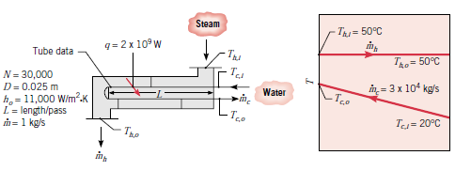
Exercise – Condensation by Shell and Tube H.E
The condenser of a large steam power plant is a heat exchanger in which steam is condensed to liquid water. Assume the condenser to be a shell-and-tube heat exchanger consisting of a single shell and 30,000 tubes, each executing two passes. The tubes are of thin wall construction with D = 25 mm, and steam condenses on their outer surface with an associated convection coefficient of h_{o} = 11,000 W/m² K. The heat transfer rate that must be effected by the exchanger is q = 2(10)⁹ W, and this is accomplished by passing cooling water through the tubes at a rate of 3(10)⁴ kg/s (the flow rate per tube is therefore 1 kg/s). The water enters at 20°C, while the steam condenses at 50°C. What is the temperature of the cooling water emerging from the condenser? What is the required tube length L per pass?
AAiT
School of Mechanical and Industrial Engineering - SMiE

Slide 56
Good Luck!

