Slide 1
Governor

Slide 2
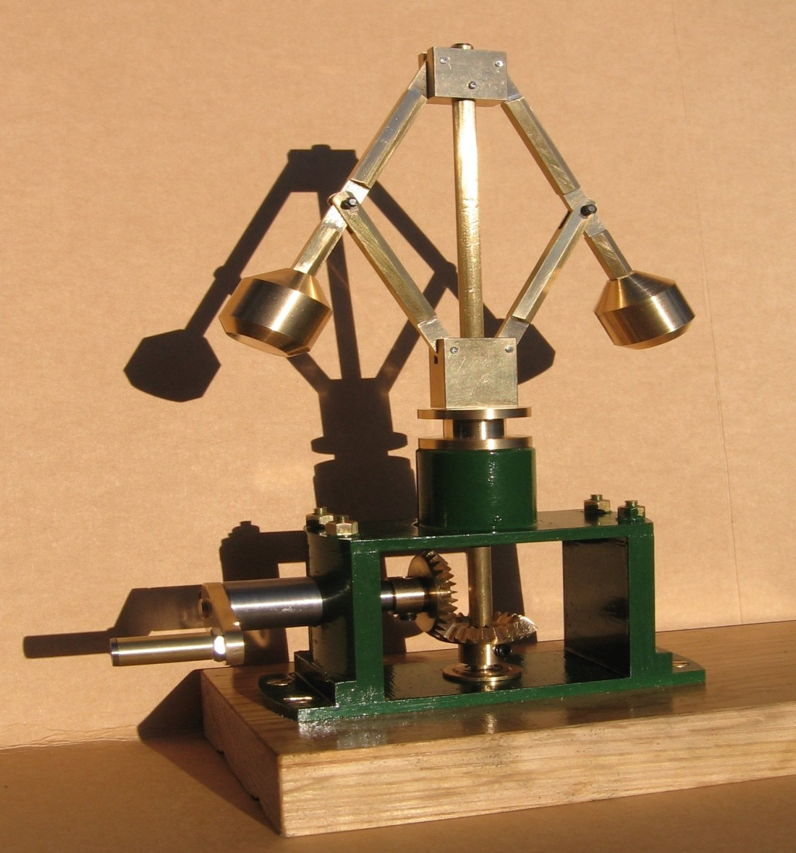
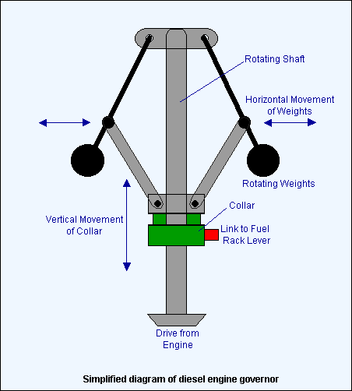
Governors

Slide 3
What Is A Governor?
A governor is a device used to measure and regulate the speed of a machine, such as an engine.
A centrifugal governor, uses weights mounted on spring-loaded arms to determine how fast a shaft is spinning.

Slide 4
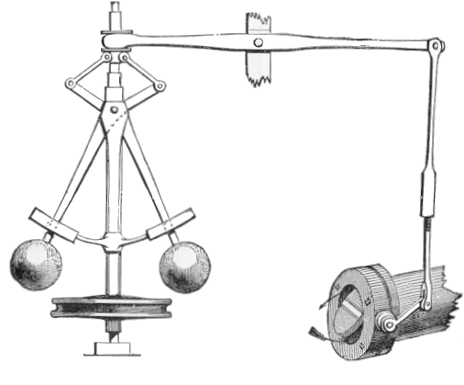
How Does It Work?
Set Arm
Valve Arm
“Final Arm”
Spring Loaded
Arms
Weighted
Balls
Gas Valve
Spinning Shaft

Slide 5
How Does It Work?
Basically:
The shaft spins causing the weighted balls to spin as well
As the balls spin faster, they are forced outwards.
As the balls move outward, they get more and more horizontal, which causes the spring loaded arms to compress.

Slide 6
How Does This Work? cont’d
This compression causes the set arm to rotate about it’s pivot counter-clockwise.
From this motion, a final arm, which is attached to a gas valve is lifted.
Thereby closing the gas valve accordingly.

Slide 7
Why/When Is It Used?
The Centrifugal Governor is used:
When and engine begins moving too fast to keep the engine at a constant speed.
2. When a vehicle is moving too fast. (For example, in order to make sudden bends in roads safe, many vehicles have a set limit of between 180-250 km/h)

Slide 8
Types of governor

Slide 9
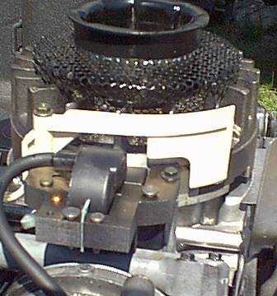
Pneumatic Governors
Sometimes called air-vane governors, they are operated by the stream of air flow created by the cooling fins of the flywheel.

Slide 10
Air-Vane Governor
When the engine experiences sudden increases in load, the flywheel slows causing the governor to open the throttle to maintain the desired speed.
The same is true when the engine experiences a decrease in load. The governor compensates and closes the throttle to prevent overspeeding.

Slide 11
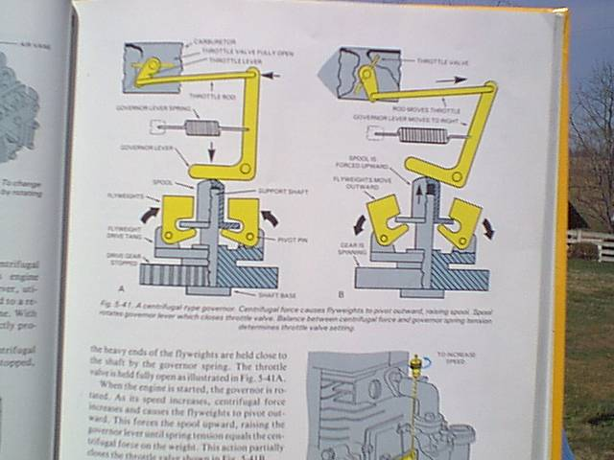
Centrifugal Governor
Sometimes referred to as a mechanical governor, it uses pivoted flyweights that are attached to a revolving shaft or gear driven by the engine.

Slide 12
Mechanical Governor
With this system, governor rpm is always directly proportional to engine rpm.

Slide 13
Mechanical Governor
If the engine is subjected to a sudden load that reduces rpm, the reduction in speed lessens centrifugal force on the flyweights.
The weights move inward and lower the spool and governor lever, thus opening the throttle to maintain engine speed.

Slide 14
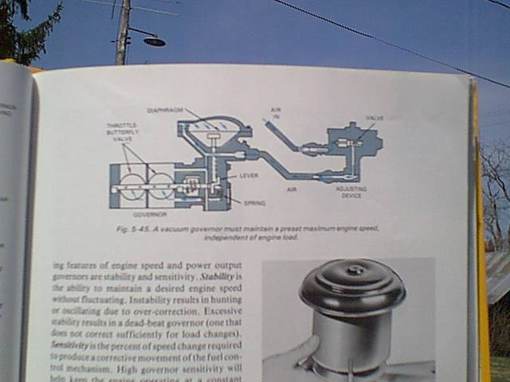
Vacuum Governors
Located between the carburetor and the intake manifold.
It senses changes in intake manifold pressure (vacuum).

Slide 15
Vacuum Governors
As engine speed increases or decreases the governor closes or opens the throttle respectively to control engine speed.

Slide 16
Hunting
Hunting is a condition whereby the engine speed fluctuate or is erratic usually when first started.
The engine speeds up and slows down over and over as the governor tries to regulate the engine speed.
This is usually caused by an improperly adjusted carburetor.

Slide 17
Stability
Stability is the ability to maintain a desired engine speed without fluctuating.
Instability results in hunting or oscillating due to over correction.
Excessive stability results in a dead-beat governor or one that does not correct sufficiently for load changes.

Slide 18
Sensitivity
Sensitivity is the percent of speed change required to produce a corrective movement of the fuel control mechanism.
High governor sensitivity will help keep the engine operating at a constant speed.

Slide 19
Summary
Small engine governors are used to:
  Maintain selected engine speed.
  Prevent over-speeding.
  Limit high and low speeds.

Slide 20
Summary
Governors are usually of the following types:
  Air-vane (pneumatic)
  Mechanical (centrifugal)
  Vacuum

Slide 21
Summary
The governor must have stability and sensitivity in order to regulate speeds properly. This will prevent hunting or erratic engine speed changes depending upon load changes.

Slide 22
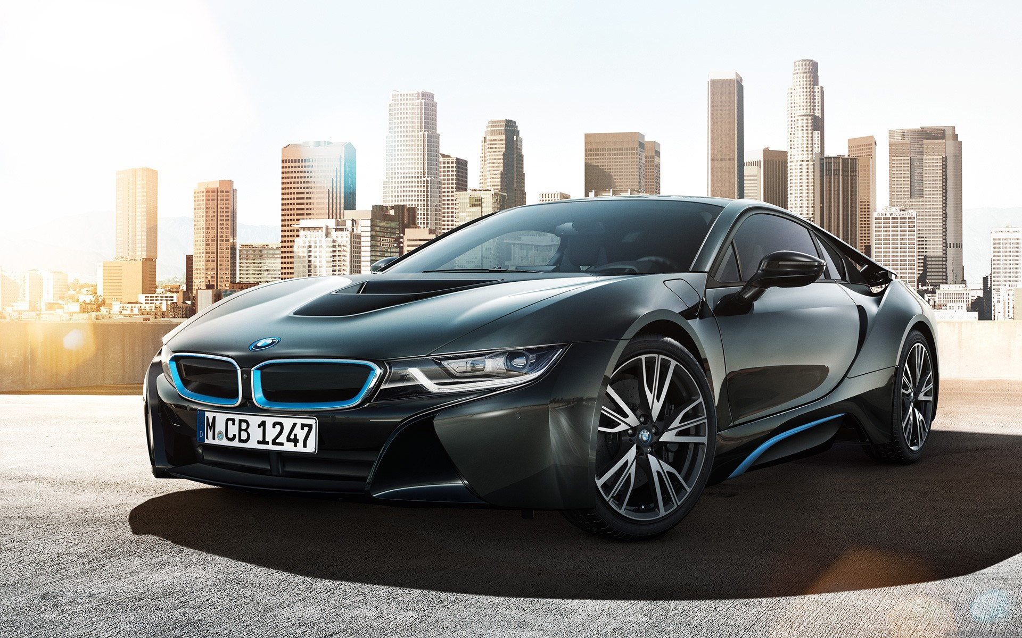
Governor Used in Vehicles

Slide 23

ImtisaaL AhmeD
Mechanical Engg
5th Semester
UCEST
University College of Engg. Science & Technology

Slide 24
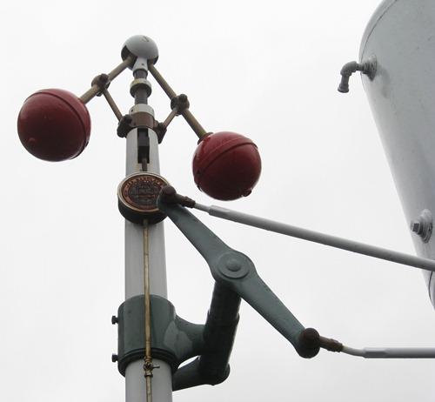
Governor:
A governor, or speed limiter, is a device used to measure and regulate the speed of a machine such as an engine.

Slide 25
FUNCTION
    To maintain the engine speed at the desire value by controlling the fuel injection.

Slide 27
Purpose of governor:
1. To automatically maintain the uniform speed of the engine within the specified limits, whenever there is a variation of the load.
2. To regulate the fuel supply to the engine as per load requirements.
3. To regulate the mean speed of the engines.
4. It works intermittently i.e., only there’s modification within the load
5. Mathematically, it can express as ΔN.

Slide 28
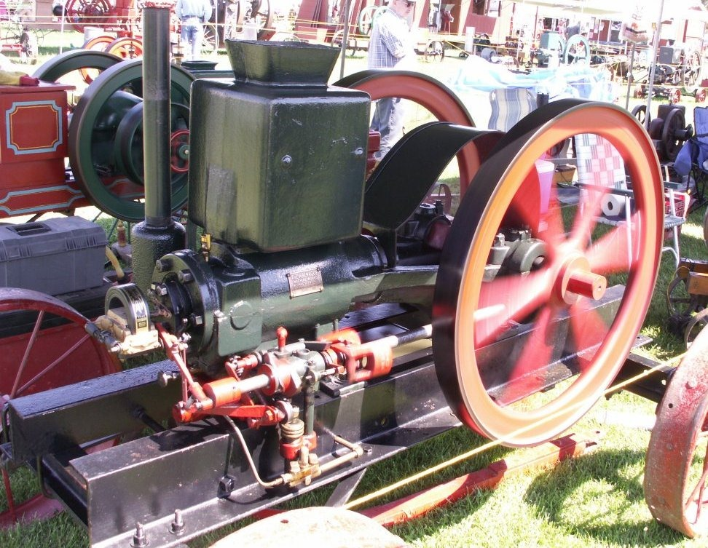

Slide 29
Types of governor:
The governor can be classified into the following types. These are given below,
1. Centrifugal governor
a) Pendulum type watt governor
b) Loaded type governor
i) Gravity controlled type
Ø Porter governor
Ø Proell governor
Ø Watt governor
ii) Spring controlled type
Ø Hartnell governor
Ø Hartung governor
2. Inertia and fly-wheel governor
3. Pickering Governor

Slide 30
Types of Governors
The type of governor used on diesel engines is dependent upon the application required. The six basic types of governors are as follows:
Mechanical centrifugal flyweight style that relies on a set of rotating flyweights and a control spring; used since the inception of the diesel engine to control its speed.
Power-assisted servo mechanical style that operates similar to the mechanical centrifugal flyweight but uses engine oil under pressure to move the operating linkage.

Slide 31
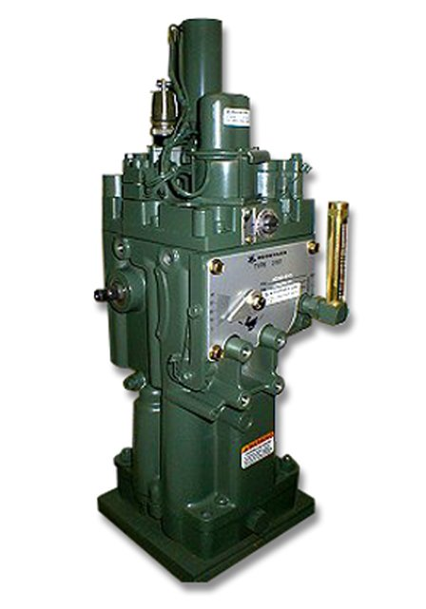
Hydraulic governor that relies on the movement of a pilot valve plunger to control pressurized oil flow to a power piston, which, in turn, moves the fuel control mechanism.

Slide 32
Pneumatic governor that is responsive to the air flow (vacuum) in the intake manifold of an engine. A diaphragm within the governor housing is connected to the fuel control linkage that changes its setting with increases or decreases in the vacuum.

Slide 33
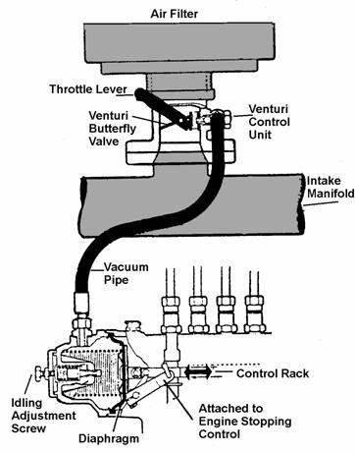

Slide 34
Electromechanical governor uses amagnetic speed pickup sensor on an engine-driven component to monitor the rpm of the engine. The sensor sends a voltage signal to an electronic control unit that controls the current flow to a mechanical actuator connected to the fuel linkage

Slide 35
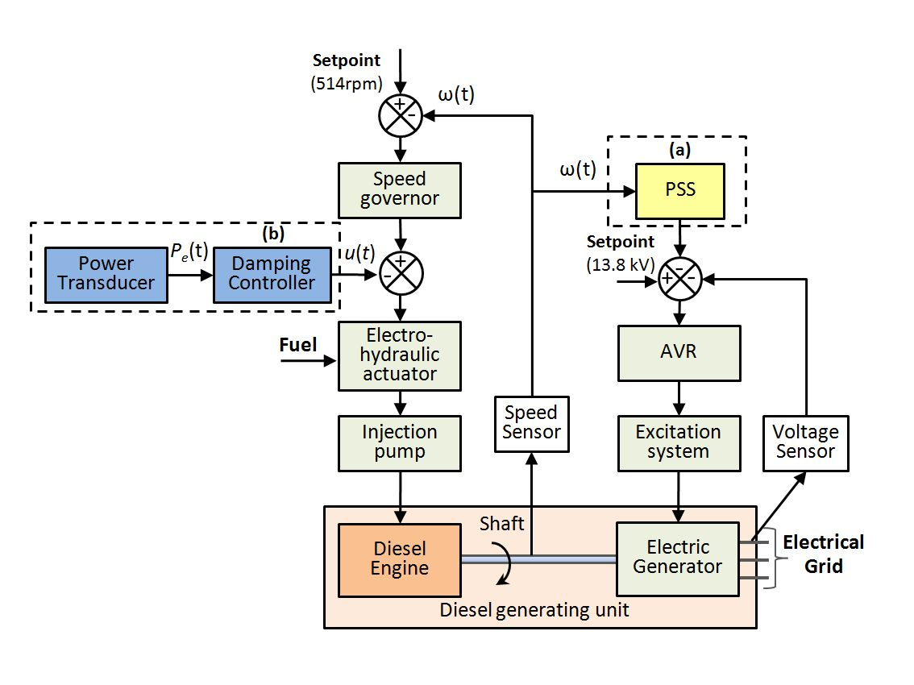

Slide 36
Electronic governor uses magnetic speed sensor to monitor the rpm of the engine. The sensor continuously feeds information back to the ECM (electronic control module).

Slide 37
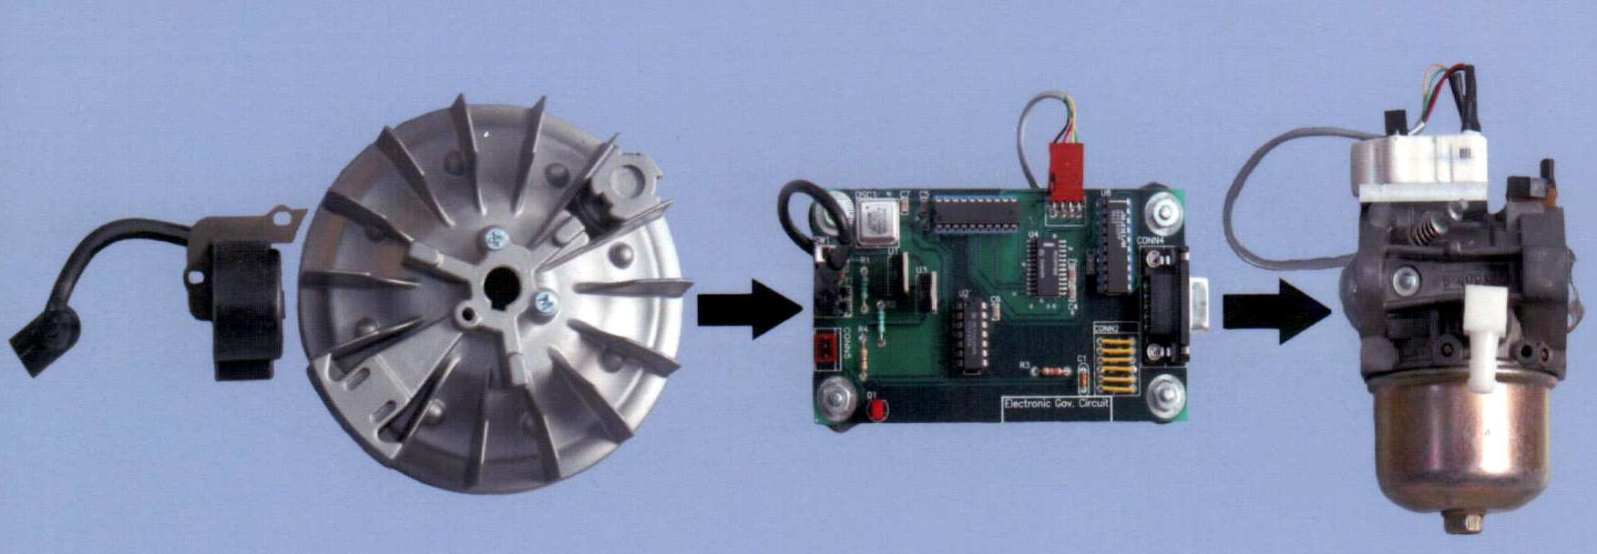

Slide 38
Working of governor:
Power is supplied to the governor from the engine's output shaft by a belt or chain connected to the lower belt wheel. The governor is connected to a throttle valve that regulates the flow of working fluid supplying the prime mover. As the speed of the prime mover increases, the central spindle of the governor rotates at a faster rate and the kinetic energy of the balls increases. This allows the two masses on lever arms to move outwards and upwards against gravity. If the motion goes far enough, this motion causes the lever arms to pull down on a thrust bearing, which moves a beam linkage, which reduces the aperture of a throttle valve. The rate of working-fluid entering the cylinder is thus reduced and the speed of the prime mover is controlled, preventing over-speeding.

Slide 39
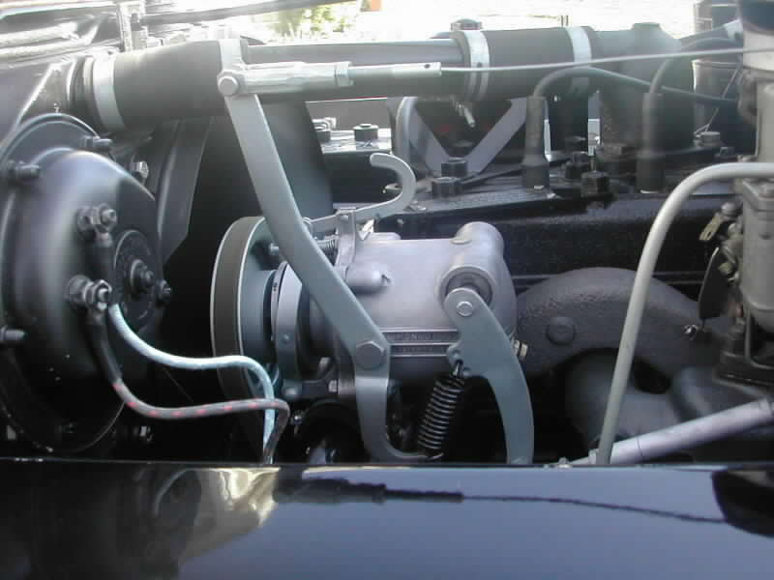

Slide 40
For example:
Assume a driver running a car in hill station, at that time engine load increases, and automatically vehicle speed decreases. Now the actual speed is less than desired speed. So driver increases the fuel to achieve the desired speed. So here, the driver is a governor for this system.
So governor is a system to minimize fluctuations within the mean speed which can occur as a result of load variation. The governor has no influence over cyclic speed fluctuations however it controls the mean speed over an extended period throughout that load on the engine might vary. When there’s modification in load, variation in speed additionally takes place then governor operates a regulatory control and adjusts the fuel provide to keep up the mean speed nearly constant. Therefore the governor mechanically regulates through linkages, the energy provided to the engines as demanded by variation of load, so the engine speed is maintained nearly constant.

Slide 41
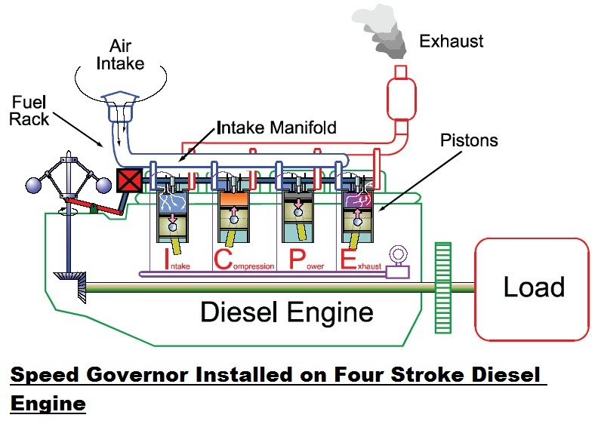

Slide 42
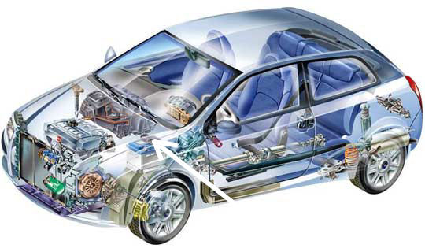
Cross Sectional view

Slide 43
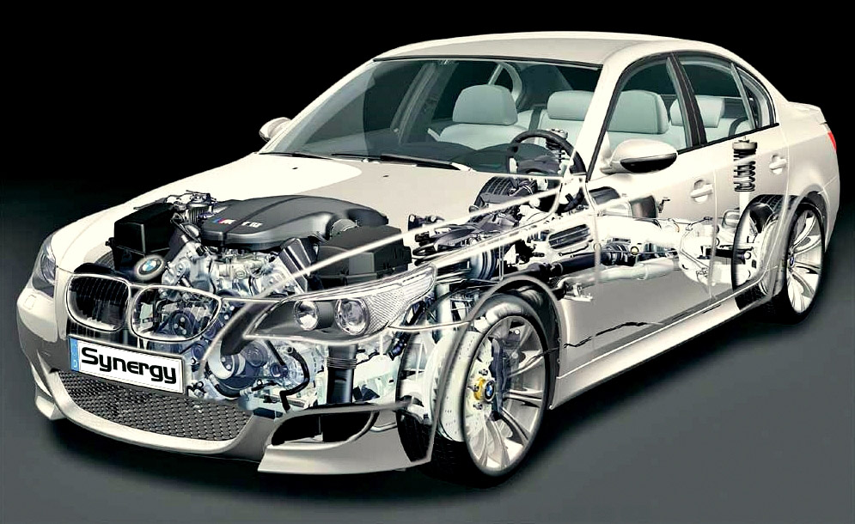

Slide 44
Cross –sectional view of Governor

Slide 45
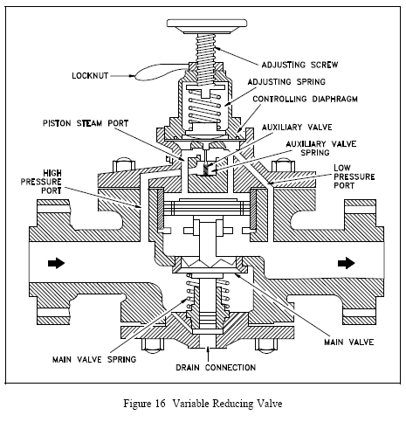

Slide 46
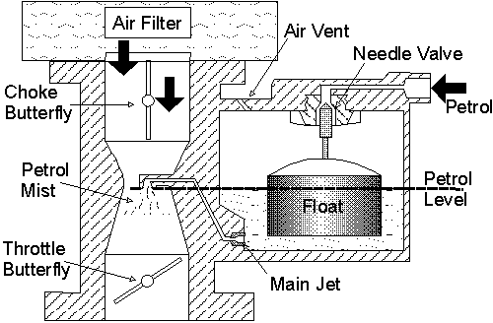
Cross Sectional view of Governor in Petrol Engine

Slide 47
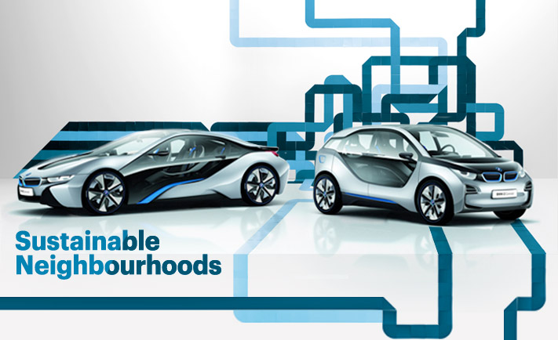
The End

Slide 48
Thank you!!!

