Slide 1
Mechanics of Machines
Meng 3071
GEARS

Slide 2
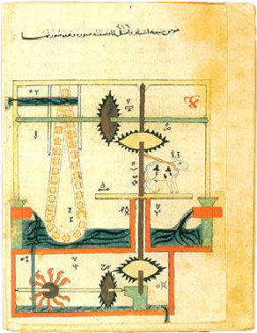
Introduction
The earliest known reference to gear trains is in a treatise by Hero of Alexandria (c. 100 B.C.). Gear trains are widely used in all kinds of mechanisms and machines, from can openers to aircraft carriers.
Whenever a change in the speed or torque of a rotating device is needed, a gear train or one of its cousins, the belt or chain drive mechanism, will usually be used.

Slide 3
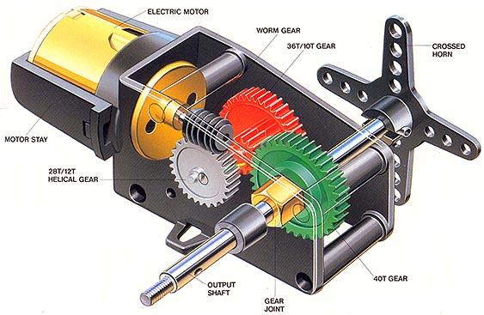
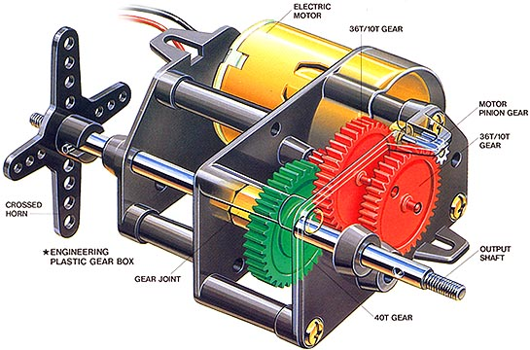
Introduction
Gears of various sizes and styles are readily available from many manufacturers. Assembled gearboxes for particular ratios are also stock items.
The kinematic design of gear trains is principally involved with the selection of appropriate ratios and gear diameters.

Slide 4
Introduction

Slide 5
Rolling Cylinders
The simplest means of transferring rotary motion from one shaft to another is a pair of rolling cylinders. They may be an external or an internal set of rolling cylinders.
Provided that sufficient friction is available, the joint at the interface will be pure rolling and the mobility of the mechanism will be theoretically zero. The cylindrical shape of the two cylinder , however, renders the length constraint between the two cylinders redundant, and the mobility will thus be one.
External Set
Internal Set

Slide 6
Rolling Cylinders
The mechanism works well as long as sufficient friction is available. There will be no slip between the cylinders until the maximum available frictional force at the joint is exceeded by the demands of torque transfer.
Some early automobiles had rolling cylinder drives inside the transmission, as do some present-day garden tractors, which use a rubber-coated wheel rolling against a steel disk to transmit power from the engine to the wheels
External Set
Internal Set

Slide 7
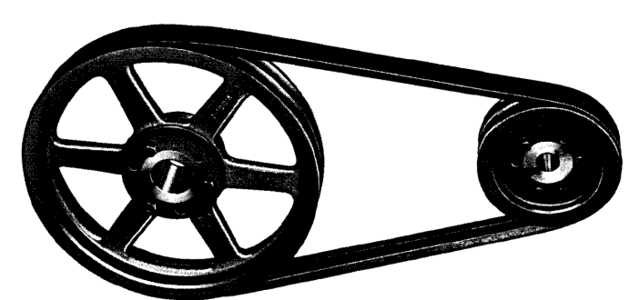
Rolling Cylinders
A variant on the rolling cylinder drive is the flat or vee belt. This mechanism transfers power through friction and is capable of quite large power levels, provided enough belt cross section is provided.
Friction belts are used in a wide variety of applications from small sewing machines to the alternator drive on automobile, to multi horsepower generators and pumps. Whenever absolute phasing is not required and power levels are moderate, a friction belt drive may be the best choice. They are relatively quiet running, require no lubrication, and are inexpensive compared to gears and chain drives.

Slide 8
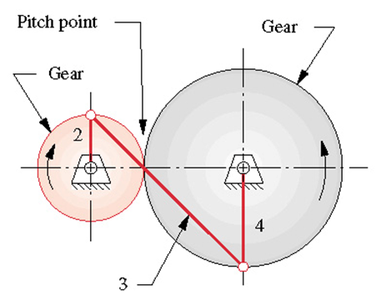
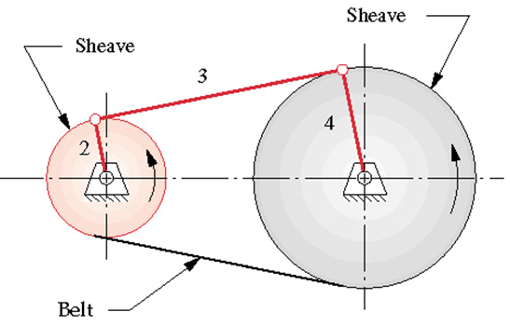
Rolling Cylinders
Both rolling cylinders and belt (or chain) drives have effective linkage equivalents.
These effective linkages are valid only for one instantaneous position but nevertheless show that these devices could be analyzed as a variation of the four­bar linkage

Slide 9
Rolling Cylinders
The principal drawbacks to the rolling cylinder drive (or smooth belt) mechanism are its relatively low torque capability and the possibility of slip.
Some drives require absolute phasing of the input and output shafts for timing purposes. A common example is the valve train drive in an automobile engine. The valve cams must be kept in phase with the piston motion or the engine will not run properly.
A smooth belt or rolling cylinder drive from crankshaft to camshaft would not guarantee correct phasing. In this case some means of preventing slip is needed.

Slide 10
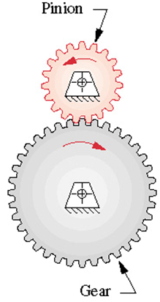
Rolling Cylinders
One way of avoiding slip between the rolling cylinder is by adding some meshing teeth to the cylinders. They then become gears and are together called a gearset.
When two gears are placed in mesh to form a gearset, it is conventional to refer to the smaller of the two gears as the pinion and to the other as the gear.

Slide 11
The Fundamental Law of Gearing
The fundamental law of gearing provides that the angular velocity ratio between the gears of a gearset remains constant throughout the mesh.
It is usually desirable to maintain a constant ratio between the gears as they rotate. Any variation in ratio will show up as oscillation in the output velocity and torque even if the input is constant with time. Such oscillations are undesirable for a number of reasons including machine maintenance and reliability, user comfort, and prime mover efficiency.

Slide 12
The Fundamental Law of Gearing
The angular velocity ratio (mv) referred to in this law is the same one that we derived for the fourbar linkage. It is equal to the ratio of the radius of the input gear to that of the output gear.
When the efficiency approaches 100%, the torque ratio (m_{T}) approaches the reciprocal of the velocity ratio (m_{v}); and the gearset becomes a device for exchanging torque for velocity or vice versa.

Slide 13
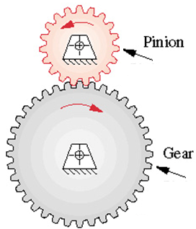
The Fundamental Law of Gearing
The radii in the speed ratio and torque ratio equations are those of the rolling cylinders to which we are adding the teeth.
The positive or negative sign accounts for internal or external cylinder sets. An external set reverses the direction of rotation between the cylinders and requires the negative sign. An internal gearset or a belt or chain drive will have the same direction of rotation on input and output shafts and require the positive sign.

Slide 14
The Fundamental Law of Gearing
The surfaces of the rolling cylinders will become the pitch circles, and their diameters the pitch diameters of the gears.
The contact point between the cylinders lies on the line of centers and this point is called the pitch point

Slide 15
The Fundamental Law of Gearing
In order to satisfy the fundamental law of gearing, the gear tooth contours on mating teeth must be conjugates of one another.
There is an infinite number of possible conjugate pairs that could be used, but only a few curves have seen practical application as gear teeth. The involute curve is the most common shape. The cycloid is still used as a tooth form in gears of watches and clocks.

Slide 16
The Involute Tooth Form
If two cylinders (pulleys) are connected by a crossed tight wire (belt), the two pulleys will turn in opposite directions and the angular velocity ratio will be constant provided the wire does not slip. The velocity ratio is equal to the inverse of the diameter ratio of the pulleys.
Assume that two rigid plates are attached to the pulleys with one plat plate attached to either pulley. Consider the trace of a point Q relative to the ground and relative to the two plates. Relative to the ground, the point Q will trace a straight line along the wire. Relative to the plates, the point will trace two involute curves.
Q

Slide 17
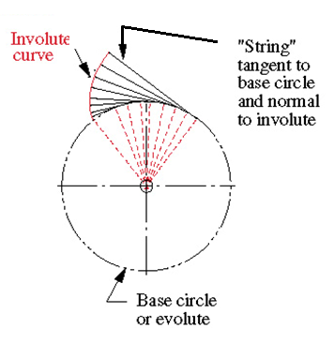
The Involute Tooth Form
The involute is a curve which can be generated by unwrapping a taut string from a cylinder (called the evolute). Note the following about this involute curve
  The string is always tangent to the cylinder.
  The center of curvature of the involute is always at the point of tangency of the string with the cylinder.
  A tangent to the involute is then always normal to the string, the length of which is the instantaneous radius of curvature of the involute curve.

Slide 18
The Involute Tooth Form
If the two plates are cut along the involute while kept attached to the cylinders, the involute on one of the plates can be used to drive the involute on the other plate, and vice-versa. The two involute will represent gear teeth.
The geometry at the resulting tooth-tooth interface is similar to that of a cam-follower joint. There is a common tangent to both curves at the contact point, and a common normal, perpendicular to the common tangent. Note that the common normal is, in fact, the "string" of the involute.
Q

Slide 19
The Involute Tooth Form
The common normal, which is also the line of action, or axis of transmission, always passes through the pitch point regardless of where in the mesh the two teeth are contacting.
The angular velocity ratio will be constant because the line of action normal to the involute at point Q cuts the line of centers at a fixed point, which is the instant center of rotation of one of the discs relative to the other. The resulting motion of the cylinders will be equivalent to that resulting from the original crossed belt configuration
Q

Slide 20
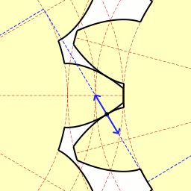
The Involute Tooth Form
The cylinders from which the strings are unwrapped are called the base circles of the respective gears.
Note that the base circles are necessarily smaller than the pitch circles, which are at the radii of the original rolling cylinders, r_{p} and r_{g} .

Slide 21
The Involute Tooth Form
Note that the shape of the involute is determined only by the diameter of its base cylinder. If the center distance is changed between the two cylinder, the two involute curves will still drive one another but different portions of the involute will be in contact.
As long as the diameter of the cylinders is not changed, the velocity ratio between the two plates will not change.
Q

Slide 22
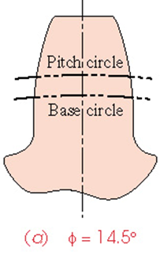
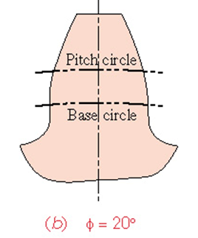
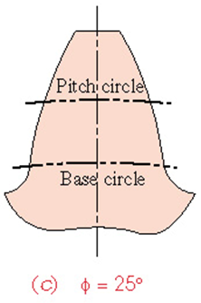
Pressure Angle
The pressure angle in a gearset is the angle between the axis of transmission or line of action (common normal) and the direction of velocity at the pitch point. Pressure angles of gearsets are standardized at a few values by the gear manufacturers.
These are defined at the nominal center distance for the gearset as cut. The standard values are 14.5°, 20°, and 25° with 20° being the most commonly used and 14.5° now being considered obsolete.

Slide 23
Pressure Angle
If there is an error in the location of the gear centers, the fundamental law of gearing still holds in the modified center distance case because the involute shape is only determined by the base circles radii, which are un changing once the gear is cut. The common normal is still tangent to the two base circles and still goes through the pitch point.
The pitch point has moved, but in proportion to the move of the center distance and the gear radii. The velocity ratio is unchanged despite the shift in center distance. As the center distance increases, so will the pressure angle and vice versa

Slide 24
Example
The base circle diameter of the gear in a gearset is 30 mm and a that of the pinion is 20 mm. Determine the pressure angle if the center distance between the gear and the pinion is (a) 60 mm, and (b) 80 mm

Slide 25
Example
The base circle diameter of the gear in a gearset is 30 mm and a that of the pinion is 20 mm. Determine the pressure angle if the center distance between the gear and the pinion is (a) 60 mm, and (b) 80 mm

Slide 26
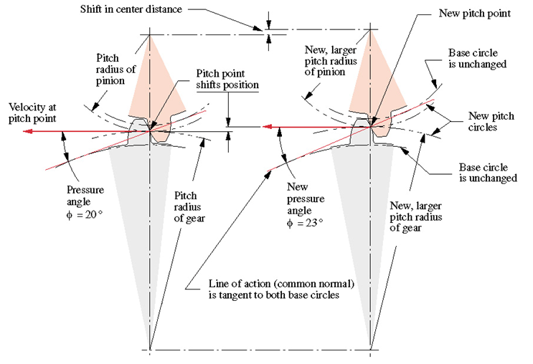
The Involute Tooth Form

Slide 27
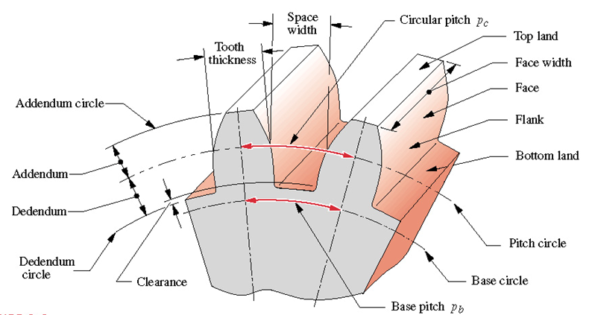
Addendum and Dedendum
The gear tooth must project both below and above the rolling cylinder surface (pitch circle) and the involute only exists outside of the base circle. The amount of tooth that sticks out above the pitch circle is the addendum, a, and the amount that goes below is dedendum, b. These are related by a_{p} = a_{g} and b_{p} = b_{g} for pinion and gear, respectively, are equal for standard, full-depth gear teeth.

Slide 28
Tooth Height and Clearance
The tooth height is defined by the addendum and the dedendum, which are referenced to the nominal pitch circle radius. The dedendum is slightly larger than the addendum to provide a small amount of clearance between the tip of one mating tooth (addendum circle) and the bottom of the tooth space of the other (dedendum circle).

Slide 29
Tooth Thickness and Tooth Space Width
The tooth thickness is measured at the pitch circle, and the tooth space width is slightly larger than the tooth thickness. The difference between these two dimensions is the backlash.

Slide 30
Tooth Thickness, Space Width and Face Width
The tooth thick­ ness is measured at the pitch circle, and the tooth space width is slightly larger than the tooth thickness. The difference between these two dimensions is the backlash.
The face width of the tooth is measured along the axis of the gear

Slide 31
Circular Pitch
The circular pitch is the arc length along the pitch circle circumference measured from a point on one tooth to the same point on the next. The circular pitch defines the tooth size. The other tooth dimensions are standardized based on that dimension as shown in the table

Slide 32
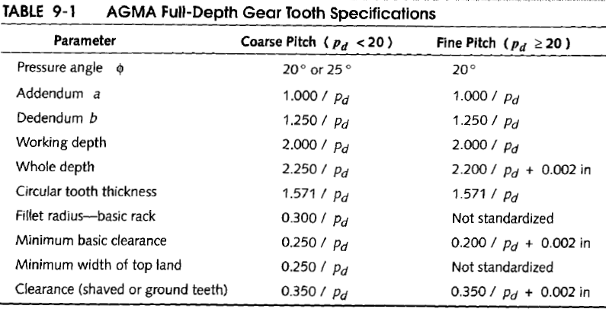
Circular Pitch

Slide 33
Base Pitch
The base pitch is defined base on the base circle diameter

Slide 34
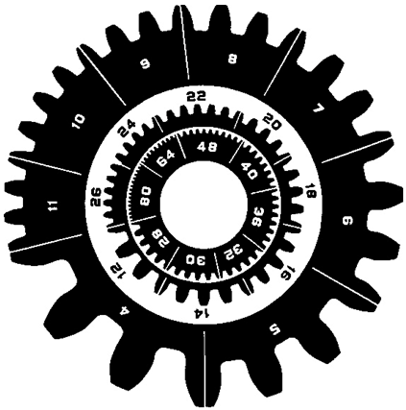
Diametral Pitch and Module
Used to define tooth size.
Diametral Pitch: American standards
Module: SI standards
Tooth size for various Diametral Pitches

Slide 35
Backlash
Manufacturing tolerances preclude a zero clearance, and all teeth cannot be exactly the same dimensions, so, there must be some small difference between the tooth thickness and the space width. Backlash is defined as the clearance between mating teeth measured along the circumference of the pitch circle. Increasing the center distance will increase the backlash and vice versa.
As long as the gearset is run with a non-reversing torque, backlash causes no problem. But, whenever torque changes sign, the teeth will move from contact on one side to the other. The backlash gap will be traversed and the teeth will impact with noticeable noise.

Slide 37
Length of Action
The figure shows a pair of involute tooth forms in two positions, just beginning contact and about to leave contact. The common normals of both these contact points still pass through the same pitch point.

Slide 38
Length of Action
The points of beginning and leaving contact define the mesh distance between the two gears
The distance along the line of action between these points within the mesh is called the length of action, Z, defined by the intersections of the respective addendum circles with the line of action.

Slide 40
The Involute Tooth Form

Slide 41
Arc of Action and Angle of Action
The arc of action is the path traced by a point on the pitch circle from the beginning to the end of engagement of a given pair of teeth. The arc of action in the figure is EPF or GPH.
The arc of action GPH is divided into two parts i.e. arc GP and arc PH. The arc GP is known as arc of approach and the arc PH is called arc of recess.
The angles subtended by these arcs at O1 are called angle of approach and angle of recess respectively. The sum of these two angles is called the angle of action.

Slide 44
Interference and Undercutting
The involute tooth form is only defined outside of the base circle. In some cases, the dedendum will be large enough to extend below the base circle.
If so, then the portion of tooth below the base circle will not be an involute and will interfere with the tip of the tooth on the mating gear, which is an involute.
Q

Slide 45
Interference and Undercutting
If the gear is cut with a standard gear shaper or a "hob," the cutting tool will also interfere with the portion of tooth below the base circle and will cut away the interfering material. This results in an undercut tooth.
This undercutting weakens the tooth by removing material at its root. The maximum moment and maximum shear from the tooth loaded as a cantilever beam both occur in this region. Severe undercutting will promote early tooth failure.

Slide 46
Interference and Undercutting
Interference and undercutting can be prevented simply by avoiding gears with too few teeth. As the number of teeth is reduced for a fixed diameter gear, the teeth must become larger. At some point, the dedendum will exceed the radial distance between the base circle and the pitch circle, and interference will occur.
The table shows the minimum number of teeth required to avoid undercutting against a standard rack as a function of pressure angle.

Slide 47
Interference and Undercutting
The table shows the minimum number of full-depth pinion teeth that can be used against a selection of full-depth gears. of various sizes (for ϕ= 20°).
As the mating gear gets smaller, the pinion can have fewer teeth and still avoid interference.

Slide 48
Example 2

Slide 50
Example 2

Slide 51
Example 2

Slide 52
Gear Types
Gears are made in many different shapes and configurations depending on the application.
Factors determining the appropriate type of gear include the required reduction ratio, space constraints, torque constraints, vibration constraints, and thrust force requirements

Slide 53
Spur Gears
Spur gears are the most commonly used gear type. They are characterized by teeth which are perpendicular to the face of the base cylinder of the gear.
Spur gears are by far the most commonly available, and are generally the least expensive.

Slide 54
Spur Gears
Advantages:
Spur gears are easy to find, inexpensive, and efficient.
Limitations:
They generally cannot be used when a direction change between the two shafts is required.

Slide 55
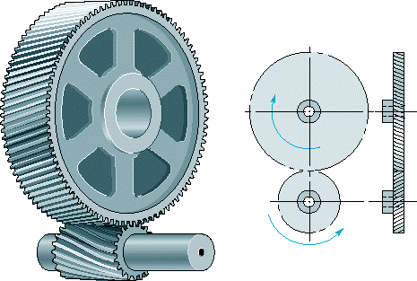
Helical Gears
Helical gears are similar to the spur gear except that the teeth are at an angle to the shaft, rather than parallel to it as in a spur gear.
The resulting teeth are longer than the teeth on a spur gear of equivalent pitch diameter.

Slide 56
Helical Gears
The longer teeth cause helical gears to have the following differences from spur gears of the same size:
  Tooth strength is greater because the teeth are longer.
  Greater surface contact on the teeth allows a helical gear to carry more load than a spur gear.
  The longer surface of contact reduces the efficiency of a helical gear relative to a spur gear.

Slide 57
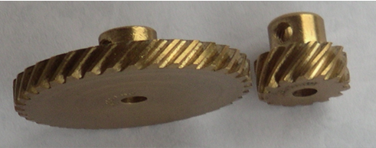
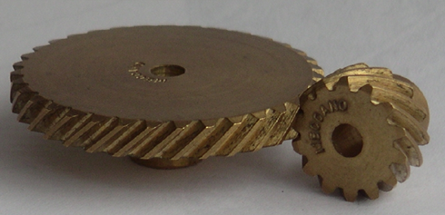
Helical Gears
Helical gears may be used to mesh two shafts that are not parallel, although they are still primarily use in parallel shaft applications.
A special application in which helical gears are used is a crossed gear mesh, in which the two shafts are perpendicular to each other:

Slide 58
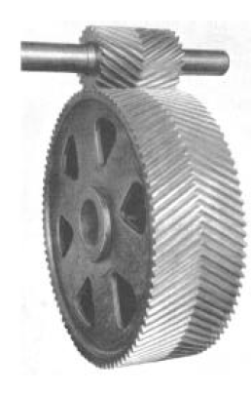
Helical Gears
One problem in helical gears is a large axial thrust on the gear shaft. This can be eliminated by a special arrangement of helical gears referred to as Herringbone gears.
Herringbone gears are formed by joining two helical gears of identical pitch and diemater, but opposite hand on the same shaft. This cancels the axial thrust which would occur if only one set of helical gears was used. This eliminates the need to use an axial thrust bearing.

Slide 59
Helical Gears
Advantages:
Helical gears can be used on non parallel and even perpindicular shafts, and can carry higher loads than can spur gears.
Limitations:
Helical gears have the major disadvantage that they are expensive and much more difficult to find. Helical gears are also slightly less efficient than a spur gear of the same size.

Slide 60
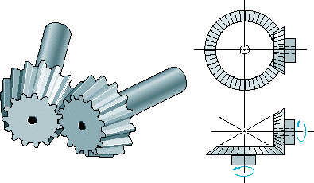
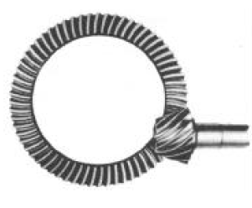
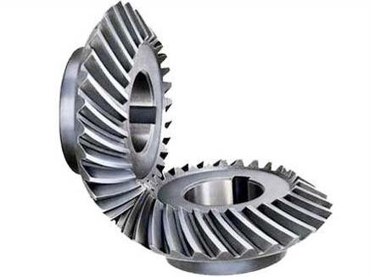
Bevel Gears
Bevel gears are primarily used to transfer power between intersecting shafts. The teeth of these gears are formed on a conical surface. Standard bevel gears have teeth which are cut straight and are all parallel to the line pointing the apex of the cone on which the teeth are based.
Spiral bevel gears are also available which have teeth that form arcs. Hypocycloid bevel gears are a special type of spiral gear that will allow nonintersecting, non-parallel shafts to mesh.

Slide 61
Bevel Gears
Straight tool bevel gears are generally considered the best choice for systems with speeds lower than 1000 feet per minute. they commonly become noisy above this point.
One of the most common applications of bevel gears is the bevel gear differential.

Slide 62
Bevel Gears
Advantages:
Excellent choice for intersecting shaft systems.
Limitations:
Limited availability. Cannot be used for parallel shafts. Can become noisy at high speeds

Slide 63
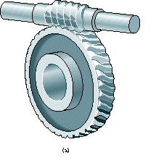
Worm Gears
Worm gears are special gears that resemble screws, and can be used to drive spur gears or helical gears.
Worm gears, like helical gears, allow two non-intersecting 'skew' shafts to mesh. Normally, the two shafts are at right angles to each other.

Slide 64
Worm Gears
A worm gear is equivalent to a V-type screw thread. Another way of looking at a worm gear is that it is a helical gear with a very high helix angle.
Worm gears are normally used when a high gear ratio is desired, or again when the shafts are perpendicular to each other.

Slide 65
Worm Gears
One very important feature of worm gear meshes that is often of use is their irreversibility : when a worm gear is turned, the meshing spur gear will turn, but turning the spur gear will not turn the worm gear.
The resulting mesh is 'self locking', and is useful in racheting mechanisms.

Slide 66
Worm Gears
Advantages:
Will tolerate large loads and high speed ratios. Provides self-locking functionality.
Limitations:
Low efficiency. The worm drives the drive gear primarily with slipping motion, thus there are high friction losses.

Slide 67

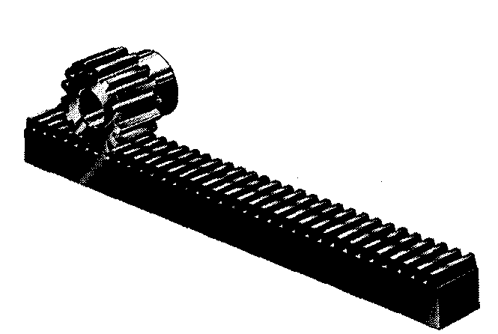
Racks (straight gears)
Racks are straight gears that are used to convert rotational motion to translational motion by means of a gear mesh. They are in theory a gear with an infinite pitch diameter.
A gearset involving one rack is commonly referred to as a “rack and pinion” gearset.

Slide 68
Racks (straight gears)
Advantages:
The only gearing component that converts rotational motion to translational motion. Efficiently transmits power. Generally offers better precision than other conversion methods
Limitations:
Limited usefulness. Difficult to find.

Slide 69
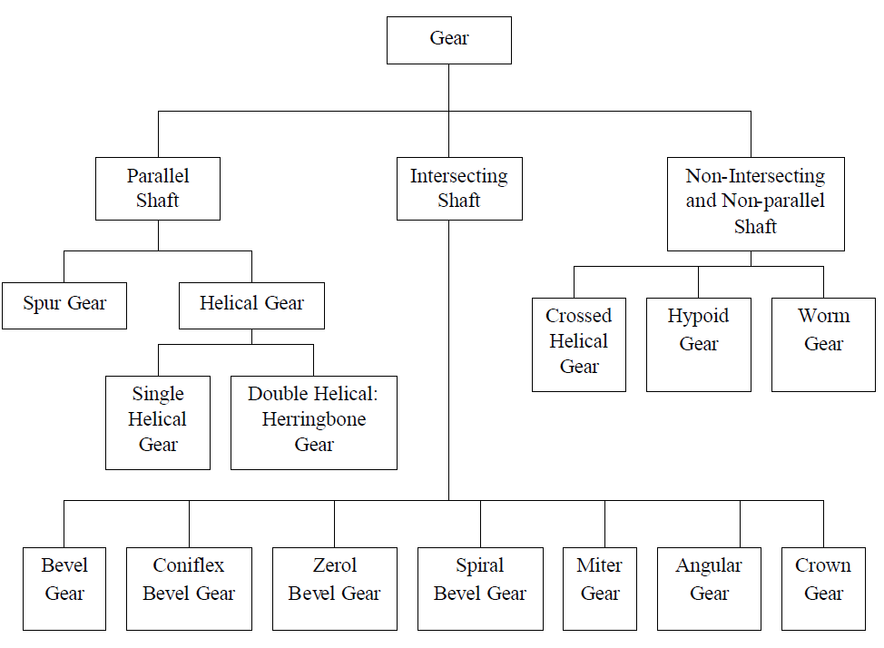
Gear Types

Slide 70
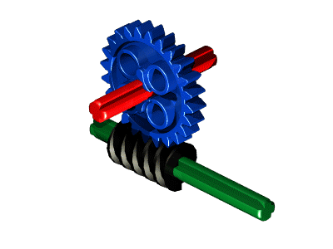
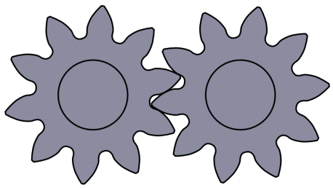
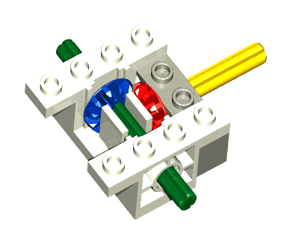
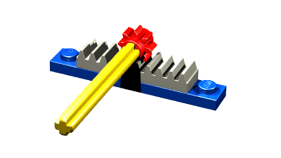
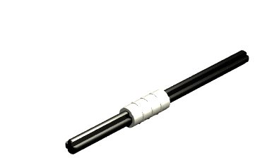
Spur Gears

Slide 71
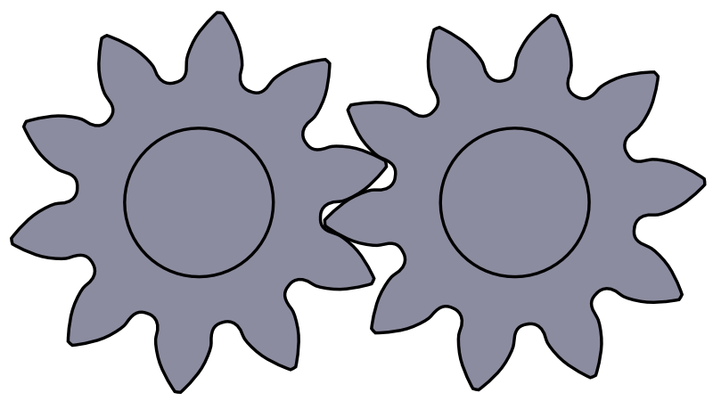
SPUR GEARS
Gear terminology, law of gearing, Characteristics of involute action, Path of contact, Arc of contact, Contact ratio of spur, helical, bevel and worm gears.
Interference in involute gears.
Methods of avoiding interference and Back lash.
Comparison of involute and cycloidal teeth Profile modification.

Slide 72
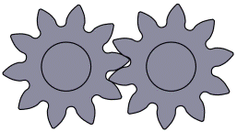
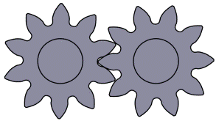
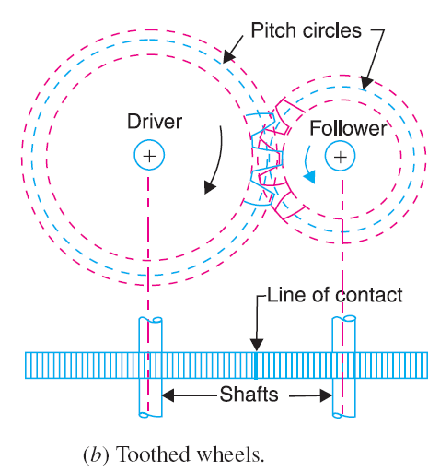
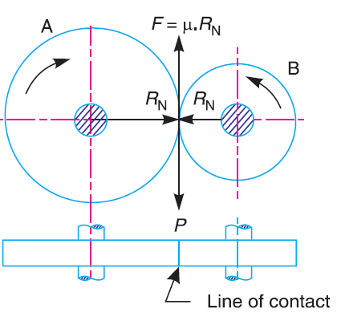
Introduction
Let the wheel A be keyed to the rotating shaft and the wheel B to the shaft, to be rotated.
A little consideration will show, that when the wheel A is rotated by a rotating shaft, it will rotate the wheel B in the opposite direction as shown in Fig. (a).
The wheel B will be rotated (by the wheel A) so long as the tangential force exerted by the wheel A does not exceed the maximum frictional resistance between the two wheels.
But when the tangential force (P) exceeds the frictional resistance (F), slipping will take place between the two wheels. Thus the friction drive is not a positive drive.
In order to avoid the slipping, a number of projections (called teeth) as shown in Fig. (b), are provided on the periphery of the wheel A, which will fit into the corresponding recesses on the periphery of the wheel B. A friction wheel with the teeth cut on it is known as toothed
wheel or gear.

Slide 73
GEAR…..
Power transmission is the movement of energy from its place of generation to a location where it is applied to performing useful work
A gear is a component within a transmission device that transmits rotational force to another gear or device

Slide 74
TYPES OF GEARS
1. According to the position of axes of the shafts.
Parallel
1.Spur Gear
2.Helical Gear
3.Rack and Pinion
b. Intersecting
Bevel Gear
c. Non-intersecting and Non-parallel
worm and worm gears

Slide 75
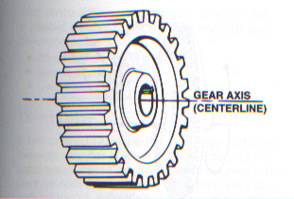
SPUR GEAR
Teeth is parallel to axis of rotation
Transmit power from one shaft to another parallel shaft
Used in Electric screwdriver, oscillating sprinkler, windup alarm clock, washing machine and clothes dryer

Slide 76
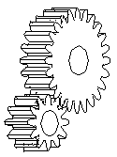
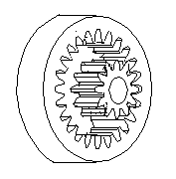
External and Internal spur Gear…

Slide 77
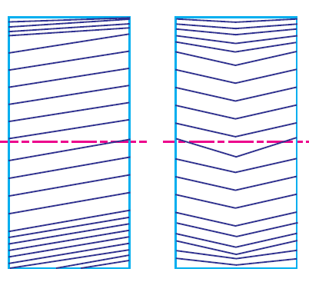
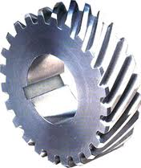
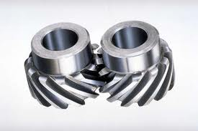
Helical Gear
The teeth on helical gears are cut at an angle to the face of the gear
This gradual engagement makes helical gears operate much more smoothly and quietly than spur gears
One interesting thing about helical gears is that if the angles of the gear teeth are correct, they can be mounted on perpendicular shafts, adjusting the rotation angle by 90 degrees

Slide 78
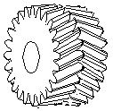
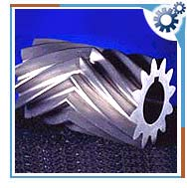
Herringbone gears
To avoid axial thrust, two helical gears of opposite hand can be mounted side by side, to cancel resulting thrust forces
Herringbone gears are mostly used on heavy machinery.

Slide 79
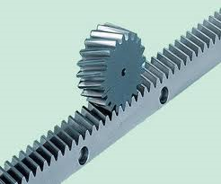
Rack and pinion
Rack and pinion gears are used to convert rotation (From the pinion) into linear motion (of the rack)
A perfect example of this is the steering system on many cars

Slide 80
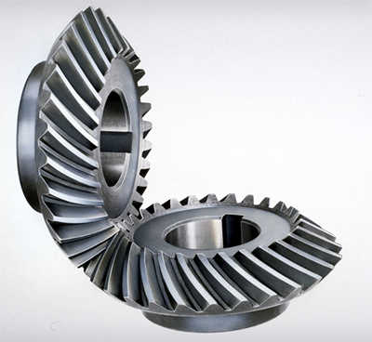
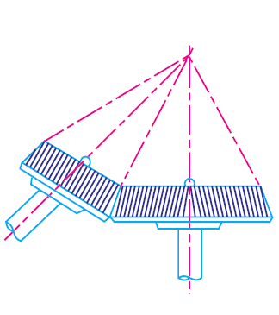
Bevel gears
Bevel gears are useful when the direction of a shaft's rotation needs to be changed
They are usually mounted on shafts that are 90 degrees apart, but can be designed to work at other angles as well
The teeth on bevel gears can be straight, spiral or hypoid
locomotives, marine applications, automobiles, printing presses, cooling towers, power plants, steel plants, railway track inspection machines, etc.

Slide 81
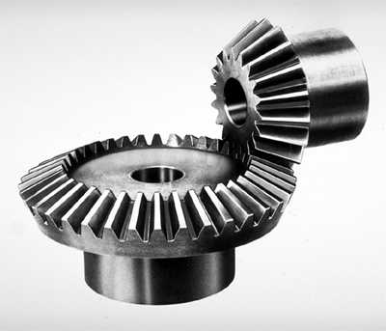
Straight and Spiral Bevel Gears

Slide 82
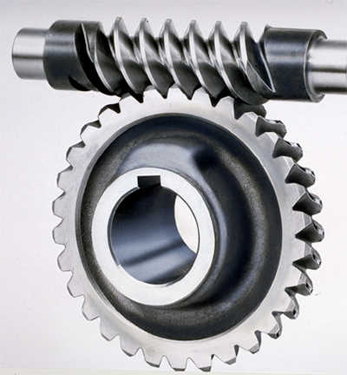
WORM AND WORM GEAR
Worm gears are used when large gear reductions are needed. It is common for worm gears to have reductions of 20:1, and even up to 300:1 or greater
Many worm gears have an interesting property that no other gear set has: the worm can easily turn the gear, but the gear cannot turn the worm
Worm gears are used widely in material handling and transportation machinery, machine tools, automobiles etc

Slide 83

NOMENCLATURE OF SPUR GEARS

Slide 84


Slide 85
Pitch circle. It is an imaginary circle which by pure rolling action would give the same motion as the actual gear.
Pitch circle diameter. It is the diameter of the pitch circle. The size of the gear is usually specified by the pitch circle diameter. It is also known as pitch diameter.
Pitch point. It is a common point of contact between two pitch circles.
Pitch surface. It is the surface of the rolling discs which the meshing gears have replaced at the pitch circle.
Pressure angle or angle of obliquity. It is the angle between the common normal to two gear teeth at the point of contact and the common tangent at the pitch point. It is usually denoted by φ. The standard pressure angles are 14 1/2 ° and 20°.

Slide 86
Addendum. It is the radial distance of a tooth from the pitch circle to the top of the tooth.
Dedendum. It is the radial distance of a tooth from the pitch circle to the bottom of the tooth.
Addendum circle. It is the circle drawn through the top of the teeth and is concentric with the pitch circle.
Dedendum circle. It is the circle drawn through the bottom of the teeth. It is also called root circle.
Note : Root circle diameter = Pitch circle diameter × cos φ , where φ is the pressure angle.

Slide 87


Circular pitch. It is the distance measured on the circumference of the pitch circle from a point of one tooth to the corresponding point on the next tooth. It is usually denoted by P_{c} ,Mathematically,
A little consideration will show that the two gears will mesh together correctly, if the two wheels have the same circular pitch.
Note : If D1 and D2 are the diameters of the two meshing gears having the teeth T1 and T2 respectively, then for them to mesh correctly,

Slide 88



Diametral pitch. It is the ratio of number of teeth to the pitch circle diameter in millimetres. It is denoted by p_{d}. Mathematically,
Module. It is the ratio of the pitch circle diameter in millimeters to the number of teeth. It is usually denoted by m. Mathematically,
Clearance. It is the radial distance from the top of the tooth to the bottom of the tooth, in a meshing gear. A circle passing through the top of the meshing gear is known as clearance circle.
Total depth. It is the radial distance between the addendum and the dedendum circles of a gear. It is equal to the sum of the addendum and dedendum.

Slide 89
Working depth. It is the radial distance from the addendum circle to the clearance circle. It is equal to the sum of the addendum of the two meshing gears.
Tooth thickness. It is the width of the tooth measured along the pitch circle.
Tooth space . It is the width of space between the two adjacent teeth measured along the pitch circle.
Backlash. It is the difference between the tooth space and the tooth thickness, as measured along the pitch circle. Theoretically, the backlash should be zero, but in actual practice some backlash must be allowed to prevent jamming of the teeth due to tooth errors and thermal expansion.

Slide 90
Face of tooth. It is the surface of the gear tooth above the pitch surface.
Flank of tooth. It is the surface of the gear tooth below the pitch surface.
Top land. It is the surface of the top of the tooth.
Face width. It is the width of the gear tooth measured parallel to its axis.
Profile. It is the curve formed by the face and flank of the tooth.
Fillet radius. It is the radius that connects the root circle to the profile of the tooth.

Slide 91


Path of contact. It is the path traced by the point of contact of two teeth from the beginning to the end of engagement.
Length of the path of contact. It is the length of the common normal cut-off by the addendum circles of the wheel and pinion.
Arc of contact. It is the path traced by a point on the pitch circle from the beginning to the end of engagement of a given pair of teeth. The arc of contact consists of two parts, i.e.
(a) Arc of approach. It is the portion of the path of contact from the beginning of the engagement to the pitch point.
(b) Arc of recess. It is the portion of the path of contact from the pitch point to the end of the engagement of a pair of teeth.

Slide 92

Forms of Teeth
In actual practice following are the two types of teeth commonly used
1. Cycloidal teeth ; and 2. Involute teeth.
Cycloidal Teeth
A cycloid is the curve traced by a point on the circumference of a circle which rolls without slipping on a fixed straight line.
When a circle rolls without slipping on the outside of a fixed circle, the curve traced by a point on the circumference of a circle is known as epi-cycloid.
On the other hand, if a circle rolls without slipping on the inside of a fixed circle, then the curve traced by a point on the circumference of a circle is called hypo-cycloid.

Slide 93

Construction of cycloidal teeth for Rack
In Fig. (a), the fixed line or pitch line of a rack is shown. When the circle C rolls without slipping above the pitch line in the direction as indicated in Fig. (a), then the point P on the circle traces epi-cycloid PA. This represents the face of the cycloidal tooth profile.
When the circle D rolls without slipping below the pitch line, then the point P on the circle D traces hypo-cycloid PB, which represents the flank of the cycloidal tooth. The profile BPA is one side of the cycloidal rack tooth.
Similarly, the two curves P' A' and P'B' forming the opposite side of the tooth profile are traced by the point P' when the circles C and D roll in the opposite directions.

Slide 94

Construction of cycloidal teeth for gear
In the similar way, the cycloidal teeth of a gear may be constructed as shown in Fig. (b).
The circle C is rolled without slipping on the outside of the pitch circle and the point P on the circle C traces epi-cycloid PA, which represents the face of the cycloidal tooth.
The circle D is rolled on the inside of pitch circle and the point P on the circle D traces hypo-cycloid PB, which represents the flank of the tooth profile.
The profile BPA is one side of the cycloidal tooth. The opposite side of the tooth is traced as explained above.

Slide 95


Involute Teeth
An involute of a circle is a plane curve generated by a point on a tangent, which rolls on the circle without slipping or by a point on a taut string which in unwrapped from a reel as shown in Fig.
In connection with toothed wheels, the circle is known as base circle. The involute is traced as follows :
A3, the tangent A3T to the involute is
perpendicular to P3A3 and P3A3 is the
normal to the involute.
In other words, normal at any point of an
involute is a tangent to the circle.

Slide 96
Comparison Between Involute and Cycloidal Gears
In actual practice, the involute gears are more commonly used as compared to cycloidal gears, due to the following advantages :
Advantages of involute gears
The most important advantage of the involute gears is that the centre distance for a pair of involute gears can be varied within limits without changing the velocity ratio. This is not true for cycloidal gears which requires exact centre distance to be maintained.
In involute gears, the pressure angle, from the start of the engagement of teeth to the end of the engagement, remains constant. It is necessary for smooth running and less wear of gears. But in cycloidal gears, the pressure angle is maximum at the beginning of engagement, reduces to zero at pitch point, starts decreasing and again becomes maximum at the end of engagement. This results in less smooth running of gears.
The face and flank of involute teeth are generated by a single curve where as in cycloidal gears, double curves (i.e. epi-cycloid and hypo-cycloid) are required for the face and flank respectively. Thus the involute teeth are easy to manufacture than cycloidal teeth. In involute system, the basic rack has straight teeth and the same can be cut with simple tools.
Note : The only disadvantage of the involute teeth is that the interference occurs with pinions having smaller number of teeth. This may be avoided by altering the heights of addendum and dedendum of the mating teeth or the angle of obliquity of the teeth.

Slide 97
Advantages of cycloidal gears
Following are the advantages of cycloidal gears :
Since the cycloidal teeth have wider flanks, therefore the cycloidal gears are stronger than the involute gears, for the same pitch. Due to this reason, the cycloidal teeth are preferred specially for cast teeth.
In cycloidal gears, the contact takes place between a convex flank and concave surface, whereas in involute gears, the convex surfaces are in contact. This condition results in less wear in cycloidal gears as compared to involute gears. However the difference in wear is negligible.
In cycloidal gears, the interference does not occur at all. Though there are advantages of cycloidal gears but they are outweighed by the greater simplicity and flexibility of the involute gears.

Slide 98

Condition for Constant Velocity Ratio of Toothed Wheels–Law of Gearing
Consider the portions of the two teeth, one on the wheel 1 (or pinion) and the other on the wheel 2, as shown by thick line curves in Fig.
Let the two teeth come in contact at point Q, and the wheels rotate in the directions as shown in the figure.
Let TT be the common tangent and MN be the common normal to the curves at the point of contact Q. From the centres O1 and O2 , draw O1M and O2N perpendicular to MN.
Let v1 and v2 be the velocities of the point Q on the wheels 1 and 2 respectively. If the teeth are to remain in contact, then the components of these velocities along the common normal MN must be equal.

Slide 99



From above, we see that the angular velocity ratio is inversely proportional to the ratio of the distances of the point P from the centres O1 and O2, or the common normal to the two surfaces at the point of contact Q intersects the line of centres at point P which divides the centre distance inversely as the ratio of angular velocities.
Therefore in order to have a constant angular velocity ratio for all positions of the wheels, the point P must be the fixed point (called pitch point) for the two wheels. In other words, the common normal at the point of contact between a pair of teeth must always pass through the pitch point.
This is the fundamental condition which must be satisfied while designing the profiles for the teeth of gear wheels. It is also known as law of gearing.

Slide 100

Path of contact

Slide 102


ARC OF CONTACT

Slide 103


Slide 104


Slide 105


Slide 106



Slide 107



Slide 108



Slide 109



Slide 110


Slide 111

Interference in Involute Gears
Fig. shows a pinion with centre O1, in mesh with wheel or gear with centre O2.
MN is the common tangent to the base circles and KL is the path of contact between the two mating teeth.
The tip of tooth on the pinion will then undercut the tooth on the wheel at the root and remove part of the involute profile of tooth on the wheel. This effect is known as interference, and occurs when the teeth are being cut.
In brief, the phenomenon when the tip of tooth undercuts the root on its mating gear is known as interference.
A little consideration will show, that if the radius of the addendum circle of pinion is increased to O 1 N, the point of contact L will move from L to N.
When this radius is further increased, the point of contact L will be on the inside of base circle of wheel and not on the involute profile of tooth on wheel.

Slide 112
Similarly, if the radius of the addendum circle of the wheel increases beyond O2M, then the tip of tooth on wheel will cause interference with the tooth on pinion. The points M and N are called interference points.
From the above discussion, we conclude that the interference may only be avoided, if the point of contact between the two teeth is always on the involute profiles of both the teeth. In other words, interference may only be prevented, if the addendum circles of the two mating gears cut the common tangent to the base circles between the points of tangency.
When interference is just avoided, the maximum length of path of contact is MN when the maximum addendum circles for pinion and wheel pass through the points of tangency N and M respectively as shown in Fig.
Obviously, interference may be avoided if the path of contact does not extend beyond interference points. The limiting value of the radius of the addendum circle of the pinion is O1N and of the wheel is O2M.

Slide 113



Minimum Number of Teeth on the Pinion in Order to Avoid Interference
We have already discussed that in order to avoid interference, the addendum circles for the two mating gears must cut the common tangent to the base circles between the points of tangency. The limiting condition reaches, when the addendum circles of pinion and wheel pass through points N and M

Slide 114







Slide 115




Minimum Number of Teeth on the Wheel in Order to Avoid Interference

Slide 116


Slide 117



Slide 118




Slide 119


Slide 120



