Slide 1
MENG 3071
Chapter 10.1
Graphical Linkage Synthesis
All figures taken from Design of Machinery, 3rd ed. Robert Norton 2003

Slide 2
Introduction
Synthesis: to design or create a mechanism to give a certain motion
Analysis: to determine the motion characteristics of a given mechanism

Slide 3
Function, Path, & Motion Generation
Function Generation: correlation of an input motion with an output motion in a mechanism
Path Generation: control of a point in a plane such that it follows some prescribed path
Motion Generation: the control of a line in a plane such that it assumes some prescribed set of sequential positions
Planar vs. Spatial Mechanisms: many spatial mechanisms duplicate planar mechanisms

Slide 4
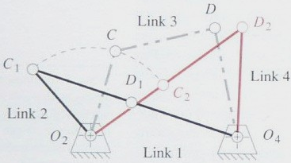
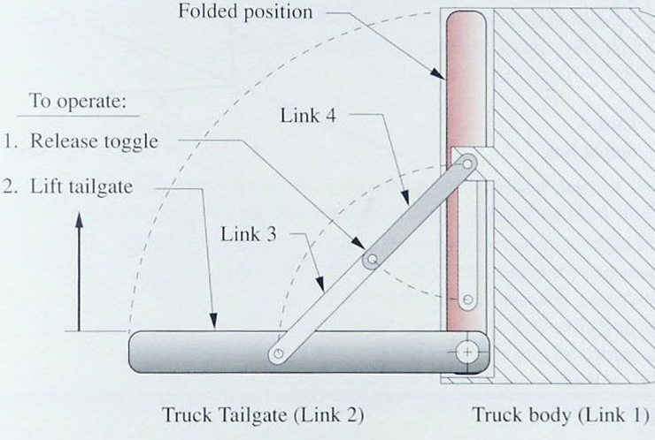
Limiting Conditions (Toggle)
Toggle: a point where the link cannot rotate anymore. Determined by the colinearity of two moving links.
Need to check when making a design (either by making a cardboard model or working model).

Slide 5
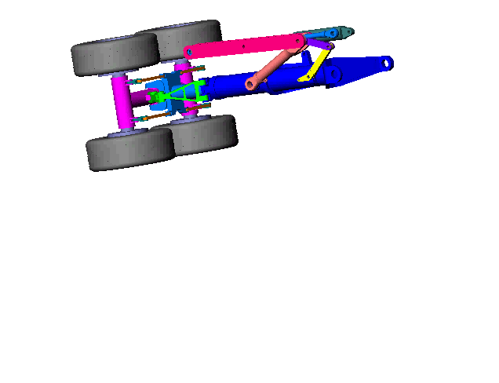
Limiting Conditions (Toggle)
Landing gear
http://workingmodel.design-simulation.com/DDM/examples/dynamic_designer_examples.php

Slide 6
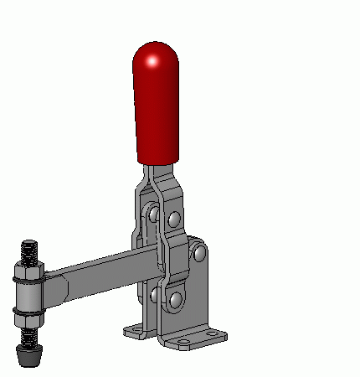
Toggle Clamp
http://commons.wikimedia.org/wiki/File:Toggle-clamp_manual_vertical_3D_animated.gif

Slide 7
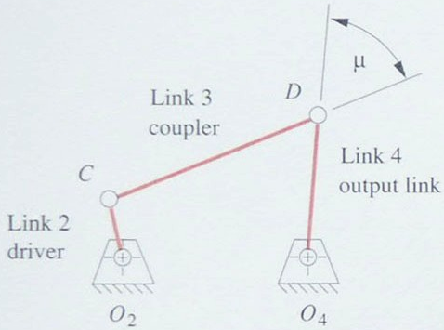
Limiting Conditions
Transmission angle (m): the absolute value of the acute angle of the pair of angles at the intersection of the two links.
Want the force in link 3 to rotate link 4
Optimum value of 90°
Try to keep the minimum value above 40°

Slide 8
Transmission Angle
Fcos(μ)
F
Fsin(μ)

Slide 9
Preliminaries: 4-bar linkage
Point A:
pure rotation
Point B:
pure rotation
A
B
3
4
2

Slide 10
Preliminaries: Center Point Construction
Given point A, known to move in a circle from A₁ to A₂. Determine the center of rotation.
A₁
A₂
Draw line connecting A₁ A₂
Bisect, draw perpendicular line
Choose center

Slide 11
Preliminaries: 4-bar Mechanism
R
L
L-R
2R
φ
As the crank moves thru 180°, the rocker makes an angle φ

Slide 12
3.4 Dimensional Synthesis
Dimensional Synthesis: the determination of the proportions (lengths) of the links necessary to accomplish the desired motions.
Types of synthesis: Rocker output (pure rotation) (function generation) and coupler output (complex motion) (motion generation)

Slide 13
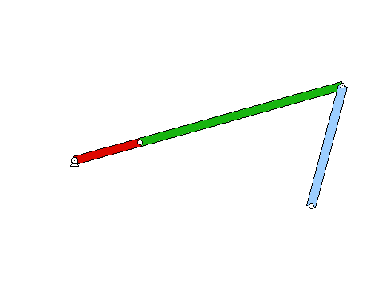
Rocker Output -Two Positions with Angular Displacement
Required: design a 4-bar Grashof crank-rocker to give 45° of rocker rotation with equal time forward and back.
45°

Slide 14
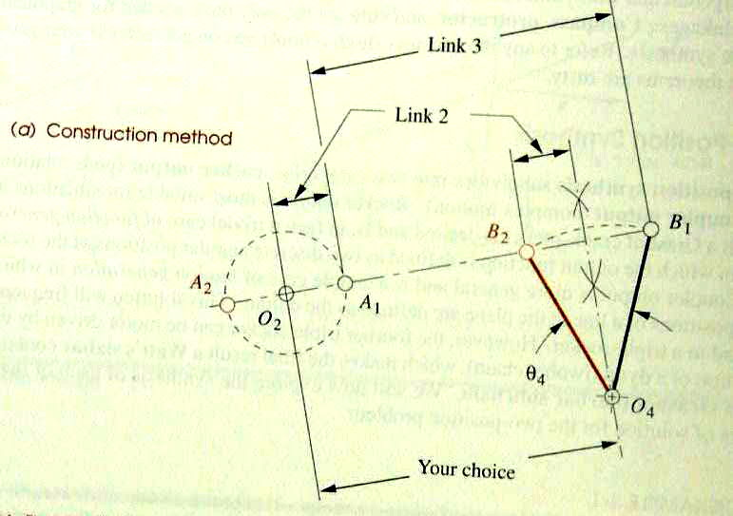
Rocker Output
Draw O₄B in two extreme positions
Draw chord B₁B₂ in either direction
Select point O₂
Bisect B₁B₂ and draw circle of that radius at O₂
Crank-O₂A, Coupler AB, Rocker O₄B, Ground O₂O₄
45°

Slide 15
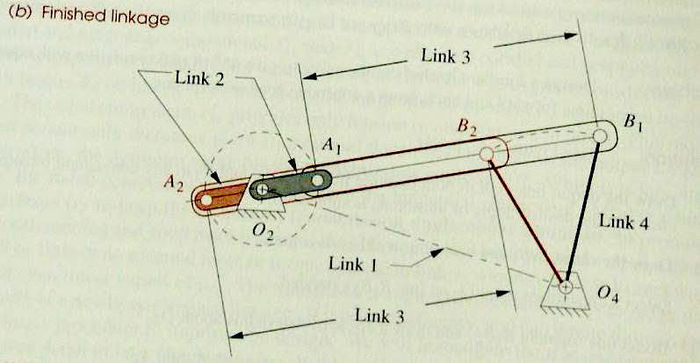
Rocker Output

Slide 16
Rocker Output

Slide 17
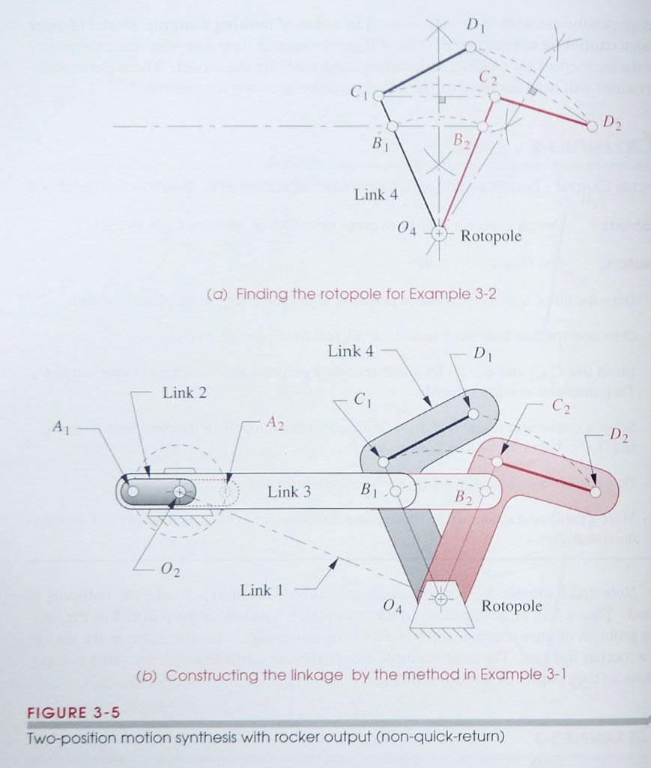
Rocker Output – Two positions with Complex Displacement.
Want to move from C₁D₁ to C₂D₂
Construct perpendicular bisectors C₁C₂ and D₁D₂
Intersection of the bisectors is the rotopole (the ground location)
The output link is shown in its two positions

Slide 18
Rocker Output – Two positions with Complex Displacement.
You can add a dyad by picking point B on the output link

Slide 19
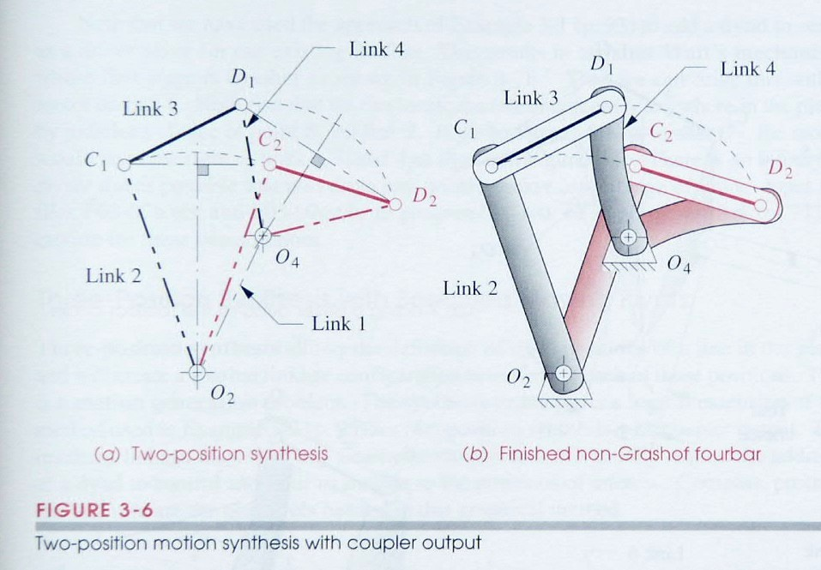
Coupler Output – Two Positions with Complex Displacement.
Want to move from C₁D₁ to C₂D₂
Construct ⊥ bisectors of C₁C₂ and D₁D₂.
Any point of bisector of C₁C₂ can be O₂ and any point on bisector of D₁D₂ can be O₄
Links are O₂C₁, C₁D₁, D₁O₄, and ground O₂O₄
Pick
Pick

Slide 20
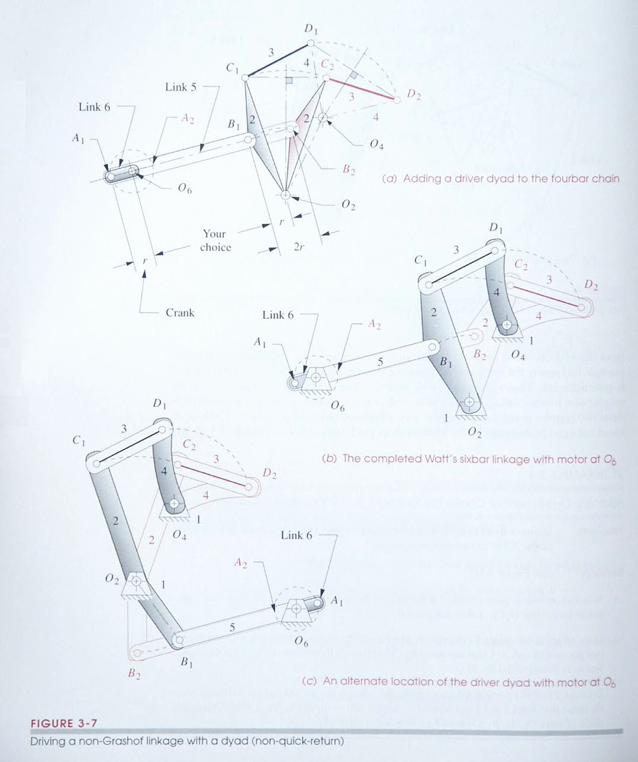
Driving a non-Grashof linkage with a dyad (2-bar chain)
The dyad does not have to be along the O₂C₁ line.
This allows a choice of many places for O₆
B₁
B₁

Slide 21
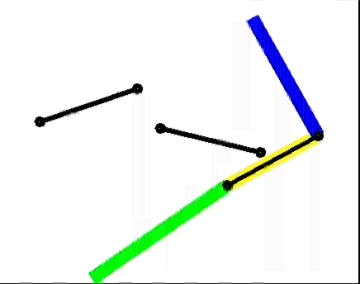
Three Position Motion Synthesis
Want the coupler to go from C₁D₁ to C₂D₂ to C₃D₃
D₁
C₁
D₂
C₂
D₃
C₃

Slide 22
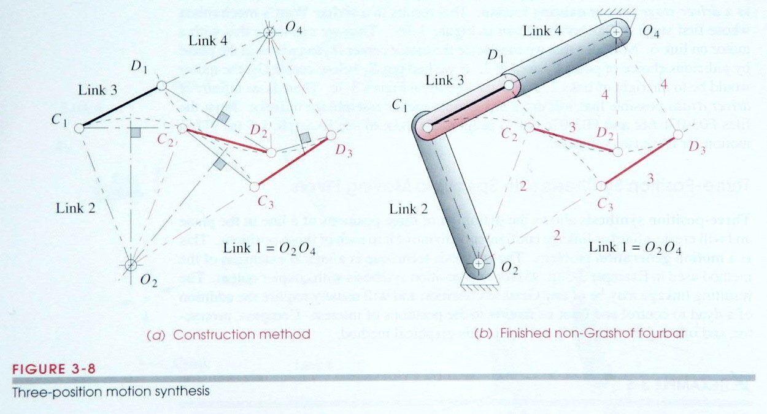
Three Position Motion Synthesis
Construct ⊥ bisector of C₁C₂ and C₂C₃. Where they intersect is O₂.
Construct ⊥ bisector of D₁D₂ and D₂D₃. Where they intersect is O₄.
Links are O₂C₁, C₁D₁, and D₁O₄, and ground is O₂O₄

Slide 23
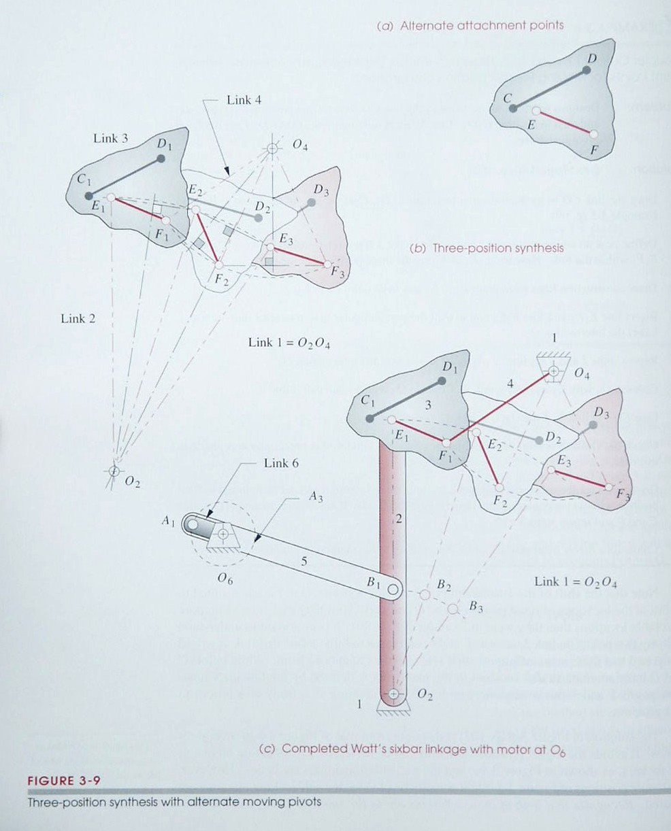
Three position synthesis with alternate attachment points
The given points do not have to be used as the attachment points
Draw points E and F relative to C and D at each position
Solve to move from E₁F₁ to E₂F₂ to E₃F₃
Can add a driver dyad
D₁
C₁
C₂
D₃
D₂
C₃

Slide 24
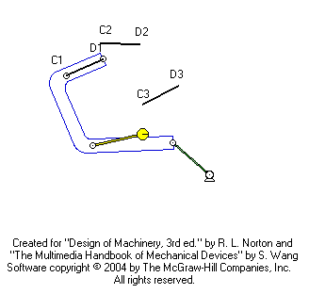
Three position motion with specified fixed pivots

Slide 25
Three position motion with specified fixed pivots
C₂
D₃
D₁
C₃
C₁
D₂
G
H
2
4
O₂
O₄
Given: O₂, O₄ & 3 positions for CD (C₁D₁,C₂D₂,C₃D₃)
Required: solve for unknown attachment points G and H

Slide 26
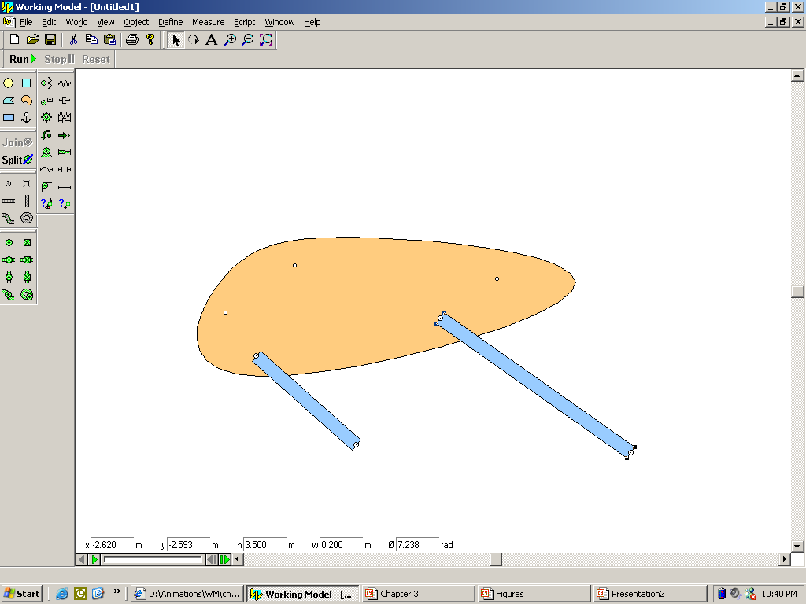
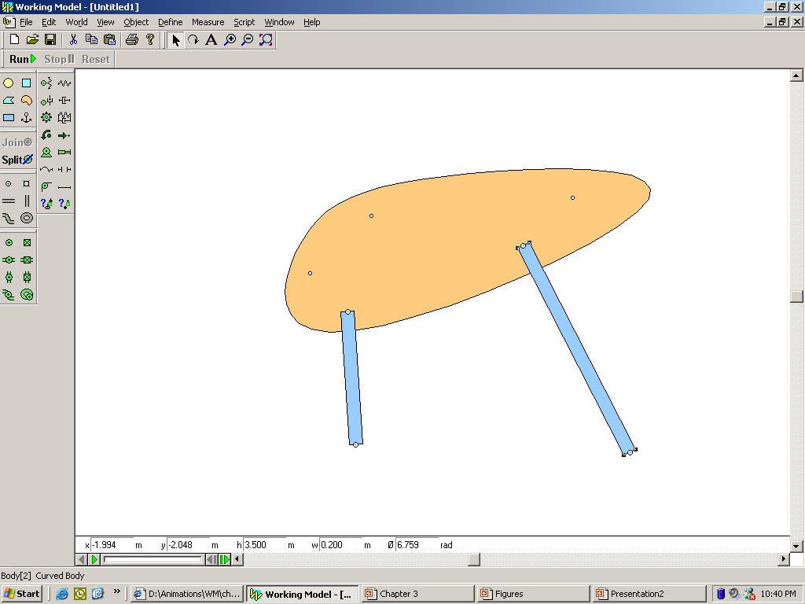
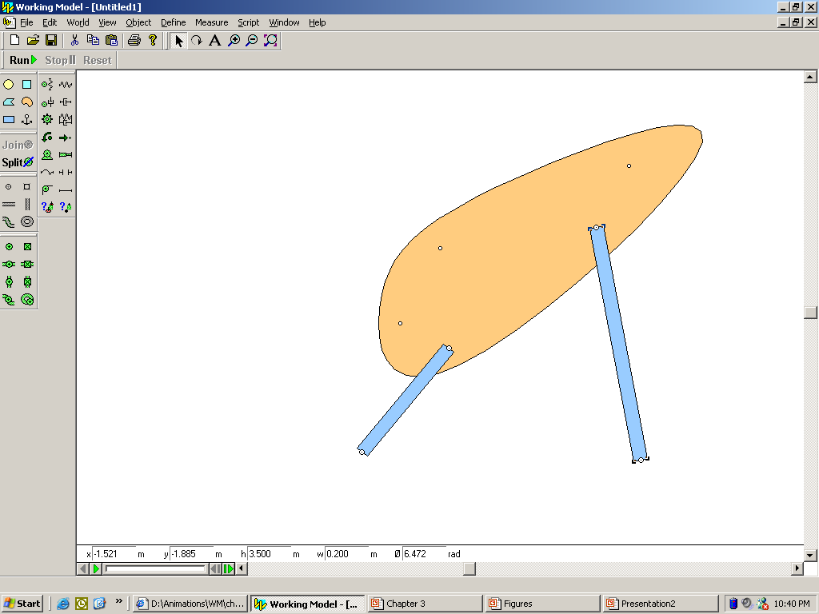
Remember: You do NOT know the attachments points!

Slide 27
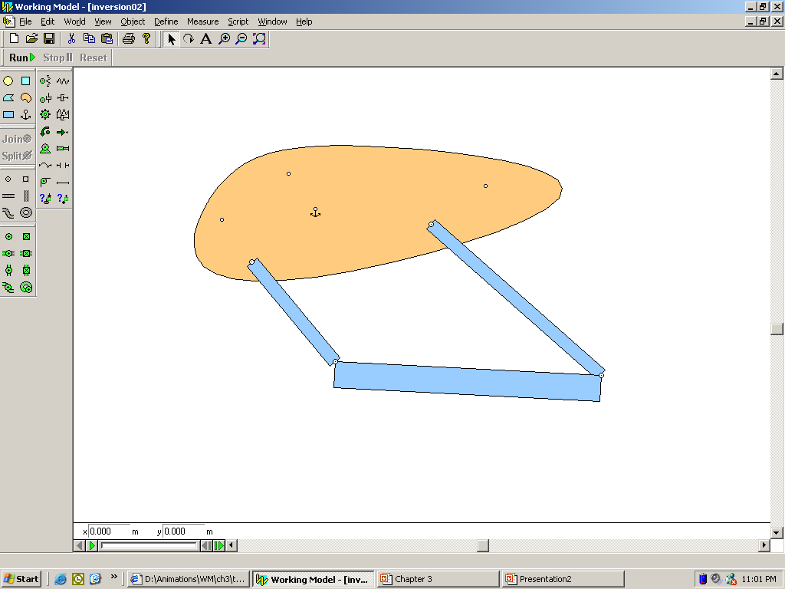
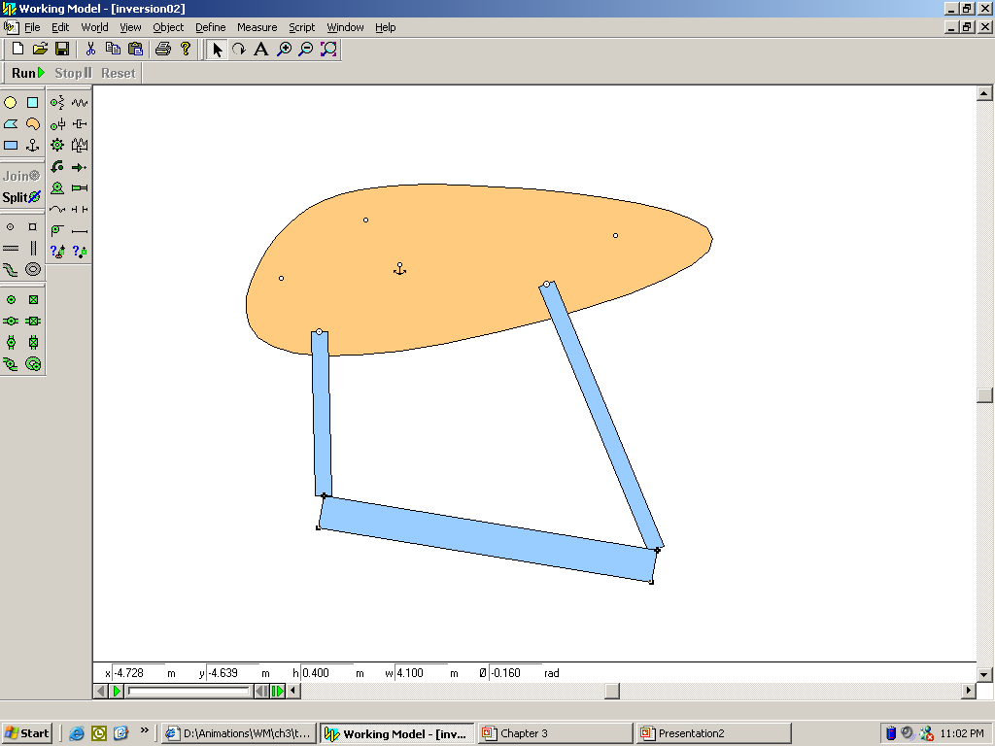
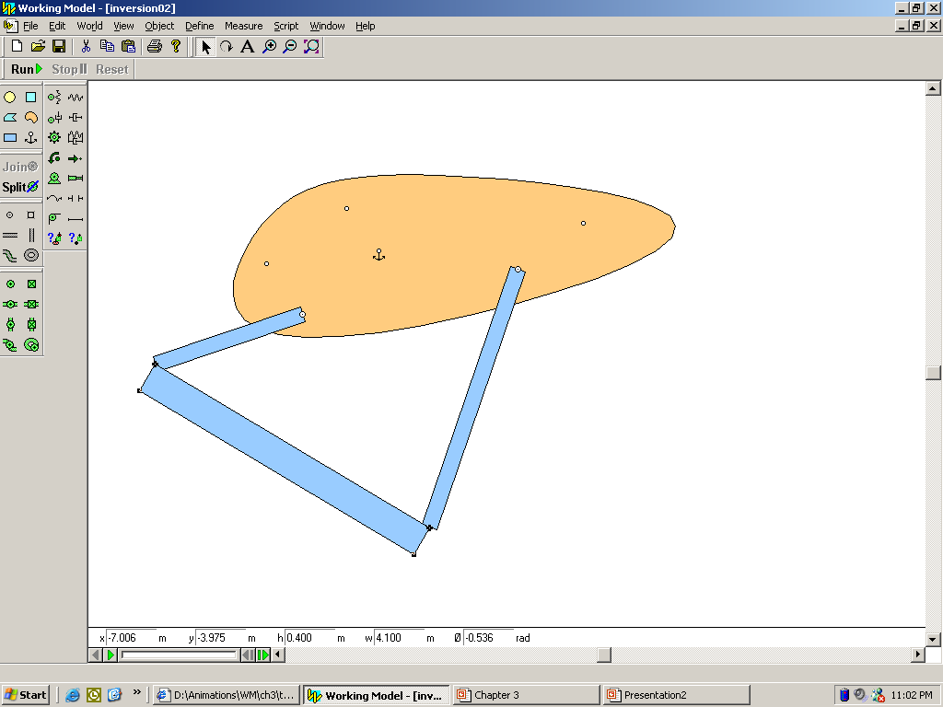
Solution by Inversion
Coupler
Now you have 3 ground positions relative to the first link. Use these to determine the attachment points
Solution is easy if you FIX the coupler in 1 position (say first), then MOVE the ground and draw it in 3 positions.

Slide 28
Coupler
Then re-invert to move attachment points to the ground

Slide 29
Inversion of Four-bar Linkage
Coupler

Slide 30
Let’s invert the mechanism on the coupler, i.e. move the ground while holding the coupler.
Coupler
This maintains the same relative position of links.
Now we have 2 ground positions relative to the coupler.

Slide 31
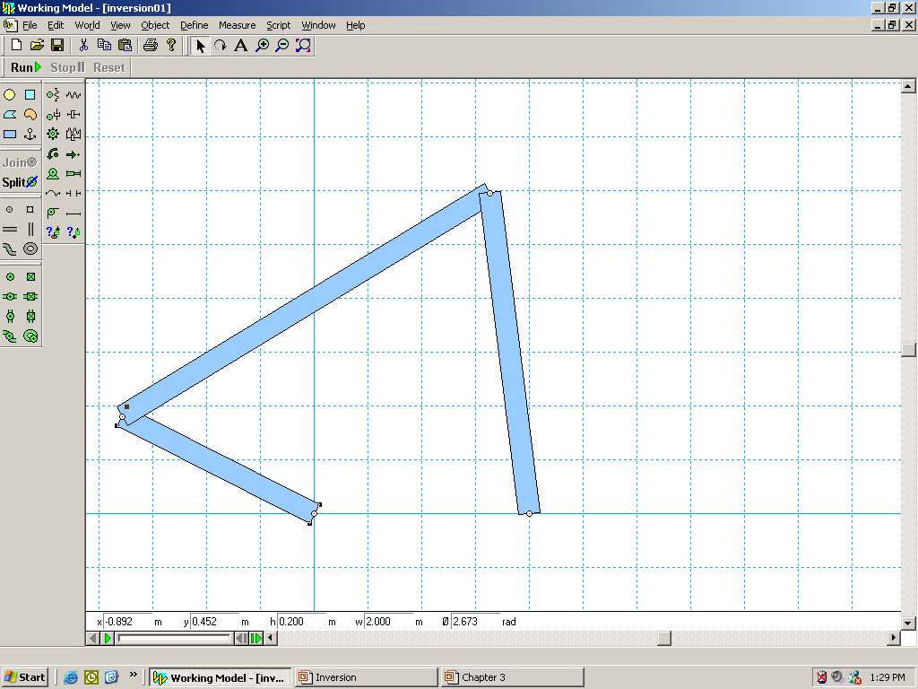
Do the same for the other position
Coupler
Another ground position relative to the coupler.

Slide 32
So now we have 3 positions of the ground relative to the first link (coupler)
Coupler
Coupler
Solve the problem assuming you want to move the ground knowing its 3 positions

Slide 33
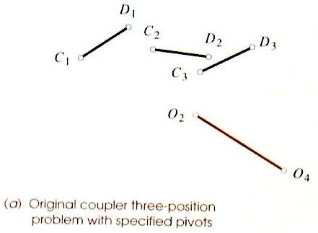
Three position motion with specified fixed pivots
Inversion Problem. Move the ground while holding the link fixed
Transfer the relative position of C₂D₂O₂O₄ to C₁D₁O₂’O₄’
O₄’
O₂’

Slide 34
Three position motion with specified fixed pivots
Transfer the relative position of C₃D₃O₂O₄ to C₁D₁O₂”O₄”
O₄’
O₂’
O₂”
O₄”

Slide 35
Three position motion with specified fixed pivots
Now we have the three ground positions relative to the first link
Label them E₁F₁, E₂F₂, E₃F₃.
F₂
E₂
O₄’
O₂’
E₃
O₂”
E₁
F₃
O₄”
F₁

Slide 36
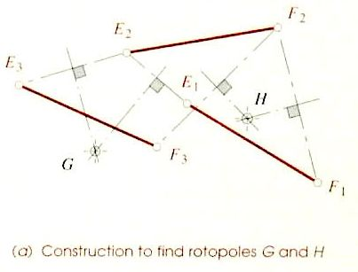
Three position motion with specified fixed pivots
Solve the problem assuming you want to move E₁F₁ to E₂F₂ to E₃F₃ finding ground positions G and H

Slide 37
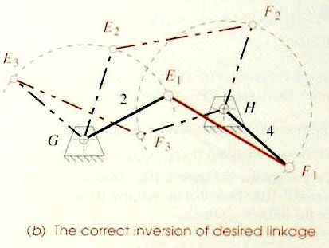
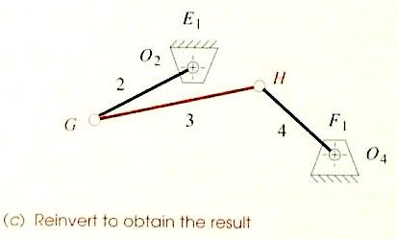
Three position motion with specified fixed pivots
The completed fourbar linkage which moves E₁F₁ to E₂F₂ to E₃F₃
G and H become the attachment points for the original linkage

Slide 38
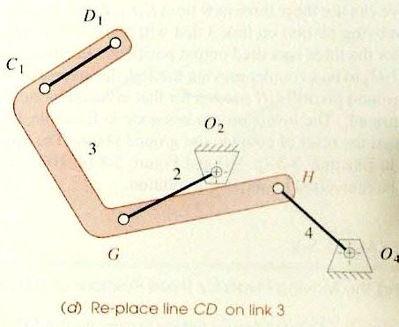
Three position motion with specified fixed pivots
The completed linkage

Slide 39
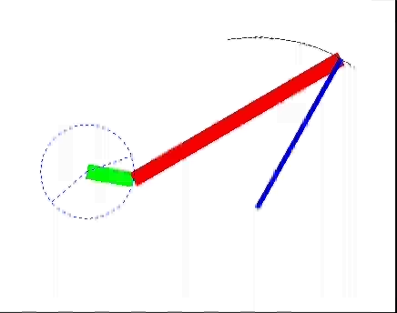
Quick Return Fourbar Mechanism
Quick return: goes quicker in one direction (α) than the other (β)
Time Ratio
T_{R}=α/β
α+β=360
β=360/(1+T_{R})
Max TR of 1:1.5
β
α

Slide 40
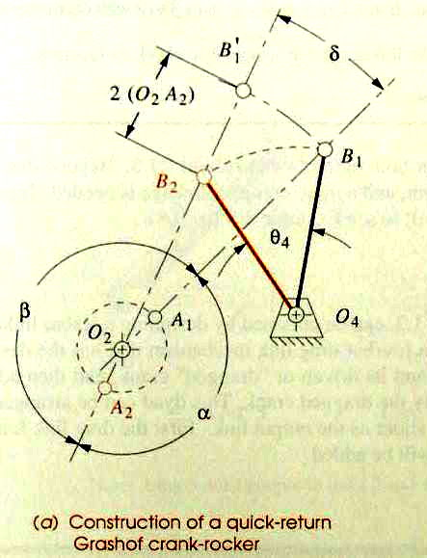
Quick Return Fourbar Mechanism
Problem: Design a 4-bar linkage to provide a TR of 1:1.25 with 45° output rocker motion
Draw output link in extreme positions (45° apart)
Calculate a, b and d, where
δ=|β−180|=|180−α|
a =160°, b =200°, d =20°
Draw a construction line thru B₁ at any convenient angle
Draw a construction line thru B₂ at an angle d from 1st line
δ

Slide 41
Quick Return Fourbar Mechanism
Intersection is O₂
Extend arc from B₁ to find
twice driver length
Return is α, going is β
δ
β
α

Slide 42
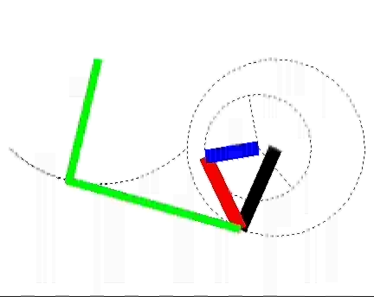
Sixbar Quick-Return
Larger time ratios of 1:2 can be obtained
Based on a Grashof fourbar crank-crank mechanism

Slide 43
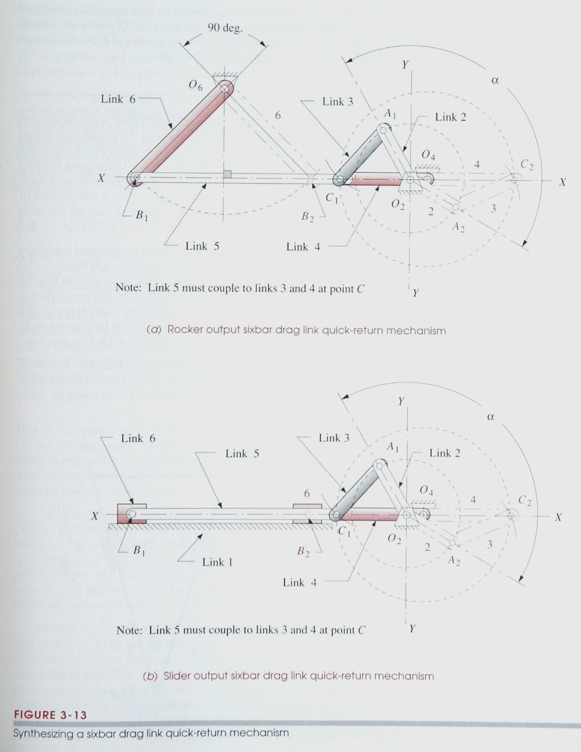
Sixbar Quick-Return
Draw line of centers X-X at convenient location
Generate line Y-Y at convenient location
Draw circle of radius O₂A at O₂
Draw α symmetric about quadrant 1
Find points A₁ and A₂
(α−90)/2
α
A₁
A₂

Slide 44
Sixbar Quick-Return
Pick radius for coupler CA such that it will cross X-X twice. Find C₁ and C₂
Bisect C₁C₂ to find O₄
Points B₁ and B₂ are the same distance apart as C₁ and C₂
Draw a line at an angle (180-γ)/2 from B₁ and B₂ to find O₆
γ
α
O₆
A₁
(180-γ)/2
O₄
C₂
C₁
B₁
B₂
A₂

Slide 45
Sixbar Quick-Return
Same base fourbar linkage (O₂ACO₄) can be used for a slider output

Slide 46
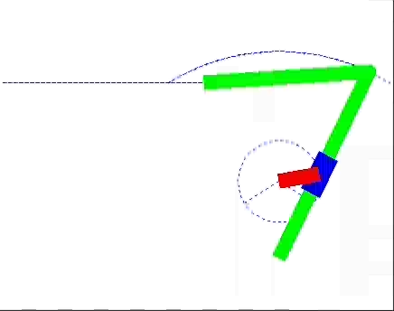
Crank Shaper Quick Return
Can be used for larger time ratios
Has disadvantage of a slider joint

Slide 47
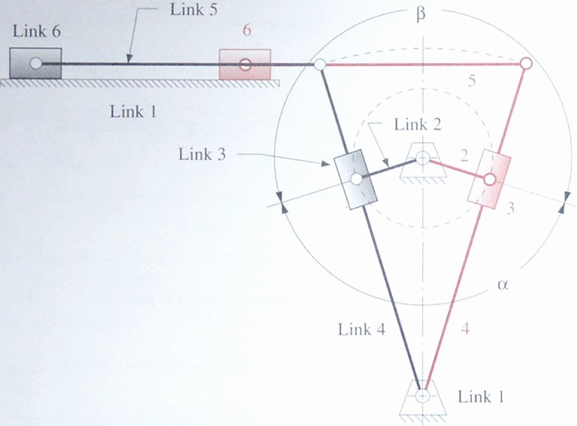
Crank Shaper Quick Return
Locate ground on vertical line. Draw a line at angle α/2. Pick length for link 2.
Draw line ⊥ to first at slider.
Where this line intersects vertical line is the ground
Length of output motion can be chosen by moving attachment point up or down
same length
α/2

Slide 48
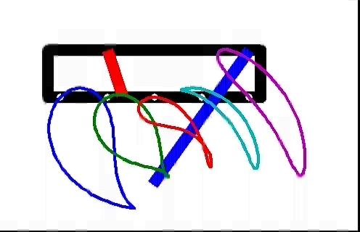
Coupler Curves
Path of a point on the coupler
Closed path, even for non-Grashof linkages
Capable of generating approximate straight lines and circular arcs.

Slide 49
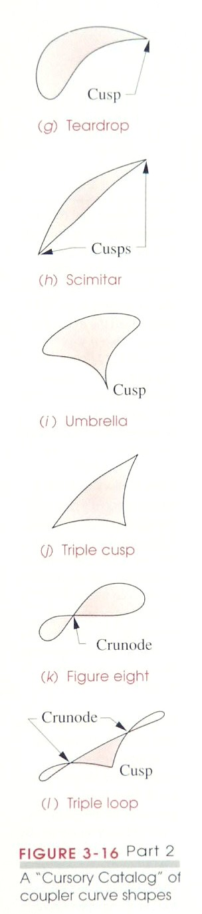
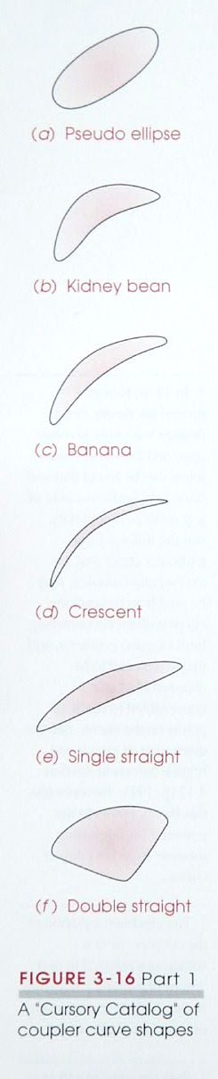
Coupler Curves
Categorized by shape
Cusp – instantaneous zero velocity
Crunode – multiple loop point

Slide 50
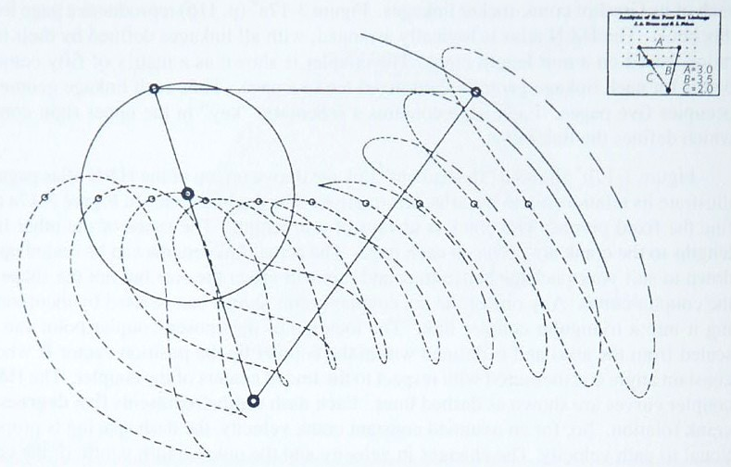
Coupler Curves
Hrones and Nelson has atlas of coupler curves
Each dash represents 5 degrees of rotation

Slide 51
Videos
Computational design of mechanical characters (Disney Research)
https://www.youtube.com/watch?v=DfznnKUwywQ
Furniture (Resource Furniture)
https://www.youtube.com/watch?v=dAa6bOWB8qY

Slide 52
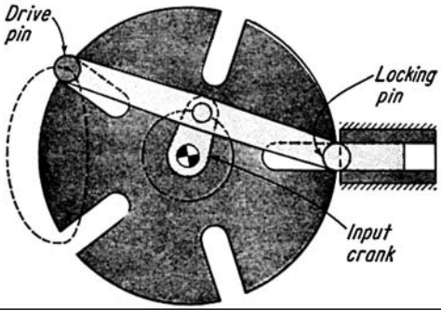
Slider-lock Geneva
Source: http://mechanicaldatahelp.files.wordpress.com/2011/02/image0271.png

Slide 53
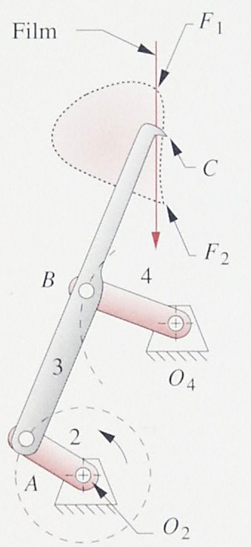
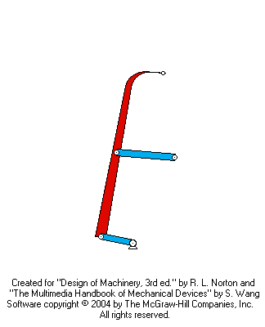
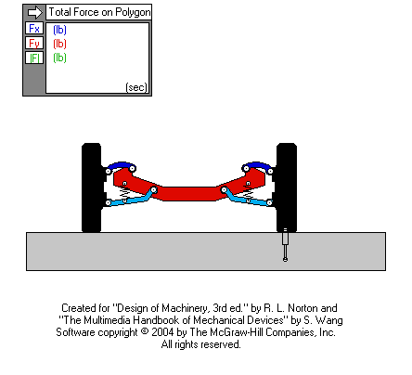
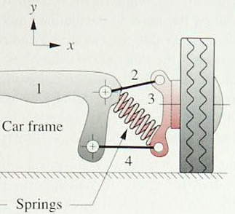
Coupler Curves (Examples)
Film advance mechanism in camera is used to pause between frames
Suspension is used to make the point of tire contact move vertically

Slide 54
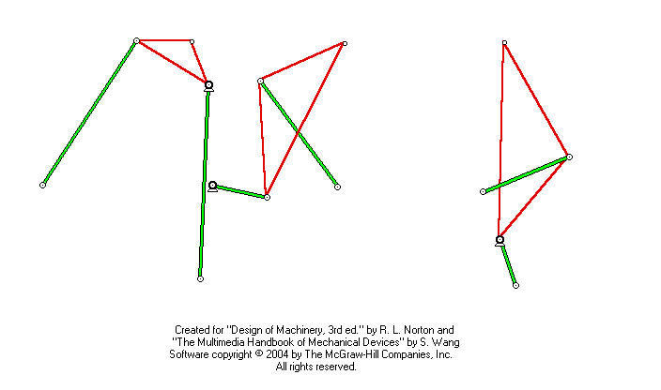
Cognates
Cognates: linkages of different geometries that generate the same coupler curve

Slide 55
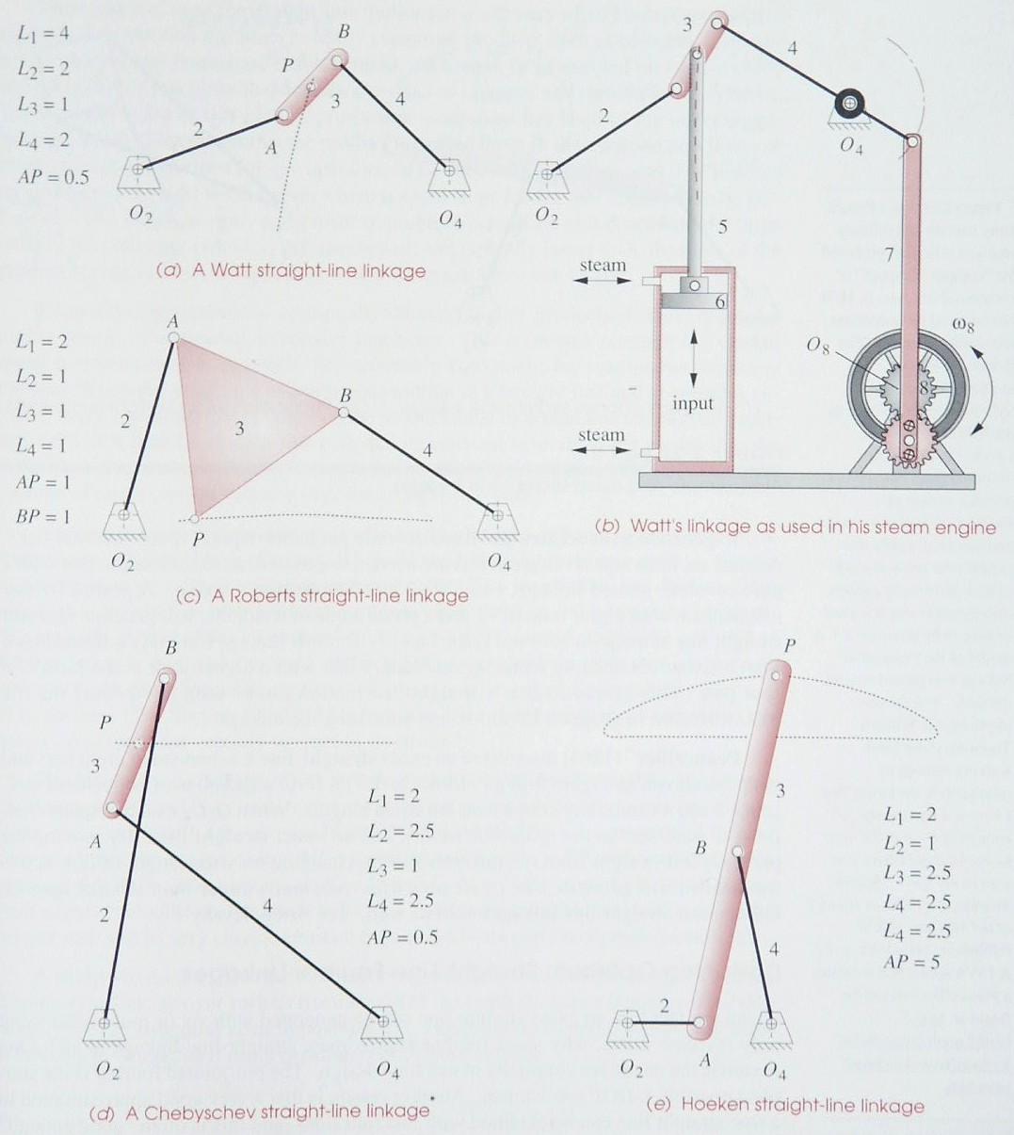
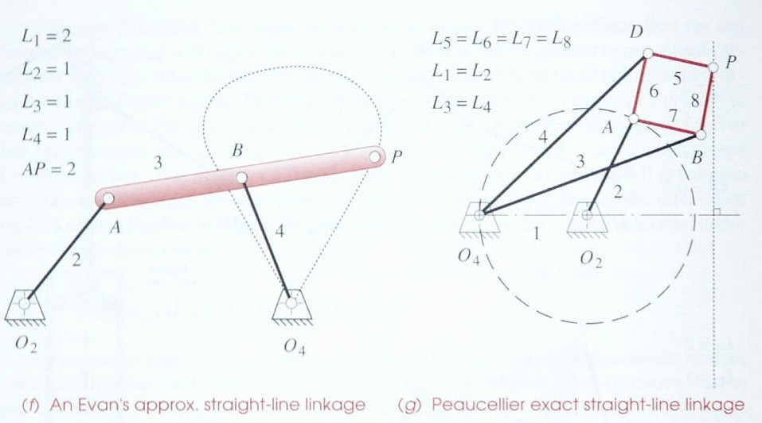
3.8 Straight-Line Mechanisms
A common application of coupler curves is in the generation of straight lines

Slide 56
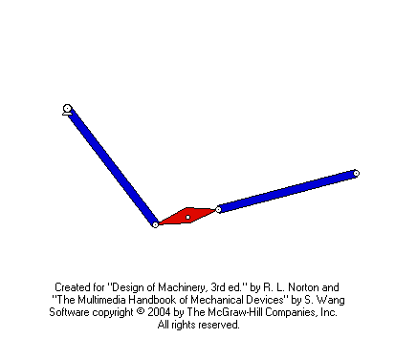
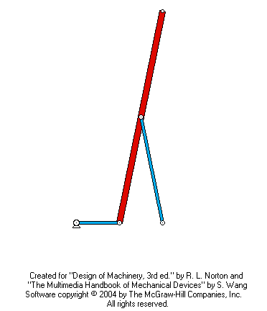
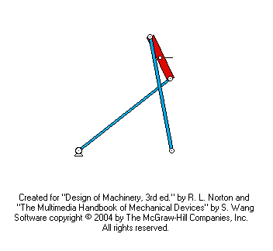
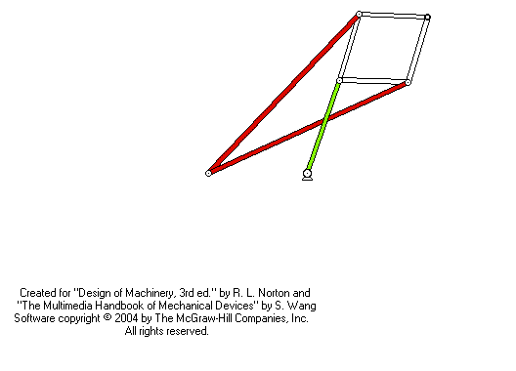
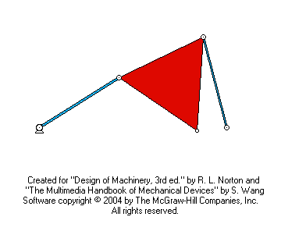
Straight-Line Mechanisms

Slide 57


Single-Dwell Linkages
Find a coupler curve with a circular arc
Add a dyad with one extreme position at the center of the arc

Slide 58


Double Dwell Sixbar Linkage
Find a coupler curve with two straight line segments
Use a slider pivoted at the intersection of the straight lines

Slide 59



More Examples
Scissors lift
MATLAB simulation of Theo Jansen mechanism
Theo Jansen mechanism

Slide 60
MENG 3071
Chapter 10.2
Analytical Position Synthesis
All figures taken from Design of Machinery, 3rd ed. Robert Norton 2003

Slide 61
5.1 Types of Kinematic Synthesis
Function Generation: correlation of an input function with an output function in a mechanism
Path Generation: control of a point in the plane such that it follows some prescribed path
Motion Generation: control of a line in the plane such that it assumes some sequential set of prescribed positions

Slide 62

Move coupler C₁D₁ to C₂D₂
D₁
D₂
C₁
B₂
B₁
C₂
A₁
A₂

Slide 63
Move coupler C₁D₁ to C₂D₂
D₁
D₂
C₁
Coupler rotates α₂
α₂
B₁
B₂
C₂
A₁
A₂

Slide 64
Move coupler C₁D₁ to C₂D₂
D₁
D₂
δ₂
Coupler rotates α₂
C₁
α₂
p₂₁
B₁
z
φ
B₂
C₂
A₁
φ+α₂
w
z
β
θ
A₂
w

Slide 65
5.2 Precision Points
The points, positions prescribed for successive locations of the output (coupler or rocker) link in the plane.
In graphical synthesis: move from C₁D₁ to C₂D₂
In analytical synthesis: move from P₁ to P₂ while rotating coupler α₂ (note: angles are measured anticlockwise)
P₁
α₂
P₂

Slide 66
Precision Points
Can define vectors Z and S from the attachment points E and F to P
Note: the coupler is not triangular, but 3 points are defined on the coupler
Points E and F are called A and B
P₁
α₂
Z₁
S₁
P₂
A
B

Slide 67

5.3 Two Position Synthesis
Want to move from P₁ to P₂ while coupler rotates α₂
Given P₂₁, δ₂ and α₂
Design each half separately
Write vector loop equation(s) to include given values, find free choices to make problem easy to solve.

Slide 68
Problem Statement
Y
Design a 4-bar linkage which will move P₁ to P₂ while coupler rotates thru a₂. P lies on coupler. Find the lengths and angles of all links.
X
R₂
R₁
Choose any coordinate system X-Y
Draw vector P₂₁ inclined at d₂
Define position vectors R₁ and R₂
Draw an arbitrary vector Z₁. Then form vector Z₂ with same magnitude but angle a₂ with Z₁.
Draw vectors W₁ and W₂ to meet at O₂.
Write vector loop equation.
d₂
P₂
P₁
P₂₁
Z₁
Z₂
a₂
W₁
W₂
O₂

Slide 69
Two Position Synthesis
Vector loop equation
W₂ + Z₂ - P₂₁ - Z₁ - W₁ = 0
Write complex vectors
Expand exponents
Combine terms

Slide 70
Two Position Synthesis
Variables
w, θ, β₂, z, φ, α₂, P₂₁, δ₂ = 8
Given
P₂₁, δ₂, α₂ =-3
Complex equations: 1
can solve for 2 unknowns =-2
Free Choices =3

Slide 71
Two Position Synthesis
Choose (θ, β₂, φ)
Gives 2 simultaneous eqns.

Slide 72
Two Position Synthesis
Choose (β₂, z, φ)
from which the magnitude and angle can be calculated
w=abs(Q), θ=angle(Q)
The other side can be calculated similarly

Slide 73
Two Position Synthesis
Once both sides have been solved, the coupler and ground can be calculated using
v=abs(V₁)
g=abs(G₁)

Slide 74

Two Position Synthesis Comparison
For graphical, position of attachment points A and B relative to P in x and y directions (4) and points of O₂ and O₄ along the perpendicular bisectors (2) gives 6 total
For analytical, 3 free choices each side * 2 sides=6 total

Slide 75


3 Position Synthesis: move C₁D₁ to C₂D₂ to C₃D₃
D₂
D₃
C₂
C₁
D₁
B₂
B₃
A₂
A₁
B₁
C₃
A₃

Slide 76
3 Position Synthesis: move C₁D₁ to C₂D₂ to C₃D₃
Coupler rotates α₂ from 1 to 2.
Coupler rotates α₃ from position 1 to 3
D₂
δ₂
D₃
C₂
p₂₁
C₁
D₁
z
z
φ
φ+α₂
C₃
w
w
β₂
θ

Slide 77
3 Position Synthesis: move C₁D₁ to C₂D₂ to C₃D₃
Coupler rotates α₂ from 1 to 2.
Coupler rotates α₃ from position 1 to 3
D₂
δ₃
D₃
C₂
C₁
D₁
z
φ
p₃₁
C₃
w
β₃
θ
φ+α₃
z
w

Slide 78

5.6 Three Position Synthesis
Want to move from P₁ to P₂ while coupler rotates α₂ and from P₁ to P₃ while coupler rotates α₃
Given P₂₁, δ₂, P₃₁, δ₃, α₂ and α₃.

Slide 79
Three Position Synthesis
Vector loop equations
W₂ + Z₂ - P₂₁ - Z₁ - W₁ = 0
W₃ + Z₃ - P₃₁ - Z₁ - W₁ = 0
Write complex vectors
Combine terms
.

Slide 80
Three Position Synthesis
Variables
w,θ,β₂,β₃,z,φ,α₂,α₃,P₂₁, P₃₁, δ₂ ,δ₃ = 12
Given
P₂₁,P₃₁,δ₂,δ₃,α₂,α₃ =-6
Complex equations *2
2*2 =-4
Free Choices =2

Slide 81
Three Position Synthesis
Choose (β₂, β₃ )
Two linear equations
Gives solution
w=abs(W), θ=angle(W)
z=abs(Z), φ=angle(Z)
.

Slide 82
Solution
Eliminate W to get:
Then solve for W:
(USE MATLAB)

Slide 83
REPEAT FOR RIGHT-HAND SIDE OF LINKAGE
Choose (γ₂, γ₃ )
Two linear equations
(USE MATLAB)

Slide 84

Three Position Synthesis Comparison
For graphical, position of attachment points A and B relative to P in x and y directions (4)
For analytical, 2 free choices each side * 2 sides=4 total

Slide 85
Example
Design a 4-bar linkage to move A₁P₁ to A₂P₂ to A₃P₃

Slide 86


Slide 87

3 Position Synthesis with Specified Fixed Pivots .
Want to move from P₁ to P₂ while coupler rotates α₂ and from P₁ to P₃ while coupler rotates α₃ and attach to ground at O₂ and O₄
Given R₁,R₂,R₃,ζ₁,ζ₂, ζ₃, α₂ and α₃
Note: if R₁ and R₂ are satisfied, P₂₁ is satisfied, and R₁ and R₃ give P₃₁
φ

Slide 88
3 Position Synthesis with Specified Fixed Pivots .
Vector loop equations
W₁+Z₁=R₁
W₂+Z₂=R₂
W₃+Z₃=R₃
Use relationships
to get
φ

Slide 89
3 Position Synthesis with Specified Fixed Pivots .
Variables
w,θ,β₂,β₃,z,φ,α₂,α₃ ,R₁, R₂, R₃,ζ₁,ζ₂,ζ₃ = 14
Given
R₁, R₂, R₃,ζ₁,ζ₂,ζ₃,α₂,α₃ =-8
Complex equations *2
3eqn*2 =-6
Free Choices (Sub) =0
φ
This makes the problem hard

Slide 90
3 Position Synthesis with Specified Fixed Pivots .
From 1st equation:
Use this to eliminate Z₁
Divide 2 eq’ns to eliminate W₁
Cross Multiply

Slide 91
3 Position Synthesis with Specified Fixed Pivots .
Arrange into form
where
using s and t:
gives
A
+
B
e
i
β
2
+
C
e
i
β
3
=
0

Slide 92
3 Position Synthesis with Specified Fixed Pivots .
(a)
Taking conjugate
Since s and t represent angles
Multiplying by st
From (a)
Substituting into (b) gives a quadratic function of only t
(b)

Slide 93
3 Position Synthesis with Specified Fixed Pivots .
where
Solving gives
Only one of the t will be valid. s can be solved using
Any 2 of the first eqns can be used to solve for W₁ and Z₁

Slide 94
3 Position Synthesis with Specified Fixed Pivots .
Summary of calculations (for MATLAB implementation)
w=abs(W₁), θ=angle(W₁), z=abs(Z₁), φ=angle(Z₁)

Slide 95

Example Problem
Move from C₁D₁ to C₂D₂ to C₃D₃ using attachment points O₂ and O₃
Call point C, P
φ₃
φ₂
φ₁

