Slide 1

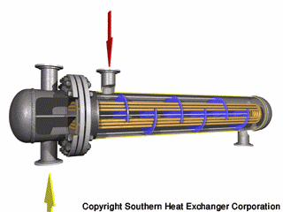
Addis Ababa University
Addis Ababa Institute of Technology
School of Mechanical & Industrial Engineering
Design of Shell and Tube Heat Exchanger
(Kern’s Method)
Prepared by: Dawit M. (M.Sc.)
Office: 314 - C
E-mail: dwtmus@gmail.com

Slide 2
Outline
  Introduction
  Objectives
  Kern’s Method
  Design Procedures – Kern’s Method
  Process (Thermal) Design Procedure
  Example - Design Problem
AAiT
School of Mechanical and Industrial Engineering - SMiE

Slide 3
Introduction
Thermal design of a shell and tube heat exchanger typically includes the determination of:
  heat transfer area
  number of tubes
  tube length and diameter
  tube layout
  number of shell and tube passes
  type of heat exchanger (fixed tube sheet, removable tube bundle etc),
  tube pitch,
  number of baffles, its type and size,
  shell and tube side pressure drop etc.
AAiT
School of Mechanical and Industrial Engineering - SMiE

Slide 4
Objectives
This lecture on designing shell-and-tube HEs serves as an introduction and covers:
Introduction to “Kern’s method” definition along with its advantages and disadvantages
Developing an algorithm for the design of shell-and-tube exchangers
Finally, following up the procedure set out in the algorithm in an example
AAiT
School of Mechanical and Industrial Engineering - SMiE

Slide 5
Kern’s Method
Kern’s was based on experimental work on commercial exchanger
Advantages:
Giving reasonably satisfactory prediction of the heat-transfer coefficient for standard design
Simple to apply
Accurate enough for preliminary design calculations
Accurate enough for designs when uncertainty in other design parameter is such that the use of more elaborate method is not justified
Disadvantages:
The prediction of pressure drop is less satisfactory, as pressure drop is more affected by leakage and bypassing than heat transfer
The method does not take account of the bypass and leakage streams
AAiT
School of Mechanical and Industrial Engineering - SMiE

Slide 6
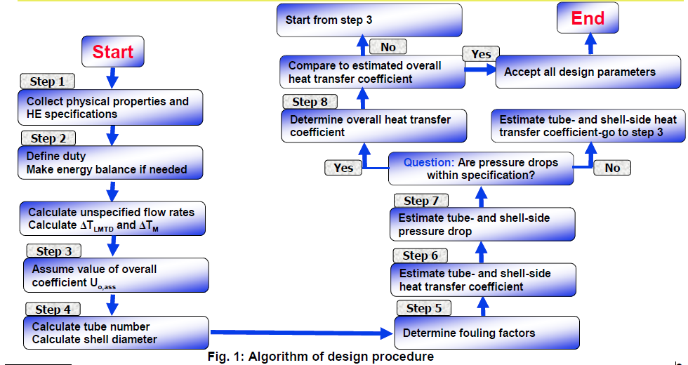
Design Procedures – Kern’s Method
AAiT
School of Mechanical and Industrial Engineering - SMiE

Slide 7
Process (Thermal) Design Procedure
Shell and tube heat exchanger is designed by trial and error calculations. The main steps of design following the Kern method are summarized as follows:
Step 1: Obtain the required thermo-physical properties of hot and cold fluids at the caloric temperature or arithmetic mean temperature. Calculate these properties at the caloric temperature if the variation of viscosity with temperature is large.
Step 2: Perform energy balance and find out the heat duty (Q) of the exchanger.
Step 3: Assume a reasonable value of overall heat transfer coefficient (U_{o,assm}). The value of U_{o,assm} with respect to the process hot and cold fluids can be taken from books/other references.
Step 4: Decide tentative number of shell and tube passes (n_{p}). Determine the LMTD and the correction factor F_{T}.
Note: F_{T} normally should be greater than 0.75 for the steady operation of the exchangers. Otherwise it is required to increase the number of passes to obtain higher F_{T} values.
AAiT
School of Mechanical and Industrial Engineering - SMiE

Slide 8




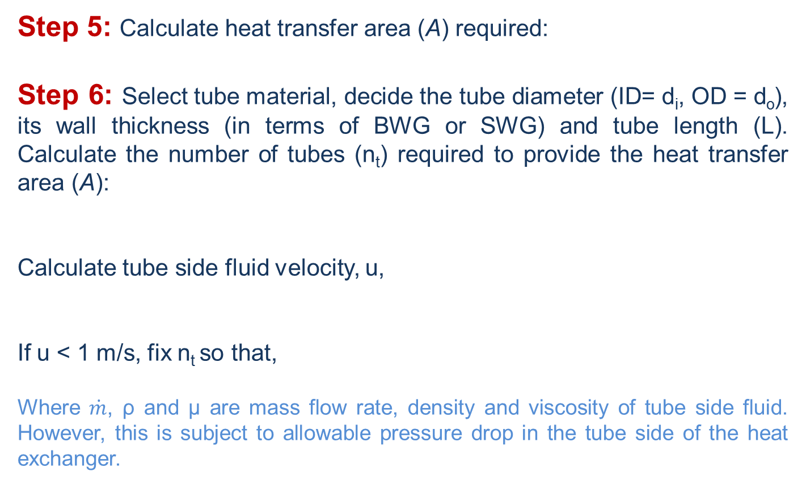
Cont’d …
Step 5: Calculate heat transfer area (A) required:
Step 6: Select tube material, decide the tube diameter (ID= d_{i}, OD = d_{o}), its wall thickness (in terms of BWG or SWG) and tube length (L). Calculate the number of tubes (n_{t}) required to provide the heat transfer area (A):
Calculate tube side fluid velocity, u,
If u < 1 m/s, fix n_{t} so that,
Where $\dot{m}$, ρ and µ are mass flow rate, density and viscosity of tube side fluid. However, this is subject to allowable pressure drop in the tube side of the heat exchanger.
AAiT
School of Mechanical and Industrial Engineering - SMiE

Slide 9
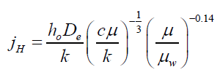

Cont’d …
Step 7: Decide type of shell and tube exchanger (fixed tube sheet, U-tube etc.). Select the tube pitch (P_{T}), determine inside shell diameter (D_{s}) that can accommodate the calculated number of tubes (n_{t}). Use the standard tube counts table for this purpose. Tube counts are available in standard text books (Check ‘Process Heat Transfer, Donald Q. Kern, 24th Edition’).
Step 8: Assign fluid to shell side or tube side (a general guideline for placing the fluids is summarized in text books). Select the type of baffle (segmental, doughnut etc.), its size (i.e. percentage cut, 25% baffles are widely used), spacing (B) and number. The baffle spacing is usually chosen to be within 0.2 D_{s} to D_{s}.
Step 9: Determine the tube side film heat transfer coefficient (h_{i}) using the suitable form of Sieder-Tate equation in laminar and turbulent flow regimes.
Estimate the shell-side film heat transfer coefficient (h_{o}) from:
You may consider:
AAiT
School of Mechanical and Industrial Engineering - SMiE

Slide 10
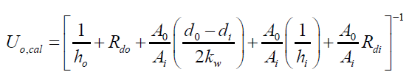

Cont’d …
Select the outside tube (shell side) dirt factor (R_{do}) and inside tube (tube side) dirt factor (R_{di})
Step 10: Calculate overall heat transfer coefficient (U_{o,cal}) based on the outside tube area (you may neglect the tube-wall resistance) including dirt factors:
If , go to step 11. Otherwise go to step 5,calculate heat transfer area (A) required using U_{o,cal} and repeat the calculations starting from step 5.
Note:
If the calculated shell side heat transfer coefficient (h_{o}) is too low, assume closer baffle spacing (B) close to 0.2 D_{s} and recalculate shell side heat transfer coefficient. However, this is subject to allowable pressure drop across the heat exchanger.
AAiT
School of Mechanical and Industrial Engineering - SMiE

Slide 11


Cont’d …
Step 11: Calculate % overdesign. Overdesign represents extra surface area provided beyond that required to compensate for fouling. Typical value of 10% or less is acceptable.
A = design area of heat transfer in the exchanger;
A_{req} = required heat transfer area.
Step 12: Calculate shell side and tube side pressure drops.
Consider the following for the shell side pressure drop:
pressure drop for flow across the tube bundle (frictional loss) (∆P_{s})
return loss (∆P_{rs} ) due to change of direction of fluid.
Total shell side pressure drop (∆P_{S} ):
Note:
If the tube-side pressure drop exceeds the allowable pressure drop for the process system, decrease the number of tube passes or increase number of tubes per pass. Go back to step 6 and repeat the calculations steps.
If the shell-side pressure drop exceeds the allowable pressure drop, go back to step 7 and repeat the calculations steps.
AAiT
School of Mechanical and Industrial Engineering - SMiE

Slide 12
Cont’d …
Step 13: The design will be completed upon fulfillment of pressure drop criteria and design output will be reported.
Note:
Further mechanical design can be carried out if the heat exchanger is going to be custom built.
AAiT
School of Mechanical and Industrial Engineering - SMiE

Slide 13
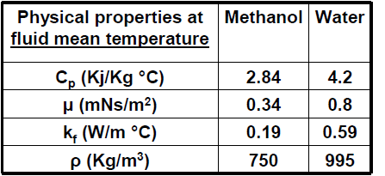
Example - Design Problem
Design an exchanger to sub-cool condensate from a methanol condenser from 95 °C to 40 °C. Flow-rate of methanol 100,000 kg/h. Brackish water (seawater) will be used as the coolant, with a temperature rise from 25° to 40 °C.
Step by Step Design
Step 1: Obtain the required thermo-physical properties of hot and cold fluids at the caloric temperature or arithmetic mean temperature. Calculate these properties at the caloric temperature if the variation of viscosity with temperature is large.
Note: Mean temp. is average film temp.
AAiT
School of Mechanical and Industrial Engineering - SMiE

Slide 14
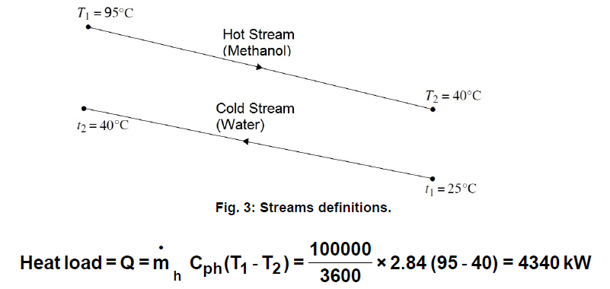
Cont’d …
Step 2: Perform energy balance and find out the heat duty (Q) of the exchanger.
To start step 2, the duty (heat transfer rate) of methanol (the hot stream or water, the cold stream) needed to be calculated.
AAiT
School of Mechanical and Industrial Engineering - SMiE

Slide 15

Cont’d …
The cold and the hot stream heat loads are equal. So, cooling water flow rate is calculated as follows:
Step 3: Assume a reasonable value of overall heat transfer coefficient (U_{o,assm}). The value of U_{o,assm} with respect to the process hot and cold fluids can be taken from books/other references.
Typical values of the overall heat-transfer coefficient for various types of heat exchanger are given in Table 1.
Fig. 5 can be used to estimate the overall coefficient for tubular exchangers (shell and tube).
The film coefficients given in Fig. 5 include an allowance for fouling.
The values given in Table 1 and Fig. 5 can be used for the preliminary sizing of equipment for process evaluation, and as trial values for starting a detailed thermal design.
AAiT
School of Mechanical and Industrial Engineering - SMiE

Slide 16
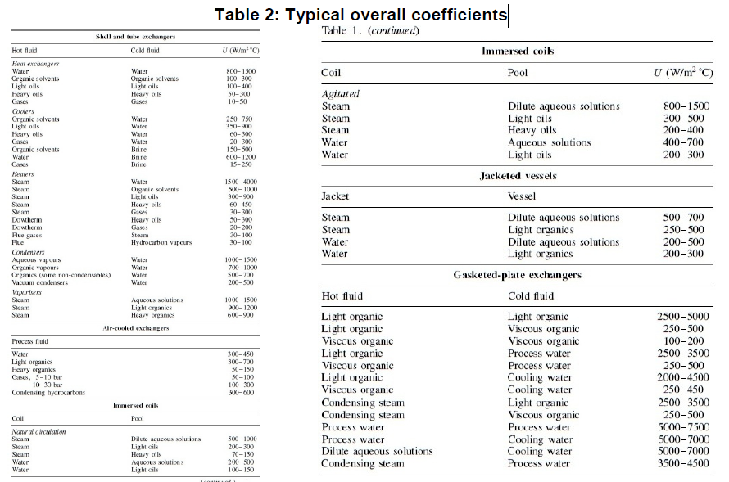
Cont’d …
AAiT
School of Mechanical and Industrial Engineering - SMiE

Slide 17
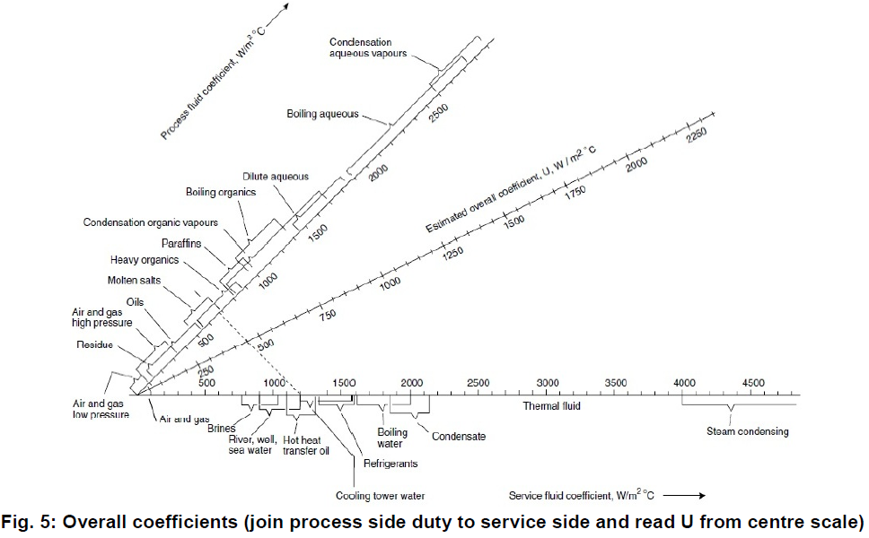

Cont’d …
AAiT
School of Mechanical and Industrial Engineering - SMiE

Slide 18
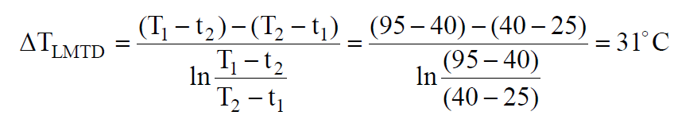

Cont’d …
Step 4: Decide tentative number of shell and tube passes (n_{p}). Determine the LMTD and the correction factor F_{T}.
Deciding on one shell 2 pass heat exchanger, the LMTD is calculated as:
The usual practice in the design of shell and tube exchangers is to estimate the “true temperature difference” from the logarithmic mean temperature by applying a correction factor to allow for the departure from true counter-current flow:
The correction factor (Ft) is a function of the shell and tube fluid temperatures, and the number of tube and shell passes.
AAiT
School of Mechanical and Industrial Engineering - SMiE

Slide 19
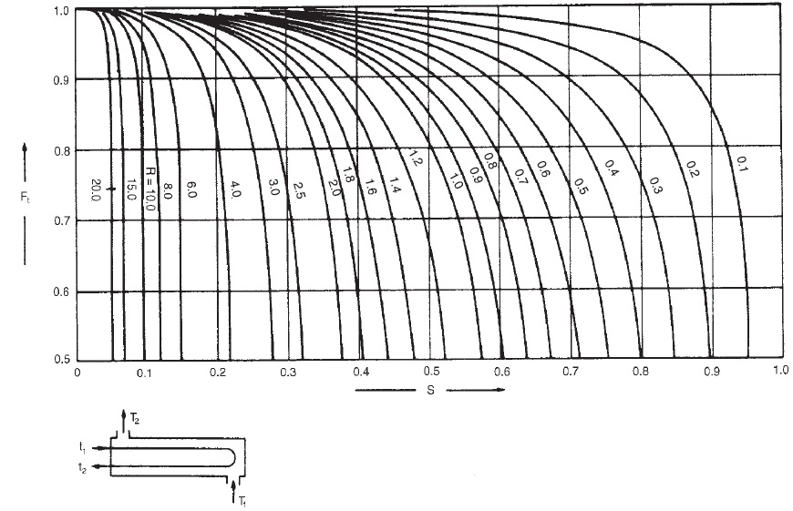
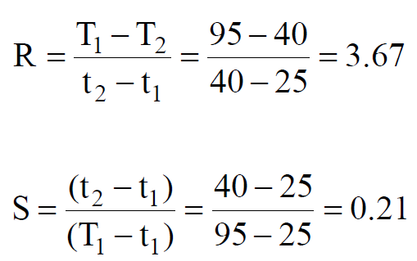

Cont’d …
For a 1 shell : 2 tube pass exchanger, the correction factor is plotted in [Kern, text book]
AAiT
School of Mechanical and Industrial Engineering - SMiE

Slide 20

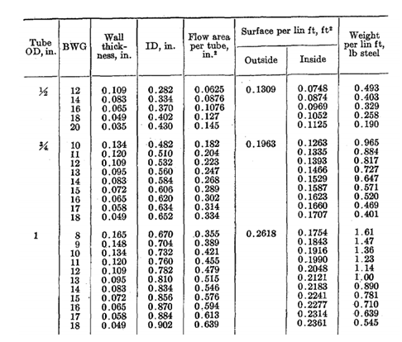
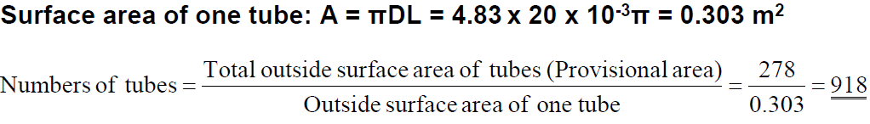
Cont’d …
Step 5: Calculate heat transfer area (A) required:
Step 6: Select tube material, decide the tube diameter (ID= d_{i}, OD = d_{o}), its wall thickness (in terms of BWG or SWG) and tube length (L). Calculate the number of tubes (n_{t}) required to provide the heat transfer area (A):
Choose 20 mm o.d. (outside diameter),
16 mm i.d. (inside diameter),
4.88-m-long tubes ( ¾ in X 16ft),
cupro-nickel.
AAiT
School of Mechanical and Industrial Engineering - SMiE

Slide 21
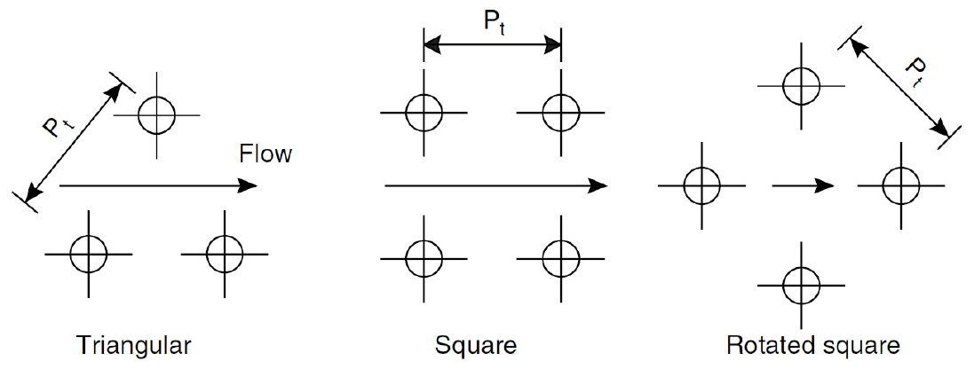
Cont’d …
Step 7: Decide type of shell and tube exchanger (fixed tube sheet, U-tube etc.). Select the tube pitch (P_{T}), determine inside shell diameter (D_{s}) that can accommodate the calculated number of tubes (n_{t}). Use the standard tube counts table for this purpose. Tube counts are available in standard text books.
Tube Arrangements:
The tubes in an exchanger are usually arranged in an equilateral triangular, square, or rotated square pattern
AAiT
School of Mechanical and Industrial Engineering - SMiE

Slide 22
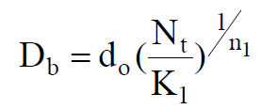
Cont’d …
The triangular and rotated square patterns give higher heat transfer rates, but at the expense of a higher pressure drop than the square pattern.
A square, or rotated square arrangement, is used for heavily fouling fluids, where it is necessary to mechanically clean the outside of the tubes.
The recommended tube pitch is 1.25 times the tube outside diameter; and this will normally be used unless process requirements dictate otherwise.
An estimate of the bundle diameter D_{b} can be obtained from equation below which is an empirical equation based on standard tube layouts. The constants for use in this equation, for triangular and square patterns, are given in Table 3.
where D_{b} = bundle diameter in mm, d_{o} = tube outside diameter in mm., N_{t} = number of tubes.
AAiT
School of Mechanical and Industrial Engineering - SMiE

Slide 23

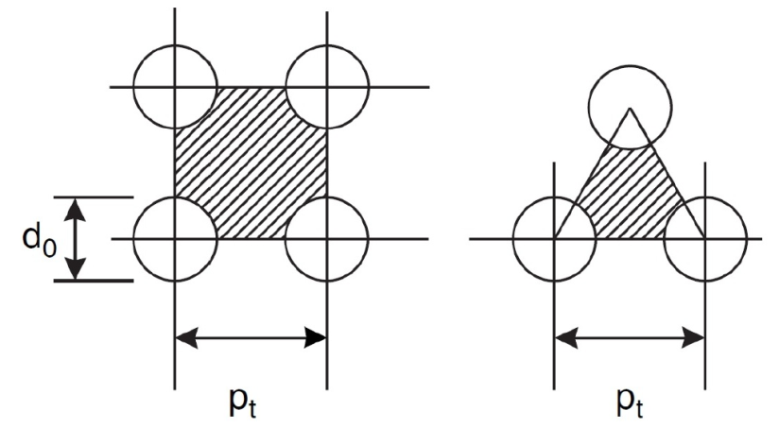
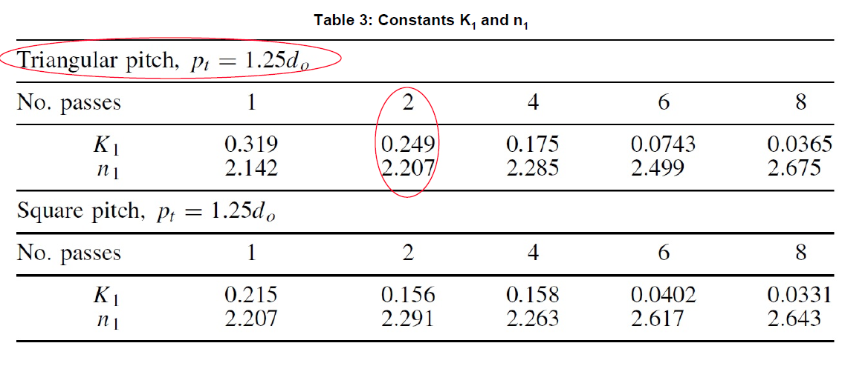
Cont’d …
Selecting, 1.25 triangular pitch
AAiT
School of Mechanical and Industrial Engineering - SMiE

Slide 24
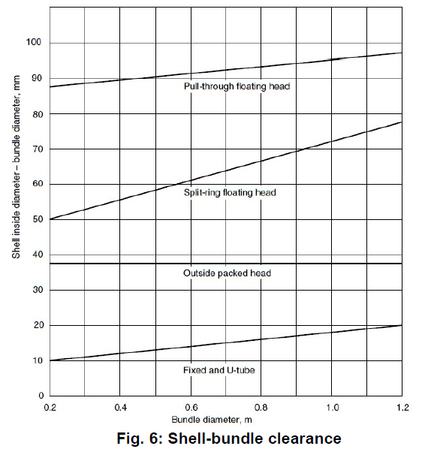
Cont’d …
To determine bundle clearance, use fixed and u - tube for Fig. 6.
Bundle diametrical clearance is 20 mm.
Shell diameter (D_{s}):
D_{s} = Bundle diameter + Clearance
= 826 + 20 = 846 mm.
Shell size could be read from standard
tube count tables
Nearest standard pipe size is 888.3mm
The standard number of tubes is 938.
AAiT
School of Mechanical and Industrial Engineering - SMiE

Slide 25
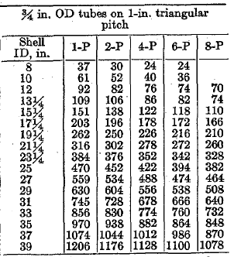
Cont’d …
Standard tube count (tube sheet data):
AAiT
School of Mechanical and Industrial Engineering - SMiE

Slide 26
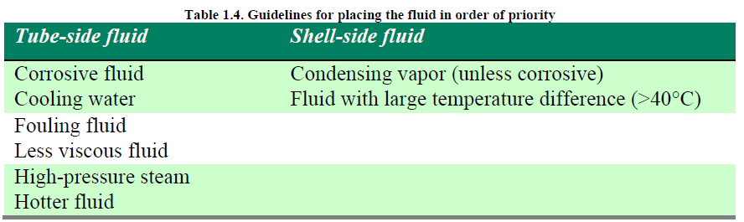
Cont’d …
Step 8: Assign fluid to shell side or tube side (a general guideline for placing the fluids is summarized in text books). Select the type of baffle (segmental, doughnut etc.), its size (i.e. percentage cut, 25% baffles are widely used), spacing (B) and number. The baffle spacing is usually chosen to be within 0.2 D_{s} to D_{s}.
Coolant (brackish water) is corrosive, so assign to tube-side.
At shell side, fluid (methanol) is a condensing vapor and relatively clean.
Baffle spacing: The baffle spacing used range from 0.2 to 1.0 X shell diameters.
A close baffle spacing will give higher heat transfer coefficients but at the expense of higher pressure drop.
AAiT
School of Mechanical and Industrial Engineering - SMiE

Slide 27

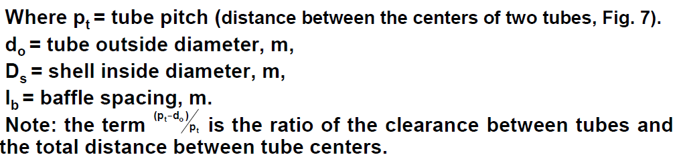

Cont’d …
Area for cross-flow: calculate the area for cross-flow As for the hypothetical row at the shell equator, given by:
Baffle spacing:
Choose baffle spacing = 0.2 D_{s}=0.2 x 894mm = 178 mm
Tube pitch:
P_{t} = 1.25 d_{o} = 1.25 x 20mm = 25 mm
Cross-flow area:
AAiT
School of Mechanical and Industrial Engineering - SMiE

Slide 28
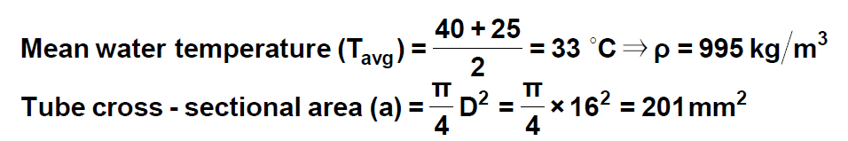

Cont’d …
Step 8: Determine the tube side film heat transfer coefficient (h_{i}) using the suitable form of Sieder-Tate equation in laminar and turbulent flow regimes. Estimate the shell-side film heat transfer coefficient (h_{o}).
Tube side heat transfer coefficient:
Since we have two tubes pass, we divide the total numbers of tubes by two to find the numbers of tubes per pass, that is:
Total flow area is equal to numbers of tubes per pass multiply by tube cross sectional area:
AAiT
School of Mechanical and Industrial Engineering - SMiE

Slide 29
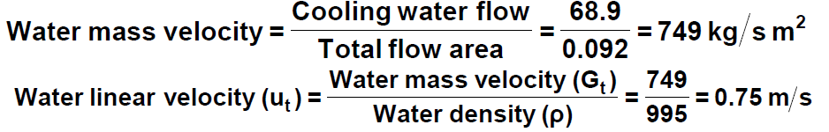

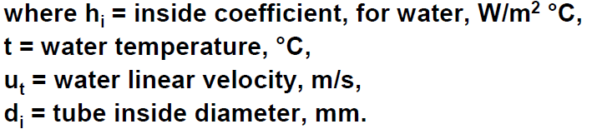
Cont’d …
Step 8: Determine the tube side film heat transfer coefficient (h_{i}) using the suitable form of Sieder-Tate equation in laminar and turbulent flow regimes. Estimate the shell-side film heat transfer coefficient (h_{o}).
Tube side heat transfer coefficient:
Coefficients for water: a more accurate estimate can be made by using equations developed specifically for water.
The physical properties are conveniently incorporated into the correlation. The equation below has been adapted from data given by Eagle and Ferguson (1930):
AAiT
School of Mechanical and Industrial Engineering - SMiE

Slide 30

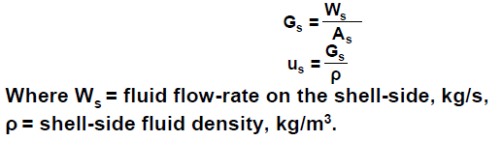

Cont’d …
The equation can also be calculated using equation below; this is done to illustrate use of this method.
Shell side heat transfer coefficient:
Shell-side mass velocity G_{s} and the linear velocity u_{t}:
AAiT
School of Mechanical and Industrial Engineering - SMiE

Slide 31


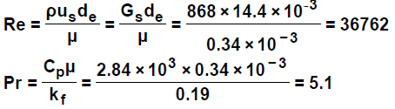


Cont’d …
Shell equivalent diameter (hydraulic diameter):
Mean shell side temperature
Choose 25% baffle cut, from Fig. 9
The tube wall temperature can be estimated using the following method: Mean temperature difference across all resistance: 68 -33 =35 °C
Across methanol film,
AAiT
School of Mechanical and Industrial Engineering - SMiE

Slide 32
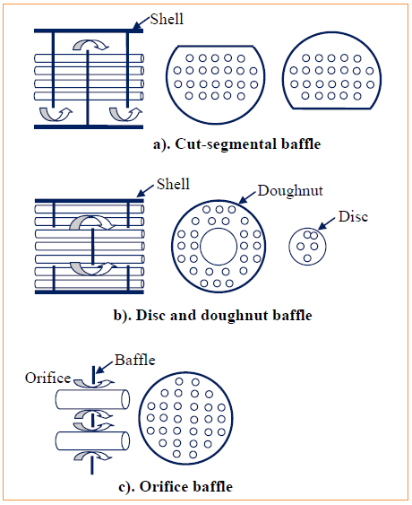
Cont’d …
AAiT
School of Mechanical and Industrial Engineering - SMiE

Slide 33
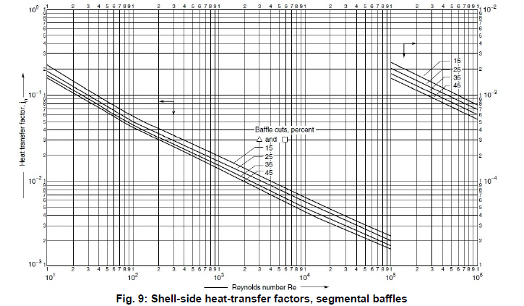
Cont’d …
AAiT
School of Mechanical and Industrial Engineering - SMiE

Slide 34
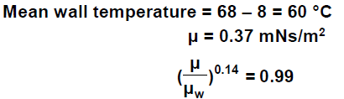
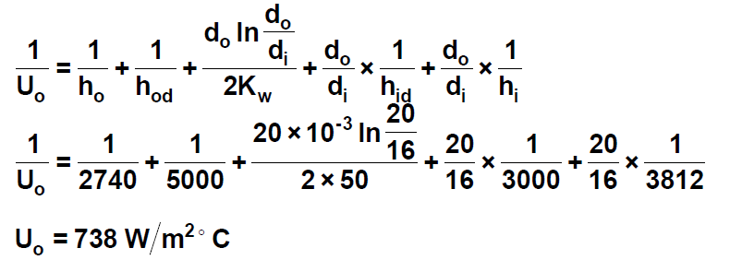
Cont’d …
Which shows that the correction for low-viscosity fluid is not significant.
Step 10: Calculate overall heat transfer coefficient (U_{o,cal}) based on the outside tube area (you may neglect the tube-wall resistance) including dirt factors:
Take the thermal conductivity of cupro-nickel alloys from tables, 50 W/m°C, the fouling coefficients from Table 3; methanol (light organic) 5000 Wm⁻²°C⁻¹, brackish water (sea water), take as highest value, 3000 Wm⁻²°C⁻¹
AAiT
School of Mechanical and Industrial Engineering - SMiE

Slide 35
Cont’d …
Fluid | Coefficient, W/m² ⁰C | Resistance, m² ⁰C/W
River Water | 3000 – 12000 | 0.003 – 0.001
Sea Water | 1000 – 3000 | 0.001 – 0.0003
Cooling Water (Towers) | 3000 – 6000 | 0.0003 – 0.00017
Towns Water (Soft) | 3000 – 5000 | 0.0003 – 0.0002
Towns Water (Hard) | 1000 – 2000 | 0.001 – 0.0005
Steam Condensate | 1500 – 5000 | 0.00067 - 0.0002
Steam (Oil Free) | 4000 – 10000 | 0.0025 – 0.0001
Steam (Oil Traces) | 2000 – 50000 | 0.0005 – 0.0002
Refrigerated Brine | 3000 - 5000 | 0.0003 – 0.0002
Air and Industrial Gases | 5000 - 10000 | 0.0002 – 0.0001
Flue Gases | 2000 - 5000 | 0.0005 – 0.0002
Organic Vapors | 5000 | 0.0002
Organic Liquids | 5000 | 0.0002
Light Hydrocarbons | 5000 | 0.0002
Heavy Hydrocarbons | 5000 | 0.0002
Boiling Organics | 2500 | 0.0004
Condensing Organics | 5000 | 0.0002
Heat Transfer Fluids | 5000 | 0.0002
Aqueous Salt Solutions | 3000 – 5000 | 0.0003 – 0.0002
AAiT
∞

Slide 36
Cont’d …
Checking:
= 23% < 30% (Ok!)
Step 10: Calculate % overdesign. Overdesign represents extra surface area provided beyond that required to compensate for fouling. Typical value of 10% or less is acceptable.
The area required (A_{req}) calculated previously as
The heat transfer area (A) from the design is:
A = n_{t} X 3.14 X d_{o} X L
= 938 tubes X 3.14 X 0.02m X 4.88m
= 287.46m²
Checking overdesign:
= 3.4% < 10% (Ok!)
AAiT
School of Mechanical and Industrial Engineering - SMiE

Slide 37
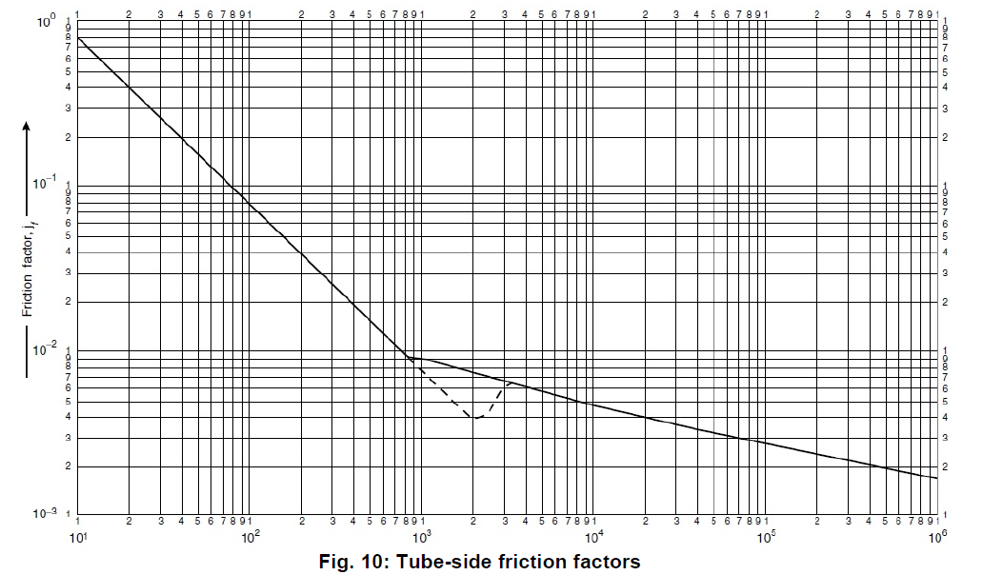
Cont’d …
Step 12: Calculate shell side and tube side pressure drops.
Tube Side Pressure Drop:
Re = 14925
From Fig. 10, j_{f} = 4.3 X 10⁻³
AAiT
School of Mechanical and Industrial Engineering - SMiE

Slide 38
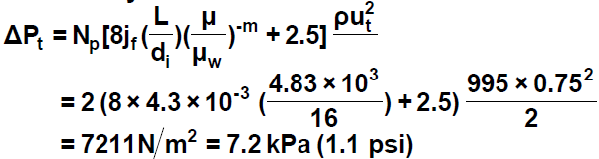

Cont’d …
Neglecting the viscosity correction term:
Low (Ok!), or could consider increasing the number of tube passes and repeat calculations from Step 6 on.
Shell Side Pressure Drop:
From Fig. 11, for Re = 36762
From Fig. 10, j_{f} = 4 X 10⁻²
Neglect viscosity correction
AAiT
School of Mechanical and Industrial Engineering - SMiE

Slide 39
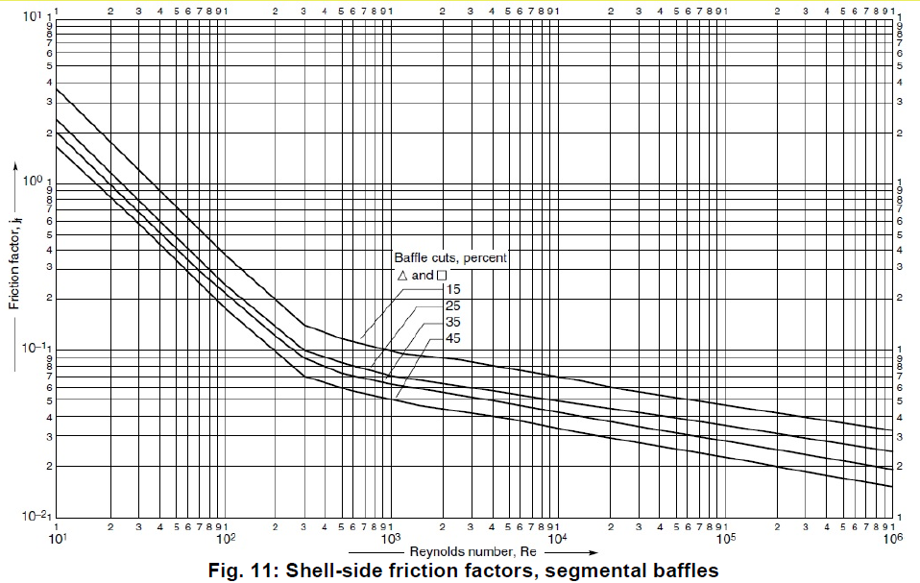
Cont’d …
AAiT
School of Mechanical and Industrial Engineering - SMiE

Slide 40


Cont’d …
This could be reduced by increasing the baffle pitch. Doubling the pitch halves the shell side velocity, which reduces the pressure drop by a factor of approximately (1/2)²
Acceptable!
This will reduce the shell-side heat-transfer coefficient by a factor of:
h_{o} = 2740 X (1/2)^{0.8} = 1573 W/m²°C
This gives an overall coefficient of 615 W/m2°C – still above assumed value of 600 W/m2°C, which makes it more acceptable.
New baffle spacing = 2 X 178mm = 356mm
AAiT
School of Mechanical and Industrial Engineering - SMiE

Slide 41
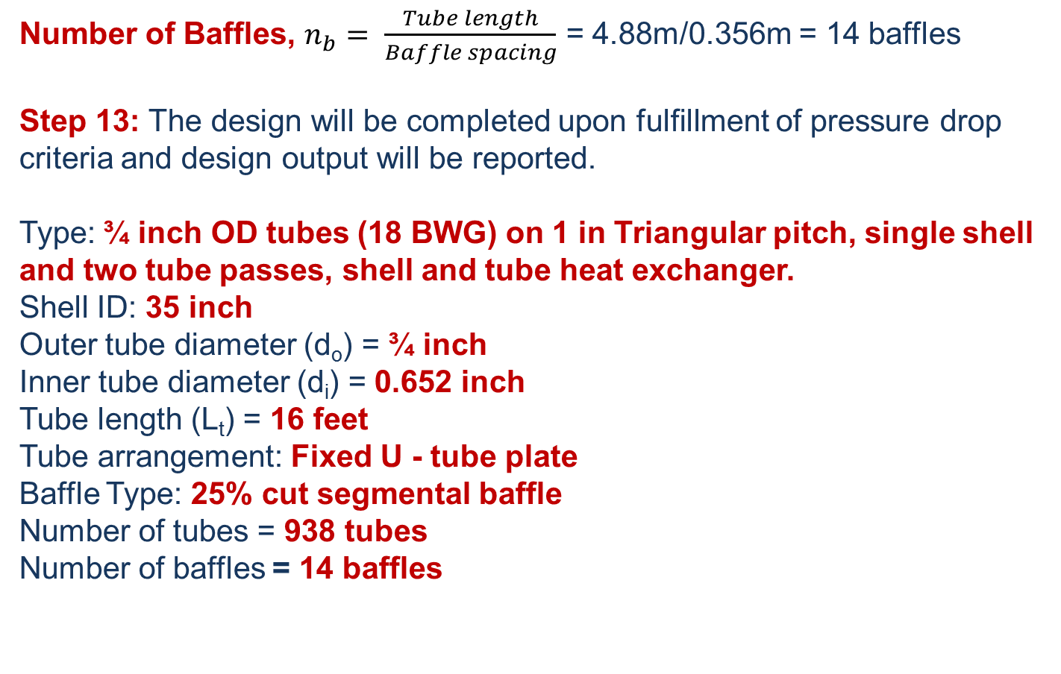
Cont’d …
Number of Baffles, $n_{b}= \frac{Tube length}{Baffle spacing}$ = 4.88m/0.356m = 14 baffles
Step 13: The design will be completed upon fulfillment of pressure drop criteria and design output will be reported.
Type: ¾ inch OD tubes (18 BWG) on 1 in Triangular pitch, single shell and two tube passes, shell and tube heat exchanger.
Shell ID: 35 inch
Outer tube diameter (d_{o}) = ¾ inch
Inner tube diameter (d_{i}) = 0.652 inch
Tube length (L_{t}) = 16 feet
Tube arrangement: Fixed U - tube plate
Baffle Type: 25% cut segmental baffle
Number of tubes = 938 tubes
Number of baffles = 14 baffles
AAiT
School of Mechanical and Industrial Engineering - SMiE

Slide 42
Thank You
Questions are Welcomed!

