Slide 1
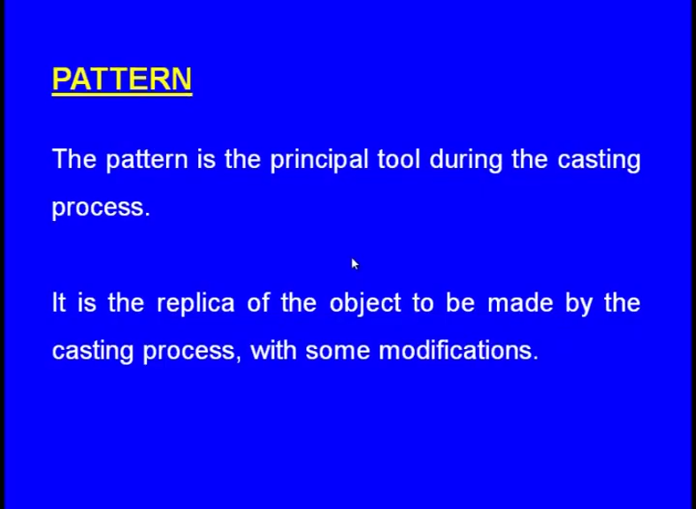
PATTERN AND PATTERN ALLOWANCES
This model will have a similar geometry to that of the casting which we want, using this model we create the cavity inside the mould this model is known as the pattern.
It is the replica of the component to be made by the casting process, but not always that the pattern is exactly similar or identical to the cast component which we are going to make sometimes there may be little modifications.

Slide 2
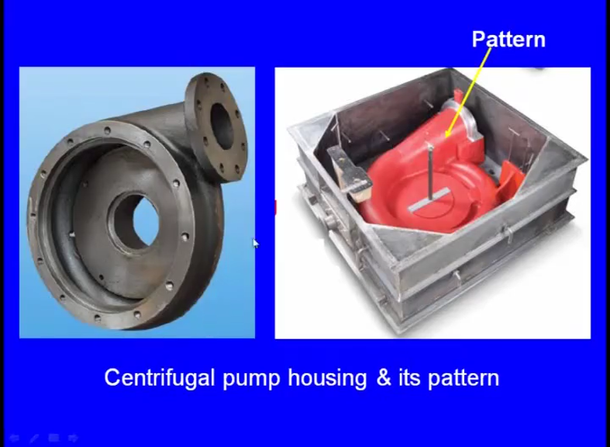

Slide 3
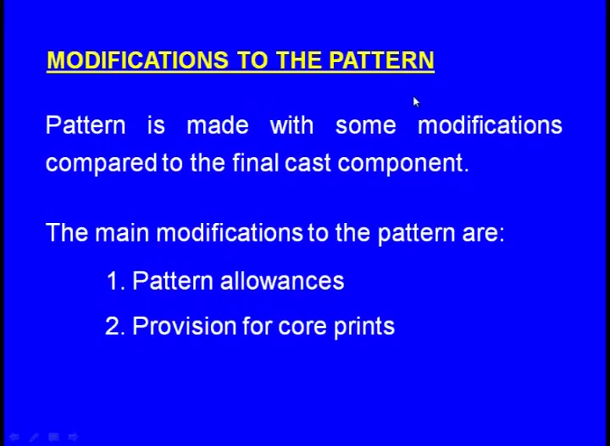

Slide 4
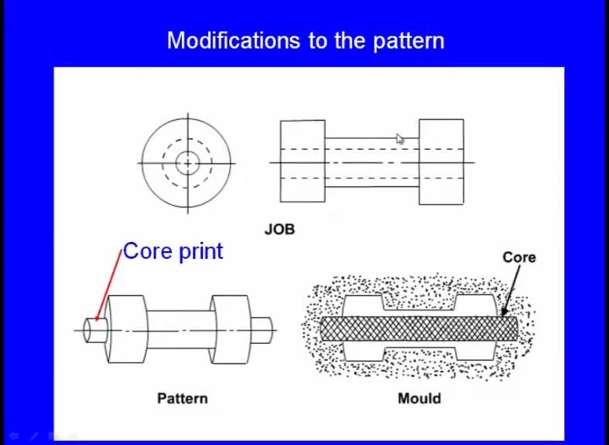
So, to make this component we have to make this a similar cavity inside the mould. So, naturally one can think that the pattern should be similar to this shape, but here you see this is the pattern.
Surprisingly the pattern its geometry is different from the geometry of the casting which we want why there is a difference and here we can see some projection is there and here also some projection is there.

Slide 5
Why we have kept this projection to the pattern because so this is the mould cavity this is the mould cavity and this is the core this is the core. So, the molten metal flows around the core and after solidification we break this core that is how we get the axial hole in the cached component. Now the core actually the at effective core is it starts from this point and up to this point, but you only if we make that much core how it will be supported that is the question.
So, to support that we are making we are extending the core up to here up to here. So, this is the extended portion of the core, now where to place this even to place this. So, we are making the cavity an extended cavity is made here and extended cavity is made here; into that extended cavity we are placing the extender portion of the core and that is how the core is supported here the extended portion of the core a what say pattern is known as the core print. Similarly the extended portion so this much portion is not part of the effective core. So, this is the core print. So, core print means it is an extra projection on the pattern to create to enable or to support the core prints of the core inside the mould cavity.
Similarly, it refers to the core print refers to the extended portion of the core also. Now
these are the functions of a pattern it prepares the mould cavity it enables creation of the
core prints. So, while we are making the pattern. So, these core prints we are these core
prints we are not making separately while making the mould itself the core prints are
made. So, the pattern has got the core prints.

Slide 6
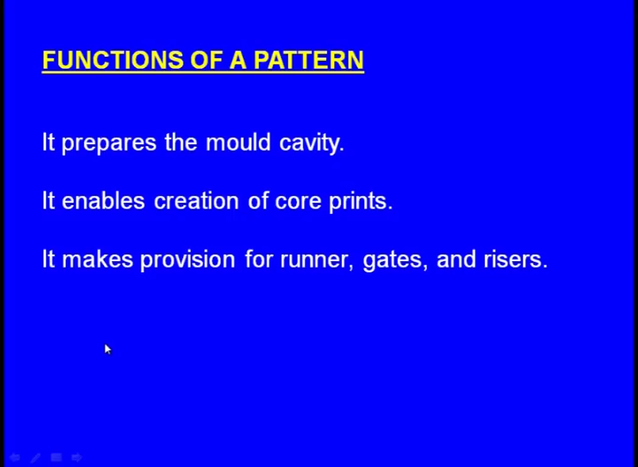

Slide 7
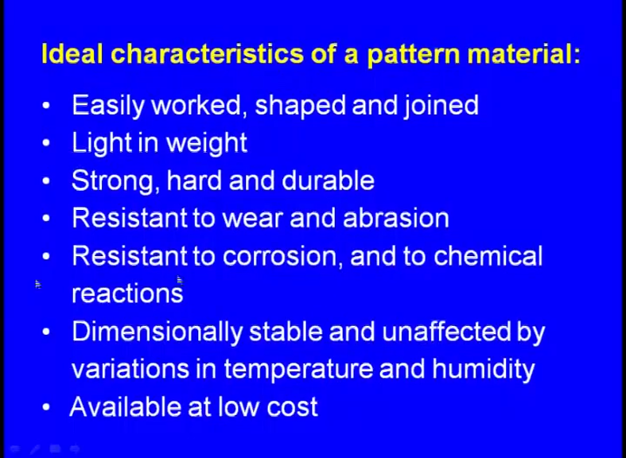

Slide 8
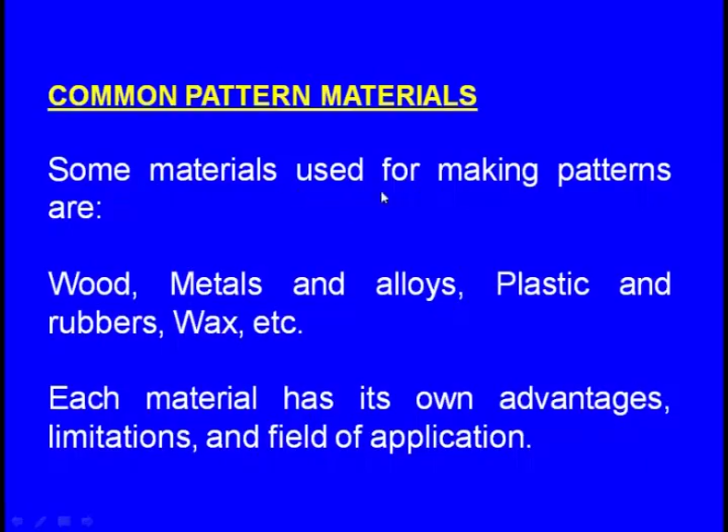

Slide 9
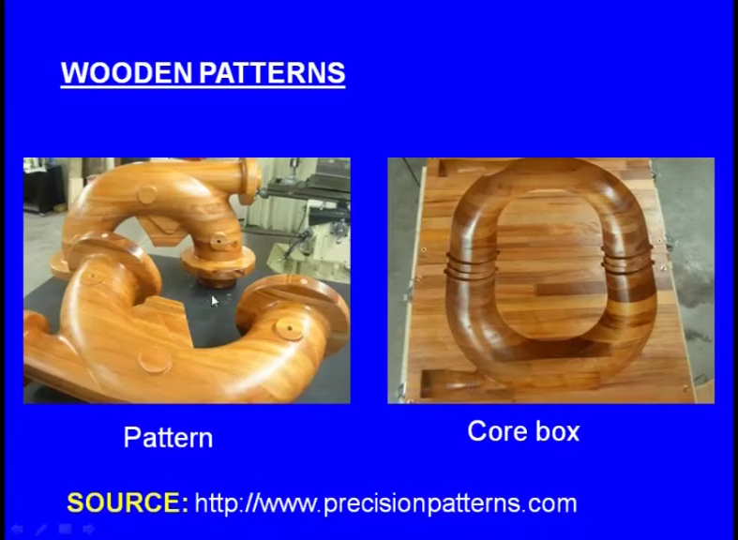

Slide 10
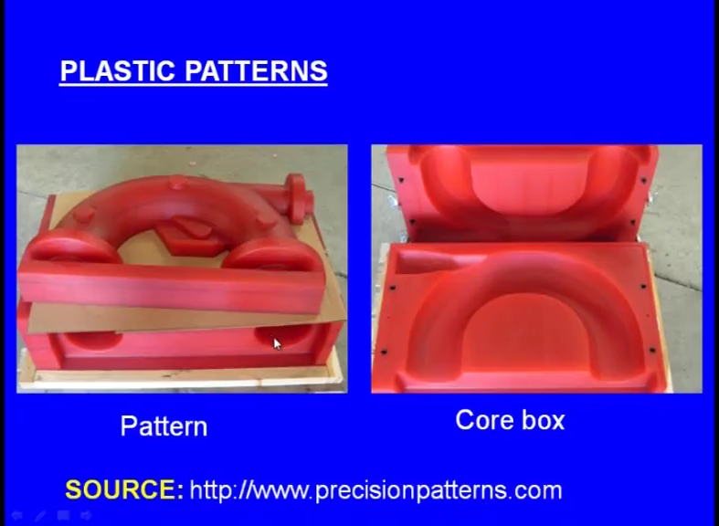

Slide 11
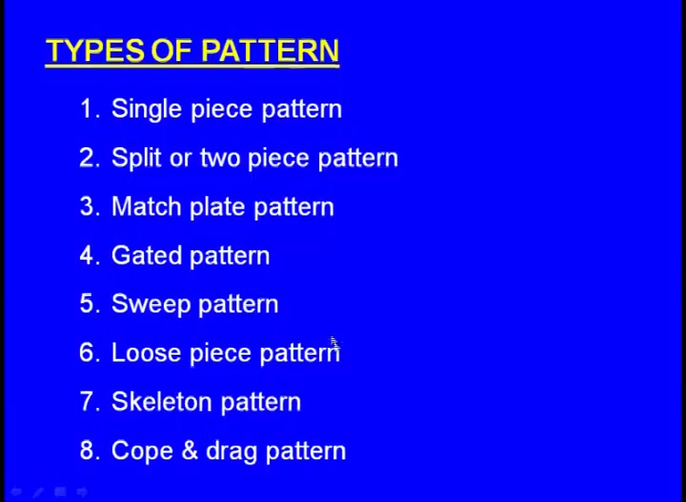

Slide 12
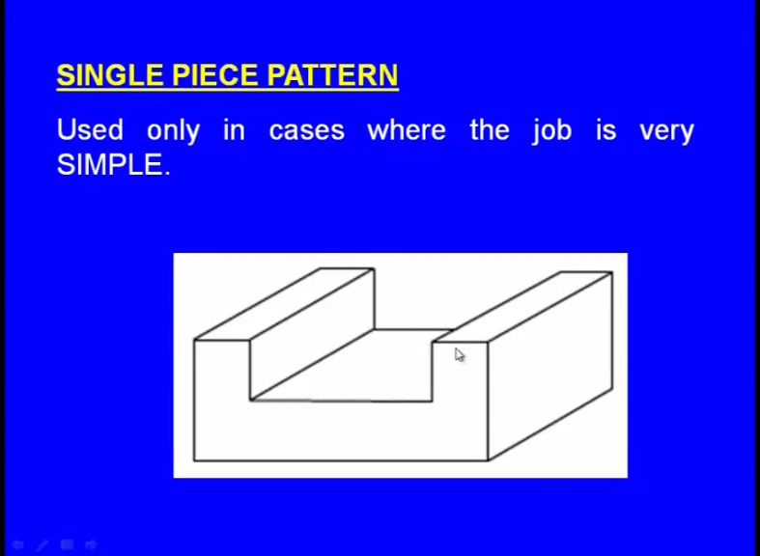

Slide 13
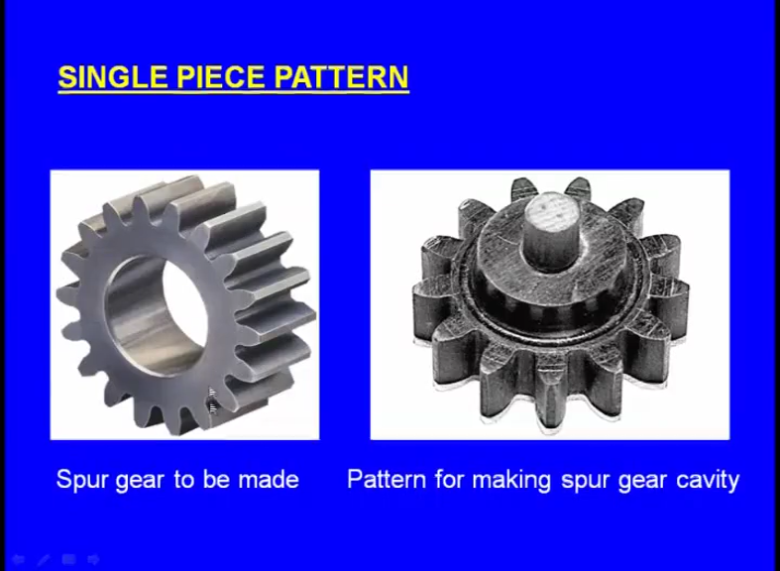
See the job is very simple. Now, this is the what; say a best what say application of the single piece pattern, now we want to make a spur gear using the casting process and the pattern will be like this. So, this single piece will be kept inside the track box and a in that drag box we compact the moulding sand afterwards, we make the drag box upside down over that, we place the cope box, and we place the riser pin and sprue pin and again we compact in the cope box. Now, in the case of this single piece pattern the mould cavity is laying only in the drag box.

Slide 14
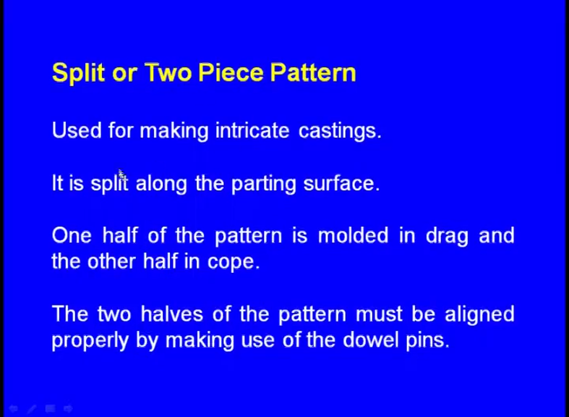

Slide 15
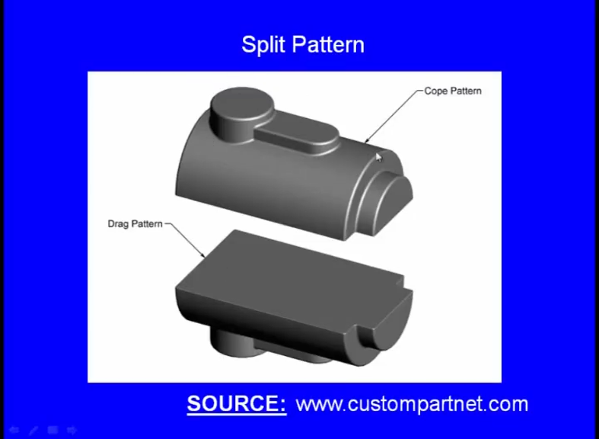

Slide 16
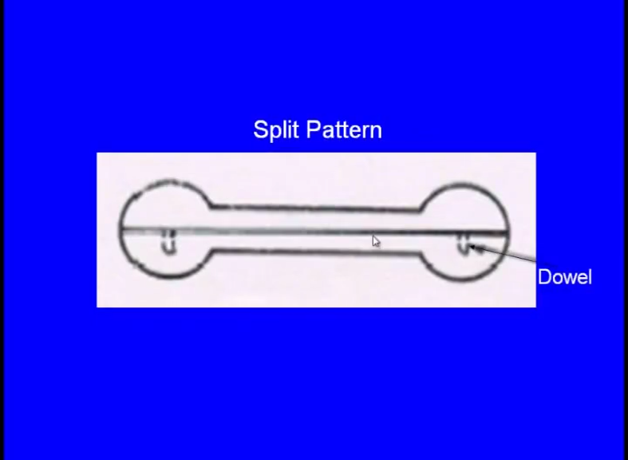
So, to prevent the misalignment we use the dowel pins means in the drag box there will be some holes will be there and for the what; say a cope pattern there will be pins will be there and we ensure that these pins rest in the holes of the what; say a drag pattern, then there would not be any misalignment.
for making the dumbbell a split piece is used. So, this is the cope pattern. So, this is the drag pattern. Now what happens initially we put the what; say a drag pattern in the drag box and we compact the moulding sand then we make it upside down now over the drag pattern we have to carefully place the cope pattern that time when we are placing the cope pattern over the drake drag pattern there should not be any misalignment.

Slide 17
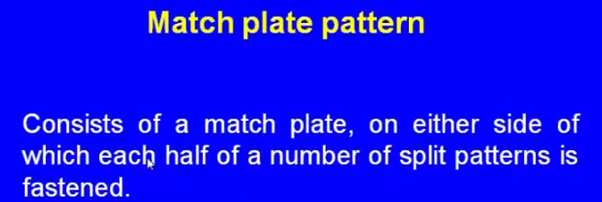
Match plate pattern consists of a match plate it is made up of it is a metallic one metallic match plate on either side of which each half of the what; say split pattern is fastened means here also we use 2 piece patterns, but the thing is in the case of these what say a split pattern or the 2 piece pattern, these 2 pieces are always independent, but here what we do is initially we make 2 pieces and we take a match plate match plate a metallic plate thick metallic plate and at the bottom we fix the drag pattern and on the other side above the plate we fix the cope patterns and they are permanently fastened.
.

Slide 18
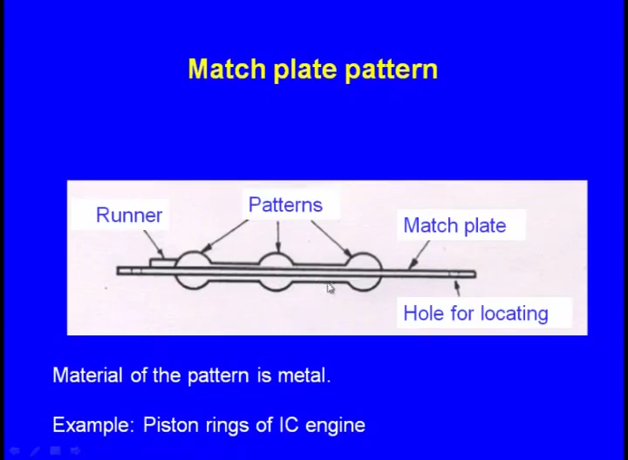

Slide 19
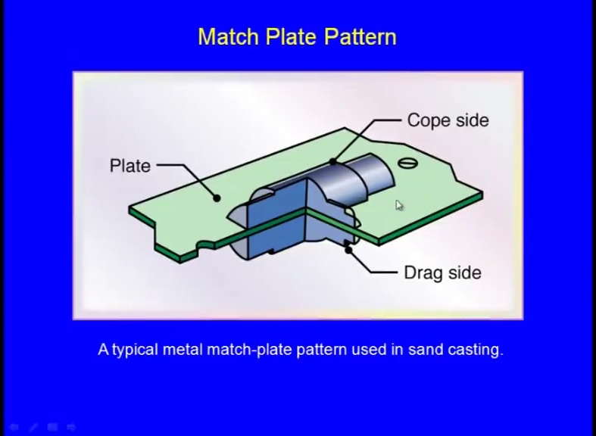

Slide 20
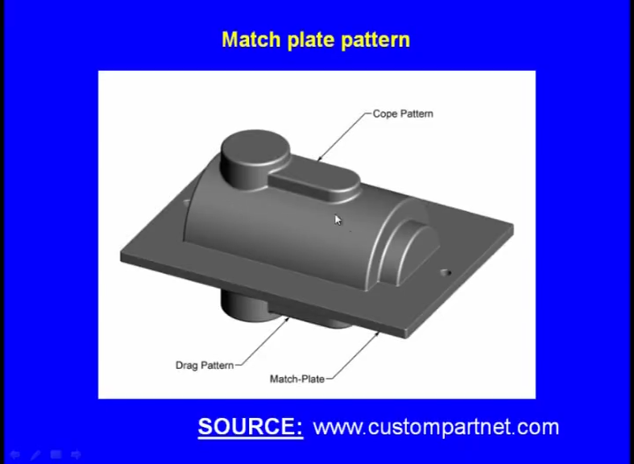

Slide 21
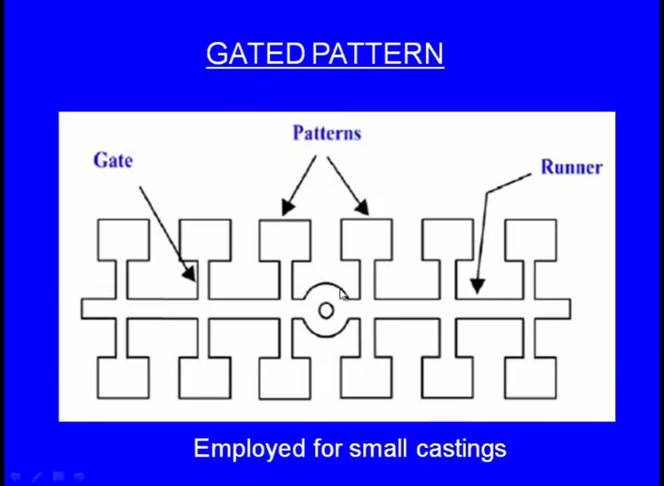

Slide 22
So, the gated pattern looks like this the gated pattern is used for making very small castings for example, say in a session say one has to make say some 12 small castings; means for each casting one has to use 2 moulding boxes and 2 what say one sprue pin and one riser pin and what say and one has to make the gating system and making the mould for each casting that consumes lot of time pattern withdrawal this takes lot of time.
Now, because the castings are very small now the question is why can not we make several castings in a single mould that is the concept of the gated pattern? Now we can see here so this is the casting this squared one is the casting and this is one casting this is one casting; this is one casting likewise in one moulding box we want to make 12 small castings of same geometry. Now what happens we make the pattern in an assembled way means there is a common sprue is there here the sprue is perpendicular here right. So, we pour the molten metal through the common sprue and this horizontal passes is known as the runner there is a common runner we pour the molten metal here and the molten metal travels like this and it flows into all the what; say gates finally, it fills in all the cavities. So, that is the concept of the gated pattern. So, while making the pattern we make the pattern in an assembled way; means the pattern contains what say for making castings for several small castings it makes cavity for several castings small castings.

Slide 23
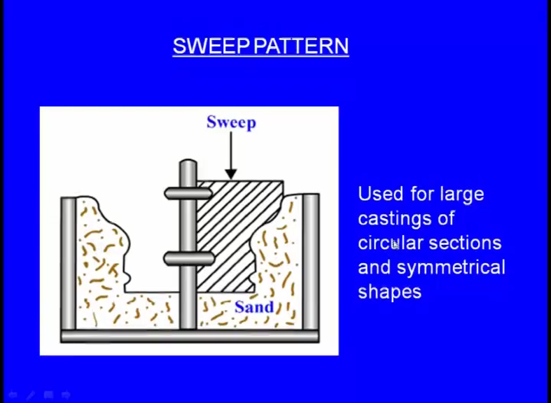
Used for large castings of circular sections and symmetrical shapes, now sometime back in the moulding sands we have seen that the loam sands we have seen right it contains excessive of clay and finally, it is what say it is nature is different from the green sand the green sand is sticking, but whereas,, but green sand does not look like a paste.
Whereas the sand used in the while using the sweep pattern looks like a paste right. So, this pasty sand is initially kept inside the moulding box. Now this sweep is a 2 dimensional pattern, just it is a 2 2 dimensional pattern now using this sweep initially right. So, we start keep rotating it we keep rotating as we keep rotate this sweep what happens a cavity is created inside this loam sand, and after this sweep is has gone completely inside then we stop rotating it then we withdraw the pattern now an what say symmetrical cavity is created inside the loam sand.

Slide 24
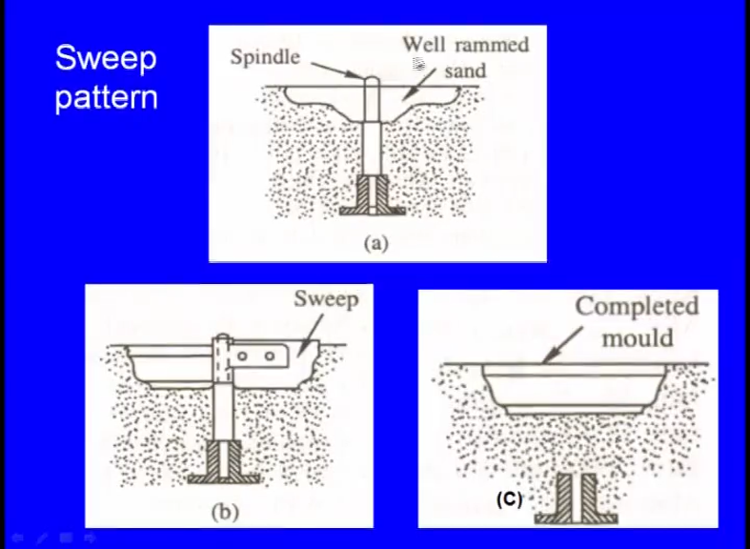

Slide 25
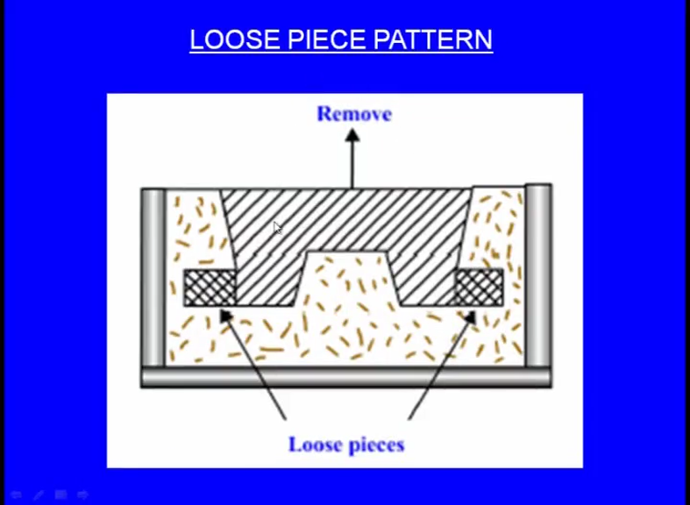
This is the a typical appearance of a loose piece pattern now you see the geometry of this pattern casting. So, we want to make a casting of this shape it is like this certainly we can use a single piece pattern now we have we have compacted this in a drag box in the drag box of course, initially it is downwards we place the pattern downwards and over that we play around that we place the drag box then we compact the sand then we make it upside down now we have made it upside down.
Now, how to remove the pattern now as we try to remove the pattern this portion and this portion they are obstructing the removal or the withdrawal of the pattern. Now how to overcome this problem, now in such a case we use the loose piece pattern loose piece pattern means here we can see this is one loose piece and this is one loose piece, yes they will be kept here on this side and the one piece will be kept on this side now keeping these loose pieces close to the pattern we what say a complete the moulding process.

Slide 26
After the moulding process is over now we can see there will be a little tapper will be there here you which will enable easy withdrawal of the main pattern we remove the main pattern like this, after we remove the or the withdraw the main pattern this what say this piece what say it has to be moved towards left and this piece will come out this piece will come out when we move left and take it up upside, what about this piece we have to move towards right and take it outside.
So, when the loose piece pattern is used. So, in this kind of situation we can withdraw it very easily. So, that is the concept of the loose piece pattern next one the skeleton pattern. Skeleton pattern is used for making very huge castings. So, if for such a huge castings and if we use the what; say a solid pattern it will consume lot of a pattern material and the cost of the pattern will go up not only that what say the what; say handling of the pattern would be very difficult.

Slide 27
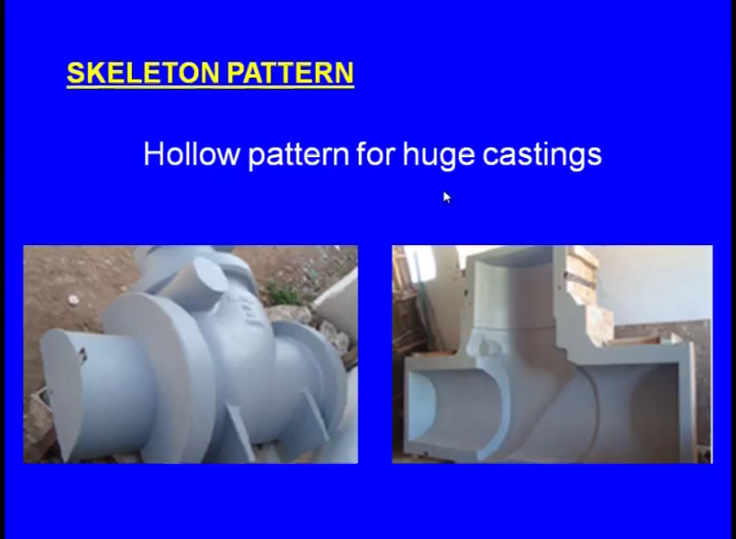

Slide 28
Because, it will be very heavy right it will become very tedious, that is why when we are making a very huge pattern when we are making a very huge casting what is important for a pattern it is outside feature.
What is inside is matter for us inside there is material or hollow space or inside there is some other material it does not matter to us. So, we ensure that the outside surface of the pattern is perfectly made, but inside it is hollow you can see the other side of the pattern now here it is hollow, but still it is able to serve our purpose using this hollow pattern we are able to make the cavity the large cavity. So, when we are able to make the cavity with this what say hollow pattern, why can not we use this and why should we go for the solid pattern which would be expensive and which would be very difficult to handle. So, that is why in such a case we use the skeleton pattern. Skeleton pattern means only there is outside feature inside it is hollow.

Slide 29
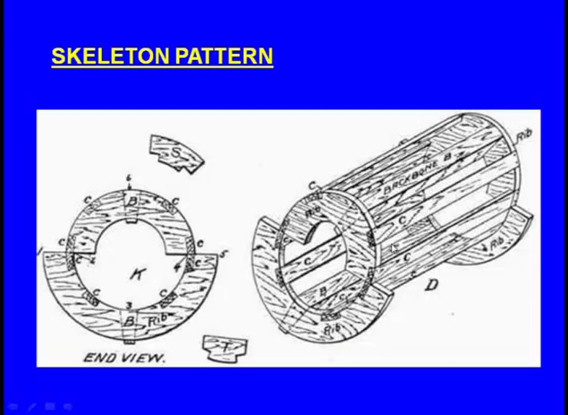

Slide 30
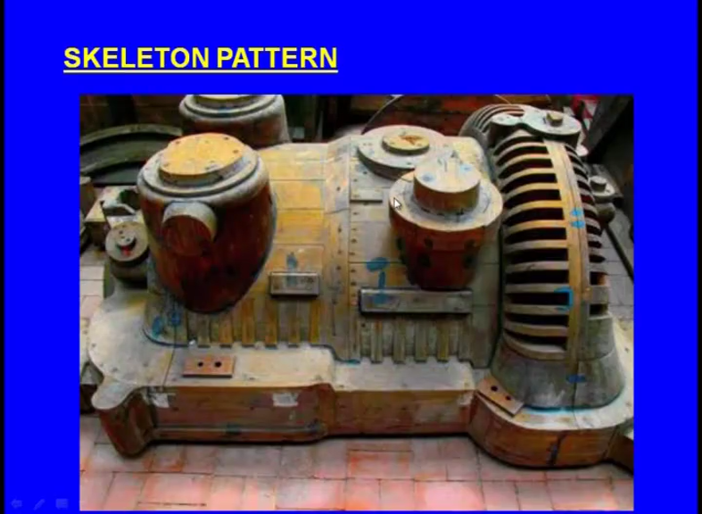

Slide 31
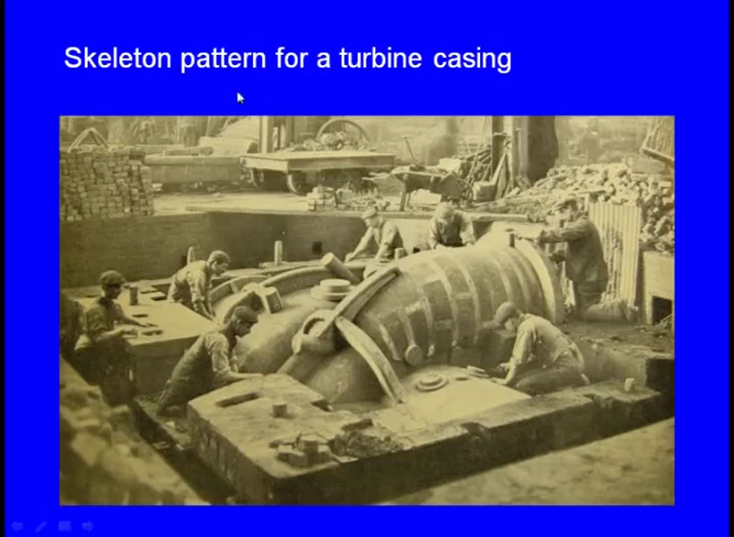

Slide 32
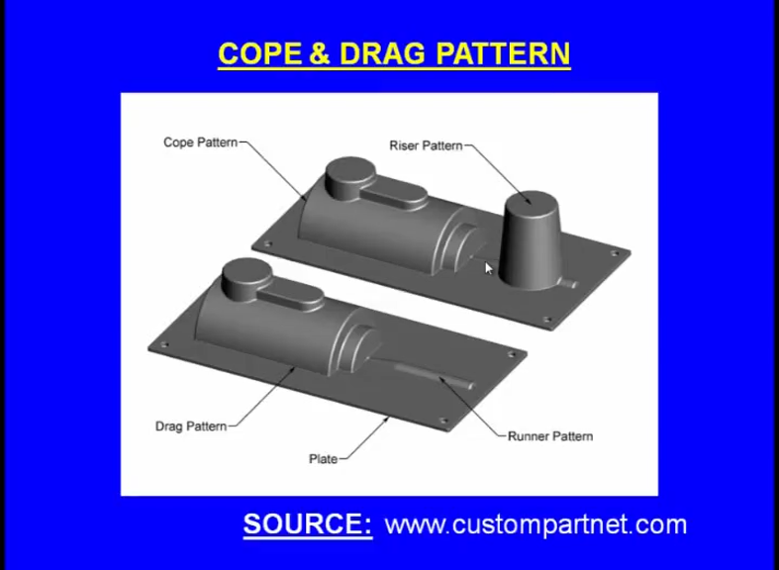

Slide 33
Whereas, in the case of the split piece pattern what say single piece pattern, match plate pattern, the creation of the sprue runner we have to do separately whereas, in the case of the cope and drag pattern, creation of the riser, creation of the runner, creation of the ingates all these features are included in the pattern itself means again we can see here 2 patterns are there.
So, this is the cope pattern and this is the drag pattern when we are what say a ramming the drag pattern in the drag box the required features are created in the mould cavity and this is the cope pattern and when we are using this pattern and we are we will place this inside the cope box and place the moulding sand what happens even the riser hole is automatically created the runner is automatically created; means this reduces the time which we spend for creating the riser and the runner.
So, that is the benefit of the cope and drag pattern. So, this cope and drag pattern includes the what; say a provisions for making riser and runner sorry right riser and runner. So, we have seen we have seen the different types of the patterns now let us see the pattern allowances.

Slide 34
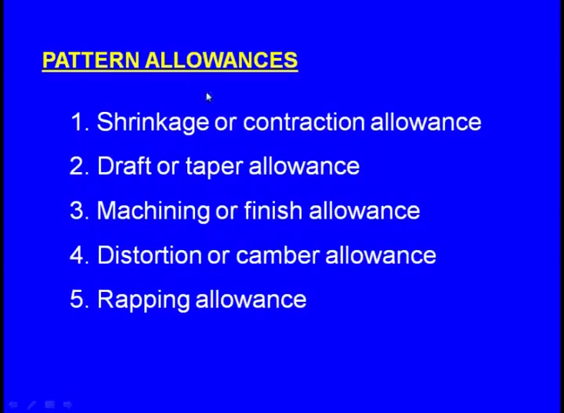

Slide 35
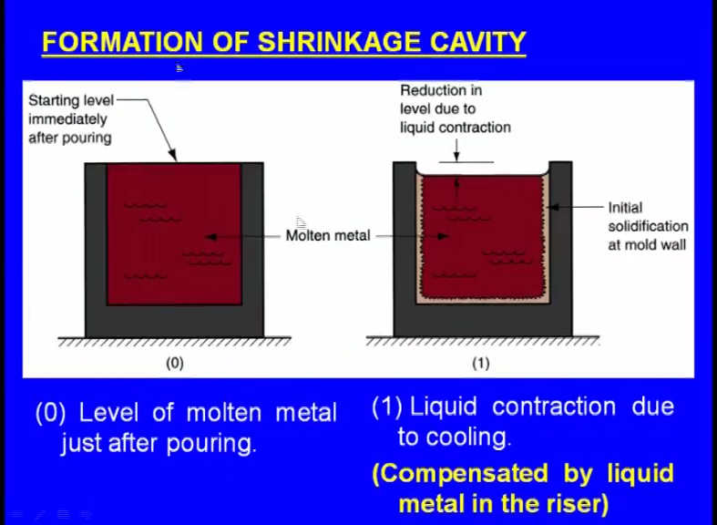

Slide 36
Now let us see what happens when we pour the molten metal into the mould cavity, now let us see let us this is the mould cavity, now immediately after we pour the molten metal it looks like this. May be after few minutes what will happen maybe if it is the aluminum right the melting temperature is 600 and 60 degree centigrade, but we pour it at about 700 and 50 degree centigrade. So, there are 2 temperatures in the casting one is the melting temperature at which the melting actually starts, but that is not enough to pour inside the mould cavity to pour into the mould cavity we still hate it above the melting point. So, that point that temperature is known as the pouring temperature and maybe we may pour at 700 and 50 degrees centigrade now from 700 and 50 to 600 and 60 it will be there will be a liquid cooling inside the molten metal.
So, because of that there will be some contraction will be there you can see this is the shrinkage. Initially there is no shrinkage why this shrinkage is taking place, because of the temperature drop from the pouring temperature to the melting temperature, but what happens fortunate the we have sufficient molten metal in the riser. So, this molten metal comes and fills this gap; means this shrinkage is compensated by the liquid metal in the riser now what happens yes this what say shrinkage is compensated by the liquid metal in the riser now inside there is solidification and because of that right there is again shrinkage this is known as the solidification shrinkage and fortunately again we have sufficient molten metal in the riser.

Slide 37
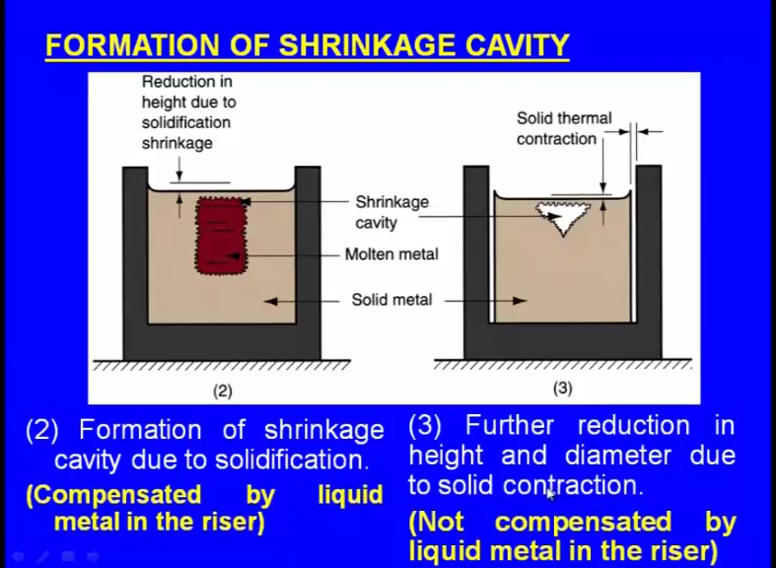

Slide 38
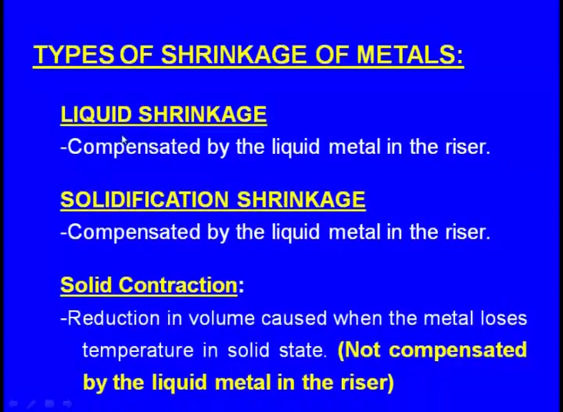

Slide 39
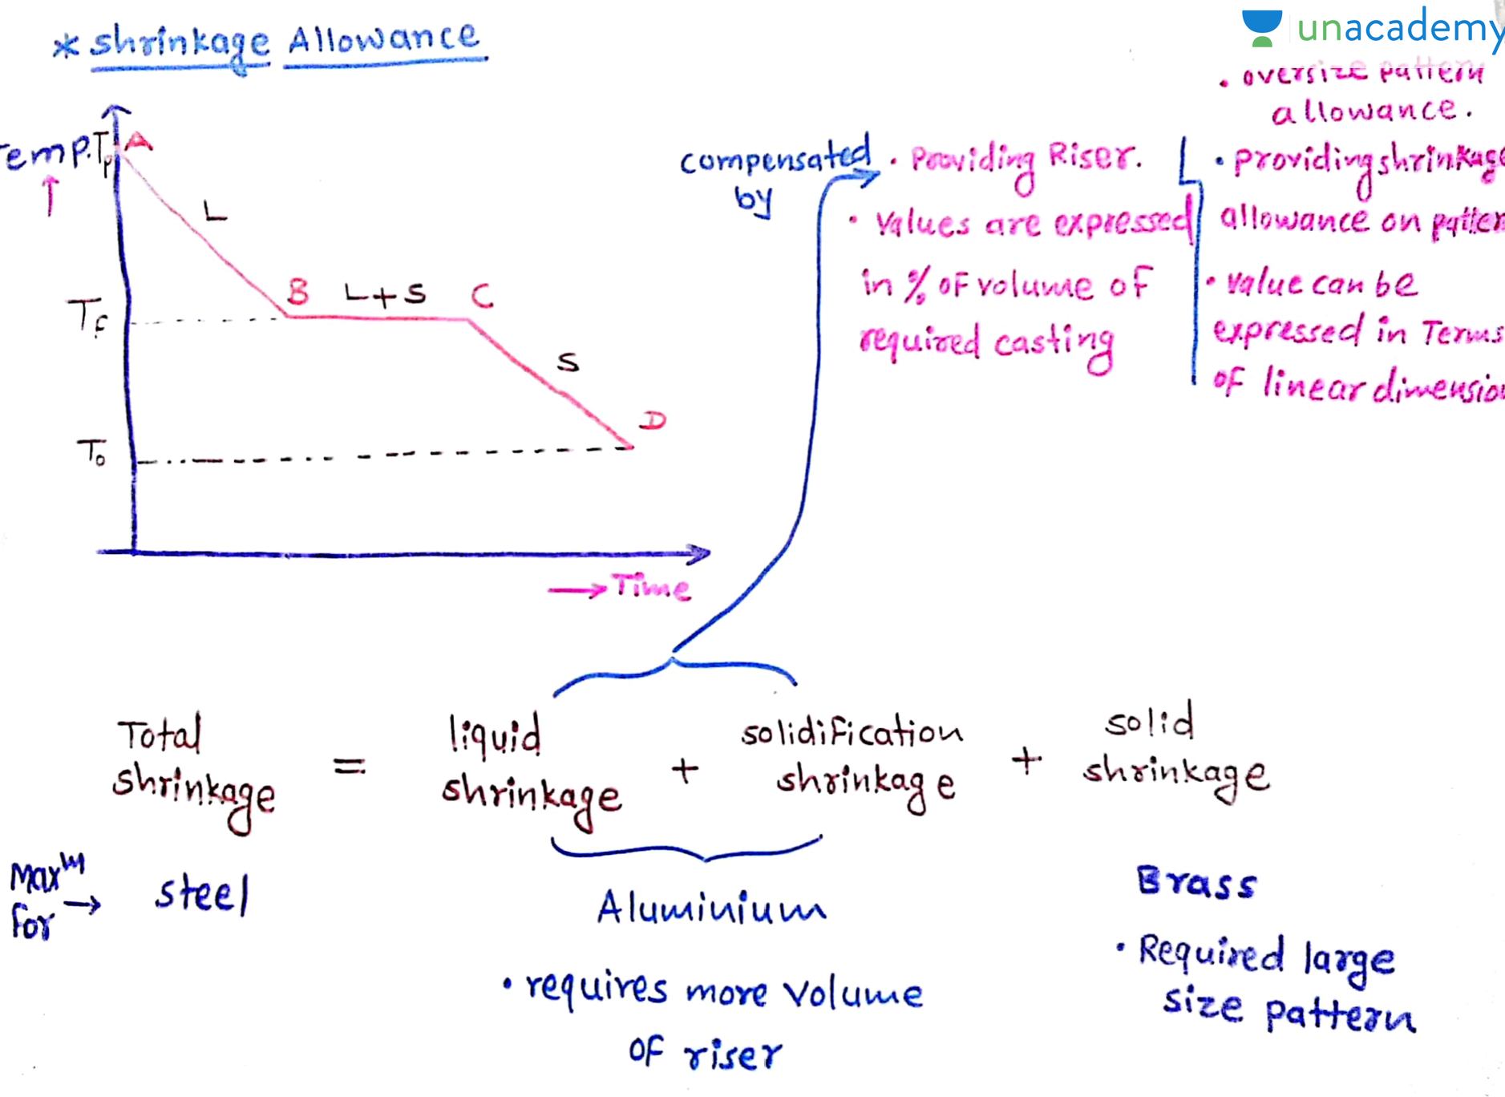

Slide 40
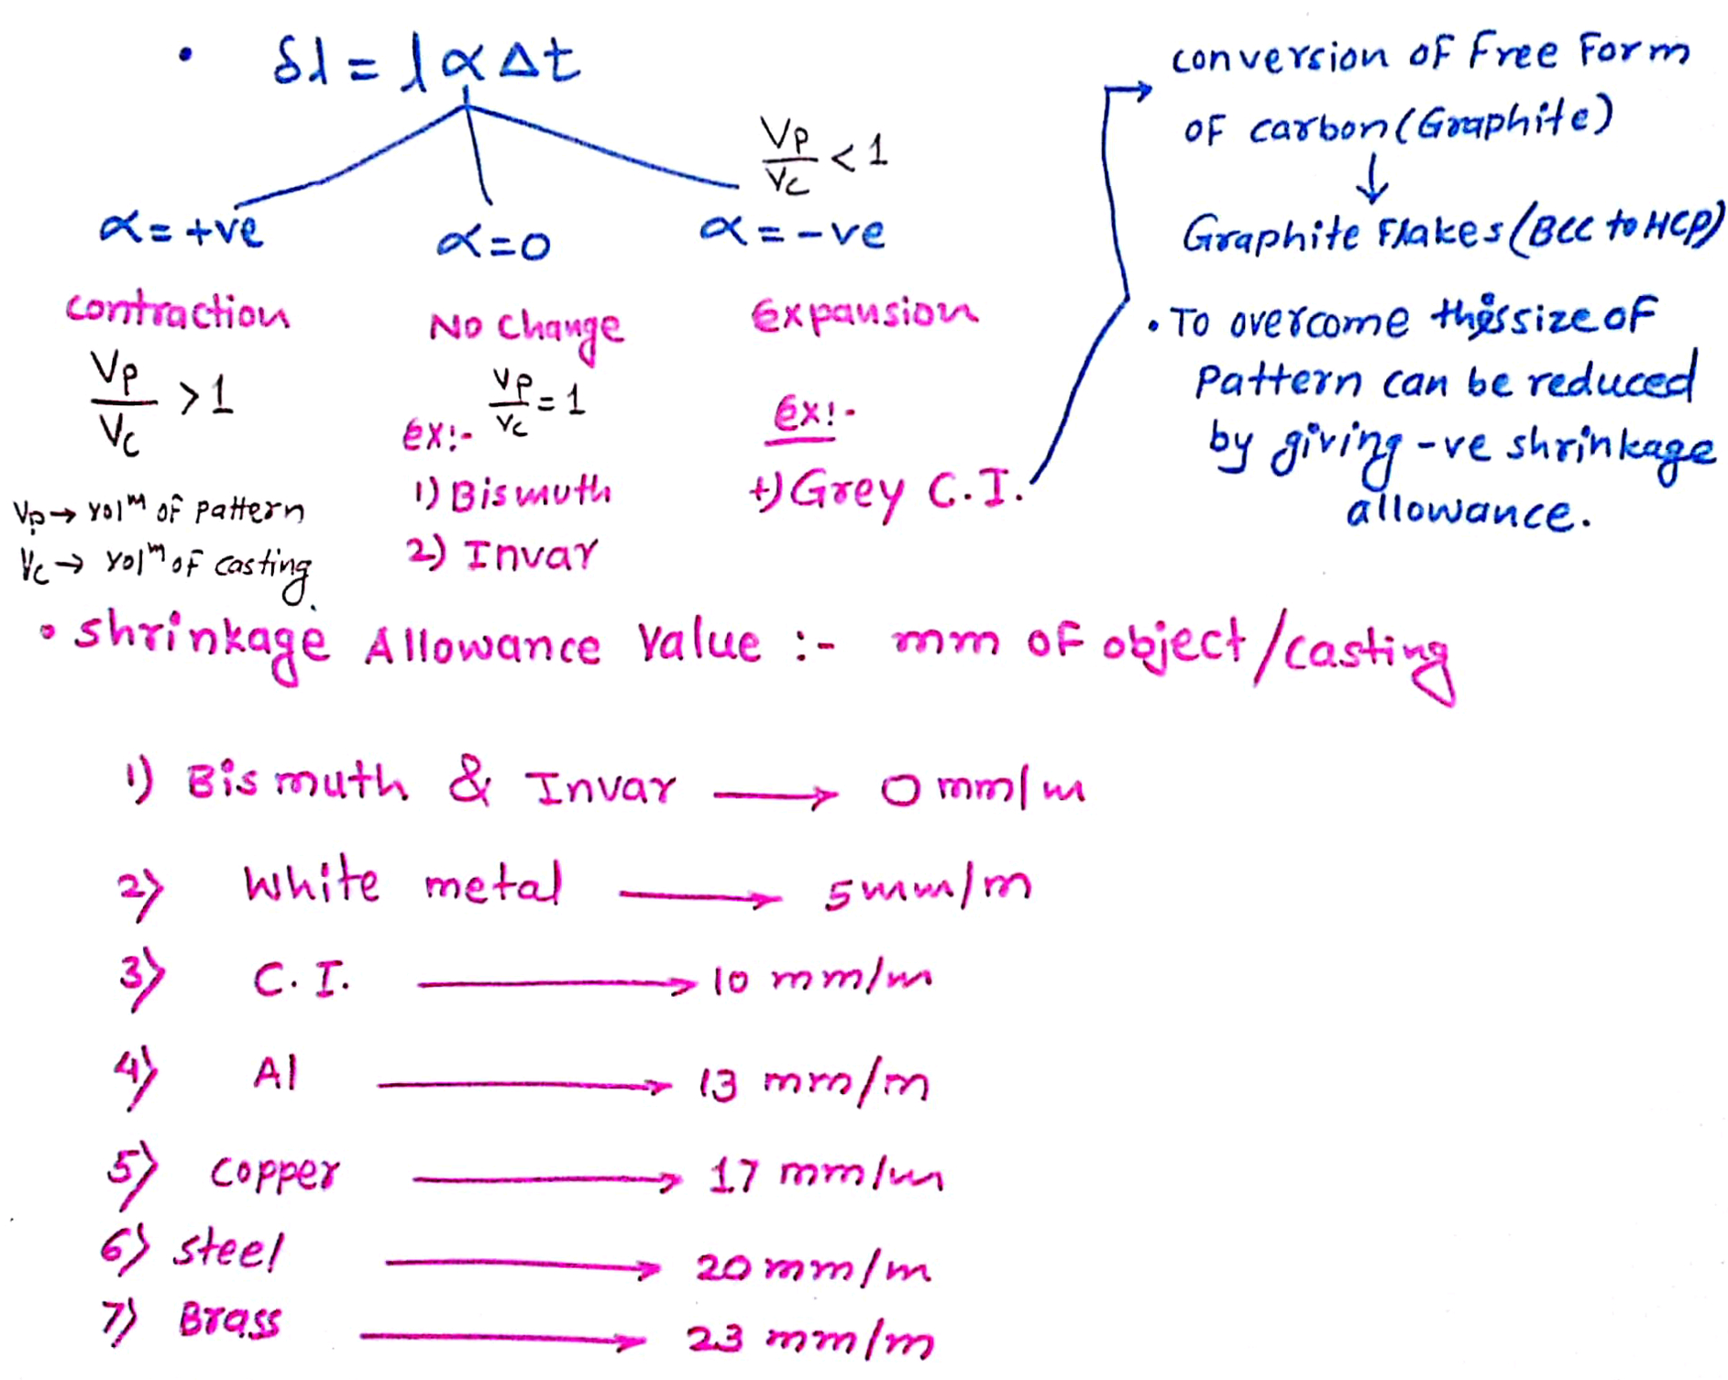

Slide 41
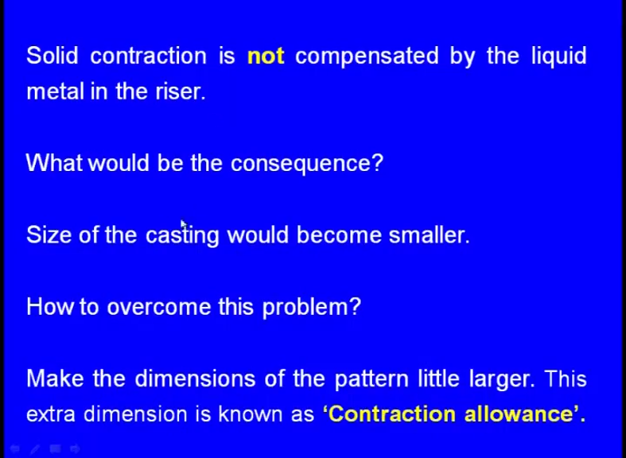

Slide 42
Solid contraction is not compensated by the liquid metal in the riser, what would be the consequence; consequence size of the casting would become smaller we might have design the pattern with keeping the what; say a actual casting size accordingly we have design in the pattern. Now because of this contraction solid contraction the size of the casting would become smaller, which we do not want now how to overcome this problem make the dimensions of the pattern little larger so that this extra right. So that after this contraction solid contraction is over the final size of the casting would be equal to the size of the casting which we want.
So, this increment in the what; say size this extra dimension is known as the contraction allowance. So, this is also known as the shrinkage allowance again this is different for different materials.

Slide 43
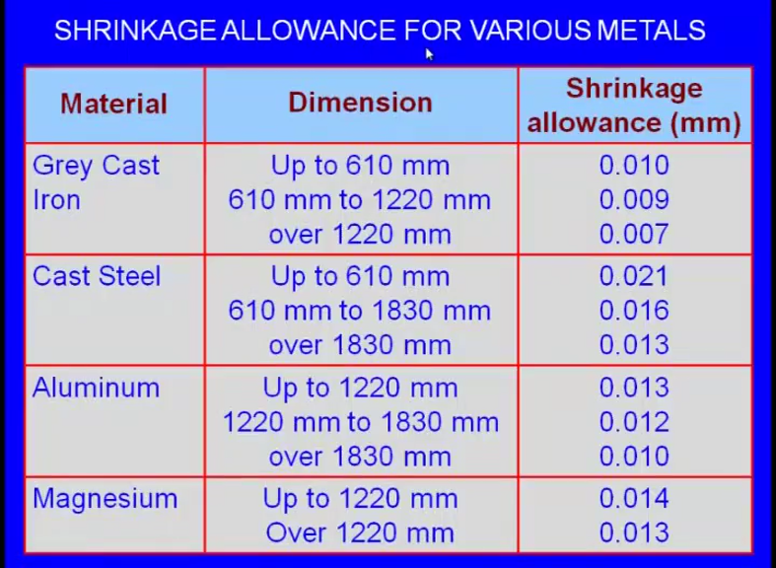

Slide 44
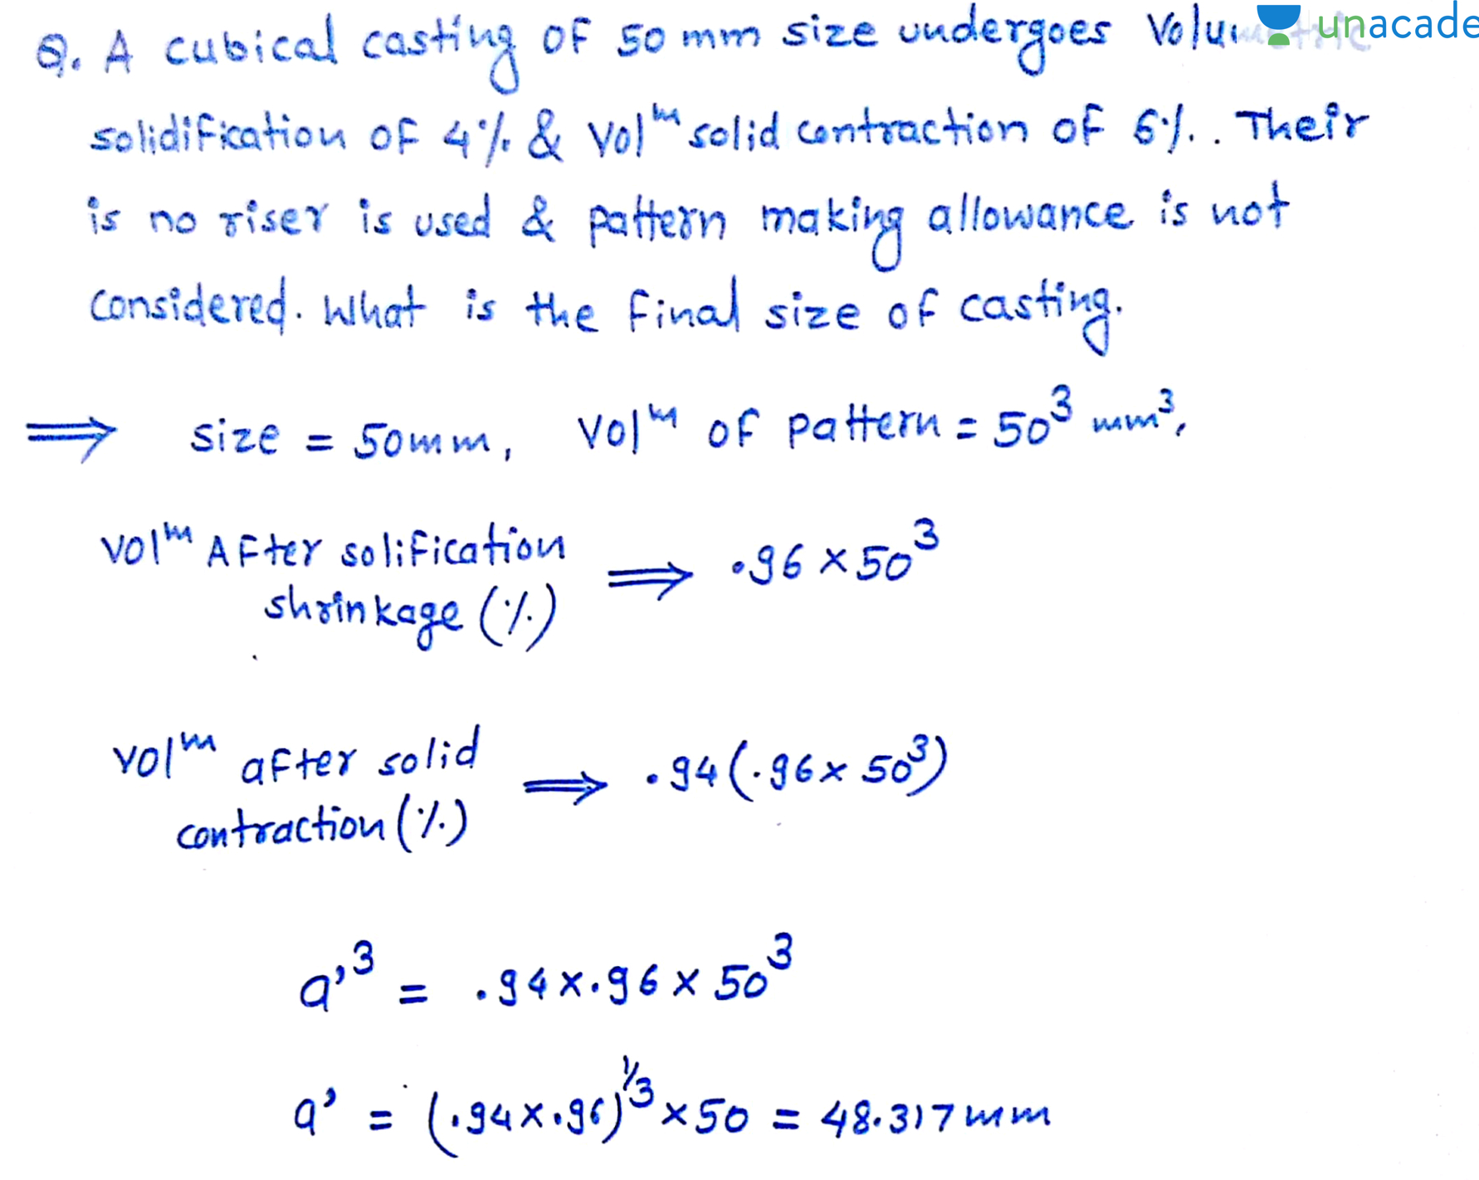

Slide 45
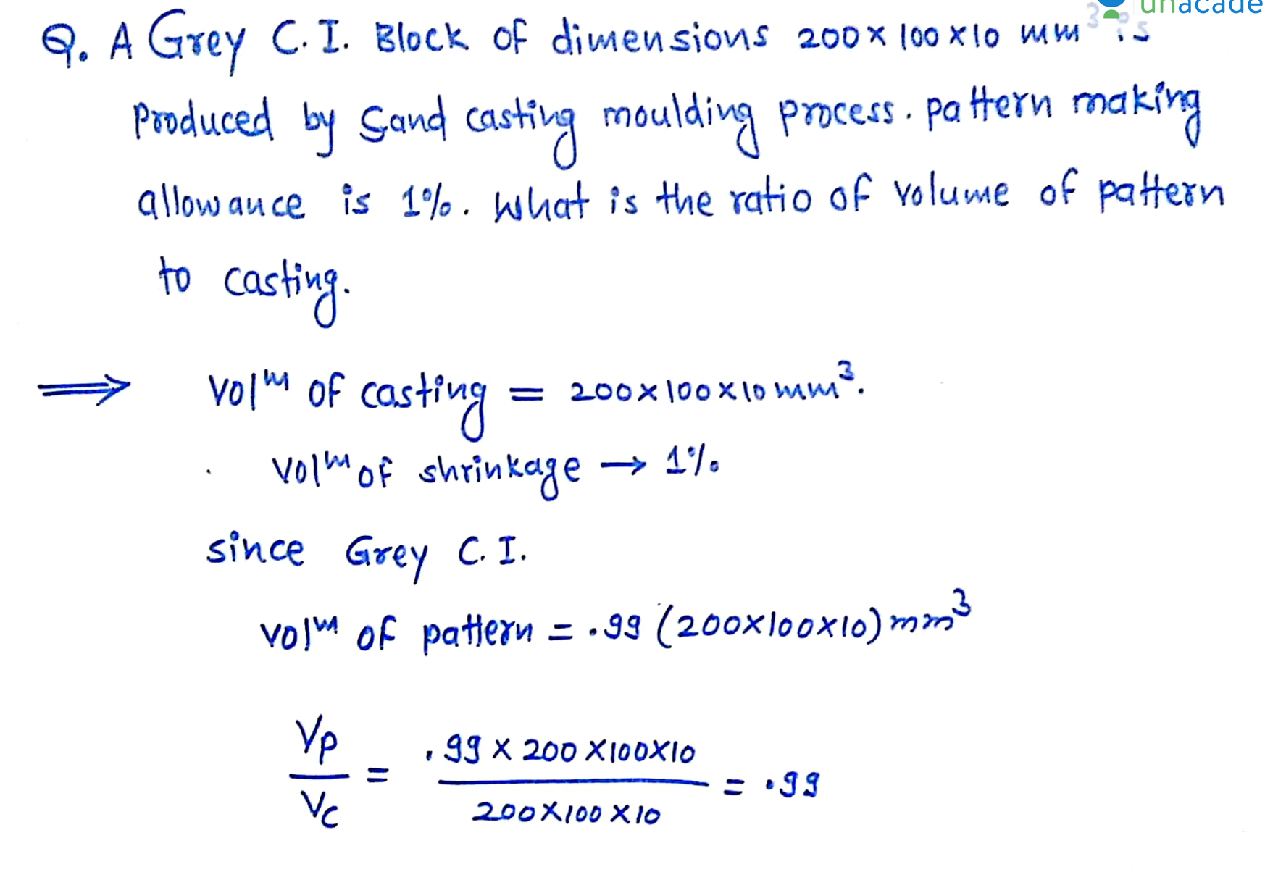

Slide 46
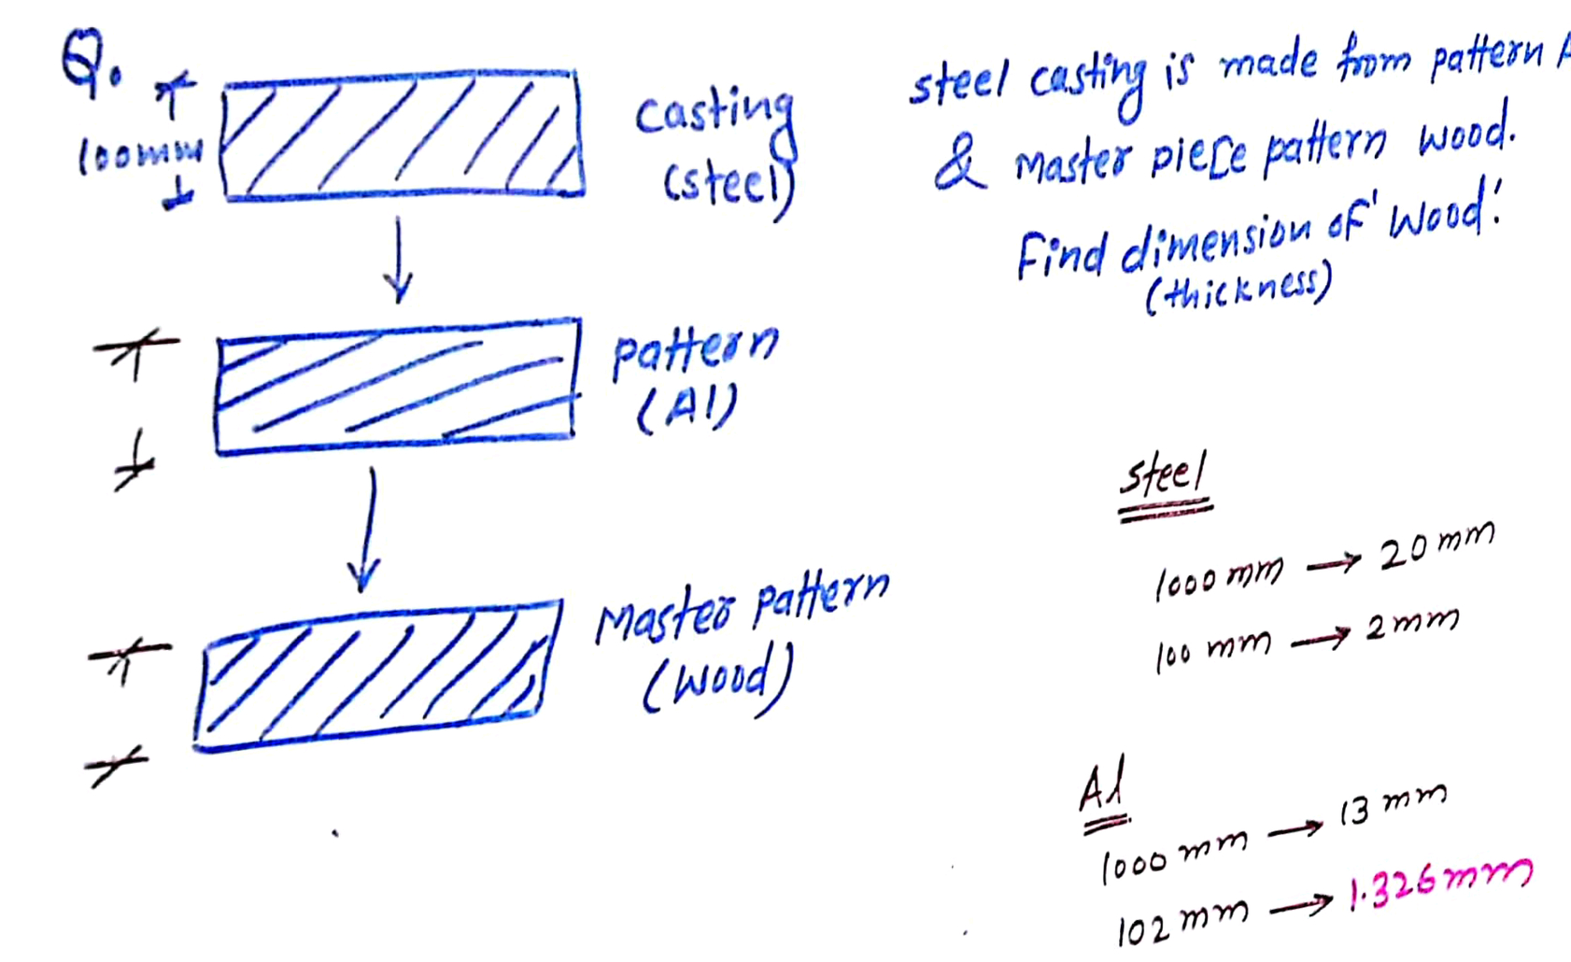

Slide 47
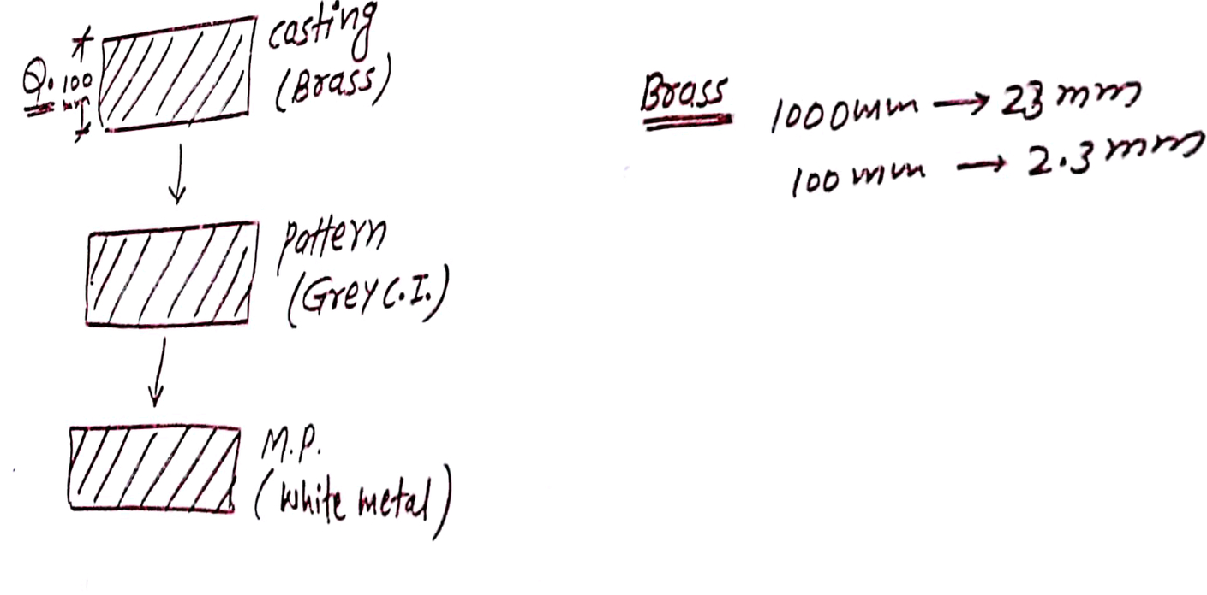

Slide 48
Shrinkage allowance
FOR Grey Cast iron
This allowance of 2.3 mm we will add to Grey cast iron Iron. Because there is no effect on Grey cast iron Because Alpha is negative
Hence this value has to be subtracted in master pattern
Grey CI 1000 mm--- 10 mm
102.3mm-------x
Therefore x= 1.023
Therefore The final thickness of Master pattern
102.3-1.023=101.27

Slide 49
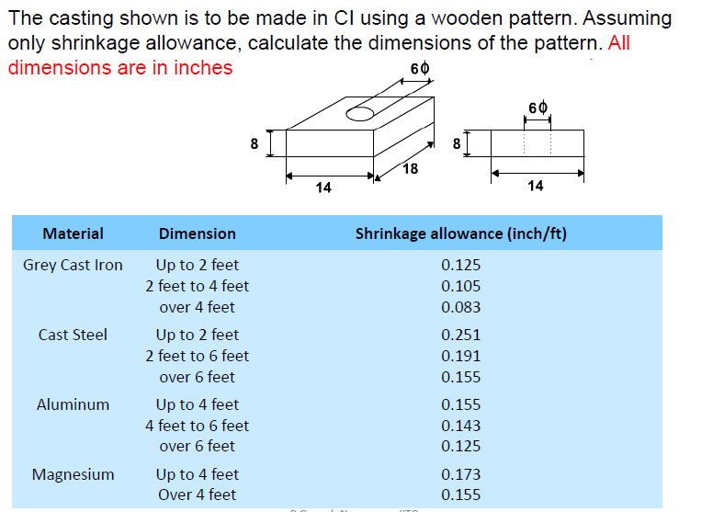

Slide 50
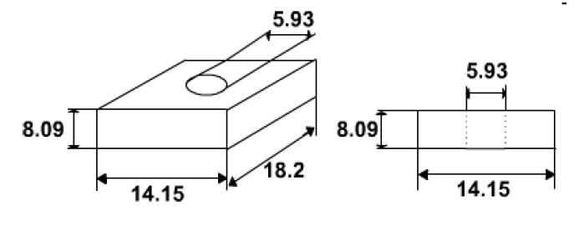

Slide 51
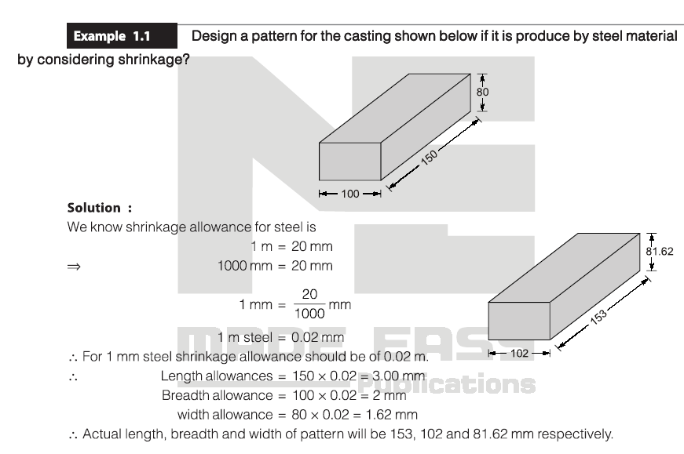

Slide 52
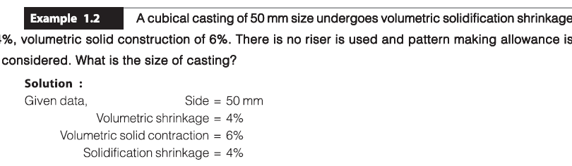

Slide 53
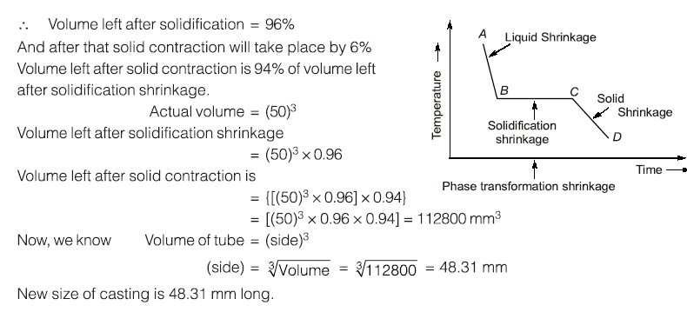

Slide 54
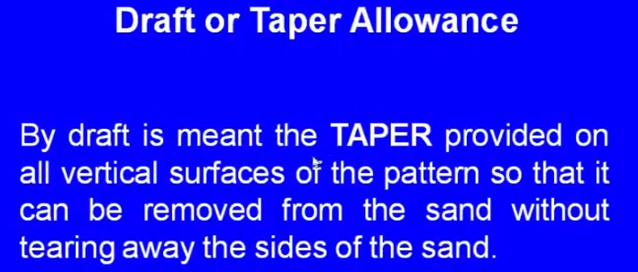
By draft is meant the taper provider on all the vertical surface of the pattern. So, that it can be removed from the sand without tearing away the sides of the sand.
When we are withdrawing the pattern the vertical surface of the pattern made tear out the mould cavity because of the friction. So, to avoid the tearing we give a taper because of that taper we can easily withdraw the pattern without causing any damage to the what; say a vertical surface of the mould. Here we can see one case. So, this is one case and this is the mould and this is the pattern and you can see here this is the vertical portion vertical element of the pattern and there is no taper, because of that after moulding is over and they are trying to withdraw it.

Slide 55
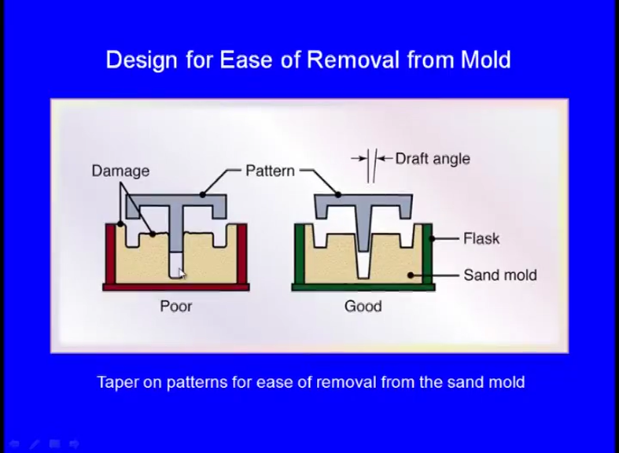

Slide 56
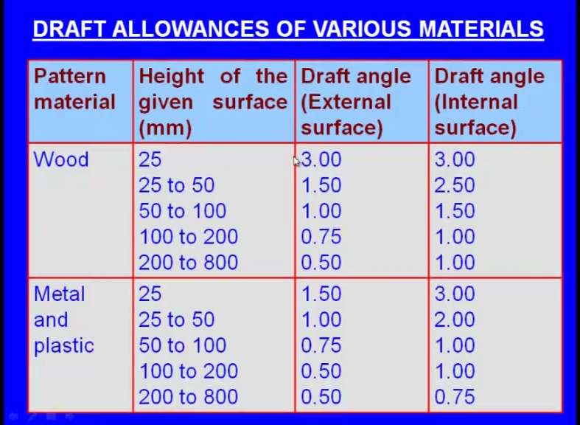

Slide 57
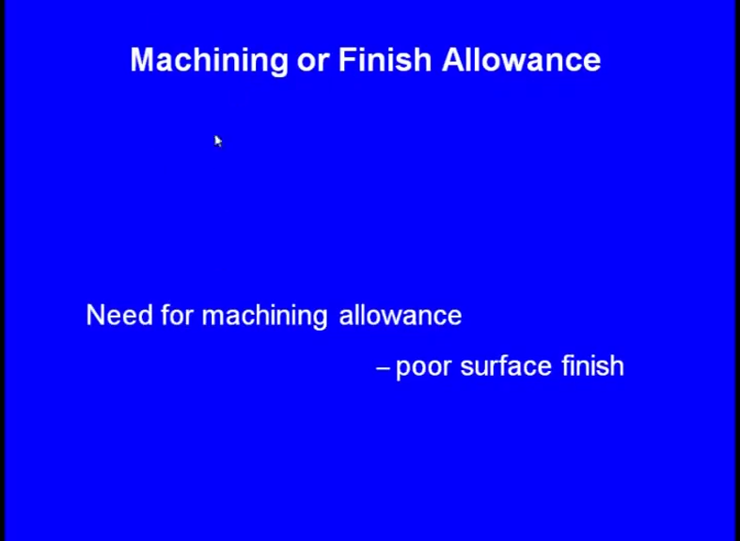

Slide 58
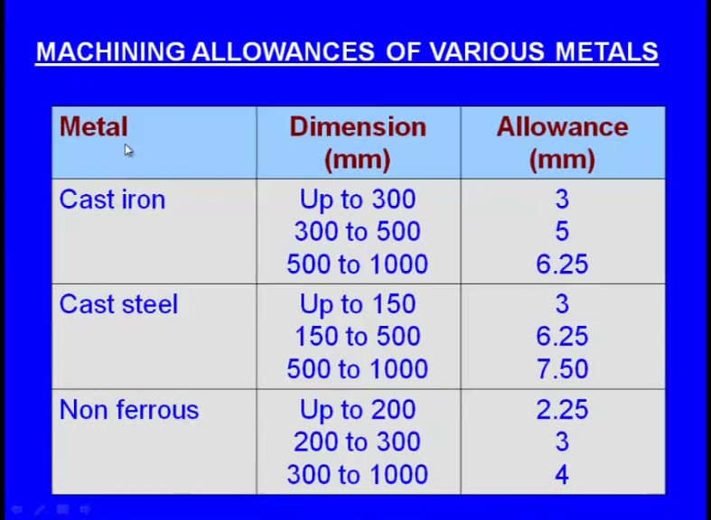

Slide 59


Slide 60


Slide 61


Slide 63


Slide 64


Slide 65


Slide 66


Slide 67


Slide 68


Slide 69

Starting from the finished part design of the mechanical part, evaluate the complete pattern design & the core design.
Stock allowance 3mm,
Linear shrinkage of 1%,
Draft angle 2⁰
Compute the stock allowance, shrinkage allowance & the draft angle for the product drawing.
Add the core print to the pattern according to the dimension.

Slide 70
Casting Pattern Design
For the pattern negligible the draft allowance
No | Nominal Dimension |  | Shrinkage allowance 1% |  | Stock shrinkage |  | Pattern shape design
1 | External | Ø140 | 140*0.01 | 1.4 | + 3 | + 3 | 147.4 | 147
2 | External | Ø100 | 100*0.01 | 1.0 | + 3 | + 3 | 107 | 107
3 | Internal | Ø80 | 80*0.01 | 0.8 | -3 | -3 | 74.8 | 75
4 | Internal | Ø40 | 40*0.01 | 0.4 | -3 | -3 | 34.4 | 34
5 | Linear | 20 | 20*0.01 | 0.2 | + 3 | + 3 | 26.2 | 26
6 | Linear | 30 | 30*0.01 | 0.3 | + 3 | -3 | 30.3 | 30
7 | Linear | 120 | 120*0.01 | 1.2 | + 3 | + 3 | 127.2 | 127
The draft allowance for the hole / core
No | Nominal Dimension |  | Shrinkage allowance 1% |  | Stock shrinkage |  | Core shape design
1 | Internal | Ø80 | 80*0.01 | 0.8 | -3 | -3 | 74.8 | 75
2 | Internal | Ø40 | 40*0.01 | 0.4 | -3 | -3 | 34.4 | 34
3 | Linear | 30 | 30*0.01 | 0.3 | + 3 | -3 | 30.3 | 30
4 | Linear | 120 | 120*0.01 | 1.2 | + 3 | + 3 | 127.2 | 127

