Slide 2
Outline
Solar Water Heating Systems
  Solar Collectors
  Solar Water Heater
  Thermal design Procedures/Process heat transfer analysis for Solar water heating systems
Solar Air Heating Systems
  Solar Driers
  Thermal design Procedures/Process heat transfer analysis for Solar air heating systems
  Solar Thermal Power Plants
Solar Desalination
    Solar Driers
    Equivalent thermal resistance circuit for solar desalination for thermal analysis of the system

Slide 3
Solar Collector
A solar collector is a special kind of heat exchanger that transforms solar radiant energy into heat.
A solar collector differs in several respects from more conventional heat exchangers.
The latter usually accomplish a fluid-to-fluid exchange with high heat transfer rates and with radiation as an unimportant factor. In the solar collector, energy transfer is from a distant source of radiant energy to a fluid.
Flat-plate collectors can be designed for applications requiring energy delivery at moderate temperatures, up to perhaps 100◦C above ambient temperature.
They use both beam and diffuse solar radiation, do not require tracking of the sun, and require little maintenance.
They are mechanically simpler than concentrating collectors. The major applications of these units are in solar water heating, building heating, air conditioning, and industrial process heat.

Slide 4
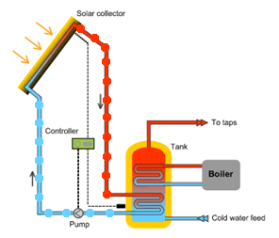
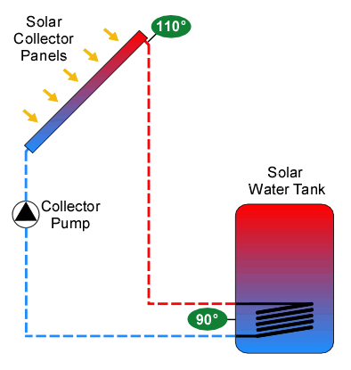
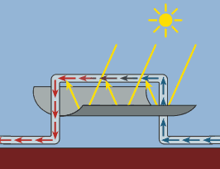
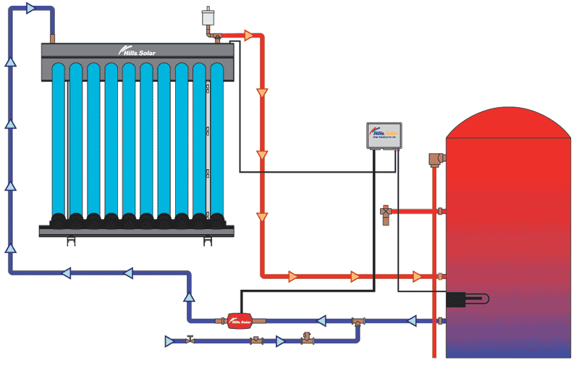
Solar Collector

Slide 5
Solar Collector
The important parts of a typical liquid heating flat-plate solar collector, as shown in fig 6.1, are the ‘‘black’’ solar energy-absorbing surface with means for transferring the absorbed energy to a fluid, envelopes transparent to solar radiation over the solar absorber surface that reduce convection and radiation losses to the atmosphere, and back insulation to reduce conduction losses.
Air heaters are fundamentally the same except that the fluid tubes are replaced by ducts.
Flat-plate collectors are almost always mounted in a stationary position (e.g., as an integral part of a wall or roof structure) with an orientation optimized for the particular location in question for the time of year in which the solar device is intended to operate.

Slide 6
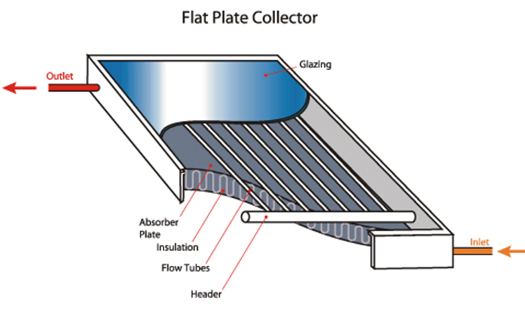
Solar Thermal Systems
3.1. Flat Plate Collector
The flat-plate collector is the heart of any solar energy collection system.
The collector absorbs solar energy, converts it into heat and then transfers this heat to a stream of liquid or gas.
It absorbs both the beam and the diffuse radiation.
A flat-plate collector, figure 6.1, usually consists of the following components:
Fig. 6.1. A Typical Liquid Flat Plate Collector

Slide 7
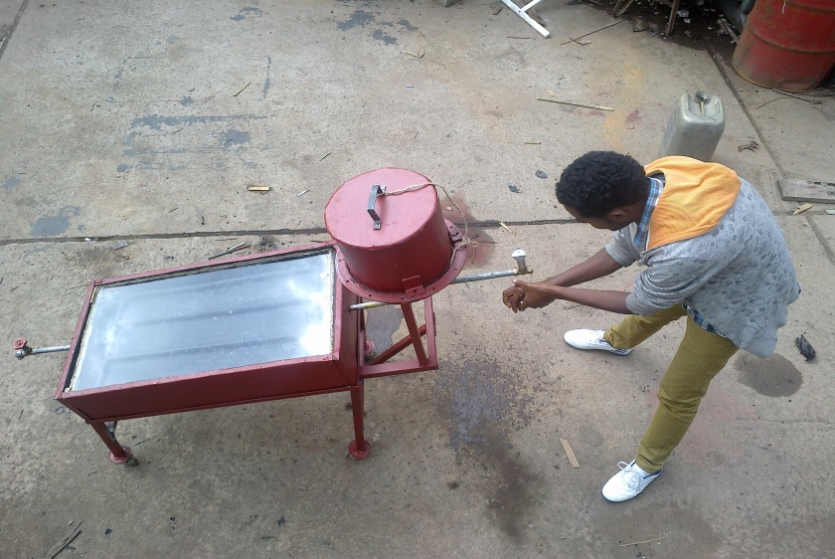
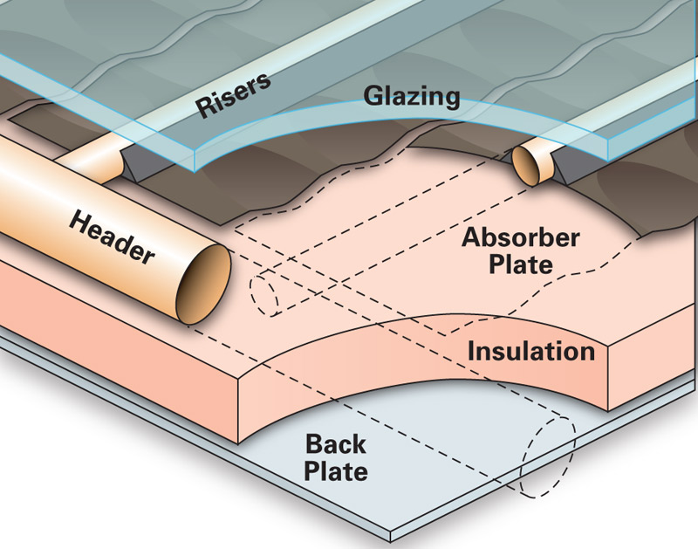
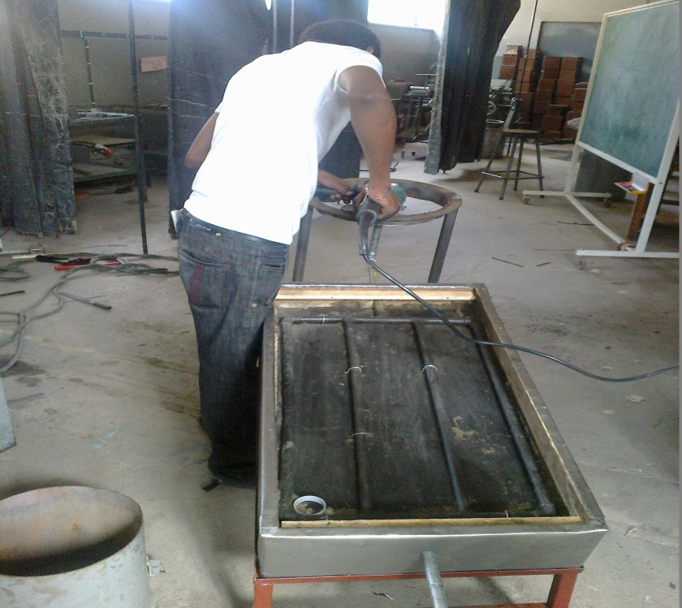
Solar Thermal Systems

Slide 8
3.1. Flat Plate Collector
1. Glazing - one or more sheets of glass or some other radiation transmitting material;
2. Tubes, fins or passages for conducting or directing the heat transfer fluid from the inlet to the outlet;
3. Absorber plate - flat, corrugated or grooved plate with tubes, fins or passages attached to it;
4. Header or manifolds to admit and discharge the fluid;
5. Insulation – to minimize heat loss from the back and sides of the collector; and
6. Container or casing which surrounds the various components and protects them from dust, moisture, etc.
Note :The role of glazing is to admit the maximum possible radiation and to minimize the upward heat losses.

Slide 9
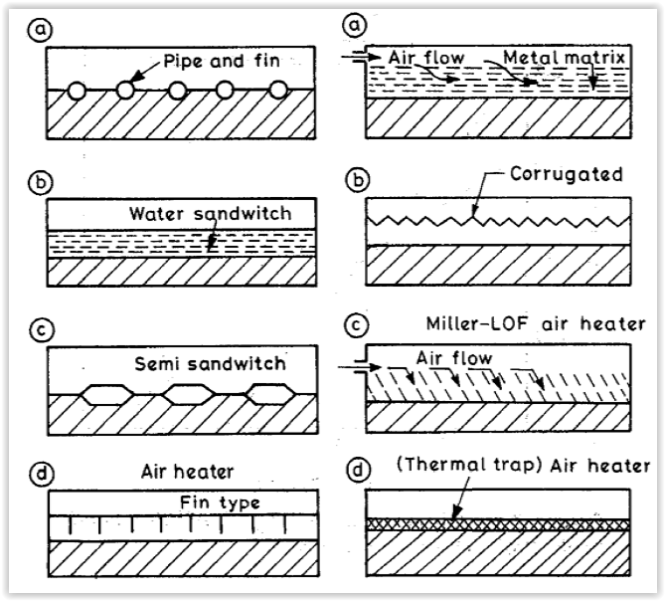
3.1. Flat Plate Collector
Fig. 3.2 .Various Types of Flat-Plate Water/ Air Heaters

Slide 10
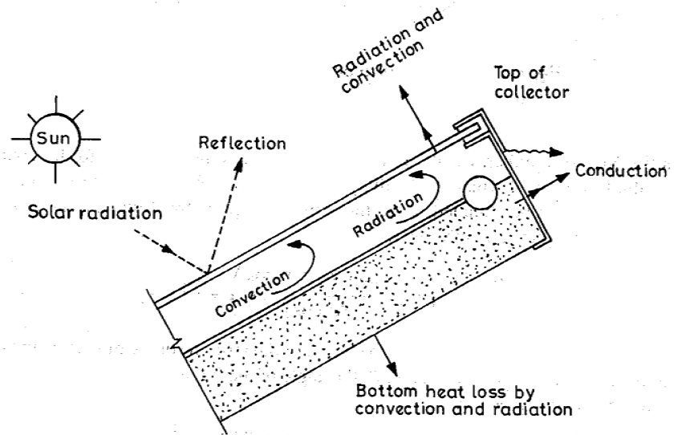
3.2 Heat Transfer Coefficients
Heat is lost to the surroundings from the plate through:
  The glass cover (referred as top loss),
  The insulation (referred as bottom loss) and
  Side (referred as edge loss)
These losses take place by conduction, convection and radiation which are shown in Fig. 3.3.
The equivalent losses are represented by a thermal resistance circuit in Fig. 3.4.
Fig 3.3. Various Heat Losses from Absorber to Ambient

Slide 11
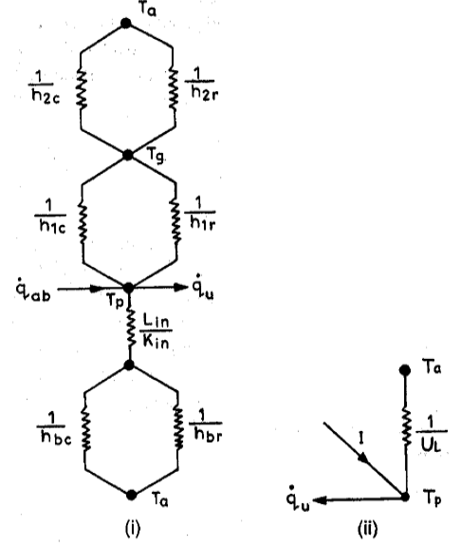
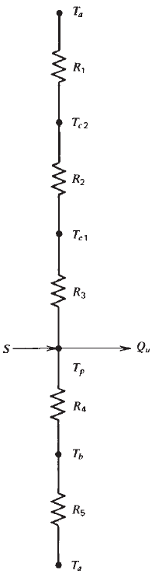
3.2 Heat Transfer Coefficients
Fig 3.4 Equivalent Thermal Circuit Diagram of Fig. 3.3

Slide 12
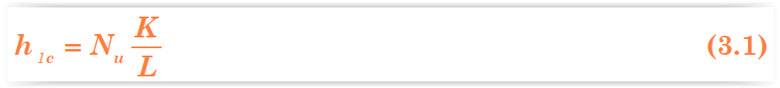
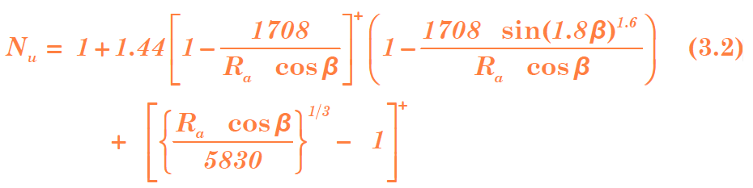
3.2.1 .Top Loss Coefficients
From Plate to Cover (h_{lc} = 1/R₃)
Nu the Nusselt number - the ratio of the convective heat transfer
to the conductive heat transfer.
The Nu can be obtained from the expression (Holland et. al. (1976)).
“+” exponent means only the positive value of the term in square bracket is to be considered,
Zero is to be used for negative values, and
The angle of inclination can vary between 0 – 75^{O},

Slide 13
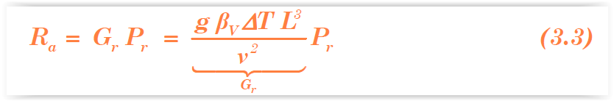

3.2.1 .Top Loss Coefficients
The Rayleigh number Ra is given by:
From Glazing Cover to Ambient (h _{2c} = 1/R₁)
Where: V is the wind velocity in m/s over the collector.
Note : In fluid mechanics, the Rayleigh number (Ra) for a fluid is a dimensionless number associated with buoyancy-driven flow, also known as free convection or natural convection.
2. Radiative Heat Transfer Coefficient
From Plate to Cover (h_{lr} = 1/R₄)
h_{lr} is the coefficient of radiative heat loss from collector plate to the cover, expressed as:

Slide 14
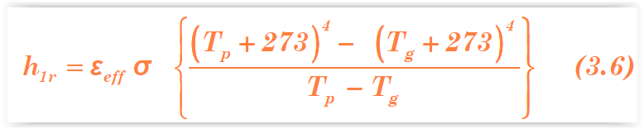
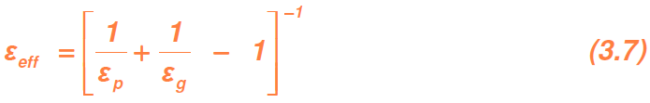
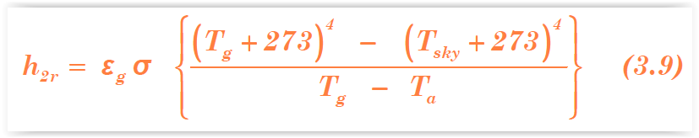
3.2.1 .Top Loss Coefficients
The effective emissivity of plate-glazing system is given by:
From Glazing Cover to Ambient (h_{2r} = 1/R₂)
The sky temperature T_{sky} is given by:
The radiative heat transfer coefficient is expressed as :

Slide 15
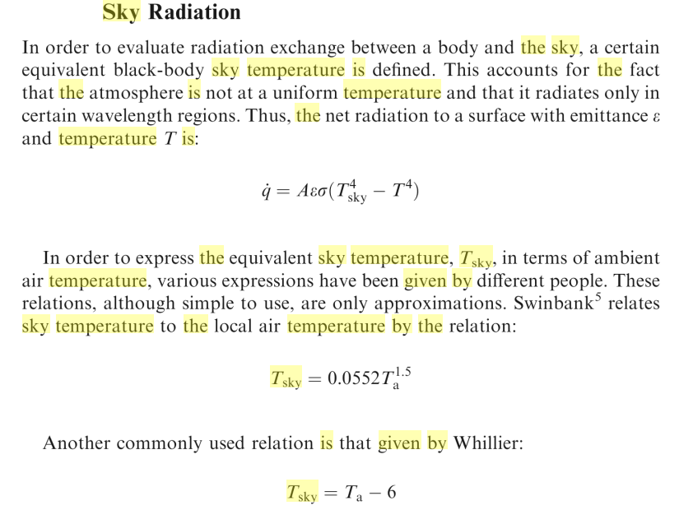
Note : Sky Radiation

Slide 16
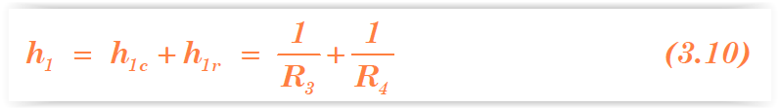
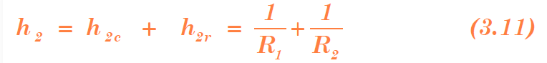
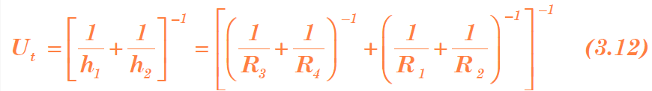
3.2.1 .Top Loss Coefficients
3. Top Loss Coefficient
The total heat transfer coefficient from collector plate to cover is expressed as the sum of h_{1c} and h_{1r.}
The total heat transfer coefficient from the cover to ambient is expressed as:
The effective top heat transfer coefficient from plate to ambient is given by:

Slide 17


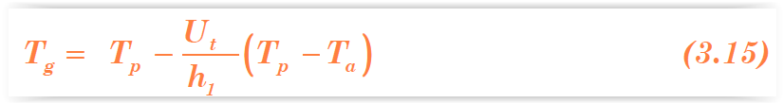
3.2.1 .Top Loss Coefficients
The rate of heat loss from the top per unit area can be given as:
The value of U_{t} is calculated by the method of iteration.
In general, the cover temperature, T_{g} is not known.
An arbitrary value of T_{g} is assumed and h_{1c}, h_{1r}, h_{2r} are calculated at the mean temperature T_{m}, and
Then using these values, the top loss coefficient is calculated.
Substituting this value of U_{t} in the energy balance condition:
A new value of T_{g} is obtained from above equation as:
With this value of T_{g} the above calculations are repeated till the two consecutive values of T_{g} obtained are nearly the same.

Slide 18
Problem 3.1
Calculate the overall top loss coefficient (U_{t}) from the absorber to ambient through the glass cover for the following collector specifications:
  Absorber-to-cover distance (L) 0.025 m
  Absorber plate emittance 0.95
  Glass cover emittance 0.88
  Inclination of collector 45°
  Wind heat transfer coefficient (h_{2c}) 10 W/m²°C
  Ambient air temperature (T_{a}) 16°C
  Mean absorber plate temperature (T_{p}) 100°C

Slide 19
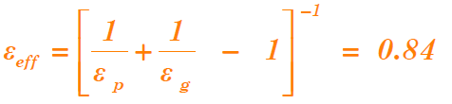

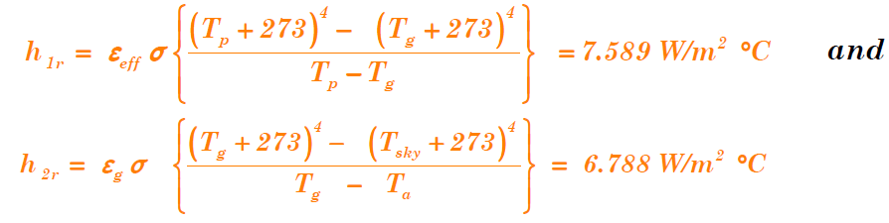
Cont’d …
From Equation (3.7):
and from Equation (3.8):
With an initial value of T _{g} = 35 ^{O}C for the glass cover, from Equations (3.6) and (3.9):

Slide 20
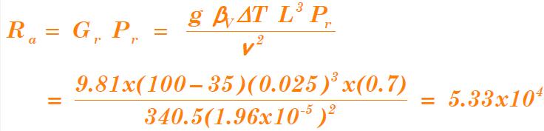

Cont’d …
In order to calculate the convective heat transfer coefficient
between the absorber and the cover, the air properties will be considered at mean temperature between the absorber and the glass cover, i.e. 67.5 ^{O}C. Air properties at 67.5 ^{O}C are n =1.96 x 10⁻⁵ m²/s, K = 0.0293 W/m ºC, T = 340.5 K and Pr = 0.7.
The Rayleigh number is:
From Equation (3.2), the Nusselt number NU = 3.19. The convective heat transfer coefficient is, therefore:

Slide 21
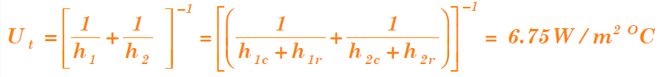
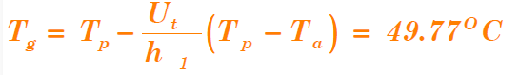
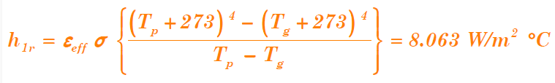
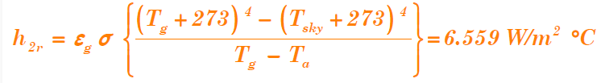
Cont’d …
The first estimate of U_{t} can be obtained from Equation (3.12) as:
With U_{t} = 6.75 W/m² ^{O}C, a new value of T_{g} is obtained from Equation (3.15) as:
With this value of Tg, new values of h_{1r} and h_{2r} will be determined.
And

Slide 22
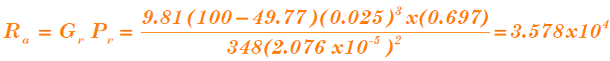

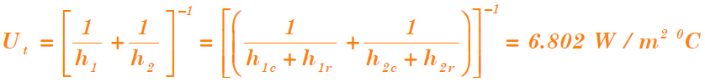
Cont’d …
Air properties at mean temperature of Tp and the new Tg, i.e. 75 ^{O}C are: and the second estimate of U_{t} is: n = 2.076 x 10⁻⁵m²/s, K = 0.03 W/m ºC, T = 348 K and P_{r} = 0.697.
The Rayleigh number is:
In this case, the Nusselt number Nu = 2.9, and the convective heat transfer coefficient is:
and the second estimate of U_{t} is:

Slide 23
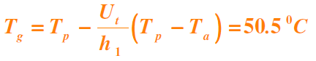
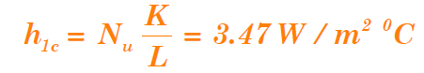
Cont’d …
With the above new value of U_{t} = 6.802W/m² ^{O}C, the new value of
T_{g} will be:
Again, with the above new value of Tg=50.5 °C, h_{1r} and h_{2r} are calculated to yield: h_{1r} = 8.087W /m ²°C and h_{2r} = 6.563 W /m²°C .
At mean temperature = 75.25 °C, approximately same as considered earlier at 75°C is used to obtain air properties.
Now, the Rayleigh number is Ra =3.524 x 10⁴, and the Nusselt number is Nu = 2.894.
The convective heat transfer is given by:

Slide 24
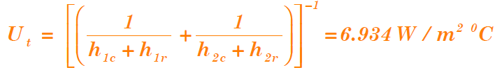
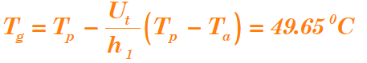
Cont’d …
A third estimate of U_{t} is then determined as:
and the new value of T_{g} is:
which is very close to the value calculated earlier. Hence, the same value of U_{t} will be obtained if calculations are repeated further.
This means the exact value of U_{t} = 6.934 W/m ² °C.

Slide 25
Practical Considerations
The main factors influencing the top heat transfer loss coefficient U_{t} are the number of covers and the emissivity of the absorber plate.
Fig. 3.5 shows the effect of the number of covers on the top heat transfer loss coefficient U_{t} for different plate temperature.
The top heat transfer loss coefficient U_{t} reduces for higher number of covers.
As may be expected, the top heat transfer loss coefficient U_{t} increases with increasing plate temperature.

Slide 26
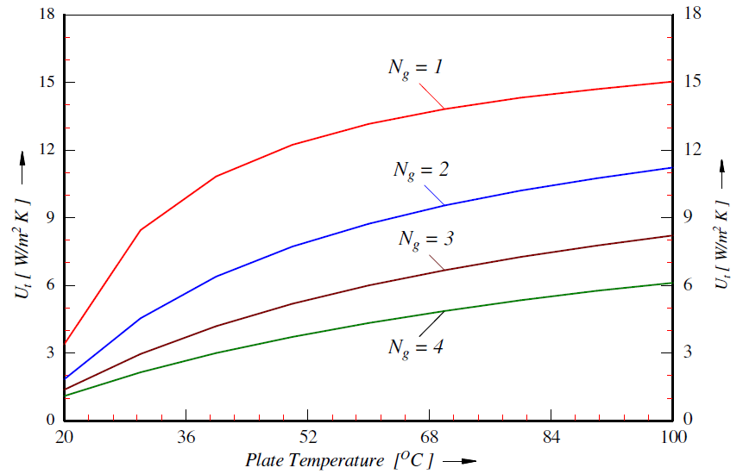
Cont’d …
Fig. 3.5. Effect of Number of Covers on Top-Loss Coefficient

Slide 27
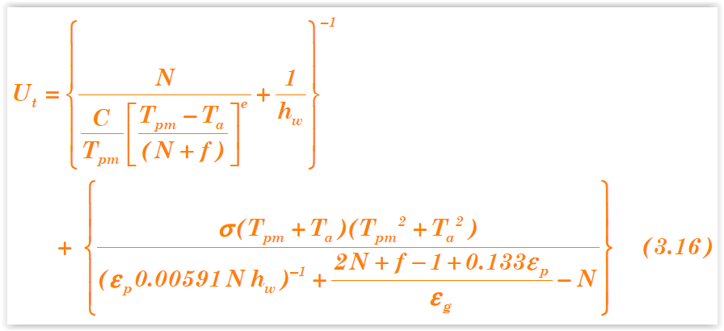
Cont’d …
The effect of the emissivity of the plate on the top heat transfer loss coefficient Ut is shown in Fig. 3.6.
The top loss heat transfer coefficient can be estimated by applying Equation (3.16) as given by Klein (1975).

Slide 28
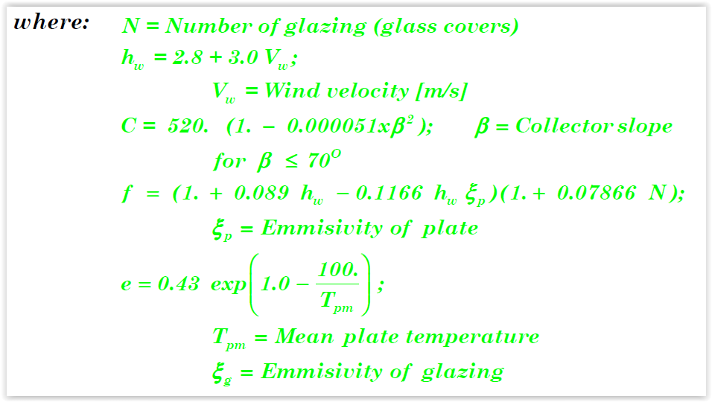
Cont’d …
The effect of the air-gap spacing on the top heat transfer loss coefficient Ut is shown in Fig. 3.8.

Slide 29
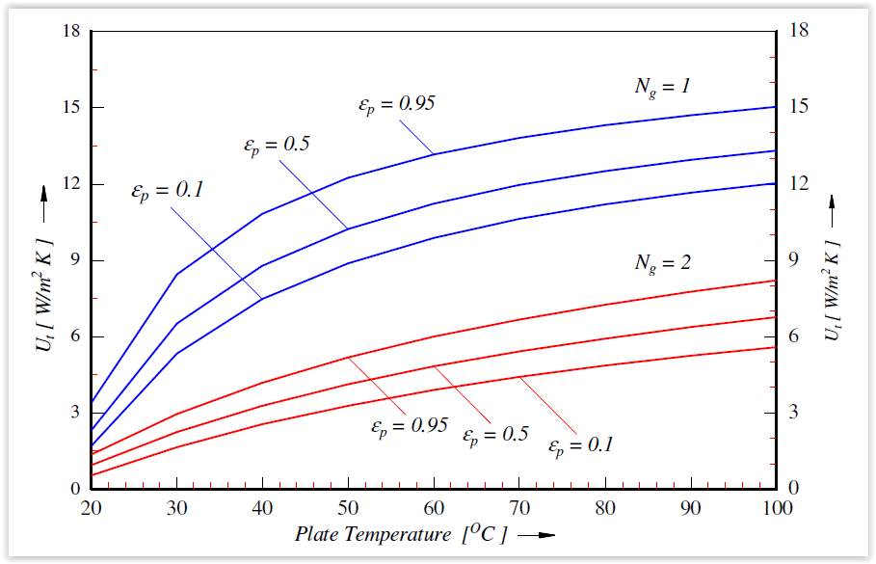
Cont’d …
Fig. 3.7 Effect of Emissivity of the Plate on Top-Loss Coefficient

Slide 30
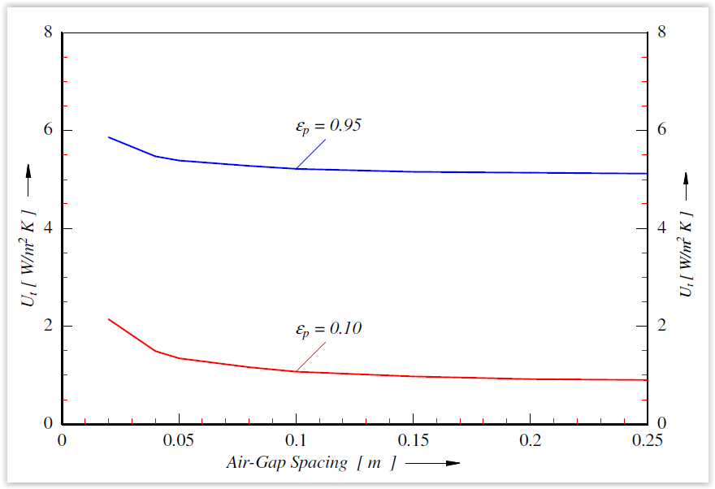
Cont’d …
Fig. 3.8 Effect of Air-Gap Spacing on Top-Loss Coefficient

Slide 31
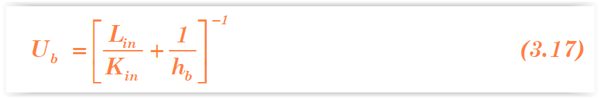
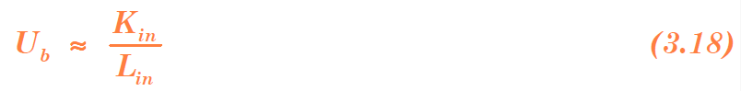
3.2.2. Back Loss Coefficient
Heat is lost from the plate to ambient by conduction through the insulation and subsequently by convection and radiation from the bottom surface casing.
The bottom loss coefficient is given by:
The magnitude of K_{in} and h_{b} are such that the second term in the Equation (3.17) is negligible. Therefore:

Slide 32
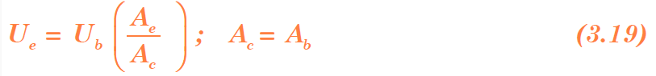
3.2.3 Edge Loss Coefficient
Energy lost from the side of the collector casing may be taken to have exactly the same value as that from the back, if the thickness of the edge insulation is the same as that of the back insulation (Tabor, 1958).
The edge loss is given as:

Slide 33

3.2.4 Overall Heat Loss Coefficient
The overall heat loss coefficient U_{L} is the sum of the top, bottom and edge loss coefficient. That is:
The overall heat lost by the absorber to the ambient per unit area per unit time can be expressed as:

Slide 34
Problem 3.2
Determine the overall heat transfer coefficient for a flat plate collector system inclined at 45° to the horizontal and facing south.
The average ambient air temperature for the day is 20°C and the glass and absorber plate temperatures are 45°C and 69°C, respectively. The system is provided with 6 cm thick insulation, with thermal conductivity of 0.04 W/m °C, at the bottom.
The wind velocity is 5 m/s.
The air space between the absorber plate and glass cover has optimum thickness of 7.5 cm and the emissivities of the glass and plate are 0.88 and 0.95 respectively.

Slide 35
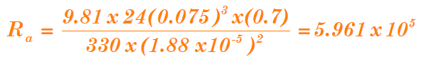
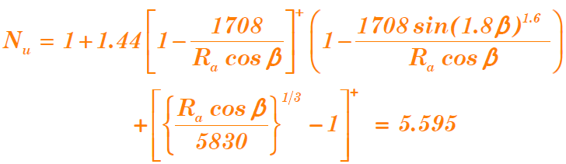
Solution
The average air temperature in the space between glass and plate is 57 ^{O}C.
The physical properties of air at this temperature are: ʋ = 1.88 x 10⁻⁵ m² /s; α = 2.69 x 10-5 m²/s; K = 0.028W/ m ⁰C, σ = 5.67 x 10-8 W/m² K⁴; g = 9.81 m/s²
Now, the Prandtl number is:
Pr = v/ α = 0.7;
Here, DT = 24 ^{O}C; L = 0.075m; Pr=0.7; bV = 1/330 K⁻¹.
Then, the Rayleigh number (from Equation (3.3) is:
Substituting the above values in Equation (3.2) yields:

Slide 36
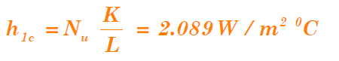

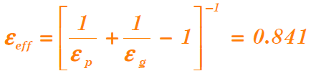
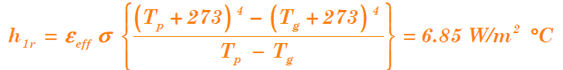
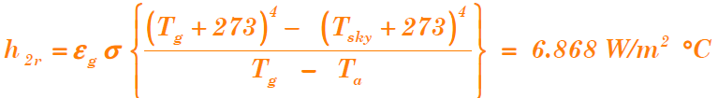
Cont’d …
From Equation (3.1):
From Equation (3.4), with V = 5 m/s:
In this problem,
From Equations (3.6), the radiative heat transfer coefficient h_{1r} from the plate to cover, is given by:
and the radiative heat transfer coefficient from the glass cover to the sky is, Equation (3.9):

Slide 37



Cont’d …
The overall top heat transfer coefficient can be obtained by using Equation (3.12) as:
Bottom loss coefficient (from Equation (3.18)) is:
The overall heat transfer coefficient is, therefore:

Slide 38

3.3. Thermal Analysis of Flat-Plate Collectors
Basic Energy Balance Equation
The useful energy output per unit time of a collector area A_{c} is the difference between the absorbed solar radiation and the thermal loss and is given by:

Slide 39


Cont’d …
The instantaneous efficiency is given by:
The collection efficiency defined as the ratio of the useful gain to the incident solar energy over the same period of time, is given by:

Slide 40
3.3 Solar Water Heating Systems
A flat plate collector can be used for heating liquid/air.
Liquid (say water) circulating through the tubes of a flat plate collector receives heat from the solar energy absorbed and the heated water is stored in an insulated storage tank.
The mode of circulation of heated water from the collector to an insulated storage tank can be either by natural circulation or forced circulation.
A solar water heating system shown in fig. 3.9 has the following main components:
  A flat plate collector;
  A heat exchanger, and
  An insulated storage tank.

Slide 41

Cont’d …

Slide 42
Cont’d …
Pump 1 is used in the collector loop (primary stream) to circulate the fluid through the collector and another pump 2 is used to circulate the water in the outer loop (secondary stream) between the storage tank and a heat exchanger.
Transient Analysis of Solar Water Heater
A typical Thermo-syphon solar water-heating system with a flat-plate collector is shown in Fig. 3,10.
A cross-section of the flat-plate collector and the thermal resistance and capacitance of the simplified collector model are given in Fig. 3.11 and Fig. 3.12.

Slide 43
Cont’d …
The transient thermal performance of the solar collector is evaluated by applying energy balance on its components.
The solar radiation energy incident on the collector surface which is inclined at an angle to the horizontal, defined in terms of the global radiation I_{t}, the diffuse radiation I_{d}, the beam radiation factor R_{b}, the diffuse radiation factor R_{d}, the ground reflectivity factor R_{r} and the ground reflectivity r is given by:
The flux collected per unit time is given by:

Slide 44

Cont’d …
Fig. 3.10 .Typical Thermo-syphon Water Heater

Slide 45


Cont’d …
1. The Absorber Plate: The plate temperature T_{p} at any time (t+D_{t}) can be determined from conditions at time t and the energy absorbed by the plate and energy losses.

Slide 46

Cont’d …
Fig. 3.12 Thermal Resistance and Capacitance of the Collector

Slide 47

Cont’d …
The plate temperature T_{p1} at any time (t+ Δτ) is estimated from energy absorbed during the time interval τ_{t} and the energy losses at the same time interval as:

Slide 48


Cont’d …
2. The Glazing/Glass Cover
Making energy balance on the glass cover, assumed single glazed collector, its temperature at any time (t+Δτ) is determined from data at time t and energy absorbed and lost from the glass cover during the time interval τ_{t} as follows:
Upon integration, Equation (3.30) yields the temperature of the glass cover, after time interval of Δτ , as:

Slide 49

Cont’d …
3. Water Stream
Application of similar approach yields an expression for the temperature of hot water leaving the solar collector as:

Slide 50
Cont’d …
Application of similar approach yields an expression for the temperature of hot water leaving the solar collector as:
Equations (3.29), (3.31) and (3.33) are derived from energy balance on the absorber plate, the glass cover and the water stream, respectively.
The given sets of equations are non-linear due to temperature dependent radiant and convective heat transfer coefficients.
The solutions are, therefore, determined by an integration scheme that linearises these equations within a set time step.

Slide 51

Cont’d …
4. Storage Tank
The temperature of the water at the inlet of the collector is evaluated by taking the hot water extracted from and the heat losses across the storage tank into account.
In the model, the level of water in the storage tank is to be controlled by a float valve keeping the mass of water in the storage constant.
After making energy balance in the time interval Δτ, the storage tank temperature is evaluated from:

Slide 52

Cont’d …
The temperature of the absorber plate varies across the width of the fin, having a maximum on the center line between the fluid ducts.

Slide 53
Cont’d …
Procedure for Simulation of the Solar Water Heater
The flow chart, Fig. 3.13, shows the procedure that can be implemented for transient simulation of water heating system.
The simulation program is used to predict the monthly and annual performance of the solar water heating system.
The parameters read from input files at the beginning of the simulation process include:
Latitude of the site, azimuth and slope of the solar collector,
Geometric dimensions and thermo-physical properties of the absorber plate, the glazing and the insulation,

Slide 54

Cont’d …
Fig. 3.13(a) Flowchart of Simulation Programme

Slide 55
Cont’d …
Thermo-physical properties of water, Storage capacity, daily hot water consumption pattern and hot water delivery and cold water supply temperatures, and Beam and diffuse solar radiation and ambient temperature for every hour of the day.

Slide 56




Solar air heater and Desalination – Applications

Slide 57

Cont’d …

Slide 58
3.4. Solar Air heaters
Air heaters have certain disadvantages:
1. Because of its poor heat transfer properties, special care is required to improve the heat transfer of air.
2. Due to its low density, large volume of air is needed to be handled.
3. Since the thermal capacity of air is low, it cannot be used as a storage fluid.
4. In the absence of proper design, the cost of air heater is very high.

Slide 59

Cont’d …
Fig. 3.14 Schematic Diagram of Air Heaters

Slide 60

Cont’d …
Transient Analysis
The transient thermal performance of the solar collector is evaluated by applying energy balance on its components.
The solar radiation energy incident on the collector surface which is inclined at an angle β to the horizontal, defined in terms of the global radiation I_{t}, the beam radiation I_{b}, the diffuse radiation I_{d}, the beam radiation factor R_{b}, the diffuse radiation factor R_{d}, the ground reflectivity factor R_{r} and the ground reflectivity ρ , is given by:
The flux collected per unit time is given by:

Slide 61

Cont’d …
Energy balance on the absorber plate, the air stream and the glass cover are performed based on the thermal circuit indicated in Fig. 3.16.
Fig. 3.15. Solar Air Heating Collector

Slide 62

Cont’d …
Fig. 3.16. Thermal Circuit of Solar Air Heater

Slide 63



Cont’d …
1. Absorber Plate
Energy balance on the absorber plate is expressed as:
Where: A₁ = collector perimeter x depth of the edge = pxde
In Equation (3.45), the overall heat transfer coefficient from the plate to the glass, U_{pg}, by convection and radiation is given by:
where the Grashof number G_{rL} is defined by:

Slide 64




Cont’d …
and the volume expansion coefficient β_{V} as:
The overall emittance factor ɛ_{pg} for the absorber plate and the glass cover is obtained from the relation:
The heat transfer coefficient U_{a} of the air is defined as:
Where :

Slide 65

Cont’d …
All properties in the above equation are evaluated at the film temperature T_{f} given by:
Due to the transient nature of the radiant and convective heat transfer coefficients, Equation (3.45) is a non-linear equation and its solution requires an integration scheme that linearises the given differential equation within a given time step.
The plate-temperature at time (t+Δτ) is evaluated from available data at time t and incident solar radiation and thermal losses during time interval Δτ.

Slide 66

Cont’d …
The temperature of the plate at time (t+Δτ) in terms of the absorbed useful incident radiation on the surface of the plate, the heat losses through the glass cover and the collector edge, the quantity of heat absorbed by the air stream and temperatures of the collector components at time t is obtained from Equation (3.45) as:

Slide 67

Cont’d …

Slide 68

Cont’d …
2. Air Stream
Considering heat transfer from the collector plate to the air-stream, heat transfer from the air-stream to the glazing and heat transfer to the air entering the collector, energy balance on the stream yields:
where the mass flow rate of air at exit from the collector is determined from the solar flux collected per unit area, I_{c}, the temperature difference between the heated air at outlet T_{ao} and the ambient (incoming) air temperature at T_{ai} = T_{a} and the plate temperature as:

Slide 69


Cont’d …
The temperature of the air stream entering the solar collector at the ambient conditions at time t gains energy from the incident radiant energy on the collector plate.
In relation to the inlet air-stream temperature, the heat losses from the plate to the glass cover and the collector edge, the temperature of the air-stream at outlet from the collector at (t +Δτ) is determined from:

Slide 70
Project
Task of the Project:
Transient thermal-analysis of a solar dryer is to be investigated using the available hourly-averaged solar radiation data - global and diffuse radiation intensities and ambient temperature - for a year, applying the theoretical analysis given in the preceding sections.
The following dimensions and parameters are to be used for the system simulation.
Collector area [ m² ] [L = 2 m, W=1 m] A_{c} 2.0
Collector perimeter [ m ] P 6.0
Collector slope (south facing) β 15^{O}
Back insulation thickness [ m ] t_{be} 0.03
Edge insulation thickness [ m ] t_{e} 0.03
Depth of edge [ m ] d_{e} 0.05
Emissivity of panel [ - ] ɛ_{P} 0 .10
Emissivity of glass [ - ] ɛ_{g} 0 .88
Conductivity of insulation [ W/m K ] K_{i} 0.045

Slide 71
Cont’d …
Absorptivity of panel [ - ] α_{p} 0.90
Transmisivity of glass [ - ] τ_{g} 0.96
Space between panel and glass [ m ] L 0.040
Mass x Sp. heat of panel [ J/K ] (m c_{p})_{p} 16500.0
Mass x Sp. heat of air [ J/K ] (m c_{p})_{a} 10050.0
Mass x Sp. heat of glass [ J/K] (m c_{p})_{g} 18200.0
Wind velocity [m/s] V_{m} 2.5
Representative results are indicated in Fig. 3.17.

Slide 72

Cont’d …
Fig. 3.17 Temperature and Absorbed Heat Distribution for April

Slide 73
Working Principles of Solar Air heaters
Drying Mechanism
In the drying process, moisture is removed from material to be dried until the required final moisture content is reached.
The material to be dried is placed on a screen (wiremesh) in the drying chamber (cabinet) of the drier.
Heated air is passed upward through the bed of material to be dried.
During the evaporation of moisture from the surface of the material to be dried into the air stream, a quantity of heat equal to the latent heat of evaporation plus the sensible heat necessary to bring the water to the temperature of the air is abstracted from the surrounding.

Slide 74

Cont’d …
Fig. 3.18 (a) Indirect Type of Solar Dryer

Slide 75

Cont’d …
Fig. 3.18 (b) Indirect Type of Solar Dryer

Slide 76

Cont’d …
Fig. 3.18 (c) Indirect Type of Solar Dryer

Slide 77

Cont’d …
Fig. 3.19(a) Psychrometric Chart Representations of Drying Processes

Slide 78

Cont’d …
Fig. 3.19(b) Psychrometric Chart Representations of Drying Processes

Slide 79

Solar Thermal Power Plant

Slide 80

Solar Thermal Power Plant

Slide 81
3.5 Solar Desalinator
3.5.1 Working Principle
Fig. 3.20 shows various components of energy balance and thermal energy loss in a conventional solar distiller unit.
It is an airtight basin, usually constructed out of concrete/cement, galvanised iron sheet or fiber reinforced plastic with a top cover of transparent material like glass, plastic, etc.
The inner surface of the rectangular base is blackened to efficiently absorb the solar radiation incident at the surface.
The distillate is collected at lower end of the glass cover.

Slide 82

Cont’d …
Fig. 3.20 Energy Flow Diagram in a Conventional Solar Still

Slide 83



Cont’d …
Consequently, the water gets heated, leading to an increased difference of water and glass cover temperatures.
There are basically three modes of heat transfer, radiation
( ), convection ( ) and evaporation ( ) from the water surface to the glass cover.
The evaporated water gets condensed on the inner surface of the glass cover after releasing the latent heat.
The condensed water trickles into the channels provided at the lower ends of glass cover, under gravity.
The collected condensed water in the channel is taken out of the system for further use.

Slide 84
Cont’d …
The thermal energy received by the glass cover, through radiation, convection and latent heat of evaporation, is lost to the ambient by radiation and convection.
A solar still system can be modeled using energy and mass balance equations on the system.
Since the main energy source is solar intensity, which depends on the time of the day, the basic energy and mass balance equations must be time dependent – transient.

Slide 85

Cont’d …
Fig. 3.21 Thermal Resistance for Conventional Solar Still

Slide 86
Thank You!
Questions, suggestions, comments … are welcomed!

