Slide 1
Riser Design

Slide 2
Now, let us see what is the primary function of a riser. It acts as a reservoir of the molten metal in the mould to compensate for the shrinkage during solidification.
We all know that all the metals when they solidify right in the liquid level and when they are solidifying they undergo shrinkage. This is known as the solidification shrinkage.
Now, that time the some molten metal will be inside the mould cavity and during the solidification because of the solidification shrinkage there will be a shrinkage cavity will be there. And the molten metal which is inside the riser comes and fills that gap and it compensates that gap. Not only during solidification, during the liquid cooling of the molten metal.
For example, let us take the aluminium. Aluminium melts at about 600 and 60 degree centigrade, but we used to pour it about 750 degree centigrade. From 750 degree centigrade to 660 degree centigrade there is liquid cooling, there is no solidification. But during this liquid curing cooling also there is a reduction in the volume inside the mould cavity. But, this reduction is compensated by the liquid metal which is inside the riser.

Slide 3
So, the riser or the liquid metal in the riser compensates the reduction in volume due to liquid cooling of the metal. It also compensates the molten metal due to solidification shrinkage.
So, that is the primary function of the riser and it has got secondary functions also. It gives us an indication that the cavity is full with the molten metal.
Yes, we keep pouring the molten metal through the sprue and through the pouring cup and through the sprue and it passes through the runner and it fills the cavity. Once the cavity is full with the molten metal, it rises up. That is why it is known as the riser.
Because, it is feeding the casting it is also known as the feeder.

Slide 4
Next one there is another secondary function. It also enables escape of hot gases during pouring of the molten metal. Yes, as we keep pouring the molten metal, immediately the moisture in the moulding sand comes in contact with the molten metal, spontaneously this moisture turns into vapour and hot gases will be released. And as, we keep pouring the molten metal, yes through the riser hole they will be escaping. But this escaping of the hot gases is possible as long as the riser is not filled with the molten metal.
Once the riser is filled with the molten metal, hot gases cannot escape through the riser any longer. That time they will be escaping through the wind holes. They also escape due to the permeability of the moulding sand. So, these are the functions of the riser.
Remember that the primary function of the casting is to feed the casting during the liquid cooling, but also during the solidification process. So, that is why it is known as the feeder. And it has got the secondary function due to rises and uses an indication that the cavity is full with the molten metal. Because it is rises it is known as the riser.

Slide 9
3 | Blind Riser | Open Riser
1 | A blind riser is closed at its top, however a vent or permeable core at the top of the riser may be provided to have some exposure to the atmosphere otherwise vacuum created between the top of the riser and the liquid metal level in the riser may not permit proper feeding of the liquid metal from the riser to the casting. Gravity is only feeding force | The top of the open riser is open i.e., exposed to atmosphere. The liquid metal in the riser is fed to the solidifying casting under force of gravity and atmospheric pressure till the top surface of the riser solidifies and thereafter gravity is only the feeding force
2 | A blind rise connected a) either at the top of the cope b) or on the side if the casting at the parting line or in the drag | An open riser is connected a) either at the top of the cope b) or on the side of the parting line
3 | A blind riser is a rounded cavity and it represents the minimum practical ratio of surface area to volume and thus associates a slow cooling rate and is more efficient | An open riser is generally cylindrical
 | Advantages i)Blind riser can be placed at any position in the mould ii) It is smaller than a comparable open riser iii)It can be removed more easily from casting iv) Being surrounded by moulding sand from all sides the metal in riser cools slowly v)Blind risering promotes directional solidification better than open risering | Advantages i)An open riser is easy to mould as compared to a blind riser ii)An open riser is open to atmosphere thus it ensures that unlike a blind riser it will not draw metal from the casting as a result of partial vacuum in the riser
 | Limitations i)It is difficult to build a blind riser ii)A blind riser may draw liquid metal from the solidifying casting | Limitations i)Open riser is not placed in the drag ii) Open riser is generally larger than a comparable blind riser iii)Being exposed to atmosphere, the liquid metal in the top portion of riser starts solidifying immediately after the mould filling is completed, because there is major heat loss to the atmosphere by radiation. The use of insulating and exothermic compounds is recommended iv) Its height is determined not by feeding requirements,but by the depth of moulding box used

Slide 10
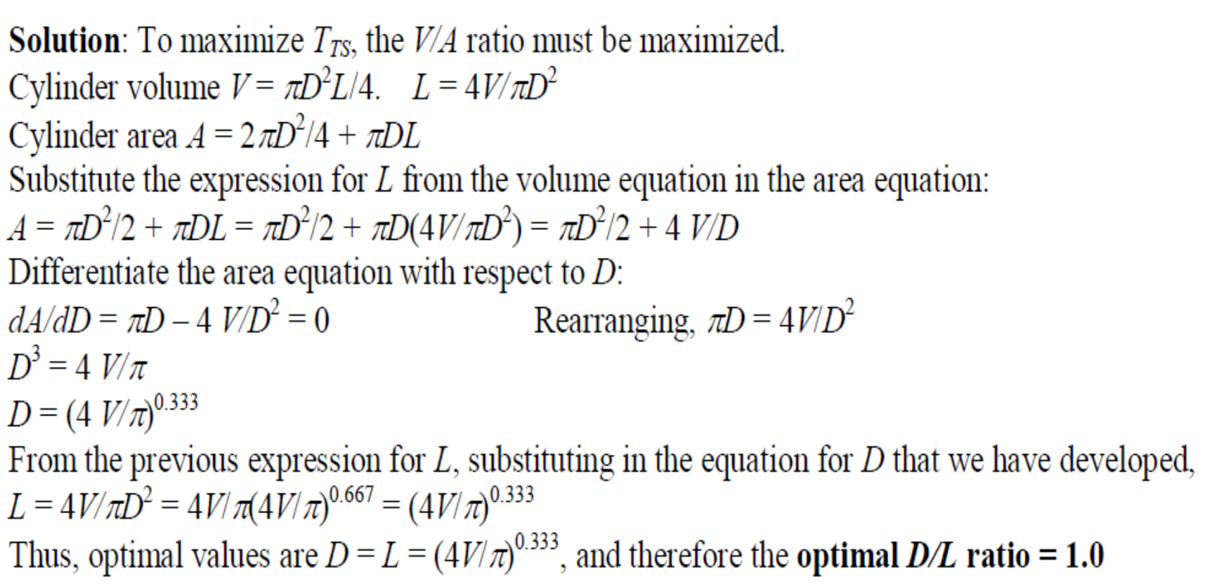
A side cylindrical riser is to be used for a sand-casting mold. For a given cylinder volume, determine the diameter-to-length ratio that will maximize the time to solidify.

Slide 11
Riser must be placed so that it enables directional solidification. The position of the riser must be such that there will be directional solidification. Now, the question is what is this directional solidification? Let us see right.
In one case directional solidification is in what way progress. Means, it is dominating. In another case, progressive solidification is dominating. Means, what is happening here? This is the casting and this is the riser. Now, here there is liquid metal is there. So, this portion this gray portion indicates the solidified casting. Now, the solidification is gradually propagating towards the riser. As it is propagating towards the riser liquid metal in the riser is able to feed any shrinkage that is taking place during the process of the solidification.

Slide 12
Methods of Riser Design

Slide 15
Now, here you can see; now the Caine has plotted a graph like this. Means, he has conducted extensive experiments on the castings and on several castings he got the shrinkage defects and in some castings he got the sound castings, and for all the castings he has calculated the freezing ratio. And he has also calculated the riser volume to casting volume. Now, with freezing ratio as the x axis and the riser volume to casting volume as the y axis he has plotted this graph.
So, this is the graph plotted by Caine.
Now, what does this graph tell us? The graph plotted by Caine predicts whether the casting would be a sound or defective one.
Now, let us see this graph here. There is a curve right, so when he has plotted taking
freezing ratio on the x axis and the riser volume to casting volume on the y axis so a curve was plotted.
Now, all the castings that fall on the right side of this curve will be sound castings without any shrinkage defects. Now, all the castings which are falling on the left side of this graph, right curve will be defective castings with shrinkage defects

Slide 16
So, this was the finding of the Caine and he this he has plotted after conducting extensive investigations.
Now the problem is what is the limitation? Definitely this is was a very good work, but what is the limitation. What say this process says that you design some riser and I will tell you whether you will get a sound casting or a shrinkage casting.
You design a riser yes this is going to give you a shrinkage defect. You design another riser, this is going to give a sound casting.
Now my question is; what is the size of the riser with which I can get a sound casting and that size of the riser must be optimum, the Caine’s method cannot give answer to this. So, that is the small limitation of this Caine’s method.

Slide 17
Now, there were this work was further extended. Now another definition was given for freezing ratio.
Now here, x is the freezing ratio.
Now freezing ratio x is equal to a divided by Y minus b plus c.
Where, X is the freezing ratio, Y is equal to volume of the riser divided by volume of the casting,
a, b, c are constants and they depend upon the material of the casting.

Slide 59
Now, here we can see this is the riser and this white color indicates the liquid metal whereas, this gray color indicates the solidified metal.
Now, the solidification is progressing in this direction and this is the riser and here there is liquid metal and the solidification is progressing in this direction. You can see slowly more and more material will be solidified more and more material will be solidified and it is going towards the riser. This is the directional solidification.
Now, let us see the second case here we can see the riser is somewhere here, but you see this is the solidified metal. The gray colored one is the solidified metal whereas, the
white one is the liquid metal and here we can see the red colored one see is this that is
the centerline of the casting. Now, the solidification is progressing perpendicular to the centerline of the casting now what happens the riser is somewhere here. The riser is what say it has sufficient metal to feed the casting, but before it could feed be casting this is slowly coming.

Slide 60
See this portion is coming towards the center of the axis similarly the bottom portion is progressing towards the axis. Finally, what will happen somewhere there will be shrinkage will be there and the riser though it has got the sufficient liquid metal it is not able to supply the liquid metal to the shrinkage area, why because the what say solidification is progressing perpendicular to the axis of the casting. So, this is the progressing progressive solidification always the directional solidification is good for the casting. If we want there should not be any what say the shrinkage cavity then there must be perfect directional solidification.

Slide 71
Now, feeding distance is the length of the casting, where there would not be any shrinkage. Whether it is due to the end effect or due to the riser effect. Now, the question is how to measure this feeding distance is it from the center of the riser or from the end of the riser right. So, the feeding distance here you can see this is the FD and this is the riser this is the riser and this is the casting. Now, the feeding distance is always measured from the edge of the riser, you see from the edge of the riser to the furthest point in the casting right. Or the casting section to be fed by that riser right. It starts from the edge of the riser to the furthest point in the casting that is fed by the riser. So, it is starts from here and it ends here. So, this is the feeding distance.

Slide 72
Now, again we will see riser zone length RZL of a casting section without end effects.
Suppose, let us assume there is no end effect, only riser effect is there. So, here the this is the riser. This is a cylindrical riser. Then what happens to the riser zone. So, zone will be a cylindrical portion. So, this in this much portion there would not be any shrinkage. So,
this the riser zone

Slide 73
Now, let us see another case end zone length EZL of the casting means if we again if we ignore the riser because of the end effect. So, this much portion there would not be any shrinkage. So, this is the end zone or this is the end zone length.
Now, let us see a problem. A steel casting of size 40 into 25 into 10 centimeters is to be fed by a side riser. Calculate the feeding distance of the riser.

