Slide 1
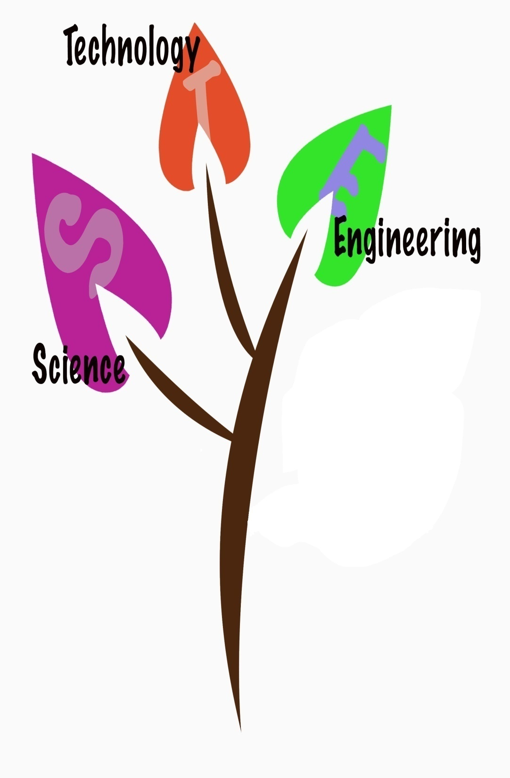
Applying
Ethics
&
Professionalism

Slide 2

Engineering as a Profession:
Engineering training deals with the exact sciences.
That sort of exactness makes for truth and conscience.
C:Sense of right and Wrong
It might be good for the world if more men had that sort of mental start in life even if they did not pursue the profession.

Slide 3

It is a great profession.
There is the fascination of watching a figment of the imagination emerge through the aid of science to a plan on paper.
Then it moves to realization in stone or metal or energy.
Then it brings jobs and homes to men/woman.
Then it elevates the standards of living and adds to the comforts of life.
That is the engineer's high privilege.

Slide 4
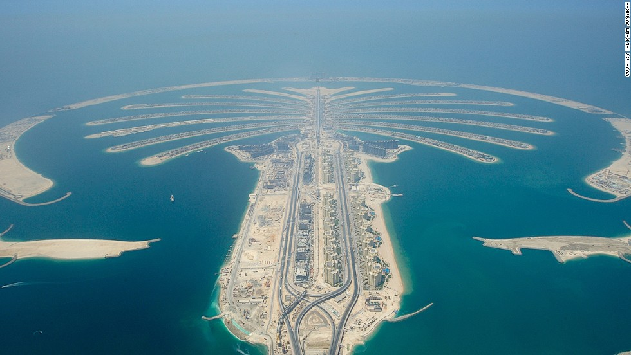
The great liability of the engineer compared to men of other professions is that his works are out in the open where all can see them.
His acts, step by step, are in hard substance.
He cannot bury his mistakes in the grave like the doctors.
He cannot, like the architects, cover his failures with trees and vines.
He cannot, like the politicians, screen his shortcomings
by blaming his opponents and hope that the people will forget.

Slide 5
On the other hand,
unlike the doctor, his is not a life among the weak.
Unlike the soldier, destruction is not his purpose.
Unlike the lawyer, quarrels are not his daily bread.
No doubt as years go by people forget which engineer did it, even if they ever knew. Or some politician puts his name on it. Or they credit it to some promoter who used other people's money with which to finance it.

Slide 6

But the engineer himself looks back at the unending stream of goodness which flows from his successes with satisfactions that few professions may know. And the verdict of his fellow professionals is all the accolade he wants.

Slide 7
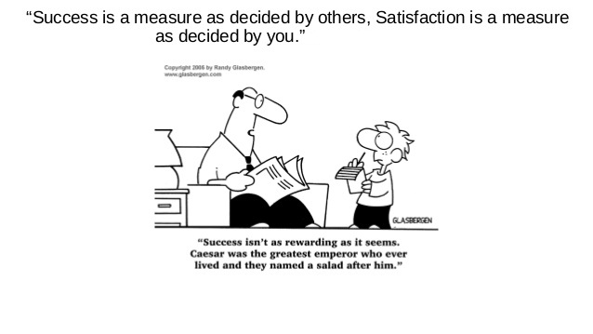

Slide 8
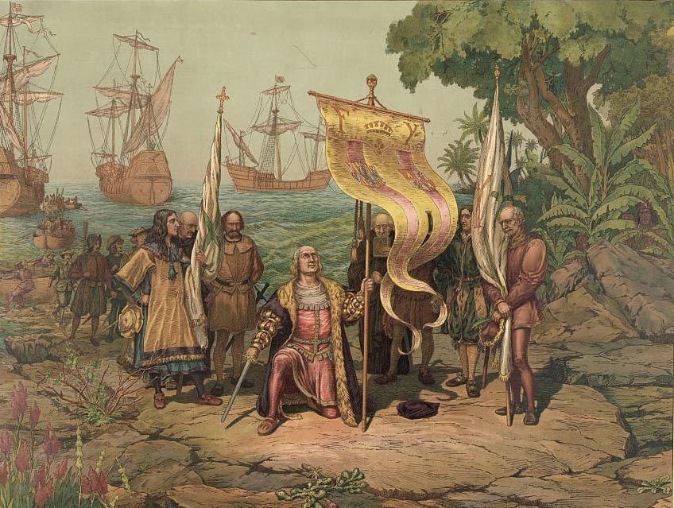
The engineer performs many public functions from which he gets only philosophical satisfactions.
Most people do not know it, but he is an economic and social force.
Every time he discovers a new application of science, thereby creating a new industry, providing new jobs, adding to the standards of living, he also disturbs everything that is.
He is also the person who really corrects monopolies and redistributes national wealth.
Columbus discovery of America

Slide 9

What is a Professional Engineer?
Professional engineering is:
Any act of planning, designing, composing, evaluating, advising, reporting, directing or supervising (or the managing of any such act);
That requires the application of engineering principles; and
Concerns the
Safeguarding of life,
health, property,
economic interests,
the public welfare or
the environment.

Slide 10
Great Reasons to Study Engineering:
Reason 1: Money
Reason 2: Prestige
Reason 3: Professionalism
Reason 4: Flexibility and Choice
Reason 5: Intellectual Development
Reason 6: Entrepreneurship
Reason 7: Challenge
Reason 8: Creativity
Reason 9: Discovery
Reason 10: Society Needs You

Slide 11

Money
This is always one of the top reasons to study anything. It's important to know that engineers are among the top-paid professions world-wide. It's well known that if you want money, engineering is one of the best ways to go. And since money is so important in our world, especially in these economic times, this is one factor you should be considering carefully.

Slide 12
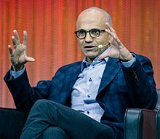
Occupation | CEO of Microsoft
Employer | Microsoft
Salary | $18.3 million (with per annum stock grant and bonus)

Slide 13

Prestige
Along with doctors and lawyers, engineers are professionals who have a lot of prestige. Wouldn't your mother be proud to tell all her relatives and friends that her son or daughter is an engineer? You'll gain a desired job image, and join a profession that supports national and global competitiveness, security, and rising living standards. Being an engineer just makes you look great!

Slide 14

Professionalism
Engineering programs worldwide are among the top, most-advanced educational programs. Study with top-of-the-line technology, receive great coop placements and training, and join a profession like no other. While working, you'll benefit from not only competitive wages and prestige- being a member of an engineering society will give you access to information and technology that will help you do your work better and enjoy life. Engineering is a professional choice.

Slide 15
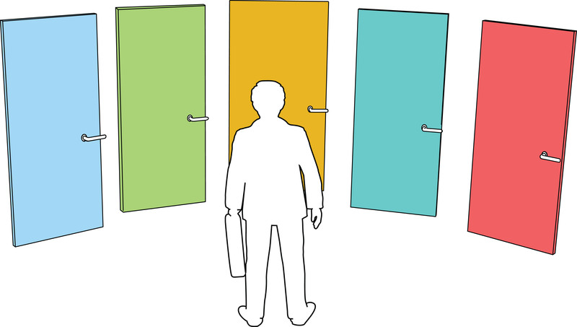
Flexibility and Choice
These days, everybody's looking for choice. Engineering offers so many choices you can have a hard time deciding on which one fits you- from electrical and mechanical to computer science or civil, the various areas of engineering are all exciting and in high demand.
Engineering is a great choice that opens up many paths for the future.

Slide 16

Intellectual Development
Engineering will help you grow and develop your ways of thinking. Becoming an engineer will force you to work on many transferable skills including problem-solving and critical reasoning. In addition you'll study a large variety of topics in school, including engineering courses but also sciences, and even some arts and languages. Knowing more and having more useful skills will develop you as a person.

Slide 17
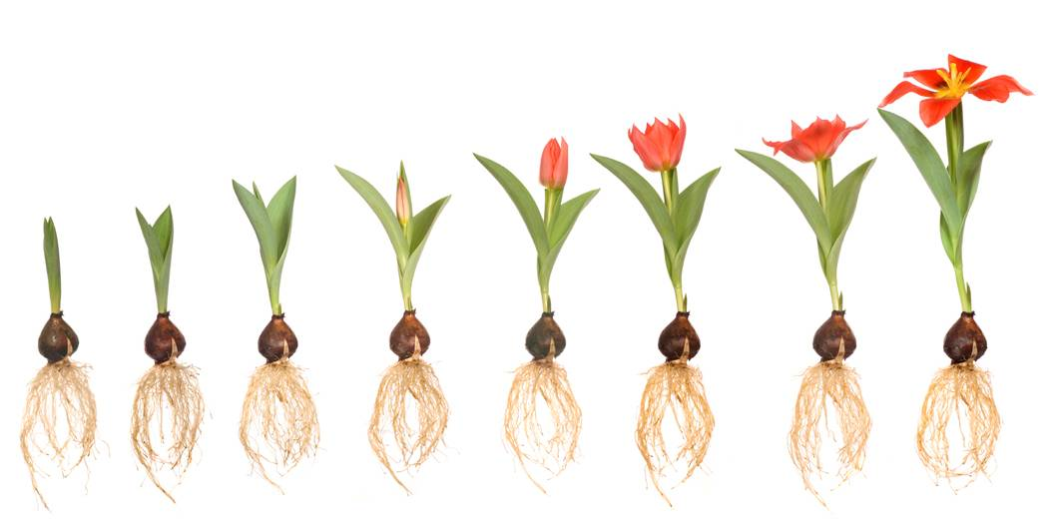
Entrepreneurship
Nobody wants to be a little bolt in a big corporate machine.
Studying engineering provides you with the knowledge and skills to open up your own business and become your own boss.

Slide 18
Engineering training exposes you to businesses and gets you more familiar with things like finance and marketing, which is important for business purposes, and transferable skills will help you run your own company.
Having technical knowledge will allow you to make a product and centre a business around it (just like John Phillip Green and Malgosia Green who studied computer science and systems design engineering and founded LearnHub!)

Slide 19

Challenge
Everyone likes a good challenge, since life would be boring otherwise. Engineering is a challenge. Throughout both your studies and your later career, you will be faced with problems which will require your creativity and logical analysis skills. Real world problems will be open ended with no wrong or right answer- it'll be up to you to find a solution and stand up to it, convincing others it's right.

Slide 20

Creativity
Most jobs don't allow you to be creative.
Engineering, on the other hand, lets you exercise your judgment however you want.
You'll need to be creative to come up with solutions to fascinating problems, and you'll be able to use both concrete knowledge and your own thoughts and views when coming up with a successful original design or development.
Engineering is the art of science!

Slide 21

Discovery
An engineering education will help you discover how the world works. You may be dealing with recent issues such as electric cars, alternative energy sources, nuclear reactors, and more. You may end up seeking for answers on how to solve world hunger or what kinds of technology cause cancer. Engineering is interconnected with science and research, and it will allow you to learn and discover a world of knowledge.

Slide 22

Society Needs You
If you're smart, you have a responsibility to society. Don't waste your brain power- become an engineer. From the early days of dawn engineers have worked to benefit society- developing everything from necessary forms of safety and security measures and transportation mechanisms, to devices and technologies that enrich life and make it better and more comfortable for everyone. New engineering trends may help solve issues like diseases, hunger, energy, and pollution problems. Make a difference- help us engineer a better tomorrow.

Slide 23

Types of Natural Resources

Slide 24

Renewable resource
Renewable resources are natural resources that can be replenished in a short period of time.

Slide 25
A renewable resource is an organic natural resource that can replenish in due time compared to the usage, either through biological reproduction or other naturally recurring processes.
Renewable resources are a part of Earth's natural environment and the largest components of its ecosphere. A positive life cycle assessment is a key indicator of a resource's sustainability
Paul Alfred Weiss defined Renewable Resources as:
"The total range of living organisms providing man with food, fibres, drugs, etc...".

Slide 26

Food and water:
Water resources
Water can be considered a renewable material when carefully controlled usage, treatment, and release are followed.
For example, groundwater is usually removed from an aquifer at a rate much greater than its very slow natural recharge, and so groundwater is considered non-renewable.
Removal of water from the pore spaces may cause permanent compaction (subsidence) that cannot be renewed. 97.5% of the water on the Earth is salt water, and 3% is fresh water; slightly over two thirds of this is frozen in glaciers and polar ice caps. The remaining unfrozen freshwater is found mainly as groundwater, with only a small fraction (0,008%) present above ground or in the air.

Slide 27
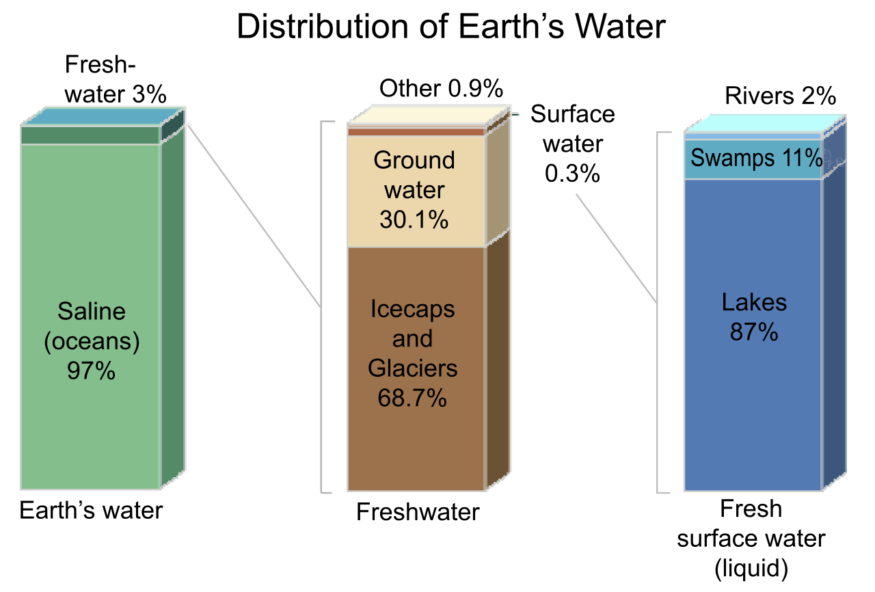

Slide 28
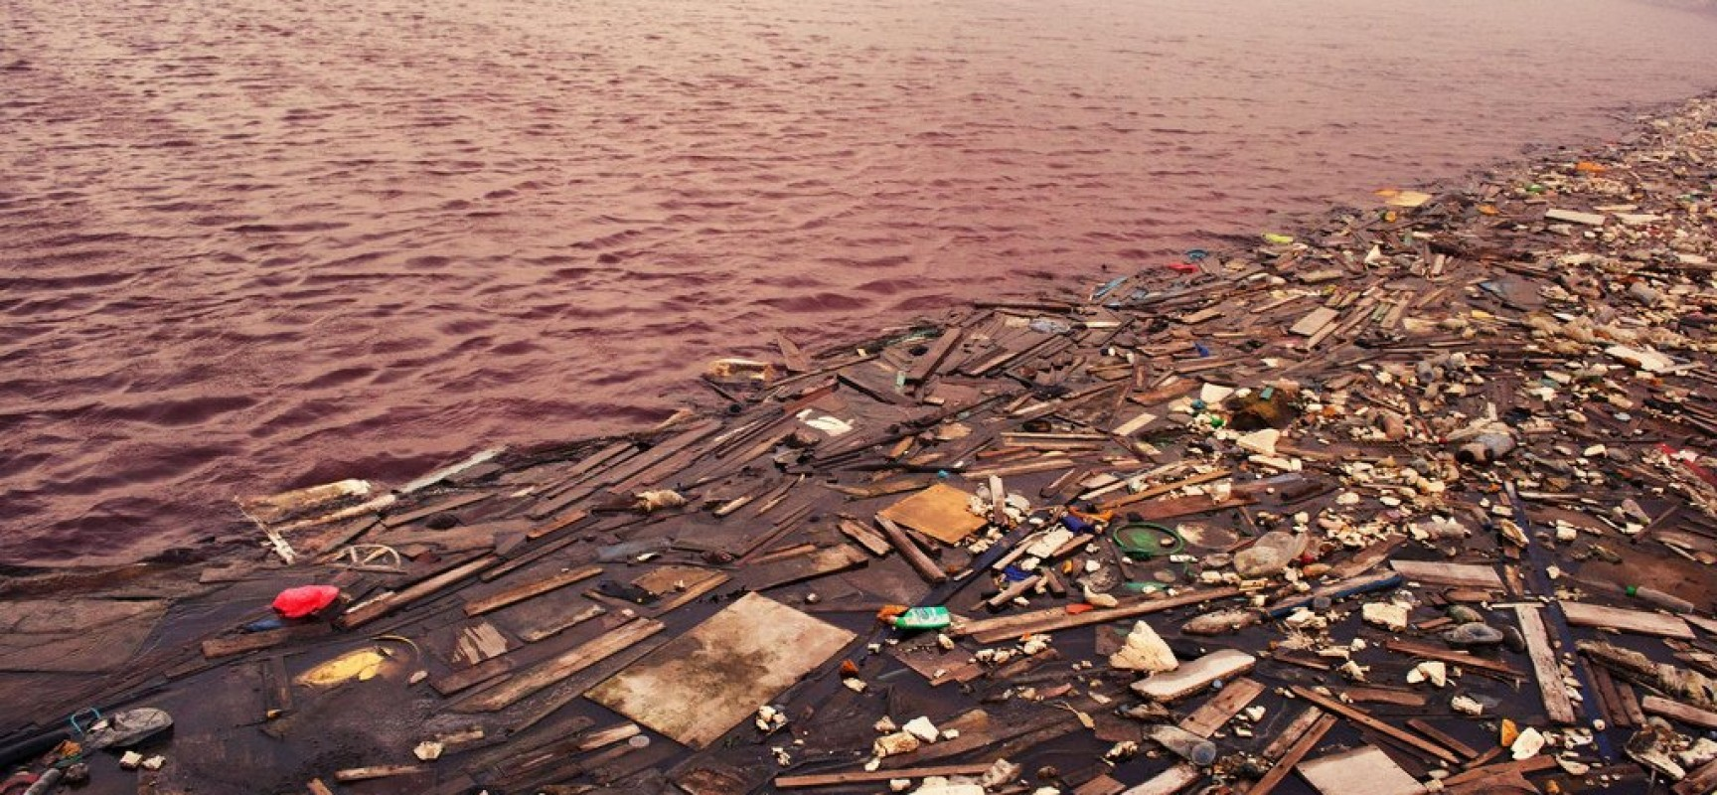
Water pollution is one of the main concerns regarding water resources.
It is estimated that 22% of worldwide water is used in industry.
Major industrial users include hydroelectric dams, thermoelectric power plants, which use water for cooling, ore and oil refineries, which use water in chemical processes, and manufacturing plants, which use water as a solvent.

Slide 29
Non agricultural food:
Food is any substance consumed to provide nutritional support for the body.
Most food has its origin in renewable resources.
Food is obtained directly from plants and animals.
Wild berries and other fruits, mushrooms, plants, seeds and naturally growing edible resources, still represent a valuable source of nutrition in many countries, especially in rural areas. in fact many wild animals are dependent on wild plants and fruits as a source of food.
Hunting may not be the first source of meat in the modernized world, but it is still an important and essential source for many rural and remote groups. It is also the sole source of feeding for wild carnivores.

Slide 30

Sustainable agriculture:
It is defined as "an integrated system of plant and animal production practices having a site-specific application that will last over
Expansion of agricultural land has an impact on biodiversity and contributes to deforestation.
The Food and Agriculture Organisation of the United Nations estimates that in coming decades, cropland will continue to be lost to industrial and urban development, along with reclamation of wetlands, and conversion of forest to cultivation, resulting in the loss of biodiversity and increased soil erosion.

Slide 31
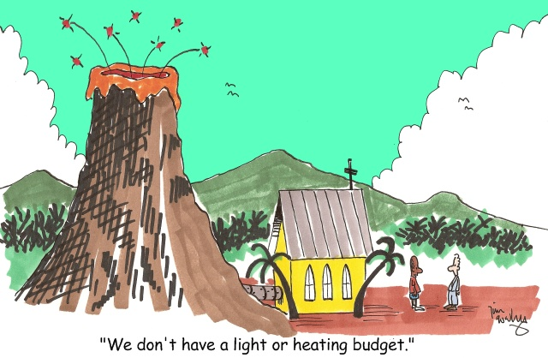
Threats to renewable resources:
Renewable resources are endangered by non-regulated industrial developments and growth.They must be carefully managed to avoid exceeding the natural world's capacity to replenish them. A life cycle assessment provides a systematic means of evaluating renewability.

Slide 32
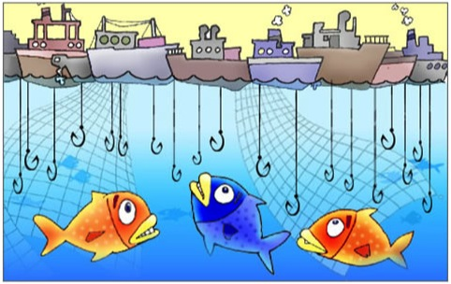
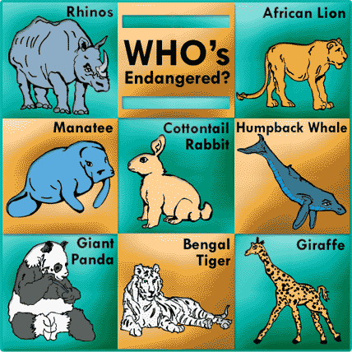
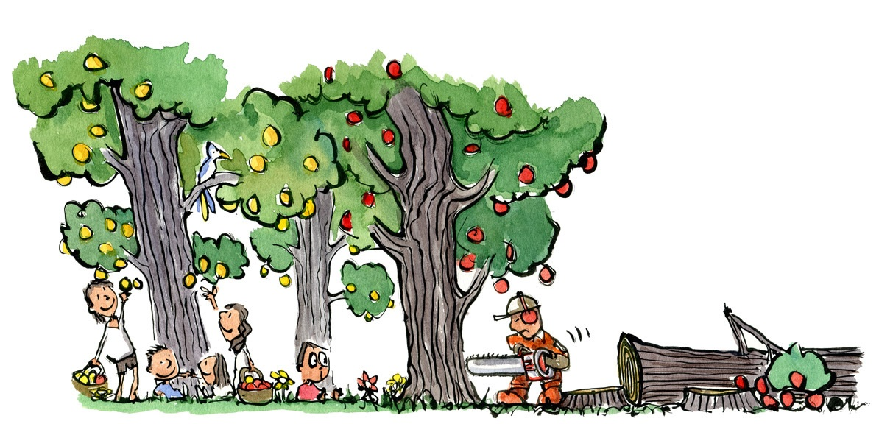
This is a matter of
sustainability in the
natural environment.
Overfishing
Deforestation
Endangered species

Slide 33
Some renewable resources, species and organisms are facing a very high risk of extinction caused by growing human population and over-consumption.
It has been estimated that over 40% of all living species on Earth are at risk of going extinct.
Many nations have laws to protect hunted species and to restrict the practice of hunting.
Other conservation methods includes restricting land development or creating preserves.

Slide 34
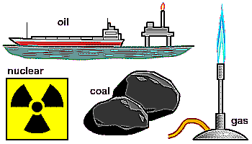
Non-Renewable Resources
A non renewable resource is a natural resource that cannot be re-made or re-grown at a scale comparable to its consumption.
Examples of Non-Renewable Resources:
Coal.
Petroleum.
Natural gas.

Slide 35
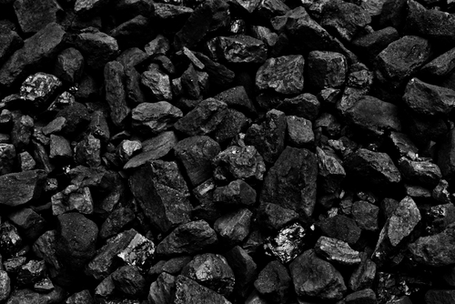
Coal:
coal is used as a fuel, it takes millions of years to regenerate it, so once we dig it all up, and, burn it, then it's finished.
It doesn't renew itself every day.
If somehow, a community uses, coal at a large scale comparable to its consumption.
It will run out, and will have to wait for a long time, so that it will regenerate for use, which is practically impossible, so it is considered as non-renewable resource.

Slide 36


Petroleum:
This type of resources are resources for which there is a limited supply.
So, The supply of petroleum comes from the Earth itself and, as it typically takes millions of years to develop and is finite.
Natural gas:
Natural gas is the result of decomposing plants and animals that were trapped beneath rock millions of years ago.
So once its used it takes a millions of time to regenerate, so it is a non-renewable resource.

Slide 37
Economic models:
In economics, a non-renewable resource is defined as goods, where greater consumption today implies less consumption tomorrow.
David Ricardo in his early works analyzed the pricing of exhaustible resources, where he argued that the price of a mineral resource should increase over time.
He argued that the spot price is always determined by the mine with the highest cost of extraction, and mine owners with lower extraction costs benefit from a differential rent.

Slide 38
However, nearly all metal prices have been declining over time in inflation adjusted terms, because of a number of false assumptions in the above.
Firstly, metal resources are non-renewable, but on a world scale, largely inexhaustible.
This is because they are present throughout the earth's crust on a vast scale, far exceeding human demand on all time scales.
Metal ores however, are only extracted in those areas where nature has concentrated the metal in the crust to a level whereby it is locally economic to extract.
This also depends on the available technology for both finding the metal ores as well as extracting them, which is constantly changing.
If the technology or demand changes, vast amounts of metal previously ignored can become economically extractable.

Slide 39
Sustainable development:
Sustainable development is a road-map, an action plan, for achieving sustainability in any activity that uses resources and where immediate and intergenerational replication is demanded.
As such, sustainable development is the organizing principle for sustaining finite resources necessary to provide for the needs of future generations of life on the planet.
It is a process that envisions a desirable future state for human societies in which living conditions and resource-use continue to meet human needs without undermining the "integrity, stability and beauty" of natural biotic systems.

Slide 40
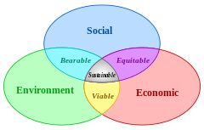

Slide 41
Sustainability and Sustainable Development:
As a working definition, sustainability can be defined as the practice of maintaining processes of productivity indefinitely—natural or human made—by replacing resources used with resources of equal or greater value without degrading or endangering natural biotic systems.
According to M. Hasna, sustainability is a function of social, economic, technological and ecological themes.
Sustainable development ties together concern for the carrying capacity of natural systems with the social, political, and economic challenges faced by humanity.

Slide 42
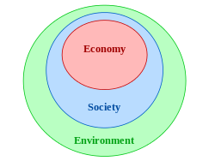
A diagram indicating the relationship between the
"three pillars of sustainability",
in which both economy and society are constrained by environmental limits

Slide 43
The term sustainable development rose to significance after it was used by the Brundtland Commission in its 1987 report Our Common Future.
In the report, the commission coined what has become the most often-quoted definition of sustainable development: "development that meets the needs of the present without compromising the ability of future generations to meet their own needs”.
The United Nations Millennium Declaration identified principles and treaties on sustainable development, including economic development, social development and environmental protection.

Slide 44
Domains of Sustainability :
There are four Domains
Ecology
Economics
Politics and
Culture

Slide 45
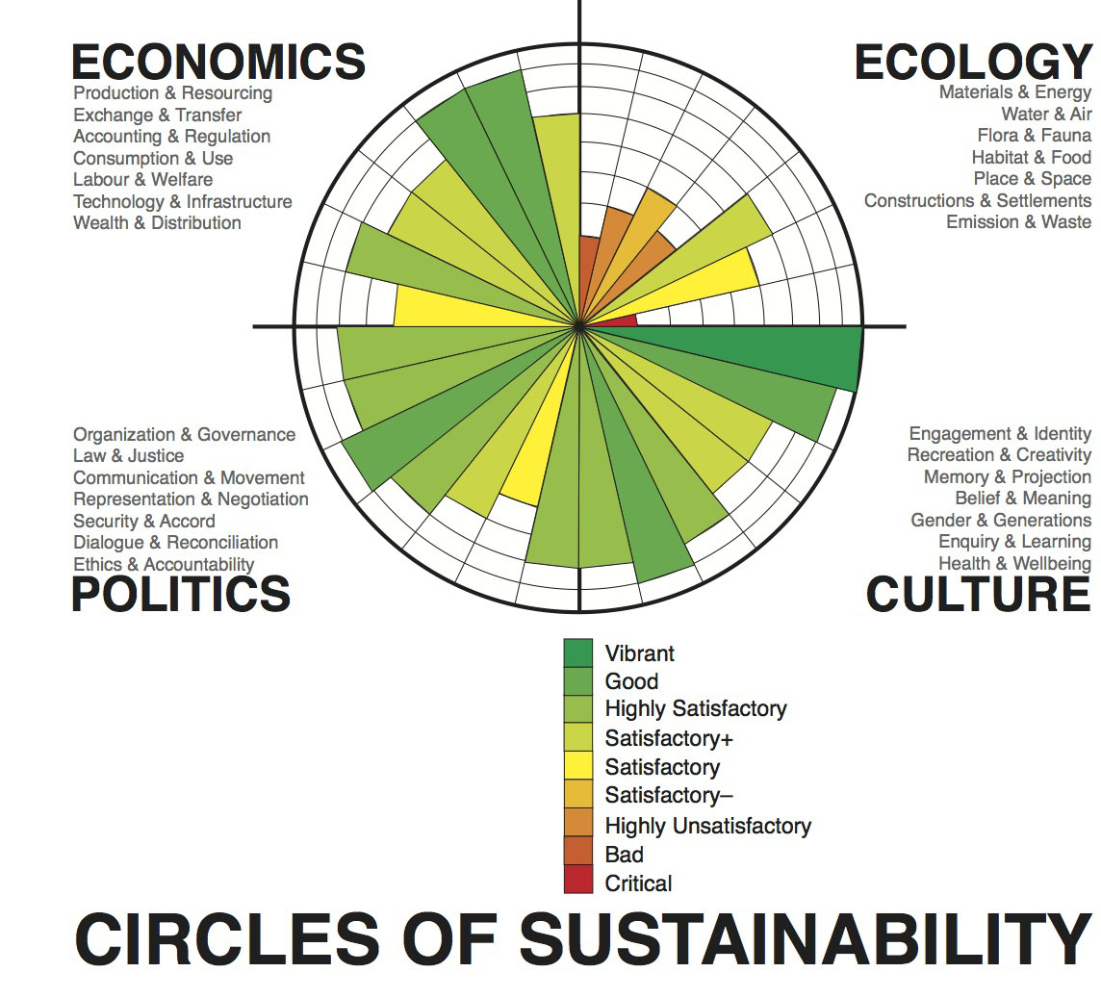

Slide 46

Ecology
Focusing on the important dimension of human engagement with and within nature, but also including the built-environment.
Materials and energy
Water and air
Habitat and settlements
Built-form and transport
Embodiment and sustenance
Emission and waste

Slide 47

Economics
Associated with the production, use, and management of resources, where the concept of ‘resources’ is used in the broadest sense of that word.
Production and resourcing
Exchange and transfer
Accounting and regulation
Consumption and use
Labor and welfare
Technology and infrastructure
Wealth and distribution

Slide 48

Politics
The political is defined as the practices and meanings associated with basic issues of social power, such as organization, authorization, legitimating and regulation. The parameters of this area extend beyond the conventional sense of politics to include not only issues of public and private governance but more broadly social relations in general.
Organization and governance
Law and justice
Communication and critique
Representation and negotiation
Security and accord
Dialogue and reconciliation
Ethics and accountability

Slide 49
Culture
The cultural domain is defined as the practices, discourses, and material expressions, which, over time, express continuities and discontinuities of social meaning.
Identity and engagement
Creativity and recreation
Memory and projection
Belief and ideas
Gender and generations
Enquiry and learning
Wellbeing and health

Slide 50

Technology transfer:
The Ethiopian government has decided to encourage technology transfer activities at different stages of educational and training institutions, to contribute to the boosting economy in the near future.
Presently, the term Industry Extension Service is one of the terms mostly associated to the TVET (Technical and Vocational Education and Training), where the TVET institutions are expected to help the local small industries, in filling their skill gaps, giving training in entrepreneurial skills, technology transfer and improvement productivity.

Slide 51
Technology is defined differently by different actors. For this purpose only in Ethiopia, it is defined as the process whereby different inputs are converted into marketable output.
Technology transfer is one of the core issues of industry extension service where technology can be identified in terms of
Techno ware,
Info ware,
Human ware or
Orga ware.

Slide 52



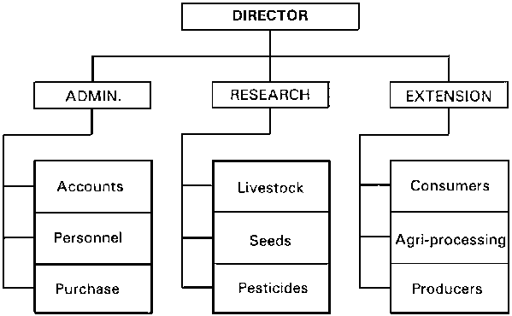
Techno ware:
includes materials, gadgets, etc.
Human ware:
includes the human knowledge,
ability, experience, etc.
Info ware:
includes organized information,
work processes, design and
blueprints, etc.
Orga ware:
includes the organizational structures,
setups, methods of doing things, etc.

Slide 53

Joint ventures of technology transfer:
Technology transfer through international joint ventures is considered important to enhance competitiveness, exploit opportunities and boost economic growth.
A common observation is, however, that such ventures often fail. Present insights regarding transfer processes, influencing factors, and relationships between technology transfer and venture success — if any — are modest.

Slide 54
Thank You

