Slide 1


Slide 2

The systematic investigation to establish facts and reaching new conclusions.
Research comprises “creative work undertaken on a systematic basis in order to increase the stock of knowledge, including knowledge of man, culture and society, and this stock of knowledge is used to develop new applications.”
A research project may also
be an expansion on past work
in the field.

Slide 3

Types of research
Basic research
Applied research
Quantitative Research
Qualitative Research

Slide 4

BASIC RESEARCH
The research which is done for knowledge enhancement,
The research which is done for human welfare, animal welfare and plant kingdom welfare. It is called basic, pure, fundamental research.
The main motivation is to expand man's knowledge.

Slide 5
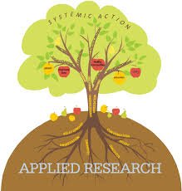
APPLIED RESEARCH
Applied research is designed to solve practical problems of the modern world.
The goal of applied research is to improve the human condition.
This research is generally conducted on large scale basis, it is expensive. As such, it often conducted with the support of some financing agency like government , public corporation , world bank, UNICEF , Etc,.

Slide 6
“applied research is an investigation for ways of using scientific knowledge to solve practical problems”
for example:-
Improving agriculture crop production, treat or cure a specific disease e.t.c

Slide 7

QUANTITATIVE RESEARCH
Quantitative research aim to measure the quantity or amount and compares it with past records and tries to project for future period.
The process of measurement is central to quantitative research because it provides fundamental connection between practical observation and mathematical expression of quantitative relationships.

Slide 8
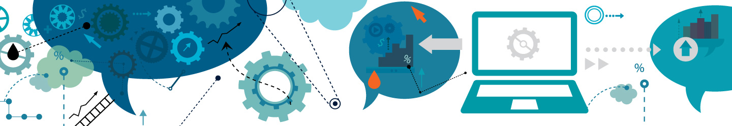
QUALITATIVE RESEARCH:
Qualitative research presents non-quantitative type of analysis.
Qualitative research is collecting, analyzing and understand data by observing what people do and say.
Qualitative research refers to the meanings, definitions, characteristics, symbols, and description of things.
Qualitative research is much more subjective and uses very different methods of collecting information, mainly individual, in-depth interviews and focus groups.

Slide 9

What is Ethics in Research
&
Why is it Important?

Slide 10

When most people think of ethics (or morals), they think of rules for distinguishing between right and wrong,
a code of professional conduct like the Hippocratic Oath ("First of all, do no harm"),
a religious creed like the Ten Commandments ("Thou Shalt not kill...“).
This is the most common way of defining "ethics": norms for conduct that distinguish between acceptable and unacceptable behavior.

Slide 11
There are several reasons why it is important to hold on to ethical norms in research.
First,
Promote the aims of research, such as knowledge, truth, and avoidance of error.
For example,
prohibitions against fabricating, falsifying, or misrepresenting research data promote the truth and avoid error.

Slide 12
Second, Values that are essential to collaborative work, such as trust, accountability, mutual respect, and fairness.
For example, many ethical norms in research, such as guidelines for authorship, copyright and patenting policies, data sharing policies, and confidentiality rules in peer review, are designed to protect intellectual property interests while encouraging collaboration.
Most researchers want to receive credit for their contributions and do not want to have their ideas stolen or disclosed prematurely.

Slide 13
Third, accountable to the public. For instance, federal policies on research misconduct, conflicts of interest, the human subjects protections, and animal care and use are necessary in order to make sure that researchers who are funded by public money can be held accountable to the public.
Fourth, public support for research. People more likely to fund research project if they can trust the quality and integrity of research.
Finally, moral and social values, such as social responsibility, human rights, animal welfare, compliance with the law, and health and safety.

Slide 14
Codes and Policies for Research Ethics
Given the importance of ethics for the conduct of research, it should come as no surprise that many different professional associations, government agencies, and universities have adopted specific codes, rules, and policies relating to research ethics.
Many government agencies, such as the National Institutes of Health (NIH), the National Science Foundation (NSF), the Food and Drug Administration (FDA), the Environmental Protection Agency (EPA), and the Department of Agriculture (DA) have ethics rules for funded researchers.

Slide 15
The following is a rough and general summary of some ethical principals that various codes address*:
Honesty
Strive for honesty in all scientific communications. Honestly report data,
results,
methods and procedures,
and publication status.
Do not fabricate, falsify, or misrepresent data.
Do not mislead colleagues, granting agencies, or the public.

Slide 16
Objectivity
Strive to avoid bias in experimental design,
data analysis,
data interpretation,
peer review,
personnel decisions,
grant writing,
expert testimony, and other aspects of research where objectivity is expected or required.
Avoid or minimize bias or self-deception. Disclose personal or financial interests that may affect research.

Slide 17
Integrity
Keep your promises and agreements; act with sincerity; strive for consistency of thought and action.
Carefulness
Avoid careless errors and negligence; carefully and critically examine your own work and the work of your peers. Keep good records of research activities, such as data collection, research design, and correspondence with agencies or journals.
Openness
Share data, results, ideas, tools, resources. Be open to criticism and new ideas.

Slide 18
Respect for Intellectual Property
Honor patents, copyrights, and other forms of intellectual property. Do not use unpublished data, methods, or results without permission. Give credit where credit is due. Give proper acknowledgement or credit for all contributions to research. Never plagiarize.
Confidentiality
Protect confidential communications, such as papers or grants submitted for publication, personnel records, trade or military secrets, and patient records.
Responsible Publication
Publish in order to advance research and scholarship, not to advance just your own career. Avoid wasteful and duplicative publication.

Slide 19
Responsible Mentoring
Help to educate, mentor, and advise students. Promote their welfare and allow them to make their own decisions.
Respect for colleagues
Respect your colleagues and treat them fairly.
Social Responsibility
Strive to promote social good and prevent or mitigate social harms through research, public education, and advocacy.

Slide 20
Competence
Maintain and improve your own professional competence and expertise through lifelong education and learning; take steps to promote competence in science as a whole.
Legality
Know and obey relevant laws and institutional and governmental policies.

Slide 21
Ethical Decision Making in Research
Although codes, policies, and principals are very important and useful, like any set of rules, they do not cover every situation.
It is therefore important for researchers to learn how to understand, assess, and apply various research rules and how to make decisions and to act in various situations.
The vast majority of decisions involve the straightforward application of ethical rules.

Slide 22
There are many other activities that the government does not define as "misconduct" but which are still regarded by most researchers as unethical.
These are called "other deviations" from acceptable research practices and include:
Publishing the same paper in two different journals without telling the editors.
Not informing a collaborator of your intent to file a patent in order to make sure that you are the sole inventor.

Slide 23
Including a colleague as an author on a paper in return for a favor even though the colleague did not make a serious contribution to the paper.
Discussing with your colleagues confidential data from a paper that you are reviewing for a journal.
Giving the same research project to two graduate students in order to see who can do it the fastest.

Slide 24
Failing to keep good research records.
Promising a student a better grade for sexual favors.
Rejecting a manuscript for publication without even reading it
Stealing supplies, books, or data

Slide 25

Paper Publication and
Ethics

Slide 26

How
to
Publish a Research Paper

Slide 27
Publishing a research paper in a journal or conference is an important activity within the academic community.
It allows you to network with other scholars and to further refine your ideas and research.
Academic journals are probably the most common place for scholars to publish their research.
Find the most suitable academic journal for your topic and writing style so you can tailor your research paper easily and increase its chance of being published.

Slide 28
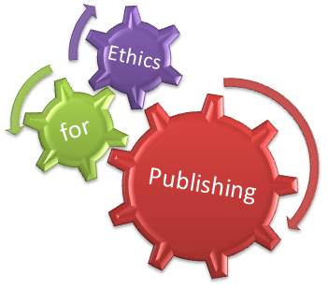
Important Steps in publishing a Research Paper:
Familiarize yourself with potential publications
Choose the publication that best suits your research paper.
Prepare your manuscript.
Ask a colleague and/or professor to review your research paper.
Revise your paper
Submit your article.
Keep trying.

Slide 29
1.Familiarize yourself with potential publications.
It is important to be aware of the research already published and the current questions and studies in your field.
Pay special attention to how other research papers are written:
the format,
the type of articles
the writing style,
the subject matter, and
the vocabulary.

Slide 30
2.Choose the publication that best suits your research paper.
Each publication has its own audience and tone of writing.
Decide if your research paper would fit better in a journal that is highly technical and meant only for other scholars or a journal that is more general in nature that would appeal to a broader audience.

Slide 31
3.Prepare your manuscript.
Format your research paper so it fits the guidelines for that publication.
Most journals provide a document called "Instruction to Authors" or "Author's Guide" that offers specific instructions about layout, type font, and length.
This guide will also tell you how to submit your paper and will provide details of the review process.

Slide 32
4.Ask a colleague and/or professor to review your research paper.
They should edit your paper for grammar, spelling errors, typos, clarity, and conciseness.
At this time, they should also verify your content. Research papers need to present an issue that is significant and relevant.
They should be clearly written, easy to follow, and appropriate for the intended audience.
Have two or three people review your paper, more if possible.

Slide 33

5.Revise your paper.
It is likely you will go through three or four drafts before final submission of your research paper.
Make a special effort to make your paper clear, engaging, and easy to follow.
This will greatly increase your chances of being published.

Slide 34
6.Submit your article.
Go back to the Author's Guide to review submission requirements.
Once you are satisfied that your paper meets all of the guidelines, submit the paper through the appropriate channels.
Some journals allow online submission, while others prefer a hard copy.

Slide 35
7.Keep trying.
Sometimes journals will ask you to revise your paper and resubmit.
Study their critiques carefully and make the necessary changes.
Do not get over-attached to your original submission. Instead, remain flexible and rework the paper in light of the feedback you received.
Use all of your skills as a researcher and a writer to create a superior paper.
Even if you are ultimately rejected by your "target" publication, continue to re-write your research paper and submit it to other publications.

Slide 36
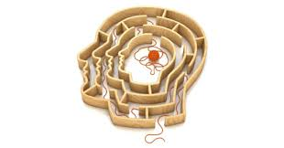
Publishing ethics

Slide 37
The publication of an article in a peer-reviewed journal is an essential building block in the development of a coherent and respected network of knowledge.
It is a direct reflection of the quality of the work of the authors and the institutions that support them. Peer-reviewed articles support and embody the scientific method. It is therefore important to agree upon standards of expected ethical behavior for all parties involved in the act of publishing: the author, the journal editor, the peer reviewer, the publisher and the society of society-owned or sponsored journals.

Slide 38

Duties of Editors
Publication decision
Fair play
Confidentiality
Disclosure and Conflicts of interest
Involvement and cooperation in investigations

Slide 39

Duties of Reviewers
Contribution to Editorial Decision
Promptness
Confidentiality
Standards of Objectivity
Acknowledgement of Source
Disclosure and Conflicts of Interest

Slide 40
Duties of Authors
Reporting standards
Data Access and Retention
Originality and Plagiarism
Multiple, Redundant or Concurrent Publication
Acknowledgement of Sources
Authorship of the Paper
Hazards and Human or Animal Subjects
Disclosure and Conflicts of Interest
Fundamental errors in published works

Slide 41
Duties of the Publisher
They are committed to ensuring that advertising, reprint or other commercial revenue has no impact or influence on editorial decisions.
In addition, Elsevier will assist in communications with other journals and/or publishers where this is useful to editors.
Finally, they are working closely with other publishers and industry associations to set standards for best practices on ethical matters, errors and retractions--and are prepared to provide specialized legal review and counsel if necessary.

Slide 42

Thank you

Slide 43


