Slide 1
Random Graphs
Social Network Analysis, Lecture 5
E&K 20.1-20.2
AAIT ITSC
Instructor: Dr. Sunkari

Slide 2
Random graphs!
Background: Probability Theory
Static random models
  Poisson random networks
  “Small World” model
  The configuration model
Calculating metrics

Slide 3
Background: Random Variables
RVs: Represent probabilistic events
  E.g., coin flip X
  X: {H, T}→{p, (1-p)}
  Options should add to 1
Instances of coin flips = samples
How flips play out = distribution
heads w/ prob p
tails w/ prob (1-p)

Slide 4
Background: Prob. Mass Function
Coin toss: Uniform
Coin toss: Weighted
Single dice: Uniform
Single dice: Weighted
How to know if it’s fair? Sample many times!

Slide 5
Background: Binomial Distr.
Out of n coin flips, how many H?
Prob n heads:
sampled 100 times
Written:
X is distr. according to a binomial distr.

Slide 6
Background: Binomial Coeff.
How many ways are there to get n out of 3 heads?
Calculate:
8 possible results
HHH
HHT
HTH
HTT
THH
THT
TTH
TTT
3 Heads:
= 1 way
Pascal’s triangle
1
1 1
1 2 1
1 3 3 1
1 4 6 4 1
1 5 10 10 5 1
1 6 15 20 15 6 1
…
2 Heads:
= 3 ways
1 Heads:
= 3 ways
0 Heads:
= 1 way

Slide 7
Group Discussion:
A 6-sided dice is a multinomial distribution.
How will this differ from binomial?
Notes:
There are more possible outcomes. You also need to estimate more parameters – a probability for each outcome (or one less that number).

Slide 8
Poisson Random Networks
Erdös and Rényi, 1959-1961; MOJ 1.2.3, 4.1.1

Slide 9
Binomial Link Formation Erdös and Rényi, 1959-1961
Nodes n = {1,…, n}
i, j links form with probability p
  No link: (1-p)
Independent probabilities
6
1
5
2
4
3

Slide 10
Individual Exercise (with calculator):
Given p, what is the probability that each graph is produced?
a) p = 0.1 b) p = 0.4
c) p = 0.1 d) p = 0.4
6
1
6
1
5
2
5
2
4
3
4
3
Notes:
(0.1)^2 * (0.9)^13 = 2.54 x 10^-3
(0.4)^2 * (0.6)^13 = 2.09 x 10^-4
(0.1)^7 * (0.9)^8 = 4.30 x 10^-8
(0.4)^7 * (0.6)^8 = 2.75 x 10^-5

Slide 11
Group Discussion:
Derive a general equation for the probability of a network with n nodes, m edges, and link formation probability p.
Notes:
(0.1)^2 * (0.9)^13 = 2.54 x 10^-3
(0.4)^2 * (0.6)^13 = 2.09 x 10^-4
(0.1)^7 * (0.9)^8 = 4.30 x 10^-8
(0.4)^7 * (0.6)^8 = 2.75 x 10^-5

Slide 12
Probability of Node degree d
Links form independently
For 1 node i (out of n nodes):
→ binomial!
Note: Not exactly independent, since 1 link affects 2 nodes. But as n increases, this effect is minimal

Slide 13
Poisson Approximation see MOJ 1.2.3
Usually: large n, small p
Poisson: normally, # events in fixed interval, with events independent

Slide 14
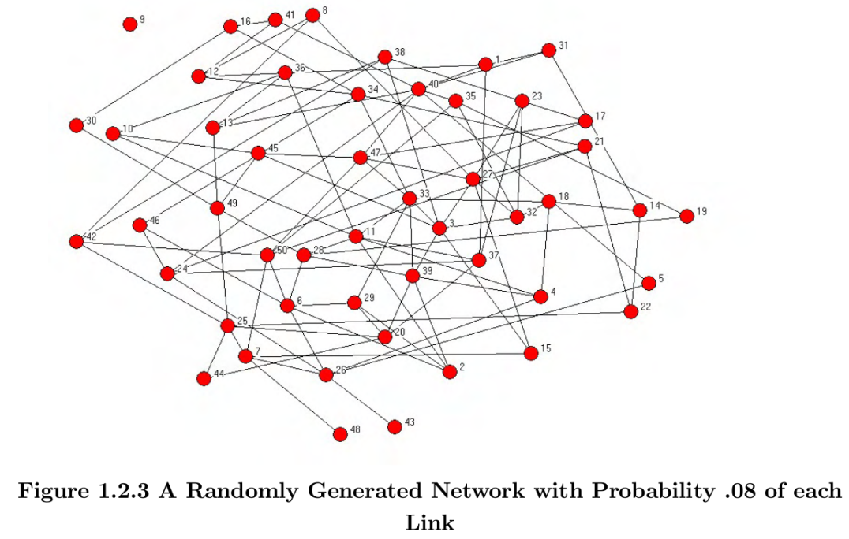
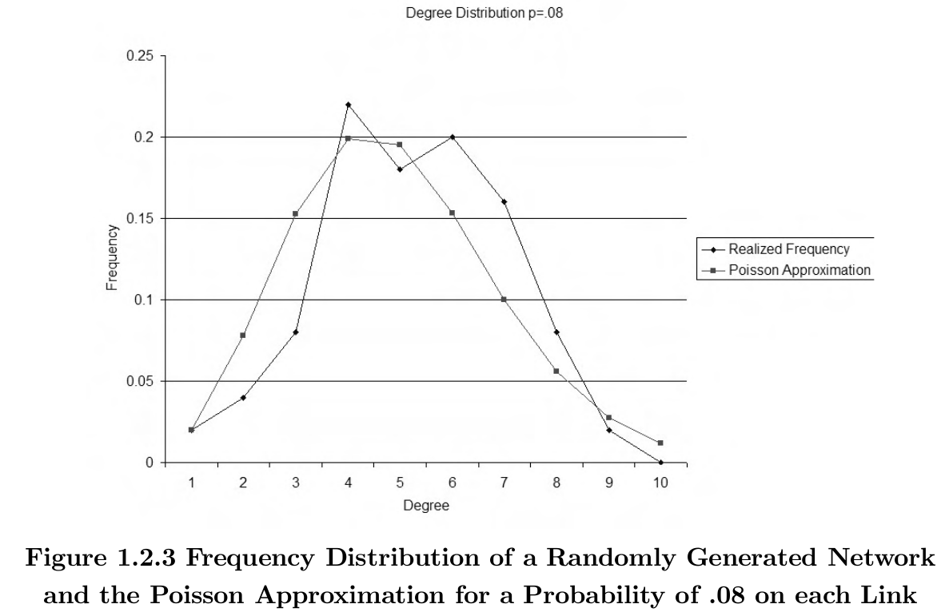
Examples: Poisson model
Images MOJ 1.2

Slide 15
Small World Model
Watts & Strogatz, 1998ff; MOJ 4.1.2, E&K 20.1-20.2

Slide 16
Why an alternate model?
Real life: high clustering, low avg. path length/diameter
  E.g., me: CC=0.556, APL=2.93, d=10
Poisson: lacks high clustering
  Any link formation prob: p
  Triadic closure? Etc?
Low avg. path length/diameter

Slide 17
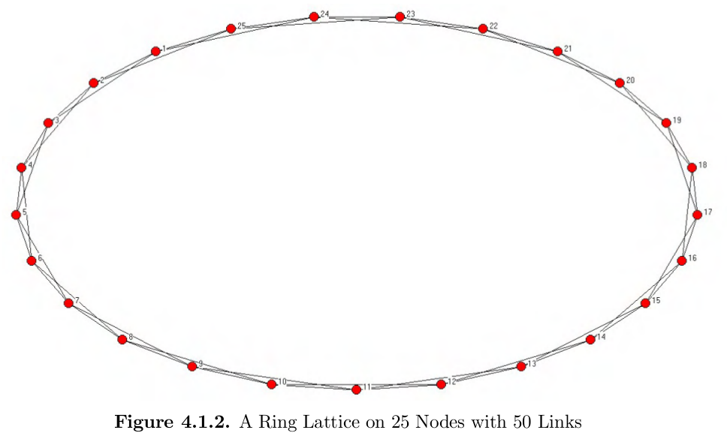
Watts-Strogatz: Starting out
each connected to 2 neighbors each side
High clustering, high diameter/APL
High clustering, high diameter/APL

Slide 18
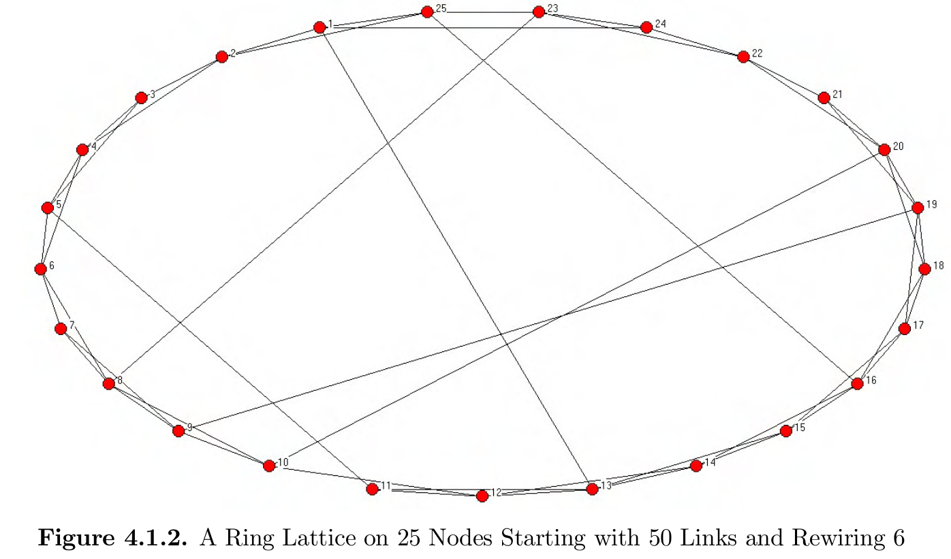
Watts-Strogatz: Rewiring
High clustering, lower diameter/APL
High clustering, high diameter/APL

Slide 19
Think-Pair-Share:
Why is the Watts-Strogatz model often called the “small world” model?

Slide 20
Watts-Strogatz: Summary
Model “small world phenomenon”
  high clustering
  low distance
Start w/ highly clustered network
Rewire some links
Explore in Assignment 3!

Slide 21
The Configuration Model
Bender & Canfield 1978; MOJ 4.1.4

Slide 22
Degr. Distributions → Sequences
Node i with degree d_{i}, list d_{i} times
  Ex: 1112233445566677788999
7
8
6
5
9
10
3
1
4
2

Slide 23
Add links
  Randomly select pairs; link & remove
  1112233445566677788999
Links:
3,7
6,6
8,9
3,7
duplicate link: multi-graph!
1,4 1,5 2,4 6,8
5,7 1,9 2,9
7
self-link
8
6
5
Despite self-links and duplicate links, new graph with similar degree distribution!
9
10
3
1
4
2

Slide 24
Modularity, revisited
Stopping criterion for partitioning
Expected random edges (Configuration model) within a community
the communities that v and u are assigned to
1_{v,u} = 1 if there is an edge v, u
1 if equal
count edges within a community
divide over all edges m

Slide 25
Modularity interpretation
Values: [-0.5, 1.0]
  - (neg): communities cut across links more than random
  0: communities capture nothing
  +(pos): communities have more links than you’d expect at random
Criterion: stop partitioning when modularity drops below threshold

Slide 26
Think-Pair-Share:
Could you use a Poisson random network to calculate modularity?
If so, how? If not, why not?

Slide 27
Calculating Metrics on Random Networks

Slide 28
Metrics will vary!
Which graph for calculations?
  E.g., Poisson, 6 nodes, p=0.4
6
1
6
1
6
1
5
2
5
2
5
2
4
3
4
3
4
3
Avg node degree: 2.33
Avg node degree: 2
Avg node degree: 3
Simulate!
Consider the Limit
Notes:
Avg node degree
3+2+1+4+1+3 -> 2.33
-> 2
-> 3

