Slide 1
CHAPTER-5
THE CONSISTENT DEFORMATION METHOD

Slide 2
Method of Virtual Work
[REVISION]

Slide 3
Methods of Indeterminate Structural Analysis
FORCE Method:- consists of writing equations that satisfy the compatibility and force-displacement requirements for the structure to determine the redundant forces.
UNKNOWNS --- FORCES
DISPLACEMENT Method:- is based on writing force-displacement relationships for each member and then satisfying equilibrium requirements for the structure.
UNKNOWNS --- DISPLACEMENTS

Slide 4
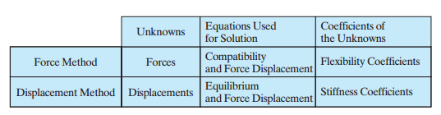
Methods of Indeterminate Structural Analysis

Slide 5


Force Method of Analysis
PROCEDURE
  1. Remove redundant supports until the structure becomes determinate. RESULT:- SUPPORTED POINTS WILL BE DISPLACED AND ROTATED.

Slide 6
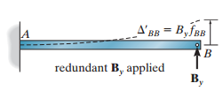
Force Method of Analysis
PROCEDURE
  2. Apply the redundant action on the primary structure.
  RESULT:- A DISPLACEMENT/ROTATION IN THE OPPOSITE SENSE TO STEP 1 WILL DEVELOP AT APPLIED POINT.

Slide 7
Force Method of Analysis
PROCEDURE
  3. Apply the principle of COMPATIBILITY at the removed support.
  RESULT:- SINCE THE DISPLACEMENT/ROTATION CORRESPONDING TO THE REDUNDANT ACTION IS ZERO, THE DISPLACEMENT/ROTATION VALUES IN STEPS 1 AND 2 MUST BE EQUAL.
  =

Slide 8


Force Method of Analysis
=
+
0

Slide 9

Force Method of Analysis
The BB subscript means “the deflection at point B due to the unknown reaction being applied at point B.”

Slide 10

Force Method of Analysis
PROCEDURE:
  Step 4:- Apply a unit load at the redundant point in the direction of the redundant action and compute the corresponding deflection developed due to this unit action.
  fBB is called the linear flexibility coefficient, and

Slide 11

Force Method of Analysis
It follows that
To get, the unknown redundant action.
Addition Example [HIBBLER : PAGE 420]

Slide 12
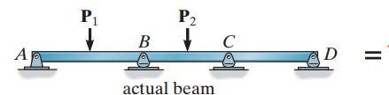


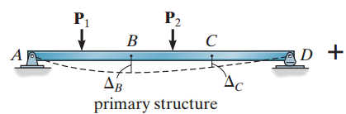

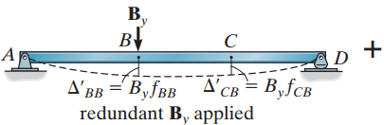

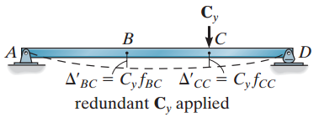

Force Method of Analysis
Indeterminacy of higher orders

Slide 13
Maxwell’s Theorem of Reciprocal Displacements
The displacement of point B on a structure due to a unit load applied at point A, is equal to the displacement at point A if the unit load is applied at point B.
PROOF: [Use the principle of virtual work]
CONSEQUENCE:- The flexibility coefficient matrix is symmetric (i.e. fCB = fBC, fCD = fDC …..)

Slide 14
BEAMS

Slide 15
TRUSSES

Slide 16
FRAMES

Slide 17
FIN

