Slide 1
CHAPTER 2
THE SLOPE- DEFLECTION METHOD

Slide 2
The Displacement Method
Requires solving for unknown displacements within the indeterminate structure.
Unknown displacements can then be solved from equilibrium and compatibility equations

Slide 3
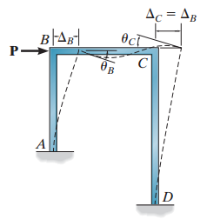
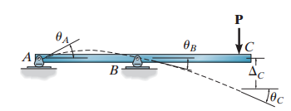
Degrees of Freedom
Rotations and Translations

Slide 4
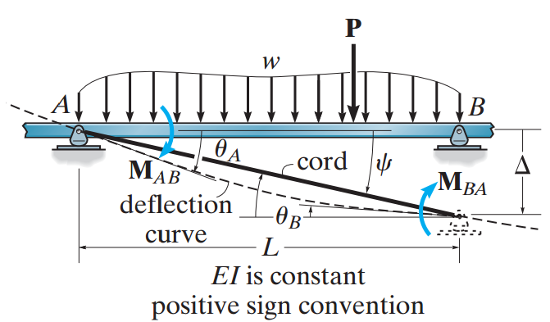
Slope –Deflection Equations
SIGN CONVENTION: CLOCKWISE MOMENTS,ROTATIONS ARE POSITIVE, DOWNWARDS DISPLACEMENTS ARE +VE

Slide 5
Slope –Deflection Equations
COMPUTATION OF UNKNOWN DISPLACEMENTS, ROTATIONS
Principle of SUPERPOSITION

Slide 6
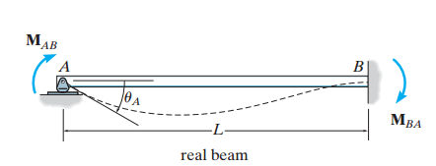
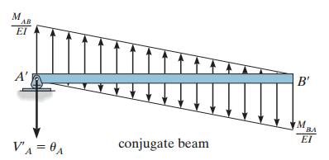
Slope-Deflection Equations
Rotation at Joint A.

Slide 7
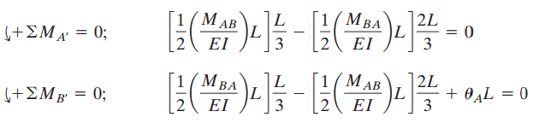


Slope-Deflection Equations
Rotation at Point A

Slide 8
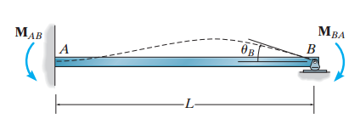


Slope-Deflection Equations
Rotation at Joint B.

Slide 9
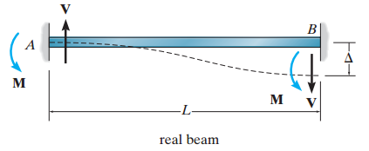
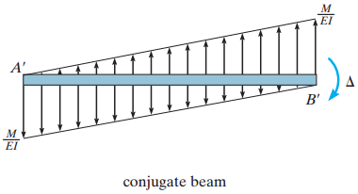
Slope-Deflection Equations
Displacement at Joint B w.r.t. A

Slide 10


Slope-Deflection Equations
Displacement at Joint B w.r.t. A

Slide 11
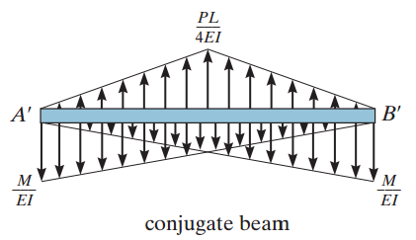
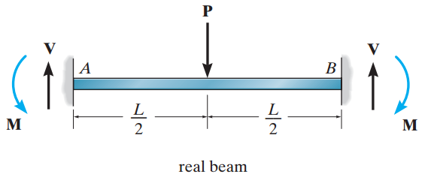


Slope-Deflection Equations
FIXED END MOMENTS

Slide 12
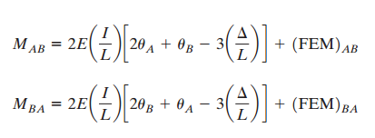

Slope-Deflection Equations
Applying the PRINCIPLE OF SUPERPOSITION

Slide 13


Slope-Deflection Equations
SD equations for Pin Supported Spans
Solving Simultaneously,

Slide 14
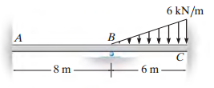
EXAMPLES
EXAMPLE 1

Slide 15
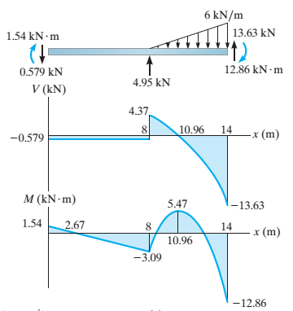
EXAMPLES

Slide 16
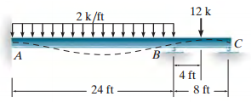
EXAMPLES
EXAMPLE 2

Slide 17
QUESTIONS ??

