Slide 1
CHAPTER 3
Cross’ Moment Distribution Method

Slide 2
Moment Distribution
Iterative Method
Directly computes End Moments.
Convenient for small to medium sized problems

Slide 3
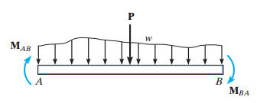
Concepts
SIGN CONVENTION = CLOCKWISE MOMENTS on the MEMBER are considered as POSITIVE.
FIXED END MOMENTS

Slide 4


Concepts
Member Stiffness Factor:- defined as the magnitude of moment M req’d to rotate end A by 1 rad.
The moment M is computed as
The member stiffness factor is defined as the term in the brackets.

Slide 5
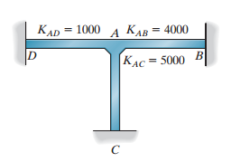
Concepts
Joint Stiffness Factor:- The total amount of moment needed to rotate a joint by 1 rad.

Slide 6


Concepts
Distribution Factor:- If a moment is applied to a fully connected fixed joint, then this moment is distributed to each connected member depending on each member’s stiffness. The distribution factor is such a percentage/ratio computed for each member.

Slide 7

Concepts
Member relative stiffness factor:- As E is usually constant for a structure, the stiffness for a single member can be defined as :
We use this value to compute the distribution factor.

Slide 8

Concepts
Carry-Over Factor:- For a rotation of 1 rad , We’ve seen that M= (4EI/L)θa and M’= (2EI/L)θa
In other words, M’=(1/2)M.
The carry-over factor represents the fraction of M “carried-over” from the pin to the wall.( In this case +1/2)

Slide 9
Moment Distribution for Beams
Examples

Slide 10



Stiffness Factor Modifications
Member Pin Supported at Far End:-
Symmetric Geometry + Loading:-
Symmetric Geometry + Anti-symmetric Loading:-

Slide 11
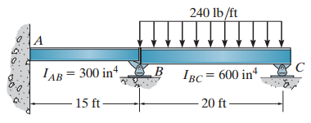
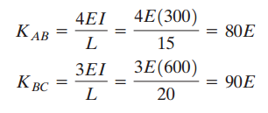
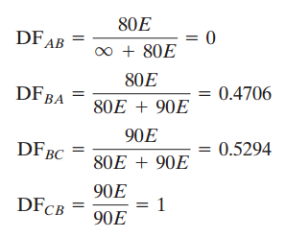
Example

Slide 12
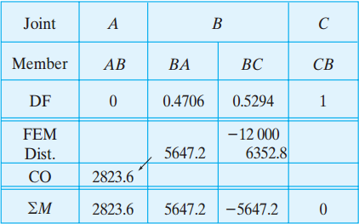
Example (Cont.)
M. Distribution Table

Slide 13
(More Examples)

Slide 14
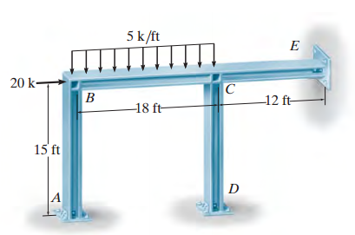
M. Distribution for Frames: NO Sidesway
Example
Joints E and D are pinned while A is fixed.

Slide 15

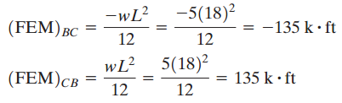
Example (Frame NO-Sidesway)
Stiffness Factors
Fixed End Moments

Slide 16
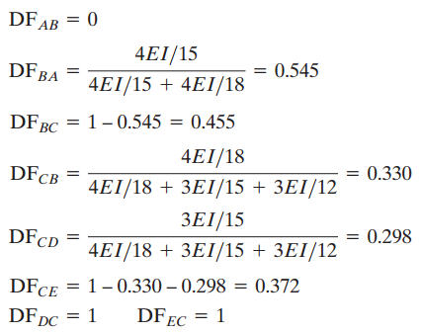
Example (Frame NO-Sidesway)
Distribution Factors

Slide 17
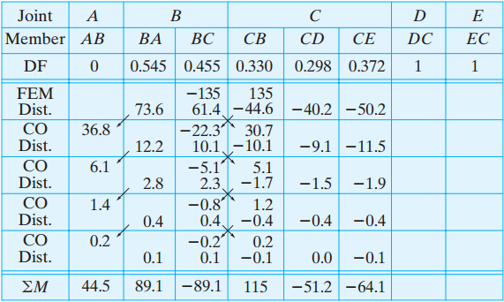
Example (Frame NO-Sidesway)
Distribution Table

Slide 18
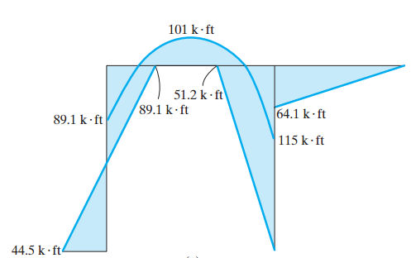
Example (Frame NO-Sidesway)
Moment Diagram

Slide 19
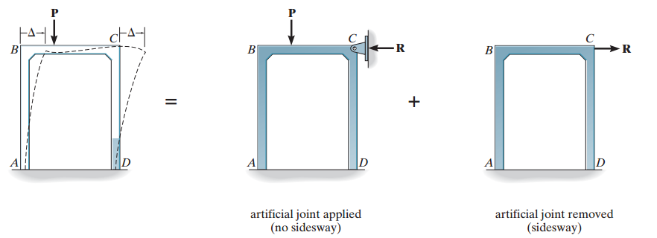
Frames (Sidesway)

Slide 20
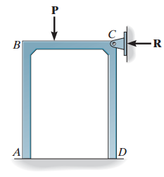
Frames (Sidesway)
Step one: Place an artificial joint to prevent sway and analyze the structure to get the imaginary reaction R

Slide 21
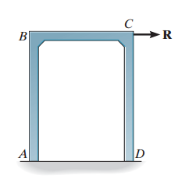
Frames (Sidesway)
Step two: Assume an equal and opposite force, R, is applied at the previous joint causing the structure to sway by a certain horizontal displacement d.

Slide 22
Frames (Sidesway)
For a certain assumed value of d, resulting end moments as well as R’ can be computed.
These magnitudes are proportional to the values developed in step one (Hooke’s law).
Hence, the final end moment is the sum of the original non-sway moments and a proportional (R/R’) magnitude of the sway moments.

Slide 23
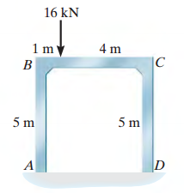
Example: Frames (Sidesway)

Slide 24
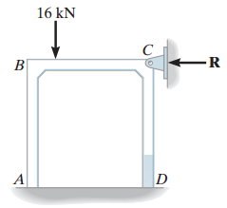
Example: Frames (Sidesway)
Step One:

Slide 25
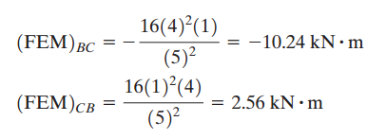
Example: Frames (Sidesway)
Fixed End Moments

Slide 26
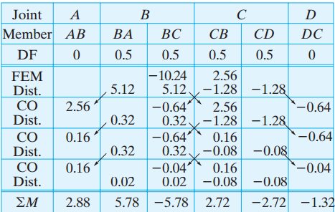
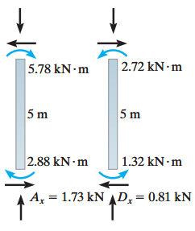
Example: Frames (Sidesway)
Step One: R= Ax+Dx= -(1.73-0.81) = -0.92 kN

Slide 27
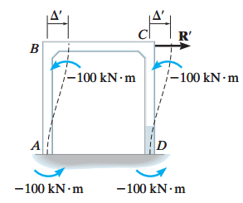
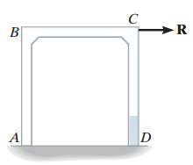
Example: Frames (Sidesway)
Step two: Assume the virtual force causes the following FEMS

Slide 28
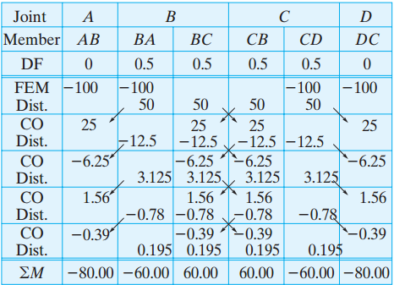
Example: Frames(Sidesway)

Slide 29
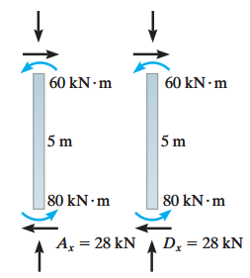
Example: Frames (Sidesway)
R’ = -(Ax+Dx) = -(28+28) =56 KN

Slide 30
Example: Frames (Sidesway)
The actual moment values caused by the sway force R are computed by taking the proportioned values of the end moments computed for R’.
→ M = (R/R’) * M’
→ M = (1.92/56) * M’

Slide 31
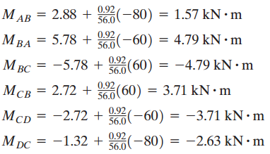
Example: Frames (Sidesway)
Total Moments = M(Non-sway) +( R/R’)*M’ (Sway)

Slide 32
ANY QUESTIONS ??

